Slide 1
Spatial Structure in Spatial Interaction
Rethinking how spatial structure is used to build and validate Spatial Interaction models.
Lenka Hasova
in collaboration with
Levi Wolf and Emmanouil Tranos
Lenka.Hasova@bristol.ac.uk
@LenkaHas
Notes:
Hello, my name is Lenka, I am a PhD student at University of Bristol

Slide 2
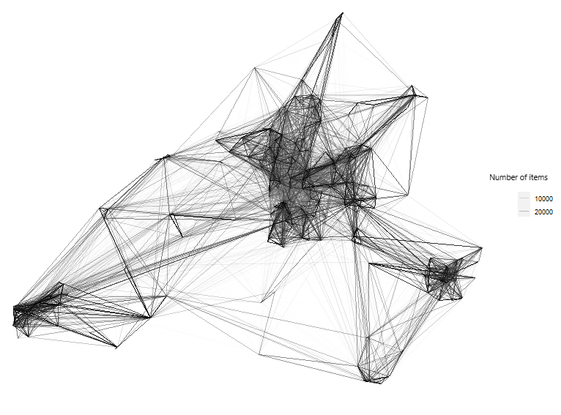
My main research interests
Rethinking how spatial structure is used to build and validate Spatial Interaction models.
Networks in human geography
Urban flows
Spatial structures
Spatial interaction
Complex networks in geography
Notes:
I am generally interested in networks in human geography, complex networks , spatial structures. And , and today I would like to talk to you about my work on
CLICK
Rethinking how spatial structure is used to build and validate spatial interaction models.

Slide 3
This presentation
What is spatial structure & how to rebuild its concept?
Why is this important & why SIMs sometimes does not work on real data?
Can we validate SIMs spatially?
Notes:
In this presentation, I will cover three main ideas.
I will first discuss what the spatial structure actually is, and how we can rethink and rebuild its concept.
I will then move into why is this important and how can it use it in our SIMs application
and lastly I would like to suggest new way of validation for spatial interaction models, based on spatial pattern replication.
So let me start with what is SIM and SS of SI

Slide 4
What is Spatial Interaction Model
ID | Origin ID | Destination ID | Flow volume/number of people | Distance
1 | UK | Germany | 500 | 59
2 | France | UK | 8505 | 3
3 | Germany | UK | 697 | 50
4 | Germany | France | 1597 | 25
Gravity Model Spatial Interaction Model
$$F_{ij}=k \frac{M_{i }{ M}_{j}}{D_{ij}}$$
$F_{ij}=k{ M}_{i }M_{j}$ f($D_{ij}$)
Notes:
Spatial interaction is a term used for movement of people, goods and information over space and, which is a result of a human decision making process.
CLICK
The most common approach to model these data are spatial interaction models. This is a regression model based on the analogy of gravity models which takes the information about the masses on the entities and the distance between the them to predict the flow. Here distance or distance decay is the primary indicator of the relationship between the nodes.

Slide 5
1
Spatial Structure in Spatial Interaction
Spatial structure characterizes the organization, distribution, or relative arrangement of entities embedded within a spatial system
relative
Spatial structure exists
We can observe it
We know:
We debate:
How do we account for it in SI models?
Notes:
Spatial structure then characterizes the organization, distribution and the relative arrangement of interacting entities in the spatial interaction system.
Here the world relative is very important, as it suggest that the SS is not just a simple spatial distribution but there are more complex relationship between the interacting entities. CLICK
Now, we know that this complex spatial structure exist, we know we can observe it, however, CLICK
we are still not sure what exactly it is and how do we account for it in our models.

Slide 6
1
Spatial Structure in Spatial Interaction
Locational element
$F_{ij}=k{ M}_{i }M_{j}$ f($D_{ij}$)
Distance decay
Behavioural element ?
Notes:
From the literature, we know that Spatial structure is primarily connected to the distance element of the gravity model.
More specifically to the distance decay that we observe in the spatial interaction CLICK
Nevertheless, we also know that there is a behavioural element, which is primarily shaped by the variation in human decision making.
Now, CLICK

Slide 7
1
Spatial Structure in Spatial Interaction
→ Use different distance measure - network (walking) distance, cost or time of the trip, (Haggett et al., 1977, Harris 1954)
→ Use different distance decay function – power la, negative exponent, square root, log-normal, pareto (Taylor, 1975, Chen, 2012)
→ Find other way to measure spatial decay (Interviewing opportunity models – Stouffler, 1940, Huff’s retail model - Huff, 1964, Radiation models - Simini et al., 2012)
→ Limit study for specific group of people (Hanson & Hanson, 1981)
→ Build multilevel model (Dennett and Wilson, 2013)
→ Use Spatial autoregressive or spatial effect model (Fischer and Griffith, 2008, LeSage and Fischer, 2014)
→ Use advanced methods (Bayesian methods, Neural Networks, Graph Neural Networks) (Griffith et al., 2017, Openshaw, 1998, Yeghikyan et al., 2020)
Notes:
In the past 60-70 years, we have seen many reserachers trying to tackle this problem from different perspective They try to account for spatial structure and the behavioural aspect by either extend our models, use different methods or even by cutting down the data samples.
The one thing that we don’t see, is a better conceptual definiton of what the spatial structure is and how it relates to what we add to our modes.
CLICK

Slide 8
1
Spatial Structure in Spatial Interaction
Spatial Network
New York
London
Functional structure
Bristol
Locational structure
Notes:
In my research I have been trying to connect lot of the spatial interaction concepts to concepts already existing in networks science. And I believe we can think of any spatial network as two-dimensional or two layered network, where the bottom layer is a locational network with the distances defining the relationships between the places.
While the top layer is functional network where the interaction volume, the actual record of how much interaction there is between places, defines the relationship between the places.

Slide 9
1
Spatial Structure in Spatial Interaction
Spatial Structure
Locational structure
Functional structure
Form
Function
Distance
Weight of interaction
(Goethe 1817)
Notes:
So essentially, we could devide the spatial structure into locational structure associated with the how wor the interacting entities are, and functional structer associated with how strong the actual interaction between the entities is. We could trace this kind of thinking back to Goethe's concepts of form and function where the distance represents the form of the interaction and the interaction volume represents the function of interaction.

Slide 10
1
Spatial Structure in Spatial Interaction
Spatial Structure
Locational structure
Functional structure
Form
Function
F (Distance)
Notes:
But I wouldn’t like to think about it as a two separate process. I would like to think about it as a scale, with form and the function on each and, and where by using different distance decay function or different methods to model spatial interaction, we are getting closer and closer to capturing the function.
The problem is that we are not getting as close as we need to. The idea of using flow volume, in order to provide insight into the interaction function and into the spatial structure is not yet fully explored in the literure, and
Although, CLICK

Slide 11
1
Spatial Structure in Spatial Interaction
→ Use different distance measure - network (walking) distance, cost or time of the trip, (Haggett et al., 1977, Harris 1954)
→ Use different distance decay function – power la, negative exponent, square root, log-normal, pareto (Taylor, 1975, Chen, 2012)
→ Find other way to measure spatial decay (Interviewing opportunity models – Stouffler, 1940, Huff’s retail model - Huff, 1964, Radiation models - Simini et al., 2012)
→ Limit study for specific group of people (Hanson & Hanson, 1981)
→ Build multilevel model (Dennett and Wilson, 2013)
→ Use Spatial autoregressive or spatial effect model (Fischer and Griffith, 2008, LeSage and Fischer, 2014)
→ Use advanced methods (Bayesian methods, Neural Networks, Graph Neural Networks) (Griffith et al., 2017, Openshaw, 1998, Yeghikyan et al., 2020)
Notes:
Many aim to capture the spatial structure, and indeed the functional structure, I found only one model that considers this at some extent CLICK

Slide 12
1
Spatial Structure in Spatial Interaction
Competing Destination model (Fotheringham, 1983)
Does flow (function) exists between points?
Locational structure
Functional structure
Form
Function
Distance
F( Distance )
Weight of interaction
Notes:
The Competing destination models From Stewart Fotheringham, which is the most commonly used model that aims to accounts for spatial structure, indirectly considered if function exists or not.
A Version of the model indirectly asks, if any flow between entities exist or not, if it doesn’t then the entities would not be considered as a competing destinations.

Slide 13
2
Why is this important in the real application?
Real data are not all the same.
Unipartite interaction
Bipartite interaction
General practitioner
Pharmacy
Notes:
Considering how big is the interaction or if it even exists, is actually very important because in real data, in real interaction systems the flow volume can carry an essential information about the nature of the system.
CLICK
For example, take a prescription flow network, where people pick up prescriptions at general practicioner, travel to the most convenient pharmacy and exchange the prescription for the prescribed drug. In this scenario, GPs are entities that only generates flow and pharmacies are entities that only receive flows
This creates what can call bipartite interaction, where although the locational structure could be same as in any other interaction, the functional structure creates constrains on where the flow can or cannot occur.
This kind network or other networks with different functional properties are increasingly found in the real-world, perhaps because our ability to collect and store such data improved significantly.
CLICK
.

Slide 14
3
How do I know if my model replicates spatial structure?
Performance measures
R2
RMSE
Common part of Commuters
Notes:
Once we clarified what the spatial structure is, at least a little bit.
We are left with one burning question,
If I build a model and make a prediction, how do I know if that model replicate the spatial patterns I’m seeing.
Because we are currently don’t have methods of validating the spatial pattern replication
CLICK
All of the methods we use for evaluating the performance of SIMs are only concerned about the relationship between two entities, so only local relationships.
We need method that evaluates both local and global relationships.

Slide 15
3
How do I know if my model replicates spatial structure?
Can we recognize spatial patterns and compare the real pattern to predicted pattern?
Spatial structure
Locational & Functional
Pattern Space Exploration (PSE)
(Cherel, Cottineau, Reuillon 2015)
Notes:
This is not a new thought to a geographers, we saw already in 2015 Cherel, cottineau and Ryllon introduced Pattern space replication method which does exactly that, takes the patterns from observe data and compares them to patterns from predicted data.

Slide 16
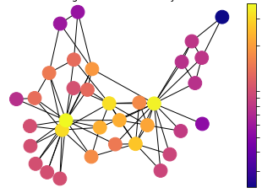
3
How do I know if my model replicates spatial structure?
Accessibility
Based on distance between competing destinations and their masses
Competing Destination model (Fotheringham, 1983)
Network Structure measures
Page Rank
Based on the flow volumes
Considers individual flow volumes, neighbouring volumes, neighbouring volumes of neighbour…
Notes:
I have been searching for method that could do that and from existing literature we could consider the accessibility term from the competing destination model as a good candiate. The accessibility term is an additional term in the model capturing the spatialstructure of the entities based on distance between the competing destinations and their masses.
CLICK
However, I also searched for suitable candidates in he concepts of network science and found that the Page Rank algorithm, which we all know, as it is used to rank webpages from google search engine, could be suitable for this job, because it is based on the actual volumes of flow, and it considers individual flows, neighbouring flows, neighbouring flows of neighbour…and so on until it captures all the entities in the interaction network.

Slide 17
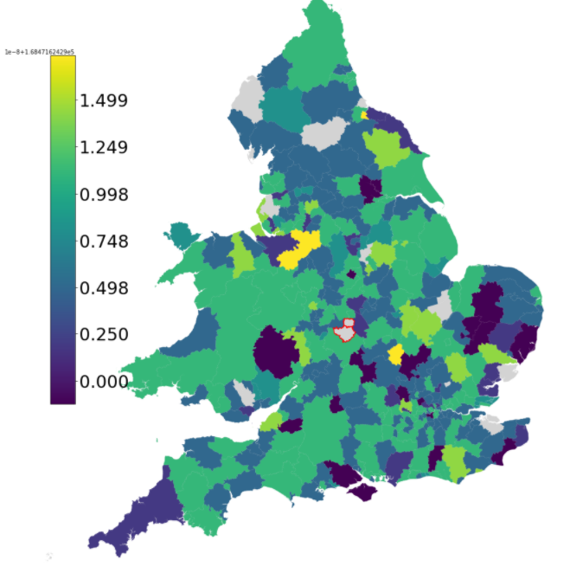
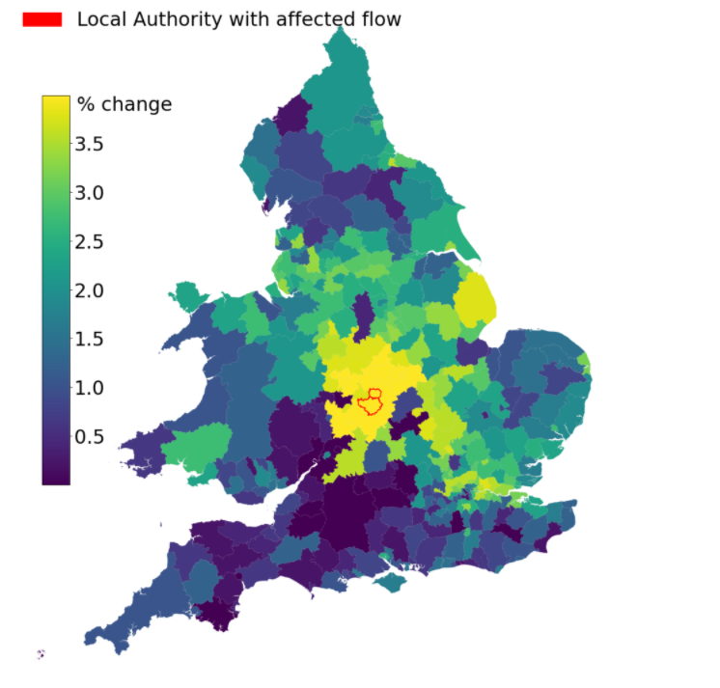
Experiment 1:
If we remove one row (flow) from the data does something changes?
Accessibility
Page Rank
UK Intra-migration
Notes:
So we designed simple experiment on real-world data.
If I change something in the network, is the structure measure going to capture it?
In this example I took Intra migration data in England and wales, removed one flow between two local authorities (Coventry and warwick), then I used both measures to capture the structure before the flow removal and after the flow removal and simply calculated the diffrenece.
CLiCK
On the first map you can see that using the accessibility measure to capture the pattern might not be the best choice. Firstly the biggest difference seems to be happening quite randomly, Some of the places are not even considered as part of the system and, the most important thing, those local authorities where we romeved the flow and should be haffected the most, are actually not affected at all.
CLICK
If you look at the second map, where Page Rank is used in the same situation. You see that the areas where flow was removed is affected the most. W also see that highly affected are areas closely connected or those that are very important for migration such as London. This suggests that page rank is more intuitive in capturing the pattern and measures it in both local and global scale.

Slide 18
Experiment 2:
How does this work on real data?
Unipartite
Bipartite
Base gravity model
Competing Destination model (with Accessibility term)
Model with Page Rank term
Notes:
Once we had measure that could evaluate how well the patterns are replicated, we can look at how well existing models replicate this spatial pattern
So in the second experiment, we defined some basic models. First one is just most basic gravity model, second we use the competing destination from stewart Fotheringham. And third just for reference model that includes page rank as an additional term.
CLICK
Because we know that not all the spatial interaction systems are the same we applied those models to two different datasets, one which has very generic structure and one which has a bipartite structure, where some entities are only generating flows and some only receiving flws.

Slide 19
Unipartite interaction
Bipartite interaction
79%
79%
98%
Observed pattern
Observed pattern
98%
97%
98%
Predicted pattern
Predicted pattern
Base gravity model
Competing Destination model (with Accessibility term)
Model with Page Rank term
Notes:
We then simply used Page rank to measure the spatial patterns from the data and the patterns from the models predictions. and found that
CLICK
In genericly structured interaction those models or no different from each other and they all replicate patterns efficiently.
However
CLICK
Once we did this with the bipartite interaction, we found that both basic interaction model and competing destination model really struggle replicating those spatial patterns, especially those on the tails of the distribution.

Slide 20
Take Away
1
Spatial structure can be broken down into locational structure and functional structure
Using the flow volumes might be a crucial in accounting for functional structure
2
Complex network incorporation in model design and development will be crucial
3
Pattern validation methods can reveal how well our models replicate spatial structure
Network structure measures such as Page Rank can be efficient capturing spatial structure
Notes:
Now if there is 3 things I want you to take out of this presentation, then
CLICK
The first is that spatial structure cab be broken down into locationa and functional, and that the flow volumes are an important source of information for the functional structure
CLICK
The second, that we need to start incorporating complex networks into our model design and development.
CLICK
And the third, that the pattern validation methods can reveal an important information about your models and that network structure measures such as page rank are very effective in doing so.

Slide 21
Spatial Structure in Spatial Interaction
Rethinking how spatial structure is used to build and validate SIMs.
Lenka.Hasova@bristol.ac.uk
@LenkaHas
Thank you
e.tranos@bristol.ac.uk
@EmmanouilTranos
levi.john.wolf@bristol.ac.uk
@levijohnwolf
Notes:
Thank you for your time.

Slide 23
Spatial Structure in Spatial Interaction
$F_{ij}=k{ M}_{i }M_{j}$ f($D_{ij}$)
What is Spatial Structure?
Measures of structure don’t work well, particularly for bipartite graphs
How do I know if my model replicates spatial structure?
3 main issues

Slide 24
My SI network is too different
How do I know if my model replicates spatial structure?
Solution - More variation
What is Spatial Structure?
Unipartite
Bipartite

Slide 25
My SI network is too different
How do I know if my model replicates spatial structure?
Performance measures
R2
RMSE
Common part of Commuters
What is Spatial Structure?

Slide 26
Can we use the flows themselves (weight of interaction) to provide additional information to our model?
Network Structure measures such as Page Rank?

Slide 27
Unipartite interaction
Bipartite interaction
Observed pattern
Observed pattern
48%
98%
81%
97%
98%
Predicted pattern
Predicted pattern
Base gravity model
Competing Destination model
Model with Page Rank term

