Slide 1
Earth2Class: An Innovative Strategy to Teach Climate Change Education
Michael J. Passow

Slide 2
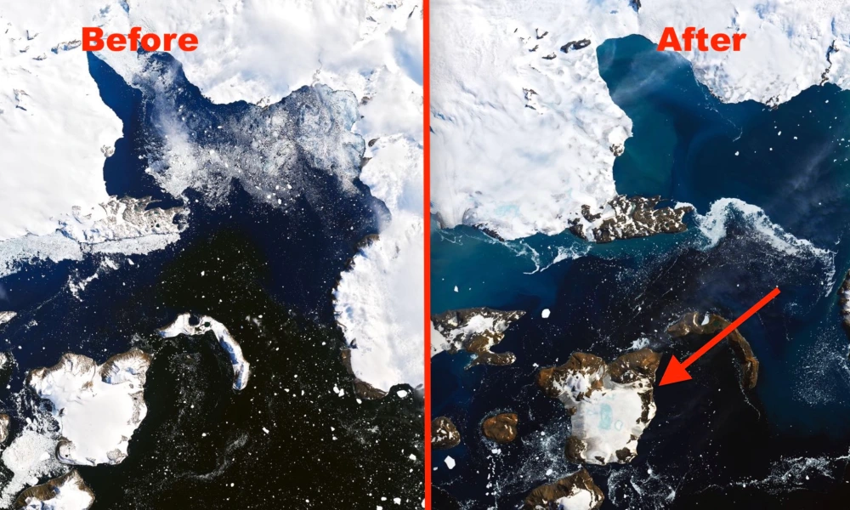
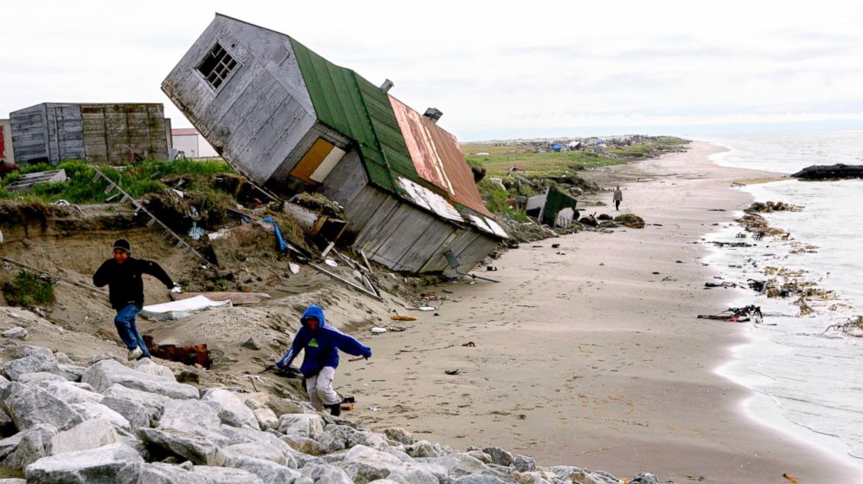
How can we help students and teachers enhance their understanding of climate change?
Is learning about climate change better based on published, agreed-upon Standards and Textbooks or
hearing directly from field researchers engaged in cutting-edge investigations?
Young children gradually develop a sense of weather from day-to-day experiences and, over time, a sense of seasonal changes. With a growing awareness of maps, they create a mental image of the wider world. Of course, no one can travel everywhere, but through positive classroom and informal learn experiences, they form a mental geography catalog through which they ‘believe’ that other places which they have never visited look in certain ways and have certain climates.
Once children form such understandings of what “is,” the next step is to form a sense of “change.”; that is, grasp the idea that things have not always been the way they are now, and will continue to change in the future. Accepting change is one of the most important, yet difficult mental constructs, in part because it requires adapting to new realities during a time when children are just learning how to deal with their current reality.
(1) Antarctica Then and Now - Bing images
https://abcnews.go.com/US/leaving-ancestral-home-alaska-village-votes-move-due/story?id=41482755

Slide 3
Developing acceptance of what one reads
Think back to when you were a child: people read books to you, and perhaps it was hard at first to distinguish between reality and fairy tales. Many stories involve change.
We usually enjoy those where the change seems for the better (e.g., Cinderella, Beauty and the Beast) and less satisfied with those where the main characters wind up for the worse (King Arthur, Don Quixote, Romeo and Juliet)
Can you provide other examples? (Please put them in the chat)
King Arthur - Wikipedia

Slide 4
Now let’s go back to thinking about climate change
Constructing mental models of climate and climate change involve melding physical science and geographic constructs. Examples of physical science concepts include global atmospheric circulation models, local environmental conditions and energy fluxes. Geographic constructs include biome and topographic features (such as deserts and rain forests) and positions on our planets (latitude and height).

Slide 5
Politics
Further complicating the teaching pf climate change are political influences. Parental, school district, and/or community ‘norms’ based on what they have read or seen in media may strongly influence what they are comfortable having their children learn.
Often such media presentations are not supported by scientific evidence.
Teachers, by training, are more readily accepting of Science Standards, so these should be of the highest possible quality.
What Standards apply to Climate Change?

Slide 6
Science and Social Studies Standards pertaining to Climate Change
Next Generation Science Standards(https://www.nextgenscience.org/)
Center for Civic Education (https://www.civiced.org/standards?page=58toc)
National Council for the Social Studies (https://www.socialstudies.org/standards/national-curriculum-standards-social-studies-introduction
National Council for Geographic Education (https://ncge.org/teacher-resources/national-geography-standards/

Slide 7
“I hear and I forget/ I see and I remember/ I do and I understand” – ancient saying
There is no need for each of us to make the same discoveries.
But what’s more inspiring: reading words in a text or hearing about cutting-edge discoveries or projects from the people conducting them?
The Earth2Class (E2C) programs at the Lamont-Doherty Earth Observatory of Columbia University in Palisades, NY ( at the NY/NJ border) have provided an effective strategy for research scientists to share their work with a broader audience. In recent years, there has been a slight shift from “pure” scientific investigations” toward projects more aligned with Social Studies and Geography, and which examine and support environmental sustainability, especially with regard to the impacts of climate change

Slide 8
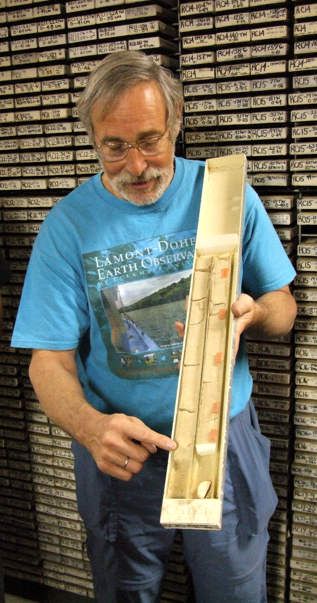
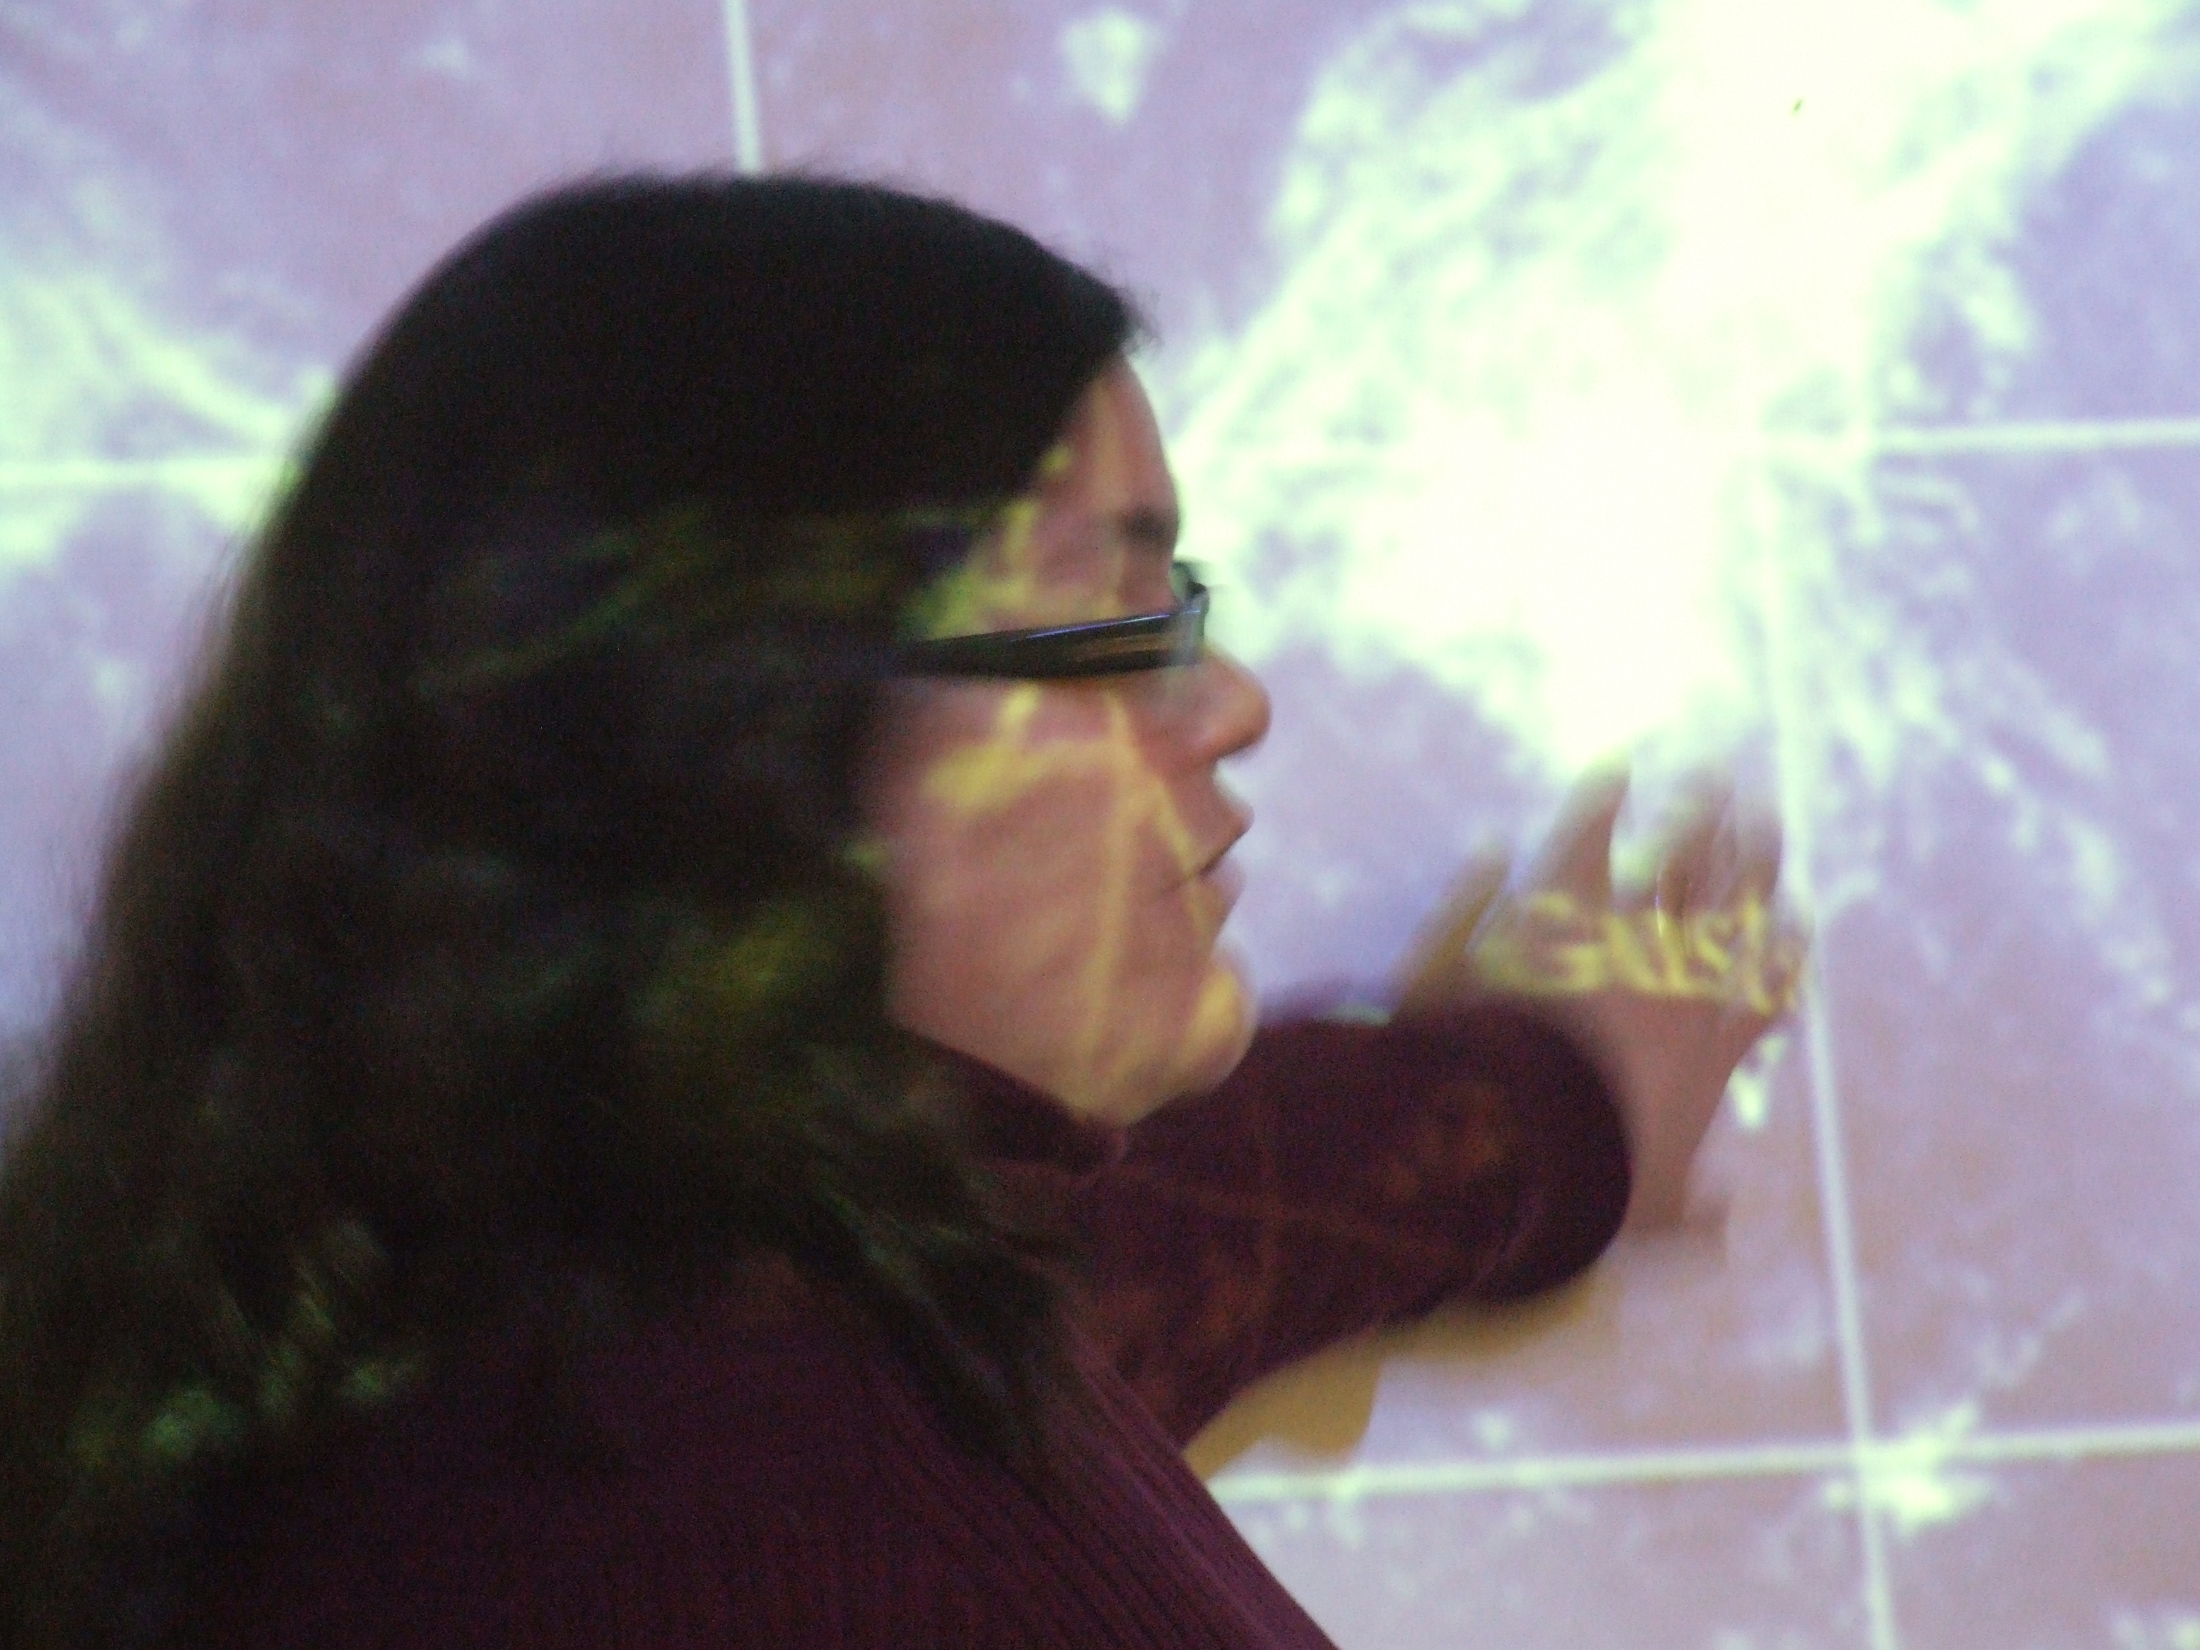
The “Earth2Class” Program
Started as Saturday morning workshops for teachers
Expanded to full-day programs for teachers and students in the NYC metropolitan region
Partly grant-supported, partly fee-supported
Transformed into free zoom-based during COVID-pandemic, thus opening E2C to participants anywhere
Educational resources available at https://earth2class.org/site
Dr. Susanne Camarga discussing tropical storm patterns during an E2C

Slide 9
Best example of E2C dealing with climate change
Ikaaġvik Sikukun: Bridging the Scientific and Indigenous Communities to Study Sea Ice Change in Arctic Alaska
with Dr. Christopher Zappa
on 6 March 2021

Slide 10
The Ikaaġvik Sikukun project has successfully built bridges between a diverse team of scientists and Indigenous Knowledge-holders to study the changing sea-ice environment of Kotzebue Sound, Alaska.
Co-producing hypotheses in partnership with an Indigenous Elder advisory council to develop research questions that cut across disciplinary boundaries and address the needs of both the local and scientific communities.
designed and carried out a research plan to observe the sea ice and marine mammals in Kotzebue Sound and how these come together as habitat and hunting grounds.
now in a unique position to turn these interrelated observations into answers to our research questions.

Slide 11
Another example of climate change, science, and social studies
“Trees, Climate, and Societal Relevance: A Case Study in Mongolia”
“with Caroline Leland and Mukund Palat Rao September 2014

Slide 12
Tree rings are a valuable proxy used for understanding past environmental conditions. Information attained from tree rings can provide information relevant to climatology, ecology, archaeology, and can also be applied to other important disciplines like infrastructure risk planning and index insurance.
We will review studies which show how tree-ring data have been instrumental for evaluating past climatic variability in semi-arid Mongolia, which is highly sensitive to changes in moisture, over centuries and millennia. These findings have significant implications for the development of human societies.

Slide 13
National Geography Standards https://www.nationalgeographic.org/standards/national-geography-standards/)
Using maps and other geographic representations, geospatial technologies, and spatial thinking to understand and communicate information.
Using mental maps to organize information about people, places, and environments in a spatial context.
Analyzing the spatial organization of people, place, and environments on Earth’s surface.
Physical and human characteristics of places.
How culture and experience influence people’s perceptions of places and regions.
Physical processes that shape the patterns of Earth’s surface.
Characteristics and spatial distribution of ecosystems and biomes on Earth’s surface.
Patterns and networks of economic interdependence on Earth’s surface.
How human actions modify the physical environment.
How physical systems affect the human systems.
Change that occurs in the meaning, us, distribution, and importance of resources.
Applying geography to interpret the present and plan for the future.

Slide 14
Selected E2C Programs about Paleoclimatology
“What Can Dust Reveal about Past Climates?” with Jerry McManus, Gisela Winckler, and Allison Jacobel (Oct 2016)
https://earth2class.org/site/?p=11637
“The Climate Mystery of 536 A.D. – The Dual Role of Multiple Mid-Latitude Eruptions and Tropical Volcanic Eruptions with Dallas Abbott (May 2021)
https://earth2class.org/site/?p=17275
“Tree-ring narratives of environmental change from the Arctic to the tropics” with Laia Andreu-Hayles (Nov 2021)
https://earth2class.org/site/?p=17460

Slide 15
E2C Programs Exploring Future Climate Change
“Can Coastal Cities Cope with Sea Level Rise?” with Klaus Jacob (Sep 2019)
https://earth2class.org/site/?p=16480
“How Do We Know the Temperature of the Earth?” with Nathan Lennsen (Oct 2021)
https://earth2class.org/site/?p=17349
“Great Rivers and Changing Oceans” with Ajit Subramaniam
(Jan 2018)
https://earth2class.org/site/?page_id=13933

Slide 16
https://earth2class.org/site
For more information or to register for future E2C programs, send an email to:
Dr. Michael J. Passow
michael@earth2class.org
THANK YOU!

