Slide 1
The dynamic roles of chronic disease, socioeconomic factors, and mobility on population vulnerability during the COVID-19 pandemic
Jessica Embury – Dept. of Geography, San Diego State University
Ming-Hsiang Tsou, PhD - Dept. of Geography, San Diego State University
Atsushi Nara, PhD - Dept. of Geography, San Diego State University
Eyal Oren, PhD - School Of Public Health, San Diego State University

Slide 2
Agenda
1. Study Area and Time Frame
2. COVID-19, Chronic Disease, and the Social Determinants of Health (SDOH)
3. Spatial Analysis & Modeling
4. Conclusions

Slide 3
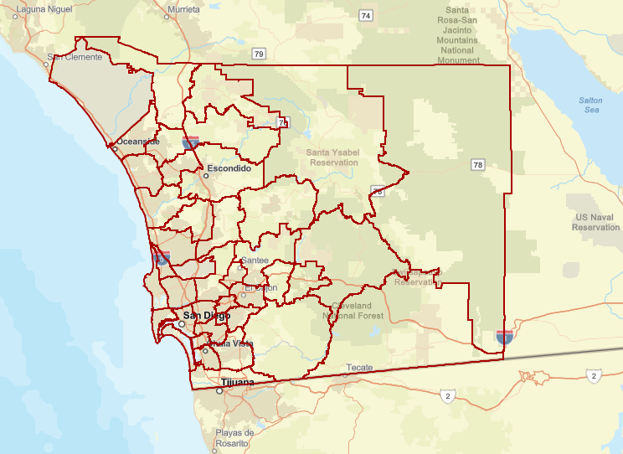
COVID-19 in San Diego County, California
41 Sub-Regional Areas (SRAs)
~12-Month period from 3/31/2020 – 4/3/2021
Stage 1 (3/31- 6/24): Introduction
Stage 2 (6/25 – 8/18): “First wave”
Stage 3 (8/19 – 10/31): Stability
Stage 4 (11/1 – 1/23): “Second wave”
Stage 5 (1/24 – 4/3): Vaccinations
Notes:
Introduce Sub-Regional Areas, general county attributes, 5 pandemic stages,

Slide 4
The links between COVID-19, Chronic Disease, and the Social Determinants of Health (SDOH)
Increases likelihood of severe COVID-19 infection, hospitalization, and mortality*
Social Determinants of Health (SDOH)
Chronic Disease
Social and environmental conditions that influence our lives and health
Socioeconomic Variables
Built Environment
Healthcare Accessibility
COVID-19
Health Disparity!
* Centers for Disease Control and Prevention. People with certain medical conditions. https://www.cdc.gov/coronavirus/2019-ncov/need-extra-precautions/people-with-medical-conditions.html
Notes:
What are SDOH? Give examples of each (socioeconomic, built environment, healthcare accessibility).
Low SES related to chronic disease development (diet, preventative care, etc.) and COVID-19 exposure (employment, information literacy/communication, etc.).
Chronic disease increases likelihood of negative COVID-19 outcomes.
SDOH + Chronic disease + COVID-19 = Health disparity

Slide 5
Question #1
Which socioeconomic variables are potential Social determinants of health?
Notes:
To better understand vulnerability in SD County (and elsewhere), we asked the 1st question.
Describe SES variables.

Slide 6
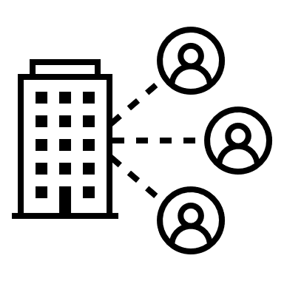
What socioeconomic variables are correlated with COVID-19 case rates?
Pearson’s correlation analysis with COVID-19 case rates and socioeconomic variables (26 highly correlated, p-values≤0.05 for the 5 pandemic stages)
5 “Potential SDOH” Categories:
(1) Language spoken at home (4) Income
(2) Employment industry (5) “Crowded” home living situation
(3) Educational attainment
Relationship strengths decrease over time
Multicollinearity concerns
Notes:
Methods.
Variables in categories (SDOH)
Multicollinearity, presents challenges to further analysis
Overall decrease in relationship strength over time – Other factors influence continued spread.

Slide 7
Can the SDOH variable subset characterize chronic disease rates?
Ridge regression modeling addresses multicollinearity
2017 hospitalization and mortality rates:
(1) Coronary Heart Disease (4) Mental Illness
(2) Diabetes (5) Pulmonary Disease
(3) Hypertensive Diseases (HTN)
Hypertensive Disease Hospitalization Rate (R² = 0.952): Relationship strengths decrease
Diabetes Death Rate (R² = 0.903): Linear relationship stable, but data suppression
Notes:
Methods.
Variables in categories (SDOH)
Multicollinearity, presents challenges to further analysis
Overall decrease in relationship strength over time – Other factors influence continued spread.

Slide 8
Question #2
Can spatial modeling with chronic disease rates identify the communities that are most vulnerable to COVID-19?
Notes:
Spatial modeling with chronic disease rates to better understand COVID-19 in SD County. Since SES variables are highly related to one another, avoid multicollinearity issues.
COVID-19 and chronic disease rates both display positive spatial autocorr (clustering) that justifies spatial analysis

Slide 9
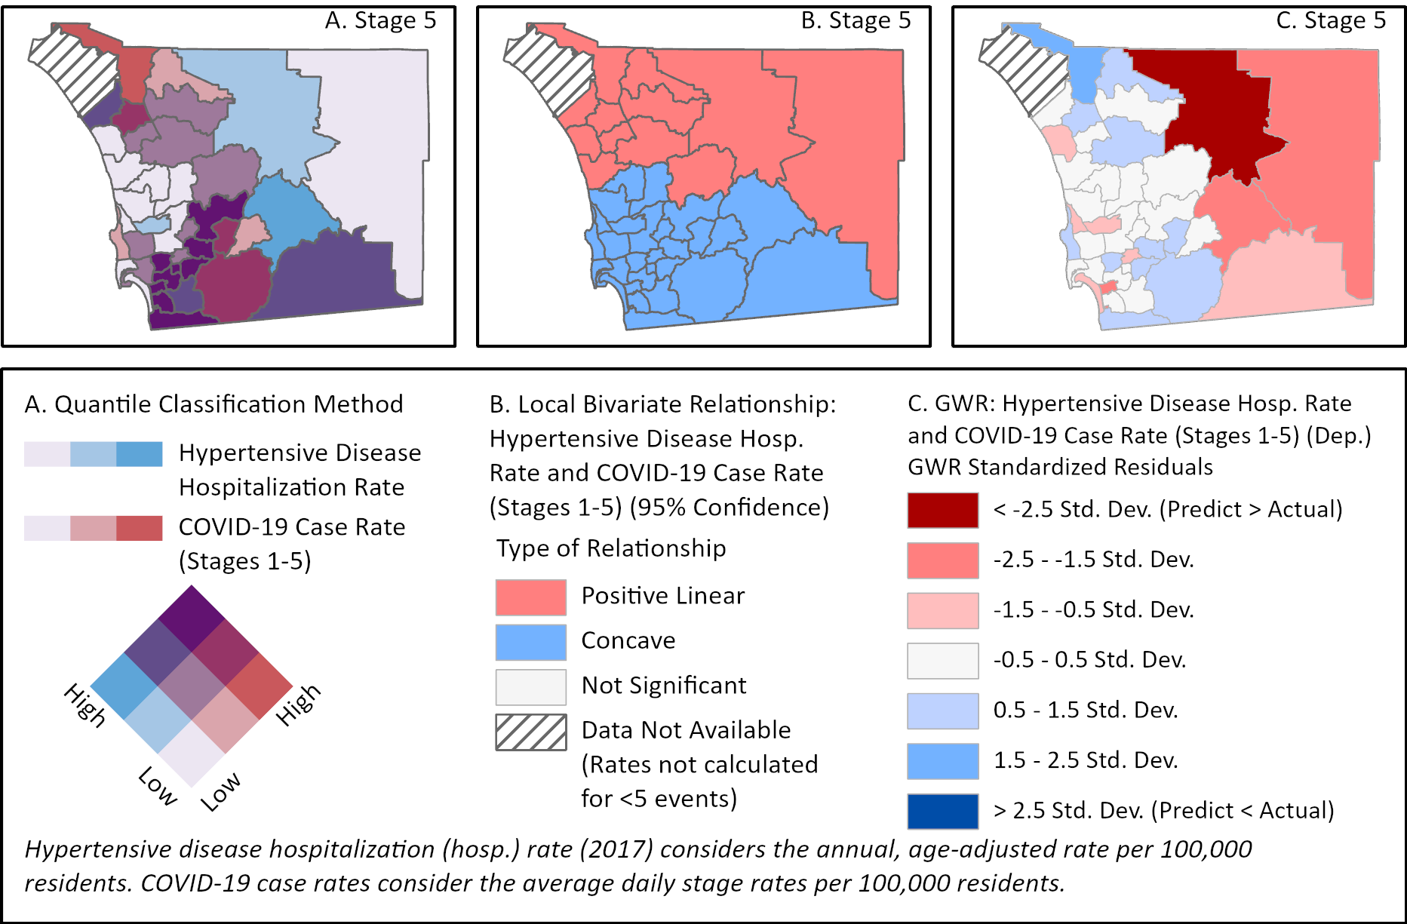
Spatial Analysis
A. QUANTILE CLASSIFICATION: General H-H, L-L pattern
B. LOCAL BIVARIATE: Transition from linear to concave in the south
C. GEOGRAPHICALLY WEIGHTED REGRESSION: Underpredictions reveal vulnerable communities
Notes:
Review A, B, C maps.
For C, describe how well predicted areas (white) are stable/resilient, underpredictions (blue) reveal communities that are vulnerable, overpredicted areas (red) are rural and military

Slide 10
Question #3
How does mobility data augment the spatial models?
Notes:
As noted before (Q1), overall influence of SES variables decreases as the pandemic progresses.
Look at other factors – Mobility.
How does adding mobility data affect the models?

Slide 11
Mobility Data
Big data from location-aware devices (e.g., mobile phones)
Origin-Destination (O-D) mobility flows aggregated to match the extents of the project (SRAs, 5 pandemic stages)
(1) Within SRA flows (4) Net flows (Inflow – Outflow)
(2) Inflows (5) Total flows (Within + In + Out)
(3) Outflows
Spatial autocorrelation (Clustering) & Linear relationships with COVID-19 case rates
Mobility Connection: Community entry/exit increases COVID-19 exposure
Notes:
What is SafeGraph data?
We had to aggregate data to match the extents of the project (time and space)
Looked at spatial autocorr and pearsons (with COVID-19) – Net flows only real option for analysis
Mobility-COVID19 connection.

Slide 12
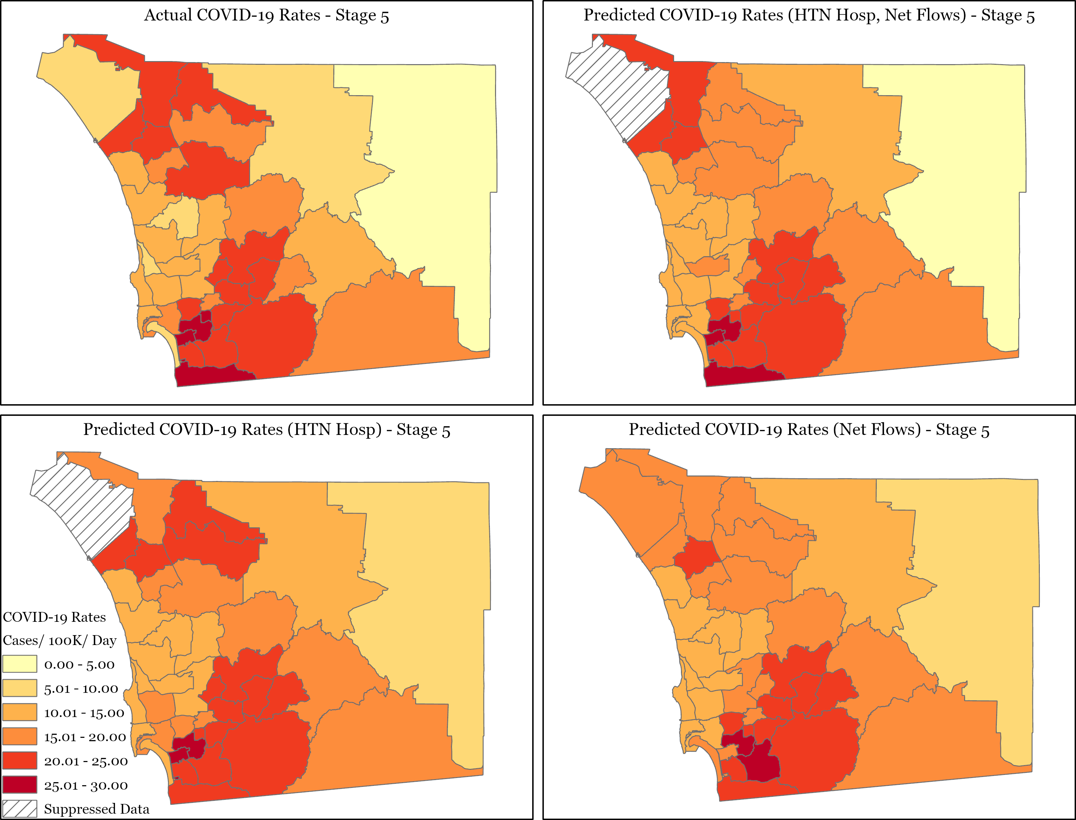
Spatial Analysis
Net flows added to GWR
Coefficients
Net flow < HTN (x100)
Net flows improve models during Stages 2, 3, and 5
HTN-only models better during Stages 1 and 4
Notes:
Back to our question - How does mobility data augment the spatial models? At these extents it really doesn’t
Coefficients
Models improved in 2, 3, and especially 5
HTN only model better in 1 (introduction phase, stay at home orders) and 4 (second wave, very high rates)
Net flows seems to add value during times of relative stability

Slide 13
Project Challenges
Data challenges:
(1) Privacy & Suppression (3) SRA (few units, high variability)
(2) Healthcare Access (4) Community level results
Effects of movement and travel:
Need to model at finer spatial and temporal resolutions
Notes:
Discuss data challenges
Need to use finer resolutions to study the effect of mobility on COVID-19 data (also time lag)

Slide 14
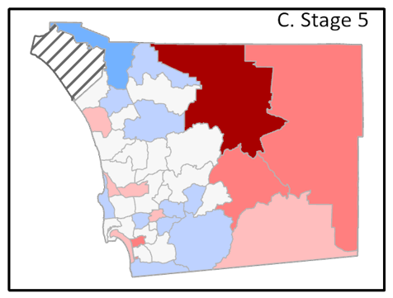
Project Findings
Clear connection between COVID-19, chronic disease, and the potential SDOH
Insights from GWR (supplemented with local area knowledge)
(1) Resilience (3) Rural communities
(2) Vulnerability (4) Military areas
Supports call for spatially differentiated public health policies to meet the needs of diverse communities
Notes:
Discuss data challenges
Need to use finer resolutions to study the effect of mobility on COVID-19 data (also time lag)

Slide 15
Acknowledgement
We thank the staff and epidemiologists in the County of San Diego, Health and Human Services Agency, Public Health Services, Epidemiology and Immunization Services Branch and Community Health Statistics Unit for their great efforts to create the public COVID-19 data sharing website and chronic disease datasets in the San Diego County Data Portal.
Data Sources: County of San Diego Health and Human Services Agency, San Diego Association of Governments, US Census Bureau American Community Survey, SafeGraph

Slide 16
Thank You!
Coming Soon to the CDC’s Preventing Chronic Disease journal:
A spatio-demographic perspective on the role of social determinants of health and chronic disease in determining COVID-19 population vulnerability
Jessica Embury; Ming-Hsiang Tsou, PhD; Atsushi Nara, PhD; Eyal Oren, PhD
https://www.cdc.gov/pcd/
Jessica Embury, jembury8568@sdsu.edu

