Slide 1
Sustainable Agroecosystems
Harnessing policy-driven land use change for the sustainability, productivity and vitality of agroecosystems
Dan Sousa¹, Amy Quandt¹, Ashley Larsen²
¹Department of Geography, San Diego State University
²Bren School, University of California at Santa Barbara
dan.sousa@sdsu.edu
NIFA Award # 2022-67019-36397, Jan 2022 - Dec 2025

Slide 2
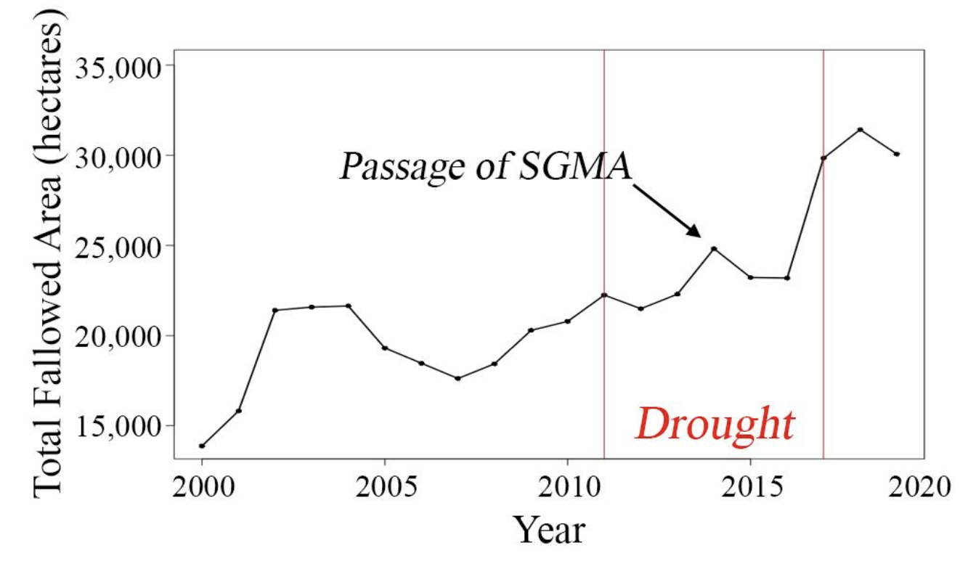
Climate is driving global increases in cropland retirement
Climate change-driven droughts are forcing governments around the world to implement policies restricting groundwater pumping.
California is a case in point, recently passing the Sustainable Groundwater Management Act (SGMA) in response to the historic 2011-2017 drought.
Reaching the mandated water balance under SGMA is projected to require the retirement of up to 315,000 hectares (780,000 acres) in California’s Central Valley, one of the world’s most productive agricultural landscapes.
2011-2017 drought provides a window into the future
Retired Lands: Areas that were once used as cropland, but are no longer in production
Total fallowed area in Kern County, CA increased by over 10,000 hectares (50%) over the course of the 2011-2017 drought.

Slide 3
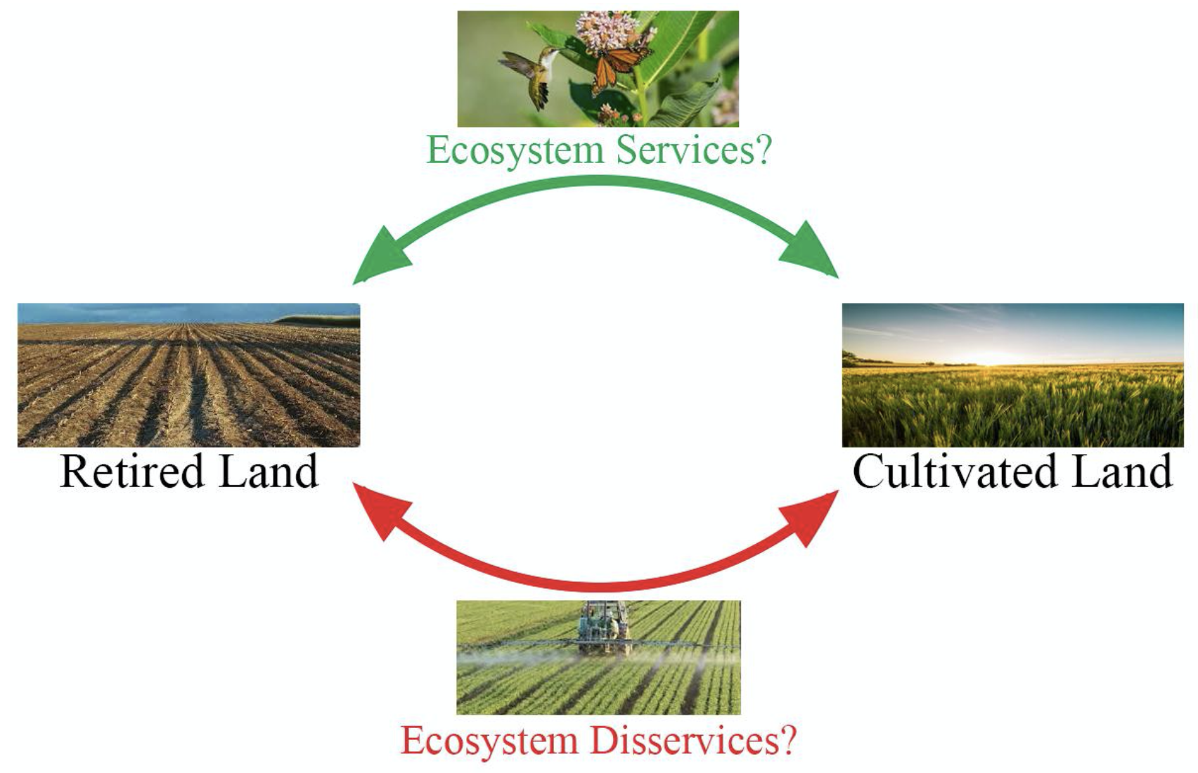
Do retired lands help or hinder adjacent crops?
Despite the staggering extent of future retirement, scientists have little understanding of how retirement affects ecosystem service (or disservice) provision on remnant croplands or how farmers can best respond to these land use changes to improve productivity and sustainability

Slide 4
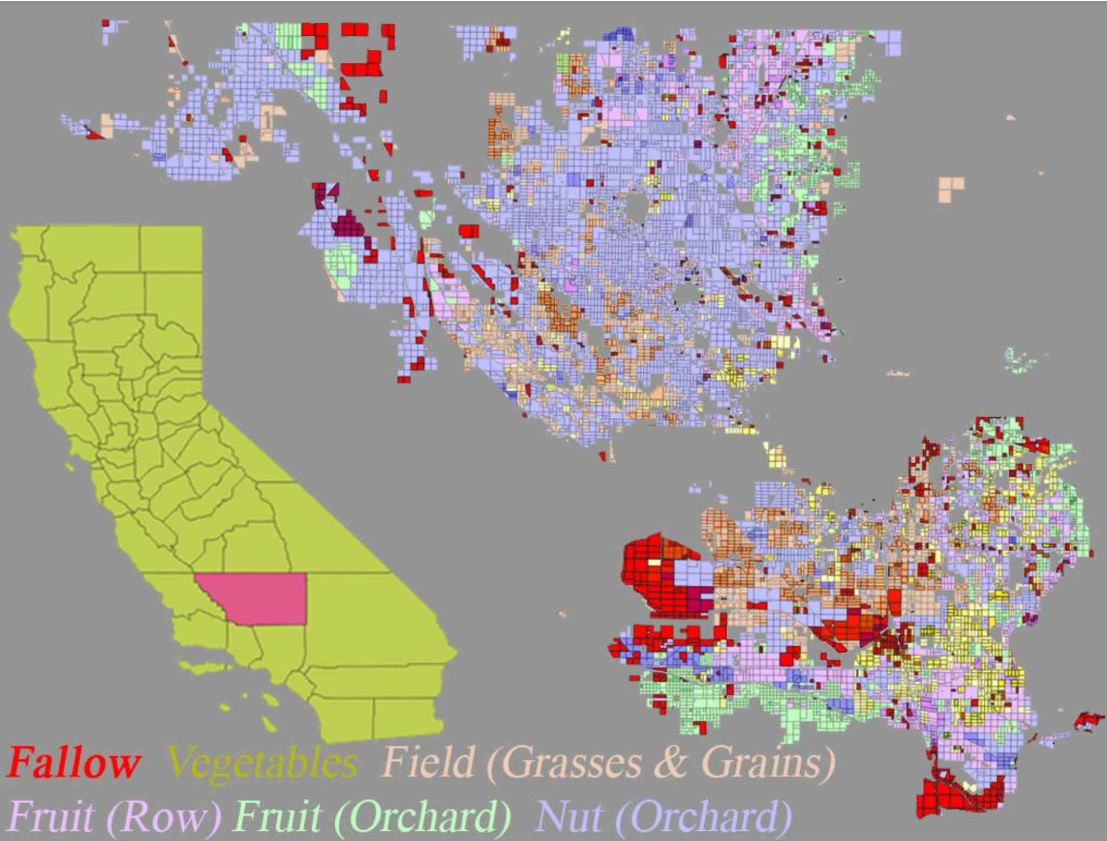
Study Area - Kern County, CA
High Value: Kern County, California is the most valuable crop producing county in the US, with crop gross value of around $7.4 billion annually
Large: Over 21,000 square kilometers (8,000 square miles) and is home to a population of over 800,000 people.
Underserved: 54.6% of Kern County residents are hispanic, 19.9% are foreign born, and 19% live below the poverty line.
Total fallowed area in Kern County, CA increased by over 10,000 hectares (50%) over the course of the 2011-2017 drought.

Slide 5
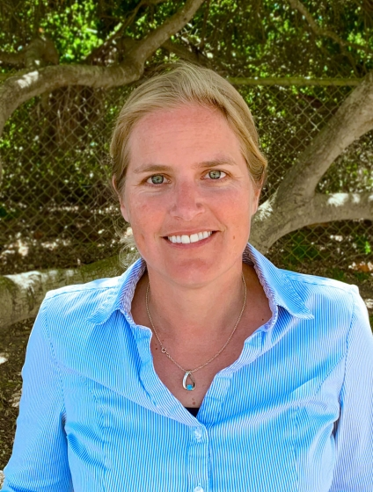
Multidisciplinary Team
Larsen (Agroecology)
Sousa (Remote Sensing)
Quandt (Perceptions)
Objectives:
1. Quantify spatial and temporal patterns of vegetation regrowth after retirement (Sousa);
2. Quantify impact of revegetation on adjacent crop health and pesticide use (Sousa & Larsen);
3. Build predictive models of ecosystem service impact for different retirement scenarios based on observed revegetation and impact (Larsen);
4. Engage producers in understanding the impacts of retirement on neighboring farms, and the co-development of management recommendations to maximize the benefits surrounding agricultural retirement (Quandt).

Slide 6
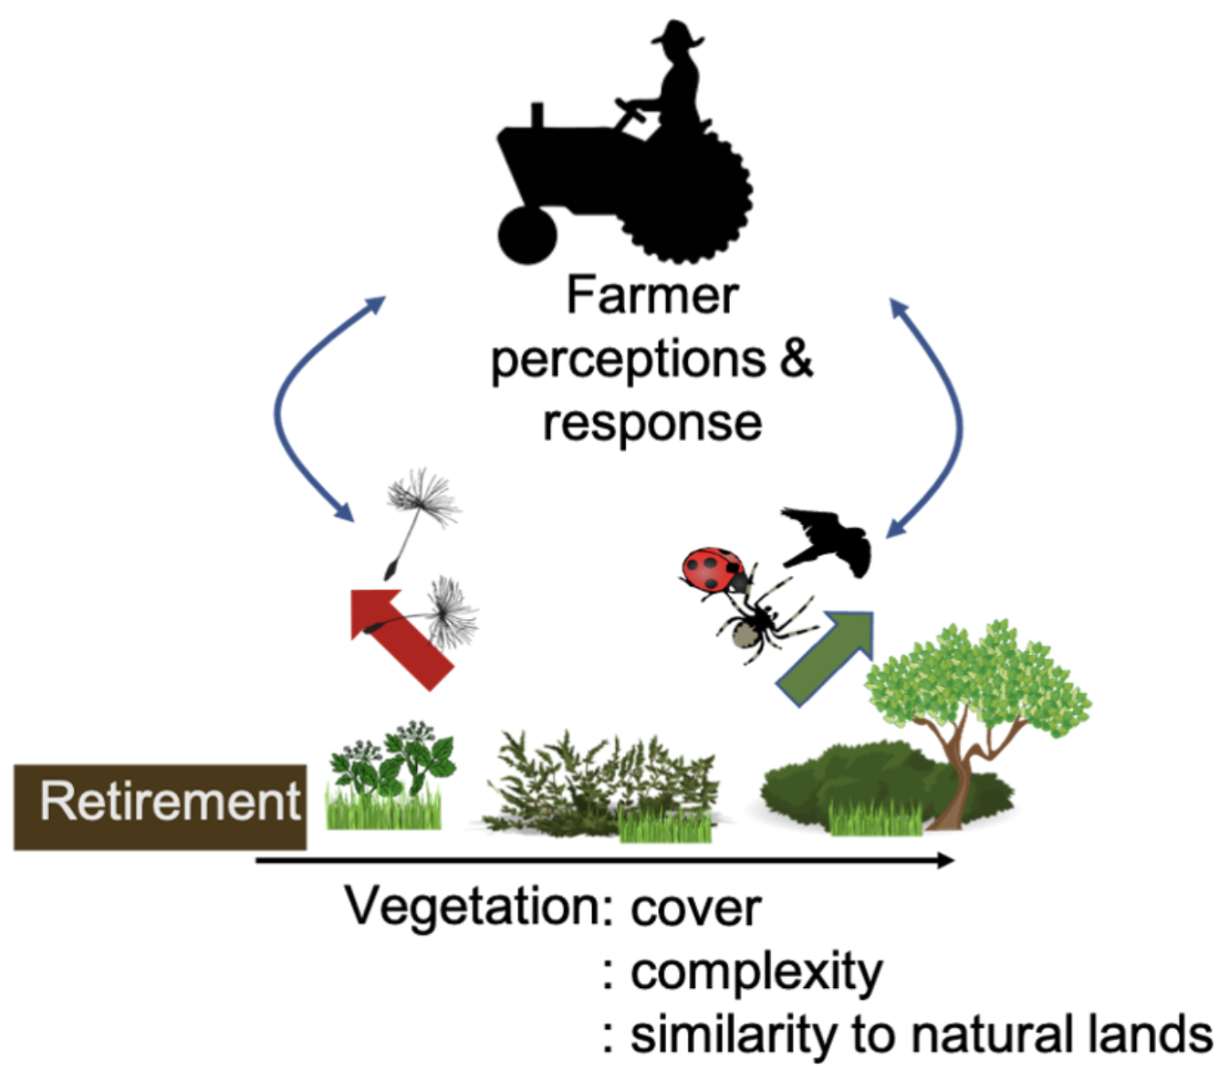
Hypotheses
Biophysical: In cultivated lands, plants nearest a retired field will have lower health than plants in the interior and plants on other field edges. This effect will be correlated with higher maximum ground temperatures and greater diurnal temperature variability in and near retired fields.
Management: On average, retired fields increase herbicide use and decrease insecticide use on nearby crops, with effects dissipating as distance from the retired field increases. Effect sizes will be crop specific.
Perception: Agricultural producers are already making farm-scale land cover allocation and land use efficiency changes in response to decreased irrigation water availability and their perceived impacts of increased agricultural retirement.
Hypothesized relationship between revegetation and pest control services (green arrow) and seen rain disservices (red arrow). Biophysical system interacts with human behavior to determine pesticide use and other interventions.

Slide 7
Remote sensing captures variations in revegetation
All historical Landsat images processed using globally standardized spectral mixture analysis (Sousa & Small, 2019; https://doi.org/10.1016/j.rse.2017.01.033)
Revegetation time series for example fields not cultivated 2000-2012 shown here.
Retired fields exhibit a wide range of vegetation phenologies, ranging from totally unvegetated to substantial seasonal plant cover.
Variability may be associated with various factors:
neighboring land use type
previous crop status
surface hydrology
landscape-scale climate variability
or area of contiguous fallowed land.

Slide 8
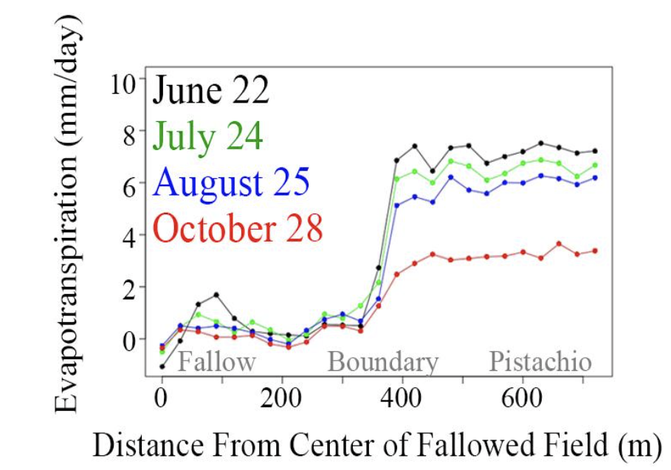
Remote sensing captures edge effects in water use
Pixel transects show evapotranspiration edge effects. Landsat- based estimates show gradually decreasing water use from field center to edge, regardless of season.

Slide 9
Summary
Remote sensing work is underway!
Multispectral and thermal image time series to evaluate historical revegetation trajectories
Early results indicate substantial spatial and temporal variability in revegetation
Anecdotally associated with climate, soils, past crop type
Potential thermal/ET edge effects?

Slide 10
Thanks!
Dan Sousa
Department of Geography
San Diego State University
dan.sousa@sdsu.edu

