Slide 1
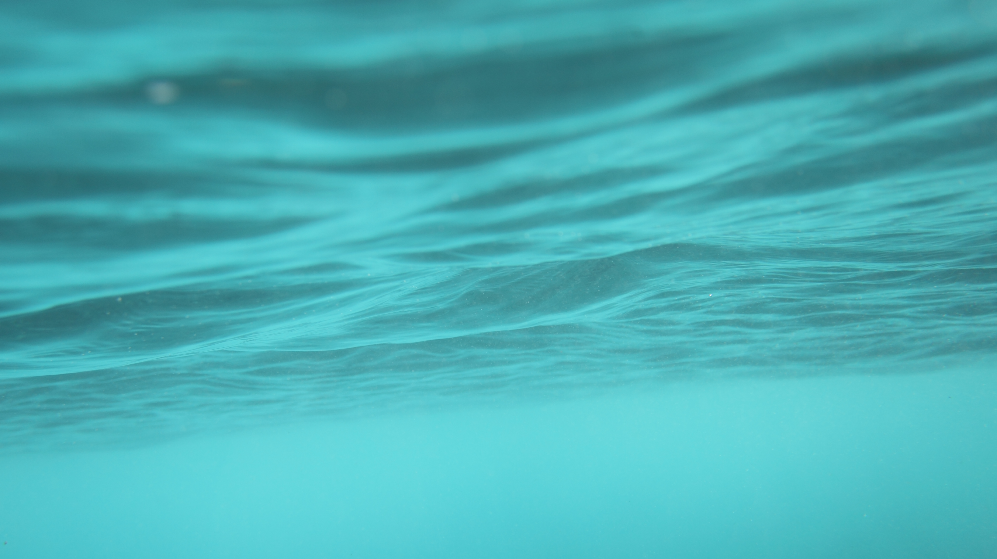
Codifying Oceanic Sovereignty
Micronesian Participation in UNCLOS-3
Meagan Harden
February 25th, 2022
American Association of Geographers Annual Conference
Notes:
Hi all, my name is Meagan Harden and I am a PhD student at the University of Hawai’I at Manoa. Today, I’m going to present a paper I’m writing entitled “Codifying oceanic sovereignty: Micronesian Participation at the Third United Nations Conference on the Law of the Sea.”

Slide 2
Water Acknowledgement
Twitter:
@kaohewai
Instagram:
Kaohewai
@oahuWP
Oahuwaterprotectors
Notes:
Before moving forward, and in keeping with the “oceanic turns” topic of this session, I want to offer a water acknowledgement in lieu of a land acknowledgement. I am presenting from the island of Oahu in the Hawaiian Islands where, as some folks may have seen on the news, US military installations have leaked jet fuel and sewage into both freshwater aquifers and saltwater bays. These Twitter and Instagram accounts contain more information related to decommissioning the fuel tanks and de-militarizing Hawai’I, so I encourage y’all to check them out, and also to note that this anti-militarism work has been spearheaded by Native Hawaiians, on whose ancestral homes these military installations are built.

Slide 3
Notes:
This group of people will be the “stars” of my presentation. They are the 1975 Congress of Micronesia, which is a legislative body modeled after the US Congress and created by the US administration, who intended the Congress to basically be a local extension of US interests. However, as I’m going to show during this presentation, that didn’t actually work out so well for the US.

Slide 4
Outline of the Presentation
Context
Conceptualizing “Oceanic Sovereignty”
Concluding Thoughts and Implications
Notes:
Quick outline

Slide 5
Arguments
Oceanic sovereignty is relational, dynamic, and based around norms of usage and sustainability.
This differs fundamentally from conventional models of sovereignty, which rely on discrete, exclusive, and static spatialities.
Turning to Indigenous and islander perspectives can help to advance “oceanic turns” by offering alternative political visions/forms, and by bringing ocean-oriented ontologies into geopolitical considerations.
Notes:
I theorize oceanic sovereignty as exhibiting 3 key characteristics: relationality, norms of use, and sustainability.

Slide 6
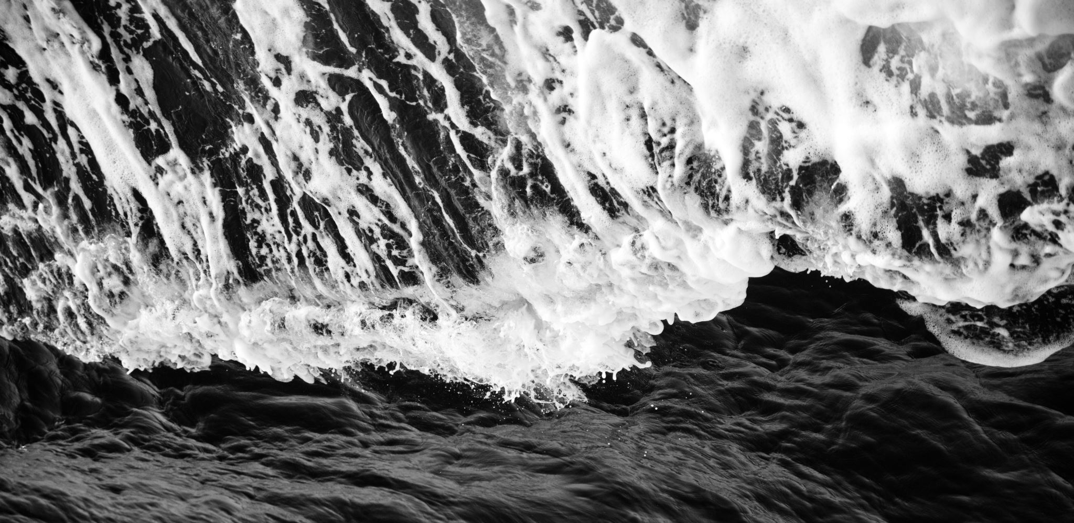
Oceanic Turns
Notes:
Steinberg and Peters’ “wet ontologies” and “more-than-wet ontologies” are foundational to my analysis in that they attend to the material dynamism, extending Stuart Elden’s work on voluminous geopolitics to engage with fluidity materially and as a metaphorical entry point into configurations of power.
One of the points that I want to make here is that, because ways of living with the ocean stretch back millennia, we can turn to Indigenous, islander ontologies of spatial governance that confound surface-level or singular interpretations of the sea (or, perhaps, seas plural).
Scholarship from Pacific Islanders provides a framework for my work, and the work of Tongan scholar Epeli Hau’ofa and Samoan scholar Damon Salesa have been especially helpful for thinking through spatial epistemologies of ocean space.
In his most well-known essay, Hau’ofa theorizes Oceania as a “sea of islands,” emphasizing that shared histories of voyaging, migration, and settlement actually link islands to one another. Here, Hau’ofa is speaking against the western trope of the ocean as an empty void or an isolating barrier, by pointing out relationships forged across it.

Slide 7
Oceanic Turns
Wet and more-than-wet ontologies (Steinberg and Peters, 2015; 2019)
Epeli Hau’ofa’s “sea of islands” (1994)
Damon Salesa’s “native seas” (2014)
Notes:
Steinberg and Peters’ “wet ontologies” and “more-than-wet ontologies” are foundational to my analysis in that they attend to the material dynamism, extending Stuart Elden’s work on vertical geopolitics to engage with fluidity materially, voluminously, and as a metaphorical entry point into configurations of power.
Scholarship from Pacific Islanders provides a framework for my work, and the work of Tongan scholar Epeli Hau’ofa and Samoan scholar Damon Salesa have been especially helpful for thinking through spatial epistemologies of ocean space.
In his most well-known essay, Hau’ofa theorizes Oceania as a “sea of islands,” emphasizing that shared histories of voyaging, migration, and settlement actually link islands to one another. Here, Hau’ofa is speaking against the western trope of the ocean as an empty void or an isolating barrier, by pointing out relationships forged across it.
Salesa’s “native seas” are also important to my theorizing. Basically, a native sea is an aquatic space that is known or marked based on norms of use. Crucially, native seas can be nested, overlapping, and adapted according to community needs.
This is a bit of an elementary visual, but if we imagine each of these circles as an area of sea space governed according to specific norms and relationships, we can visualize the points of overlap and connection across spaces. This of course looks very different than a political map of nation-states, and in the remainder of the presentation I’m going to talk about why and how I interpret the concept of oceanic sovereignty as functioning much more like Salesa’s model of native seas than [change slide].

Slide 8
Notes:
This.

Slide 9
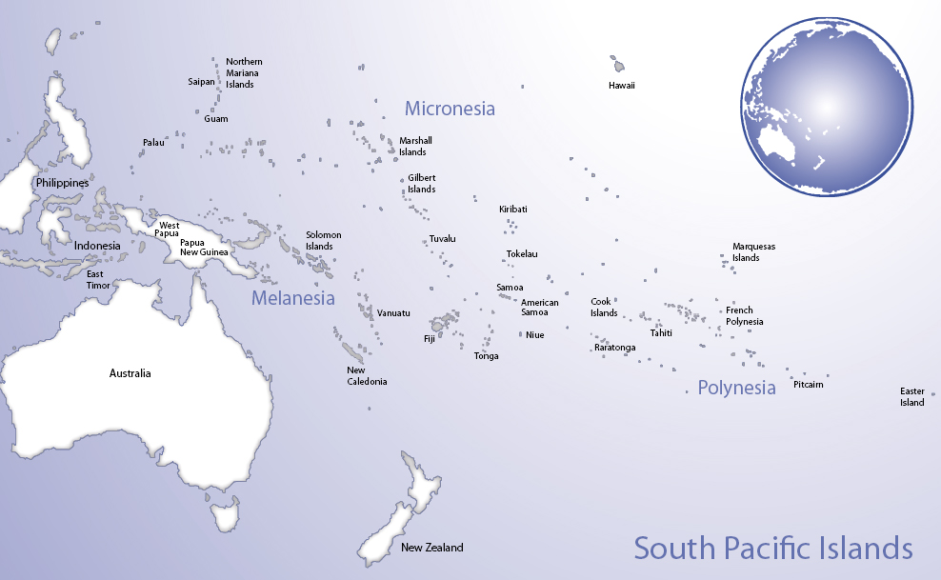
Pacific Peoples’ Partnership (2020).
Notes:
At the conclusion of World War II, the US claimed administrative authority over Japan’s colonies in the Pacific, and this area of Micronesia became governed under the UN’s Trust Territory system. This system was geared towards political and economic development for the trust territory, with the ultimate goal of supporting transitions to independence.
-details of the trust agreement enabled the US to establish a military presence in the islands.

Slide 10
Pacific Peoples’ Partnership (2020).
Notes:
The future political status negotiations to determine how the trusteeship would end started in 1969 and lasted well into the 1990s. Over the course of the negotiations, the TT splintered into what are today the commonwealth of the Northern Mariana Islands –which are in a commonwealth relationship with the US; and the independent republics of the Marshall Islands, Palau, and the Federated States of Micronesia.
The three independent states each has a Compact of Free Association with the United states, which basically allows the US to maintain exclusive defense authority over the islands and surrounding waters, in exchange for ongoing economic aid and visa-free travel to the US.

Slide 11
Timeline
UNCLOS-3
Political Status Negotiations
Trust Territory of the Pacific Islands
1950
1970
1990
Notes:
The following analysis is derived from my archival research over the past year, conducted in the TTPI archives housed at Hamilton Library here in Honolulu.

Slide 12
Law of the Sea
Notes:
So, a few points about the third Conference on the Law of the Sea, which I expect most folks here have at least some familiarity with. The goal of the Conference was to establish an international convention outlining oceanic governance, with the stated goal of preserving humankind’s common heritage –the sea, and everything in it.
For the sake of brevity, I’m just going to emphasize that the Convention established both vertical and horizontal delineations of sea space, on the general premise that the further one goes from shore whether up, down, or out horizontally, the less exclusive the rights of use and mobility become. So, for example, the territorial waters closest to the shore are under the jurisdiction of the coastal state, while the high seas ways off this direction are not under any state’s jurisdiction.

Slide 13
Oceanic Sovereignty | Westphalian Sovereignty
Relational | Exclusionary
Membership determined by demonstrated use, (local scale) | Citizenship based on membership in national body (national scale)
Sustainable, Reciprocal | Competitive
Notes:
So I’m going to introduce what I’m calling oceanic sovereignty, which I define based on these three key characteristics.
Whereas conventional models of sovereignty, especially in the sort of ideal Westphalian form, necessitate excluding others, oceanic sovereignty is constitutionally relational; whereas Westphalian sovereignty defines citizenship on the basis of membership in this imagined community, oceanic sovereignty necessitates demonstrable use of the sea at very local scales.
whereas Westphalian sovereignty, especially in the capitalist era, prompts states to compete with other states for resources, oceanic sovereignty aims to nurture local ecologies for benefits across local, national, regional, and even global scales. This is related to the relationality characteristic, but I’m distinguishing the two here for the sake of emphasizing the ecological sustainability aspect.
Lastly, whereas conventional sovereignty aims to preserve the boundaries/borders of territory, oceanic sovereignty recognizes that governance is necessarily dynamic, Like the sea itself, whose ebbs, flows, currents, waves, and whirlpools keep it in constant motion, the form and function of oceanic sovereignty change in response to local, national, regional, and global contexts.
It’s important to note here that scholars such as Alex Mawyer, Paul D’Arcy, and Tamatoa Bambridge have proposed similar terms for distinguishing forms of sovereignty in the Pacific Islands, but that these, and most other scholarship at least in the social sciences, is focused on sovereignty in the context of anthropogenic change. So, while this is related to my work, I want to emphasize that my theorization gets at the root of oceanic sovereignty, whereas this more conservation-focused work tackles possible outcomes/implications.

Slide 14
Characteristics of Oceanic Sovereignty
Relationality
Local, use-based
Sustainability and Care
Dynamism
Notes:
So, returning to the issue of spatial governance of the oceans, there are several possible interpretations of Micronesia’s participation in UNCLOS-3, each of which has its own merits. For example, a neoliberal institutionalist perspective might read their participation as an attempt to cement independent state status by participating in international institutions. Even though the Trust Territory was not yet independent, gaining recognition at the United Nations would mark the Congress of Micronesia as representing a state rather than a territory, shooing them into this international system of state actors.
We could also take a more realist approach to the Congress’ participation in UNCLOS by approaching it as a material-driven attempt to assert Westphalian forms of sovereignty. In this perspective, we could read LOS as a strictly territorializing effort geared towards maximizing economic resources and establishing clearly delimited borders that could legitimately exclude outsiders.
While both of these arguments provides a partial explanation for Micronesian participation in the Conference on the Law of the Sea, I want to suggest that a more ocean-centered perspective reveals something quite different being played out at the conference, and this “something different” is what I’m calling oceanic sovereignty. So, relatively quickly for the sake of time, I’m going to go through what I see as the four main characteristics that distinguish oceanic sovereignty from more conventional, western versions of sovereignty exemplified by the Westphalian state system.

Slide 15
U.S.
Congress of Micronesia
Access to minerals and migratory species
Maximum “freedom of the seas”
Military mobility
Economic self-sufficiency
International recognition
Existing use, relationships
Notes:
The Trust Territory began sending a Micronesian delegation to the Conference on LOS in 1975. Even though the TT was still under US admin, they requested observer status so that they’d have a chance to pursue their expectations and hopes for the Conference, which differed substantially from those of the US
The main difference was that the US wanted to maximize the amount of waters under the high seas classification, because this would enable the large continental state to move its military more freely outside other states’ jurisdictions, and to potentially exploit resources from the deep seabed.
Conversely, the Congress of Micronesia wanted to maximize the expanse of water that it would be able to claim upon independence. This is in part because doing so would allow for economic development on the form of regulating commercial fishing, and to gain recognition as an international actor. More importantly, though, was the fact that islanders’ lives were already deeply entrenched in the surrounding waters; in the archives, I found quote after quote referring to the seas as an extension of the land, as owned similar to land, and as absolutely fundamental to subsistence, spirituality, travel, and so on. So this highlight the first characteristic contributing to what I’m calling oceanic sovereignty: that is the local scale of governance and demonstrated use of the sea beyond economic/market purposes.

Slide 16
“The point is that the sea affects the lives of islanders in a more pervasive and intimate manner than it affects residents of continental nations.”
–Andon Amaraich

Slide 17
Use-based, Local
“Micronesians own the sea. They own it because they live on it… They own it because they have sailed it for thousands of years. They own it because they learned how to tame its and cope with its awesome power before anyone else did. They own it because they are totally dependent upon it for survival.”
–Tosiwo Nakayama and Fred Ramp
Notes:
This quote, pulled from a 1973 report by members of the Congress of Micronesia, addresses this facet of oceanic sovereignty:
“Micronesians own the sea. They own it because they live in it… They own it because they have sailed it for thousands of years. They own it because they learned how to tame it and cope with its awesome power before anyone else did. They own it because they are totally dependent upon it for survival.” (Nakayama and Ramp, 1974).
Rather than inclusion in a national body or imagined community, authority over sea spaces and resources stems from sustained use and responsibility.
Even though the delegation is asserting this at the international scale, the reasoning is based around the local, lived experiences of individuals and smaller communities; the delegation’s stake in LOS isn’t specific to a national identity.

Slide 18
Relational
Island nations “are simply small communities joined by various forms of binding ties”
–Nakayama and Ramp
Notes:
The second characteristic I include is Relationality. This is evident in this quote that I’ve pulled from a report by the Micronesian delegation to the LOS, which states that island nations “are simply small communities joined by various forms of binding ties.”
Thinking back to Hau’ofa’s sea of islands, we can interpret these “binding ties” as material in the form of the sea itself, political in the form of regional collaboration networks, and cultural in the form of shared histories. So, sovereignty over any swath of sea is inherently intertwined with other swaths of sea, necessitating a relational approach to governance.

Slide 19
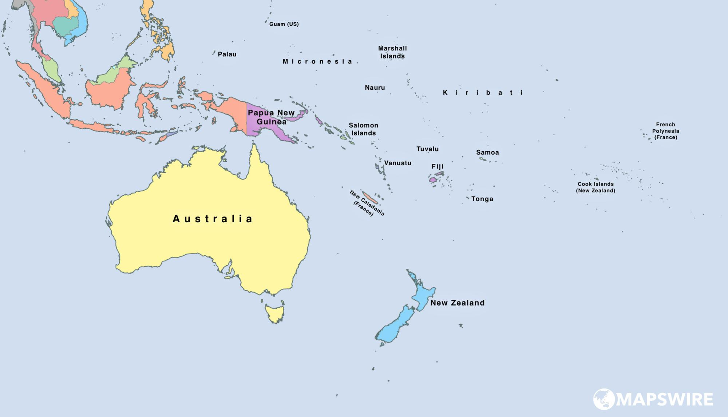
Oceania Group
MapsWire (2022)
Notes:
To illustrate the relationality characteristic, let’s look at the Oceania Group that emerged at the Conference. As an observer to the Law of the Sea conference, the Micronesian delegation forged alliances with other states in Oceania, many of which were themselves newly independent.
In a formal capacity, the Micronesian delegation joined the Oceania Group at the conference, which was comprised of New Zealand, Australia, Fiji, Tonga, Samoa, and Papua New Guinea.
The main goal of this regional group was to form a coalition of states with a vested interest in maximizing islanders’ authority over sea space.
We can see this through the delegation’s involvement with the Oceania Group, in which they collaborated not only for the sake of strength in numbers, but also because the group members recognize that they are connected by the sea.
The island entities represented by the Oceania group have shared histories of voyaging and settlement, and therefore have a literal common heritage manifested in the ocean.

Slide 20
Sustainable, reciprocal
“Intertwined with the issue of resource rights to the oceans is that of conservation. The resources of the sea are not unlimited. Many forms of sea-life are now threatened by over-exploitation.”
“It is important that Micronesia protect these resources from those who are presently able and willing to exploit these resources: the developed nations of the world.”
–Andon Amaraich
Notes:
Oceanic sovereignty is further characterized by a general focus on sustainability and reciprocity. By that I mean that with the right to use or enjoy the sea comes the obligation to respect its limits and to cultivate a relationship of care with it.
These quotes, both from a 1973 report by the Micronesian Joint Committee on the LOS, illustrate this.

Slide 21
Dynamism
Notes:
Finally, the fourth characteristic of oceanic sovereignty is dynamism. Because authority over the seas is relational and exhibited based on usage, reciprocity, and longevity, it is necessarily also dynamic.

Slide 22
Oceanic Sovereignty | Westphalian Sovereignty
Relational | Exclusionary
Determined by demonstrated use, local scale | Based on membership in national body
Sustainable | Competitive
Notes:
So, to conclude, I read the Micronesian delegation’s participation in Conference on the Law of the Sea as an exercise in “oceanic sovereignty,” which is a specifically ocean-oriented concept that is rooted in islanders’ relational ontology of land/sea/human relationships.
Oceanic sovereignty is a form of authority over sea spaces forged over millennia of settlement on the islands, and iterations of it can likely be traced back much further than the 17th century Westphalian state system.

Slide 23
Oceanic Sovereignty
Look backwards to look forwards
Geopolitical stakes
Alternative political futures
Notes:
So, what can all this tell us about oceanic turns?
First, it shows that ocean-oriented ways of thinking about the world have been present far longer than is represented in scholarship. This is an obvious point to make, but finding documents from the 1970s that reference oral histories oriented around the sea stretching back more than a millennium, really drives that point home.
Second, the fact that this oceanic sovereignty was asserted at the UN, the epitome of a state-centered international institution, suggests that there are real geopolitical stakes in unpacking oceanic sovereignty in its theoretical and practical forms.
Finally, → alternative political futures, especially regarding territoriality on land and sea.
Turning to Indigenous and islander perspectives can help to advance “oceanic turns” by offering alternative political visions/forms, and by bringing ocean-oriented ontologies into geopolitical considerations

Slide 24
Thank you! Email: mharden@hawaii.edu Twitter: @meaganharden_

