Slide 1
Differential Privacy and Digital Displacement of Communities of Color in Census 2020 Data: What Geographers Need to Know
Nick Chun, PhD Student
Jason Jurjevich, Associate Professor of Practice

Slide 2
Overview
FROM START TO FINISH
What is Differential Privacy?
A brief overview of differential privacy and how it affects the accuracy of 2020 Decennial Products
“On-Spine” Geographies
Compare accuracy of results between the 2019 and 2021 vintages of the 2010 Demonstration Data
“Off-Spine” Geographies
A look at the accuracy of DP voting age population data aggregated to North Carolina voting precincts

Slide 3
Why Do Accurate Census Data Matter?
Backbone of U.S. democracy
Constitutional mandate
Political and Economic Apportionment
Supports drawing state and local political districts
Enforce voting rights and civil rights legislation
Supports data-driven decision making
Source: U.S. Census Bureau
Notes:
Article 1, Section 2 of the U.S. Constitution mandates a decennial headcount of everyone residing in the 50 states, Puerto Rico, and the Island Areas of the United States
As the most accurate data on populations and households in the US, Decennial Census data serve as benchmarks for surveys, weighting, and longitudinal research

Slide 4
Disclosure Avoidance
Title 13 mandates that the U.S. Census Bureau ensure individual confidentiality
Traditional disclosure avoidance is not longer effective
Unpublished parameters
USCB researchers were able to re-identify the race, age, sex, and location (census block) of 219 million individuals
Balancing Accuracy and Privacy
Notes:
110,000 Japanese-Americans put into internment camps during wwii
Data aggregation, variable suppression, data swapping, and other techniques

Slide 5
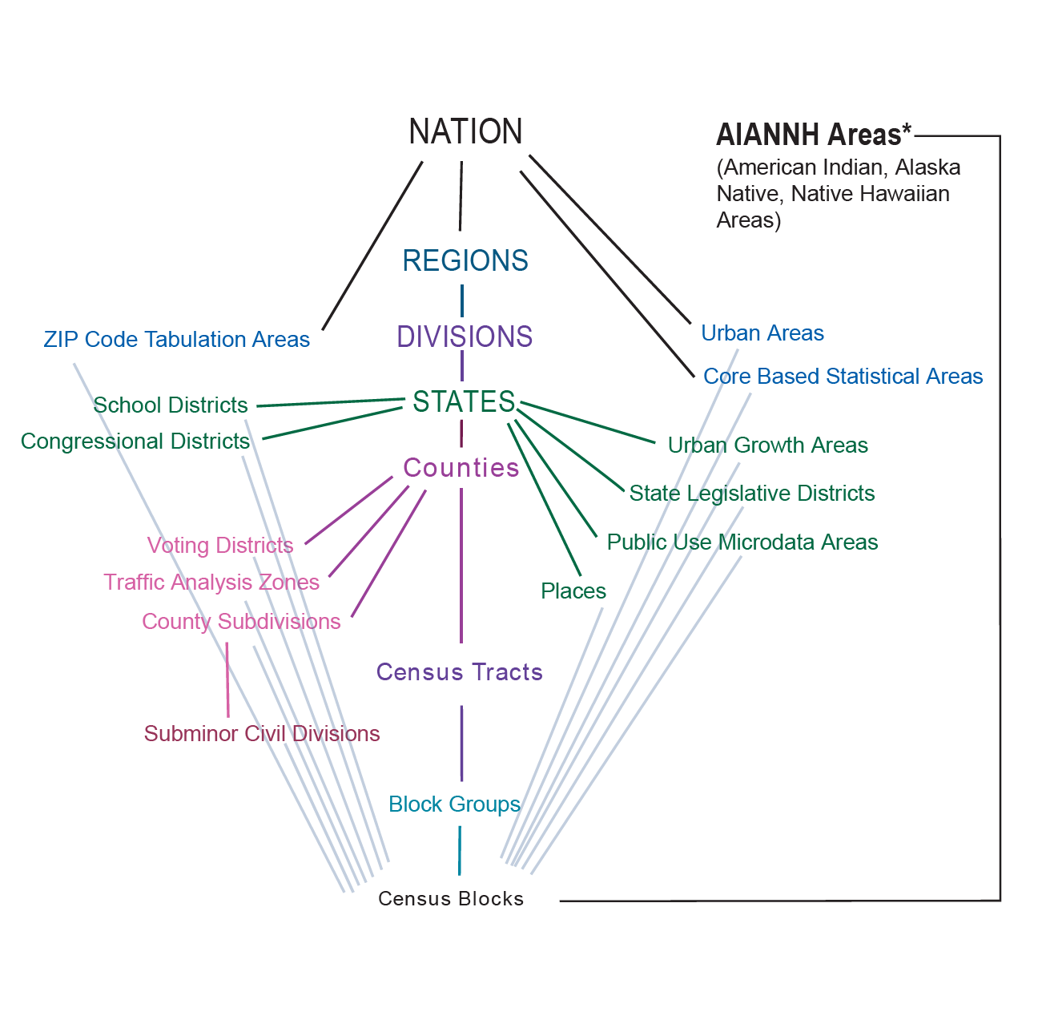
Differential Privacy & The TopDown Algorithm
Differential Privacy (DP)
A method quantifying the relationship between accuracy and privacy. Ensures the confidentiality of respondents while minimizing noise (error) injection.
The TopDown Algorithm (TDA)
The new Disclosure Avoidance System for the 2020 Census
Data accuracy for these “on-spine” geographies
Data accuracy for these “off-spine” geographies
On-Spine
high
Accuracy
low

Slide 6
2010 Privacy Protected Demonstration Data
Comparison of 2010 DP Data vs 2010 Summary File (SF) Data
What would the published 2010 Decennial Data have looked like curated under the TDA?
Multiple Vintages: Oct. 2019 …… June 2021
Higher privacy loss budget permitting more accurate data (4.0 vs 17.1)
Improvements to the accuracy of “off-spine” geographies
Notes:
The U.S. Census Bureau released demonstration data so researchers could assess the potential effects of DP across various geographies

Slide 7
Overview
FROM START TO FINISH
What is Differential Privacy?
A brief overview of differential privacy and how it affects the accuracy of 2020 Decennial Products
“On-Spine” Geographies
Compare accuracy of results between the 2019 and 2021 vintages of the 2010 Demonstration Data
“Off-Spine” Geographies
A look at the accuracy of DP voting age population data aggregated to North Carolina voting precincts

Slide 8
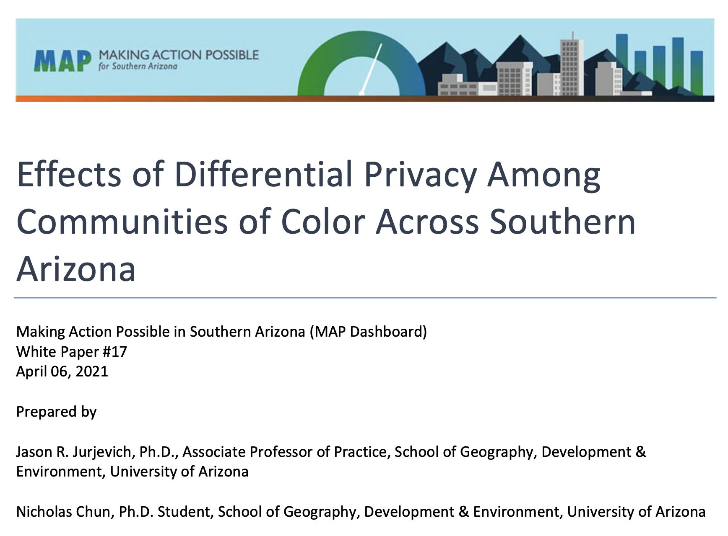
How accurate are differentially-private tract data for Southern Arizonans of color?

Slide 9
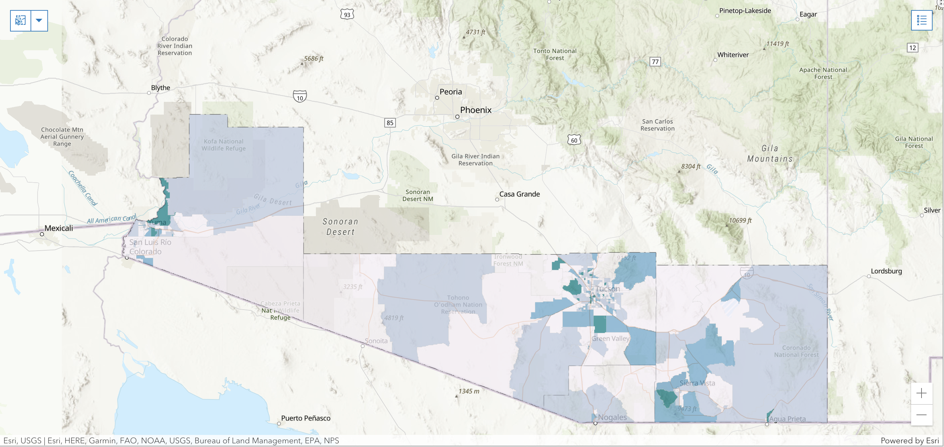
Study Area
Southern Arizona—Cochise, Pima, Santa Cruz, and Yuma Counties
Source: Jurjevich and Chun (2021)

Slide 10
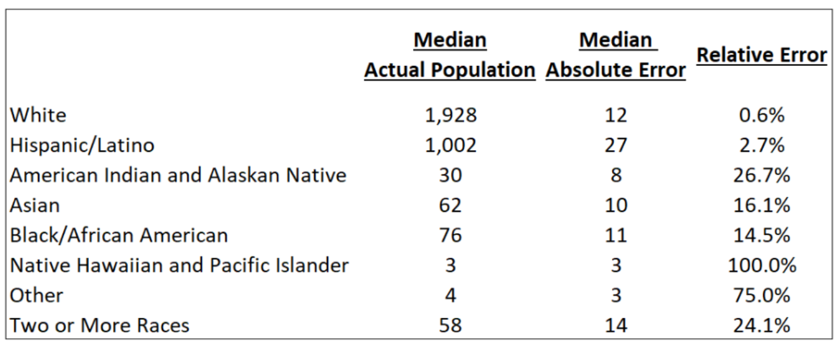
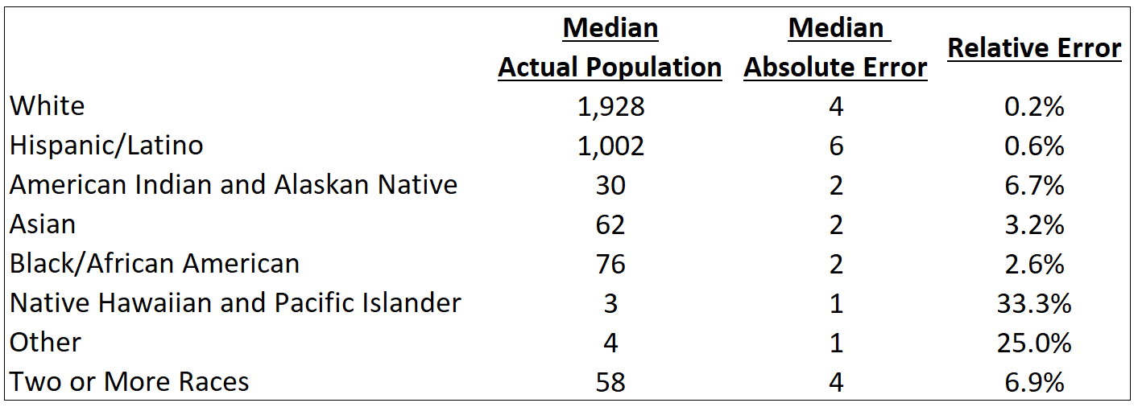
Improvements in accuracy for “On-Spine” Geographies (Tracts)
Nov. 2019
Final
Source: Jurjevich and Chun (2021)
Notes:
Many of the egregious cases, such as tracts with DP data that suggested population loss from 2000, when there was population growth based on the SF data, were gone

Slide 11
Overview
FROM START TO FINISH
What is Differential Privacy?
A brief overview of differential privacy and how it affects the accuracy of 2020 Decennial Products
“On-Spine” Geographies
Compare accuracy of DP results between the 2019 and 2021 vintages of the 2010 Demonstration Data
“Off-Spine” Geographies
A look at the accuracy of DP voting age population data aggregated to North Carolina voting precincts

Slide 12
Off-Spine Geography: Voting Precincts (Districts)
Voting Precincts
Built up from Census Blocks
An “off-spine” geography
North Carolina
2,700 voting precincts
Voter registration data with race-ethnicity
20% of the voting age population identify as Non-Hispanic Black.
On-Spine

Slide 13
What would the 2010 voter registration rate for the Black population have looked like under differential privacy?
2010 DP & SF Non-Hispanic (NH) Black voting age population
Voting precincts and tracts where SF Black voting age pop >= 100
Number of registered (NH) Black voters in Nov. 2010
$$Voter Registration Rate =\frac{2010 Black Registered Voters}{2010 Black Voting Age Population}$$

Slide 14
Goals
Identify census tracts & voting precincts where the difference between the DP and SF Black voting age pop is at least 5%
Identify voting precincts where the difference between the DP and SF Black voter registration rate is at least 5%
Example: SF vot. reg. rate is 65% and the DP vot. reg. rate is 60%

Slide 15
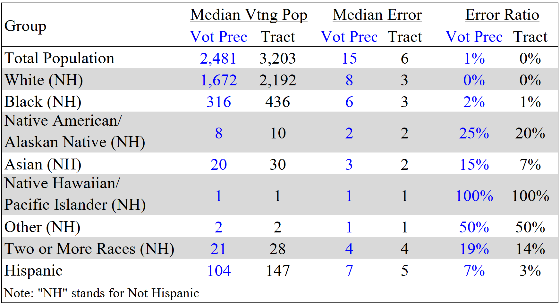
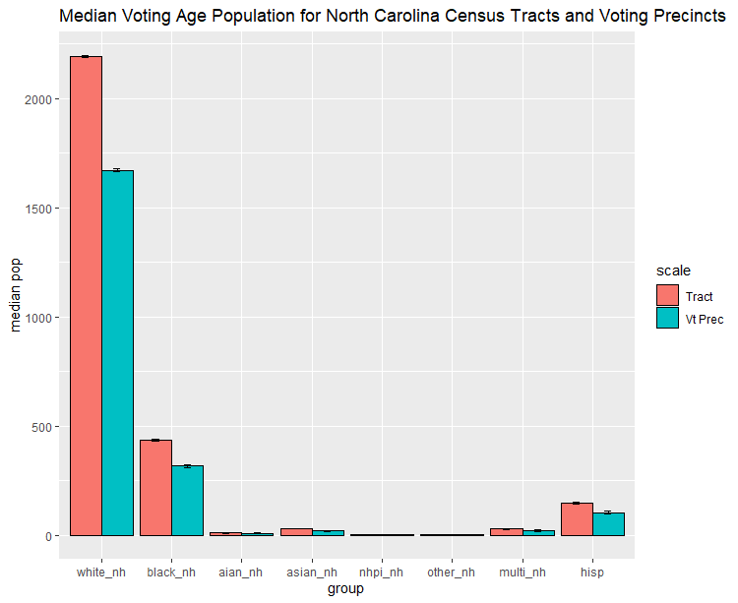
Summary: NC Voting Precincts vs Census Tracts
Summary statistics suggest accuracy between the two geographies are relatively comparable… but what about individual cases?

Slide 16
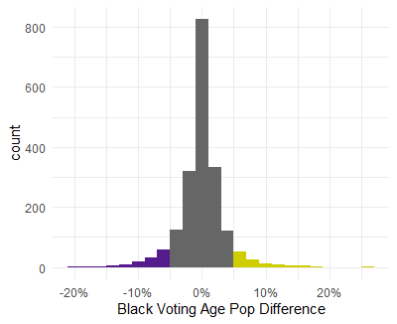
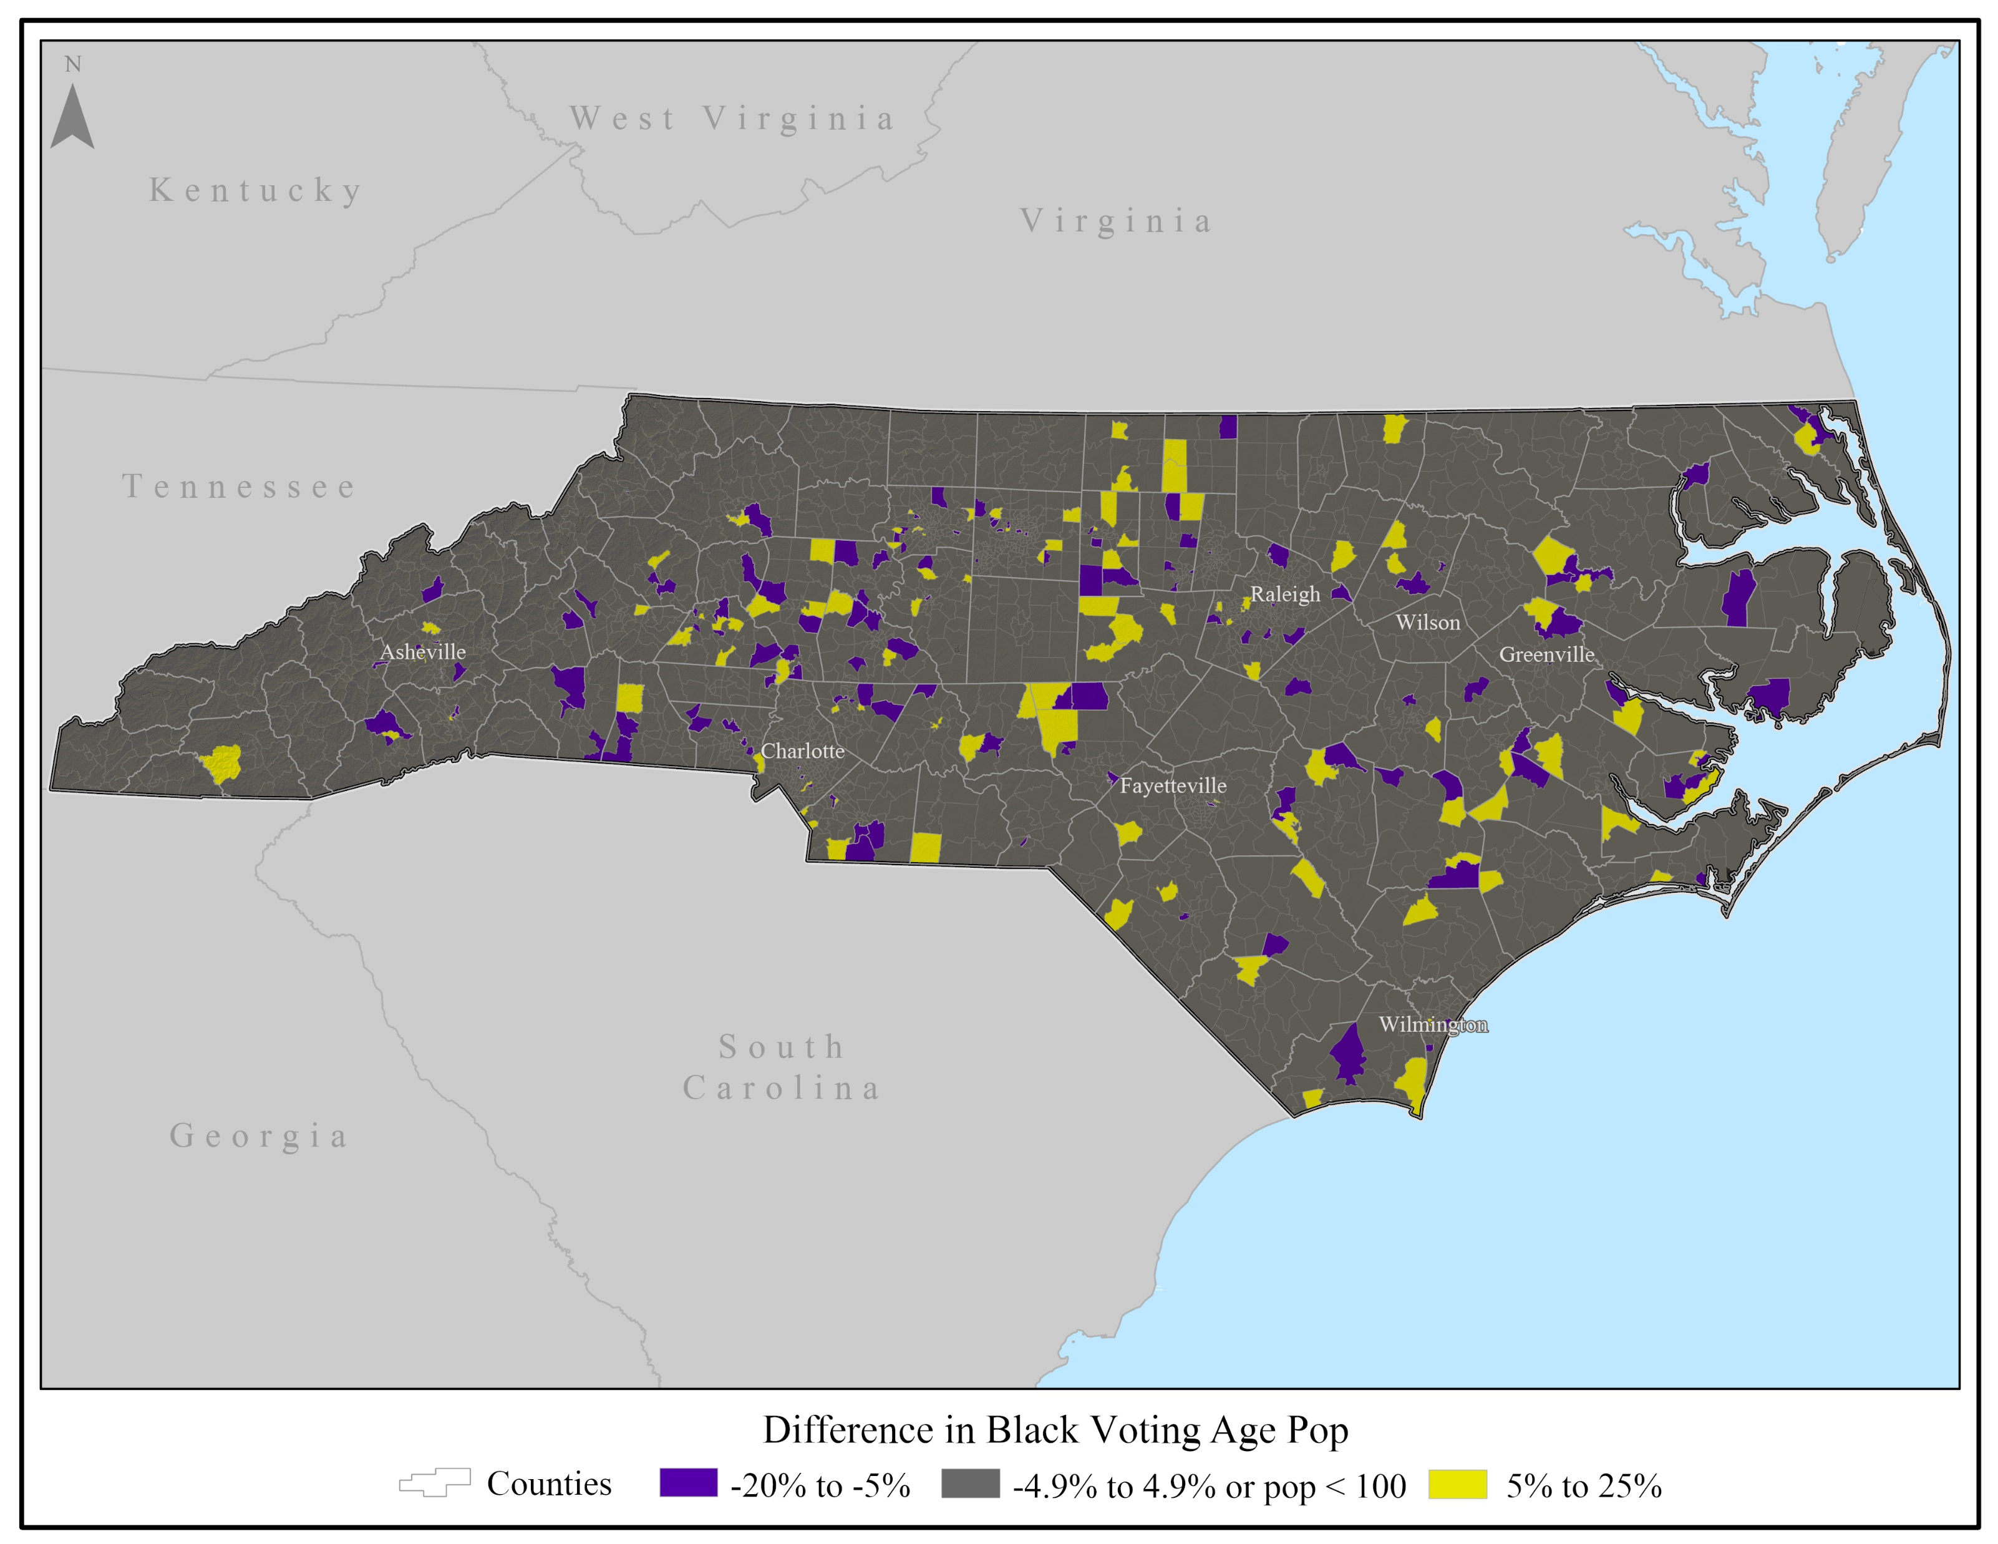
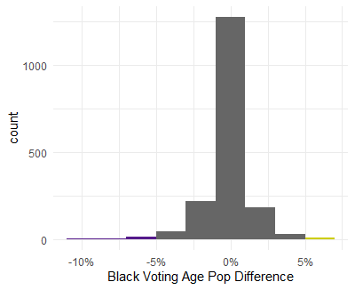
NC Voting Age Population Comparison
Voting Precincts
NC Voting Precincts
12% of voting precincts w/ abs error >=5%
Census Tracts
1% of census tracts w/ abs error >=5%

Slide 17
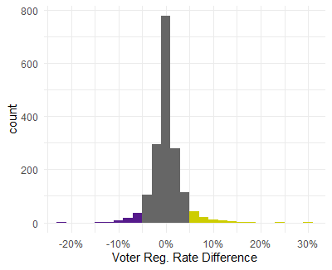
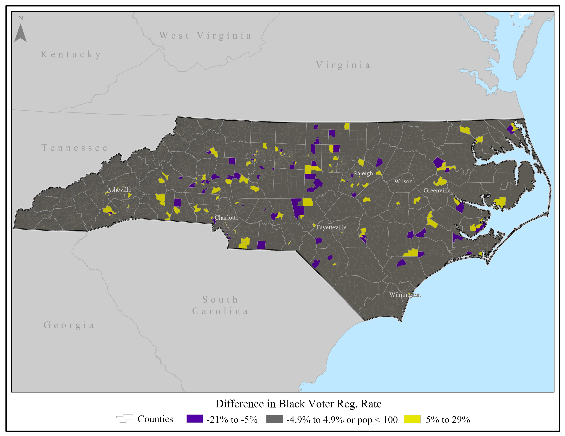
NC Voter Registration Rate Error
Voting Precincts
NC Voting Precincts
8% of voting precincts w/ abs vtrg error >=5%

Slide 18
Concluding Thoughts
Demonstration data aggregated to NC voting precincts (off-spine) produced higher DP variance than tract level data (on-spine) despite comparable population sizes.
This variance at the precinct level creates challenges for longitudinal studies that rely on accurate denominator data (voting age population).
More work is needed to see how DP & the TDA affect different regions and geographies in the U.S.
Source: U.S. Census Bureau

