Slide 1
AAG 2022 Annual Meeting
A study on urban network in Seoul Metropolitan Area
2022.02.26.
Yoohoon Kim
Ph.D Student of Geography
Seoul National University

Slide 2
Contents
Ⅰ. Introduction
Ⅱ. Background
Ⅲ. With Howard
Ⅳ. With Mumford
Ⅴ. Summary

Slide 3
1. Introduction
The modern concept of the new-town originated from Howard’s Garden City
In the West
In Korea
The purpose of this study

Slide 4
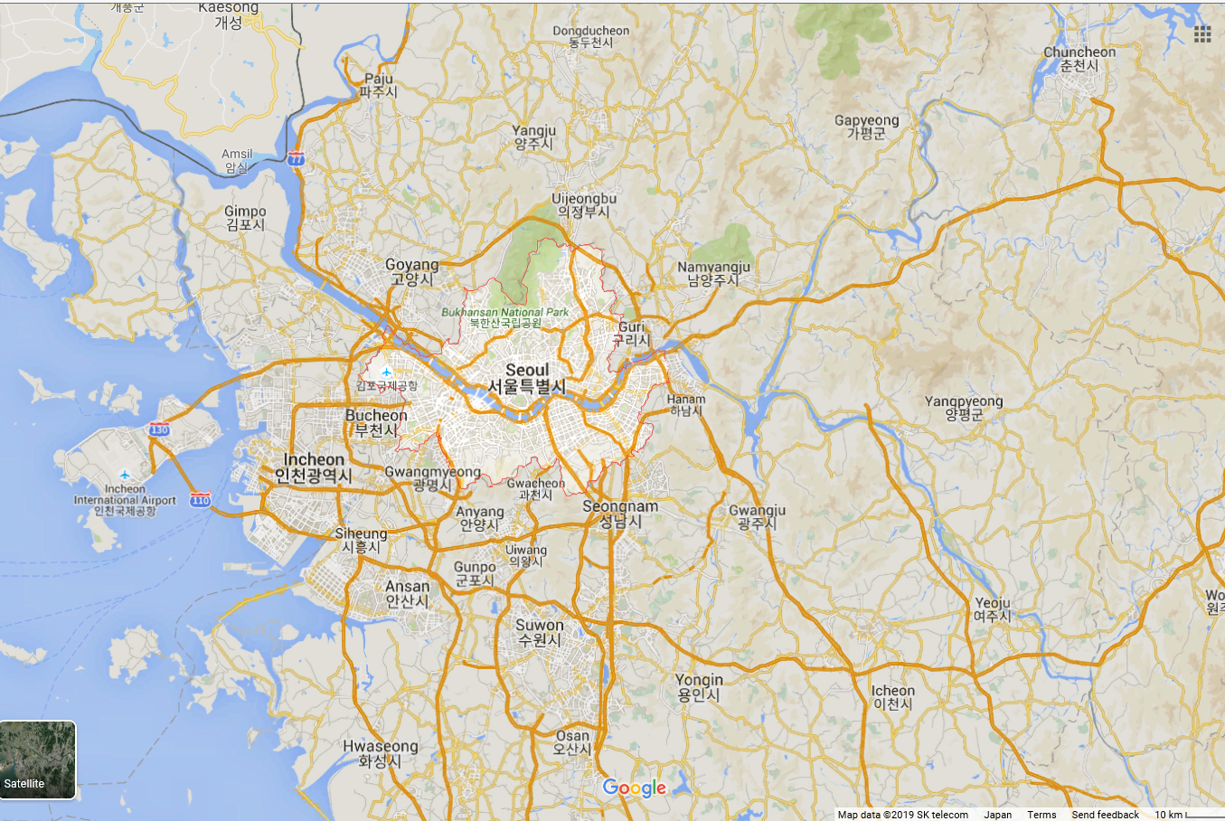
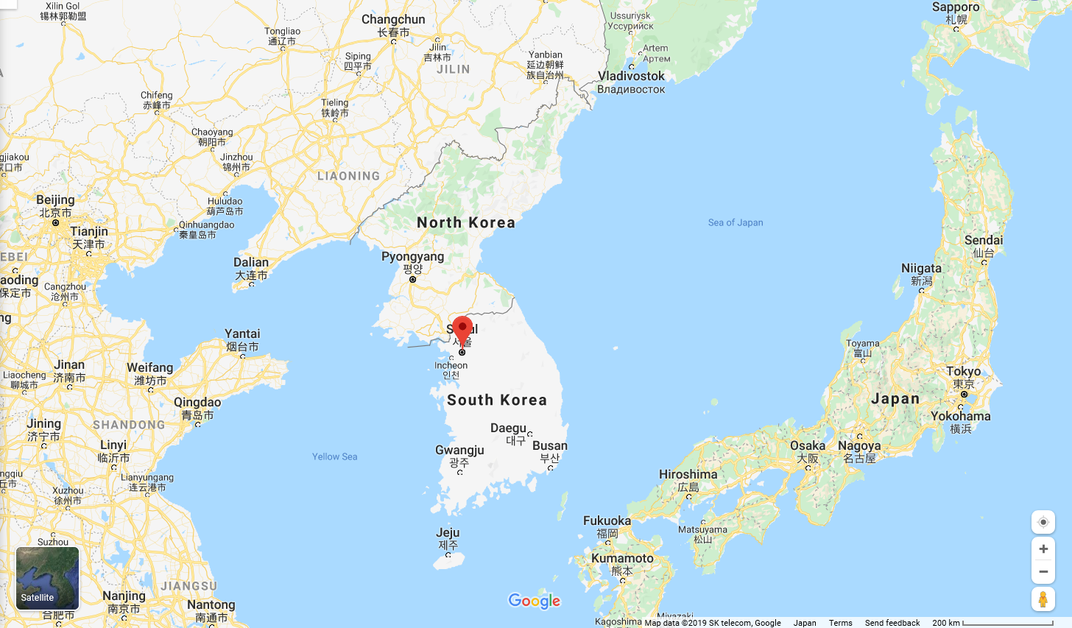
1. Introduction
The modern concept of the new-town originated from Howard’s Garden City
In the West
In Korea
The purpose of this study

Slide 5
2. Theoretical Background - 1
1) Howard’s Garden City
Howard’s Garden city in 1892
Consisting of 1 central city + 6 garden cities + green areas (total 250,0000 people)
1 central city : factories, parks, shopping, main roads, residential areas etc.(58,000 people)
6 garden cities : residential areas, employment functions (32,000 people)
Green areas : farming in some of them

Slide 6
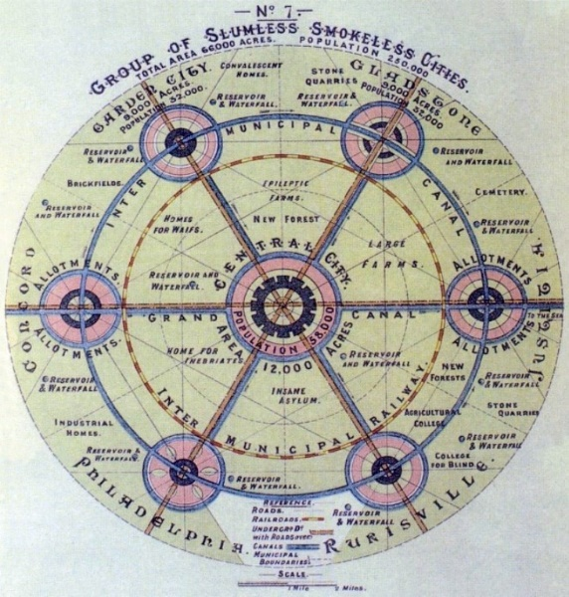
2. Theoretical Background - 1
1) Howard’s Garden City
Howard’s Garden city in 1892
Consisting of 1 central city + 6 garden cities + green areas (total 250,0000 people)
1 central city : factories, parks, shopping, main roads, residential areas etc.(58,000 people)
6 garden cities : residential areas, employment functions (32,000 people)
Green areas : farming in some of them

Slide 7
3. Theoretical Background - 2
2) The perspective of Mumford
Influenced by Geddes and Howard
Ecological approach to the city
Emphasizing on the concept of community and life zone

Slide 8
4. With Howard’s Garden City - 1
1) Space structure and composition aspect
Howard’s model vs Korean new-towns
Location of Korean new-towns
Functions

Slide 9
4. With Howard’s Garden City - 1
Location
1) Space structure and composition aspect
Howard’s model vs Korean new-towns
Location of Korean new-towns
Functions

Slide 10
5. With Howard’s Garden City - 2
self-sufficiency index
 | 1995 | 2000 | 2005
Seong-nam(Bun-dang) | 0.95 | 0.94 | 0.80
Goyang(Il-san) | 0.55 | 0.77 | 0.92
Buchoen(Joong-dong) | 0.90 | 0.91 | 0.84
An-yang(Pyeong-chon) | 0.65 | 0.67 | 0.59
Gun-po(San-bon) | 0.40 | 0.48 | 0.46
Lee H.Y. & Lee S.M.(2008)
2) Relating to self-efficiency
Importance of self-efficiency
Lee H.Y. and Lee S.M.(2008)
Jeong D.W. and Kim H.S.(2010)

Slide 11
6. With the perspective of Mumford - 1
1) Organic perspective
Kim Y.H.(2016)
Type A
Type B
Type C
Created at the same time, but various characteristics

Slide 12
6. With the perspective of Mumford - 1
Type A, B, and C (star shape)
1) Organic perspective
Kim Y.H.(2016)
Type A
Type B
Type C
Created at the same time, but various characteristics

Slide 13
7. With the perspective of Mumford - 2
2) Emphasizing on community and life zone
Kim Y.H.(2016)
Moving to a new adjacent place (case 1)
Moving to a new remote place (case 2)
Longer period or not

Slide 14
7. With the perspective of Mumford - 2
Case 1, and 2 (star shape)
2) Emphasizing on community and life zone
Kim Y.H.(2016)
Moving to a new adjacent place (case 1)
Moving to a new remote place (case 2)
Longer period or not

Slide 15
8. Summary
Korean new-towns look different from Howard’s Garden City.
Not urban-rural combined, functions missed
Positive aspect
Korean new-towns have an organic aspect.
Those who live longer in their neighborhood show strong tendency to consider similar environment.
Suggest to rethink about urban sprawl of Seoul and its surrounding areas

Slide 16
References
김선범, 1995, 실천적 도시계획가 에베네저 하워드, 국토, 74-81
김선범, 1995, 20세기 미국 최대의 도시이론가 루이스 멈포드, 국토, 85-90
김유훈, 2012, 2기 신도시 입주민들의 이주요인, 서울대학교 대학원 석사학위논문
김유훈, 2016, 신도시 특성과 거주경험에 따른 신도시 이주자들의 주거이동 성향, 한국도시지리학회지, 19(2), 211-229
박경환·류연택·정현주·이용균(역), 2012, 도시사회지리학의 이해 제6판, 시그마프레스
(Paul Knox and Steven Pinch, 2010, Urban Social Geography : An Introduction, 6th Edition, Pearson Education Ltd.)
이우종, 2007, 도시와 농촌의 결합을 통한 도시계획 모색, 내일의 전원도시 에베네저 하워드 지음, 조재성·권원용 옮김, 한울, 국토, 136-137
이희연·이승민, 2008, 수도권 신도시 개발이 인구이동과 통근통행패턴에 미친 영향, 대한지리학회지, 43(4), 561-579
정다운·김흥순, 2010, 수도권 1기 신도시의 자족성 및 중심성 분석, 한국도시지리학회지, 13(2), 103-116
한상진, 1992, 서울 대도시권 신도시 개발의 성격, 사회와역사, 37, 61-101
Altman, I. and S. M. Low, 1992, Place attachment, Plenum Press, New York
Feldman, R.M., 1990, Settlement-identity : Phychological bonds with home places in a mobile society, Environment & Behavior, 22, 183-229

Slide 17
THANK YOU
YOOHOON KIM
E-mail : kyh0902@snu.ac.kr
kyh0902@hanmail.net

