Slide 1
Impacts of worldwide individual non-pharmaceutical interventions on COVID-19 transmission across waves and space
Yong Ge^{1,2*#}, Wen-Bin Zhang^{1,2#}, Haiyan Liu^{3#,} Corrine W Ruktanonchai^{4,5#}, Maogui Hu^{1,2}, Xilin Wu^{1,2}, Yongze Song⁶, Nick W Ruktanonchai^{4,5}, Wei Yan^{7#}, Eimear Cleary⁵, Luzhao Feng⁸, Zhongjie Li⁹, Weizhong Yang⁸, Mengxiao Liu^{1,2}, Andrew J Tatem⁵, Jin-Feng Wang^{1,2}, Shengjie Lai^{5*}

Slide 2
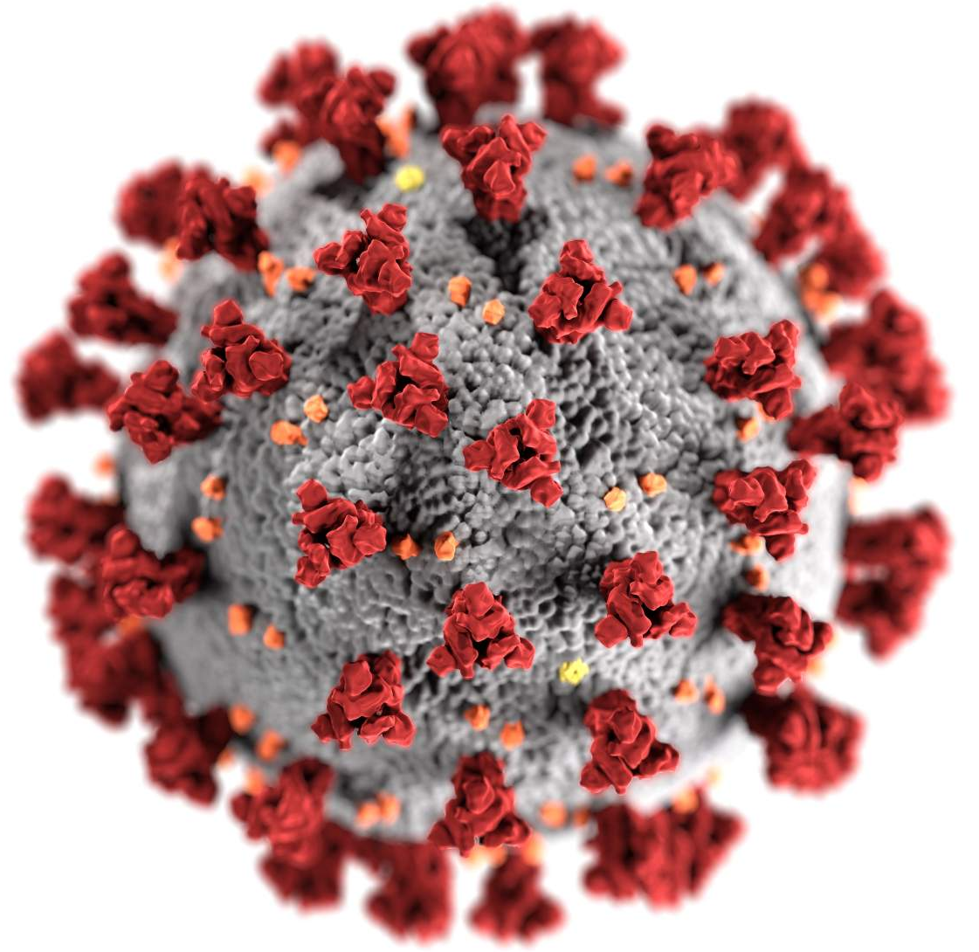
Contents
01
Background
02
Method
03
Results
04
Discussion

Slide 3
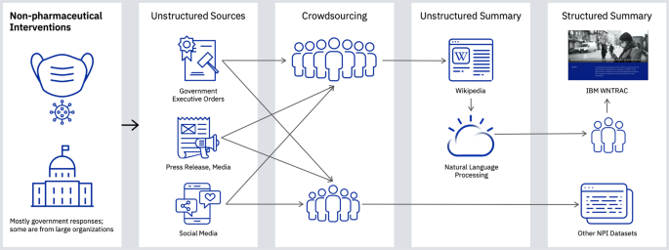
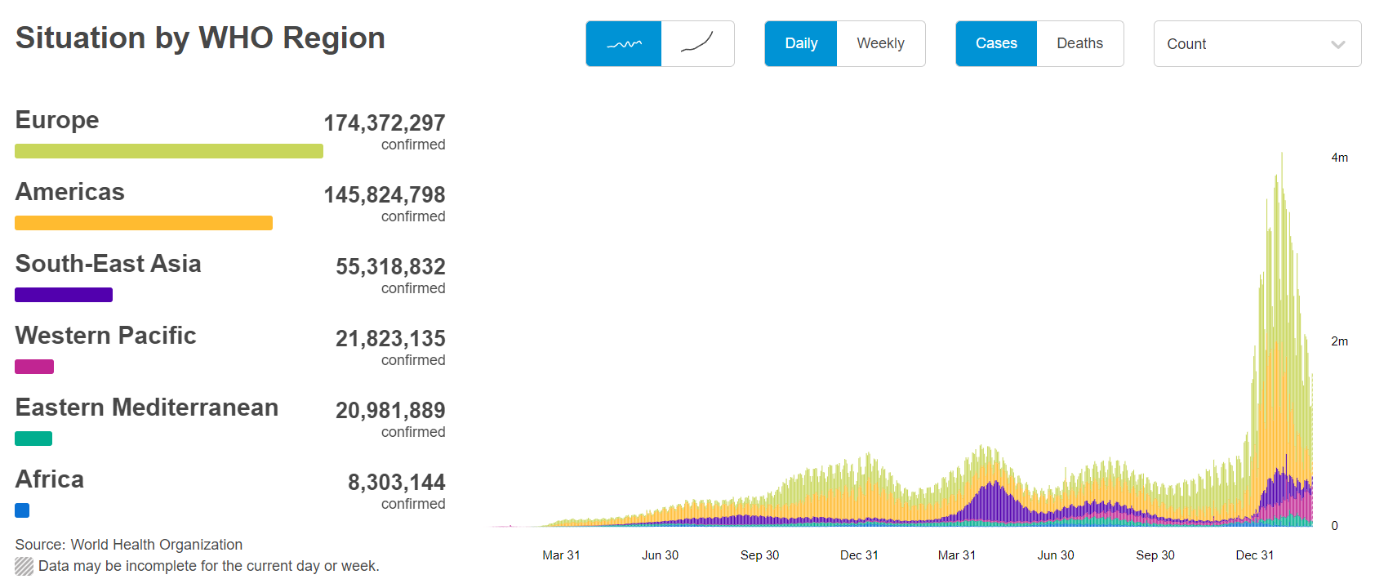
1.Background
Background:
The COVID-19 pandemic has caused significant disruption to daily lives, causing over 400 million confirmed cases and 5.8 million deaths as of 24 February, 2022 (WHO, 2022). Non-pharmaceutical interventions (NPIs) have been deployed across the World to curb the pandemic (Perra, 2021).
Understanding the role of different NPIs in reducing COVID-19 transmission before vaccine rollouts is critical for tailoring effective NPI strategies for future COVID-19 waves.
The potential differences in NPI effectiveness across multi-geographical levels are rarely discussed in existing analyses.
Object:
Estimated the effects of several individual NPIs by identifying their contributions to the decay ratio of COVID-19 infections across waves at different geographical levels before the onset of any vaccination program

Slide 4
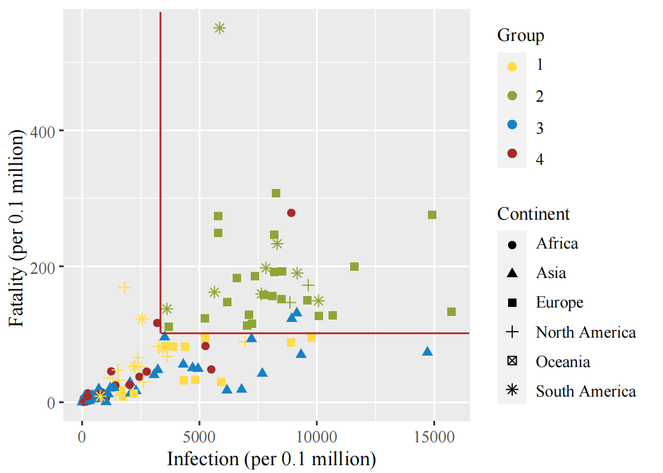
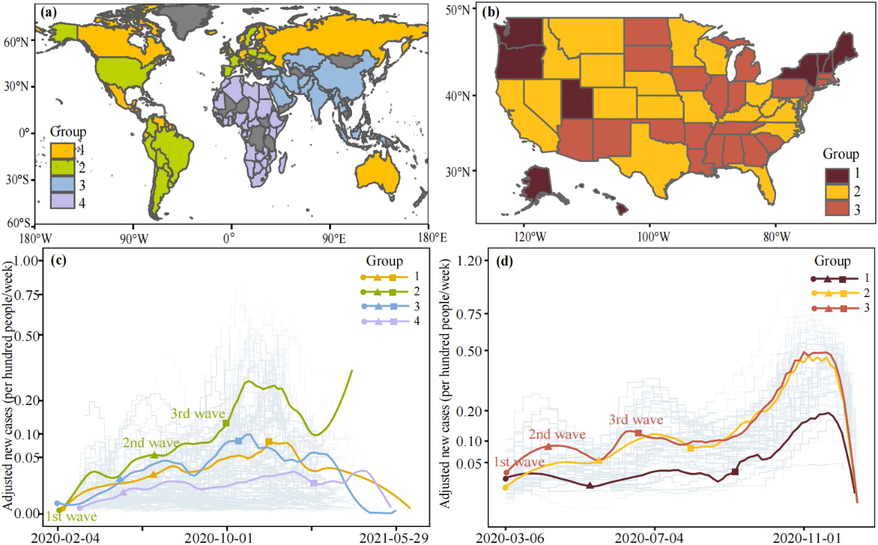
2.Method
2.1 Definition of waves and groups
Waves definition: The first and last days of time periods when the daily numbers of cases all exceeded 5% of the maximum daily number of cases in 2020 in corresponding countries/states were defined as the start and end of the corresponding wave, respectively.
Regional stratification: We divided 133 countries into 4 groups at the regional level and 51 United States into 3 groups at the subnational level based on their COVID-19 morbidity and mortality together with geographical proximity.

Slide 5
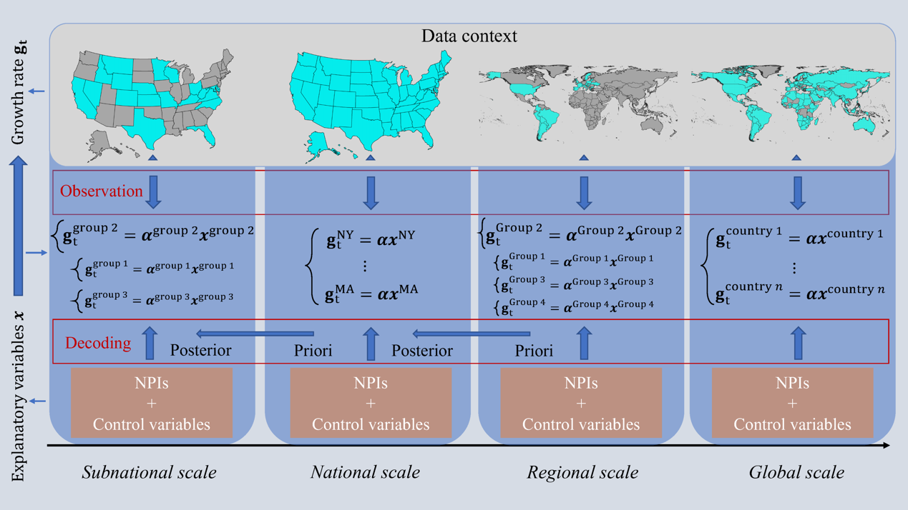
2.Method
2.2 Model description
 | Analysis scale
NPIs | Global | Regional | National | Subnational
School closures | ✓ | ✓ | ✓ | ✓
Workplace closures | ✓ | ✓ | ✓ | ✓
Public events cancellations
Gathering restrictions | ✓ | ✓ | ✓ | ✓
Public transport closures | ✓ | ✓ | ✓ | ✓
Stay-at-home orders | ✓ | ✓ | ✓ | ✓
Internal movement restrictions |  |  | ✓ | ✓
International travel restrictions | ✓ | ✓ | ✕ | ✕
Facial coverings | ✓ | ✓ | ✓ | ✓
A Bayesian inference model (Brauner et al., 2021; Flaxman et al., 2020) was built to measure relative contributions of NPIs on the observed decay ratio of COVID-19 infections (denoted as ${\%ω}_{t}$ ) using the existence and intensity change of these interventions.
where $ω_{0}$ represents the baseline growth rate without interventions, $α_{i}$ is the coefficient of NPIs and control variables $x_{i,t}$ on day $t$ , and $ε$ is the error term representing the uncertainty of decay ratio.
The effect of NPIs set $X$ in a period, such as the first wave of the pandemic, can be interpreted as a decay ratio in $ω_{0}$ by computing $e_{i}=1−\prod_{x_{i}}{exp(−α_{i}\overline{x_{i}})}$, where $\overline{x_{i}}$ is the average strength of the NPI $x_{i}$ during that period. The highest effect of NPIs set $X$ is 1, representing that the transmission is fully contained or interrupted by the set.
All estimations were performed using Markov chain Monte Carlo (MCMC) methods. The reliability of our model was assessed by the cross-validation for overall intervention effects. Sensitivity analyses were also performed to assess model robustness in terms of our assumptions.
The computational environmental settings for analysis from subnational scale to global scale. We used growth rate as the outcome variable to describe the trajectory of the pandemic. The empirical changes of growth rate were decoded into the effectiveness of both NPIs as well as the control variables.

Slide 6
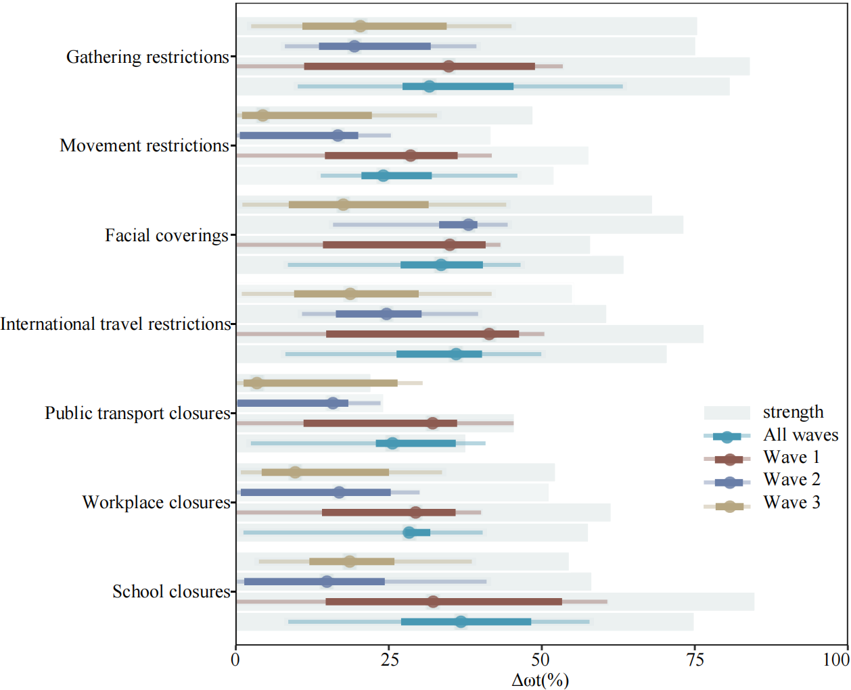
3.Results
3.1 Global effects of individual NPIs across waves
The four NPIs with the highest impacts (>30%) on transmission growth rate included :
school closures (median 36.8%, interquartile range [IQR] 27.0 - 48.3%),
international travel restrictions (36.0%, 26.3 - 40.2%)
facial coverings (33.6%, 27.0 - 40.4%)
gathering restrictions (31.7%, 27.2- 45.4%).
In the first wave, the most effective NPI was international travel restrictions (median 41.4%, IQR 14.8- 46.3%);
In the second wave, facial coverings became the NPI with the highest effect (38.0%, 33.2 - 39.5%);
In the third wave, gathering restrictions became the most effective NPI (20.4%, 10.9 - 34.5%).
Effects of individual NPIs on reducing the transmission of COVID-19 across waves within our data context.

Slide 7
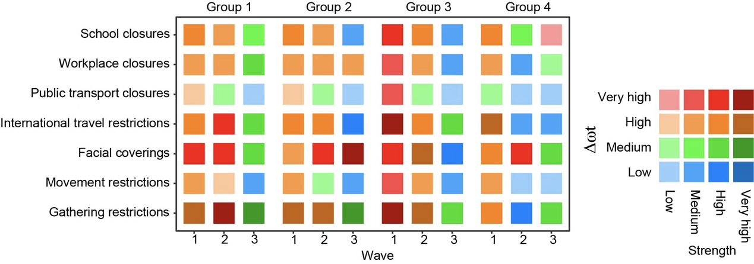
3.Results
3.2 Regional NPIs impacts across waves by country group
In the first wave, gathering restrictions in group 3 had the highest contribution (median 52.5%, IQR 30.5 - 58.6%) to transmission reduction. All NPIs in Group 3, i.e., Asian countries, were generally more effective than other groups for the first wave, especially gathering restrictions (52.5%, 30.5 - 58.6%), school closures (45.7%, 36.4 - 54.6%) and facial coverings (43.7%, 35.4 - 44.8%).
The overall synergistic effectiveness of NPIs showed a downward trend as the COVID-19 pandemic spread across the USA, from 83.3% (IQR 82.1- 84.6%) in the first wave to 58.7% (57.0-60.3%) in the third wave, of which gathering restrictions and stay-at-home orders had the highest effect (>15%).
The cross-wave and cross-group effects of individual NPIs. Effects of individual NPIs on reducing the transmission of COVID-19 across waves and groups are illustrated by different colours associated with their average implementation strength. The dark colour indicates higher strength, while the NPIs effects increased from low level (blue) to high level (red).
3.3 National and subnational effectiveness of NPIs in the United States
The individual efficacy estimates of the seven NPIs for the USA and its subnational regions. Different NPIs are represented by different colours. The groups as well as the USA are demonstrated by different symbols.

Slide 8
4.Discussion
Before the implementation of mass vaccination, the effectiveness of each individual NPI had been over 24.1% on the global level, 10.7% on the regional level, 1.0% on the USA national level, and 1.2% on the USA subnational level. Regardless of geographic scale and pandemic wave, the overall impact of integrated NPIs had been over 52.9% before the start of mass vaccination.
The overall effectiveness of NPIs shows a downward trend between waves, possibly due to policy fatigue. Even though the synergistic efficiency of NPIs has been over 50% in recent waves before the vaccine rollout, the reducing effect over time deserves our vigilance, especially in areas lacking vaccines.
The limitations in our analysis:
First, data collected from public data sources may generate certain uncertainty;
Second, the interactions among the seven NPIs were not considered in this study.
Third, we used grouped regional research instead of researching each country while the effects of NPIs might have some differences in different countries
More details can be found in https://doi.org/10.1016/j.jag.2021.102649

Slide 9
Thank You
Reported by Xilin Wu

