Slide 1
Conducting the Census through the Pandemic: Low-response census tracts and other challenges
Heather L. Bloom
AAG 2022 Annual Meeting
Virtual 23: “Using 2020 U.S. Census Data: What’s New? What’s Noisy?”
February 28, 2022, at 11:20 a.m.

Slide 2
My work as a Partnership Specialist
I was the CRM & Tableau lead for the Nebraska-North Dakota-South Dakota team.
I analyzed data, geocoded addresses, checked for errors and helped input data.
I was the lead for the City of Omaha CCC and co-lead for the Douglas County CCC.
Presented to civic organizations a couple times a week.
Prior to March 2020
Visited all Omaha-area schools with low-response score (LRS) values higher than 20.
Connected with more than 40 neighborhood associations in census tracts with LRS values higher than 20.
Analyzed data and looked for businesses and community groups to partner with in low-response tracts.
Worked with disability groups statewide.

Slide 3
Technology advances for Census 2020
Low response score (LRS) values
Response Outreach Area Mapper (ROAM)
Advances in the Customer Relationship Management (CRM) database
Launch of Tableau’s 2020 Response Rate Map open data effort
Internet-first self-response method; mail and phone were still available response methods
Improved efficiency of Address Canvasing by using satellite imagery, administrative data and other federal sources to verify addresses first, then complete fieldwork.
Increased use of Administrative Records

Slide 4
Low Response Score (LRS)
The Bureau developed a metric to categorize census tracts by their tendency to self-respond to prior censuses and surveys; this is known as the low response score (LRS).
The Ordinary Least Squares (OLS) regression model predicts how far the actual return rate falls below 100 percent, using 25 socioeconomic and demographic variables relating to age, race, income, education and household make-up from the Census Bureau Planning Database (PDB).
Planning Database, which is updated yearly, includes: Low Response Score value, 2010 Census data, select American Community Survey estimates from 2012 to 2017, and FCC Internet connectivity data.
A LRS score of 20 or higher suggest the tract will have a lower self-response rate, thus census partnership specialists and community leaders should spend more time and resources in this neighborhood.

Slide 5
Response Outreach Area Mapper (ROAM)
In 2017, Census Bureau staff requested a low-response score (LRS) map to aid partnership specialists and community leaders in planning census outreach and inform operations.
This idea grew from a static choropleth map to an interactive ESRI web GIS tract map that displays Census Planning Database statistics.
This interactive map was designed for people with little or no experience with demographic data or geography.

Slide 6
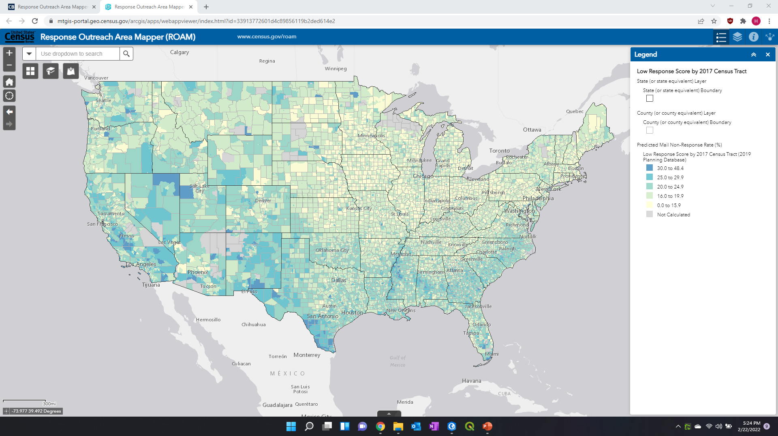
LRS values are displayed in ROAM
You can click on a census tract to identify its Low Response Score (predicted mail non-response rate) and information about its population and households.
An LRS is not calculated when a census tract:
Contains zero housing units.
Falls below a minimum threshold for qualifying addresses in the 2010 Census mail back areas.
Has its 2013-2017 ACS 5-year estimates suppressed to avoid data disclosure.
Experiences a geographic boundary change.

Slide 7
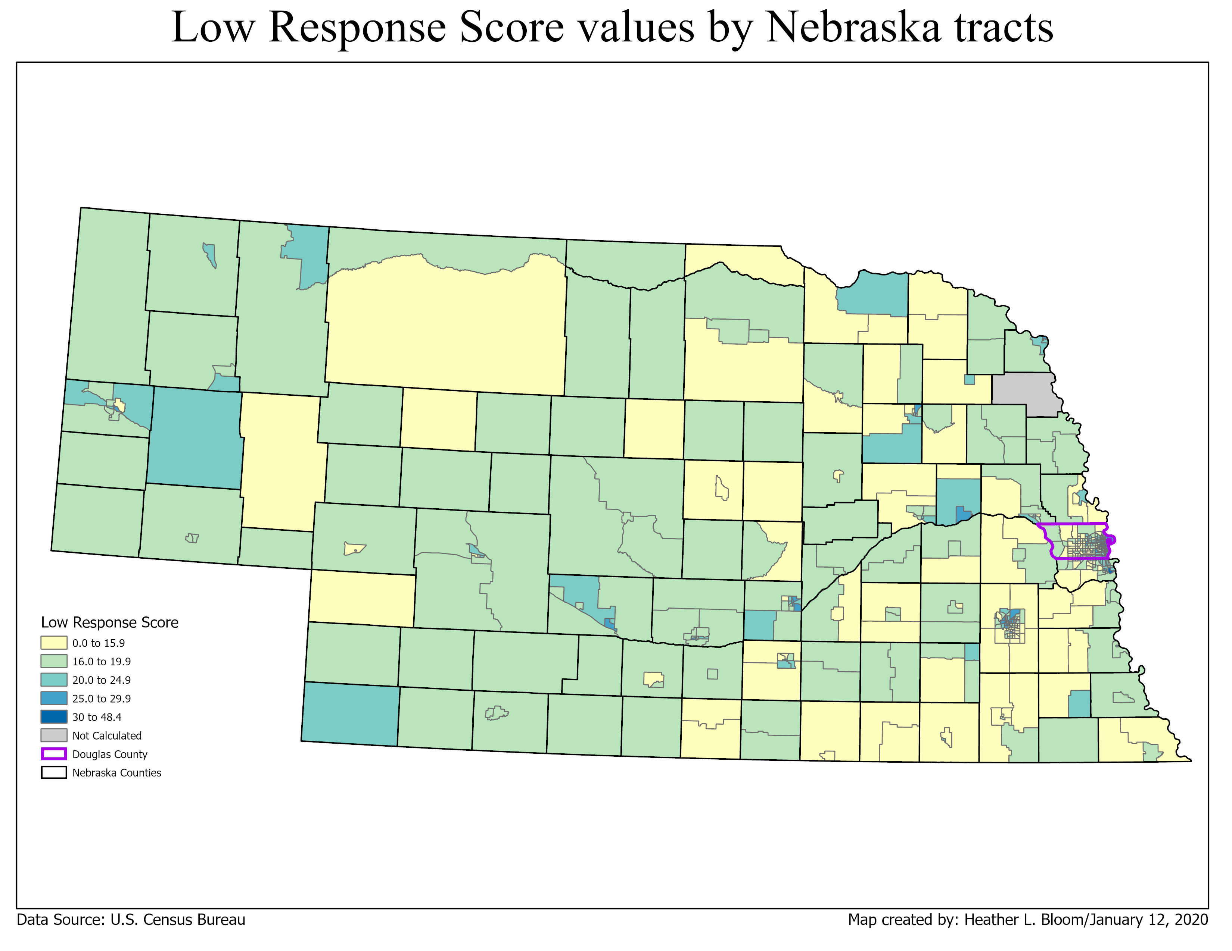
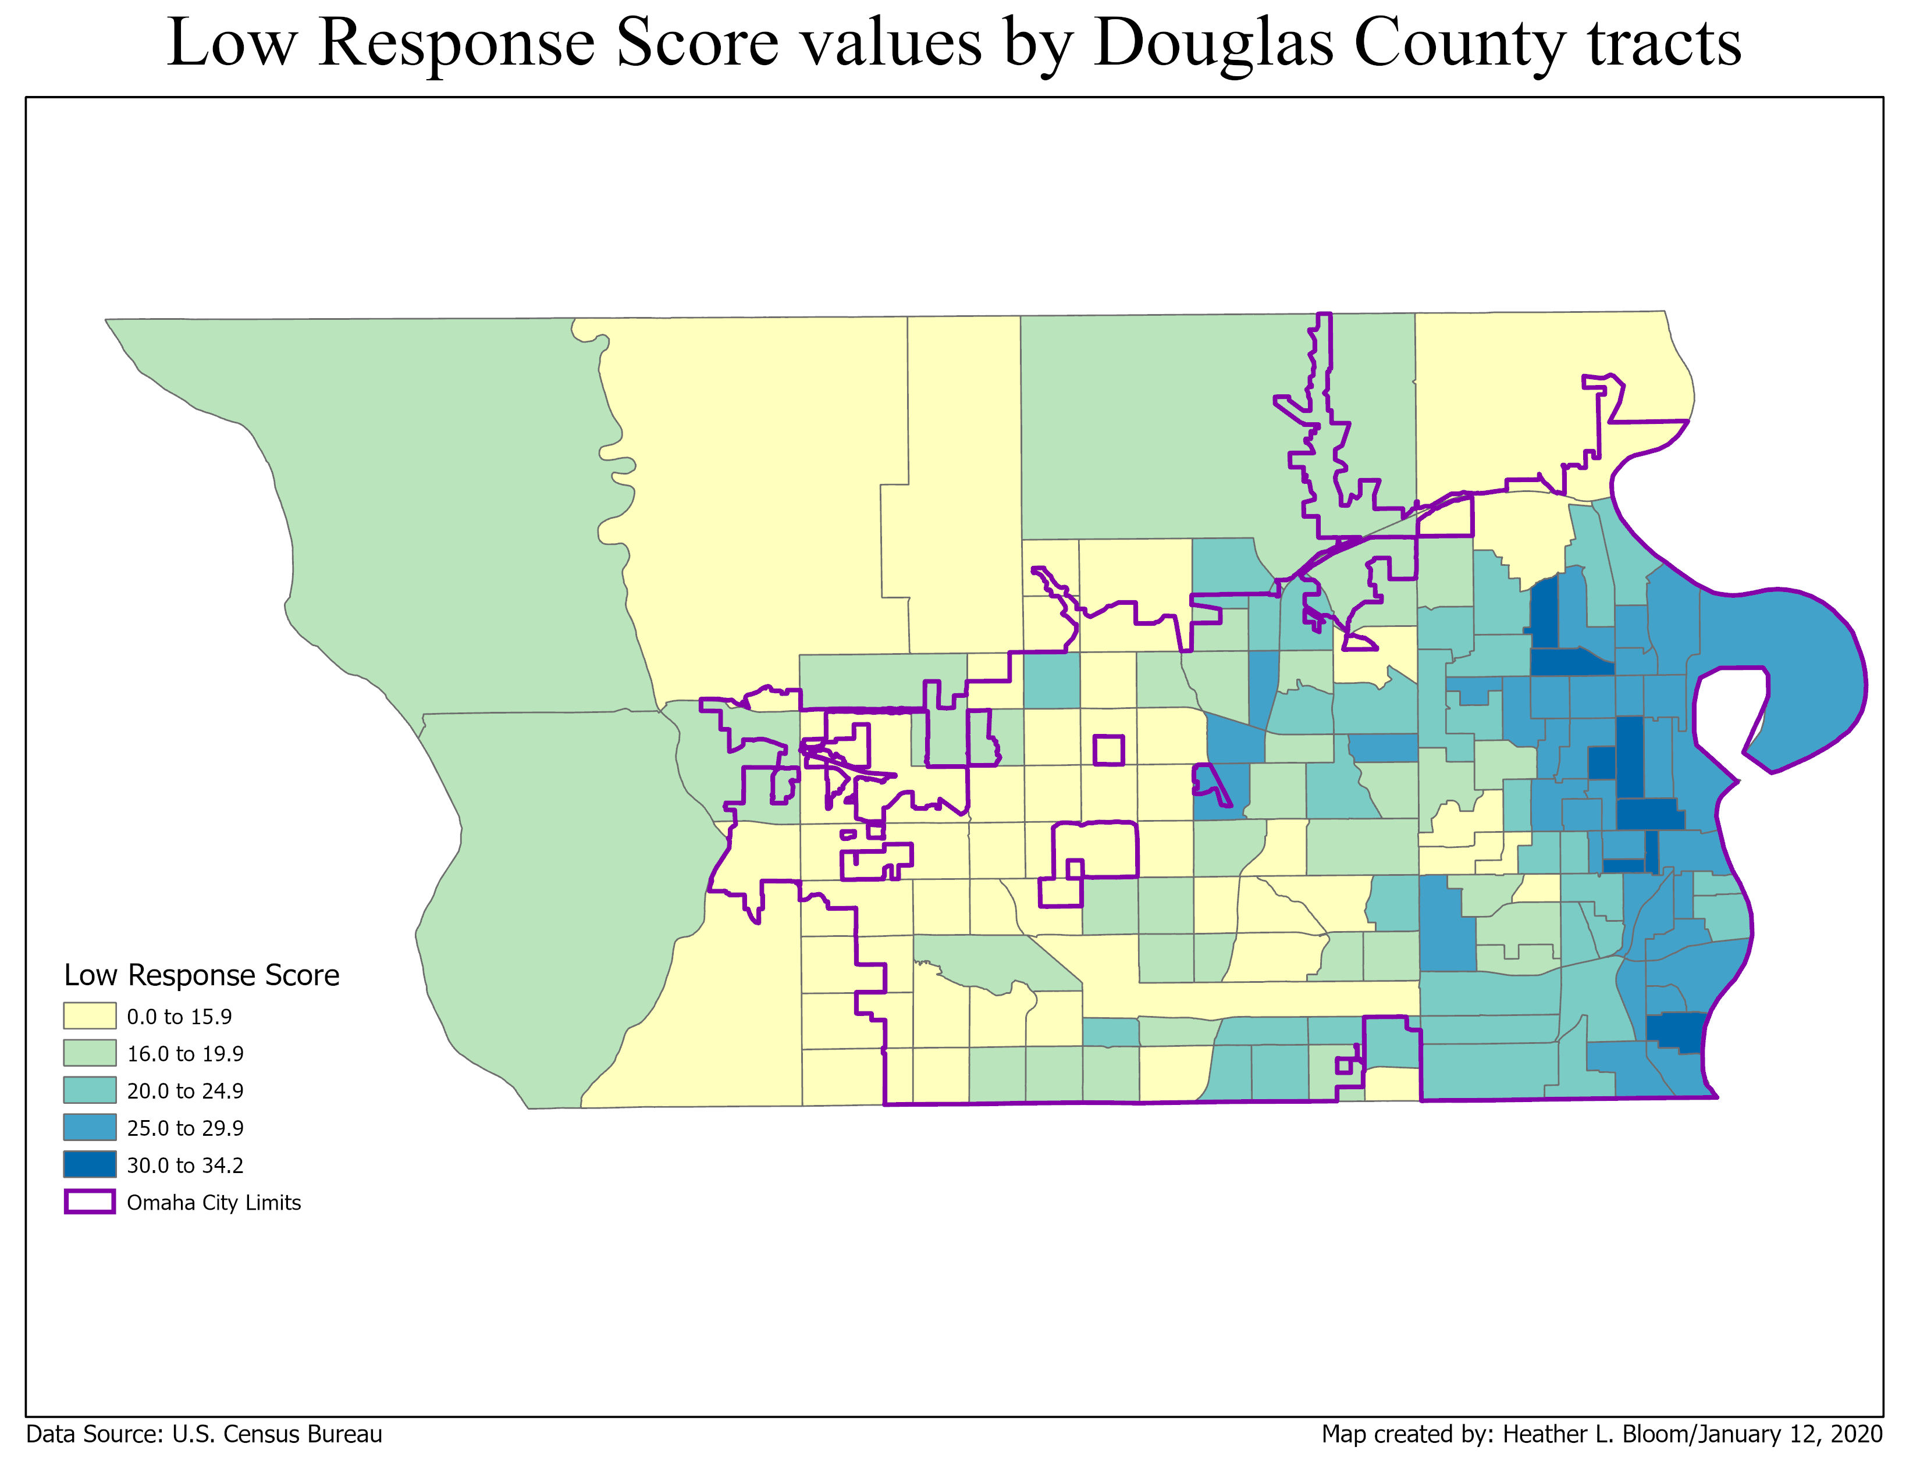
Notes:
Four census tracts in Nebraska had no LRS value: Census Tract 35 and 36.01 in Lancaster County and 9401 and 9402 in Thurston County. LRS values ranged from 5.5 to 34.2. Eleven census tracts in Nebraska had LRS values higher than 30, all in Lancaster, Sarpy and Douglas counties. In Douglas County, 8 census tracts had LRS values higher than 30. All but 4 of the census tracts with LRS values above 25 were east of 72nd Street. In 1950, Omaha City Limits did not pass 72nd Street.

Slide 8
2020 Partnership Objectives
Form Complete Count Committees (CCCs) in all states and cities with populations of 200,000 or more people by January 2020
Provide support for more than 100 languages, via the partnership specialists or community partnerships
300,000 partnership agreements by March 2020
Establish partnerships in all tracts with a LRS of 30 or above (9 percent of all census tracts) and
Establish partnerships in 70 percent of tracts with a LRS between 20 and 30 (41 percent of all tracts)

Slide 9
January/ February 2020
On January 21, 2020, Census Bureau Director, Dr. Steven Dillingham helped enumerate the first household in Toksook Bay, Alaska.
Partnership specialists were scrambling to get Statistics in Schools information to all elementary, middle and high school students, especially to those schools in low-response score tracts.
The scramble to beat the 256,000 partners gained during the 2010 Census was focused on finding partners that served children, minority groups, persons with disabilities, renters, among others in the low-response score tracts that were identified in ROAM.
I drove around to more than 70 Omaha Public Schools in 3 days, convincing their principals to share Census materials with their students.
Notes:
Many of the poorest students in Omaha attend an OPS school, with more than 73.67 percent of students received free or reduced-price lunches based on their family income in 2019-20 (Omaha World Herald 2022). More than 18,000 OPS students have received English Language Learner services, while parents and students speak more than 100 different languages (Nitcher 2021).

Slide 10
March 2020
In mid-March, individual housing units were invited to respond to the census either by mail or by hand delivery to rural/PO Box, non-USPS housing units.
Only a few addresses were hand delivered copies of the census questionnaire before the government shutdown.
On March 18, 2020, all federal government travel had stopped, and partnership specialists were restricted to only working at home.

Slide 11
Notes:
I chose the classification based on what the Census Bureau’s Tableau 2020 Response Rate Map open data effort. They used choropleth map with a maximum of 10 classes, in a diverging color scheme. To show more data, I created these as bivariant maps, by numbering the states by response rate, with 1 being the highest or best response rate, while 51 being the lowest response rate. Due to the small size of most counties, I did not do this for the U.S. county map. As you can tell from these two maps, the Midwest has higher response rates; this trend continues throughout the response period.

Slide 12
Notes:
Again, I created these as bivariant maps, by numbering the Nebraska counties by response rate, with 1 being the highest or best response rate, while 93 being the lowest response rate; in Douglas County, there are 162 tracts. Eastern Nebraska has better self-response scores; In Douglas County, the tract with the best self-response score is where Governor Pete Rickett’s Omaha residence. I found this humorous, since Pete Ricketts did not want Nebraska to have a state Complete Count Committee.

Slide 13
Census Day – April 1, 2020
Census Day referenced where you lived on that date.
NRFU was to start in May and finish in July.
The count to be delivered to President Trump by December 31, 2020.
These events did not go as planned.
Census Day was changed from where you were on April 1st, to where you should have been on April 1st, since colleges sent students home and some people fled urban areas due to COVID-19.

Slide 14
Notes:
A pattern is emerging that Midwestern counties have better response rates

Slide 15
Notes:
There are 3 counties already lagging. Thurston County (#91 or in Northeast Nebraska) is home to an Indian Reservation. In Douglas County, a couple of tracts response rate is about what the final response rate for the U.S. is.

Slide 16
April/May 2020
For the latter part of March, April and May, the work of the partnership specialists was completely virtual.
We started email blasts, letting partners know about the latest news about the new census timeline and offering postcard-sized graphics for them to share via their social media platforms to encourage self-response.
In Omaha, I worked with Millard Public Schools, one of many schools that were offering meals to be picked up for families, since school was not in-person, to hand out census literature to encourage self-response.
Although only a couple tracts within the school district boundaries were labeled low response, by quickly increasing tract self-response to about 70 percent or higher, this helped increase response levels for the City of Omaha, Douglas County and Nebraska.

Slide 17
Notes:
The higher response rate spread east; most census tracts in Iowa and Illinois have response rates above 57 percent. Overall; Northern states have better response rates than southern states. New York was having response issues related to COVID.

Slide 18
Notes:
Eastern Nebraska continued to have better response rates; In Douglas County, a collaboration with Millard Public Schools helped improve response rates in the southern part of the district.

Slide 19
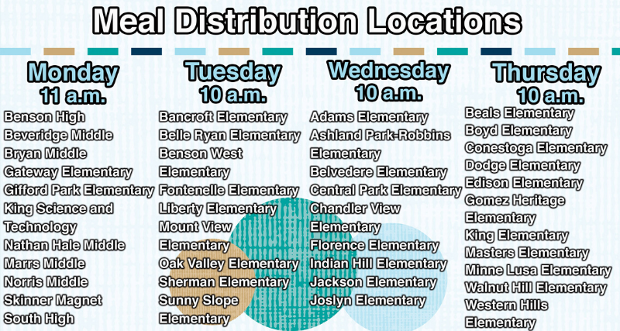
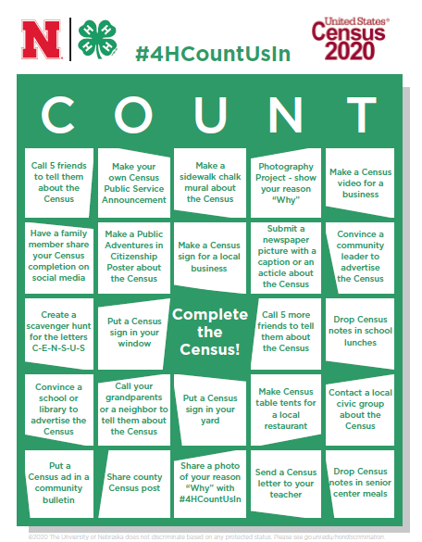
June 2020
In June, partnership specialists were allowed to attend small gatherings, while wearing masks.
Omaha Public Schools allowed Census Partnership Specialists to hand out Census literature to cars.
We worked with Metro Bus to offer free Internet and free bus passes to people who were filling out the 2020 Census on site.
A team of 13 Census Bureau employees (eight Partnership Specialists and five Recruiting Assistants) distributed 2020 Census printed materials and promotional items for three weeks at a total of 28 schools.
The strategy and results were to hand out materials to 776 cars the first week, distribute materials and census fans to 1,099 cars and people the second week, and distribute materials and water bottles to 675 cars and people who were picking up food items the third week.
A total of 2,550 cars were reached.
While about two-thirds of Nebraskans live in three urban counties, there are 90 counties that are primarily rural.
Census partner Nebraska Extension created a Census Bingo game, where participants completed activities, such as putting flyers in windows, creating new materials and calling neighbors and elected officials about promoting the 2020 Census.
The goal of the game was to increase awareness and self-response.
Nebraska Extension shared self-response data with all counties and recruited about 30 county extension clubs to participate in Census Bingo.

Slide 20
Notes:
Data collection by the Census was supposed to end in August 2020 and partnership specialists were expected to be released by June 2020, although our final day was September 26, 2020. Response rates improved in coastal states.

Slide 21
Notes:
In Nebraska, Sarpy County (directly south of Douglas County) has a response rate of 75 percent; their county election commission office coordinated efforts for a successful county count. Six tracts in Douglas County have response rates above 86 percent.

Slide 22
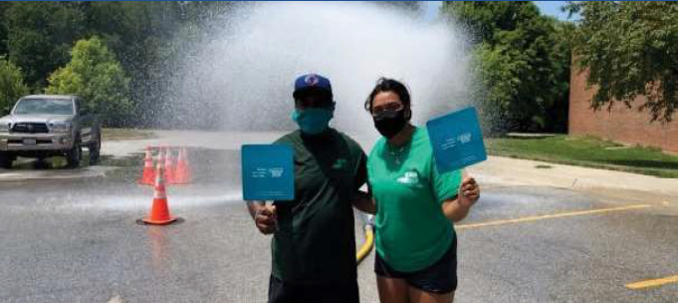
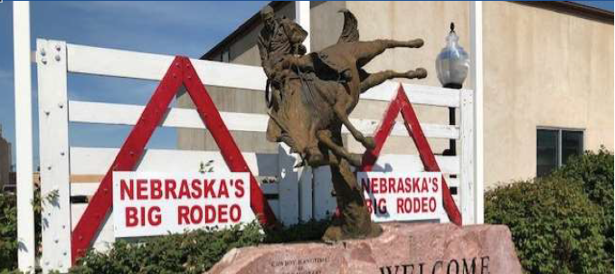
July 2020
In July, Census partner City of Omaha Parks, Recreation and Public Property hosted their neighborhood hydrant parties despite COVID-19.
The census team chose locations with response rates below Douglas County’s average and handed out census flyers, fans, and water bottles to those in attendance.
Four partnership specialists and one recruiting assistant talked to residents about the census, and the recruiting assistant helped several families fill out their census questionnaire.
The team had a presence at 12 locations throughout Omaha, connecting with about 100 community members.
Starting in July, Mobile Questionnaire Assistance (MQA) tables were set up at rodeos and county fairs.
In rural Nebraska, connectivity is an issue, so Internet response was not always a popular method of self-response. Recruiting assistants helped enumerate with iPads at community events.

Slide 23
Notes:
Self-response was supposed to run through July 2020, but it was extended since Non-Response Follow-Up (NRFU) was delayed by nearly three months. Enumerating in counties with Native American reservations was difficult; all states had response rates above 47 percent.

Slide 24
Notes:
Response rates continued to increase in Central and Western Nebraska. Some western Douglas County tracts have response rates above 90 percent.

Slide 25
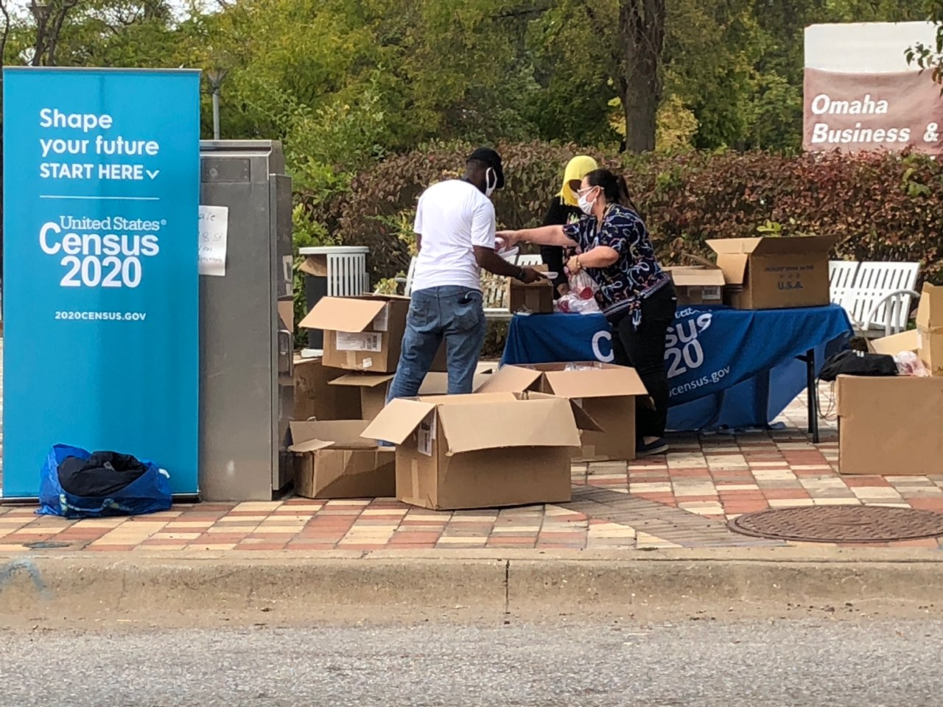
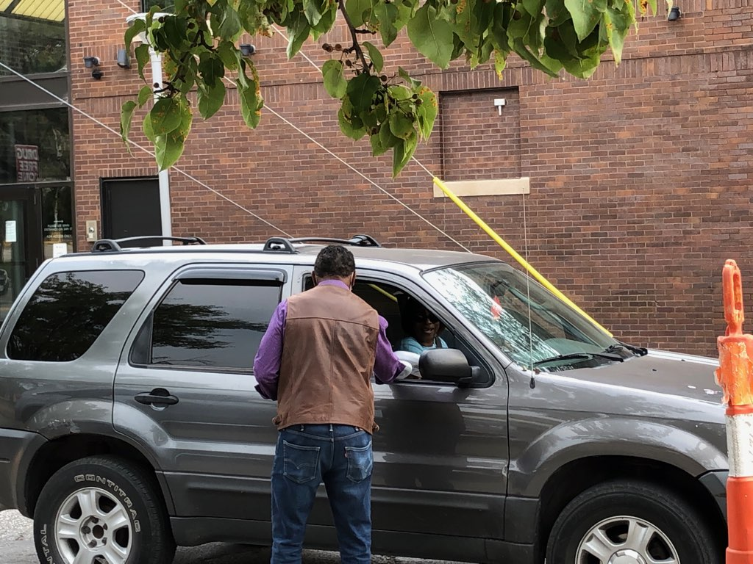
August 2020: outdoor gatherings resumed
A MQA at the Spanish-speaking business district of South Omaha was held to encourage and assist hard-to-count households with their questionnaires, interacting with about 250 people, assisting 15 people completing their questionnaires on site.
The team stood on street corners with census banners to create a visible presence and local businesses were offered census materials to distribute to their patrons.
Congressman Don Bacon (NE2-R) sponsored two events at Salvation Army locations in North and South Omaha.
At that time, about 7 out of every 10 Nebraska households had completed the 2020 Census, more than 6 out of 10 families in Omaha and Douglas County, while only about 4 out of 10 households in North and South Omaha had completed the questionnaire.
These two areas included a high percentage of immigrants, families with young children, poverty and a lack of Internet connectivity.

Slide 26
Notes:
NRFU ran from August 9th to September 30th but was finished in October in some areas. Although Alaska began enumeration first, response rates were the lowest here.

Slide 27
Notes:
Most partnership specialists lived in Douglas County and Lancaster County (#4). Since milage was lower to travel to eastern Douglas County tracts and population density was greater, we spent most of our efforts here; costs were less when overnight trips weren’t necessary. There

Slide 28
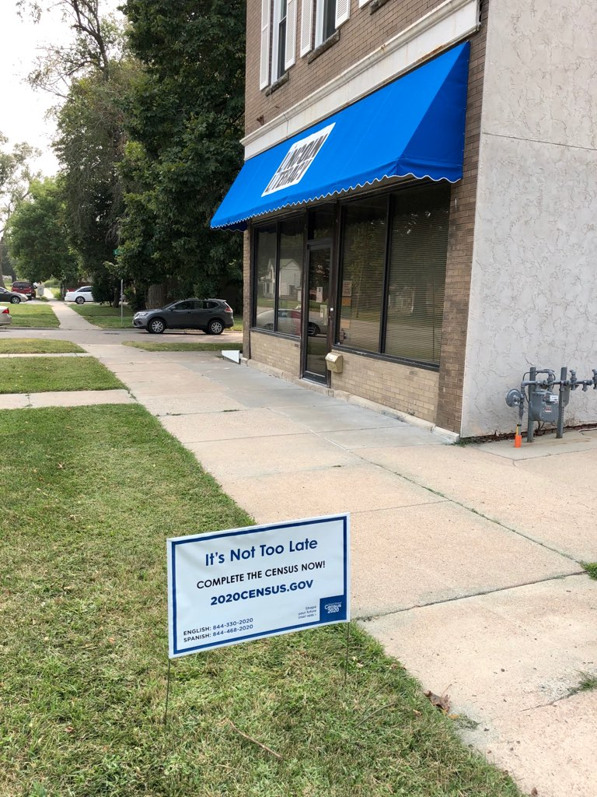
September 2020
MQAs continued to be held at outdoor events.
From July 13 to September 26, 140 MQAs were completed in Nebraska, while the CCCs were wrapping up their last meetings.
Enumerators were in the field with iPhones, but partnership specialists were still working to encourage self-response.
Partnership specialists handed out 400 yard signs in eastern Omaha tracts that were performing in the bottom 20 percent of self-response.
There were 23 Douglas County tracts that still had response rates below 55 percent.

Slide 29
Notes:
There were still a few tracts with response rates below 15 percent. Alaska final raised its self-response rate above 50 percent.

Slide 31
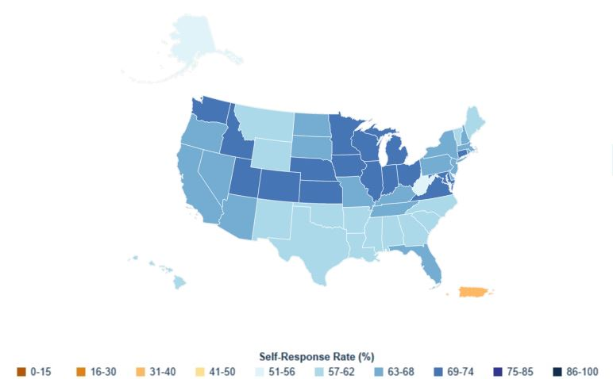
Census Self-Response: United States (responses received through 9/22/20)
Notes:
On September 22nd, four days before partnership specialists were out of jobs, 95.8 percent of Americans were enumerated, while 66.2 percent participated in self-response.

Slide 32
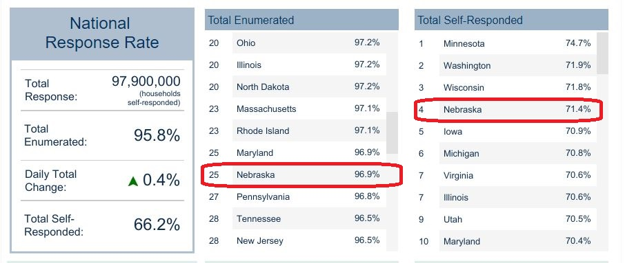
Census Self-Response: United States (responses received through 9/22/20)
Notes:
Nebraska had enumerated 96.9 percent of its residents, and was finishing 4th in self-response at 71.4 percent, below Minnesota, Washington and Wisconsin.

Slide 33
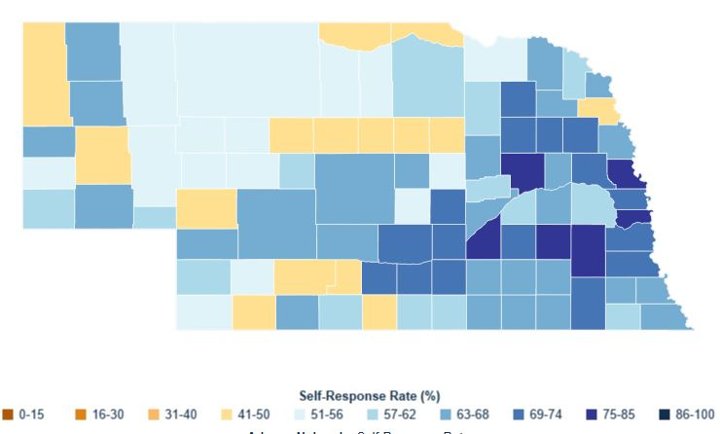
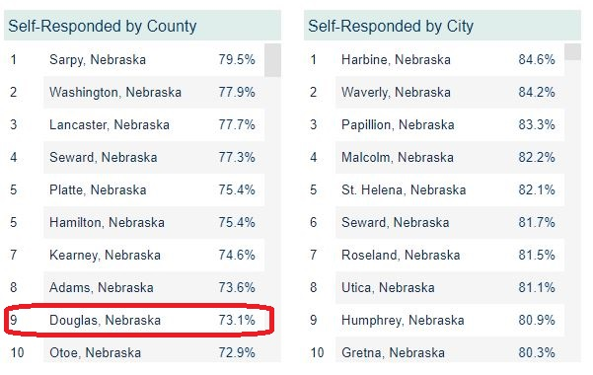
Self-Response: Nebraska (responses received through 9/22/20)
Notes:
In Nebraska, Douglas County finished 9th, with a 73.1 percent self-response rate, while the City of Omaha had a 72.2 percent response rate.

Slide 34
Cities with populations above 450,000

Slide 35
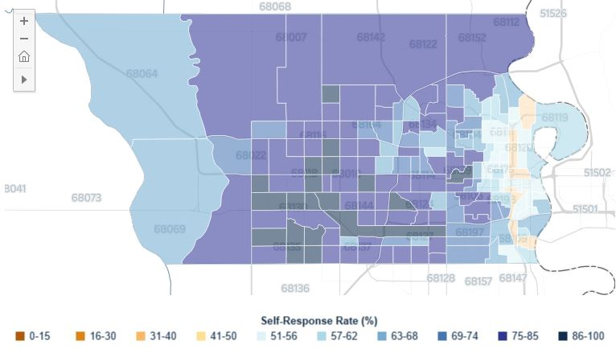
Self-Response: Douglas County, Neb. (responses received through 9/22/20)

Slide 36
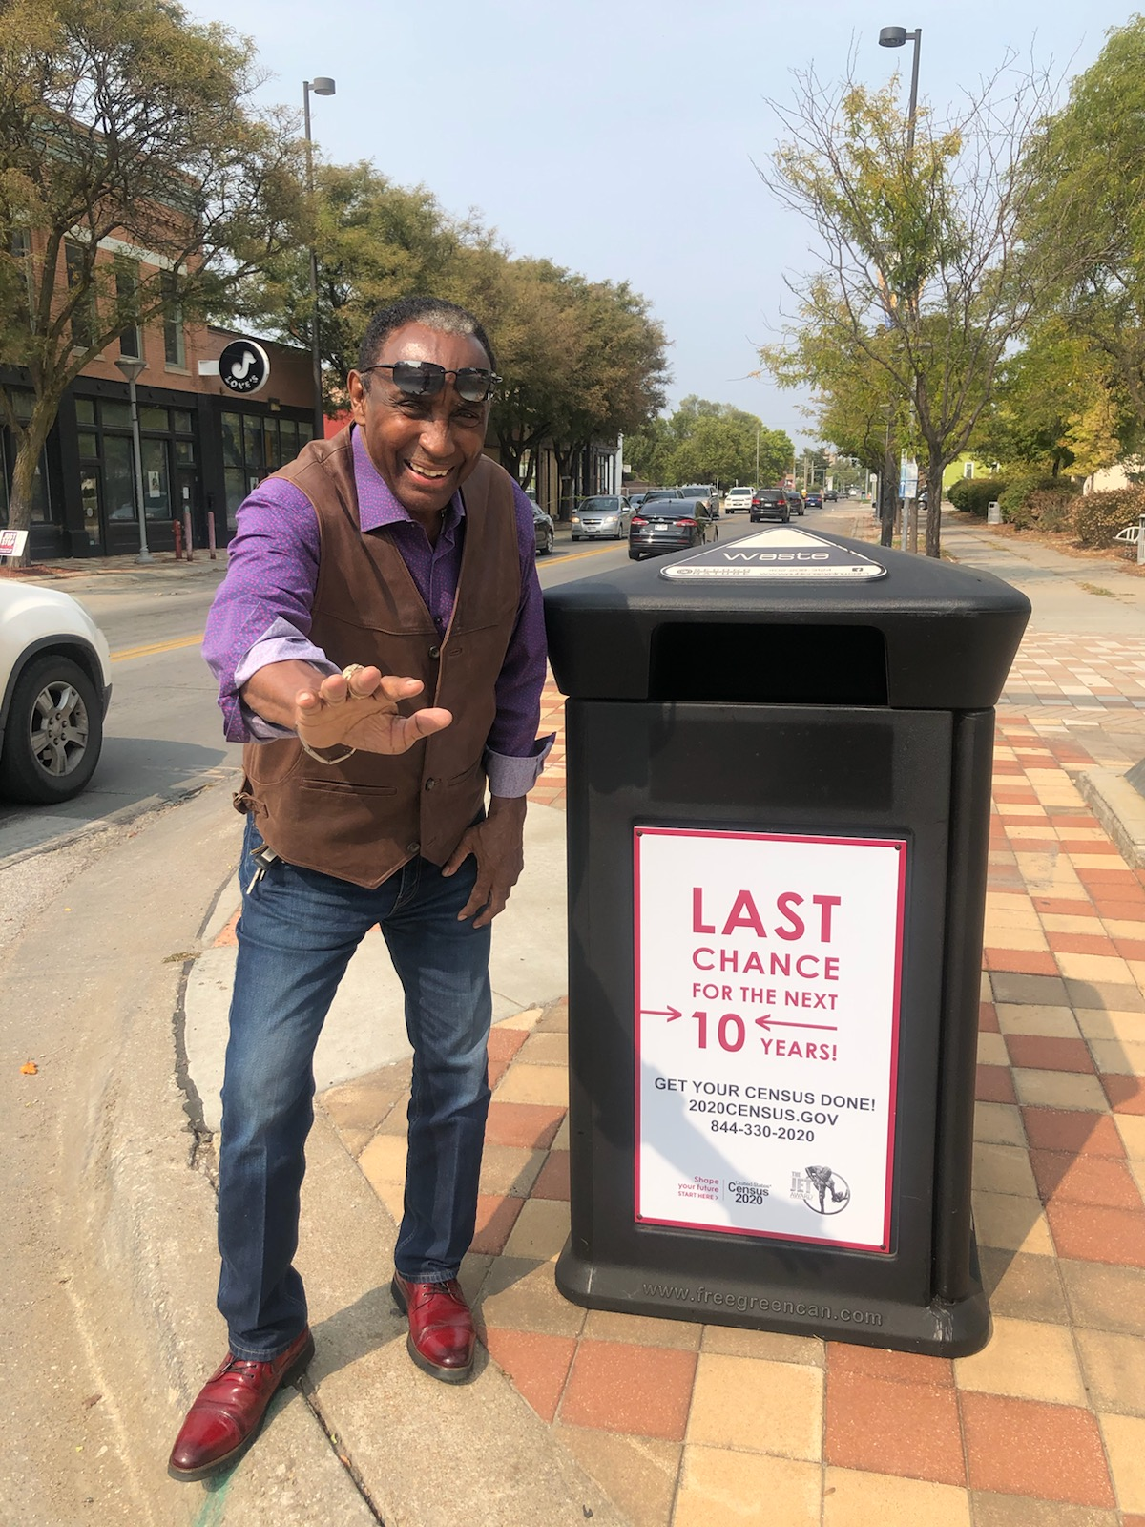
The Last Push
On our last workday, Friday, September 25th at 1 p.m., we held our “Last Push Press Conference” at Dreamland Park at 24th and Lizzie Robinson Avenue in North Omaha.
There was a press conference with city and county leaders, one last MQA and debuting census messaging on trash cans along North 24th Street in Omaha.
The Census Bureau employed local celebrity, Nebraska football player and 1972 Heisman Trophy winner, Johnny Rodgers, as a partnership specialist.

Slide 37
Notes:
Apportionment and redistricting data was delayed by about 9 months. All states, but Alaska and West Virginia, completed the Census with response rates above 57 percent.

Slide 38
Notes:
Apportionment and redistricting data was delayed by about 9 months.

Slide 39
Notes:
It is difficult to see the dark blue areas; many of them were in urban areas that are too small to see on these maps; the Response Rate dark blue areas are a lot of the “Not Calculated” areas were Native American Reservations.

Slide 40
Notes:
In rural Nebraska, response rates were lower than predicted Low Response Scores.

Slide 41
Notes:
Low Response Rates are similar to the final response rates in Douglas County.

Slide 42
Notes:
Low Response Rates are similar to the final response rates in Douglas County.

Slide 43
Map Data provided by
Data provided by the Center for Urban Research / CUNY Graduate Center via the www.censushardtocountmaps2020.us map.
U.S. Census Bureau. (2021, October 8). 2020 Census: Tracking Self-Response Rates Map. Census.Gov. https://www.census.gov/library/visualizations/interactive/2020-census-self-response-rates-map.html.
Response Outreach Area Mapper (ROAM). (n.d.). Census.gov. https://mtgis-portal.geo.census.gov/arcgis/apps/webappviewer/index.html?id=33913772601d4c89856119b2ded614e2.

Slide 44
Reference List
Bachman, R. (2019, September). National Partnership Program. U.S. Census Bureau. https://www2.census.gov/cac/sac/meetings/2019-09/2020-census-partnership-program.pdf
Bates, N., & Mulry, M. H. (2011). Using a geographic segmentation to understand, predict, and plan for census and survey mail nonresponse. Journal of Official Statistics, 27(4), 601, http://www.sverigeisiffror.scb.se/contentassets/ca21efb41fee47d293bbee5bf7be7fb3/using-a-geographic-segmentation-to-understand-predict-and-plan-for-census-and-survey-mail-nonresponse.pdf.
Bruce, A., & Robinson, J. G. (2003, October). The Planning Database: Its Development and Use as an Effective Targeting Tool in Census 2000. In Annual Meetings of the Southern Demographic Association, Arlington, VA, https://citeseerx.ist.psu.edu/viewdoc/download?doi=10.1.1.115.3349&rep=rep1&type=pdf.
Bruce, A., & Robinson, J. G. (2007). Tract level planning database with Census 2000 data. US Government Printing Office, Washington, DC, https://www2.census.gov/programs-surveys/research/guidance/planning-databases/2000/pdb-tract-2000.pdf.
Center for Urban Research. (n.d.). Census Self-Response Rates Mapped and Analyzed: 2000, 2010, and (soon) 2020. City University of New York Graduate Center. Retrieved December 25, 2021, from https://www.gc.cuny.edu/Page-Elements/Academics-Research-Centers-Initiatives/Centers-and-Institutes/Center-for-Urban-Research/CUR-research-initiatives/Census-2020/Census-Self-Response-Rates-Mapped-and-Analyzed-2000,-2010,-and-(soon)-2020.
United States Census Bureau. (n.d.). The 2020 Census at a Glance, https://www2.census.gov/. Retrieved December 9, 2021, from https://www2.census.gov/geo/pdfs/maps-data/maps/roam/2020_Census_at_a_Glance-ROAM.pdf.

Slide 45
Contact me:
hbloom3@huskers.unl.edu
Maps are available at: hbloom3.github.io/AAGSpring2022/mapsBloom.pdf

Slide 46
LRS variables
2020 Census LRS variables (25)
Renter-occupied units | Age 45-64
Ages 18-24 | Persons per household
Female head, no husband present | Moved in 2005-2009
Non-Hispanic white | Hispanic
Ages 65+ | Single-unit structures
Related child | Population density
Males | Below poverty
Married-family households | Different housing unit 1 year ago
Ages 25-44 | Ages 5-17
Vacant units | Black
College graduates | Single-person household
Median household income | Not a high school graduate
 | Median house value

Slide 47
Past census response rates
Year | Response Rate
1950: first census to have a pro bono marketing campaign | 90 percent (enumerated by May 1, 1950)
1960: first mail-out census | 85 percent (enumerated by mid-April 1960)
1970: first mail-out/mail-back census for urban areas | 78 percent (final self-response rate)
1980: 95% enumerated via mail-out/mail back | 75 percent (final self-response rate)
1990: more focus on the undercount; outreach efforts on rural populations, renters, racial & ethnic minorities for better self-response rates | 65 percent (final self-response rate)
2000: last census with a long form; first census with a paid marketing campaign | 67.4 percent (final self-response rate)
2010: short form census only; ACS introduced in 2005 | 66.5 percent (final self-response rate)
2020: Internet-first self-response census debuted | 67.0 percent (final self-response rate)

