Slide 1
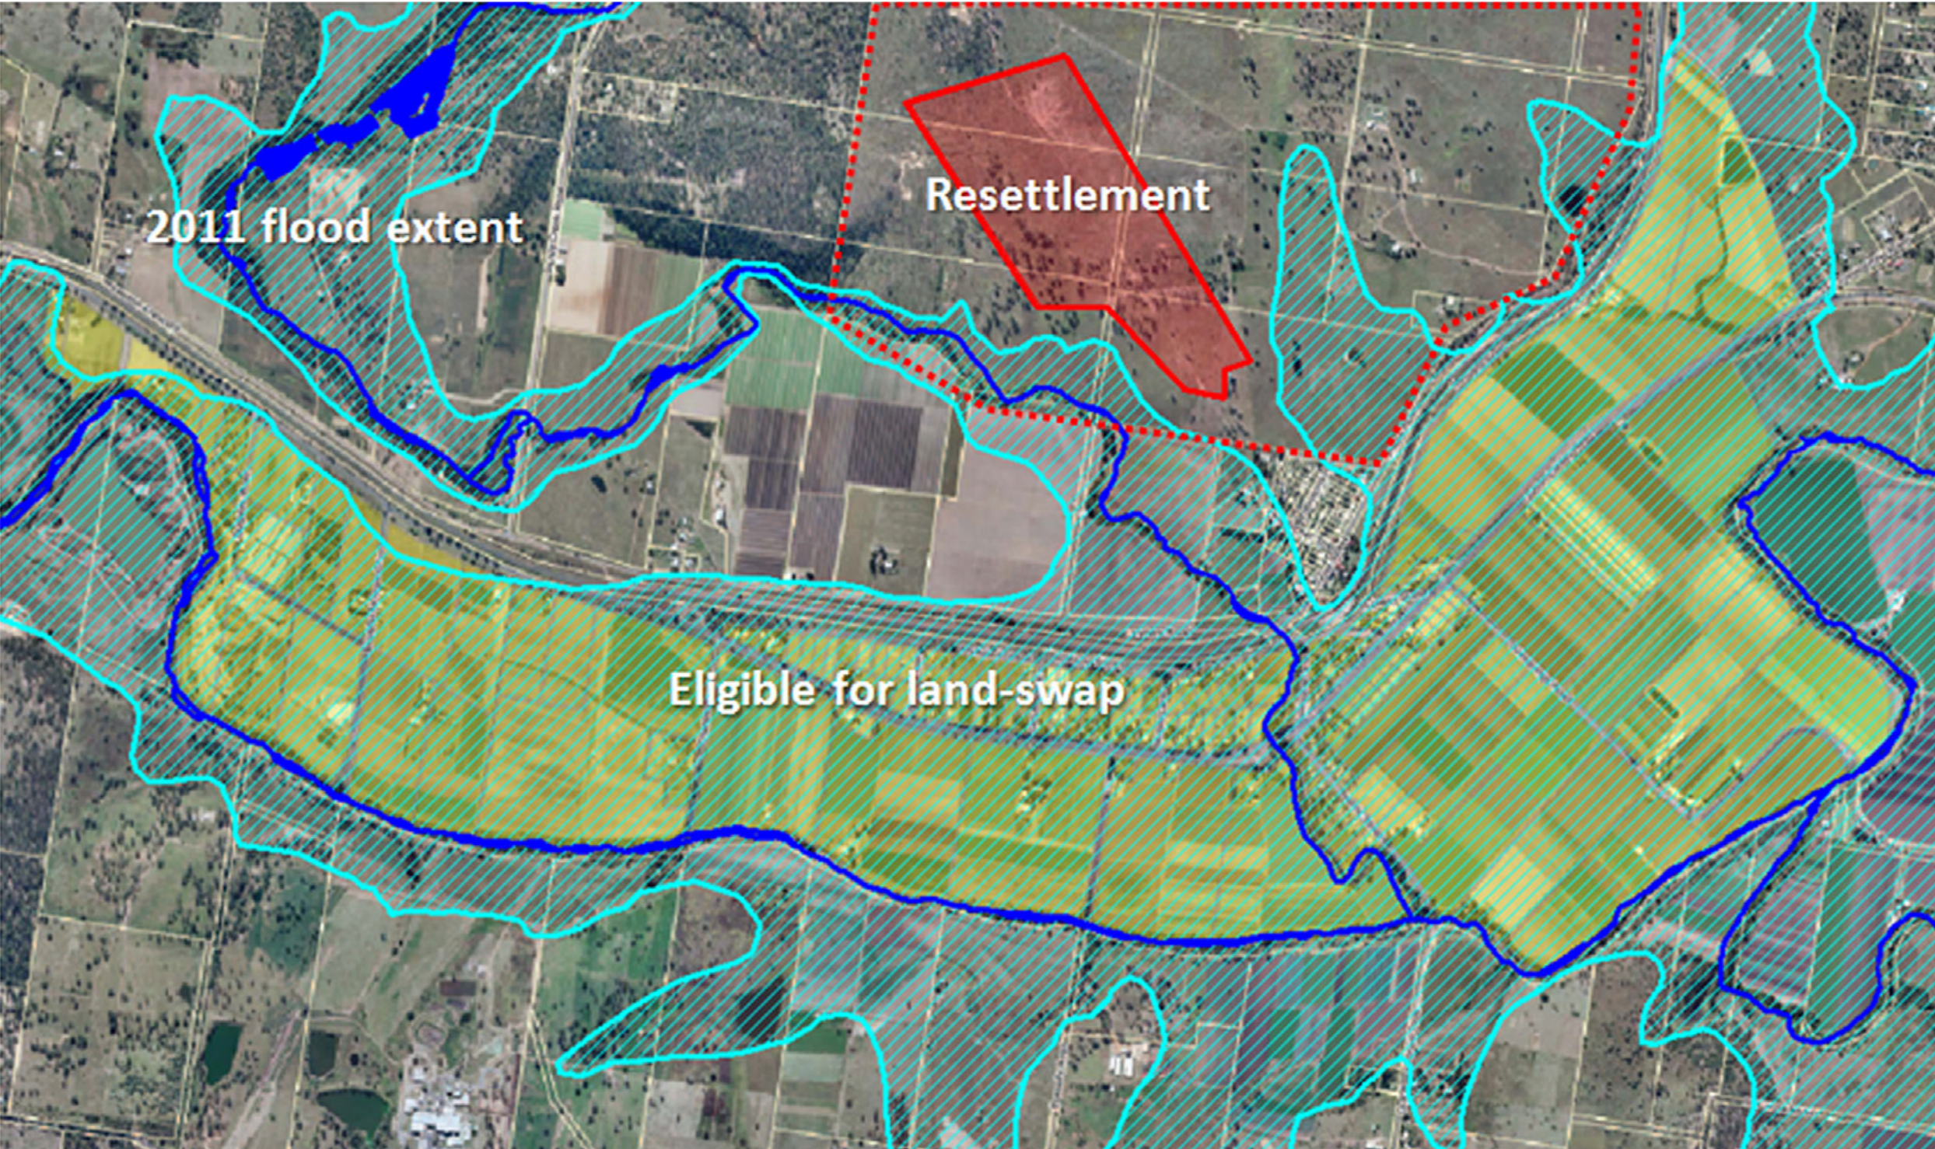
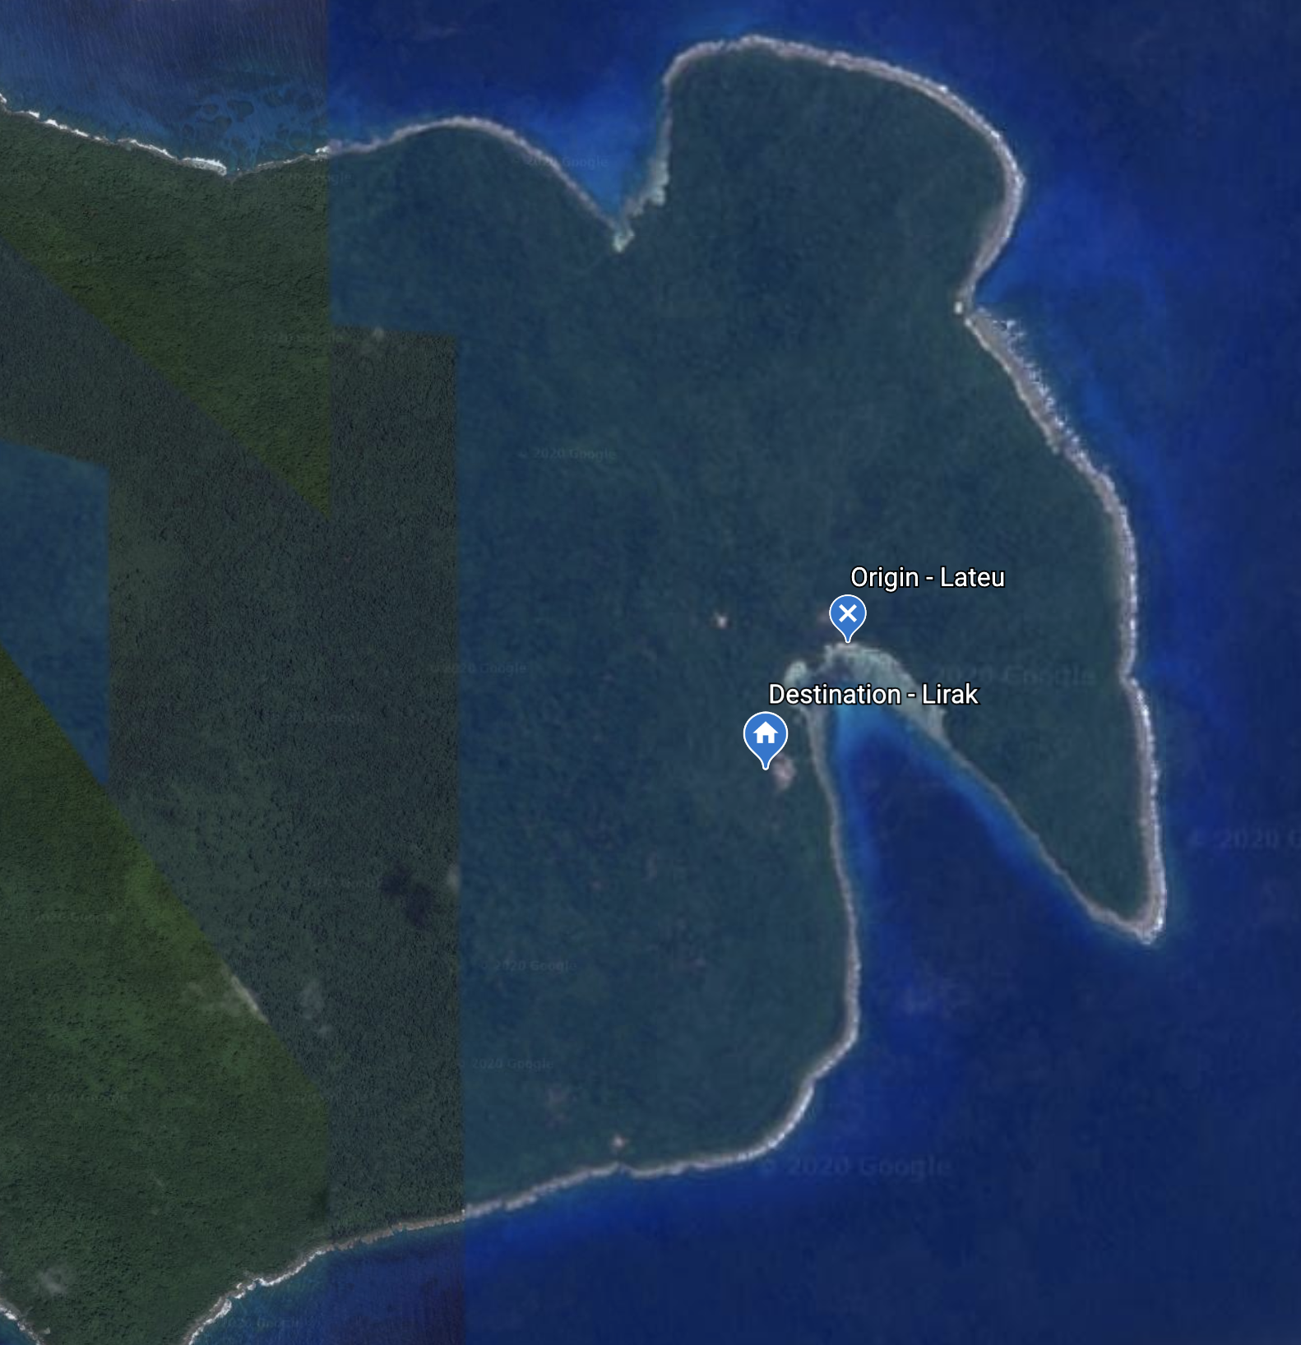
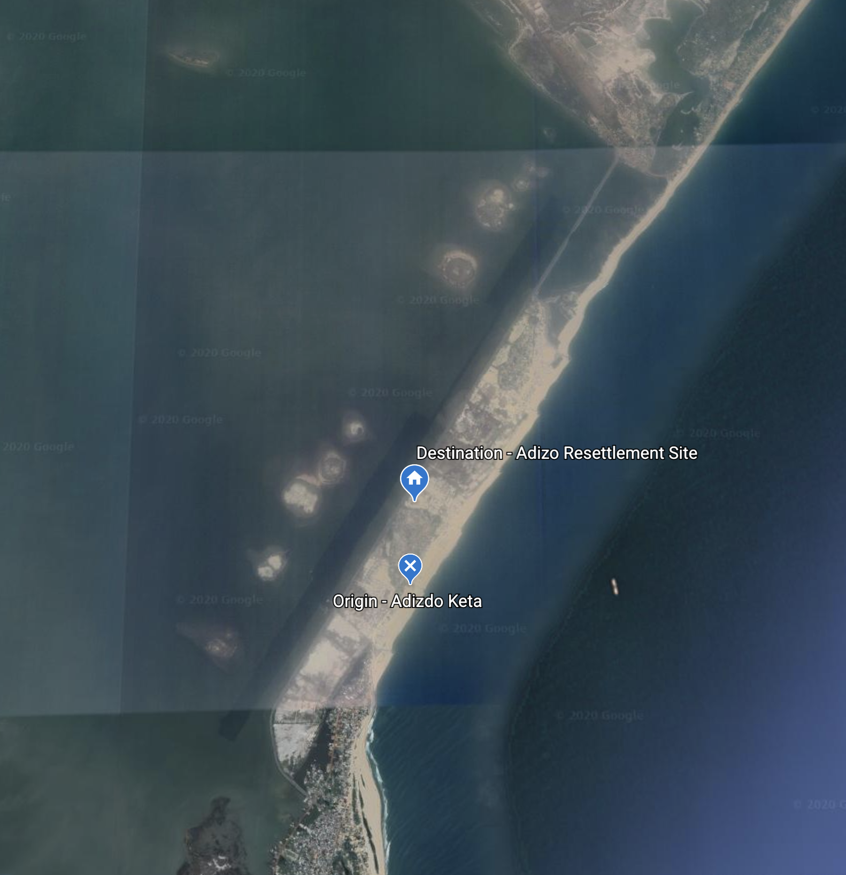
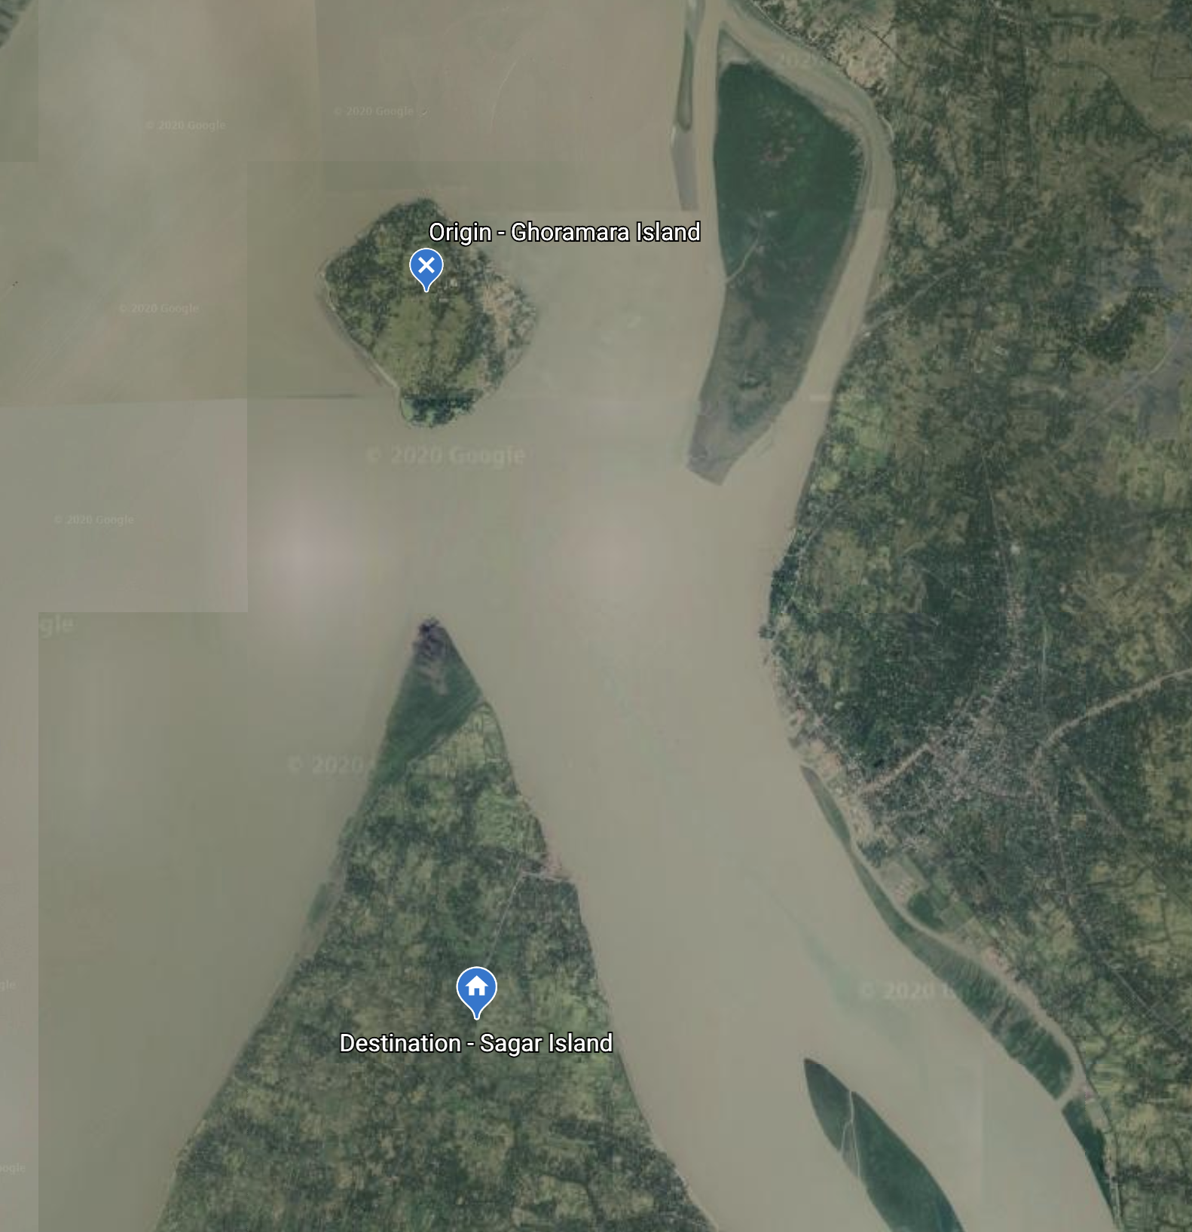
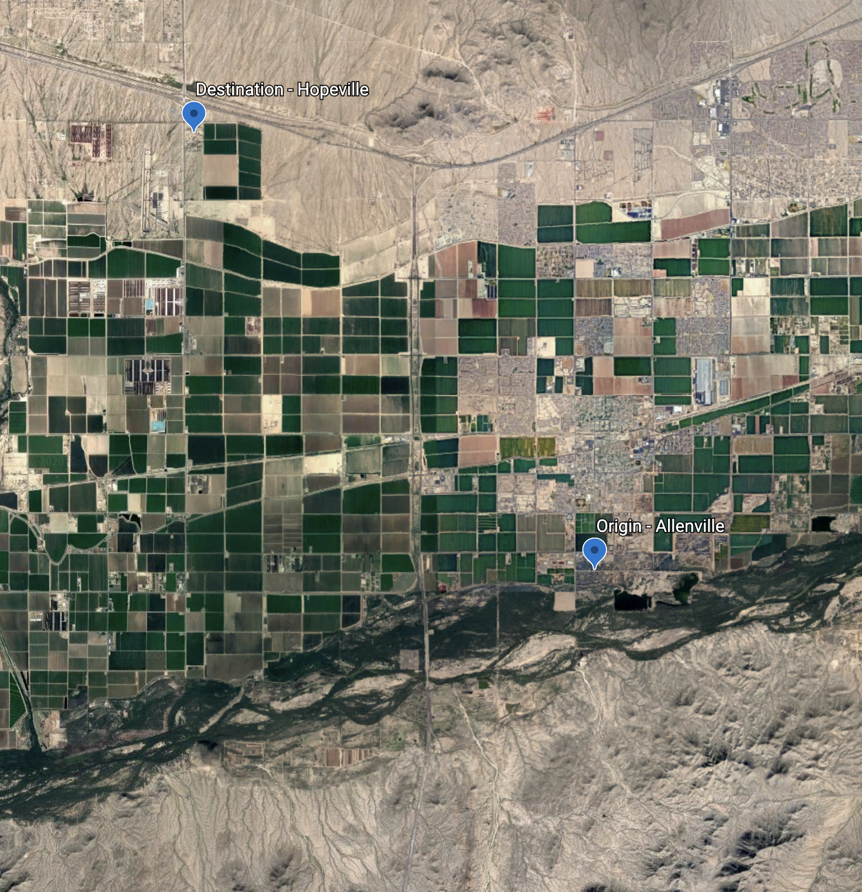
Planned relocation as climate adaptation:
A Qualitative Comparative Analysis of pathways to more positive livelihood outcomes
AAG 2022
Climate Mobility: Bridging Research to Policy
Erica R. Bower
February 25 2022

Slide 2
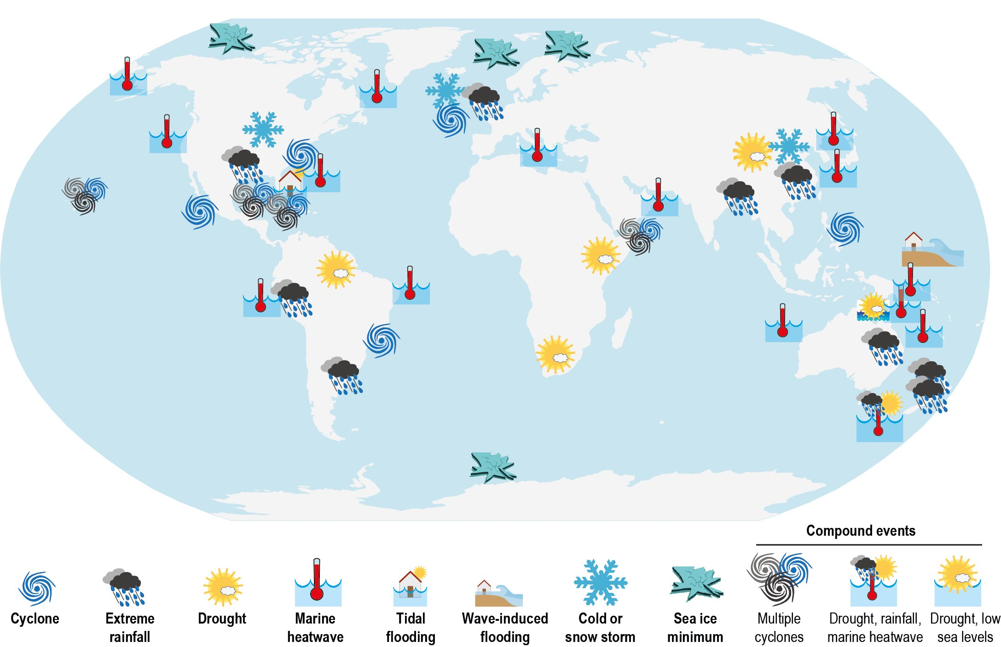
Introduction
Discussion
Methods
Results
(IPCC SROCC, 2019)

Slide 3
Landscape of climate adaptation strategies
Introduction
Discussion
Methods
Results
Planned relocation is unique:
Movement
Community scale
Shared destination
Transformational change
(Siders 2019)

Slide 4
Landscape of ways that humans move
Introduction
Discussion
Methods
Results
Planned relocation is unique:
Permanent
Community scale
Supporting actor
Displacement
Migration
Planned relocation

Slide 5
What is planned relocation?
Introduction
Discussion
Methods
Results
“The planned, permanent movement of a group of people from identifiable origin(s) to identifiable destination(s), predominantly in association with one or more [natural] hazard(s)” (Bower & Weerasinghe 2021)
5

Slide 6
Gaps in existing empirical evidence
Introduction
Discussion
Methods
Results
Comparative
Outcome -
focused
Single case study design
Limited evaluation of outcomes

Slide 7
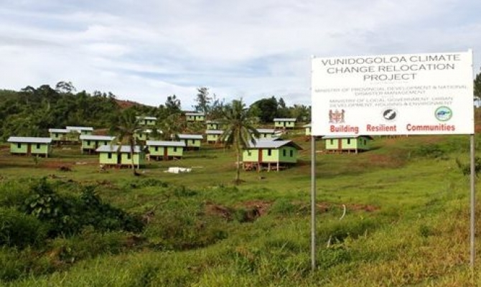
Research question
Introduction
Discussion
Methods
Results
What planning decisions, alone or in combination, are associated with improved livelihood outcomes across planned relocation cases?
(Fiji Government)

Slide 8
Planned Relocation Outcomes
Introduction
Discussion
Methods
Results
Many approaches to measure relocation outcomes for people
Sustainable livelihoods (Piggott-McKellar et al. 2019)
Livability (Palagi & Javernick-Will 2020),
Human security (Ferris & Weerasinghe 2020),
Impoverishment risks (Edwards 2013)
Durable solutions (Lee et al. 2014)
Societal transformation (Siders et al 2021)
Wellbeing (Huang & Noy 2020)
Reasons for a livelihoods framing:
Analysis of change in potential access to assets
Comprehensive and multi-dimensional

Slide 9
Outcomes: sustainable livelihoods framework (SLF)
Introduction
Discussion
Methods
Results
Human assets
Access to services for education, skill building, healthcare
Human assets
Access to services for education, skill building, healthcare
Cultural assets
Connection to land, religion, language, rituals, traditional practices
Social assets
Relationships (family, friend), social networks, community unity and cohesion
Natural assets
Land size and quality, access to resources (oceans, forests, rivers), crop quality, food security, hazard exposure
Physical assets
Housing, infrastructure (buildings, roads), transportation, access to amenities
Financial assets
Opportunities for income (e.g. tourism), access to markets, expenses, compensation
Asset categories of the Sustainable Livelihoods Framework (SLF), adapted from Scoones (1998) and Piggott-McKellar et al (2019)

Slide 10
What planning decisions leads to better livelihood outcomes? Five hypotheses
Introduction
Discussion
Methods
Results
10

Slide 11
Fuzzy set Qualitative Comparative Analysis (fsQCA), Ragin (1987, 2000)
Introduction
Discussion
Methods
Results
Set of small, close & community engaged relocations
Set of “Community Engaged” Relocations
Set of “Close” Relocations
Appropriate for this research question:
Medium N (10-50 cases)
Causal complexity
Equifinality
Set of “Small” Relocations

Slide 12
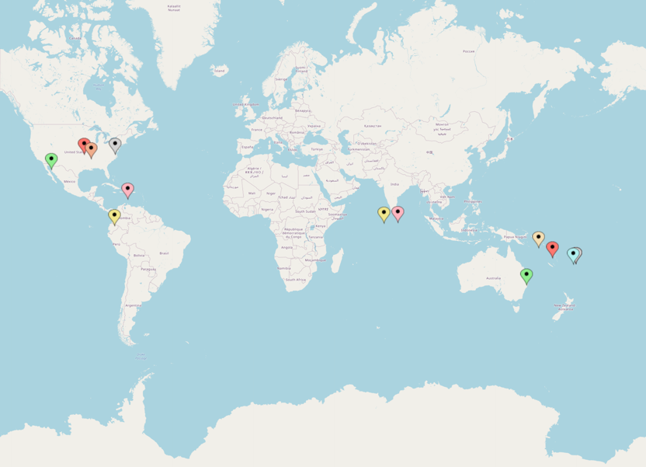
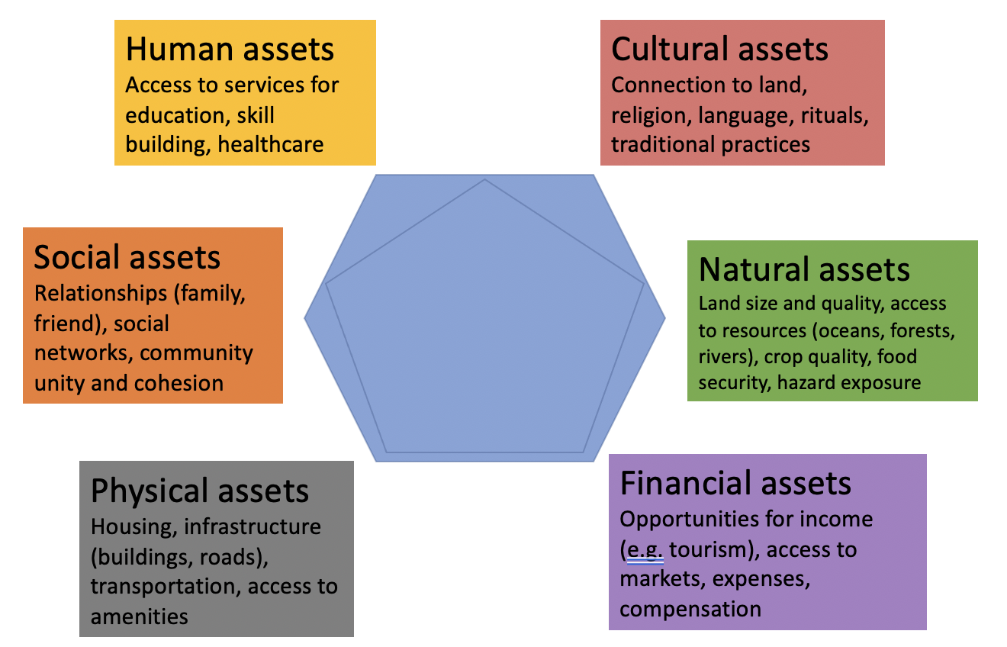
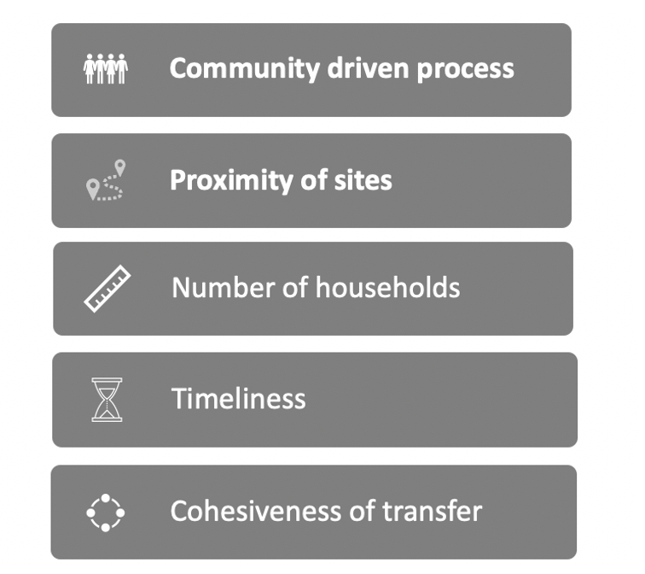
Fuzzy set qualitative comparative analysis (fsQCA), Ragin (1987, 2000)
Introduction
Discussion
Methods
Results
Define outcomes
Select Cases
Data Matrix
Select conditions
Necessity of individual conditions
Identification of Pathways
12

Slide 13
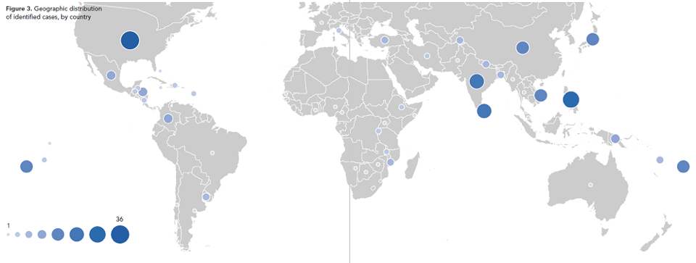
Global Database: 308 Cases
Introduction
Discussion
Methods
Results
Source: Leaving Place, Restoring Home (2021)
13

Slide 14
Case Selection: 14 flood-related completed relocations
Introduction
Discussion
Methods
Results
United States:
Allenville
Valmeyer
Soldier’s Grove
Pattonsburg
Maldives:
Kandholhudhoo
Fiji:
Vunidogoloa
Denimanu
Vunisavisavi
Dominican Republic:
La Barquita
Solomon Islands:
Mondo
Colombia:
El Choncho
Sri Lanka:
Matara
Vanuatu:
Letau
Australia:
Grantham
Source: Google Maps
14

Slide 15
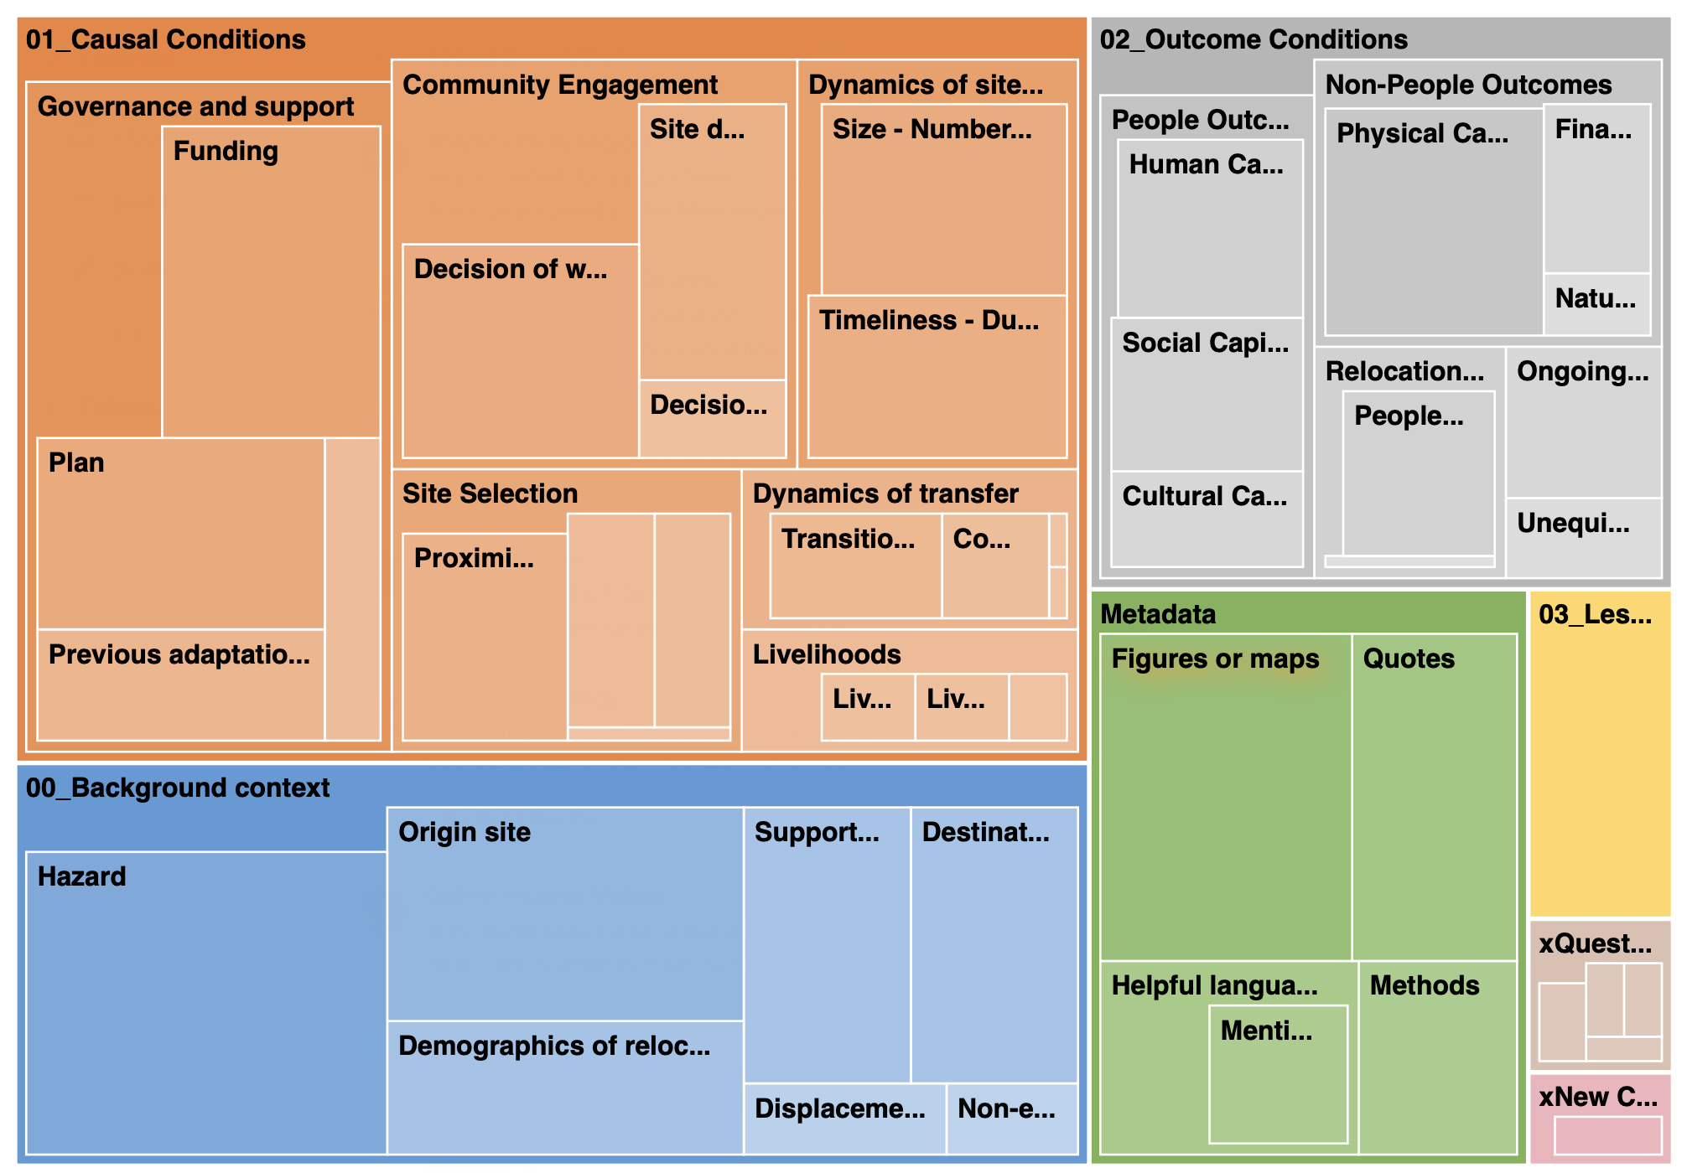
14 cases coded in NVivo
Introduction
Discussion
Methods
Results
15

Slide 16
Summary of cases: Data Matrix
Introduction
Discussion
Methods
Results
 | Causal Conditions |  |  |  |  | Outcome Conditions (SLF) |  |  |  |  |  | Average Outcomes
Case | Time_yrs | Prox_km | Scale_hh | CommEng | CohTransfer | Human | Social | Cultural | Natural | Financial | Physical | People | Non-People | Overall
Vunidogoloa, Fiji | 8 | 2 | 26 | 0.8 | 1 | 1 | 1 | 0 | 0.8 | 1 | 0.6 | 0.67 | 0.8 | 0.73
Allenville, USA | 12 | 3 | 35 | 1 | 0.8 | 0.4 | 0.6 | 0.8 | 0.6 | 0.6 | 1 | 0.6 | 0.73 | 0.67
Kananke Watta, Sri Lanka | 1.5 | 1.5 | 18 | 0 | 0 | 0.8 | 0.2 | 0.4 | 0.6 | 0.6 | 0.2 | 0.47 | 0.47 | 0.47
Denimanu, Fiji | 1 | 0.5 | 19 | 0.2 | 0.4 | 0.2 | 0.6 | 0.8 | 0.2 | 0.4 | 0.4 | 0.53 | 0.33 | 0.43
Mondo Village, Solomon Islands | 1 | 1 | 80 | 0.8 | 0.6 | 1 | 0.6 | 0.2 | 0.6 | 0.4 | 1 | 0.6 | 0.67 | 0.63
Vunisavisavi, Fiji | 3 | 0.04 | 4 | 0.4 | 0.2 | 0.6 | 0 | 0 | 0.6 | 0.6 | 0.6 | 0.2 | 0.6 | 0.4
El Choncho, Columbia | 2 | 0.2 | 10 | 1 | 1 | 0.2 | 0.4 | 0.2 | 0.6 | 0 | 0.8 | 0.27 | 0.47 | 0.37
Valmeyer, USA | 2 | 2.7 | 200 | 1 | 0.4 | 1 | 0.8 | 0.6 | 1 | 0.2 | 1 | 0.8 | 0.73 | 0.77
Pattonsburg, USA | 4 | 5 | 50 | 1 | 1 | 1 | 0.4 | 0.4 | 0.6 | 0.6 | 0.4 | 0.6 | 0.53 | 0.57
Soldier’s Grove, USA | 5 | 1 | 22 | 1 | 0.8 | 1 | 0.2 | 1 | 0.6 | 0.8 | 0.6 | 0.73 | 0.67 | 0.7
Grantham, Australia | 1 | 0.05 | 115 | 0.8 | 0.2 | 0.8 | 0.6 | 1 | 1 | 1 | 1 | 0.8 | 1 | 0.9
Lateu, Vanuatu | 8 | 1 | 8 | 1 | 0.8 | 0.6 | 0.8 | 0.8 | 1 | 0.6 | 1 | 0.73 | 0.87 | 0.8
La Barquita, Dominican Republic | 3 | 3 | 1500 | 0 | 0.4 | 0.8 | 0.2 | 0.2 | 0.6 | 0.2 | 0.8 | 0.4 | 0.53 | 0.47
Kandholhudhoo, Maldives | 4 | 16 | 600 | 0 | 0.2 | 0.8 | 0.4 | 0.4 | 0.4 | 0.2 | 0.6 | 0.53 | 0.4 | 0.47
16

Slide 17
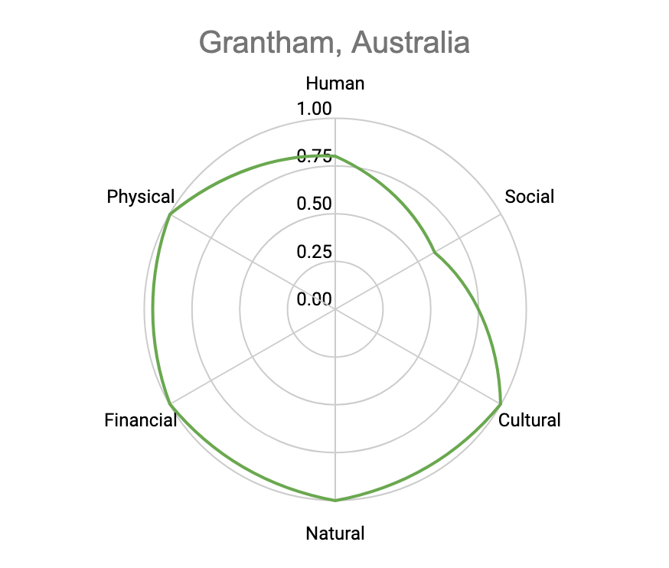
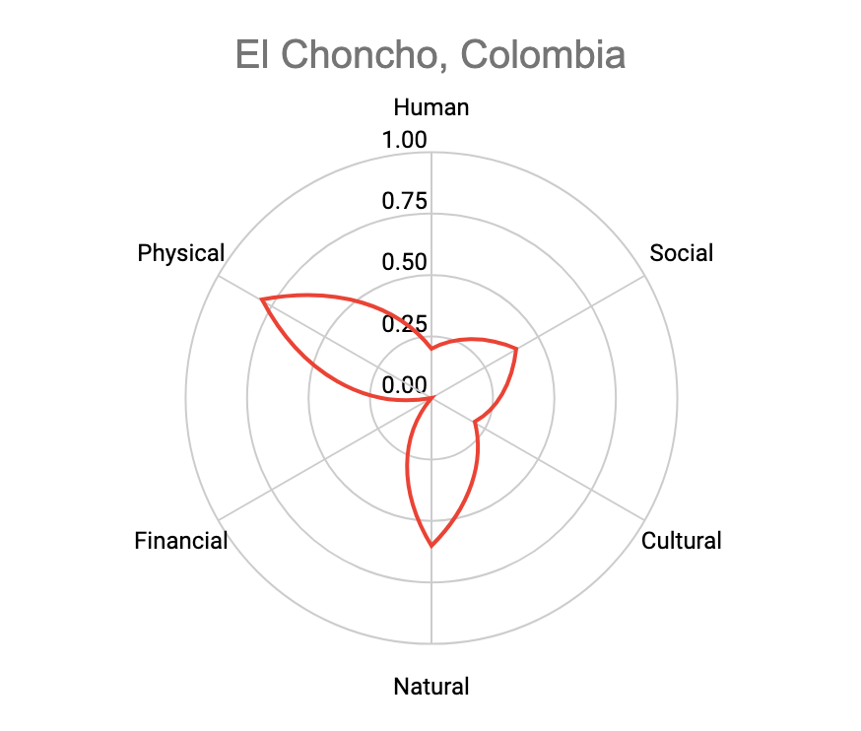
Sustainable livelihood outcomes: two cases
Introduction
Discussion
Methods
Results
17

Slide 18
Results: Are any conditions necessary for positive livelihood outcomes?
Introduction
Discussion
Methods
Results
 | Consistency Coverage
Community engagement | 0.792363 0.737778
Cohesive Transfer | 0.744630 0.800000
Scale | 0.493361 0.800034
Proximity | 0.442138 0.751557
Time | 0.648236 0.827071
*** No conditions met the consistency threshold score 0.9

Slide 19
Results: Which pathways are sufficient for positive livelihood outcomes?
Introduction
Discussion
Methods
Results
Cases: Grantham, Australia; Mondo Village Solomon Islands; Valmeyer USA
Community Engagement
Large Scale
Short time
+
+
Small Scale
Long time
Cohesive Transfer
Cases: Lateu Vanuatu; Soldier’s Grove USA; Vunidogoloa Fiji; Allenville USA
+
+
+
Solution coverage: 0.687
Solution consistency: 0.964
*** The importance of community engagement holds during robustness tests!
19

Slide 20
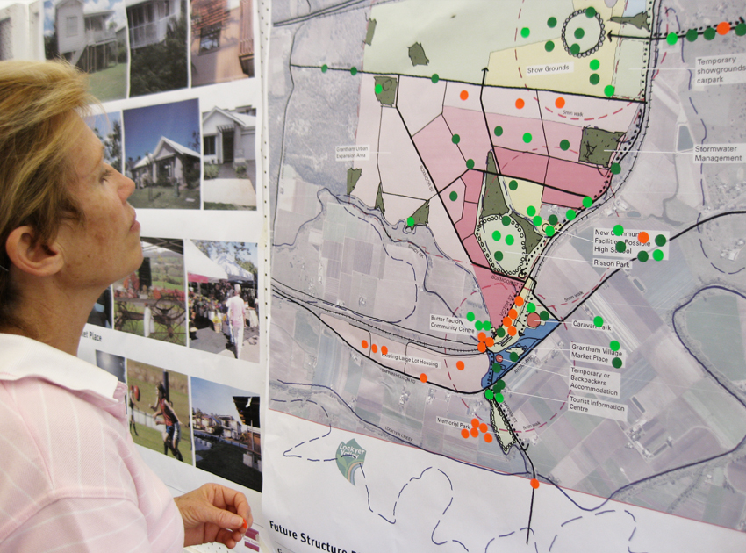
Discussion: community engagement matters
Introduction
Discussion
Methods
Results
In combination with other conditions
Multiple stages:
Initiation, site selection, site development
Need for further research
WHO is community? Whose voices are upheld / ignored?
What is ‘meaningful’ engagement – spectrum?
Source: Simmons 2020

Slide 21
Takeaway points
Introduction
Discussion
Methods
Results
Pathways that policy makers and practitioners can reference when planning relocations to enhance potential for better livelihood outcomes
Meaningful community engagement at initiation, site selection and site development stages really matters !
Value of comparative case study analyses (e.g. fsQCA) to inform climate migration decision- and policy-making

Slide 22
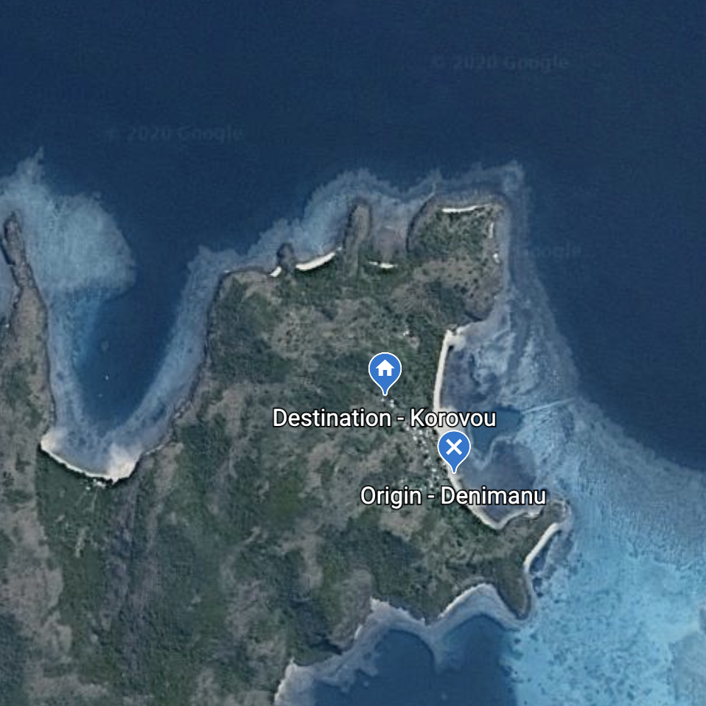
Thanks!

