Slide 1
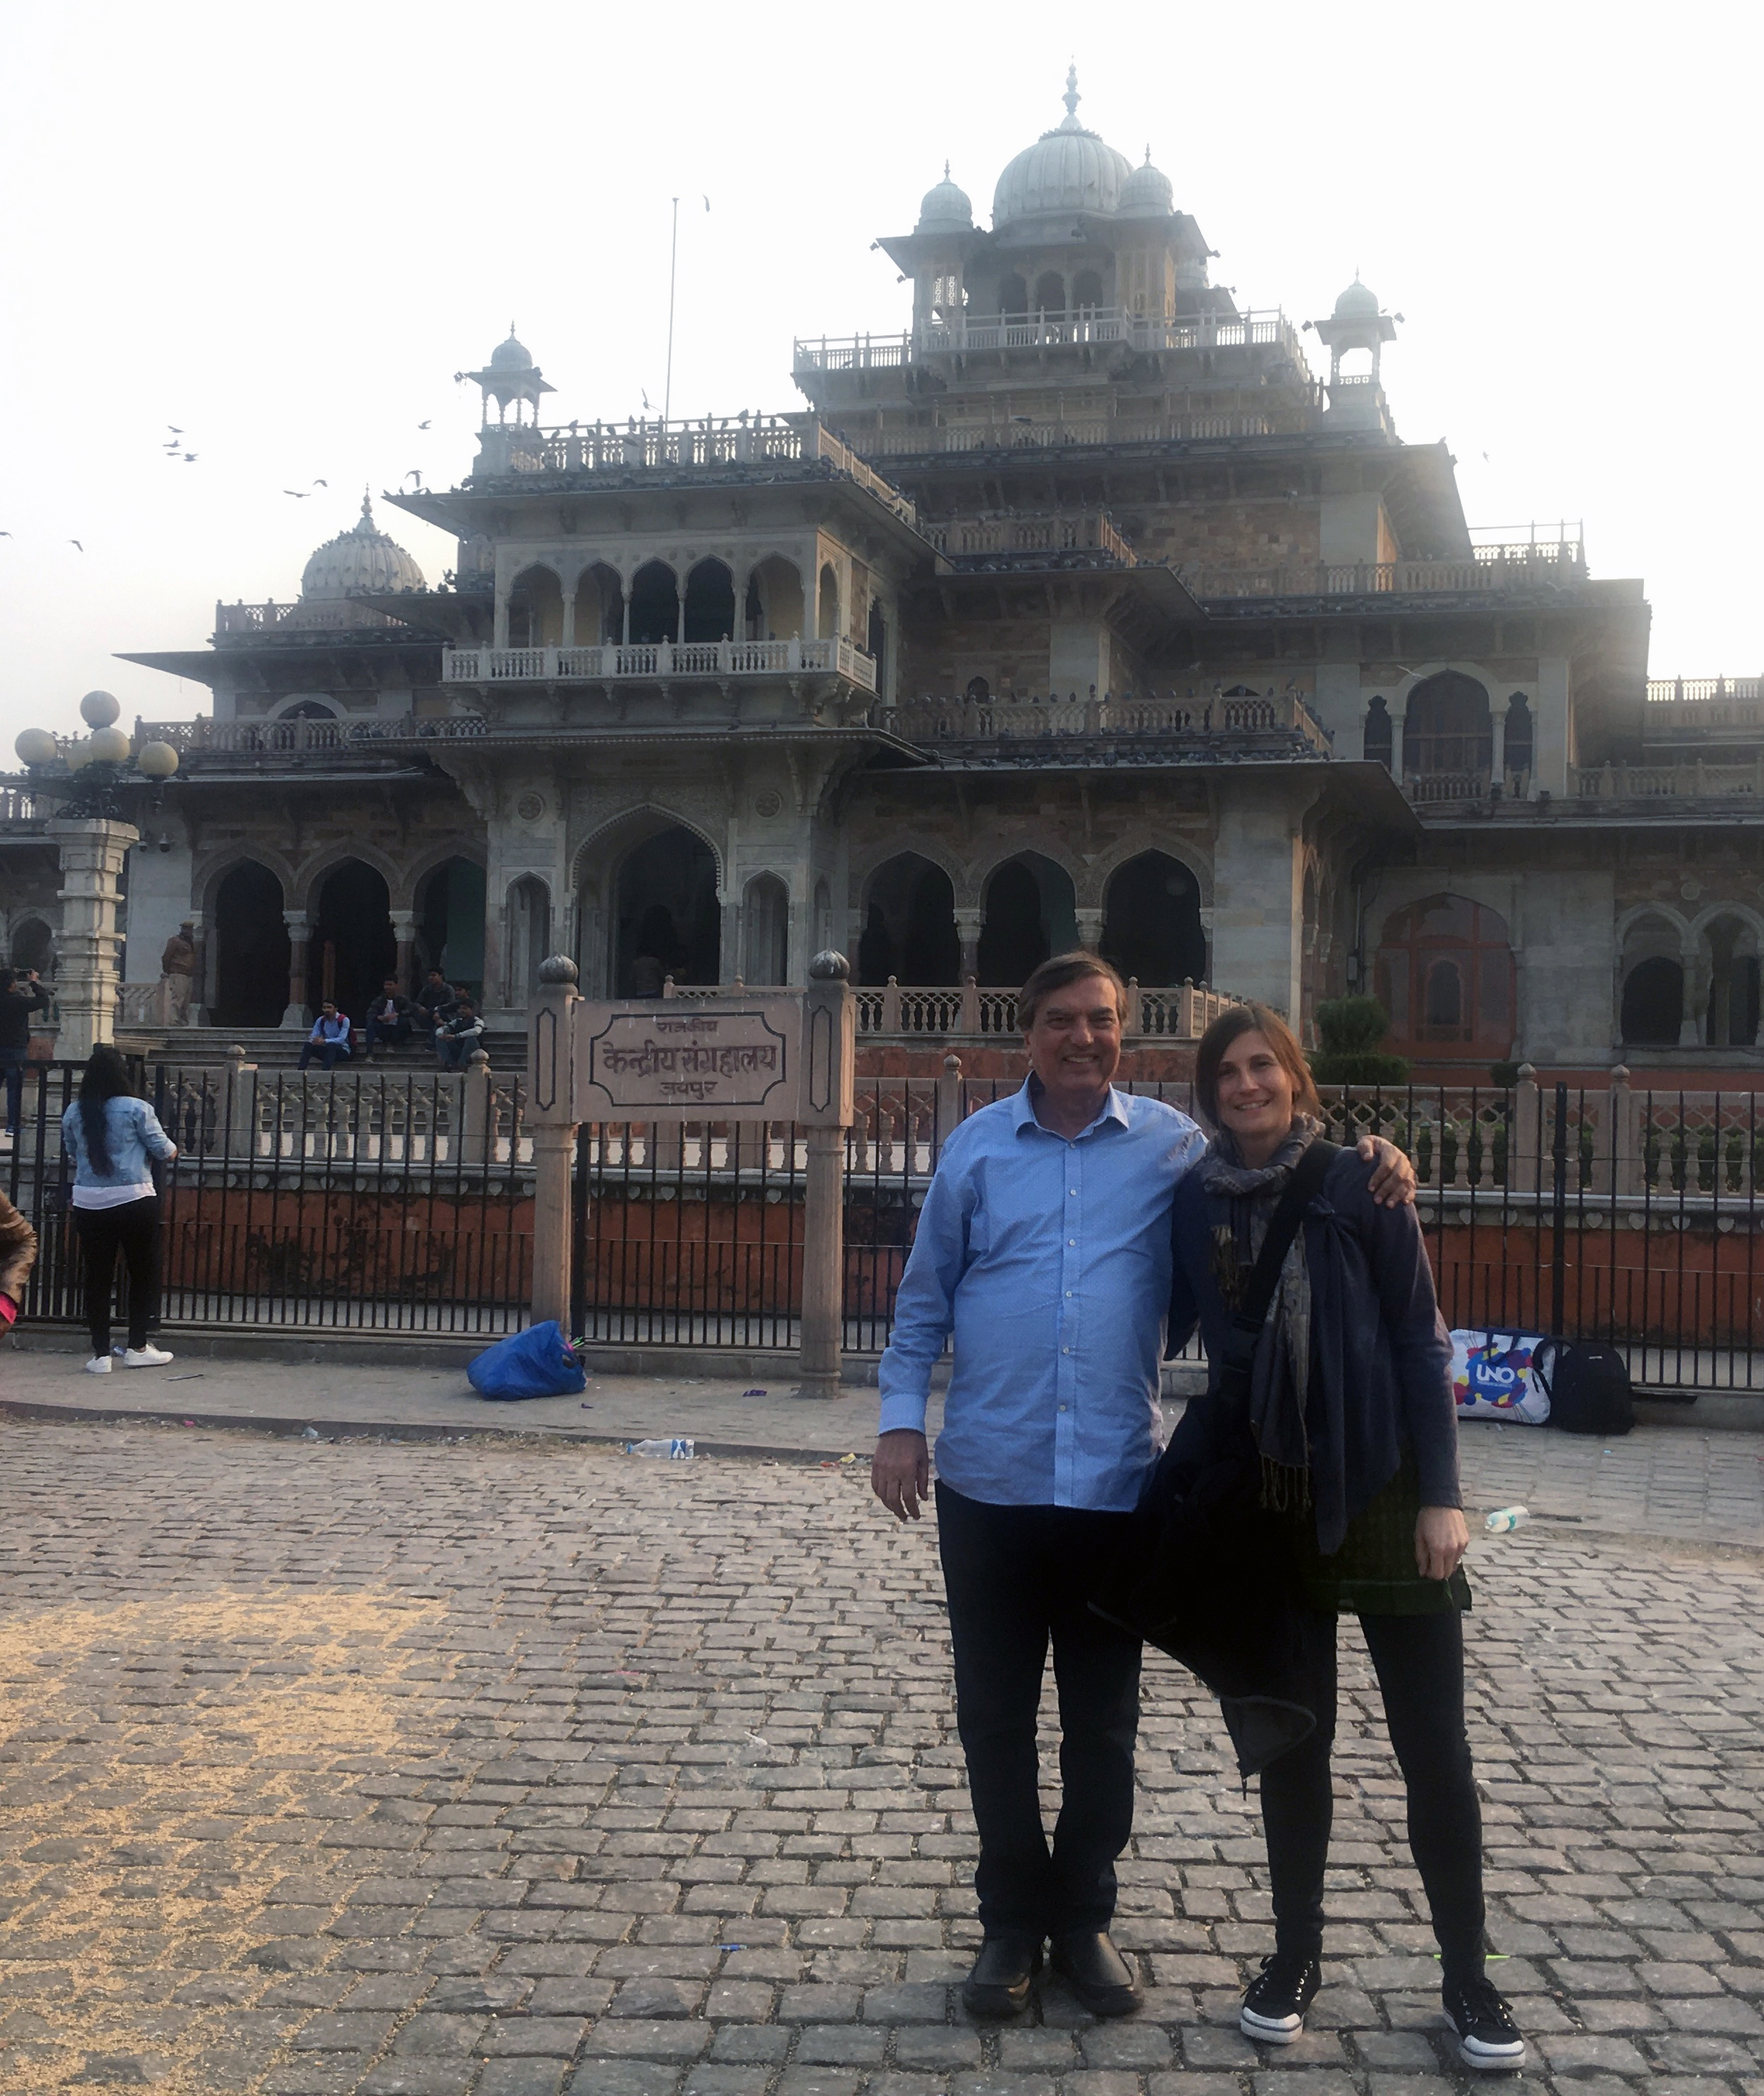
Planning for social sustainability in Indian cities: Lessons in identifying and designing spaces of co-presence and community
Jessica R. Barnes, Senior Lecturer, Department of Geography, Planning, and Recreation at Northern Arizona University
& Amar Sawhney, Professor of Architecture, Building Construction and Interior Design at Miami-Dade College

Slide 2
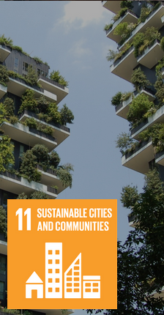
Project goals:
United Nations Sustainable Development Goal #11: Sustainable cities and communities
Applying theory to complex local contexts
International comparisons and best practices
Innovative analysis and solutions
Funded by
American Association of Indian Studies

Slide 3
Suggested use:
Learning modules for courses in human geography, urban planning, and architecture
Image source: https://unalab.eu/sites/default/files/2019-11/ReNature%20Training%20Course%3A%20Nature-based%20Solutions%20in%20Urban%20Planning_2019-11-13_1918.jpg
Notes:
Vary by case

Slide 4
social sustainability – emphasizes equity, social justice, and community resilience as a way to humanize cities by nurturing strong communities (Hemani and Das, 2016)

Slide 5
Co-presence consists of people of different identities sharing space as a means to gain knowledge about and acceptance of others – a counter practice to segregation (Legeby, 2013)
Notes:
“Software matters because of the ways it changes the nature of everyday practices” (19), it creates “code/space” where socio-spatial relations are dependent on the operation of software. Zook calls for more research to begin describing how digital communication technologies work at the level of the everyday performance of space

Slide 6
India’s Smart Cities Mission:
to foster sustainable and inclusive development through providing more efficient infrastructure and access to services particularly for the poor (Ministry of Housing and Urban Affairs, 2016)
to drive economic growth and improve the quality of life of people by enabling local development and harnessing technology as a means to create smart outcomes for citizens
Notes:
The states of Punjab and Himachal Pradesh have India’s largest shares of scheduled caste within their populations with 31 and 25 percent respectively. Both states are experiencing trends of urbanization through migration from rural areas, with rapid urbanization in Punjab (about 40 percent) and slower urbanization spread across small towns in Himachal Pradesh (about 10 percent).

Slide 7
India’s Smart Cities Mission:
digital and information technologies, urban planning best practices, public-private partnerships, and policy change
Encourage open and public space
Notes:
The states of Punjab and Himachal Pradesh have India’s largest shares of scheduled caste within their populations with 31 and 25 percent respectively. Both states are experiencing trends of urbanization through migration from rural areas, with rapid urbanization in Punjab (about 40 percent) and slower urbanization spread across small towns in Himachal Pradesh (about 10 percent).

Slide 8
Urbanization and caste
Scheduled caste / Dalits traditionally marginalized spatially and economically in Indian society
Cities thought to offer socio-economic opportunities, better standards of living, educational and health facilities as compared to rural areas
However, disproportionately live in slums: concentrated in marginalized urban spaces that manifest poverty and exclusion
Slums in Chandigarh
Notes:
20 percent of Indians are SC, mostly rural, but approximately one in every three Dalits living in urban areas was settled in a slum.

Slide 9
We argue that vibrant public spaces that create opportunities for co-presence are key for social sustainability:
Offer preliminary analysis of two public spaces
Using spatial and discourse analysis
Mapping ward-level demographics
Visual discourses / landscape of online images of the sites

Slide 10
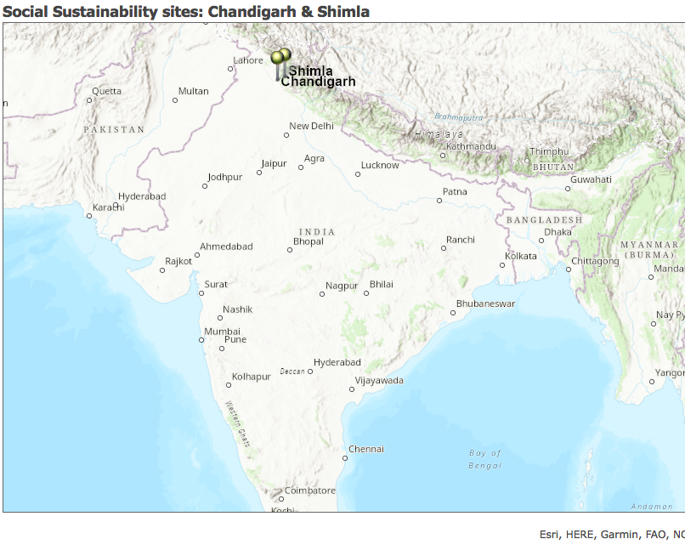
We will examine public spaces in two cities in northern India:
Chandigarh, the capital city of both Punjab and Haryana states with about 1 million people
Shimla, the capital of Himachal Pradesh with about 200,000 people
Notes:
The states of Punjab and Himachal Pradesh have India’s largest shares of scheduled caste within their populations with 31 and 25 percent respectively. Both states are experiencing trends of urbanization through migration from rural areas, with rapid urbanization in Punjab (about 40 percent) and slower urbanization spread across small towns in Himachal Pradesh (about 10 percent).

Slide 11
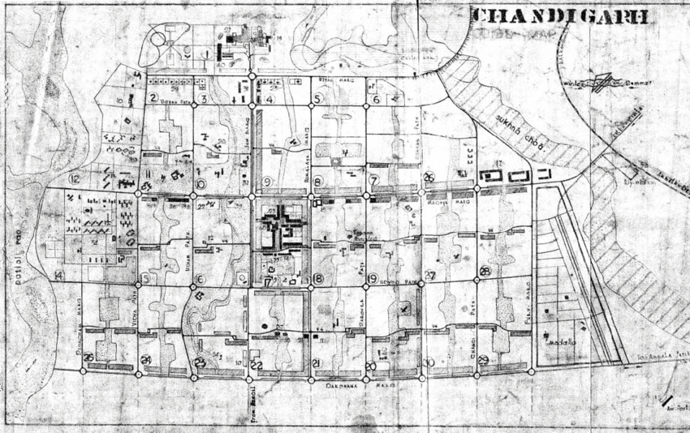
First modern planned city in India Modernist architect & planner Le Corbusier

Slide 12
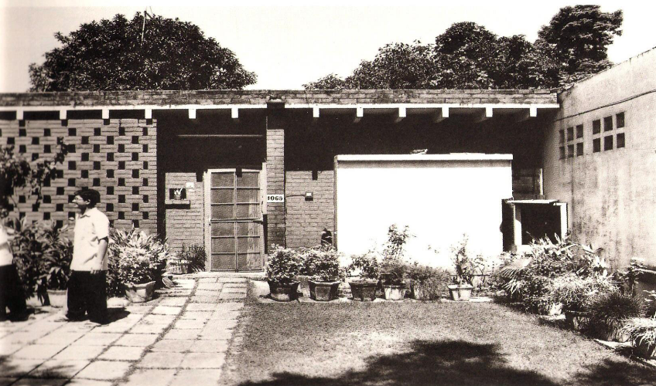
Low-cost housing through innovative design solutions – budget and climate
Low density, low rise city
Lots of green space
Government housing
Lower cost for construction, but also operation and maintenance
Hierarchy of housing types based on income

Slide 13
In the Chandigarh, Capital Complex, we will examine the “Open Hand Monument,” designed by Le Corbusier as a symbolic structure meant to signify unity in one of the many green spaces of the city.
Notes:
The states of Punjab and Himachal Pradesh have India’s largest shares of scheduled caste within their populations with 31 and 25 percent respectively. Both states are experiencing trends of urbanization through migration from rural areas, with rapid urbanization in Punjab (about 40 percent) and slower urbanization spread across small towns in Himachal Pradesh (about 10 percent).

Slide 15
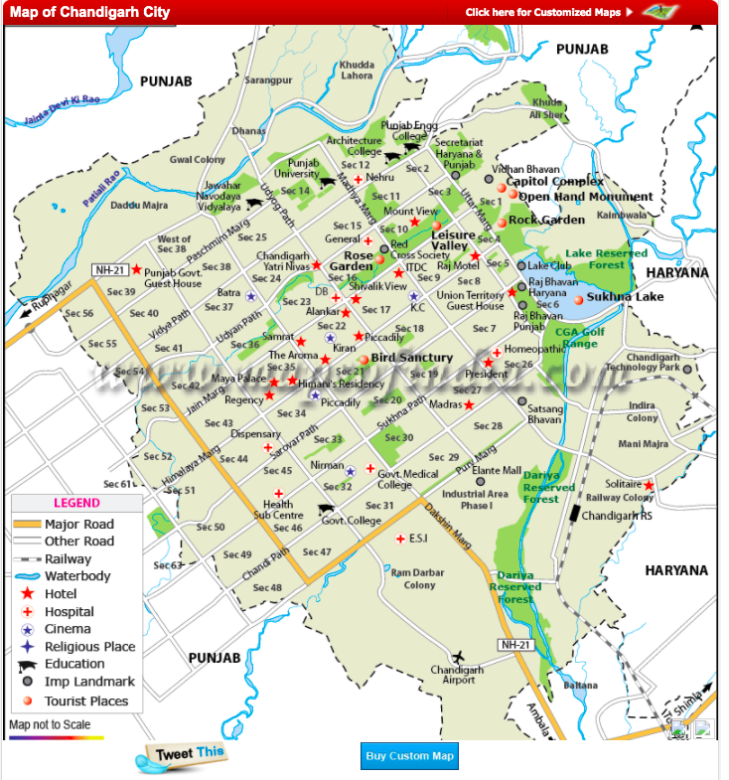
2011 Census
40 - 50 % SC
20 - 30 % SC
Notes:
ORange 40 -50 % SC
Yellow 20 – 30 % SC

Slide 16
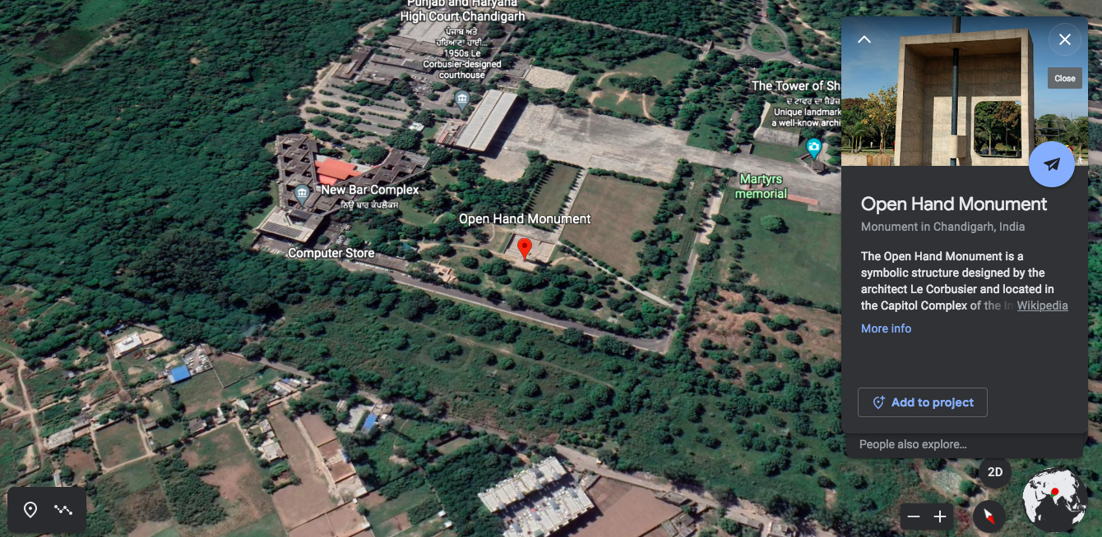
Capital complex: focal point if the city, both visually and symbolically
designed as a great pedestrian plaza
complex of Govt. buildings representing
Esplanade where a number of monuments symbolizing Le Corbusier’s theories of City planning have been placed

Slide 17
Open hand and contemplation hollow intended by Le Corbusier as a temple to democracy:
- a place to discuss public affairs
2 amphitheaters
Speakers’ platform with acoustic shell

Slide 18
Image analysis:
Lower use
Somewhat isolated
Lacks programing
Government area

Slide 19
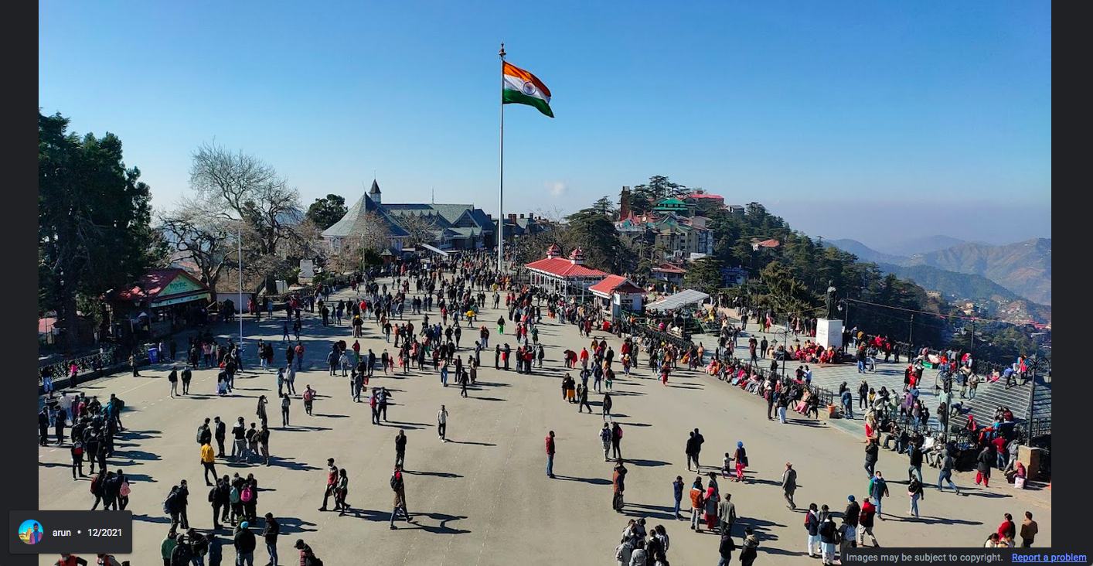
In Shimla, a government and tourism focused hill town with a treasure of Victorian and vernacular architecture
“The Ridge,” large open spaces that host cultural activities, markets, and festivals

Slide 20
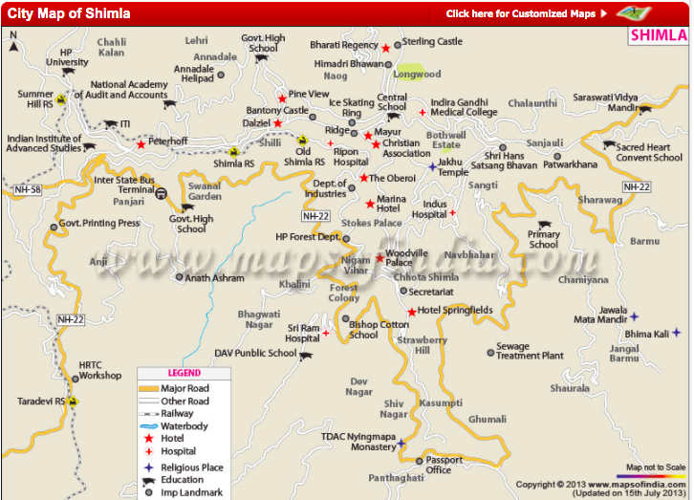

Slide 21
2011 Census
20 – 26 % SC
50% SC

Slide 22
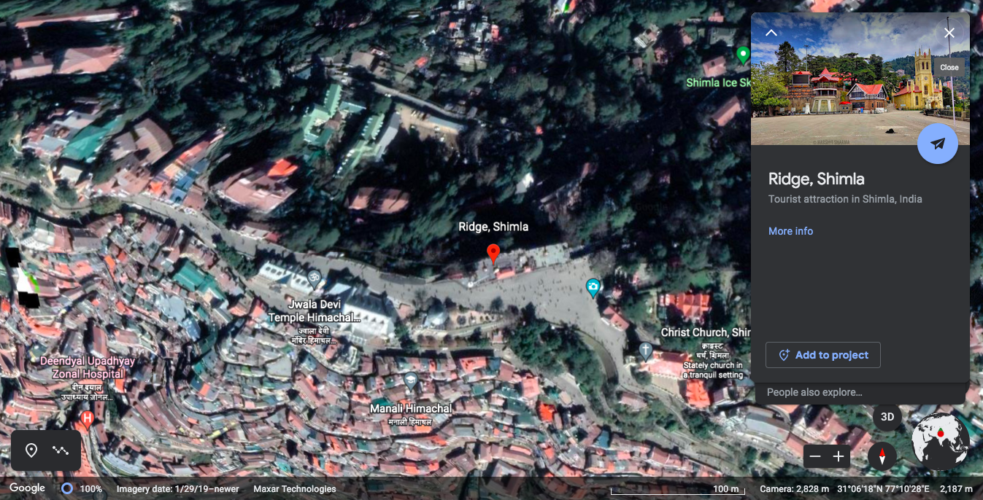
Pedestrian, wide-open street
social and cultural hub of city
Shopping, cafés, bars, restaurants, library
Site for various government functions, fairs and festivals
No entrance fee

Slide 23
Image analysis:
higher use
mixed use
programing such as festivals
Proximity to residential

Slide 24
Preliminary analysis: - proximity to residential, mixed use, programming, shows higher utilization, but:
Who are the people utilizing these sites?
Is there co-presence between people of different castes and religions?
Does sharing space improve relations between these groups?
How has Co-VID 19 impacted the use of public space?
Traveling to India in fall of 2022 for field research including multi-media walkthroughs, interviews with local stakeholders, city officials, NGOs.

Slide 25
Works cited:
Ami, D. & Kaur, N. (2014). Erasing the ‘Ugly’ from ‘City Beautiful’: Demolitions of slums in Chandigarh. Economic & Political Weekly. ISSN (Online) - 2349-8846 < https://www.epw.in/node/129820/pdf>.
Francisco Cháirez-Garza, J. (2014) Touching space: Ambedkar on the spatial features of untouchability, Contemporary South Asia, 22:1, 37-50, DOI: 10.1080/09584935.2013.870978
Chatterjee, I. (2009). Violent morphologies: Landscape, border and scale in Ahmedabad conflict, Geoforum, Volume 40, Issue 6, 2009,Pages 1003-1013.
Field, E., Levinson, M., Pande, R. and Visaria, S. (2008). "Segregation, Rent Control, and Riots: The Economics of Religious Conflict in an Indian City." American Economic Review, 98 (2): 505-10.
Ganguly, S. (2018). Socio-spatial Stigma and Segregation: A Balmiki Colony in Central Delhi. Economic & Political Weekly, 53(50); 50 – 57.
Gupta, J.K. & Rai, N. (2019). Chandigarh Experiment with low-cost housing. Journal of the Indian Institute of Architects. April: 9 – 13.
Hemani, S. & Das, A. K. (2016) Humanising urban development in India: call for a more comprehensive approach to social sustainability in the urban policy and design context, International Journal of Urban Sustainable Development, 8:2, 144-173, DOI: 10.1080/19463138.2015.1074580
Legeby, A. (2013). Patterns of co-presence : Spatial configuration and social segregation (PhD dissertation). Stockholm. Retrieved from http://urn.kb.se/resolve?urn=urn:nbn:se:kth:diva-133678
Morrissey, M. & Gaffikin, F. (2006). Planning for peace in contested space. International Journal of Urban and Regional Research, 30(4): 873-893. https://doi.org/10.1111/j.1468-2427.2006.00696.x
Ministry of Housing and Urban Affairs, Government of India. (2016). Smart Cities Mission. Accessed Feb 3, 2020. < http://smartcities.gov.in/content/ >.
Municipal Corporation of Shimla, Himachal Pradesh. (2013). Detailed project report Krishna Nagar Pilot Slum, Shimla, Himachal Pradesh Volume 1. < http://www.shimlamc.org/file.axd?file=2013%2F7%2FDPR+Krishna+Nagar+Slum+under+RAY+Part-1.pdf>.
Pawson, E., Fournier, E., Haigh, M., Muniz, O., Trafford, J. & Vajoczki, S. (2006) Problem-based Learning in Geography: Towards a Critical Assessment of its Purposes, Benefits and Risks, Journal of Geography in Higher Education, 30:1, 103-116, DOI: 10.1080/03098260500499709
Teotia, M. K. (2015). Housing for the Urban Poor in Chandigarh. Shelter. 16(2): 56-63.
Vithayathil, T. & Singh, G. (2012). “Residential segregation in Indian Cities: Spaces of Discrimination. Economic and Political Weekly, Vol. 47, No. 37 (September 15, 2012), pp. 60-66.
Waghmore S., & Contractor Q. (2015) On The Madness of Caste: Dalits; Muslims; and Normalized Incivilities in Neoliberal India. In: Mohan B. (eds) Global Frontiers of Social Development in Theory and Practice. Palgrave Macmillan, New York.
Webb, M. (2013). Meeting at the Edges: Spaces, Places, and Grassroots Governance activism in Delhi. South Asian Multidisciplinary Academic Journal. https://journals.openedition.org/samaj/3677

Slide 26
Questions?
Contact us to collaborate:
asawhney@mdc.edu
jessica.barnes@nau.edu
Thanks to American Association of Indian Studies and Northern Arizona University’s Interns-to-scholars program for supporting this research.

