Slide 1

Title Slide
Assessing Social Vulnerability and Understanding the Flood Risk Factors in Massachusetts
Cielo A. Sharkus, Seda Şalap-Ayça, Eve Vogel, Christine Hatch, Karl Tacheron, Christian D. Guzman
Notes:
Hello everyone and welcome to my presentation titled “Assessing social vulnerability and understanding the flood risk factors in Massachusetts”. My name is Cielo Angelica Sharkus and I am a PhD candidate in the Department of Civil and Environmental Engineering here at Umass Amherst.

Slide 2




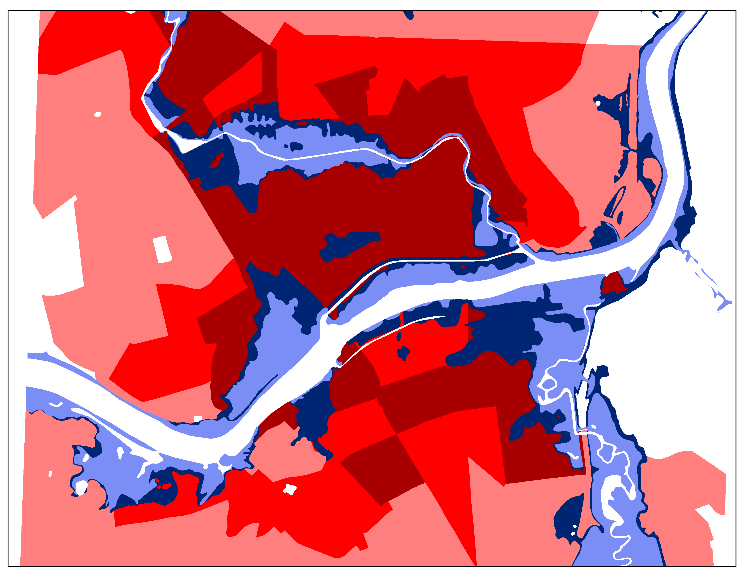
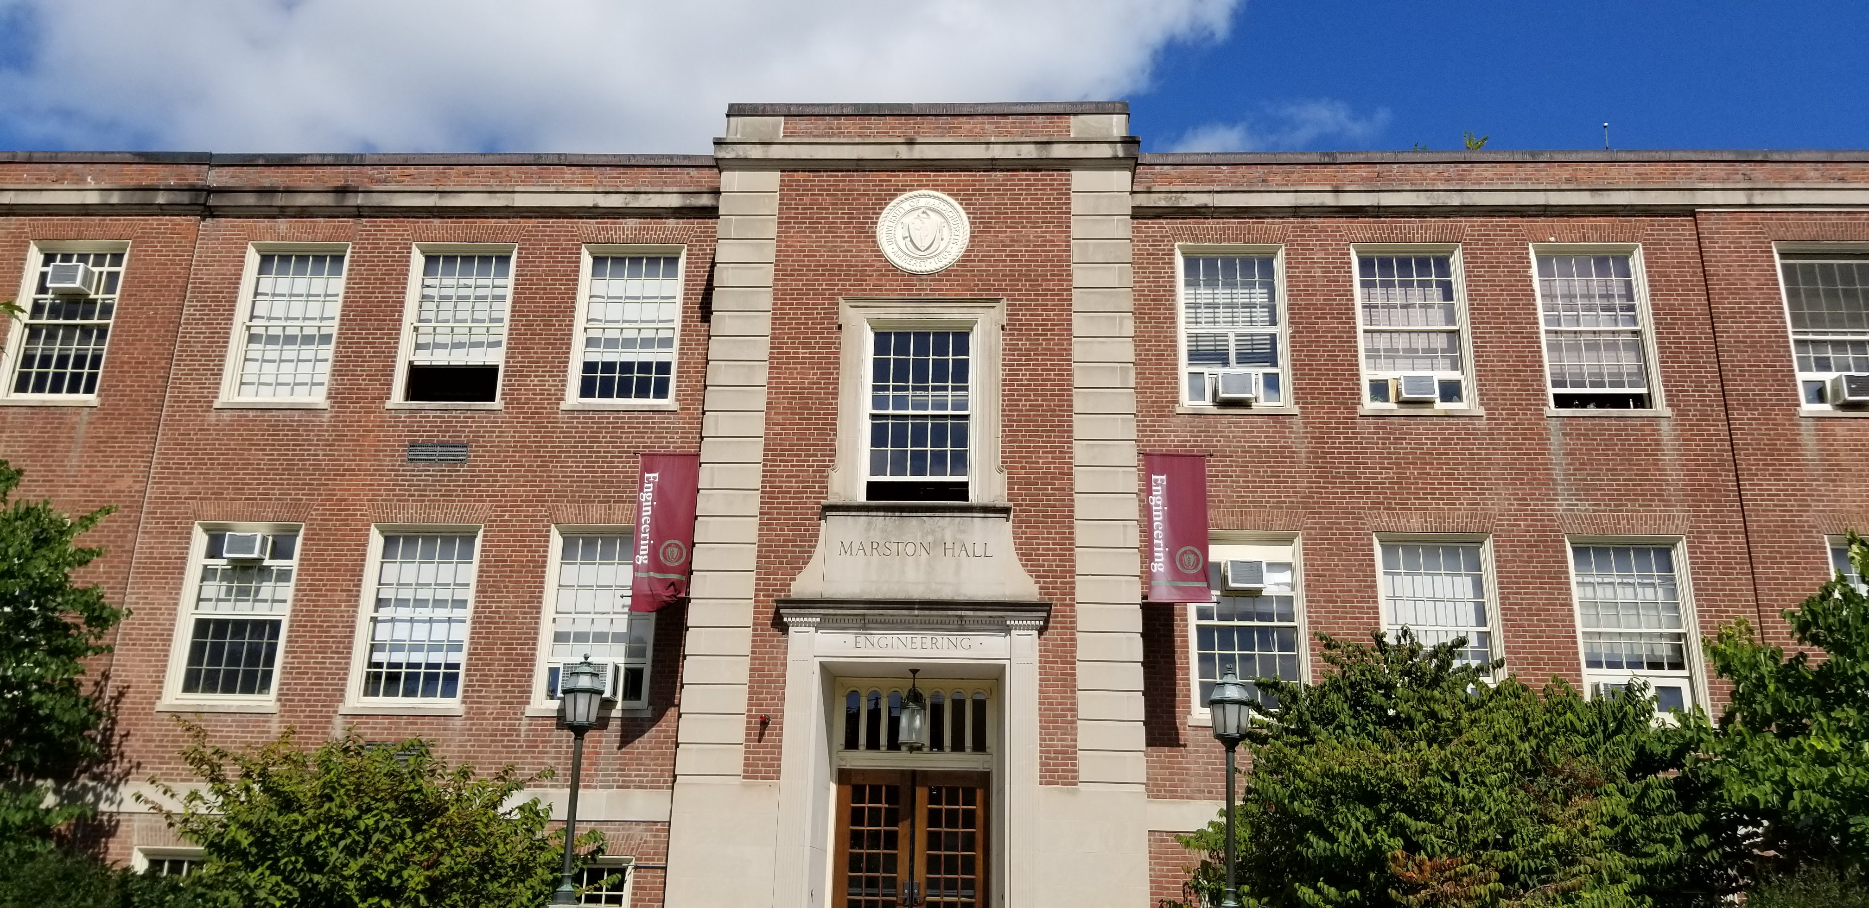
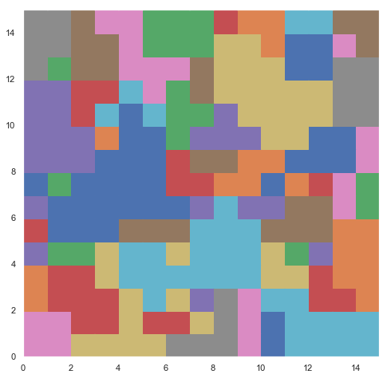

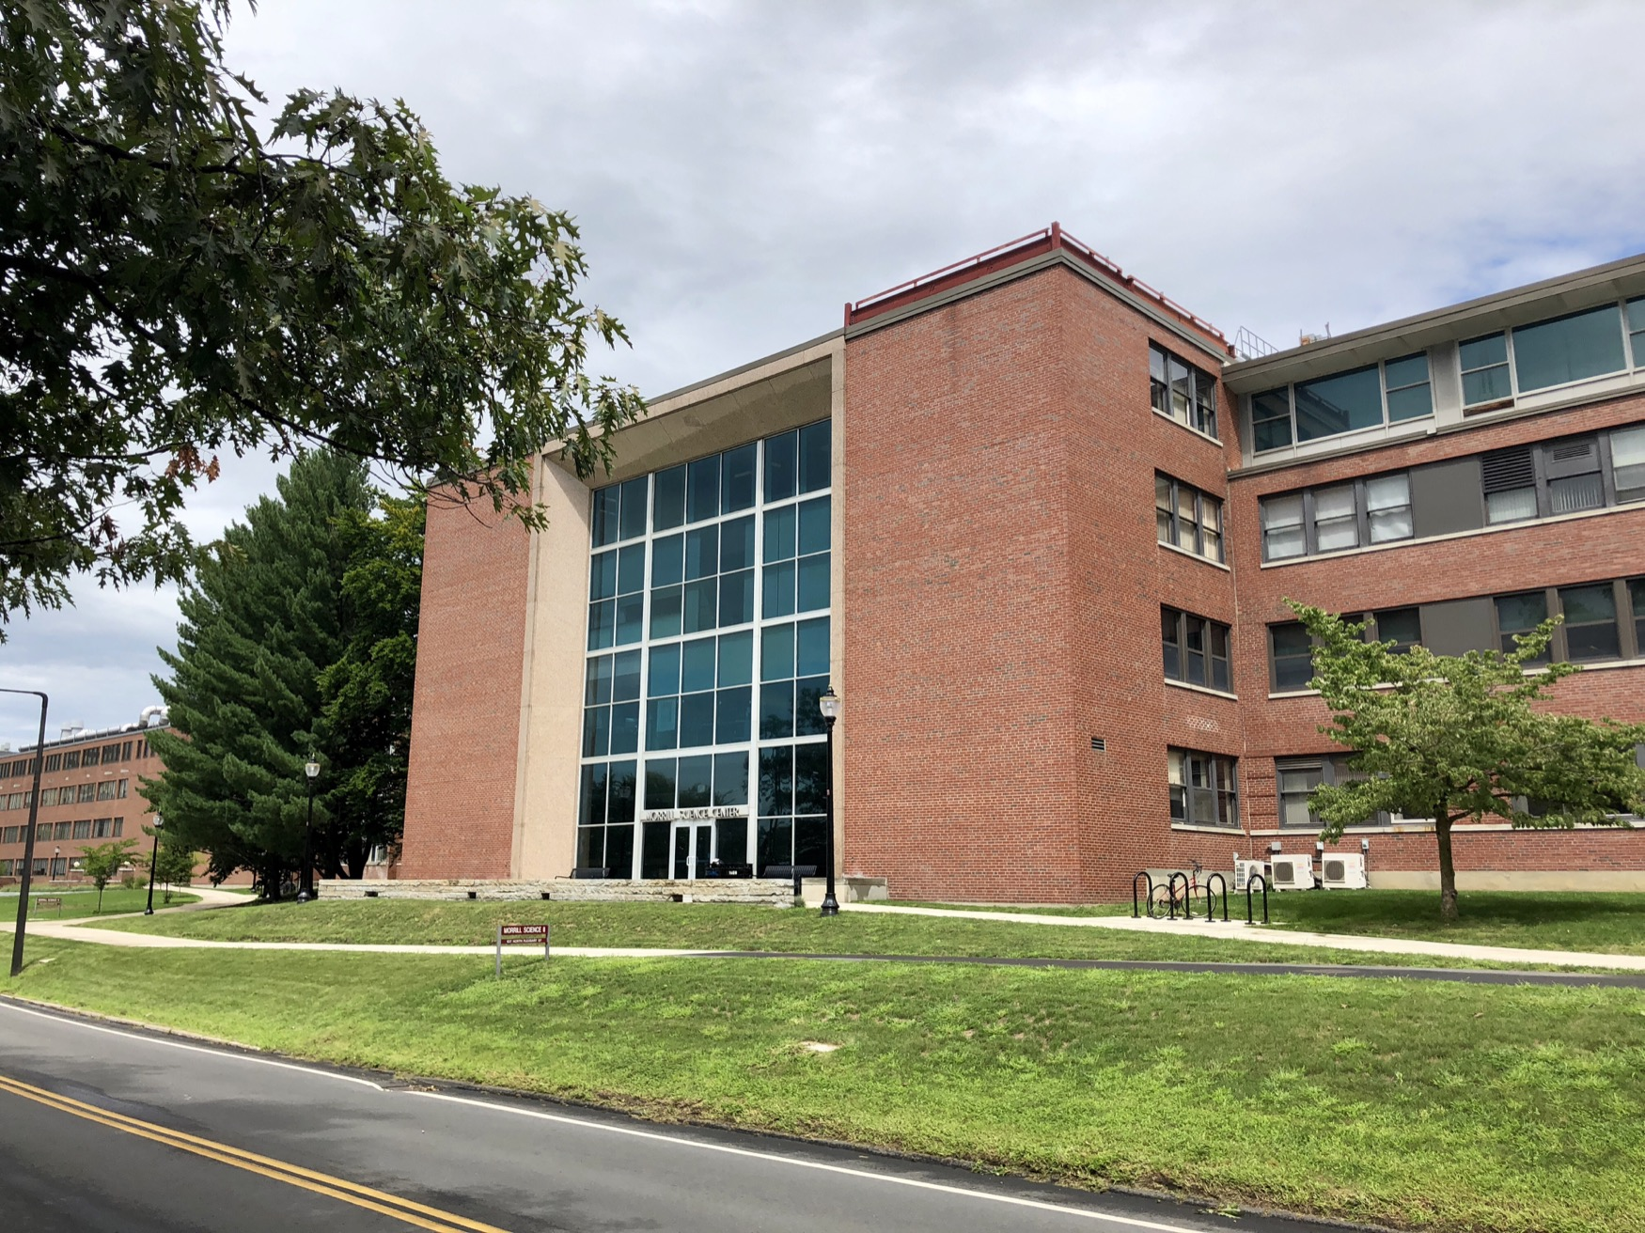
Team and Coordination
Cielo A. Sharkus
NSF ELEVATE Fellow
Agents of Change Fellow
Spaulding-Smith Fellow
NE CASC Graduate Fellow
@CieloSharkus
Seda Şalap-Ayça, Karl Tacheron
Geosciences, Mt. Ida
@sedasalap
Christian Guzman
Civil and Environmental Engineering
@DavidGuzzy
Christine Hatch, Eve Vogel
Geosciences
@UMassRiversmart, @UMassGeo
Notes:
This research would be impossible without my collaborators! I would like to thank my advisor, Christian Guzman, who is an assistant professor at the university of Massachusetts Amherst. Seda Salap Ayca, is a professor of geosciences at the Umass Mt ida campus along with her graduate student Karl Tachero. Aand lastly we have Christine and Eve, professors of the geoscience department as well. Research is nothing without collaboration and I am thankful for my team.

Slide 3
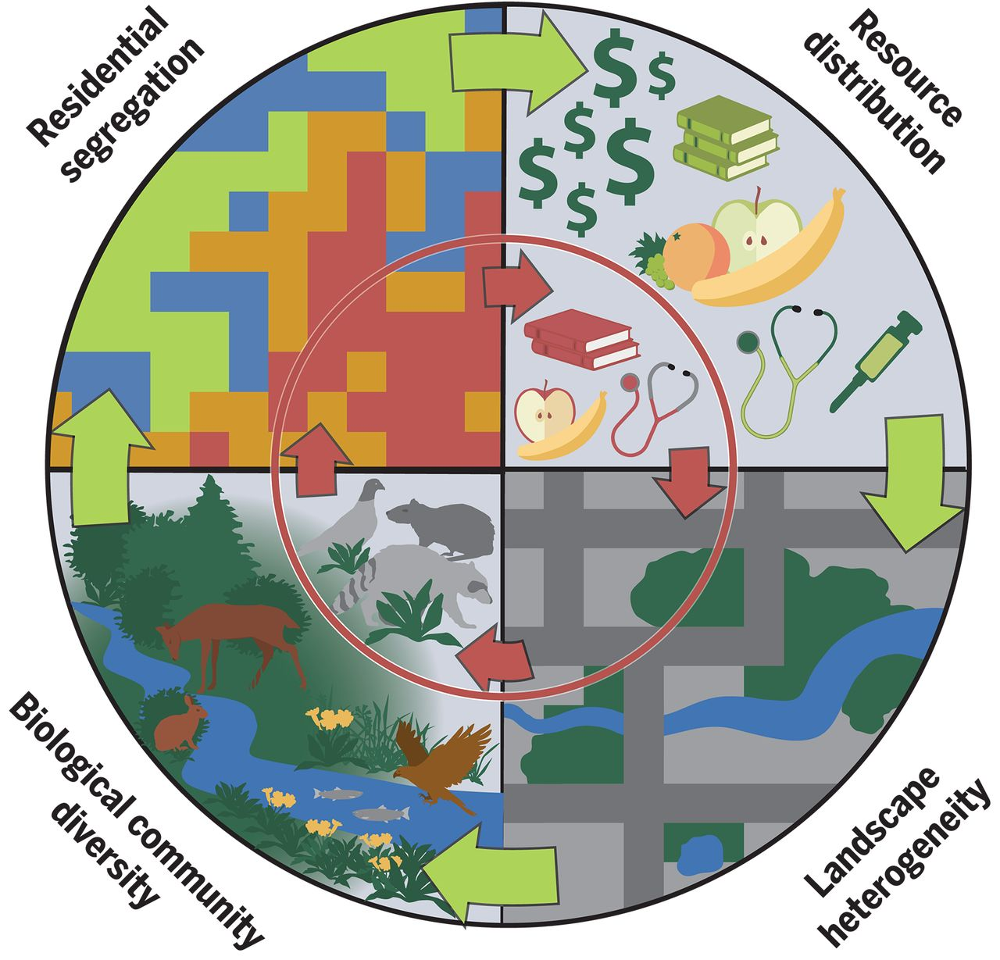
Environmental Justice
Introduction
Methods
Results
Differential exposure yields varying environmental risks by socioeconomic status (Bullard, 1993; Martuzzi, 2010)
The politics of marginalization increase vulnerabilities (Baah, 2019)
Notes:
The motivation of this research is centered around Environmental Justice, or EJ, which describes the fair treatment and meaningful involvement of all people, regardless of race, color, national origin, or income with respect to the development, implementation and enforcement of environmental laws, regulations and policies.
By “fair-treatment”, no group of people should bear a disproportionate share of the negative environmental consequences resulting from industrial, governmental and commercial operations or policies. However, this is certainly not always the case, especially when it comes to disasters and flooding.
For decades, researchers demonstrated that differential exposure yields varying environmental risks that disproportionately impact historically marginalized communities. Robert Bullard, who is considered to be the founder of environmental justice, described this as an interplay between environmental and social factors that lead to communities of color shouldering the burden of environmental injustice.

Slide 4
Institutional Injustice
Introduction
Methods
Results
“After a disaster, minorities and the poor suffer a much slower recovery because of the lethargic response of agencies whose participation is critical to their recovery. They often receive less information, are rejected more often for necessary loans, receive less government relief, and endure discrimination and rejection in their search for housing. ”
- Robert Bullard and Beverley Wright (2009)
“
Notes:
This interplay between socioeconomic status and vulnerability to environmental disasters has resulted in large disparities for marginalized communities. In urban areas, efforts to manage and mitigate risks are connected to affluence, whereas those of lower socioeconomic status find them selves displaced or placed in undue harm. Many of these patterns od disparity raise multifaceted questions of how will climate change, extreme weather, and flooding affect those who are in these precarious situations. Robert Bullard again describes how social factors contribute to and affect disaster recovery. He described that “Read quote by father of environmental justice”
Researchers like Robert Bullard and Beverly Wright use this environmental justice paradigm as a framework for examining and explaining the spatial relationship between disaster occurrence and the lived experiences of marginalized communities. Clearly, people of color communities have borne a disproportionate burden and have received differential treatment from government in its response to health threats such as hurricanes, floods and related weather-related disasters. The research project helps brings to the surface the ethical and political questions of “who gets hit by flooding, why, and how much” and why some communities get left behind before and after disasters strike.

Slide 5
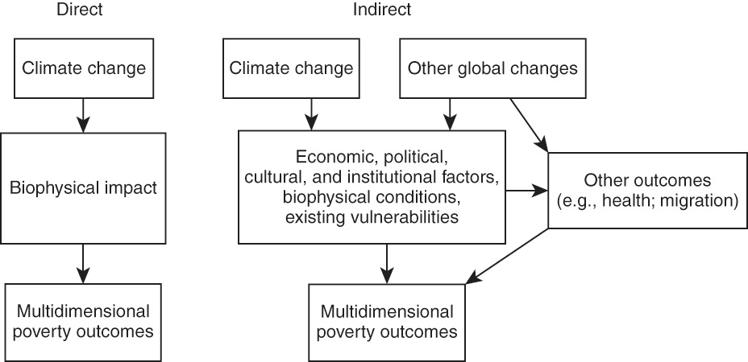
Inequalities in Climate Change
Introduction
Methods
Results
Notes:
So, where does our responsibility as geographers lie in dissecting these challenges and forces? When I think about anthropogenic climate change and its most pertinent effects to society, what stands out to me is the intersectionality of race, gender, and social class as it relates to climate-based precarity, and geospatial risk. In this regard we analyze “climate-based risk” as a multifaceted entity that encompasses a broad range interdisciplinary work ranging from food, water, and energy systems to discrepancies in the built environment. Both kinds of hazards, the direct impacts and the indirect impacts, exacerbate existing social, political, and economic inequalities causing a vicious cycle where the initial inequality causes the disadvantaged communities to suffer disproportionately from the adverse effects of climate change, resulting in greater subsequent inequality.
We therefore aim to understand the underlying economic, political, and institutional factors and their impacts on the way communities experience climate disasters.

Slide 6
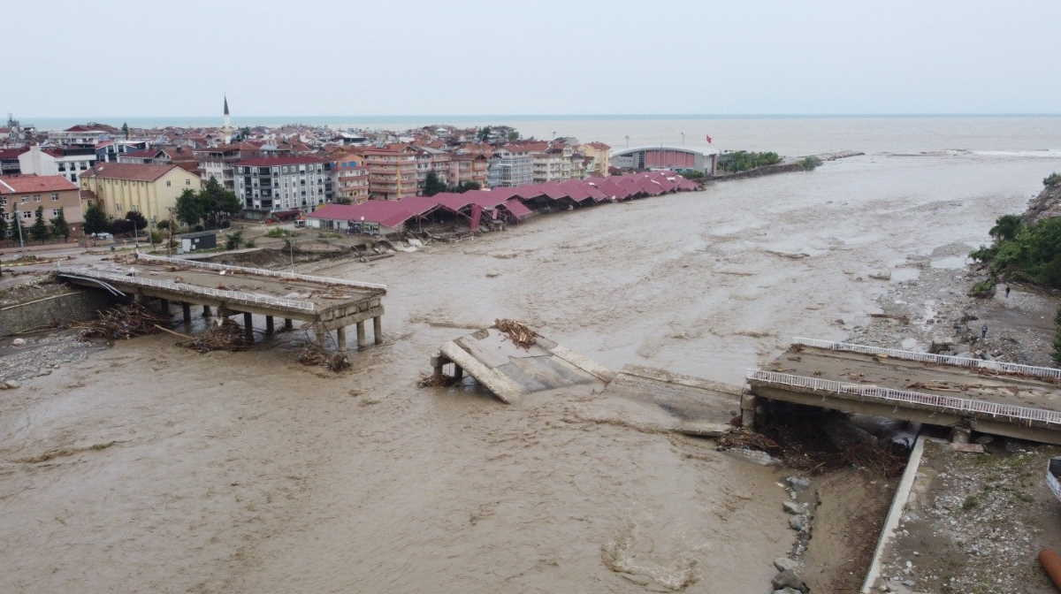
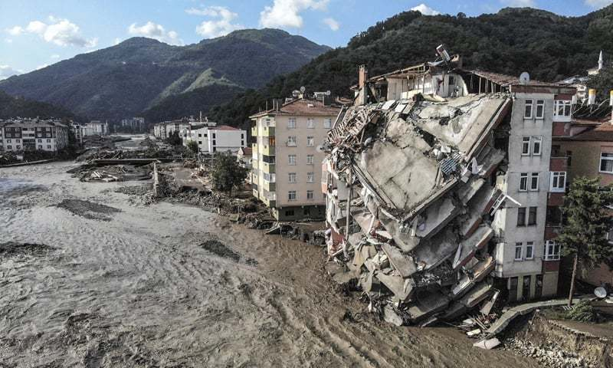
How Do We Quantify Inequality in Flooding?
What are the commonalities ?
How can we understand and try to find a solution for hazard?
Introduction
Methods
Results
How can we understand and try to find a solution for hazard?
What are the commonalities ?
Notes:
This study aims to combat shortcomings of common generalized vulnerability indices by examining root causes of social vulnerability, interactions between flooding, and geographic scales of operation in Massachusetts. In this paper we attempt to answer questions such as “Do characteristic hotspots of flooding differ substantially based on urban and rural settings?”, “What is the relationship between flood exposure, vulnerability, and development?” and “How do the intersecting social and physical vulnerabilities affect development in flood prone areas”. We attempt to address these questions to provide evidence to support more equitable strategies in flood hazard reduction and disaster recovery.
We seek to understand analytically, how we can solve this spatial problem and How can we better understand the problem.

Slide 7
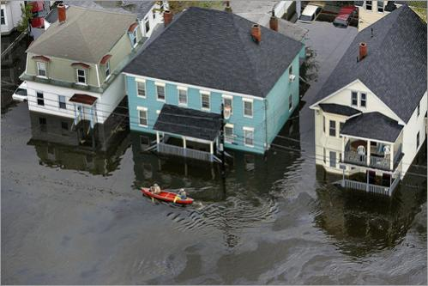
Who Bears the Burden?
What are the commonalities ?
How can we understand and try to find a solution for hazard?
Introduction
Methods
Results
41 million Americans live in flood risk zones
Social vulnerability - socio economic status, race and ethnicity, age/gender, family/household structure , and disability
  CDC – 15 factor Social Vulnerability Index
  Massachusetts’ 3-factor Environmental Justice Scale
What are the most influential demographics in flood zones?
Notes:
The way we answer these questions is by analyzing who bears the burden.
Researchers on social vulnerability to flood hazards developed methods like the CDC’s 15-factor Social Vulnerability Index (Flanagan et al., 2011) to answer this question. This index is uses American community survey data and demographic factors to assign a ranking of vulnerability to a census tract.
Similarly, Massachusetts’ developed a 3-factor Environmental Justice scale (EEA, 2017), to demonstrate the greater preponderance of these factors within flood zones, and to predict which factors predict greater social vulnerability to compounding negative effects within a flood zone. They used 3 categories: race, minority composition, and English-speaking ability to rank vulnerability in census block groups. However, there may be other demographic factors outside these indices that are concentrated (or largely absent) within flood risk zones. So the question becomes, what are the most influential demographics in flood zones? This is an important question to better assess the flood vulnerability risk of different groups and demographic factors, target policies and programs more effectively, increase the likelihood of recovery during all stages of a disaster, decrease human suffering, and reduce economic loss.

Slide 8
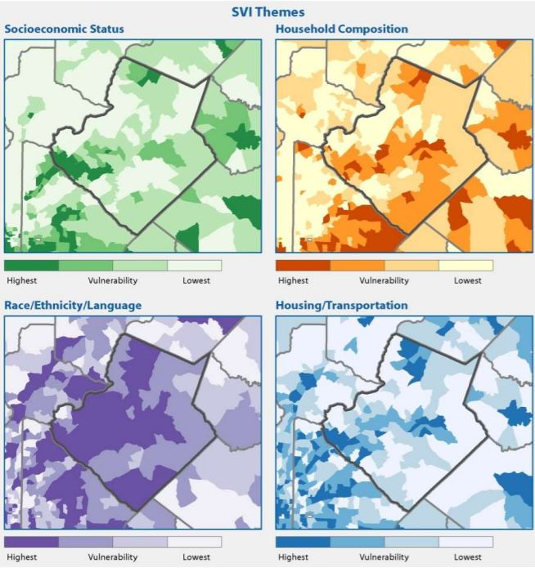
What are the commonalities ?
How can we understand and try to find a solution for hazard?
Introduction
Methods
Results
Indices of Risk
SVI:
Socioeconomic status
Household composition & disability
Minority status & language
Housing & transportation
Based on census bureau data
EJI:
Annual median household income
English Language proficiency
Minority composition
Finer spatial and temporal scales
Notes:
In this study, we first combined the two indices SVI, developed by the CDC, and EJI, developed by Massachusetts, to assess hot spots of vulnerability that intersect with 100- and 500-year flood risks. We ranked the highest growing cities in Massachusetts using population density and household income growth from 2010-2019 using publicly available data from the American Community Survey (ACS) and the Donahue Institute
The underlying social vulnerability model used is sourced from the CDC SVI publicly available dataset that draws on data from the American community survey. We delineated census tracks data from 2018, split into four socioeconomic themes. The four “percentile ranking” (RPL) themes assessed factors summarized in Table 1. For more detailed spatial analysis into trends specific to census block groups, we accessed additional socioeconomic data from MassGIS on environmental justice populations. The overlapping vulnerability model “Environmental Justice Index” used census block group data from 2020 using three criteria: Minority population, median household income, and household English language isolation. FEMA Q3 digital flood insurance risk maps (FEMA FIRMs), which represented known flood hazards for 100- & 500-year fluvial flooding, were projected together under varying colorimetric ranges.
the annual median household income is not more than 65 per cent of the statewide annual median household income;
minorities comprise 40 per cent or more of the population;
25 per cent or more of households lack English language proficiency; or
minorities comprise 25 per cent or more of the population and the annual median household income of the municipality in which the neighborhood is located does not exceed 150 per cent of the statewide annual median household income.

Slide 9
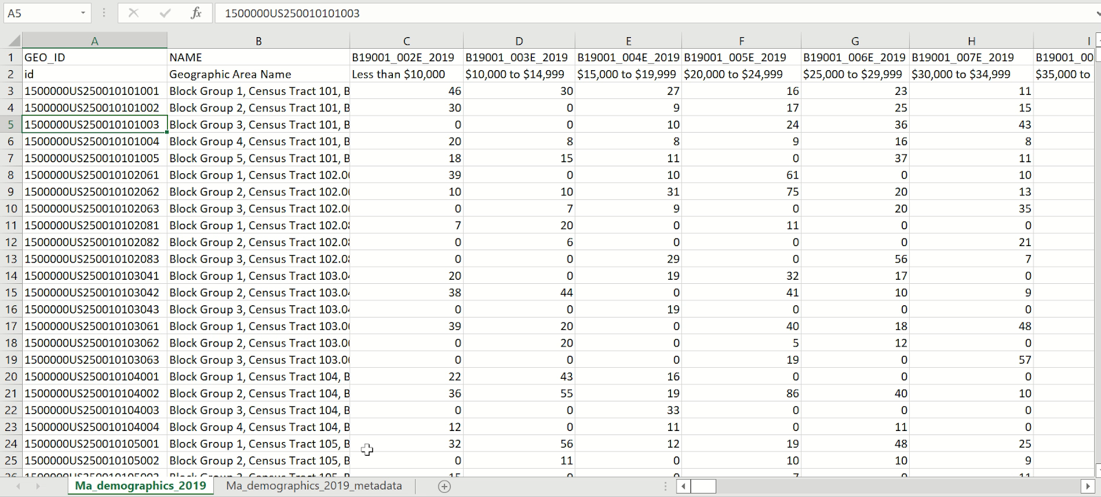

Introduction
Methods
Results
Pattern Demographics
Pattern is a repeated form or design
"the brain not only receives information, but interprets and patterns it“
Notes:
The next methodology we used refers to analyzing commonalities between flood zones and hot spots of socioeconomic vulnerability. When we say commonalities, we refer to the spatial pattern of repeated occurrences.
Take this picture for example, which displays a beautiful color tessellation which follow a direction and cluster in some regions, it is so easy for our trained eyes to detect and differentiate blues, yellows, oranges, and reds unless we have a color deficiency . In some areas, they have fuzzy boundaries, but overall, we can understand the pattern.
It takes milliseconds for us to see the color patterns in this image and we are very good at differentiating it.
Here , we are talking about a handful of different variables though. What happens if we have more than 100?
Now , you are looking a screenshot of Massachusetts demographics, based on block groups. The file has 134 columns. How can we understand the pattern behind this data? We might not convinced with numbers unless we see something visually represented. Why it is important to understand these columns also known as attributes and their relations with block groups?
Well, the engaging of computational techniques with cartography is found to be valuable in delivering richer and more transparent information visualization. And now, let’s look at how we can get some help from our friendly machines to understand the patterns.

Slide 10

Introduction
Methods
Results
Pattern Demographics
Self-Organizing Maps – Kohonen Networks
SOM is used to explore and visualize patterns in high-dimensional datasets
Introduced by Teuvo Kalevi Kohonen in 1982
Clustering technique that identifies groups in a dataset without having to use traditional statistical techniques
Notes:
Self-organizing maps (SOM) are a type of neural network , also known as convolutional neural network. And they are used to explore and visualize patterns in high-dimensional datasets. It is found to be effectively applicable to data sets containing a very large number of observations and or dimensions for pattern discovery, exploring relationships, and detection of irregularities in the data. SOM is applied as a dimension reduction technique for attribute space in various fields such as demographic change, street network , motorcycle flow , or trajectory analysis .

Slide 11
Introduction
Methods
Results
What is a Computational Neural Network?
Information processing system that autonomously develop operational capabilities in adaptive response to an information environment.
Notes:
Neural networks are a network of functions, where all inputs and outputs are intertwined and associated with each other with an n-dimensional vector. So, the computer learns from examples to better approximate the output. The superiority of the SOM over other clustering algorithms is observed for its ability to see natural clusters in high-dimensional data. Obviously, it has its own limitations, and we will talk about them at the end.

Slide 12

Introduction
Methods
Results
Self-Organizing Maps
GOAL : Transfer all input data objects with n attributes (n dimensions) to the output in a way that the objects are related to each other.
OBJECTIVE : Find the set of centroids (neurons) to represent the cluster, but with topological restrictions.
TOPOLOGY : Each neuron in the SOM grid is closely related to each other and each of the inputs are connected to each of the output nodes by means of a connection weight.
$\left\{{feature}_{i}\right\} :({attribute}_{1},{attribute}_{2},⋯,{attribute}_{n})$
Notes:
Since it is the core of the study, I would like to go over how a SOM network works.
So, we have our input, in our case our demographic attributes, and we would like to transfer this data to output where we can see the relations better.
Each census block group, that we could have find the most available demographic granularity, is a feature vector for our model. Which is transferred to the network layer.
So where these vectors end up are not random, they are organized based on their similarities. Each neuron, the white circles here, are actually very closely related to each other by weights calculated based on the n dimensional attribute.
The algorithm tries to get the best fit and organize the given vectors in a way that the similar vectors are clustered together.

Slide 13
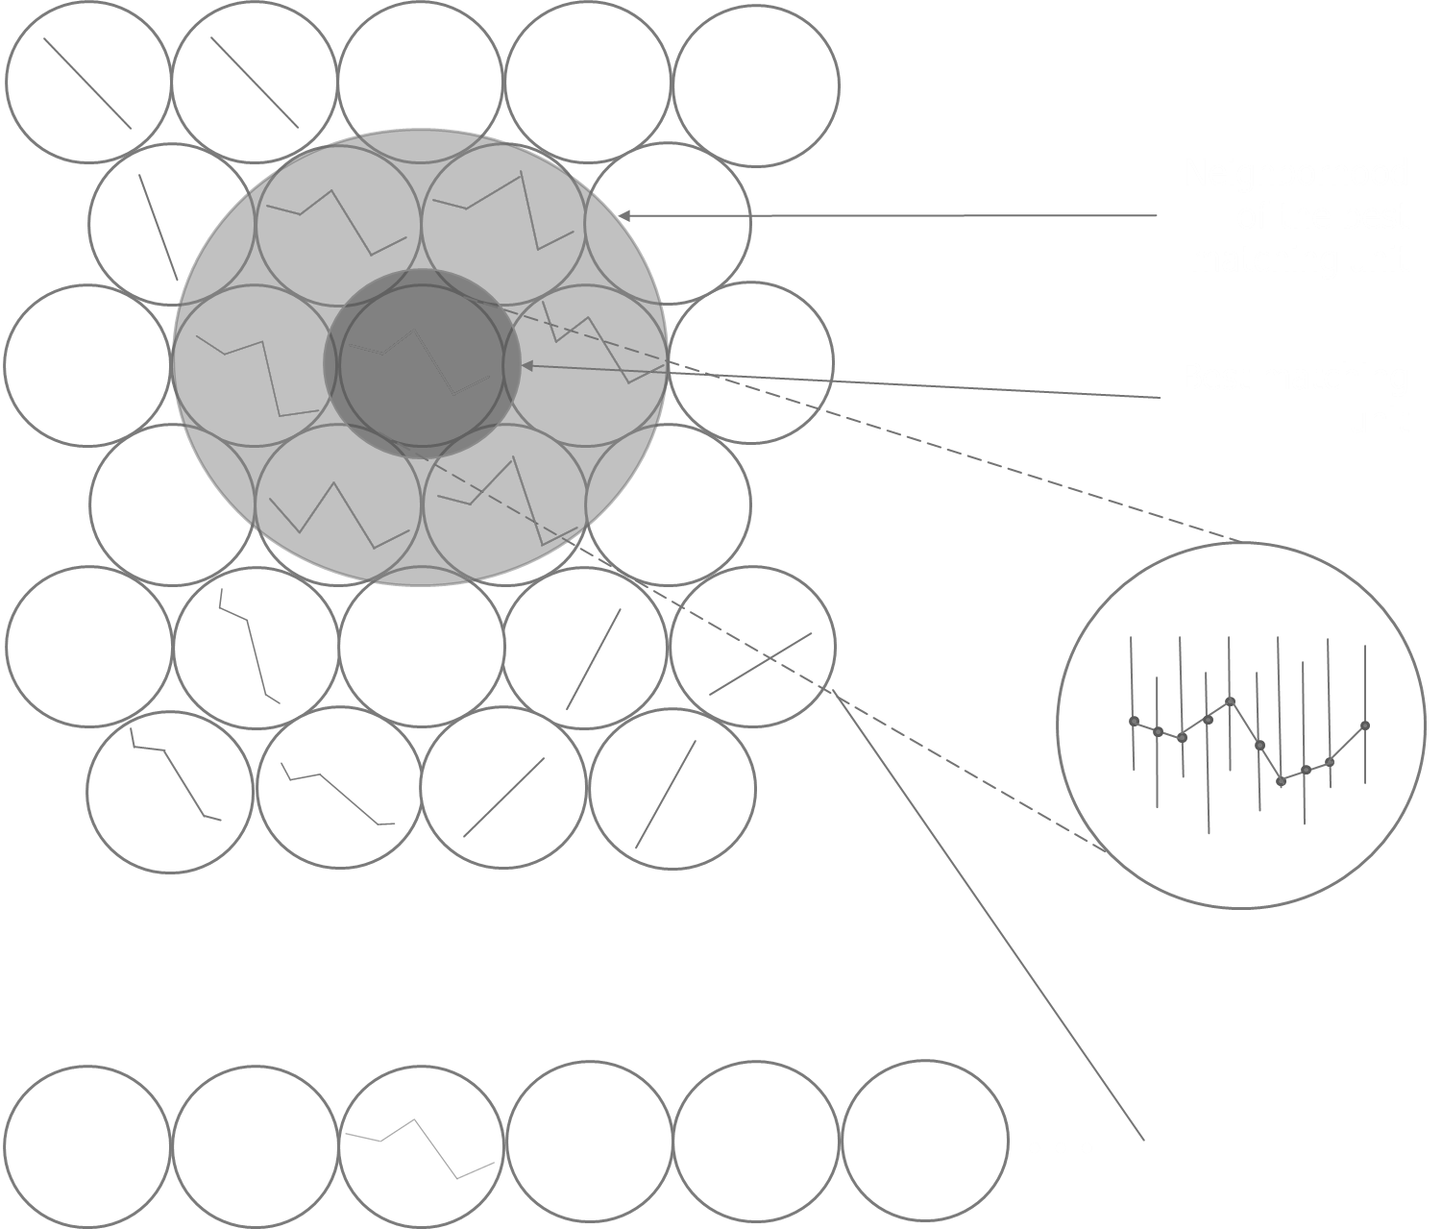
Introduction
Methods
Results
Unified Distance Matrix
U-matrix visualizes the distances between the network neurons or units.
It contains the distances from each unit center to all of its neighbors.
The distance between the adjacent neurons is calculated and presented with different colorings.
Notes:
During the training process, the individual input vectors are presented to the neuron grid one at a time; each time BMU is found and weights of that and other neuron vectors are adjusted accordingly. Additionally, neighboring neurons are modified to better fit that input vector which eventually forces the similar input data to be associated with the closely positioned neurons and enforces the similarity.
This representation can be used to visualize the structure of the input space and to get an impression of otherwise invisible structures in a multidimensional data space.

Slide 14


Introduction
Methods
Results
Before Training
First Vector Used
Second Vector Used
Third Vector Used
Fourth Vector Used
$$y_{1}$$
4
Example derived from Agarwal, P. and Skupin, A. (2008) ‘Self-Organising Maps: Applications in Geographic Information Science’, Self-Organising Maps: Applications in Geographic Information Science, pp. 1–205. doi: 10.1002/9780470021699.
$$x_{1}$$
Notes:
Here let’s look at the process of self-organization during SOM training , A 3 by 3 neuron SOM is trained with only four observations.
Starting with the initialized SOM, the first input vector finds the neuron at location x1, y2 to be its best matching unit. Which means, it is the closets distance, most similar place that observation 1 looks like.
Accordingly, weights of that node are adjusted toward the input vector. Then, the neurons within a single-neuron neighborhood are slightly adjusted. So now, our vector feels more comfortable in its location, making its neighborhoods also look like to its weights.
For the next cycle, the second vector finds a place at x3, y3 on the neuron lattice, and adjusts the weights for that neuron and neighborhoods as first one did. Those adjustment caused the third vector to be drawn to the vicinity of the previous vector at x3 y2. Once 3rd vector is drawn to that neuron, the weight are again adjusted. However, the single-neuron neighborhood includes neurons that previously underwent modification on account of the first and second vector. Those neurons now undergo further modification.
Notice that how the x2, y2 becomes a separator between cluster regions, since members of the two clusters have attempted to pull it in either direction.
This whole process would be repeated many times over when dealing with real data. As training progresses, an input vector may then be reused and find a BMU that is different from the previous cycle it was involved in. For example, the first input vector may now find the neuron at (x = 1; y = 1) to be a better fit. As a rule though, major global relation-ships will be established early, followed by a distinction of finer structures late during training.

Slide 15
Closing Slide
Central Findings

Slide 16
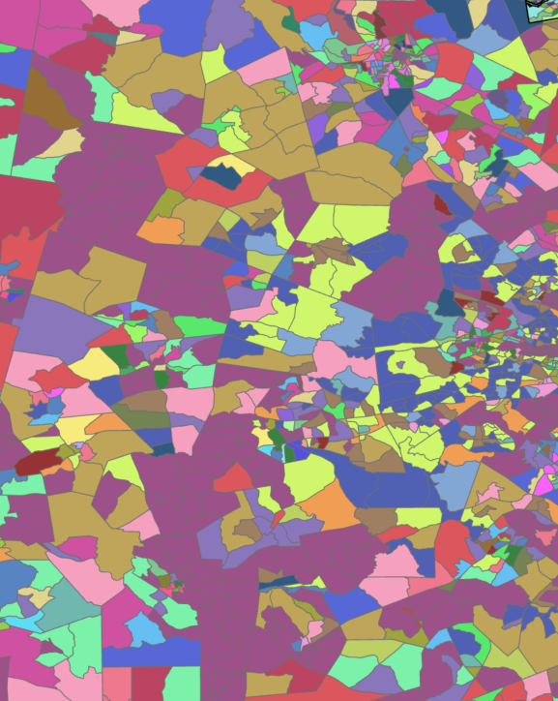
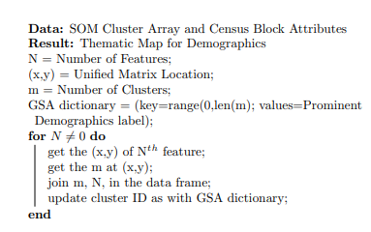
Introduction
Methods
Results
Clustering
Notes:
The main goal in SOM is to transfer all the input data features (i.e., polygons) with 10 attributes (e.g., first, and high-order sensitivity indices) to the output in a way that the objects are related to each other. All data points are passed through a square grid and are matched with a group. For example, towns with similar demographics might end up clustering together. The unified matrix segments the SOM weight lattice in regions where specific features have high values. The labeling numbers are representing the feature ID’s that are selected for the clusters.
By iterating through cluster array and census block attributes list, corresponding cluster-ID which is determined based on SOM weight lattice is assigned as an attribute to each feature. Then by using the geopandas library , the resulting pandas data frame joined with the shapefile which has the geometric attributes of the feature. This final geopandas data frame consists of major influence clusters and can be visualized thematically . This influence map follows the SOM weight lattice topology. Clusters that are found to be closer on the SOM weight lattice are spatialized on features that are adjacent or close to each other; whereas higher distances on weight lattice are projected as distant features.

Slide 17
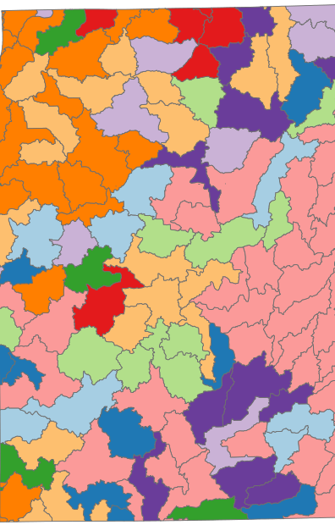
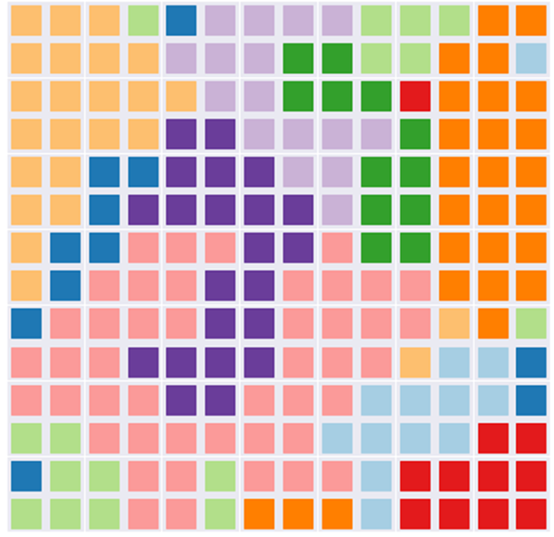
Introduction
Methods
Results
Clustering
Notes:
Once the unified matrix is calculated, each winning neuron (corresponding demographics attributes) can be assigned to each census block as the most influential demographic output. Then, the weight can be used to map the SOM weight lattice to see how demographics are influential in each cluster.
The places of the demographic's clusters on the SOM weight lattice also reveal how these attributes are close to each other. We are still working on to get the same color scheme for this, which is hard for 115 attributes. But let me show you how it will look like once we complete the code.

Slide 18
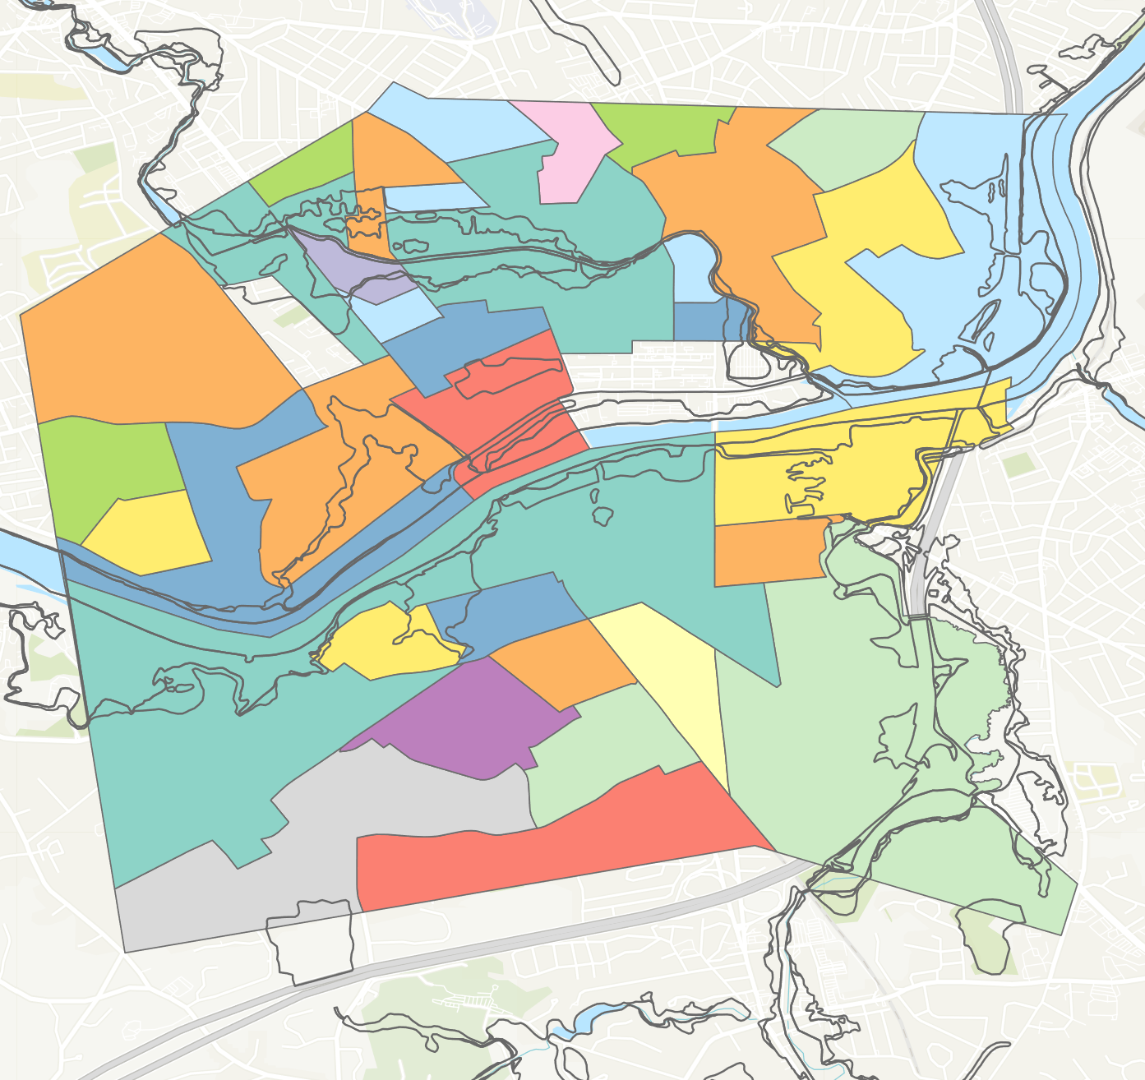
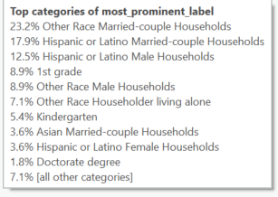
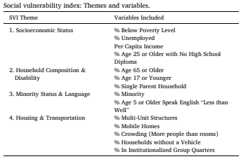

Introduction
Methods
Results
Lawrence, MA
Notes:
Here is a a small portion of the output, which is easier to understand since we have only 13 categories. And this map not only reveals the most prominent demographics, but also tells are where they are most influential. The black lines are showing the boundaries of FEMA based flood zones and as you can see in the middle of the map, they are surrounded by the other race, Hispanic, or Latino populations. What is more specific on this information, opposed to Social vulnerability index, which only sees the variable as minority status, we can now see other disparities among minorities such as whether they are living alone or not, married or not. Also, the attribute distribution can be seen on the right top image. How the Lawrence, MA is dominated by certain demographic factors, specifically marginalized communities.

Slide 19
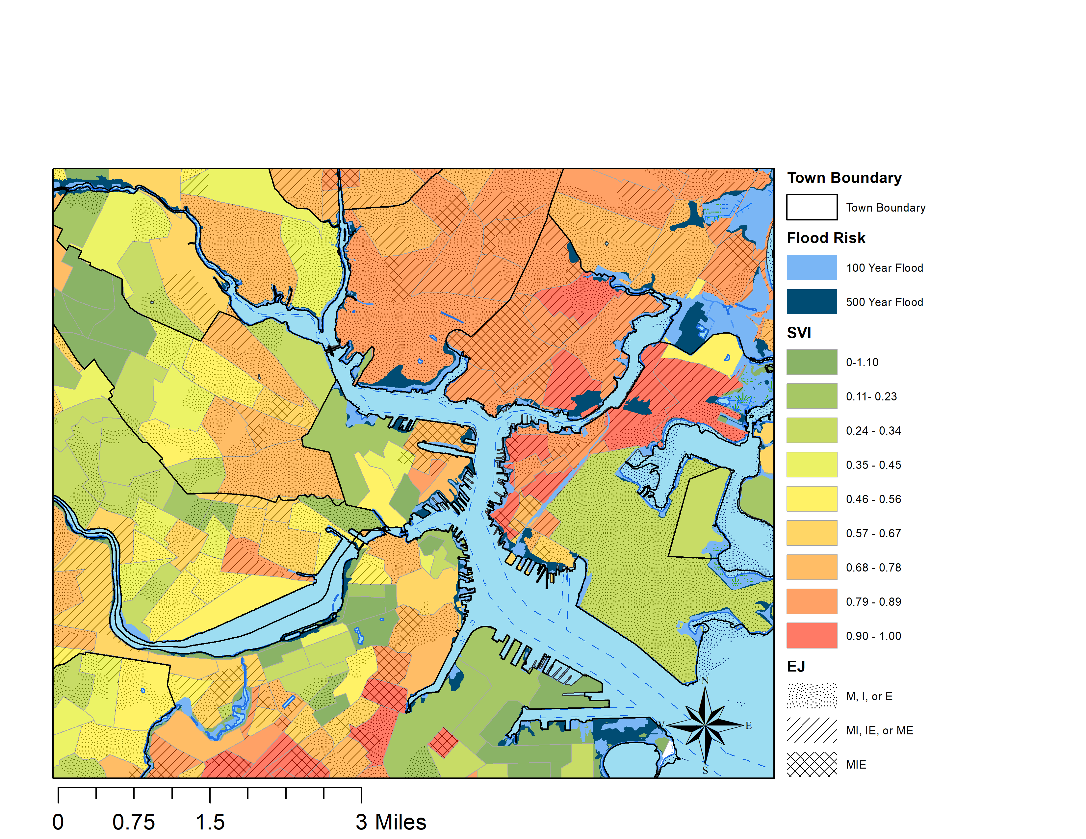
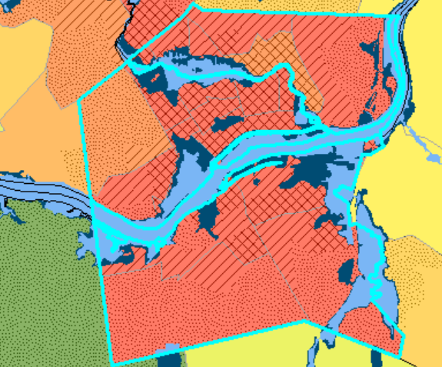
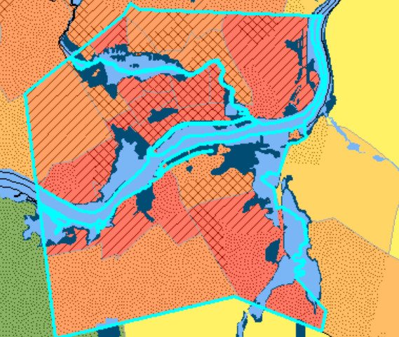
Introduction
Methods
Results
Lawrence, MA 2010-2020
Notes:
Next we have a sample of the output of overlapping SVI with the EJI indices. The dotted, hatched, and cross hatched lines represent the Massachusetts Environmental Justice Index. The three categories, Minority, Income, and Education are represented in the census block groups. If a single census block group has just 1 of these categories, it ranks lower. If it has 3 or more, it is ranked the highest. The blue lines show the boundaries of FEMA based flood zones and as you can see in the middle of the map, they are surrounded by the other race, Hispanic, or Latino populations. What is more specific on the EJI index, opposed to Social vulnerability index, is that EJI has a finer resolution. Since it maps at the census block group level over tracts, we are able to visualize vulnerability more distinctly than SVI. This therefore visualizes how areas north of the Merrimack are more acutely vulnerable, signifying a need for better environmental policies surrounding flooding in these areas. We also mapped these results from 2010 to 2020 using community survey data to see how flood risks change with respect to time. As you can see, in 2020, the social vulnerability index shows a decrease in the intensity of vulnerability, whereas the EJI index shows that vulnerability is staying the same or worsening in areas with these changes. These differences in vulnerability demonstrate the need for more specific maps that are based upon community vulnerabilities

Slide 20
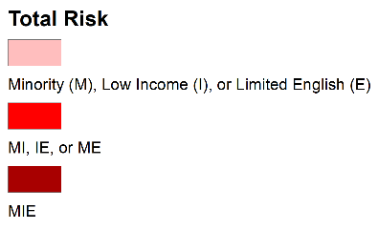
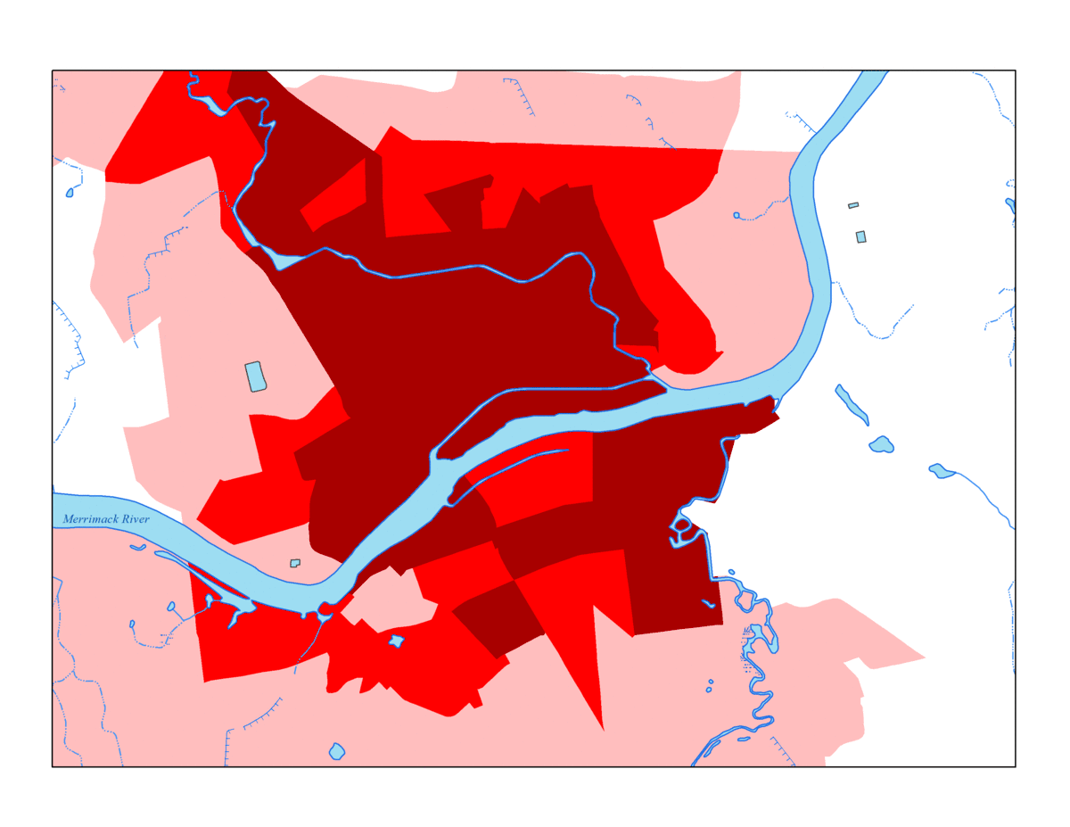
Lawrence, MA
Notes:
Here is Lawrence MA again with just the environmental justice index. I created this gif to show just how much flood waters overlap with neighborhoods that have 3 factors that contribute to socioeconomic vulnerability. In areas with high minority, low income, and low English proficiency, the flood waters overlap by 34%. This is much higher than the neighboring town of andover, which does not have any environmental justice communities overlapping with flood risk. Even compared to Boston, a city of similar racial and ethnic composition, other socioeconomic factors drive up the flood risk in Lawrence over 5 times that of Boston.

Slide 21
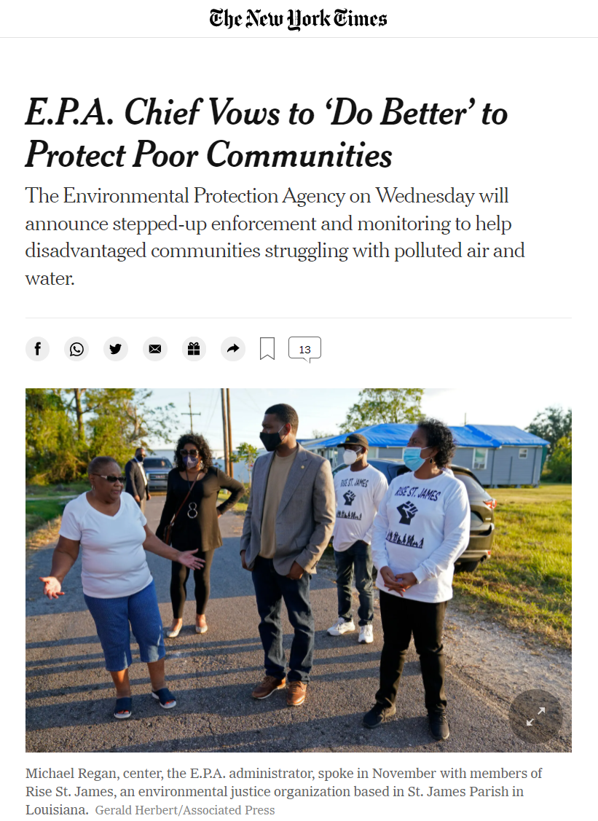
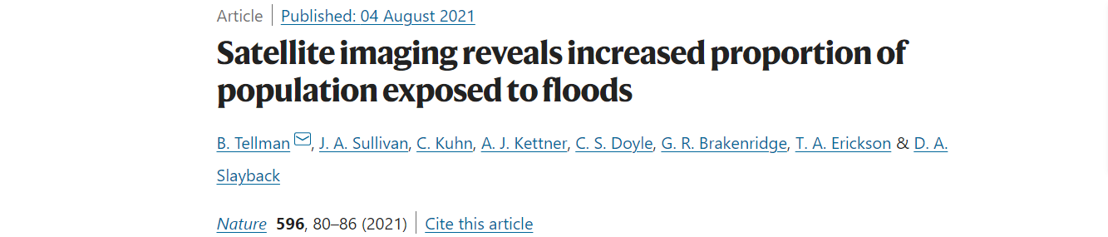
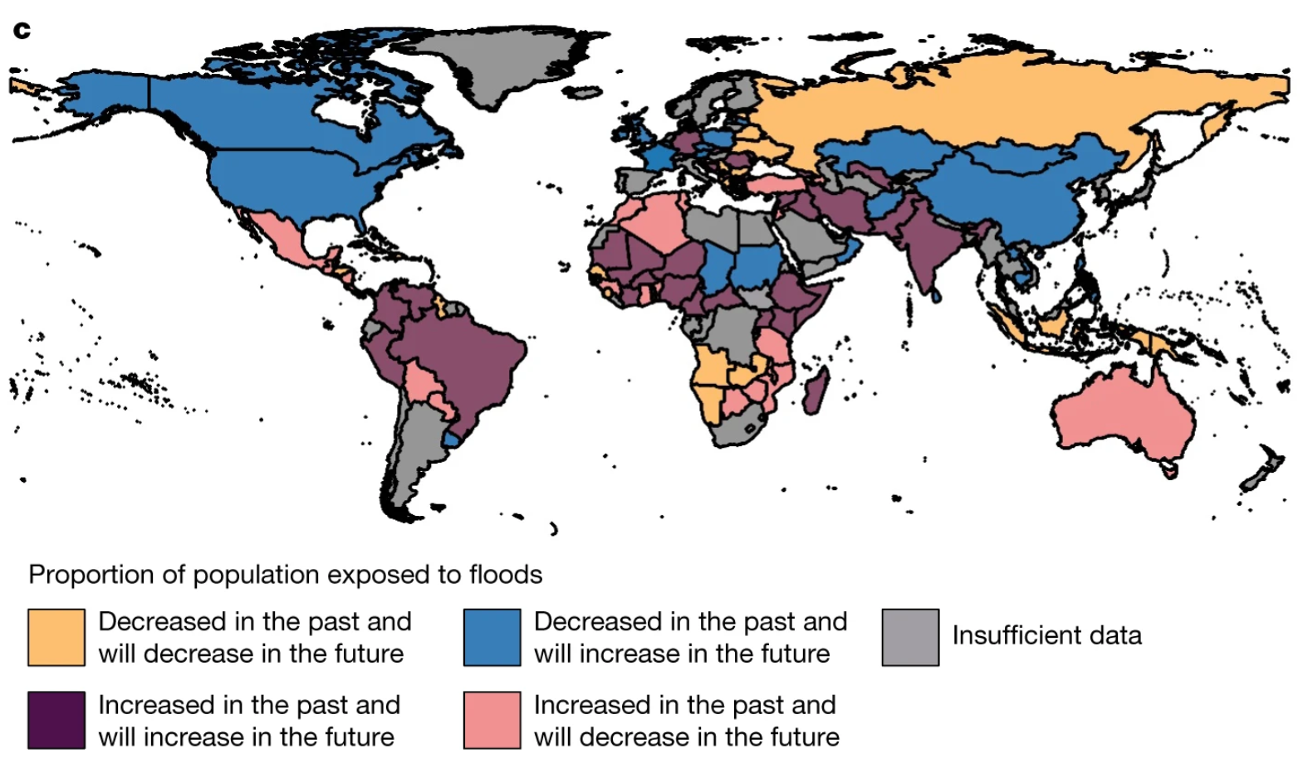
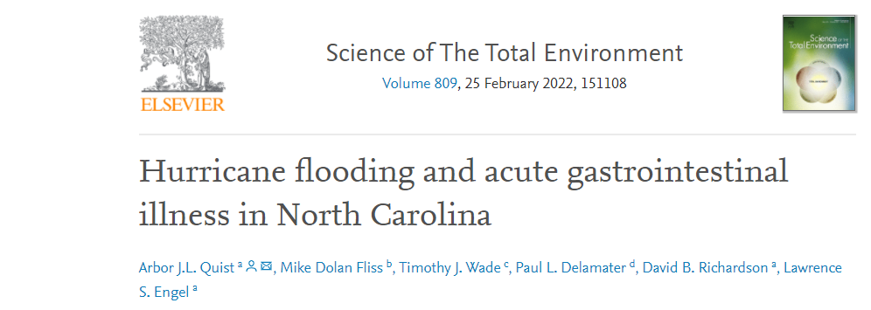
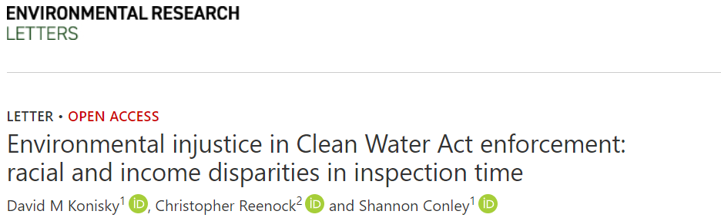
Connection to larger trends and needs
Notes:
Overall, this research pushes the need to connect flood vulnerability and socioeconomic status to larger trends in climate change. The threat of hurricanes, heavy rainfall, and flooding pose much more of a threat than just inundation to homes and businesses. Flooding is able to spread legacy contamination such as PFAS and PFOAS, bacteria, and other things that make us sick.

Slide 22
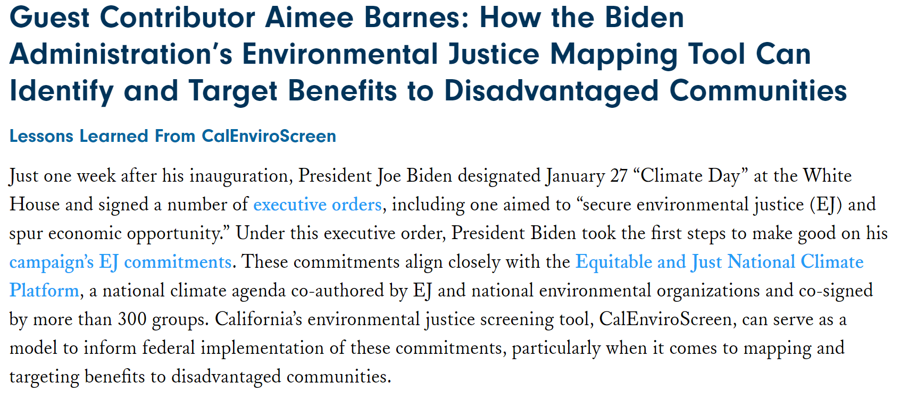
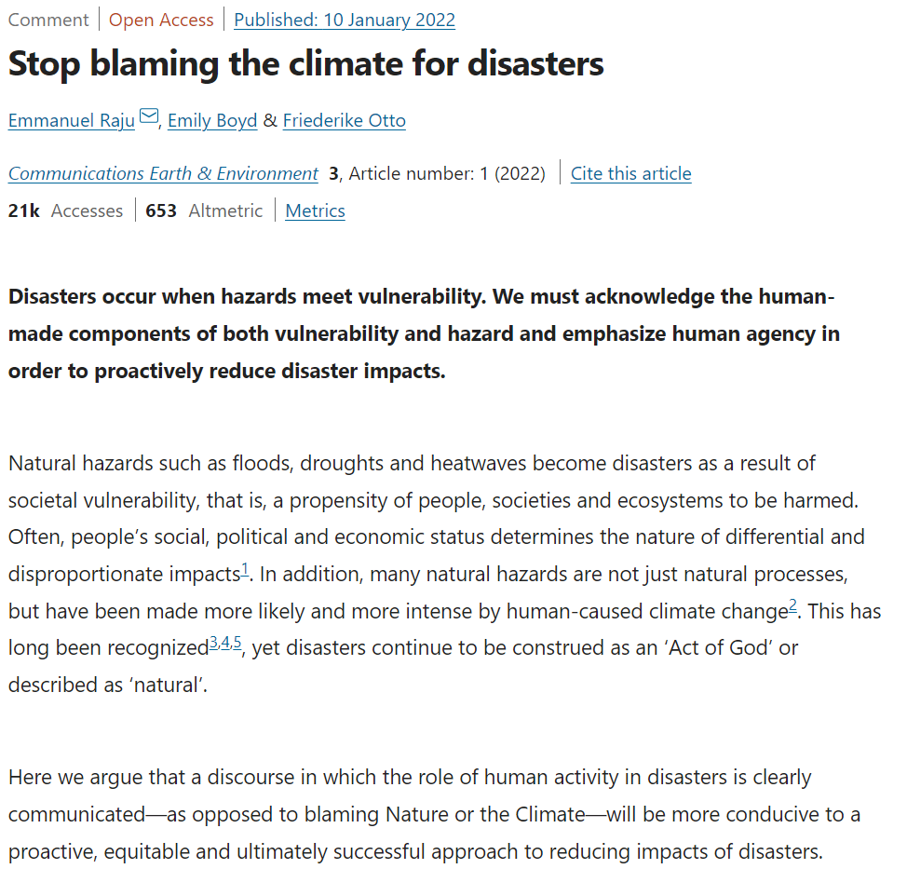

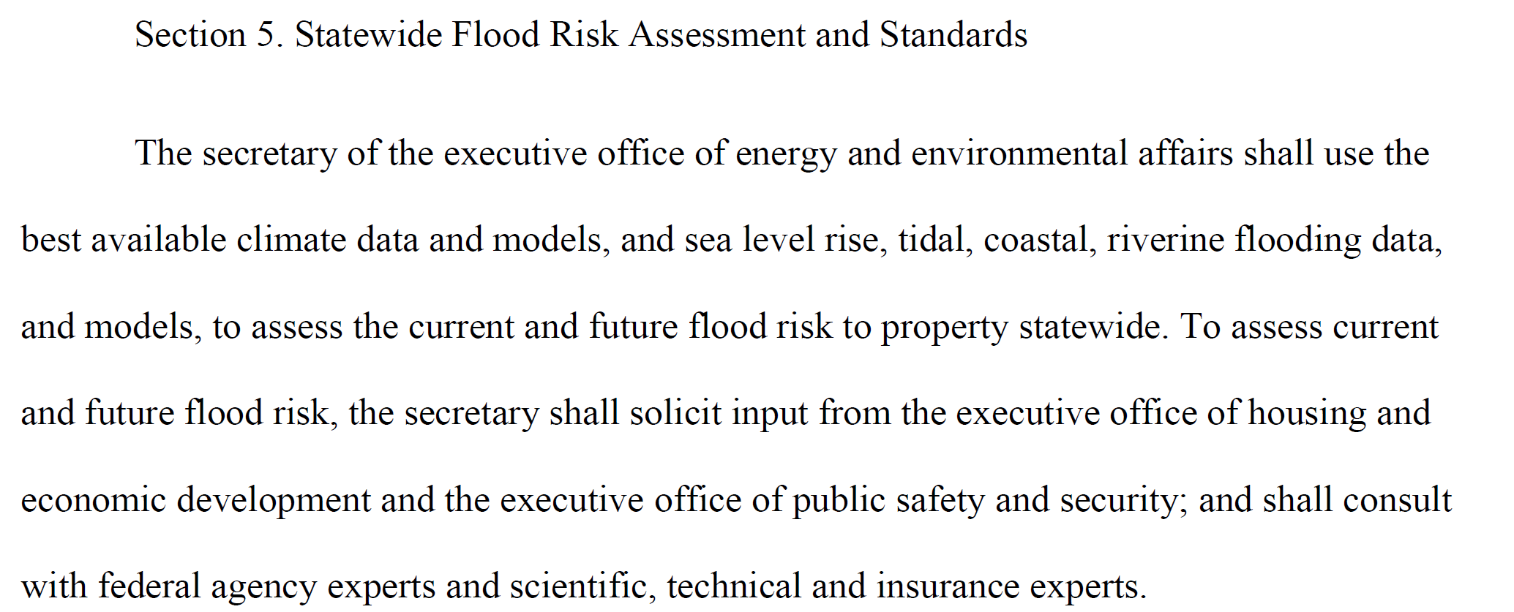
Application for findings
Notes:
These findings stress the importance of parsing out the role that socioeconomic status, racial composition, and other demographic factors have in disaster risk. It is critical that we work to establish flood risk protection programs that cater to those who are most vulnerable, and develop them in a participatory manner that includes voices historically excluded. In the future, we plan to improve our Training dataset to train SOM. We also plan to examine Feature Selection, where we will look at the individual attributes of Social Vulnerability Index and environmental justice index. We also plan to examine the differences between urban and rural areas from 2010 to 2020.

Slide 23





Acknowledgements
Christian D. Guzman – Department of Civil
and Environmental Engineering
Seda Şalap-Ayça– Department of Geosciences
Jennifer Givens - Department of Sociology, Social Work, and Anthropology, Utah State University
Sheila M. Saia - Department of Forestry and Environmental Resources, North Carolina State University
James Knighton - Department of Natural Resources and the Environment, University of Connecticut
Sheila Saia Karl Tacheron, UMass, Amherst, Department of Geosciences, MSc. Student
Ivini de Souza, UMass, Amherst, Department of Geosciences, GIST MSc Graduate
Notes:
In my last slide I would like to acknowledge the participation of my all my collaborators. In addition, I would also like to acknowledge the support of the Spaulding Smith Fellowship, Energy Transition Institute, and NE CASC for funding this study.

Slide 24
Closing Slide
THANK YOU!

Slide 25
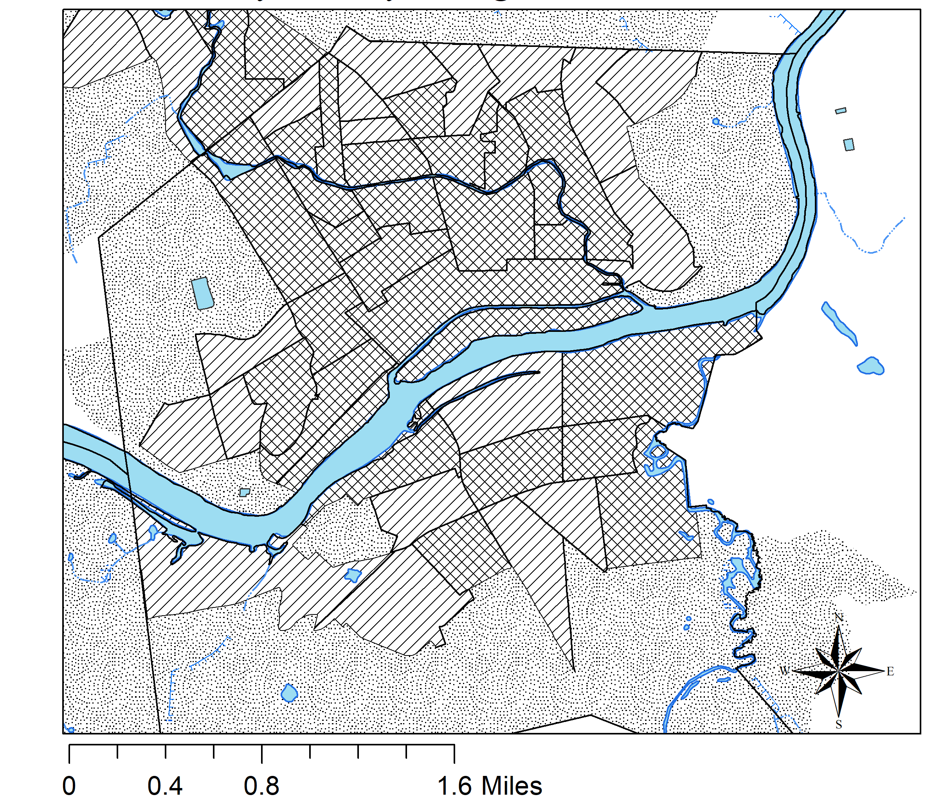
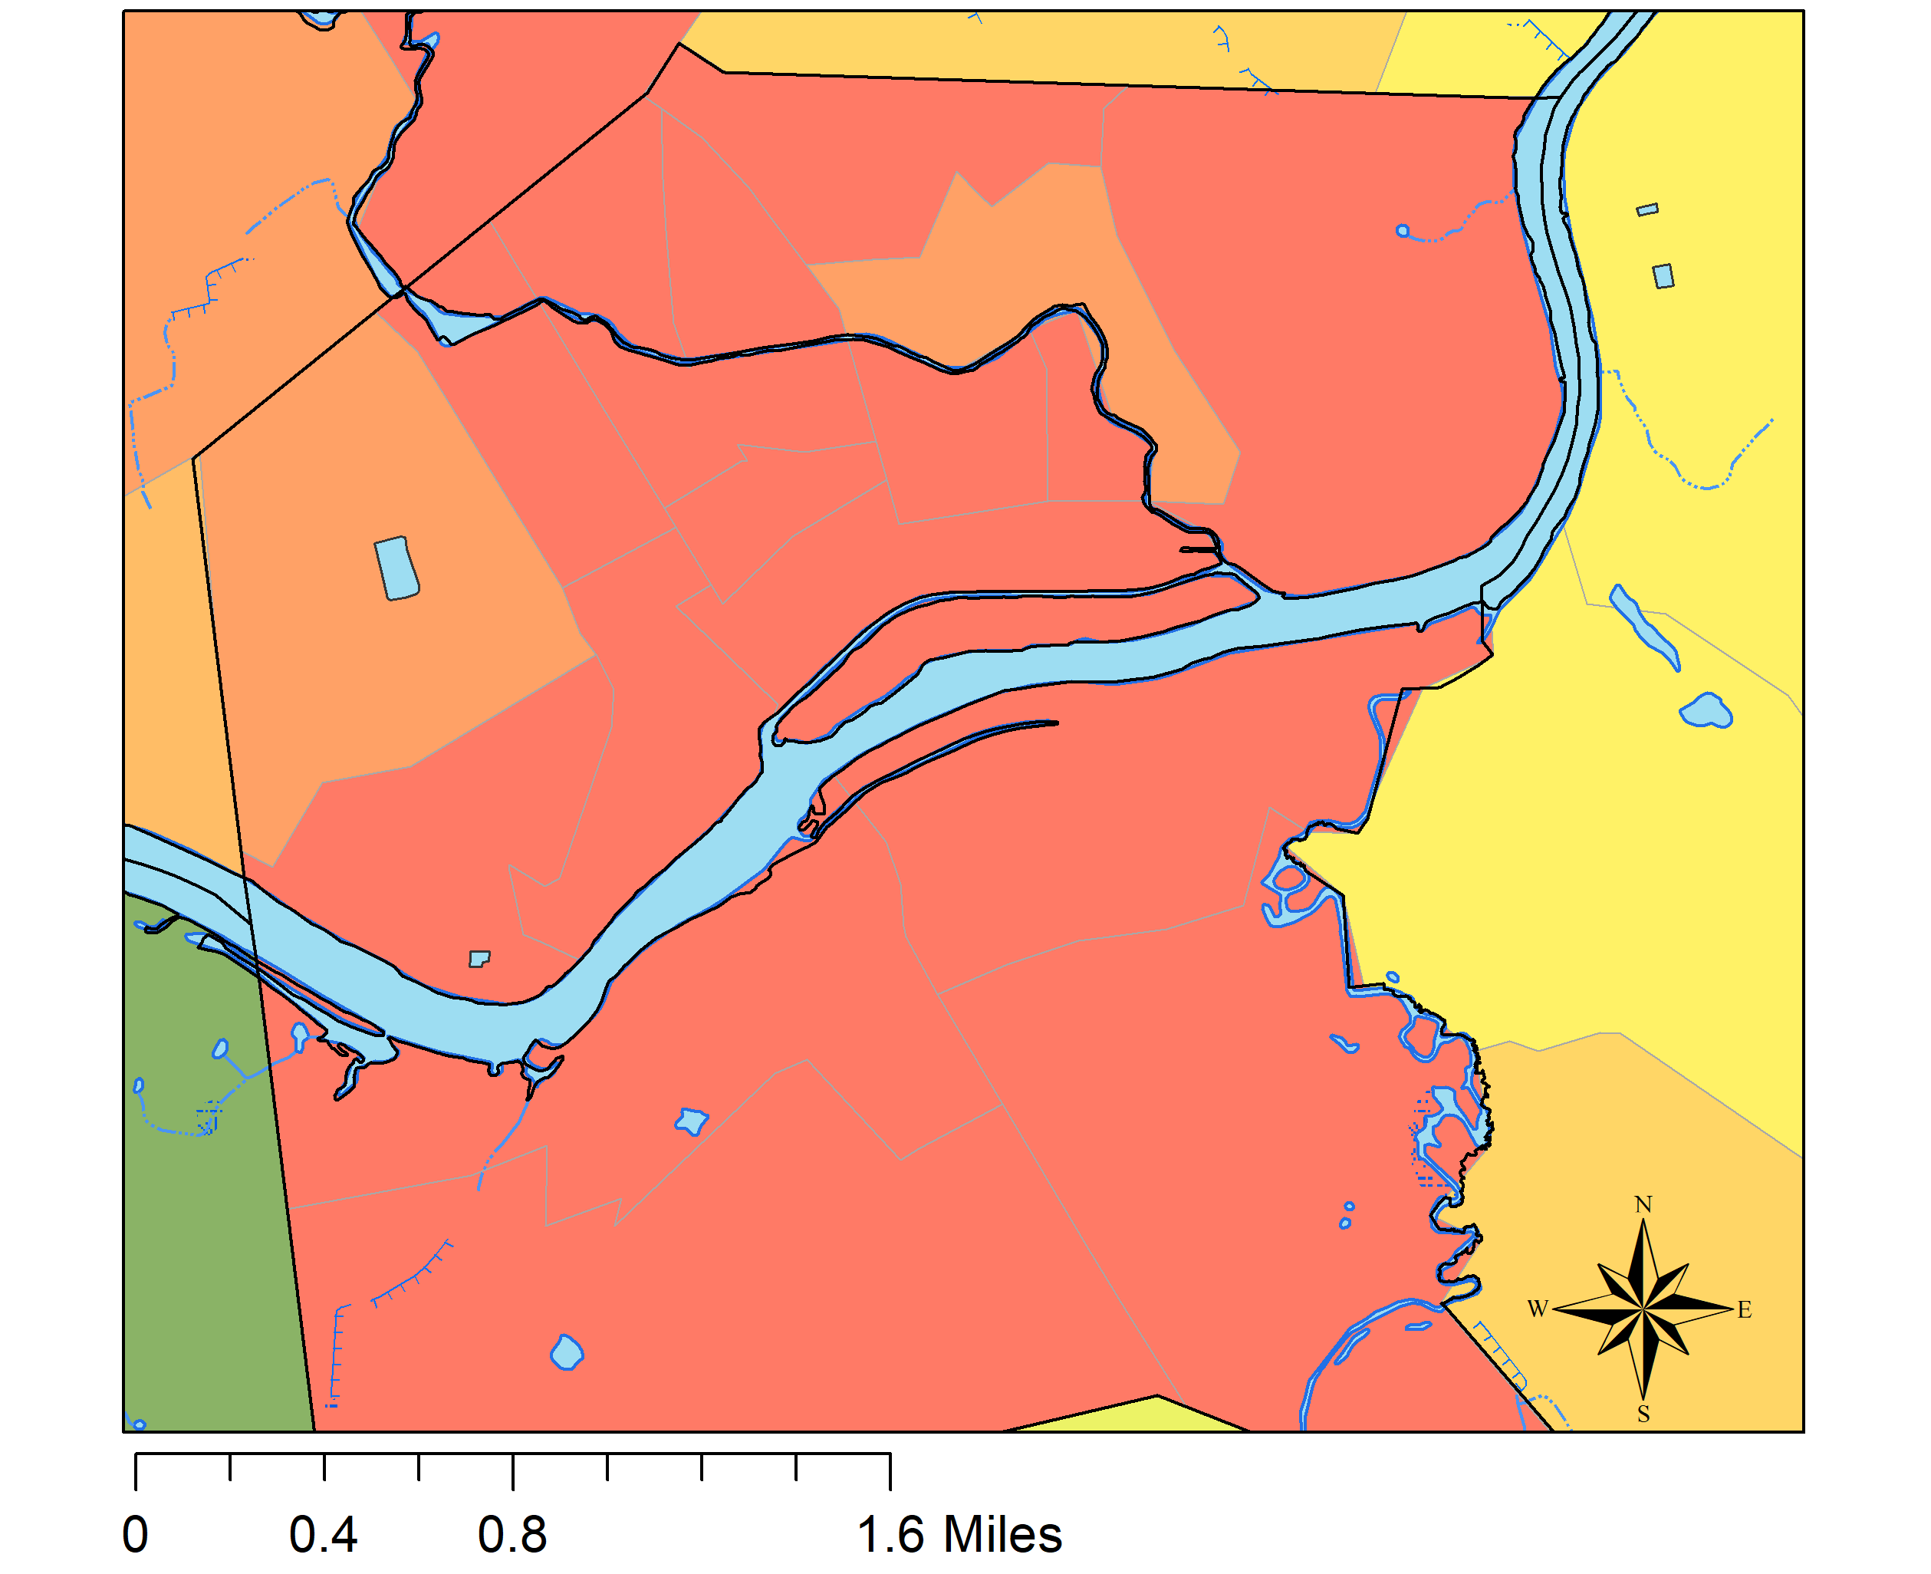
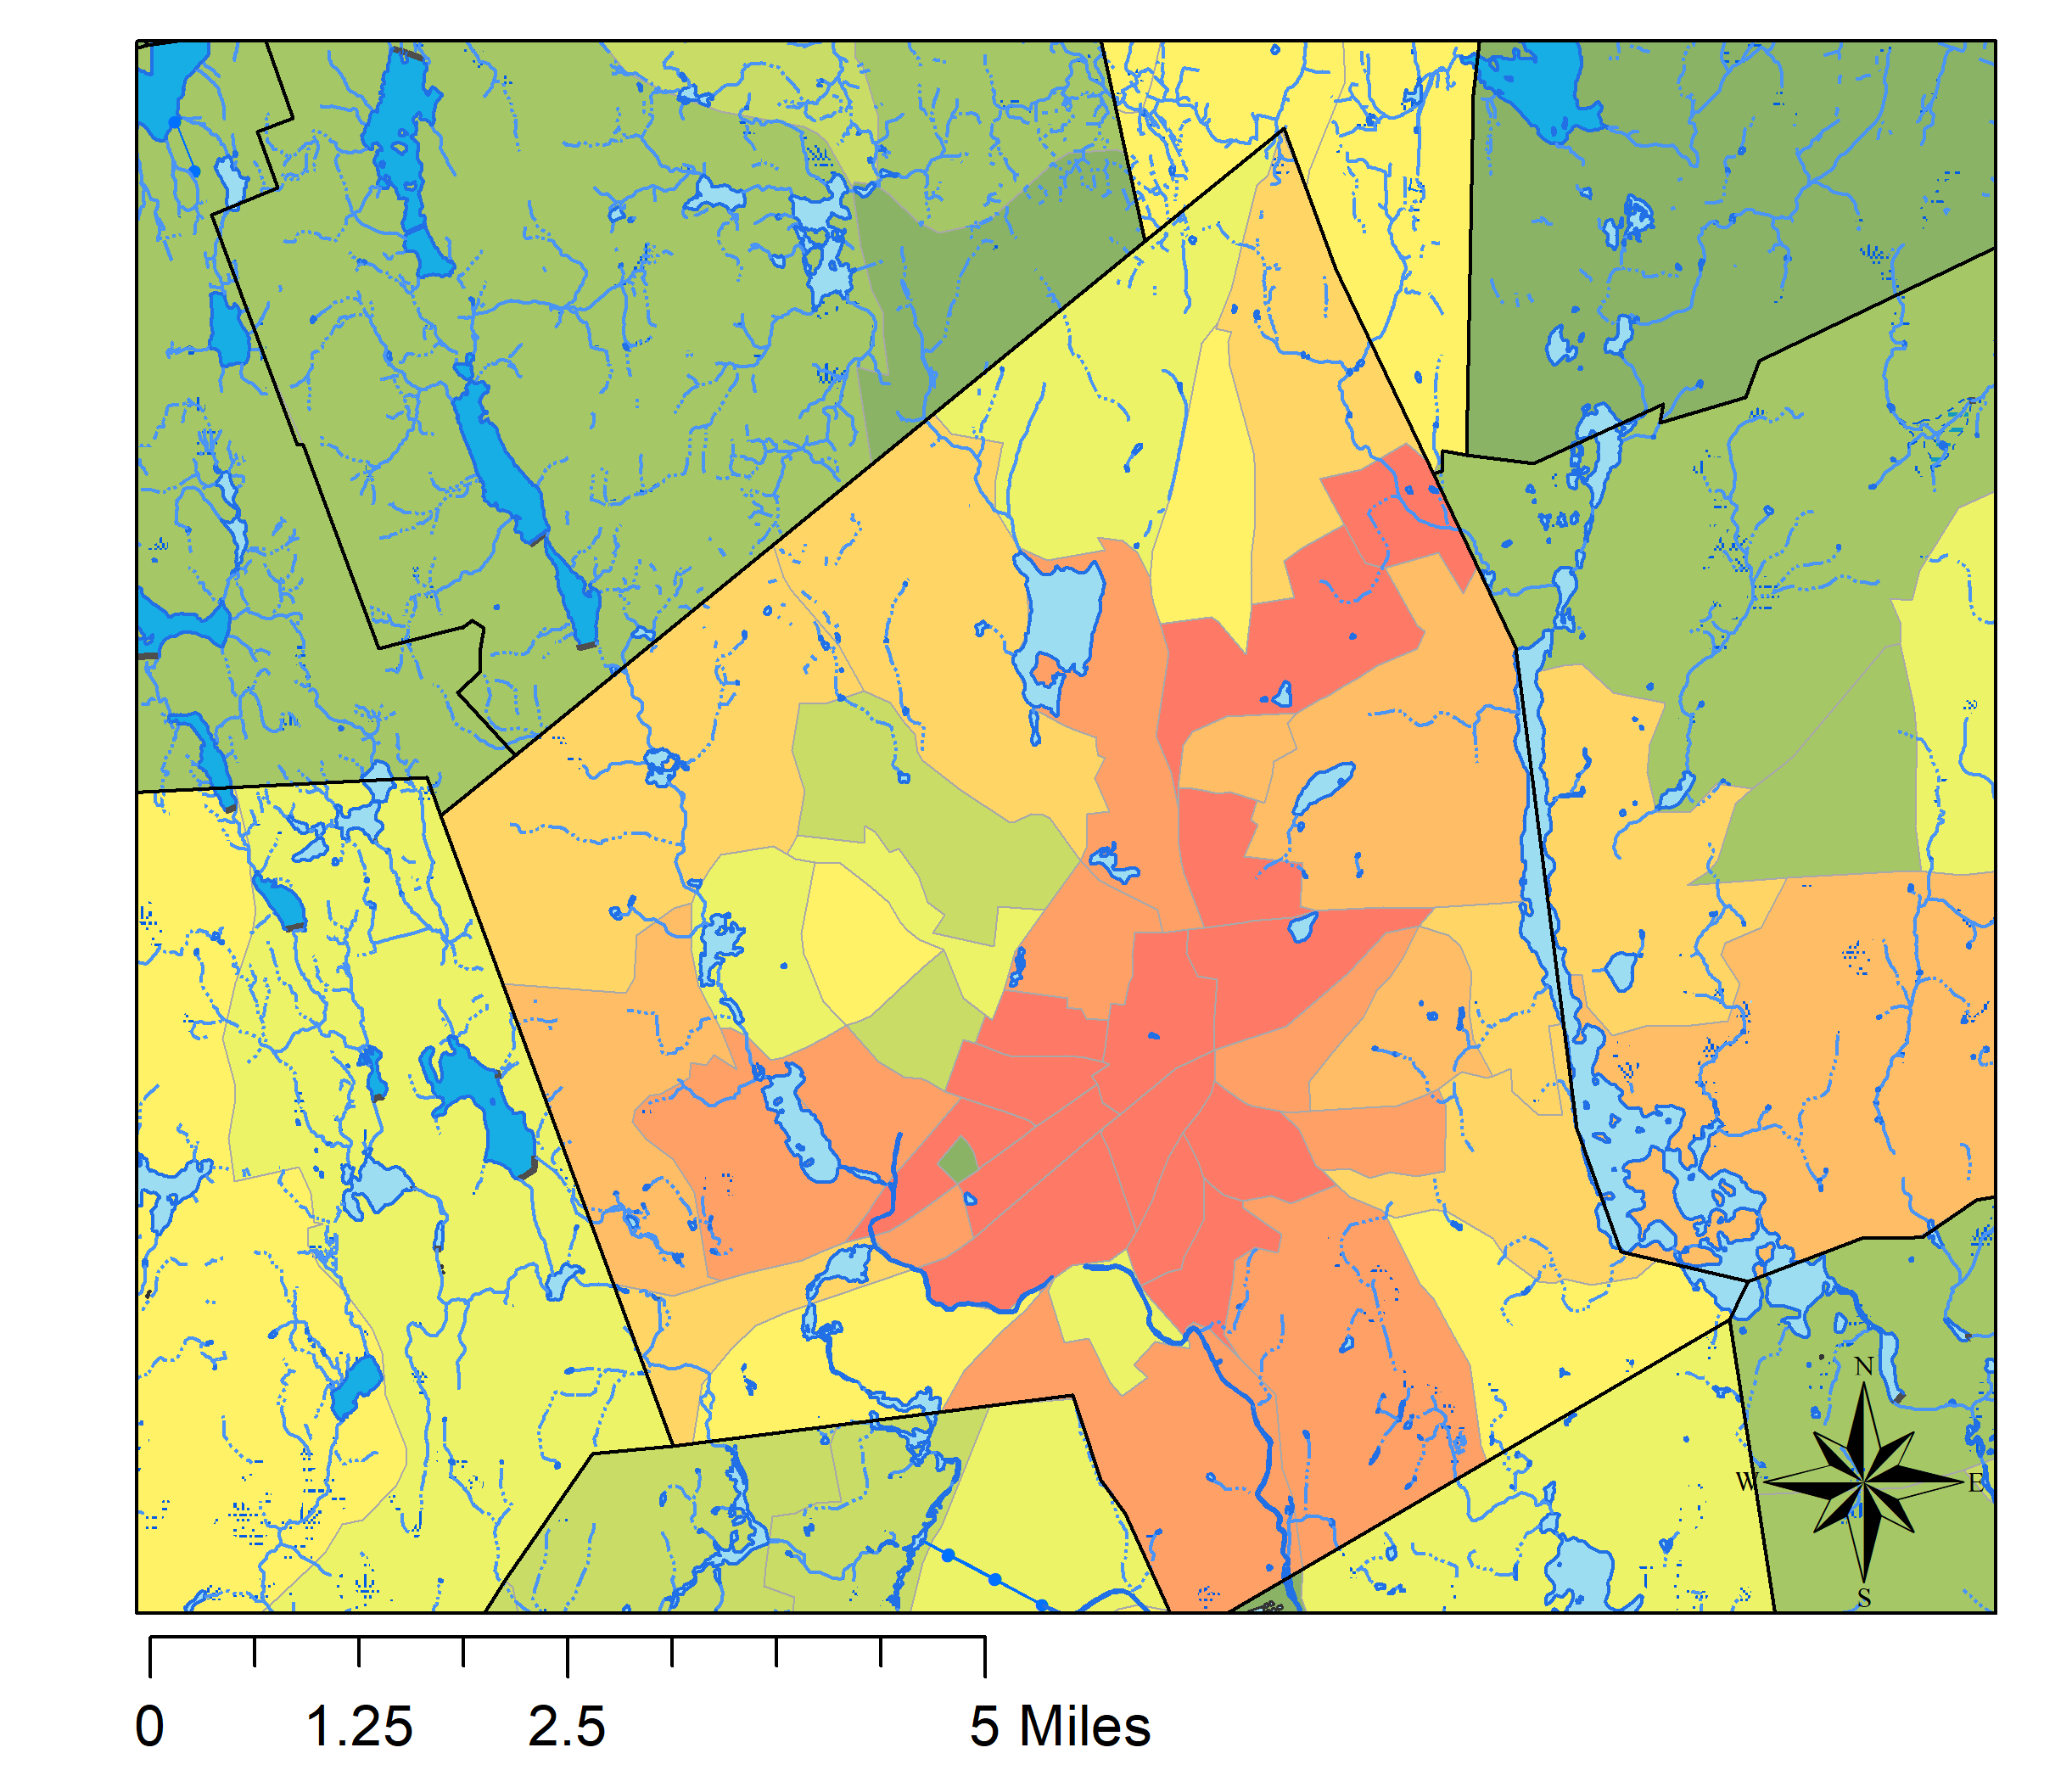
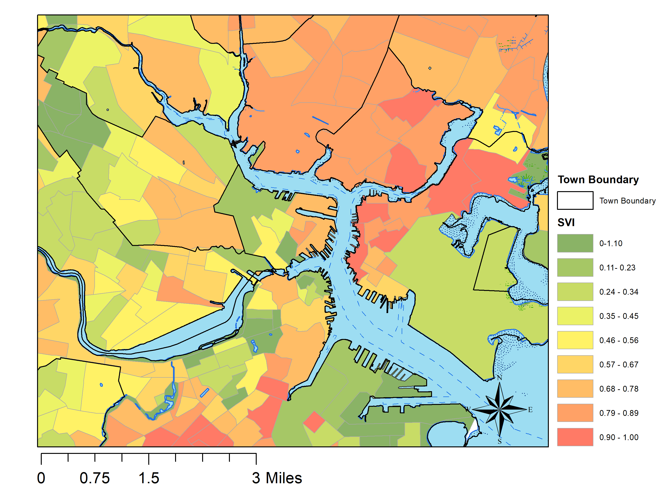
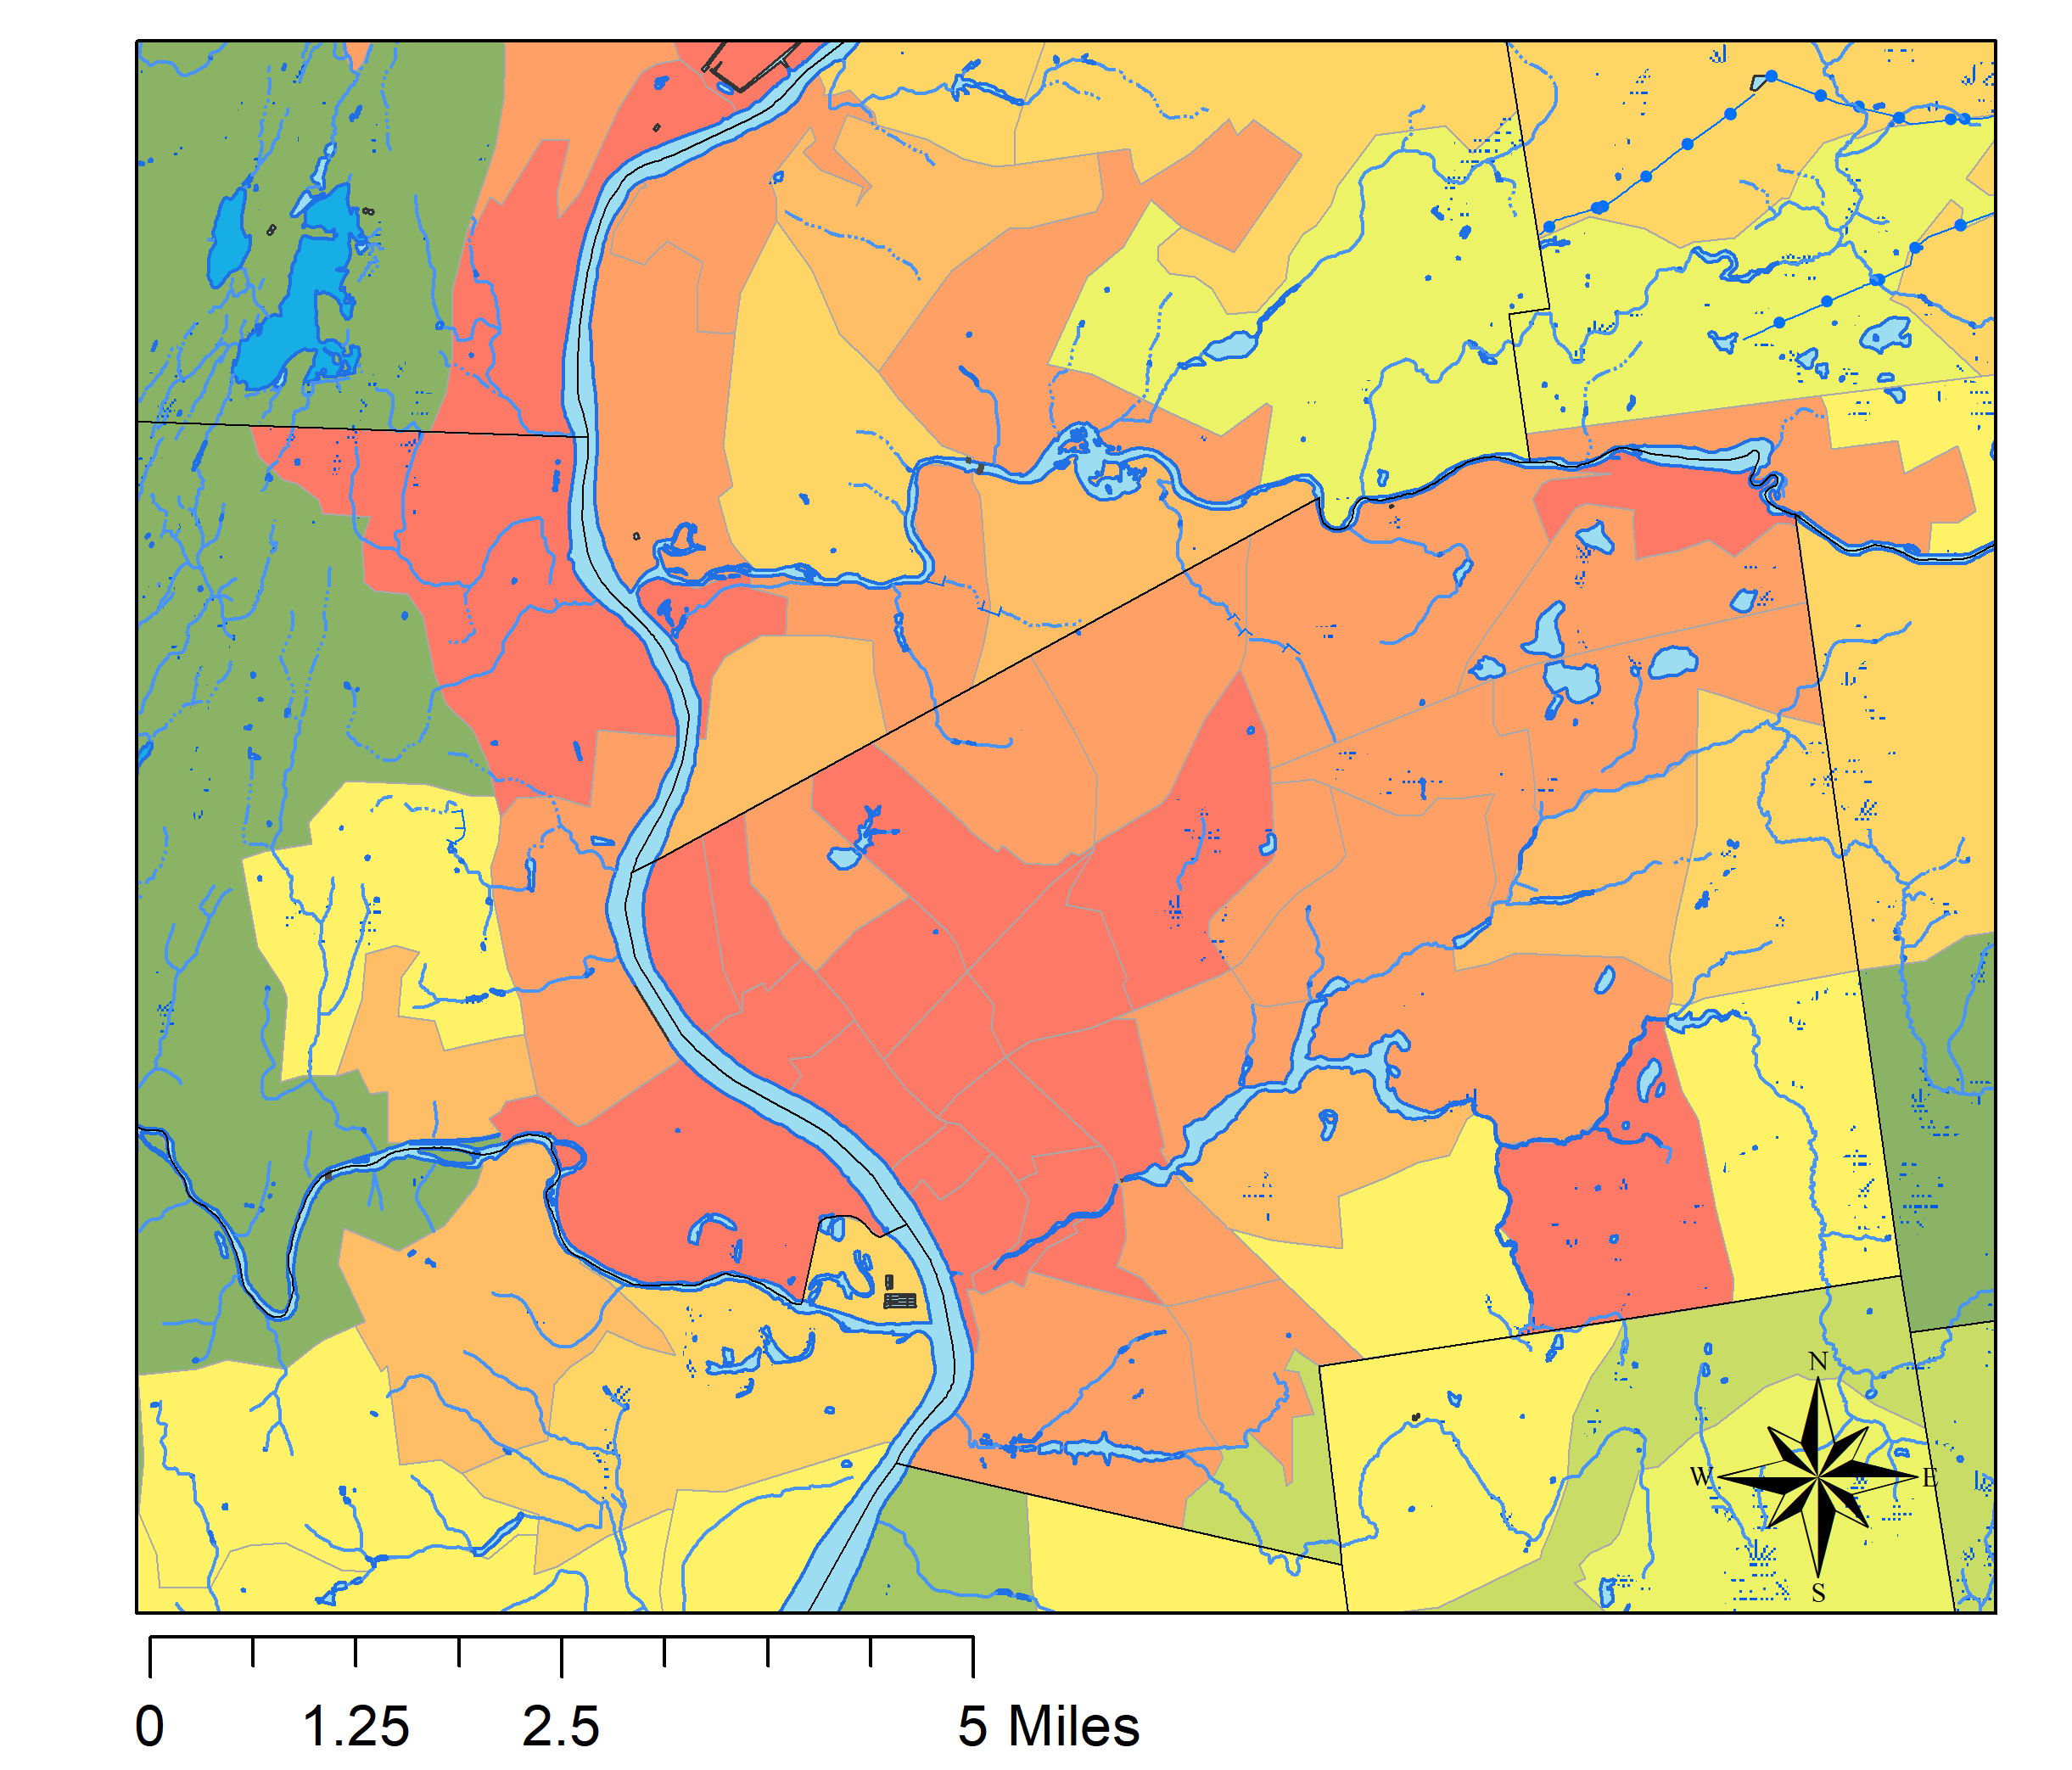
SVI Index
Lawrence (left)
Worcester
Boston
Springfield (left)
Notes:
To project social vulnerability, I first used census tract data (2010) from the CDC (RPL Themes) ArcMap to demonstrate the spatial distribution of vulnerability in Massachusetts as delineated by socioeconomic themes.
The red colors indicate the highest disparaging social vulnerabilities, while the green colors indicate the relative priviledge levels

Slide 26
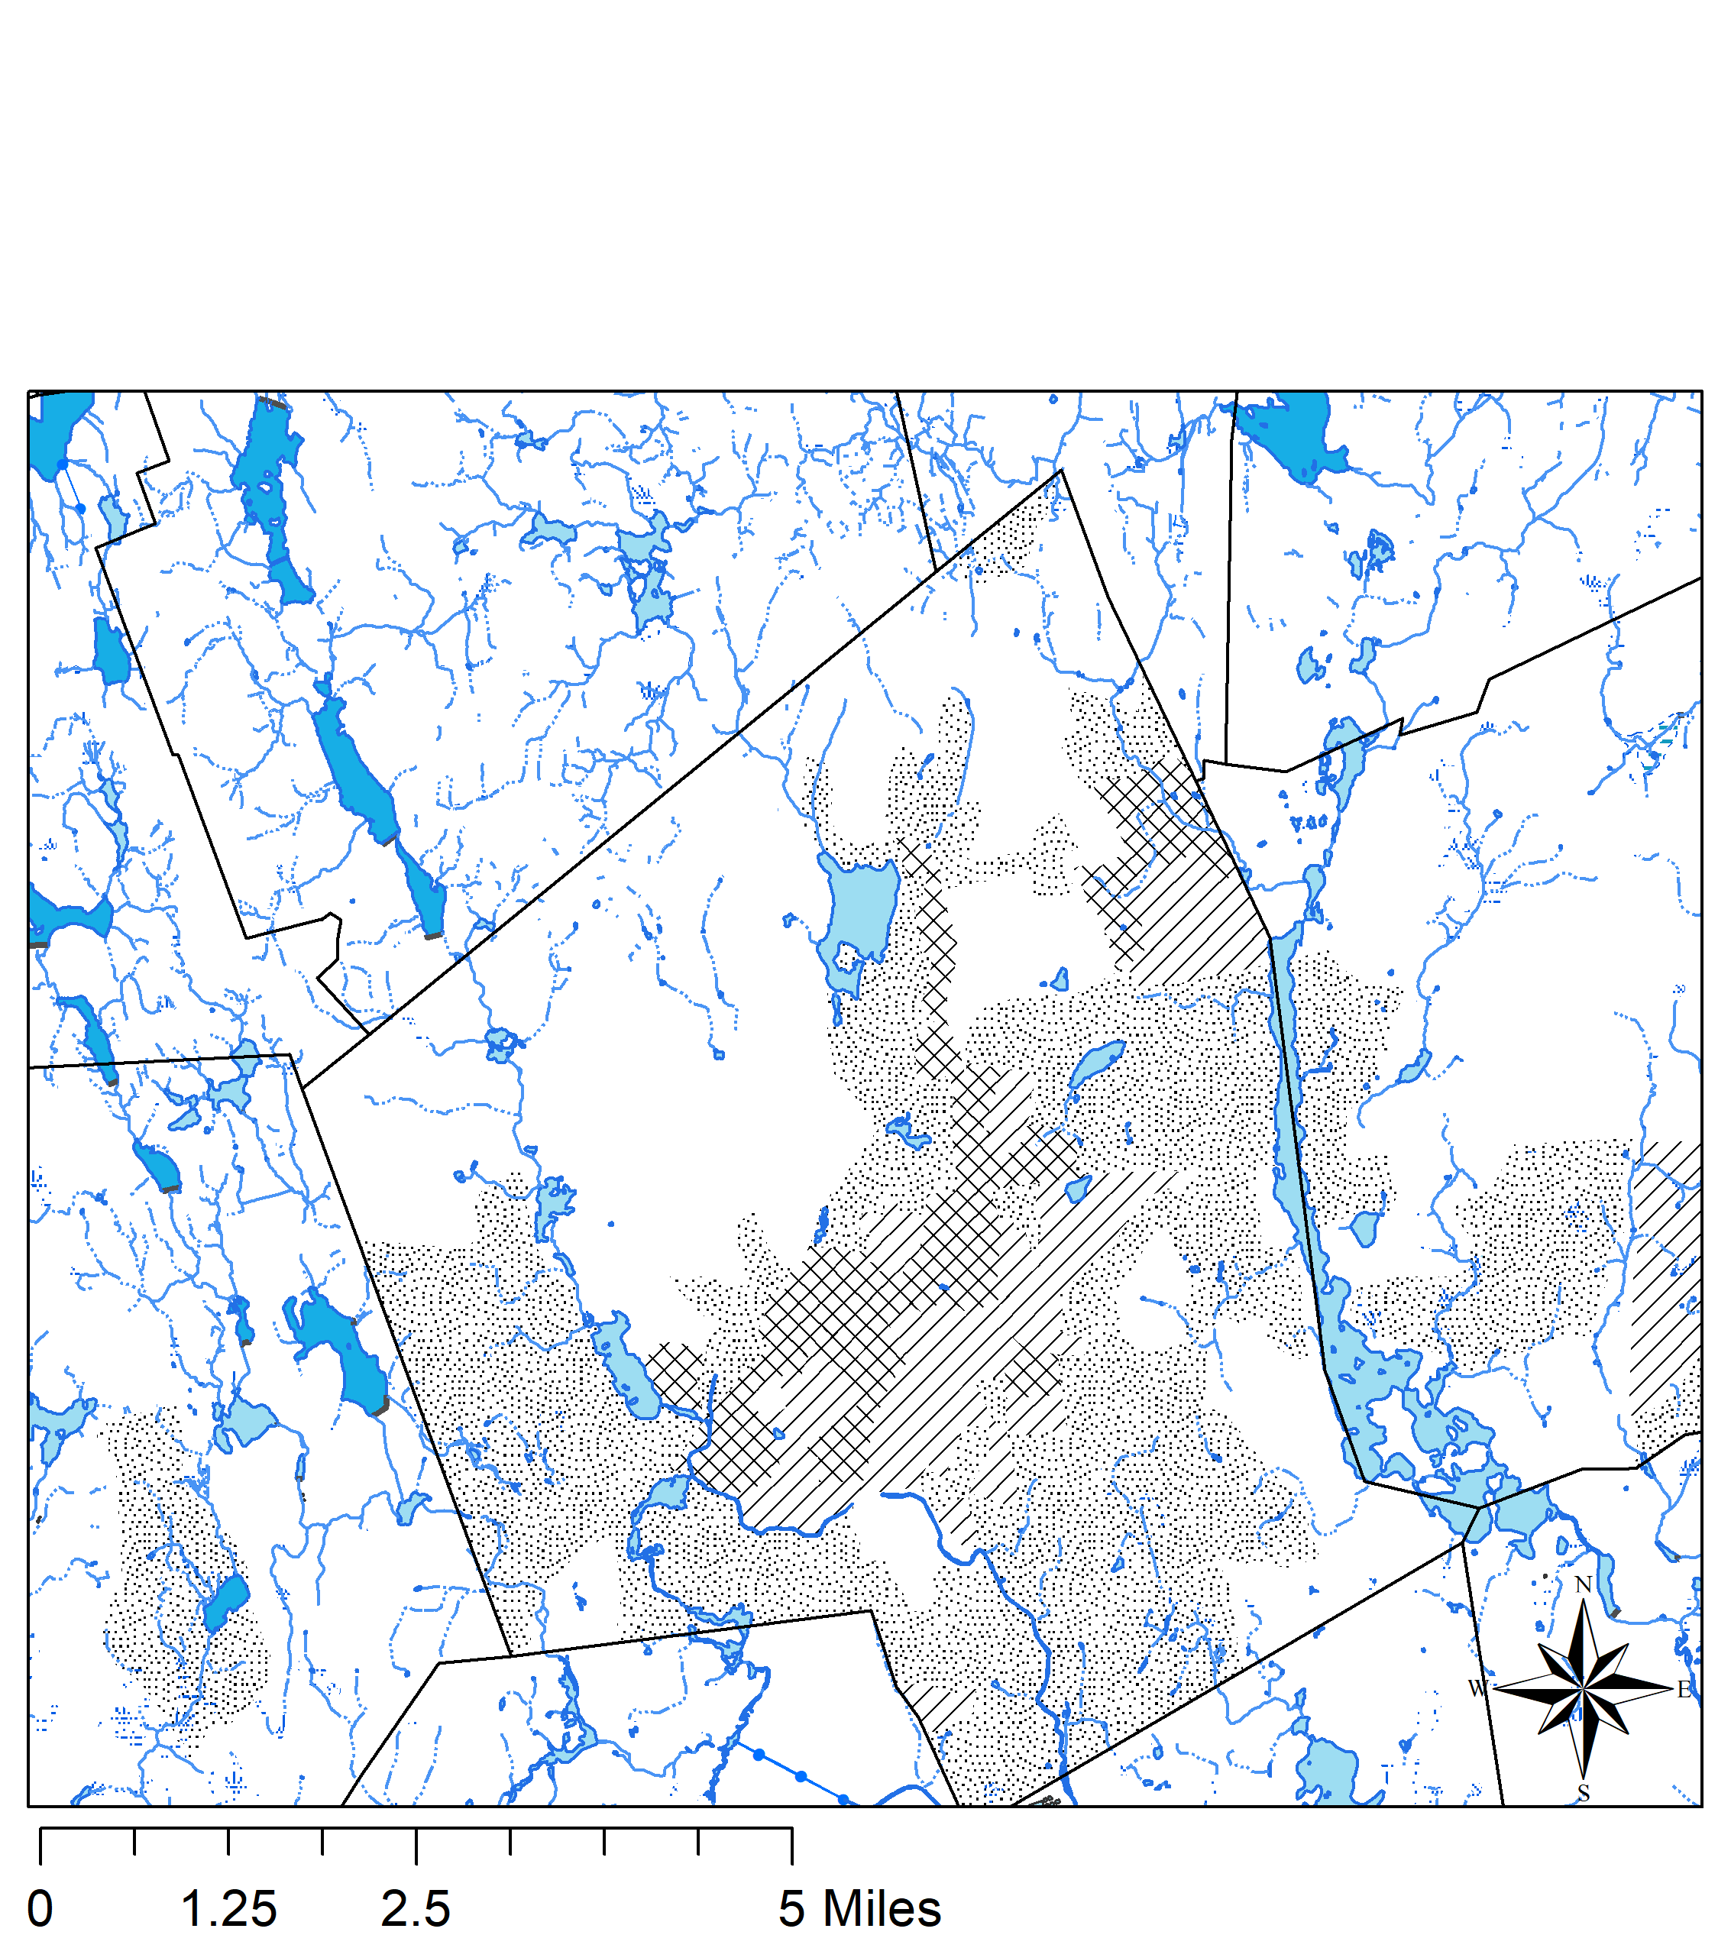
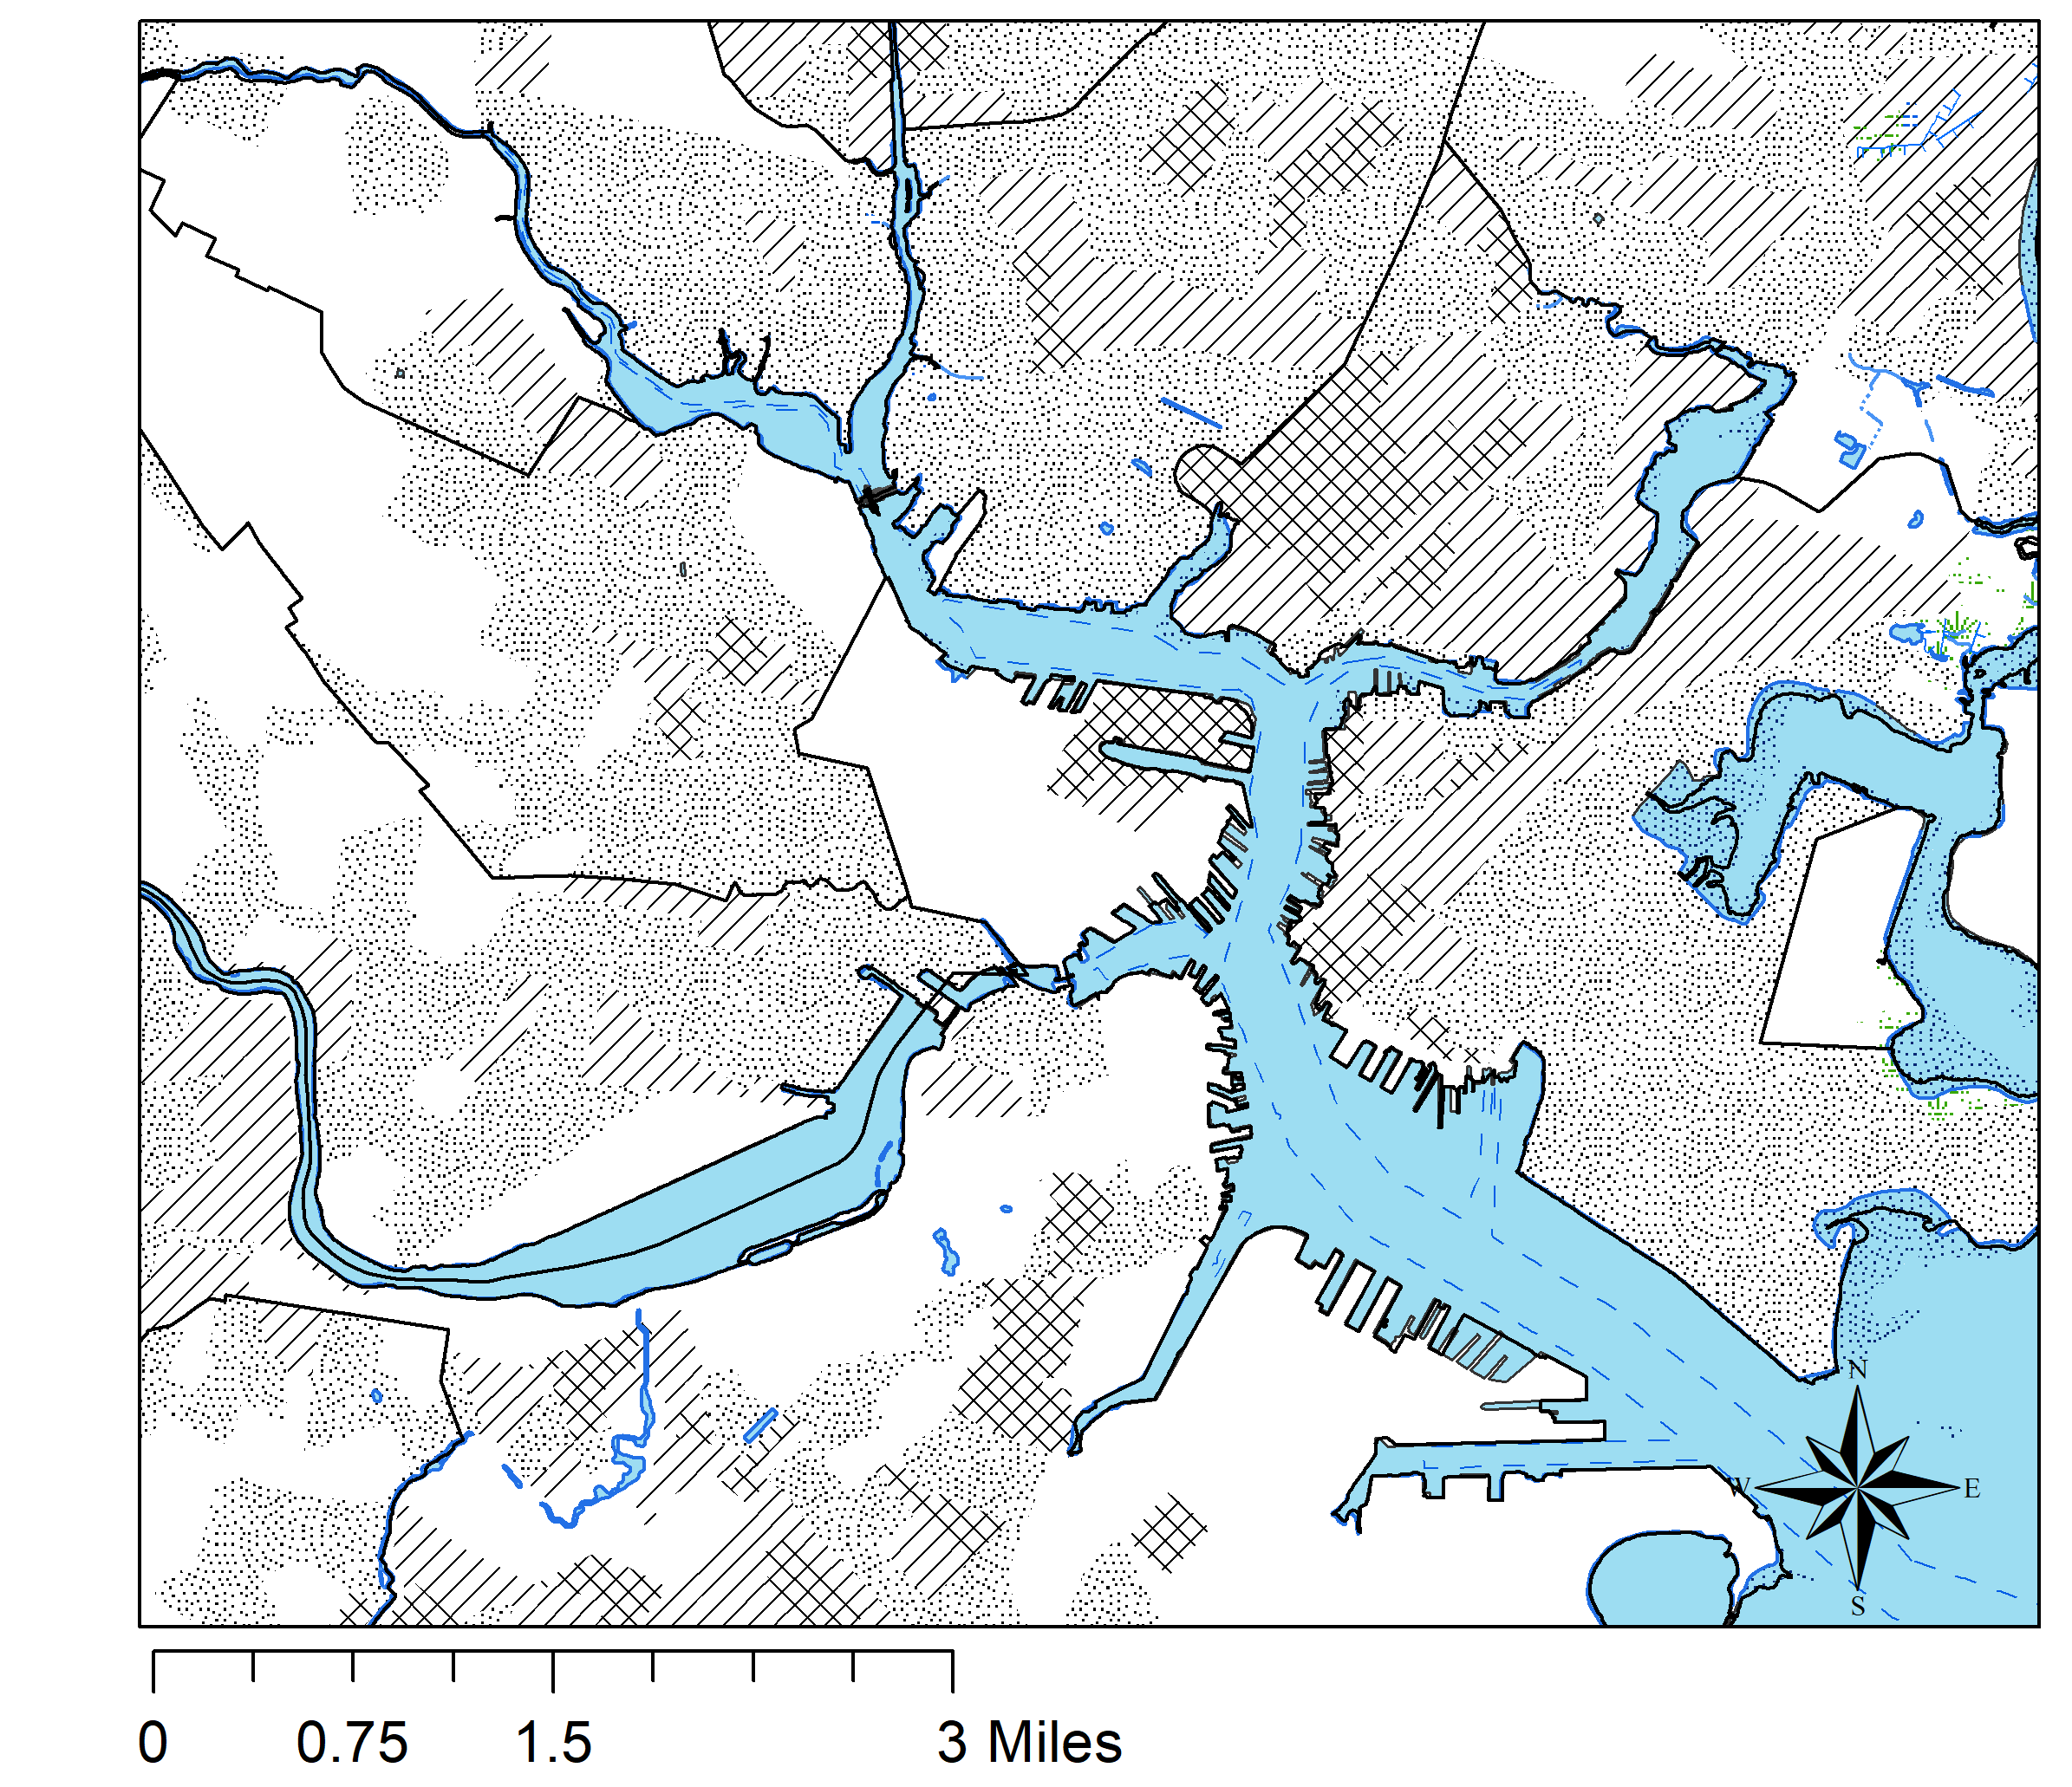
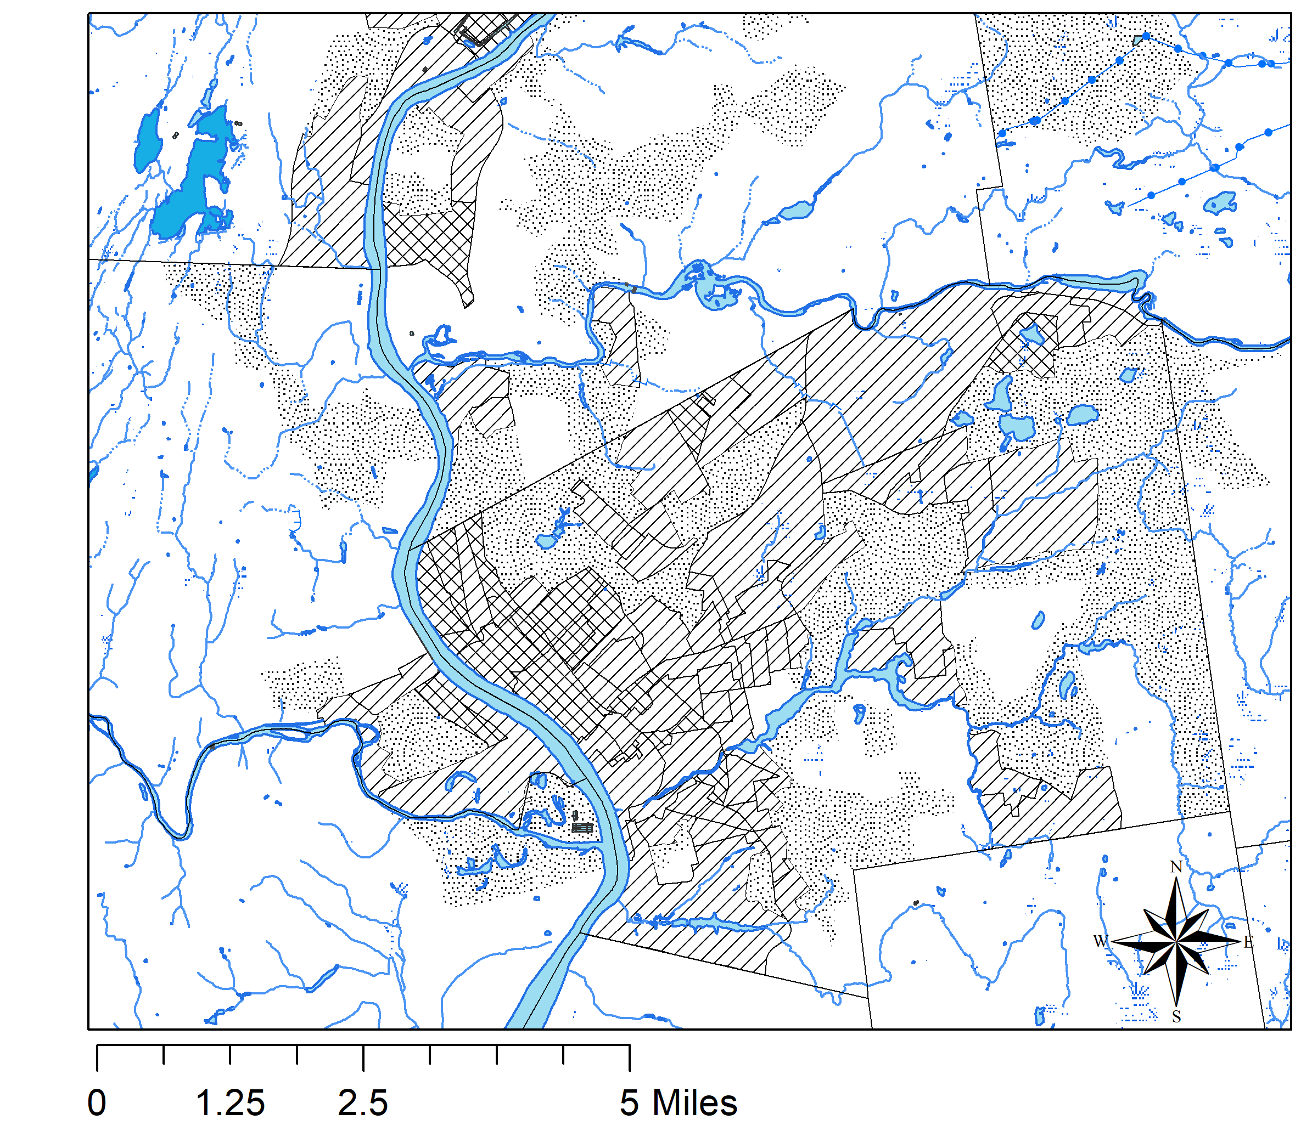
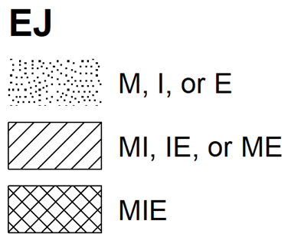
Environmental Justice Communities
Lawrence (left)
Worcester
Boston
Springfield (left)
Notes:
Next, I used Environmental Justice (EJ) population data from 2010 Census data to examine areas with high minority (M), non-English speaking (E), and/or low-income populations (I).
The single black and white docs are M I OR E
The STLANTED HASING means MI, IE, or ME
The cross hatches represent total MIE.
Lawrence 100% vulnerability

Slide 27
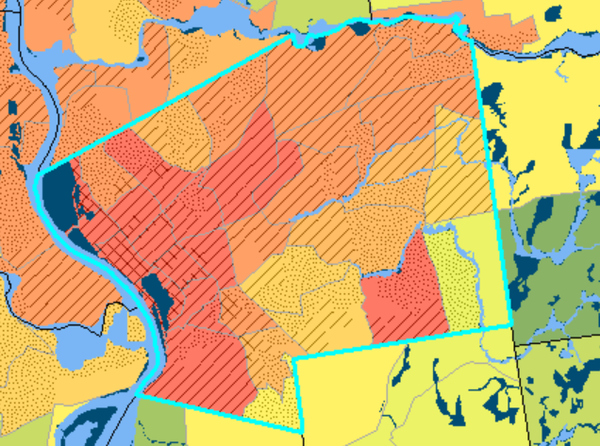
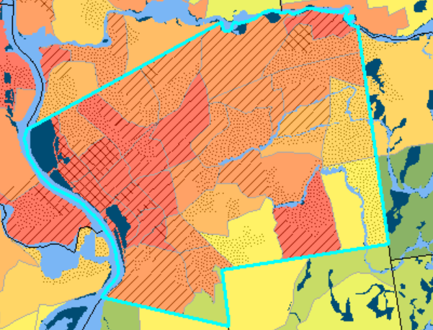
Spatial Variation of Risk in Urban EJI Communities Under Climate Change

Slide 28
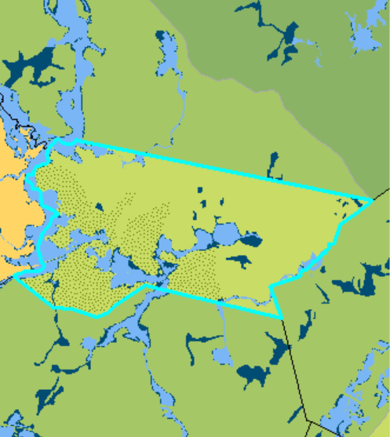
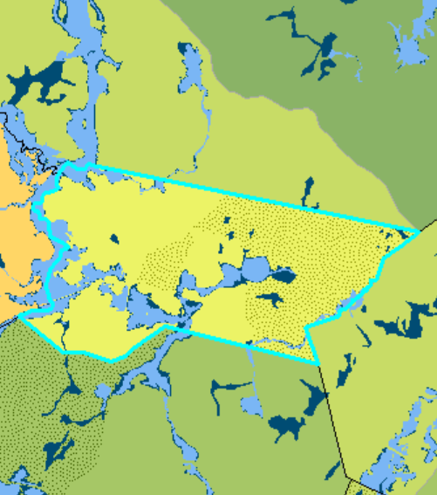
Increasing Hydrological Risk in Rural Areas
Notes:
After identifying EJ block grops and SVI areas, I emaxined the FEMA Flood insurance map rates which describe special flood hazard areas.
Special Flood Hazard Areas (SFHAs) are areas located within the 100-year floodplain, defined as any area that has a one percent chance of flooding in any given year. Smaller scale floods (50-year and 10-year) have a greater chance of occurring in any given year and can also pose a significant flood hazard to persons and property in close proximity to channels and streams. Additionally, floods larger than the mapped 100-year event can occur.
These maps are utilized as the basis for local floodplain management regulations and mitigation efforts, to assess flood risk, and to determine if flood insurance is required for structure(s) on a property. Because detailed analyses are not performed for such areas; no depths or base flood elevations are shown within these zones.
We manage flood risks through these maps, and this is a current attempt at that. Sometimes these are off and sometimes this is not the case. They are politically mediated, and people can pay to change them;
this is our preliminary attempt at characterizing these flood risks.

