Slide 1
CyberGIS-ABM: Synergizing High-Performance Computing and Network Science for Scalable Agent-Based Modeling of Human-Environment Interactions
Rebecca Vandewalle and Shaowen Wang
CyberGIS Center for Advanced Digital and Spatial Studies
CyberInfrastructure and Geospatial Information Laboratory
Department of Geography and Geographic Information Science
University of Illinois at Urbana-Champaign
AAG Annual Meeting
2-26-2022

Slide 2
Outline
What is CyberGIS-ABM?
How does CyberGIS-ABM enable scalable modeling of human-environment interactions?
CyberGIS-ABM

Slide 3
What is CyberGIS-ABM?
Agent-Based Model (ABM)
CyberGIS
(GIS + cyberinfrastructure)

Slide 4
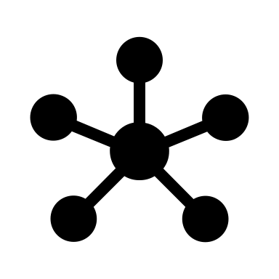
What is CyberGIS-ABM?
Agent-Based Model (ABM)
Agents
Networks
Data Layers

Slide 5
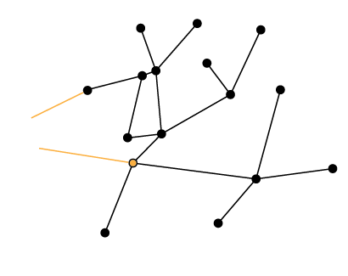
CyberGIS-ABM Core
Object-oriented design
Extensible and reusable
Spatial network representation
Scalable computing
Computational reproducibility
CyberGIS-ABM

Slide 6
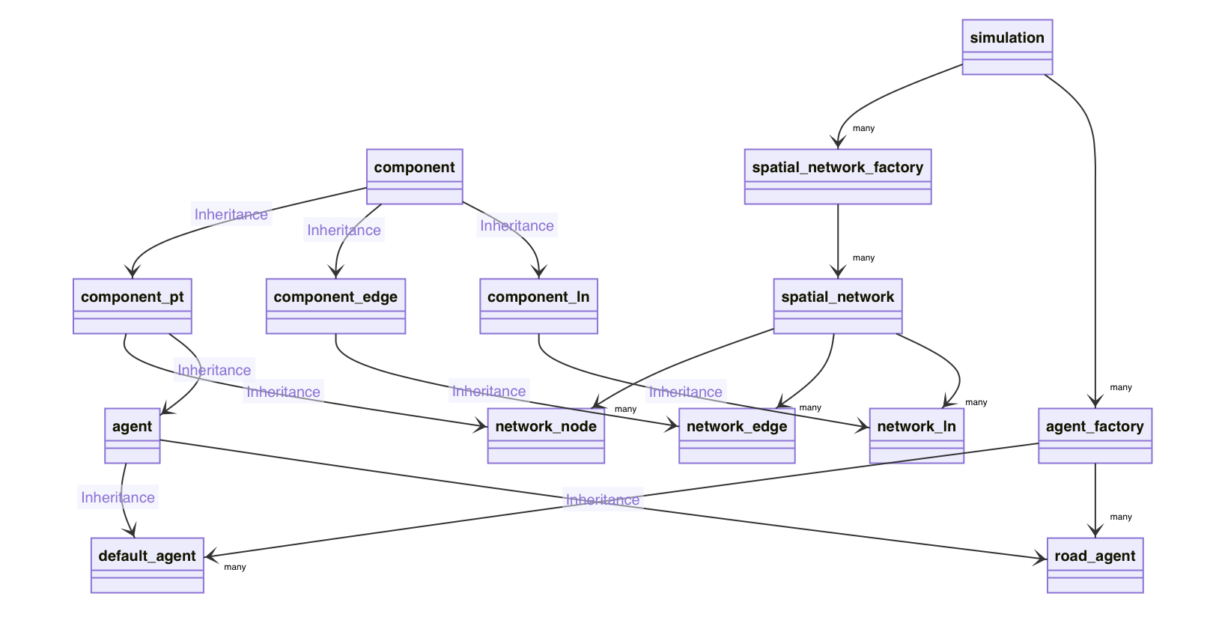
Object-Oriented Design

Slide 7
CyberGIS-ABM Implementation
CyberGIS-ABM
C++
GDAL + OGR, proj4
RapidXML
Cimg
Message Passing Interface (MPI)
Catch2

Slide 8
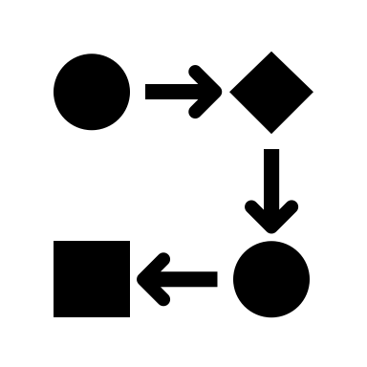
Scaling CyberGIS-ABM
Parallel partitioning using MPI for:
Larger study areas
More agents
More complex agent behavior & interactions
More diverse geospatial data

Slide 9
CyberGIS Architecture
CyberGIS-ABM
HPC
User
CyberGIS-ABM
CyberGIS-Compute
HPC
User
CyberGISX

Slide 10
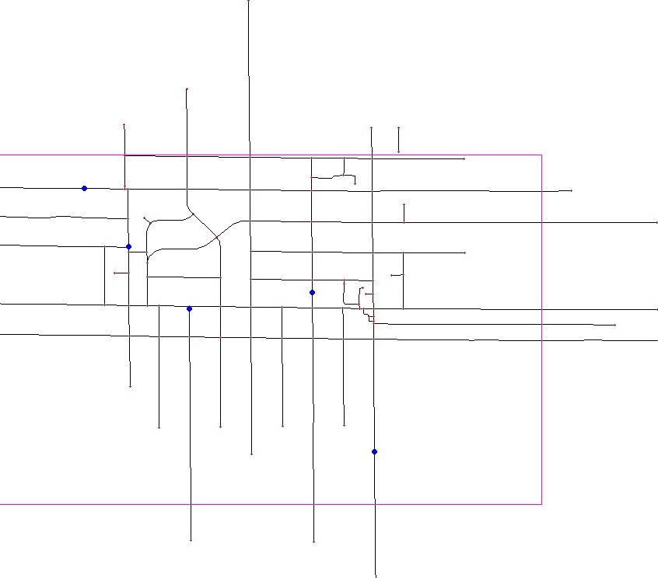
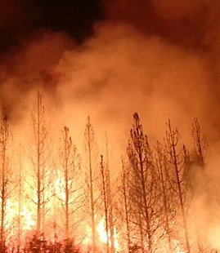
Example: Emergency Evacuation
CyberGIS-ABM
Evacuation Boundary
Agent
Street Geometry

Slide 11
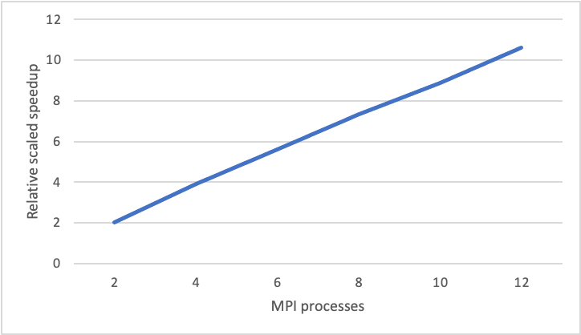
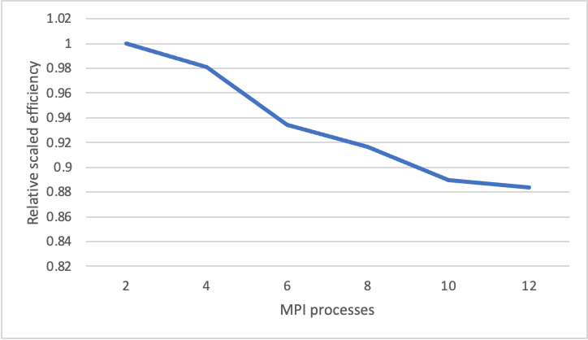
Computational Scalability
Scaled Speedup
Scaled Efficiency
Relative scaled speedup relative to 2-MPI process simulation times (10,000 agents per MPI process, results averaged over 3 simulation executions per setup)
Relative scaled efficiency relative to 2-MPI process simulation times (10,000 agents per MPI process, results averaged over 3 simulation executions per setup)

Slide 12
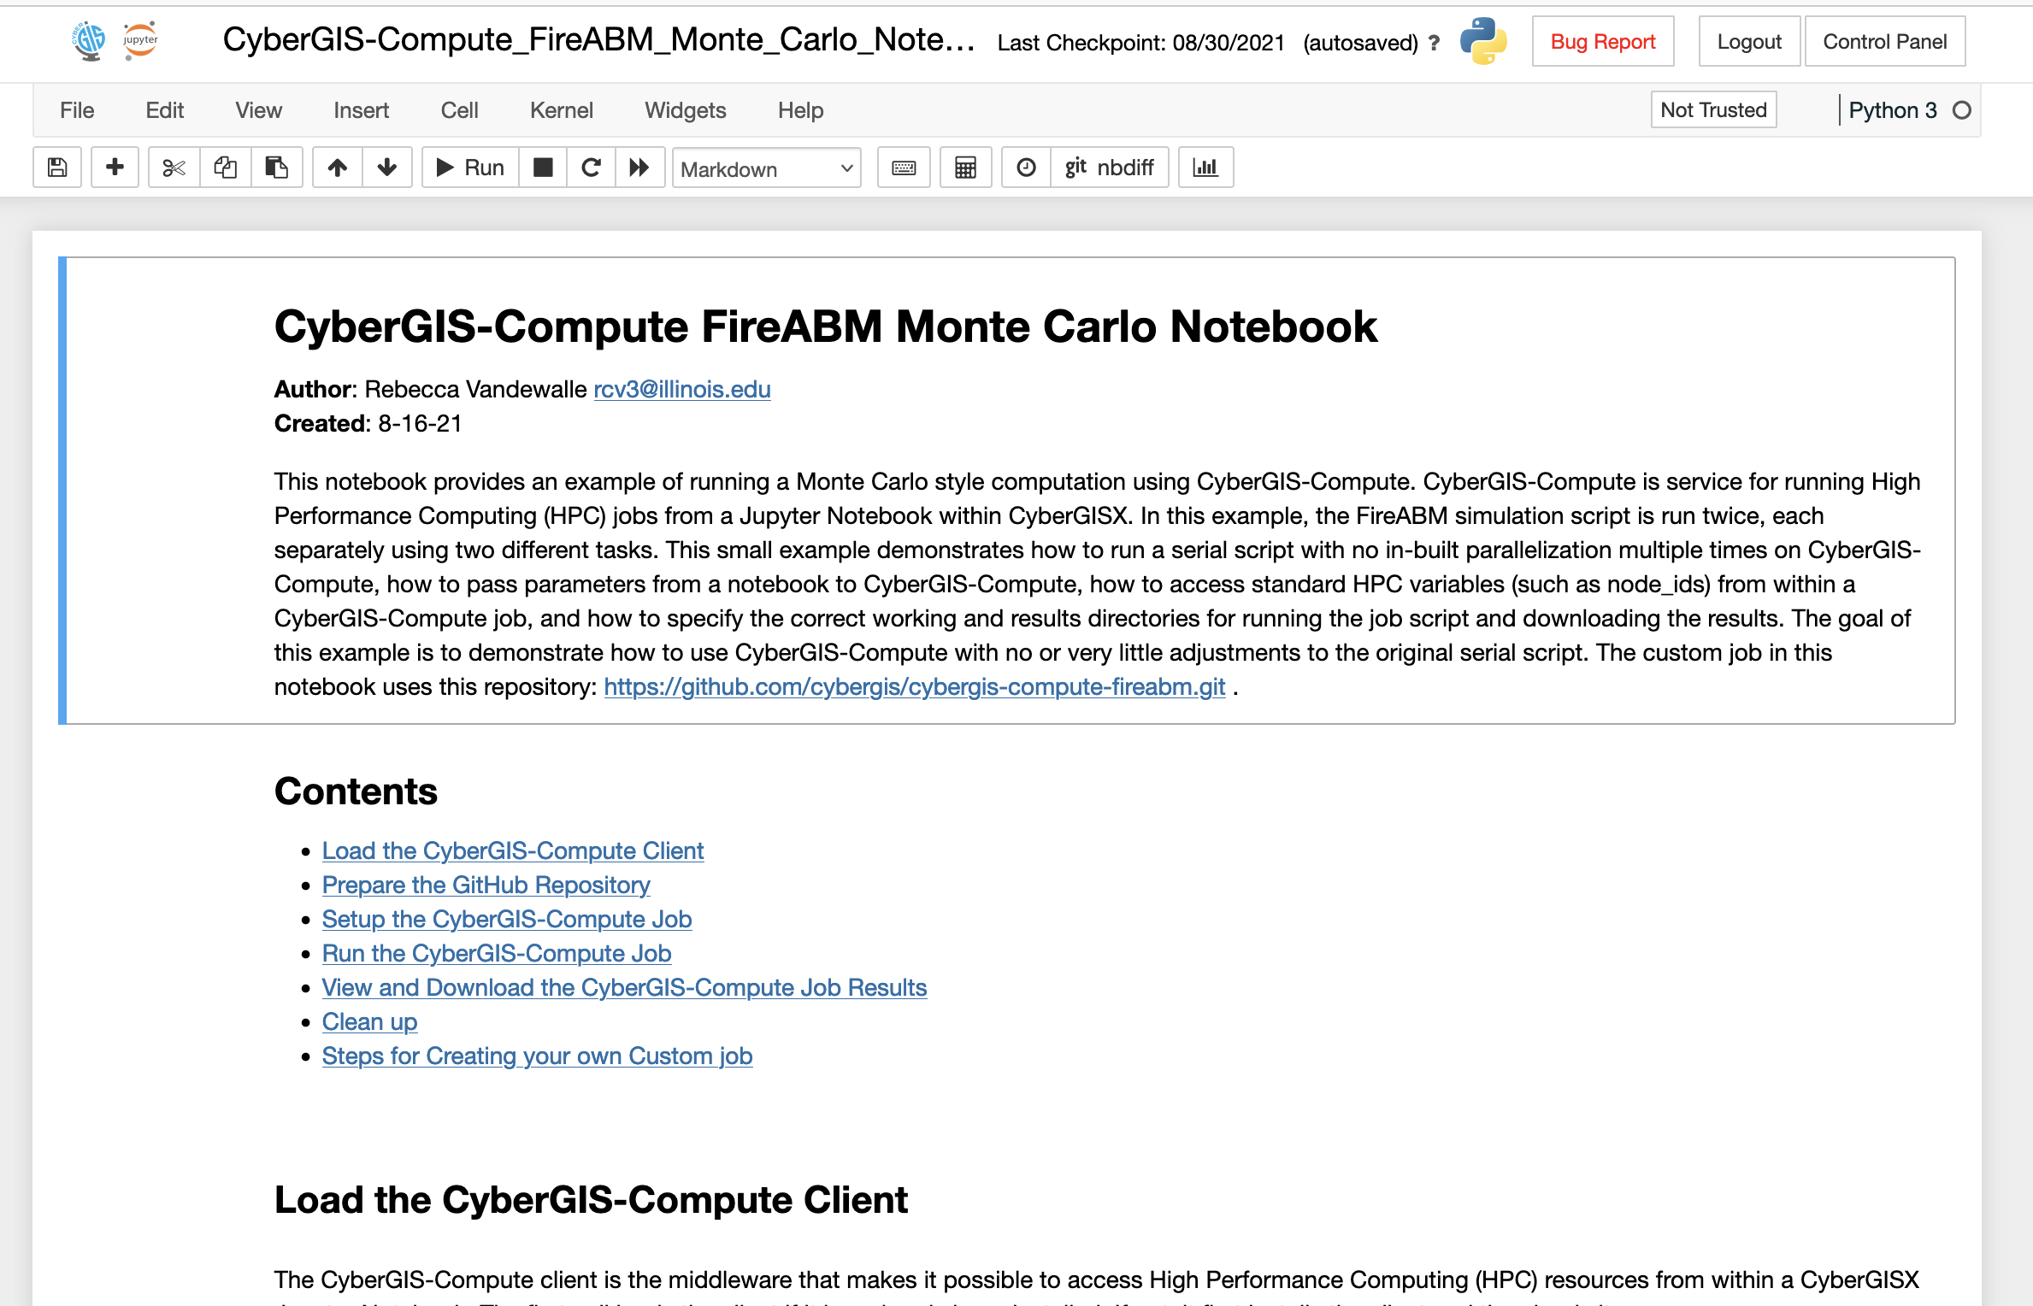
Computational Reproducibility

Slide 13
Summary of Major Contributions
A novel framework for holistically integrating cyberGIS and ABM
A computationally scalable approach to ABM based on spatial network representation
An object-oriented design for high-performance and reusable ABM
Computational reproducibility support based on a cutting-edge cyberGIS platform

Slide 14
What’s Next?
CyberGIS-ABM
Future goals:
Implement dynamic network-based partitioning
Support generalized spatial network-based ABMs

Slide 15
Acknowledgements
CIGI Lab members
Furqan Baig
Zhiyu Li
Alexander Michels
National Science Foundation
2112356
2118329

Slide 16
Thanks!
For questions or comments, contact rcv3@Illinois.edu
Agent-Based Model (ABM)
CyberGIS
(GIS + cyberinfrastructure)

