Slide 1
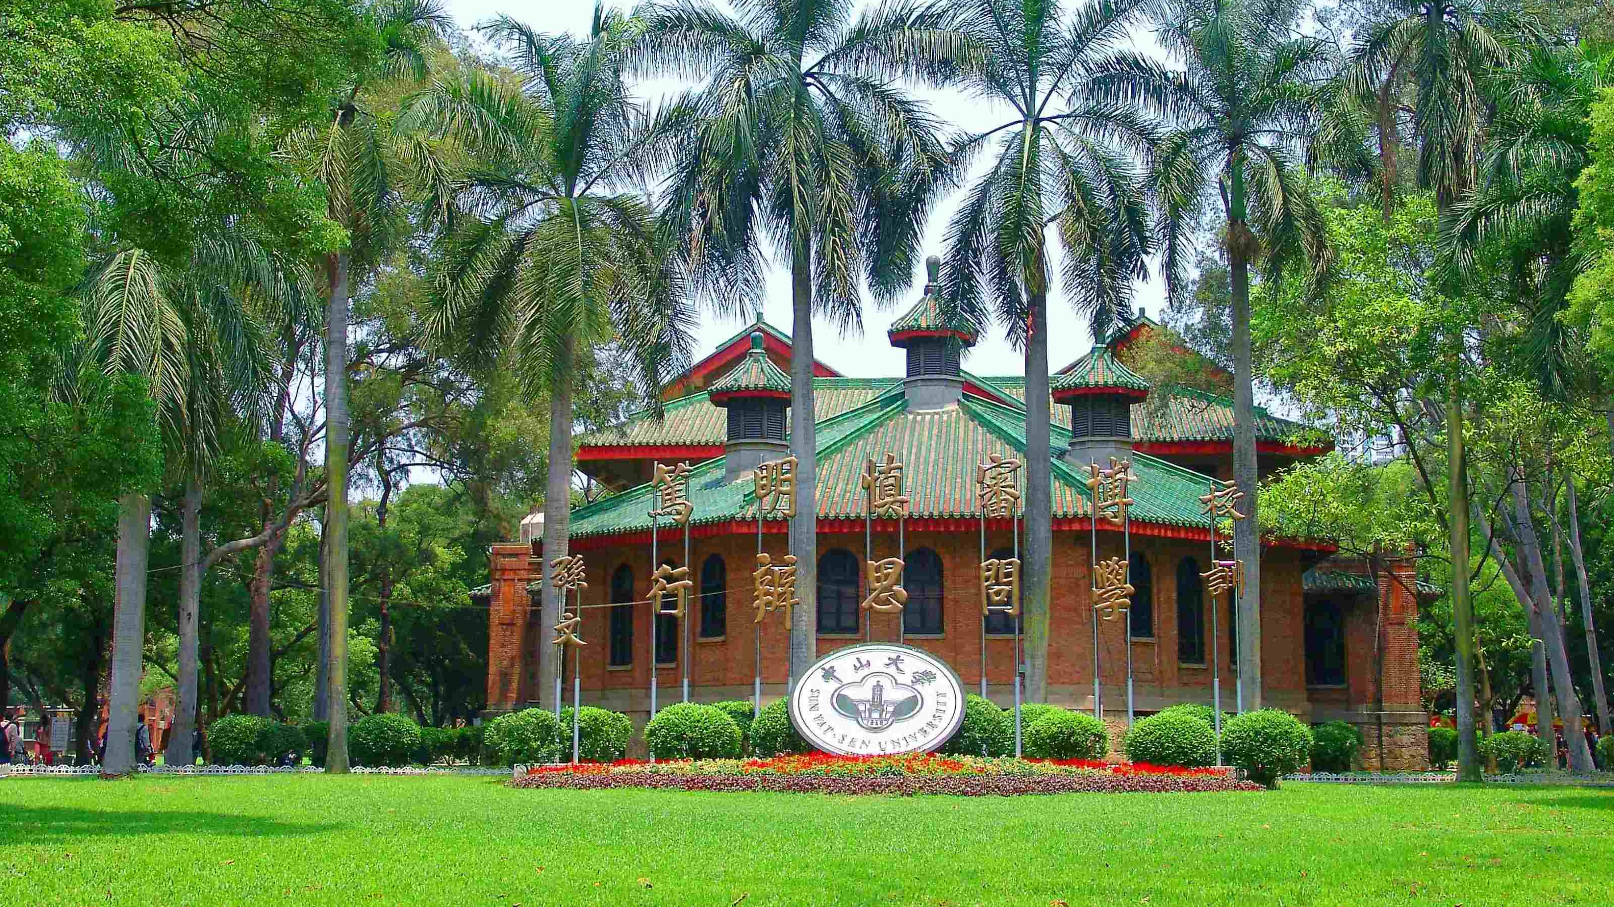
A novel and simple downscaling approach for generating a 250m resolution NDVI database since 1982 at global scale
Zhimin Ma, Chunyu Dong, Mingcong Liang
Center for Water Resources and Environment, School of Civil Engineering, Sun Yat-sen University, Zhuhai 519082, China

Slide 2
Introduction
1 Characteristics of the global coarse-resolution NDVI instruments with more than 10 years of coverage
Instrument | Satellite | Spatial resolution | Time coverage
AVHRR 2 | NOAA-7, 9, 11, 14 | 1.1 km, 0.05°, 1/12° | 1981–2001
AVHRR 3 | NOAA-16, 17, 18, 19 MetOp-A, B, C | 1.1 km, 0.05°, 1/12° | 2000 to present
SeaWiFS | OrbView-2 | 4 km | 1997–2010
SPOT-Vegetation | SPOT 4 and 5 | 1 km | 1998–2013
MODIS | Terra, Aqua | 250 m to 1 km, 0.05° | 2000 to present
TM/ETM+/OLI | Landsat 4, 5, 7, 8 | 30 m | 1972 to present

Slide 3
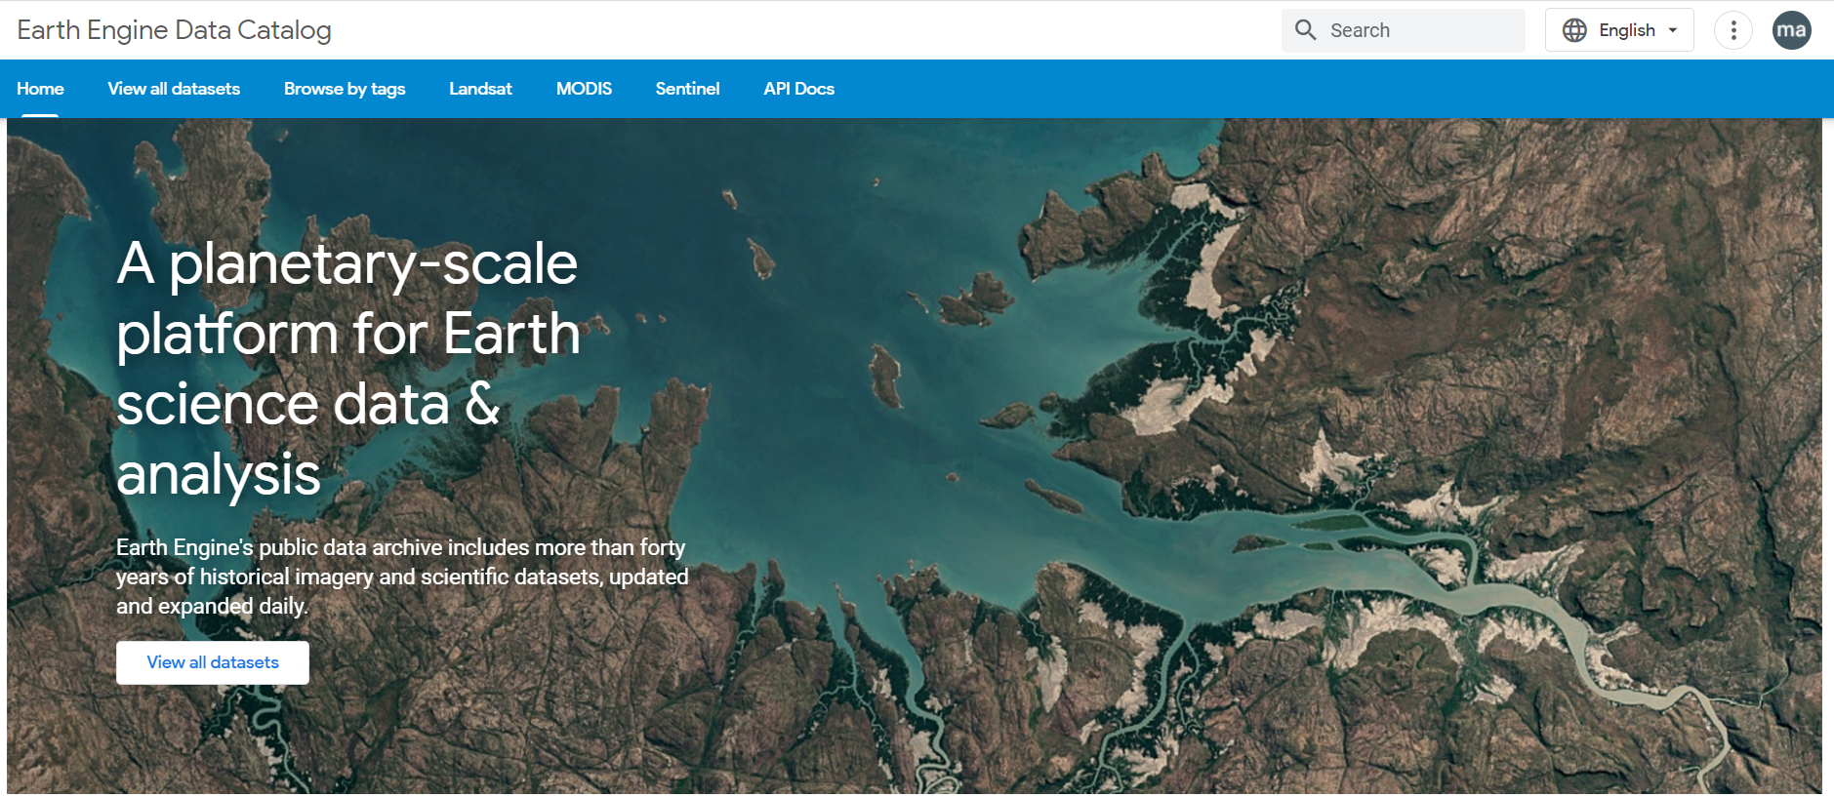
Introduction
2 Google Earth Engine platform
Big data！
Online processing！
View results in time！

Slide 4
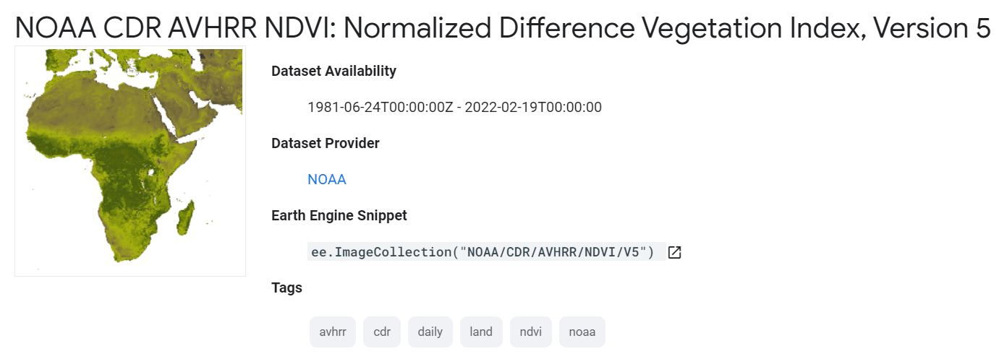
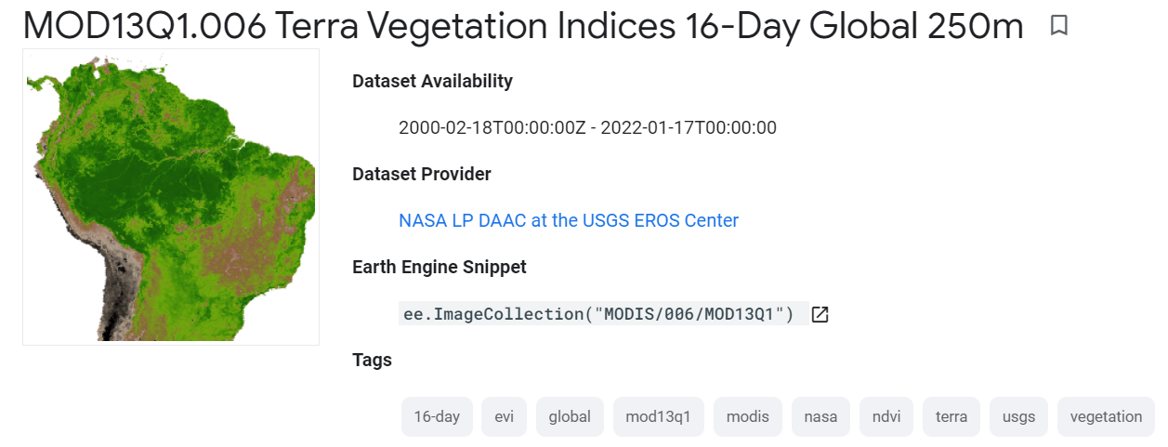
Introduction
2 Google Earth Engine platform
The NOAA Climate Data Record (CDR) of NDVI contains gridded daily NDVI derived from the NOAA AVHRR Surface Reflectance product. It provides a measurement of surface vegetation coverage activity, gridded at a resolution of 0.05° and computed globally over land surfaces.

Slide 5
Method
Daily AVHRR NDVI time series
16-days MODIS NDVI time series
Datasets and
Pre-processing
MCV
Bicubic spatial
interpolation
MCV
Monthly AVHRR NDVI (250-m resolution) from 1982 to 2020
Monthly MODIS NDVI (250-m resolution) from 2001 to 2020
Baseline value filter
The CV value filter
Select the downscaled and MODIS NDVI products from 2016 to 2020
The different monthly median
MODIS- NDVI and AVHRR-NDVI monthly CV
Validation period
(2016-2020)
image.expression()
image.expression()
The $K_{x,y,t}$ about every monthly temporal change
RMSE
MAE
The month-series ${CV}_{x,y}$about spatial change
Pearson(r)
Training period
(1982-2015)
image.expression()
High-quality downscaled NDVI time series from 1982 to 2020

Slide 6
Method
Core Formulas
Temporal information
$$K_{x,y,t}= ({NDVI}_{L,x,y,t} − {NDVI}_{L,x,y,bl}) / {NDVI}_{L,x,y,bl}$$
where ${NDVI}_{L,x,y,t}$ is the pixelwise monthly AVHRR NDVI in the entire time series, and ${NDVI}_{L,x,y,bl}$ is the baseline median NDVI in different months during the training period.
${CV}_{x,y}=MODIS_CV/NOAA_CV$
Spatial information
where $MODIS_CV$ and $NOAA_CV$are respectively the pixelwise monthly coefficients of variation (CV) of the MODIS and AVHRR products.
$${NDVI}_{H,x,y,t} = {NDVI}_{H,x,y,bl} × (1+ {K }_{x,y,t}× {CV}_{x,y}) + {ε }_{x,y,t }$$
where ${NDVI}_{H,x,y,bl}$ is the monthly median MODIS NDVI in the training period (baseline NDVI), and $ε_{x,y,t }$ is the random errors generated in the downscaling process

Slide 7
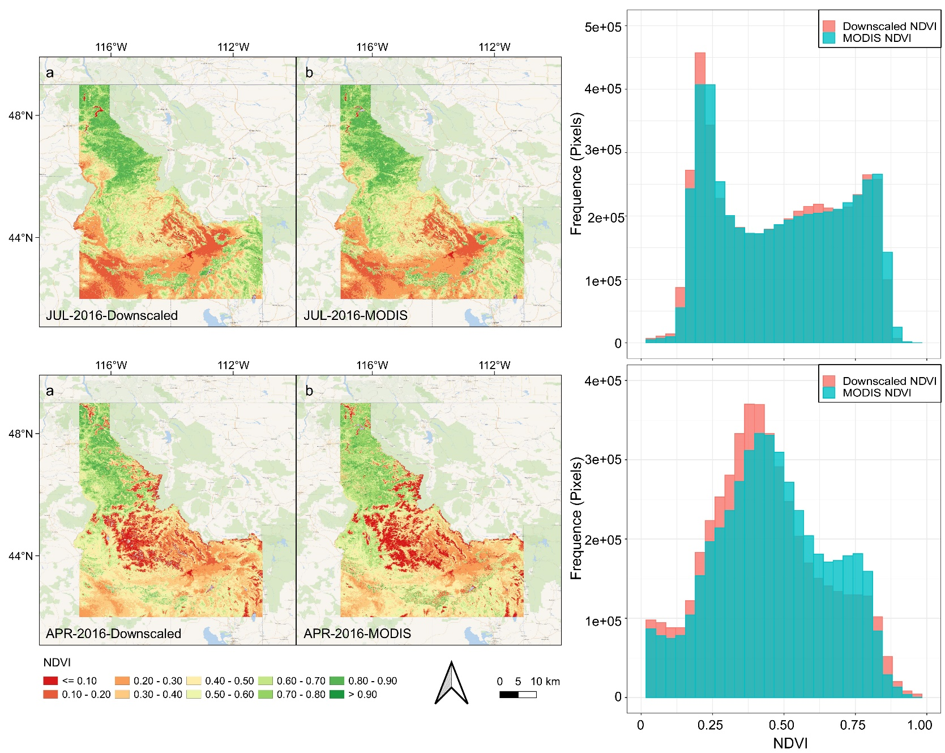
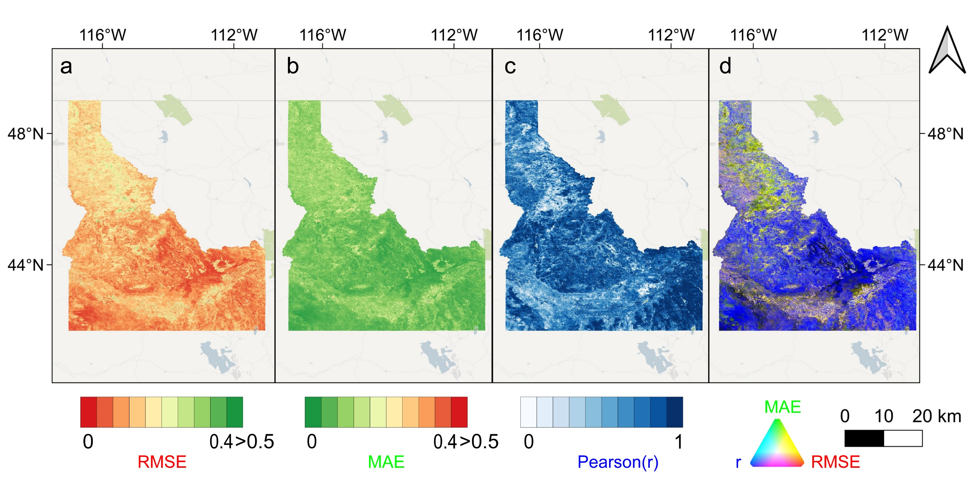
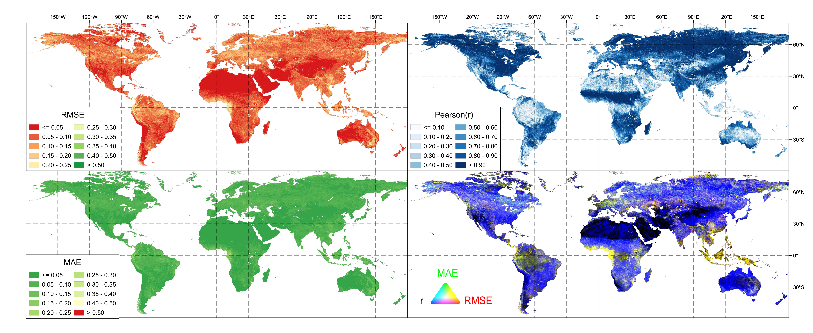
Results and validation
Spatial variation of the goodness of fit indices. (a) RMSE, (b) MAE, (c) Pearson (r), and (d) RGB image of all above three measures (Red: RMSE, Green: MAE, and Blue: Pearson-r)
Spatial variation of the goodness of fit indices. (a) RMSE, (b) MAE, (c) Pearson (r), and (d) RGB image of all above three measures (Red: RMSE, Green: MAE, and Blue: Pearson-r)
Maps of NDVI compared between downscaled and MODIS datasets for April and July in 2016

Slide 8
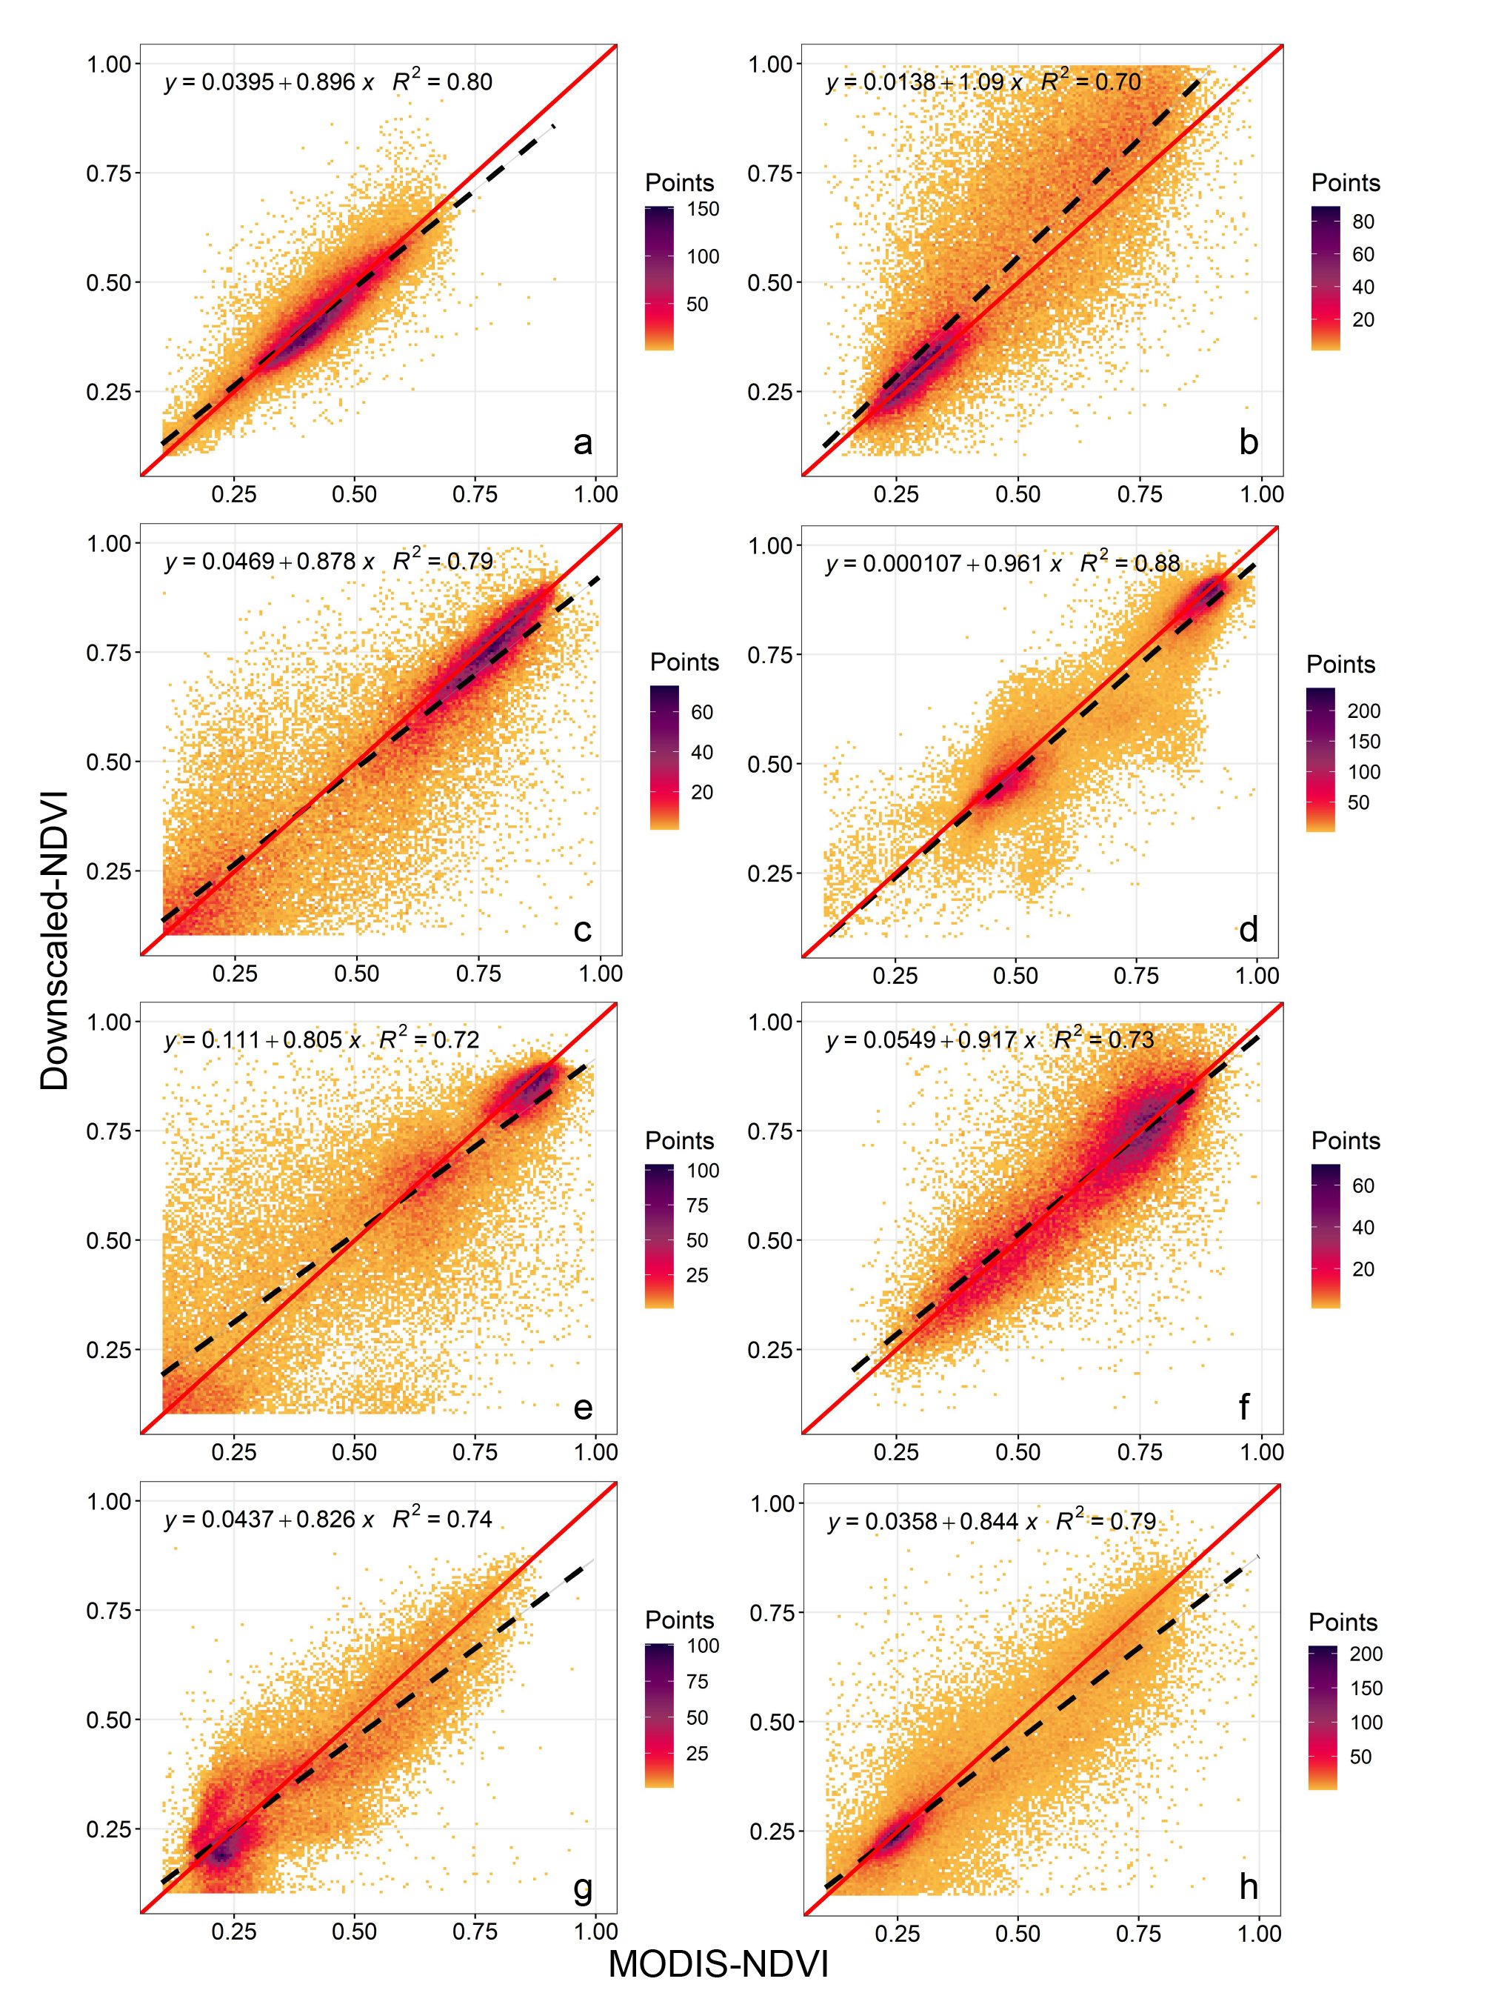
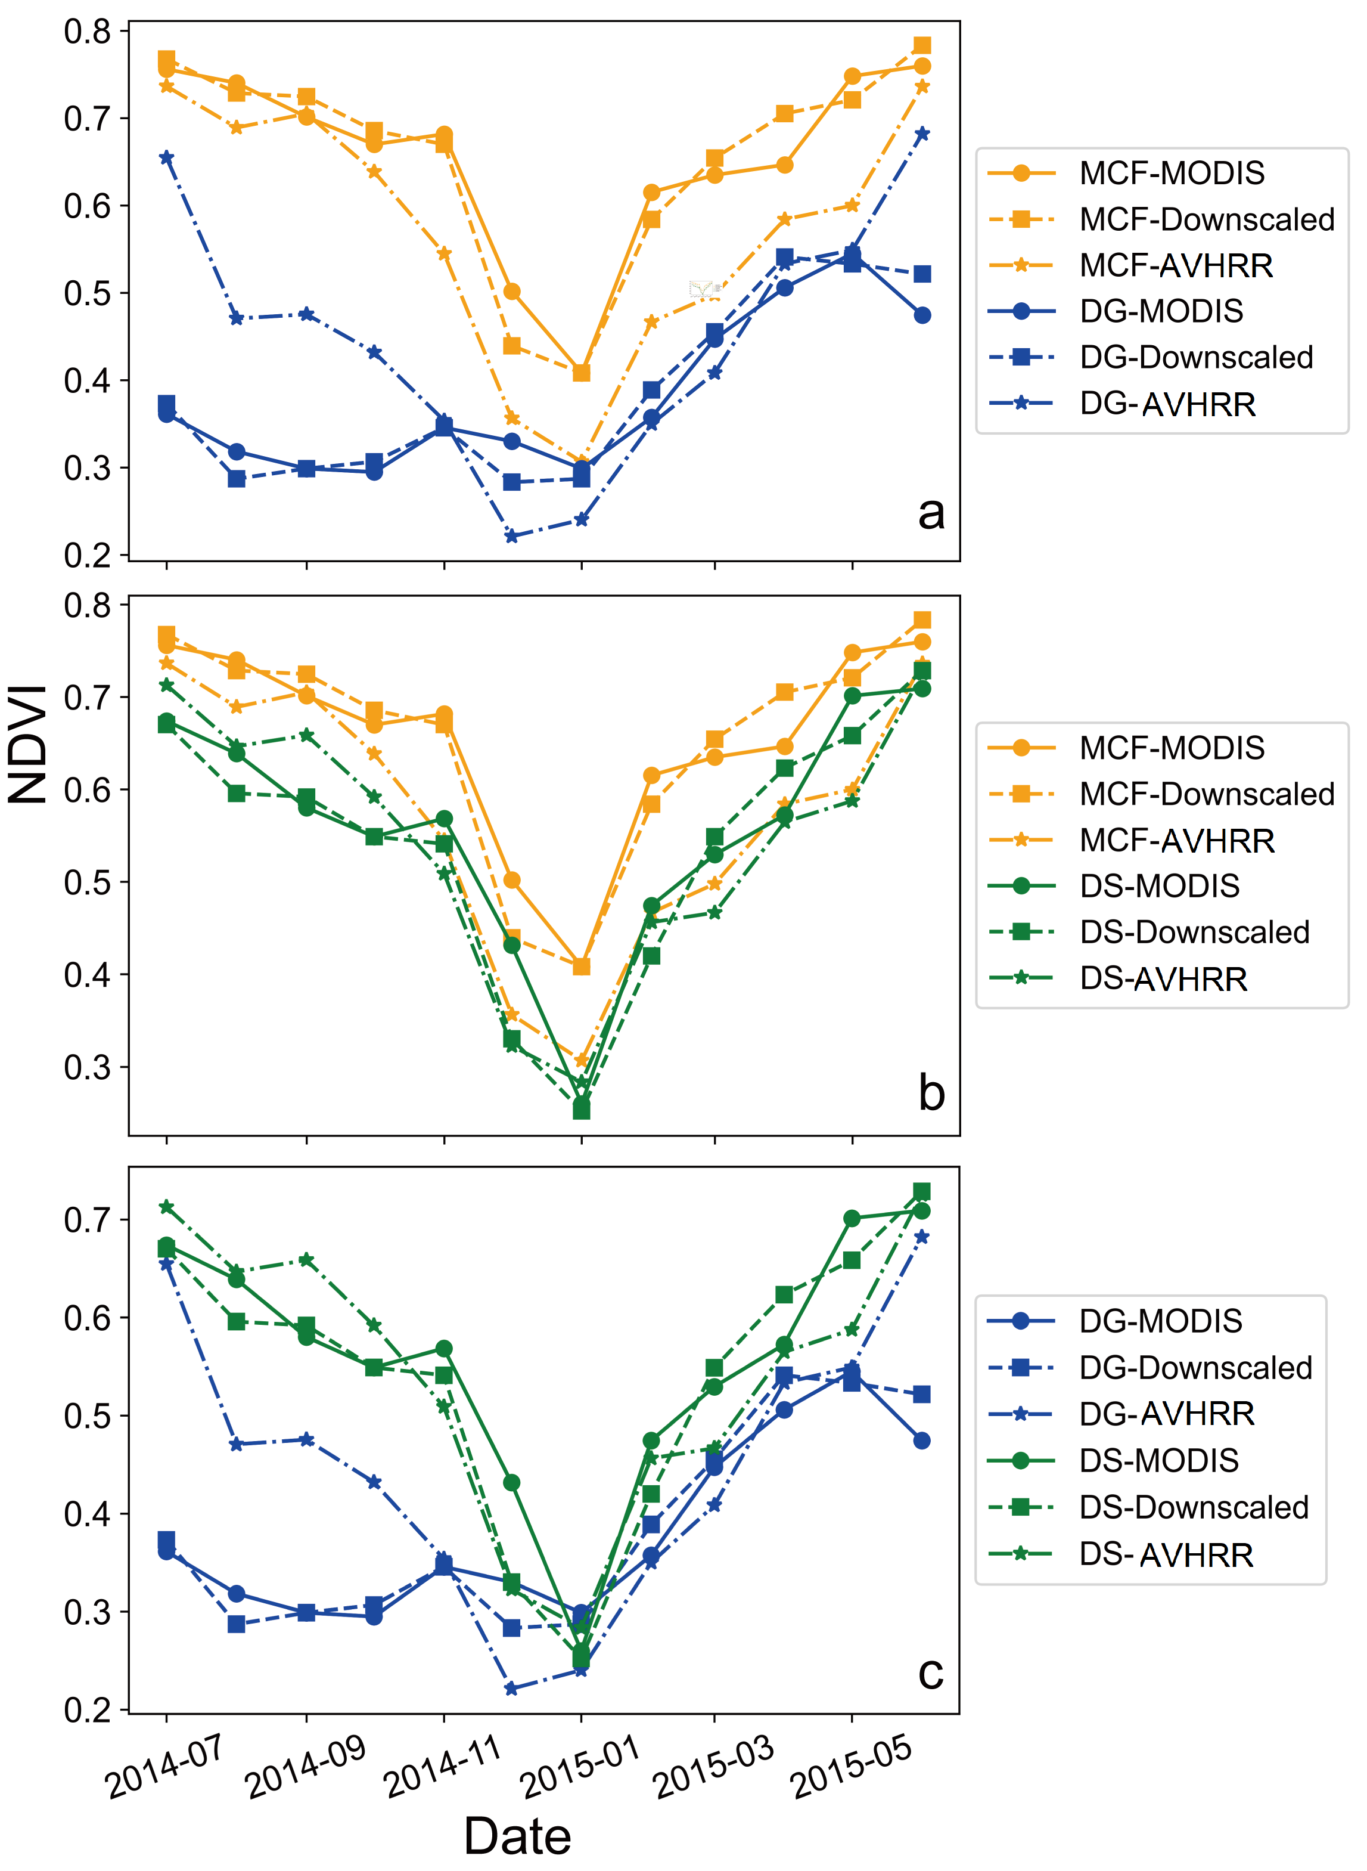
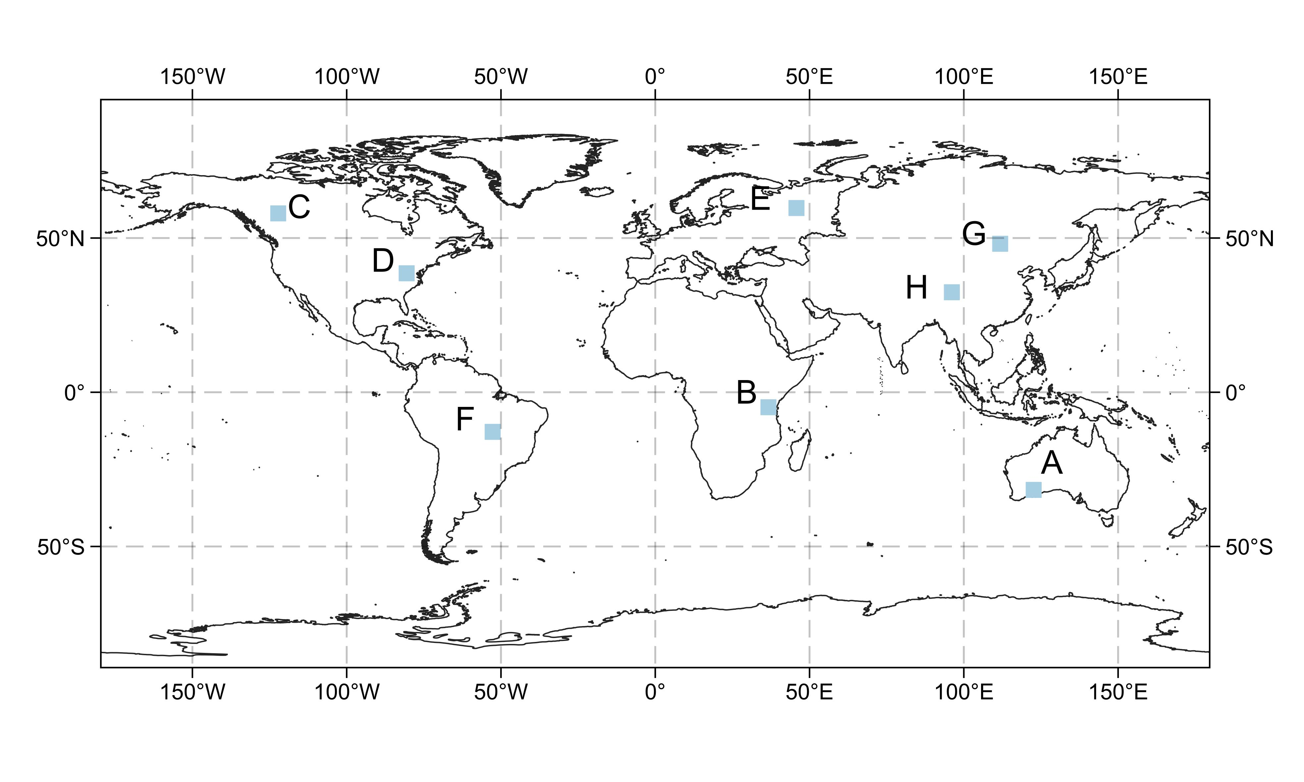
Results and validation
The correlation verification between downscaled and MODIS NDVI for different vegetation types
Locations of the eight selected verification areas that have eight representative vegetation types
Performance comparison of the three NDVI datasets for distinguishing different vegetation types

Slide 9
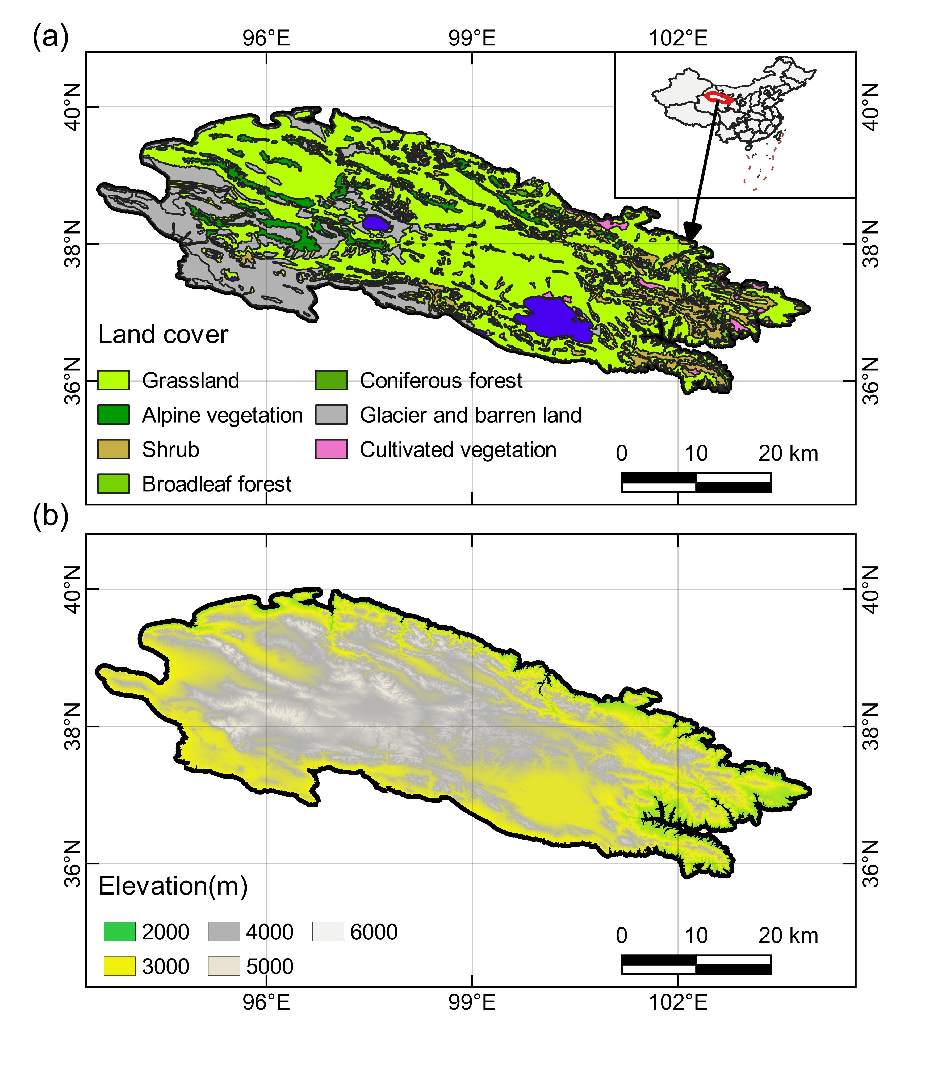
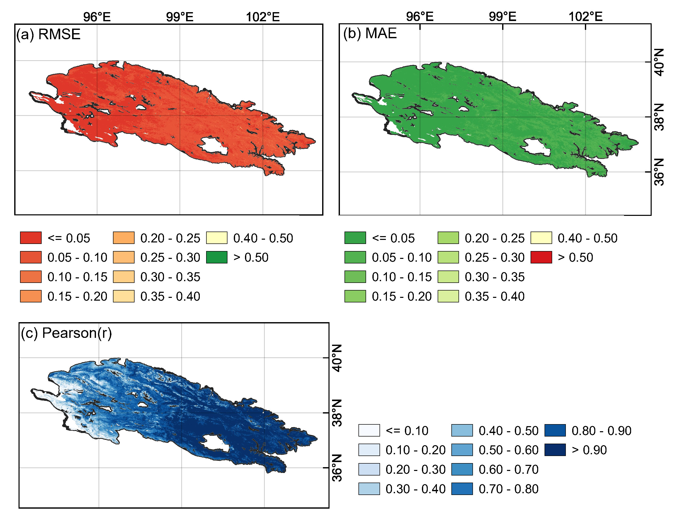
Practical research applications
Geographic location of QLMs with the distribution of vegetation (a), and elevation distribution (b)
Spatial variation of the goodness of fit indices

Slide 10
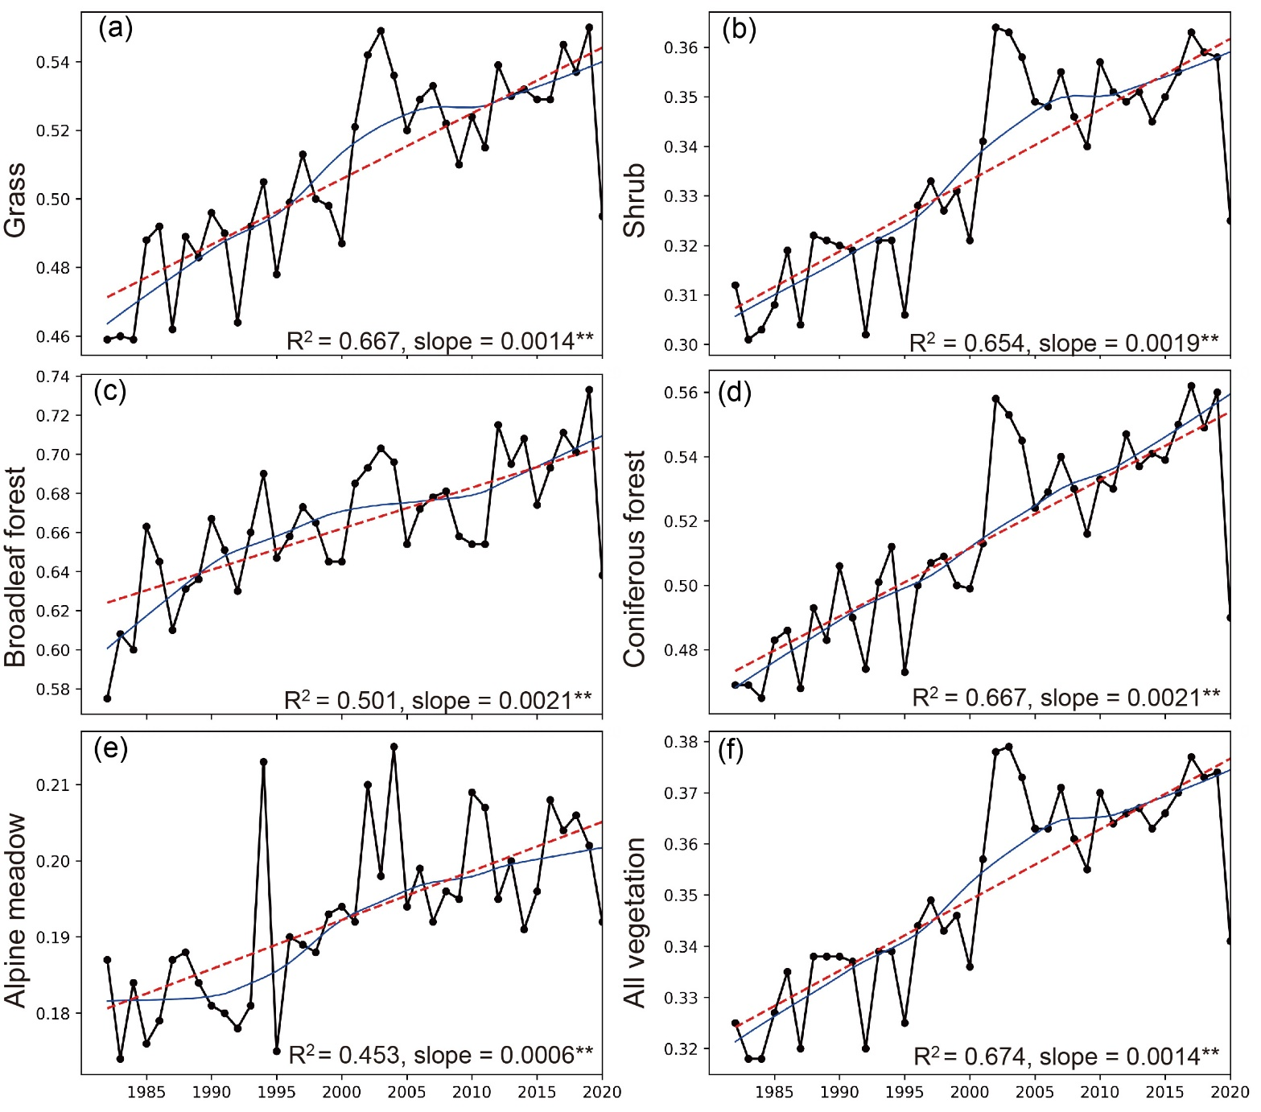
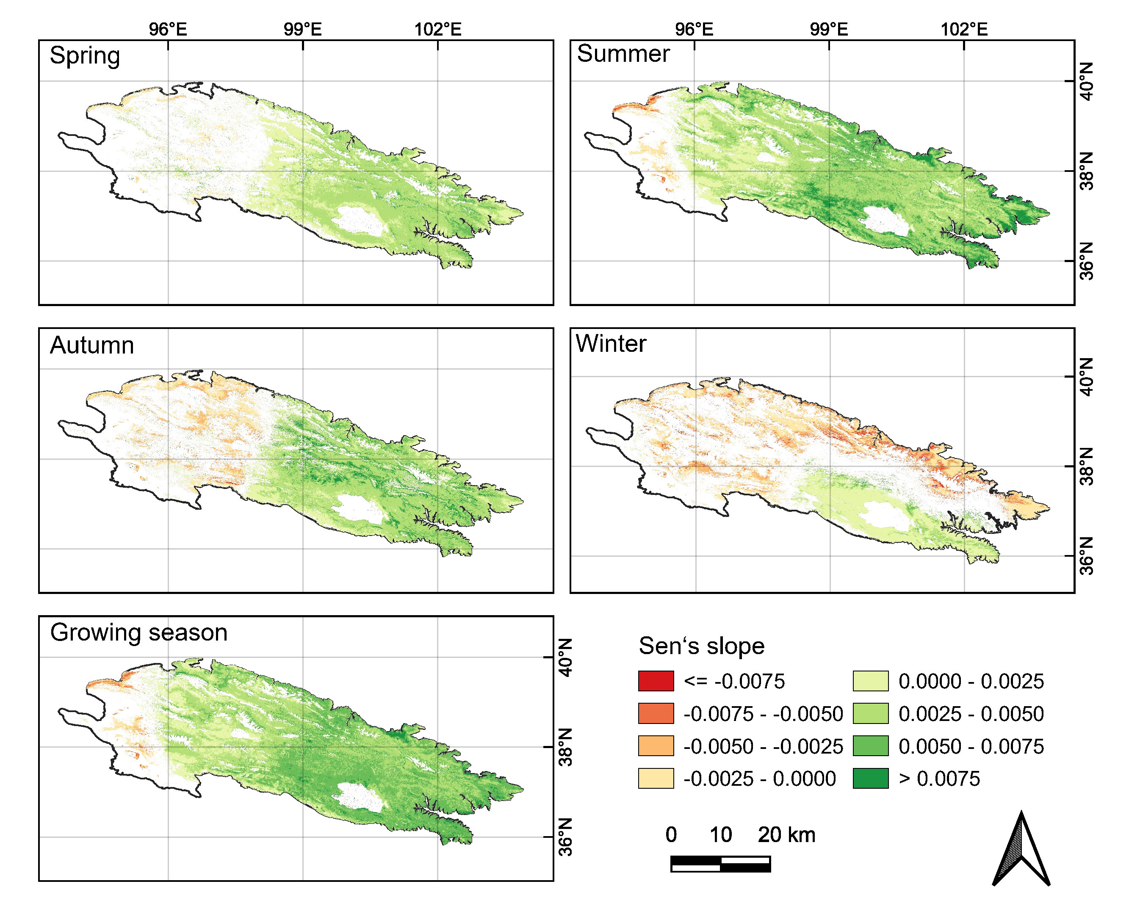
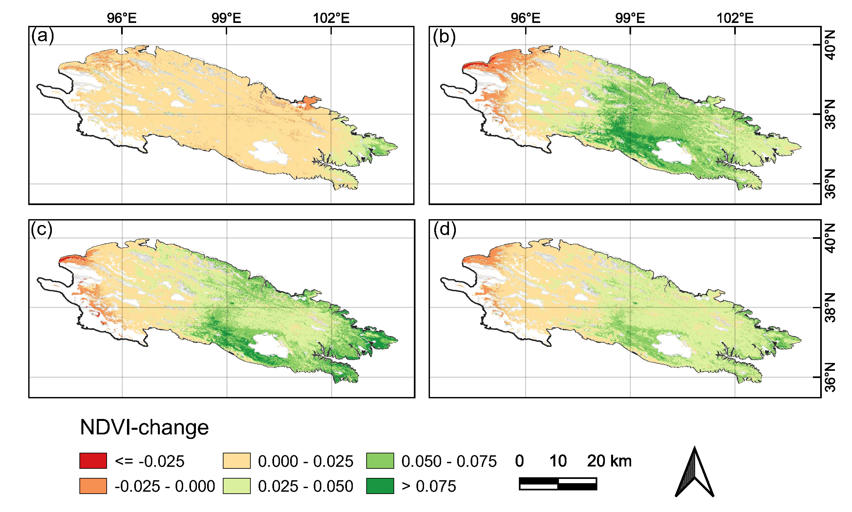
Practical research applications
Interannual NDVI in QLMS over the period 1982–2020 with different vegetation types. The linear trend (red dashed lines) is based on Ordinary Least Square while the nonlinear trend (blue solid lines) is fitted by LOWESS
Spatial distribution of long-term NDVI Sen’s slope for four seasons and growing season during the period 1982-2020 and the results represent the trends are significant (p<0.05)
The spatial distribution of interdecadal cumulative change of NDVI, (a) from 1992 to 2001, (b) from 2002 to 2011, (c) from 2012 to 2020, (d) from 1992 to 2020

Slide 11
Thanks for listening!

