Slide 1
Fine resolution air quality dynamics related to socioeconomic and land use factors in the most polluted desert metropolitan in the American Southwest
Yubin Li
Soe W. Myint
Arizona State University

Slide 2
Introduction
Burning fossil fuels
Greenhouse gas emission
Air pollution
Urbanization
55% of global population lived in the urban area in 2018
68% expected by 2050

Slide 3
Introduction
Air pollution
Health problems
Lung cancer, cardiovascular diseases, respiratory diseases, heart diseases, etc.
Urban area
Higher volume of hospital intake with air pollution related diseases in urbanized cities

Slide 4
Introduction
Aerosol Optical Depth (AOD)
Measures the sunlight that is blocked by aerosol particles suspended in the atmosphere

Slide 5
Introduction
Aerosol Optical Depth (AOD)
Measures the sunlight that is blocked by aerosol particles suspended in the atmosphere
Data availability
Aerosol Robotic NETwork (AERONET)

Slide 6
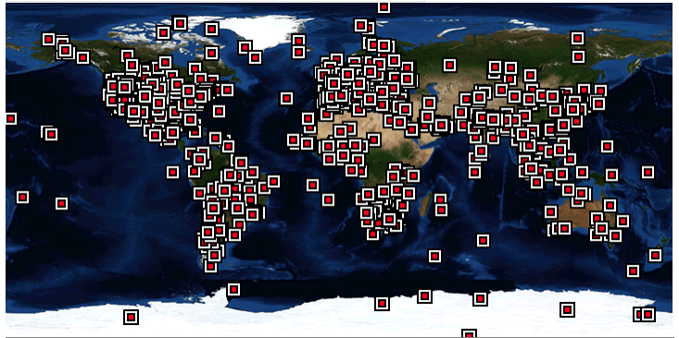
Introduction
Aerosol Optical Depth (AOD)
Measures the sunlight that is blocked by aerosol particles suspended in the atmosphere
Data availability
Aerosol Robotic NETwork (AERONET)

Slide 7
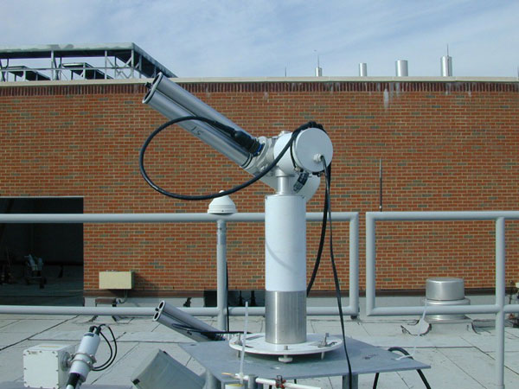
Introduction
Aerosol Optical Depth (AOD)
Measures the sunlight that is blocked by aerosol particles suspended in the atmosphere
Data availability
Aerosol Robotic NETwork (AERONET)

Slide 8
Introduction
Aerosol Optical Depth (AOD)
Measures the sunlight that is blocked by aerosol particles suspended in the atmosphere
Data availability
Aerosol Robotic NETwork (AERONET)
Total Ozone Mapping Spectrometer (TOMS)
Multi-angle Imaging Spectro-Radiometer (MISR)
MODerate Resolution Imaging Spectrometer (MODIS)

Slide 9
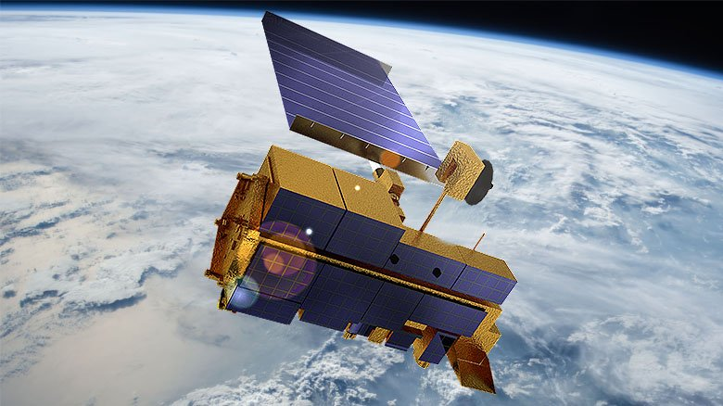
Introduction
Aerosol Optical Depth (AOD)
Measures the sunlight that is blocked by aerosol particles suspended in the atmosphere
Data availability
Aerosol Robotic NETwork (AERONET)
Total Ozone Mapping Spectrometer (TOMS)
Multi-angle Imaging Spectro-Radiometer (MISR)
MODerate Resolution Imaging Spectrometer (MODIS)

Slide 10
Introduction
Environmental inequality in Phoenix
In 1999
Model-based Ozone, CO, NO distribution VS. socioeconomic status, race, immigrant status
In 2008 and 2010,
Ground station monitoring data of PM₁₀ and Ozone VS. income, age, race, ethnicity

Slide 11
Objectives
Generate
Generate 30 m resolution AOD for 2000 and 2010
Evaluate
Evaluate environmental inequality of air pollution exposure among different socioeconomic status groups
Analyze
Analyze the differences of AOD variation in 2000 and 2010 among different land cover types

Slide 12
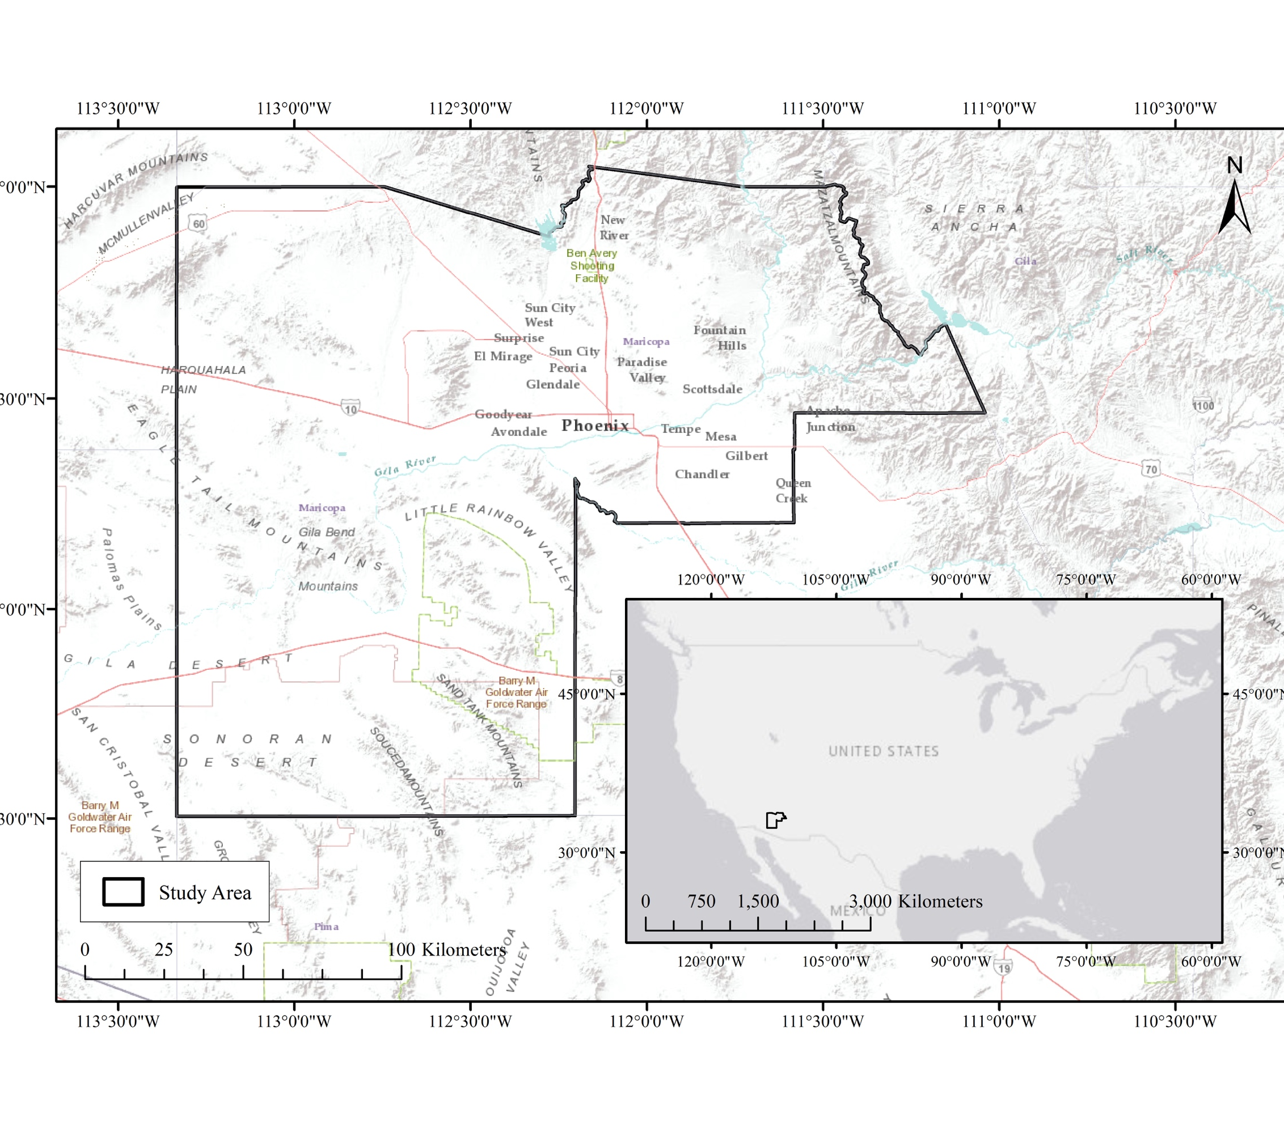
Study Area
Maricopa County
Phoenix, Mesa, Scottsdale, Tempe, Chandler, etc.
Fastest growing state in the US, 4th most populous county since 2000
Most polluted area

Slide 13
Methods
Data
Generate AOD
All available Landsat 5 images in 2000 and 2010
All available AERONET Maricopa station measurement in 2000 and 2010

Slide 14
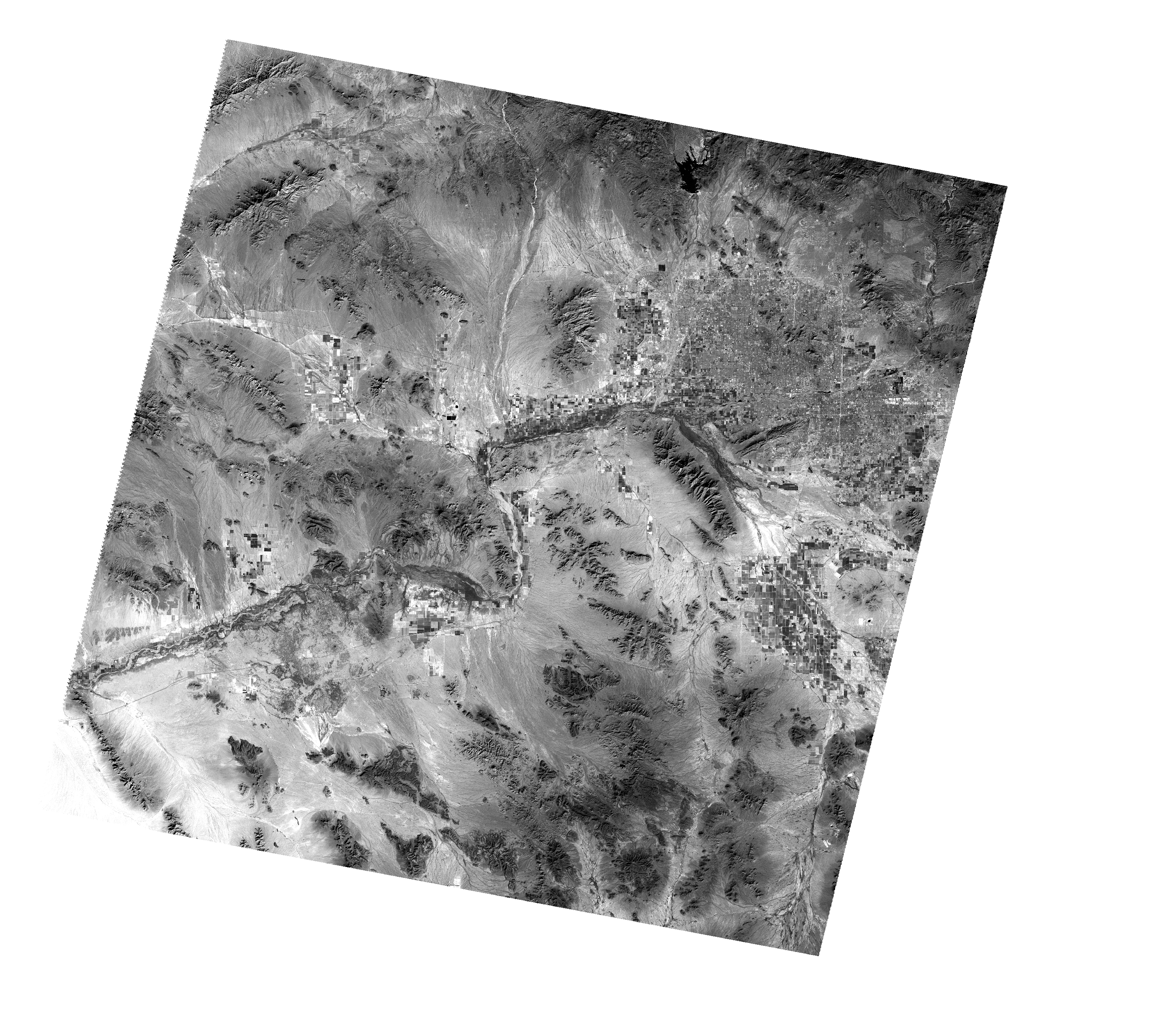
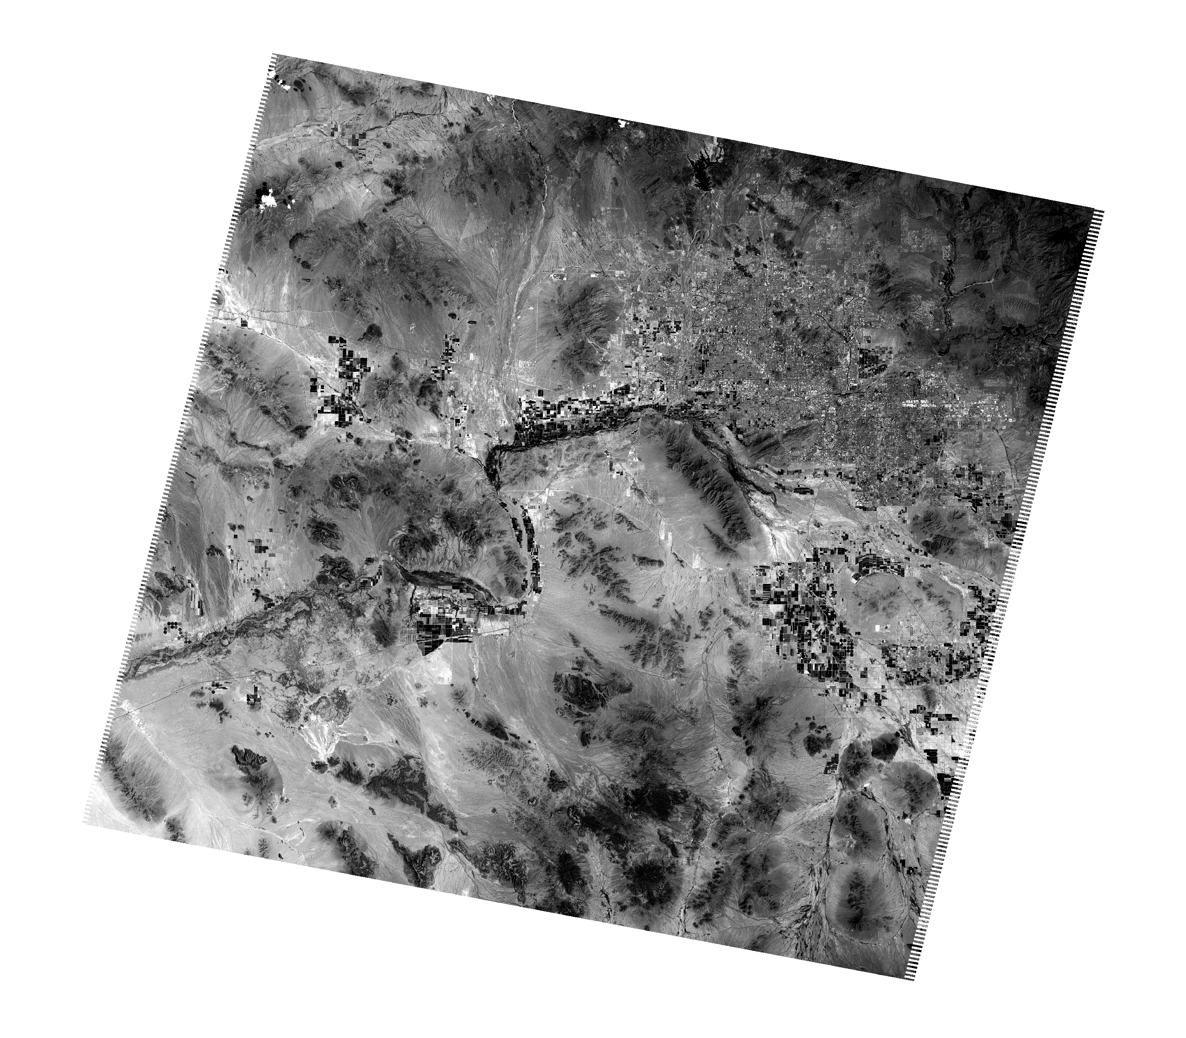
2000 Landsat 5
2010 Landsat 5

Slide 15
Year | Landsat Product Identifier | Year | Landsat Product Identifier
2000 | LT05_L1TP_037037_20000326_20160918_01_T1 | 2009 | LT05_L1TP_037037_20090506_20160905_01_T1
 | LT05_L1TP_037037_20000411_20160918_01_T1 |  | LT05_L1TP_037037_20090607_20160905_01_T1
 | LT05_L1TP_037037_20000427_20160918_01_T1 |  | LT05_L1TP_037037_20090623_20160905_01_T1
 | LT05_L1TP_037037_20000513_20160918_01_T1 |  | LT05_L1TP_037037_20090725_20160903_01_T1
 | LT05_L1TP_037037_20000529_20160918_01_T1 |  | LT05_L1TP_037037_20090810_20160903_01_T1
 | LT05_L1TP_037037_20000614_20160918_01_T1 |  | LT05_L1TP_037037_20090911_20160905_01_T1
 | LT05_L1TP_037037_20000716_20160918_01_T1 |  | LT05_L1TP_037037_20091013_20160903_01_T1
 | LT05_L1TP_037037_20000801_20160918_01_T1 |  | LT05_L1TP_037037_20091029_20160903_01_T1
 | LT05_L1TP_037037_20000817_20160918_01_T1 |  | LT05_L1TP_037037_20091114_20160902_01_T1
 | LT05_L1TP_037037_20000902_20160918_01_T1 |  | LT05_L1TP_037037_20091130_20160902_01_T1
 | LT05_L1TP_037037_20001004_20160918_01_T1 |  | LT05_L1TP_037037_20091216_20160903_01_T1
 | LT05_L1TP_037037_20001020_20160918_01_T1
 | LT05_L1TP_037037_20001207_20160918_01_T1
 | LT05_L1TP_037037_20001223_20160918_01_T1
2001 | LT05_L1TP_037037_20010108_20160918_01_T1 | 2010 | LT05_L1TP_037037_20100202_20160901_01_T1
 | LT05_L1TP_037037_20010124_20160918_01_T1 |  | LT05_L1TP_037037_20100306_20160901_01_T1
 | LT05_L1TP_037037_20010209_20160918_01_T1 |  | LT05_L1TP_037037_20100322_20160902_01_T1
 | LT05_L1TP_037037_20010313_20160918_01_T1 |  | LT05_L1TP_037037_20100407_20160901_01_T1

Slide 16
Methods
Data
Socio-economic parameters (U.S. Census Bureau)
Population
Per capita income
Median household income
Median housing value

Slide 17
Methods
Data
Normalized Difference Vegetation Index (NDVI)
NDVI indicates robustness of vegetation
Calculated based on Landsat 5
NDVI 2010

Slide 18
Methods
Data
Land use and land cover types
Central Arizona – Phoenix Long-Term Ecological Research (CAP LTER) land cover map at 30 m resolution

Slide 19
Methods
Data
Land use and land cover types
National Land Cover Database (NLCD) at 30 m

Slide 20
Methods
Generating AOD
Simplified high resolution Aerosol Retrieval Algorithm (SARA) (Bilal, et al., 2013)
$τ_{a}=\frac{4μ_{s}μ_{v}}{ω_{0}ρ_{a\left(θ_{s}, θ_{v}, φ\right)}}\left[ρ_{TOA\left(λ, θ_{s}, θ_{v}, φ\right)}−ρ_{Ray\left(λ, θ_{s}, θ_{v}, φ\right)}−\frac{e^{−\frac{τ_{R}+ τ_{a}}{μ_{s}}}e^{−\frac{τ_{R}+ τ_{a}}{μ_{v}}}ρ_{s\left(λ, θ_{s}, θ_{v}, φ\right)}}{1−ρ_{s\left(λ, θ_{s}, θ_{v}, φ\right)}(\left(0.92τ_{R}+\left(1−g\right)τ_{a}\right)exp\left[−\left(τ_{R}+ τ_{a}\right)\right])}\right]$
Bilal, M., Nichol, J. E., Bleiweiss, M. P., & Dubois, D. 2013. A Simplified high resolution MODIS Aerosol Retrieval Algorithm (SARA) for use over mixed surfaces. Remote Sensing of Environment. 136, 135-145.

Slide 21
Results
AOD in 2000 and 2010

Slide 22
Results
AOD in 2000 (top) and 2010 (bottom)
Population increased by 24%
Higher aerosol accumulation at more urbanized block groups

Slide 23
Results
 | 2000 AOD |  | 2010 AOD
 | Coefficient | R | Coefficient | R
Population Density | NS | NS | NS | NS
Per Capita Income | -0.0011* | -0.011 | -0.0007* | -0.19
Median Household Income | -0.0013* | -0.016 | -0.0005* | -0.07
Median Housing Value | -0.0014* | -0.016 | -0.0010* | -0.04
Note: * = significance < 0.01 NS = Not Significant
Socioeconomic and AOD
Relationship between AOD and population density was not significant
AOD and per capita income, median household income, and median housing value were all negatively correlated

Slide 24
Results
Urban development and AOD
High intensity: 80% to 100%
Medium intensity: 50% to 79%
Low intensity: 20% to 49%
Open space: parks, golf courses, single-family houses
 | 2000 | 2010
Developed Open Space | -0.019* | -0.015*
Developed Low Intensity | -0.015* | -0.014*
Developed Medium Intensity | -0.013* | -0.015*
R² | 0.054 | 0.07
Note: * = significance < 0.01 Note: Developed high intensity land cover is the reference category

Slide 25
Results
Land cover types and AOD
Vegetation
Lowest AOD
Highest percentage increase of AOD (21%)
 | 2000 | 2010
Crop | 0.013* | 0.012*
Residential | 0.025* | 0.020*
Soil/Desert | 0.017* | 0.013*
Urban Mixture | 0.028* | 0.023*
R² | 0.092 | 0.101
Note: * = significance < 0.01 Note: vegetation is the reference category

Slide 26
Results
NDVI and AOD
NDVI < 0.1 eliminated
Significant negative correlation

Slide 27
Discussion
Socioeconomic inequalities
Financially deprived population are more vulnerable
AOD negatively correlated to NDVI
Housing value and proximity to green spaces
Vegetation maintenances are expensive

Slide 28
Discussion
Vegetation had highest AOD percentage increase

Slide 29
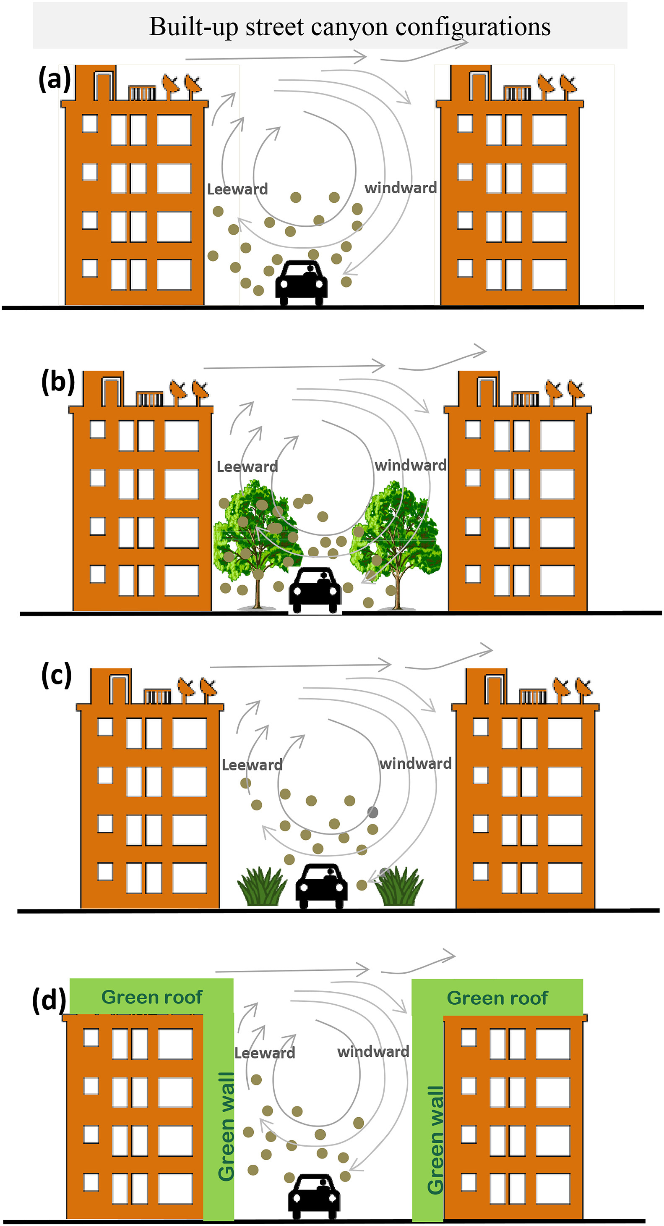
Discussion
Vegetation had highest AOD percentage increase

Slide 30
Discussion
Vegetation had highest AOD percentage increase
Tree species, placement, impervious surface configuration are critical
Vegetation cover in Phoenix accumulates more air pollutants, needs careful evaluation

Slide 31
Discussion
Policies and regulations
Lowered allowable daily PM_{2.5} concentration (2006)
Woodburning regulation (revised in 1999 and 2008)
Restricts outdoor woodburning when air quality exceeds standard level
Reduce greenhouse gas emission by 5% (adopted in 2008)
Advanced methane collection at landfills, solar energy, improved building efficiency
Decreased AOD over impervious surfaces

Slide 32
Conclusion
Significant socioeconomic inequalities found in both 2000 and 2010
Air quality improved over impervious surfaces (entire Maricopa county)
Successful employment of environmental regulation and policies
Air quality worsened over vegetation surfaces (central region of Maricopa county)
Raises concern for green infrastructure planning

Slide 33
Thank you.
Li, Y., & Myint, S. W. (2021). Fine resolution air quality dynamics related to socioeconomic and land use factors in the most polluted desert metropolitan in the American Southwest. Science of The Total Environment, 788, 147713.

