Slide 1
A modular machine learning Platform for Resilience Inference Measurement and Enhancement
Debayan Mandal, Binbin Lin, Bing Zhou, Heng Cai, Joynal Abedin, Mingzheng Yang, Lei Zou*

Slide 2
2020 gave us a reality check of how vulnerable the world is to a global catastrophe
More than 100 disasters during first 6 months
More than 50 million people affected
More than 10 different types of disasters affecting 250000 people by climate and weather disasters

Slide 3
Past 10 years, 83% of all disasters triggered by natural hazards were by extreme climate events – floods, storms, heatwaves
Number of disasters have risen from 1990s by 35%
Killed more than 410000 people during the past ten years
Affected more than 1.7 billion people worldwide

Slide 4
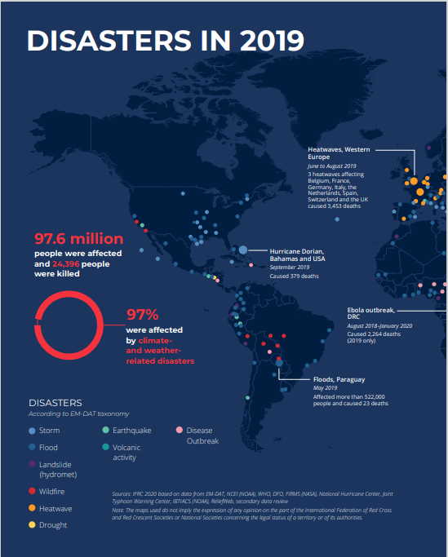
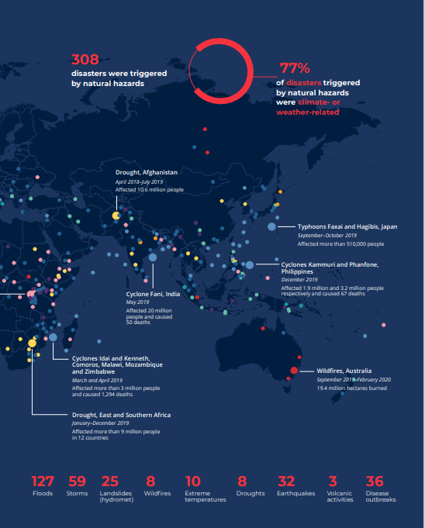
Notes:
Add source

Slide 5
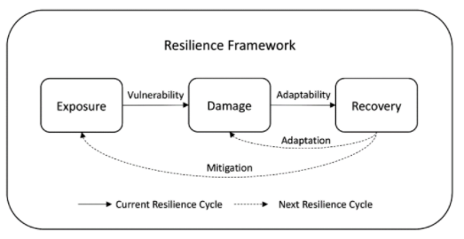
RIM Model Framework
RIM model is used to quantify resilience – building a toolbox based on it.
Uses 3 dimensions:
Exposure to hazards – E.g., Frequency of disasters
Damage suffered – E.g., Property, Crop Damage
Disaster Recovery – E.g., Population return, Employment rate
Source: N. Lam, N. S., Reams, M., Li, K., Li, C., & Mata, L. P. (2016). Measuring community resilience to coastal hazards along the northern Gulf of Mexico. Natural Hazards Review, 17(1), 04015013. https://doi.org/10.1061/(asce)nh.1527-6996.0000193
Notes:
Add Source

Slide 6
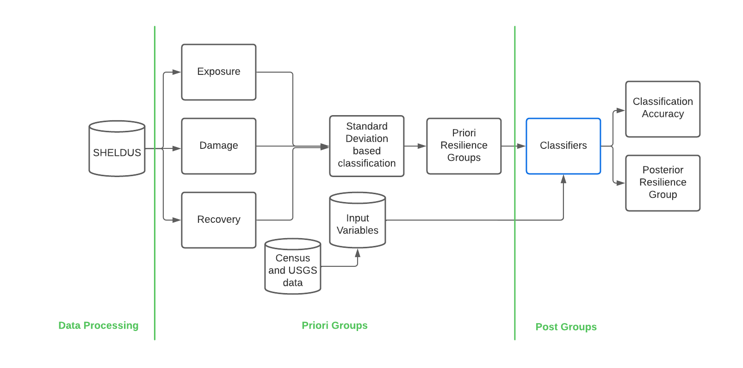
Workflow
Notes:
USGS and Census data

Slide 7
SHELDUS data
Hazard Begin Date
Hazard End Date
Hazard Types
Names
Postal Codes
FIPS Code
Injuries
Fatalities
Property Damage
Crop Damage
Damages adjusted to current year
Source: Arizona State University

Slide 8
Input variables
A synthesis of disaster resilience measurement methods and indices.
Cai, Lam, Qiang, Zou, Correll, & Mihunov. 2018. International journal of disaster risk reduction.
Median rent
Median value of owner-occupied housing
Percent under 5 years old
Percent over 65 years old
Average number of people per household
Percent rural farm population
Percent of the workforce that is female
Percent female-headed households
Percent of the population living below poverty
Percent of the population that rents
Percent of homes that are mobile homes
Number of houses per square mile
Percent of the population over 25 with no high school diploma

Slide 9
Input variables
A synthesis of disaster resilience measurement methods and indices.
Cai, Lam, Qiang, Zou, Correll, & Mihunov. 2018. International journal of disaster risk reduction.
Percent of the workforce that is employed
Percent of the population that voted in 2000 presidential election
Local government finance revenue per capita
Local government finance general expenditures per capita
Local government finance expenditures for education
5-year average infant mortality per 10000 births
3-year average chronic illness deaths per 10000 individuals
Disabled and nonworking labor forces per 10000 individuals
3-year total low-birth-weight babies per 10000 live births
Households with no fuel used per 10000 individuals
Households with no plumbing per 10000 individuals
Non-federal active medical doctors per 10000 individuals

Slide 10
Data processing toolbox

Slide 11
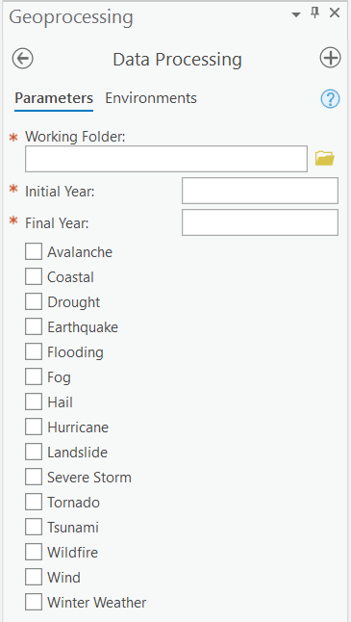
Data processing script
The first toolbox is geared towards data processing and indicator calculations. - User based parameter inputs
Duration input is taken in years and data is trimmed (Sample Run – 2000 to 2010)
Filtered dataset according to chosen parameters is passed.

Slide 12
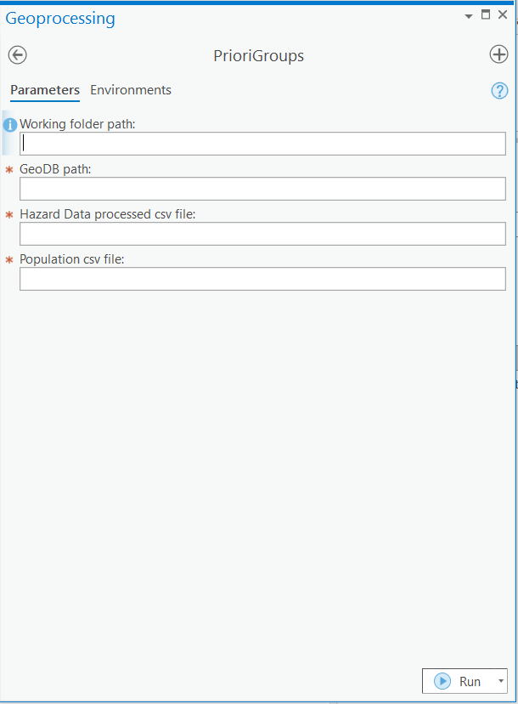
Priori groups toolbox

Slide 13
Formulas used

Slide 14
Priori groups script
Weightage for each hazard type = Damage per day per capita / Count
Days is calculated with a minimum set to one.
Per Capita Damage is calculated per county by Summary Statistics. ( Sum of total damage divided by lower bound population. ) This forms our damage values.
Recovery is calculated by increase in population divided by the initial population.

Slide 15
Priori groups script
Product of weight of hazard types and duration is summed per county to evaluate Exposure
This is then normalized using z-score for each of the three indicator columns.
Vulnerability Index is calculated from the difference of normalized damage to normalized threat.
Adaptability Index is calculated from the difference of normalized recovery to normalized damage.
These were then divided according to quantiles (1st and 3rd).

Slide 16
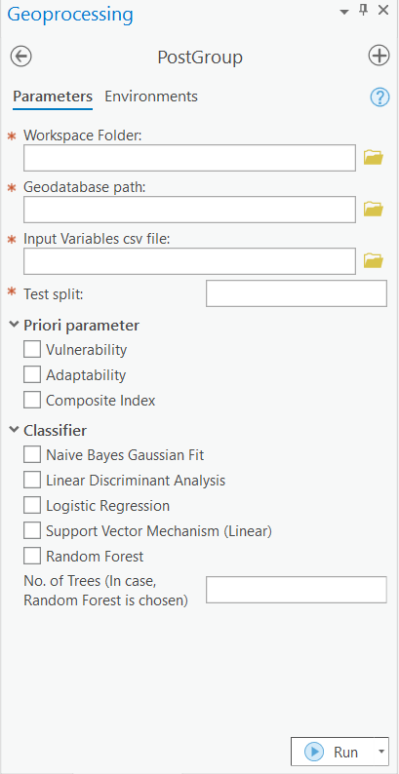
Post groups toolbox

Slide 17
Post groups script
The final toolbox uses scikit learn modules for the classifiers shown beside.
User specified split is used to divide for training and testing.
Special Cases – 0 will use the whole dataset for train and test; 1 will use the Leave One Out Method
For our runs, we have used 90% of the dataset for training.

Slide 18
Advantages of this toolbox
Amount of Flexibility and Customizations Available
It can fit into any study based on resilience.
Empowers the user to either use their own data or otherwise.
Actionable variables can be changed to increase resilience score.

Slide 19
Normalized threat

Slide 20
Normalized damage

Slide 21
Normalized recovery

Slide 22
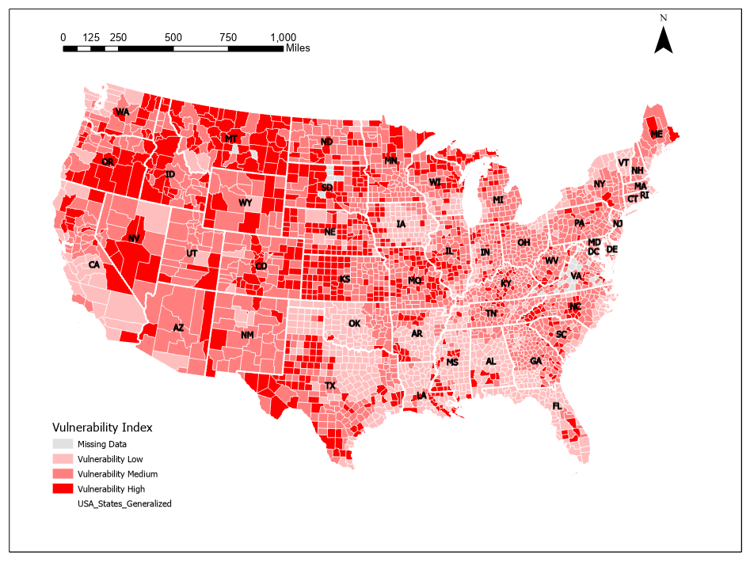
Vulnerability priori map
Western side of US has much more vulnerability as compared to the Eastern sides!

Slide 23
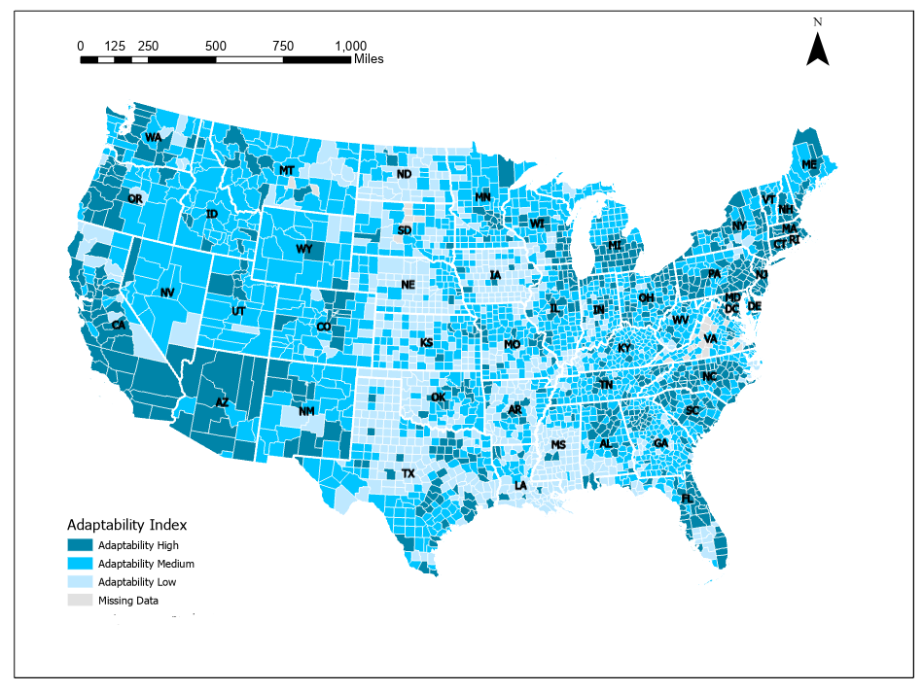
Adaptability Priori map
The coastal zones have a much higher rate of recovery comparatively to the middle regions!

Slide 24
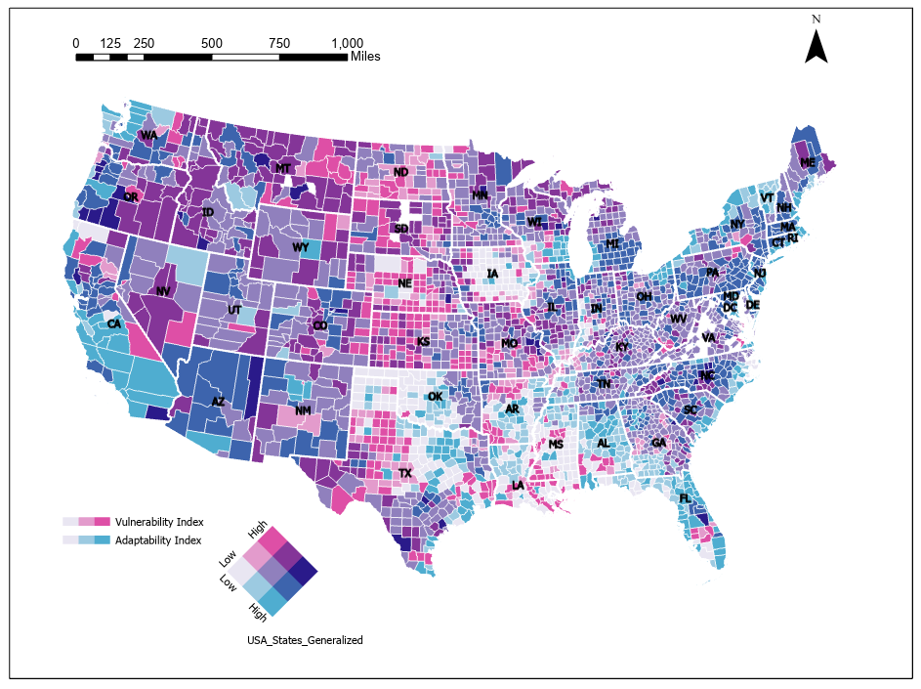
Bivariate map
The blue at the bottom most square in the legend signifies the best kind of resilience having high adaptability to low vulnerability. (More along the coastal regions)
Whereas the pink on the top, is very vulnerable while not adaptable. (More in middle of US)

Slide 25
Example show – (90-10) split, logistic regression
Notes:
LR is consistently best because Population is in the recovery. But it being normalized by damage is why we can use them.

Slide 26
Significant variables
Positive
Median value of owner-occupied housing
Number of houses per square mile
Local government finance general expenditures per capita
Non-federal active medical doctors per 10000 individuals
Negative
Percent under 5 years old
Percent over 65 years old
Percent rural farm population
Percent of the population that rents

Slide 27
Next steps
Developing a Cyber GIS tool with much more functionality, so it can be an open-source tool and be easier for research.

Slide 28
Thank you

