Slide 1
Identifying multi-scale spatial heterogeneity in urban housing market:
A fusion approach combining random effects eigenvector spatially filtering-based spatially varying coefficient (RE-ESF-SVC) model with Fused LASSO
Zhan Peng, Ryo Inoue
February 25-March 1, 2022
2022 AAG Annual Meeting
Graduate School of Information Sciences, Tohoku University
Notes:
Hello, everyone. I am very glad to attend the conference.
Today I want to talk about identifying multi-scale spatial heterogeneity in urban housing market: A fusion approach combining RE-ESF-SVC model with fused lasso

Slide 2
Introduction
Multiple spatial scales of spatial heterogeneity in urban housing market
Continuous spatial scale:
Impacts of factors on housing prices are gradually changing throughout the region
e.g.) Since customers living in the city center value more on the living convenience, the impact of
accessibility to the city center on housing prices are varying from the city center to the suburbs.
Discrete spatial scale:
Significant differences occur in specific regions with well-defined boundaries
e.g.) Despite having the same structure, houses in brand-name neighborhoods, famous school districts,
and around major stations are significantly more expensive.
Notes:
Spatial heterogeneity is one of general properties of spatial data. In urban housing market, the spatial heterogeneity can be observed on multiple spatial scales.
First, on a continuous scale, due to different customer preferences, impacts of factors on housing prices are gradually changing throughout the region. On the other hand, the discrete scale means that the significant differences occur in specific regions with well-defined boundaries, such as brand-name neighborhoods or famous school districts.
For example, Since customers living in the city center value more on the living convenience, the impact of accessibility to the city center on housing prices will be different in different part of the city.
For example, although houses have the same structures, those located in brand-name neighborhoods, famous school districts, or near the major stations are significantly more expensive than others.

Slide 3
Introduction
Previous studies consider continuous and discrete scale of spatial heterogeneity separately.
Continuous scale | Discrete scale
Estimate spatially varying coefficients (SVC) on each sample site | Estimate the coefficient for each discrete subregion
(Multi-scale) Geographically weighted regression Bayesian SVC (Random effect) Eigenvector spatial filtering-based SVC | Sparse modeling (MCP, Fused LASSO, etc.) approaches based on geographic segmentation
However, spatial heterogeneity with multiple scales may exist simultaneously in urban housing market with complex characteristics and formations.
Notes:
Previous studies mainly consider these multiple scales separately.
For example, first, spatially varying coefficients could be estimated on each sample site to obtain the continuous spatial heterogeneity. The famous geographically weighted regression, Bayesian SVC and Eigenvector spatial filtering-based SVC model fall into this framework.
Then, for the discrete spatial heterogeneity, the common practice is to divide the whole region into many subregions based on geographic segmentation, then sparse modeling approaches such as MCP and Fused LASSO can be used to estimate the coefficient for each subregion.
However, in urban housing market which has complex characteristics, the continuous and discrete spatial heterogeneity may exist at the same time. Just pay attention to a single scale may be not enough for us to interpret the actual status of the housing market.

Slide 4
Purpose of this study
Modeling multi-scale spatial heterogeneity simultaneously to better understand characteristics of the real estate market
Propose a fusion model by combining random effect eigenvector spatial filtering-based SVC (RE-ESF-SVC) and Fused LASSO.
Propose a restricted maximum likelihood-based iterative algorithm for parameter estimation.
Apply the proposed model to real estate prices data
Continuous scale
Discrete scale
RE-ESF-SVC
Fused LASSO
Notes:
So, in this study, we aim to extract the multi-scale spatial heterogeneity simultaneously to better understand characteristics of the real estate market.
To achieve this, we combine the random effect eigenvector spatial filtering-based SVC model and Fused LASSO into a fusion model so that we can extract both continuous and discrete spatial scale with just one model at the same time.
Besides, we also propose a novel algorithm for parameter estimation.
Next, I will introduce the proposed model in detail.

Slide 5
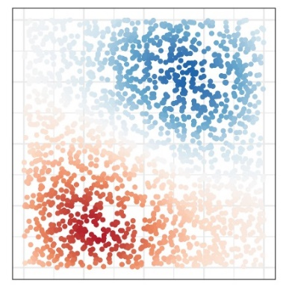
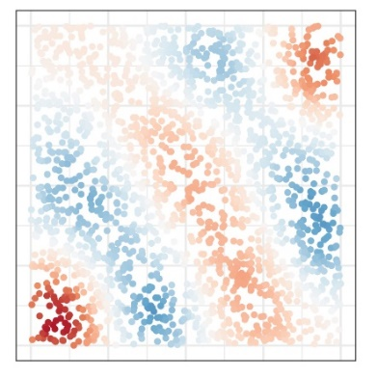
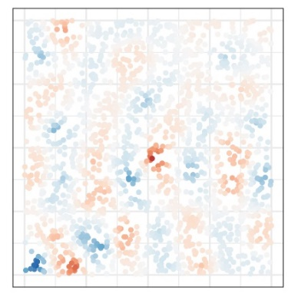
Method: continuous spatial heterogeneity
RE-ESF-SVC (Murakami et al., 2017):
Extract eigenvectors $E=\left[e_{1},…,e_{L}\right]$of the spatial proximity matrix to model spatial variations in data
$$y :$$ | response variable vector
$$x_{k}:$$ | $k$-th explanatory variable vector
$$β_{k}:$$ | the average of $k$-th regression coefficient
$$γ_{k}:$$ | random effect coefficient vector
$$∘ :$$ | column-wise (Hadamard) product
$$Λ\left(α_{k}\right):$$ | a diagonal matrix with $l$-th element $λ_{l}\left(α_{k}\right)={λ_{l}^{α_{k}}\left(\sum_{l}{λ_{l}}\right)}/{\left(\sum_{l}{λ_{l}^{α_{k}}}\right)}$
$$y=\sum_{k=1}^{K}{x_{k}∘β_{k}+ε, }$$
$$ε\sim N(0,σ^{2}I)$$
$$β_{k}=β_{k}1+Eγ_{k},$$
$$γ_{k}\sim N(0_{L}, σ_{k\left(γ\right)}^{2}Λ\left(α_{k}\right))$$
Each eigenvector shows a distinct continuous pattern of variation
Random effect coefficient $γ_{k}$controls the pattern for each $β_{k}$ by variance parameter $α_{k}$
$e_{1}$: Global
$$e_{10}$$
$e_{50}$: Local
Global-scale $β_{k}$
large $α_{k}$
$$Eγ_{k}$$
$$⋮$$
$$⋮$$
small $α_{k}$
Local-scale $β_{k}$
Notes:
I will start with capturing continuous spatial heterogeneity by RE-ESF-SVC model.
RE-ESF-SVC is a regression method which applies eigenvectors from a spatial proximity matrix to address spatial variations in data.
In the following equation, the regression coefficient beta k is not a constant but consists of a linear combination of eigenvectors. And the coefficient of eigenvectors is a random variable which obeys a multivariate normal distribution with zero means.
It is noted that each eigenvector shows a distinct continuous pattern of spatial variation, just as shown in the bottom left figure. And all eigenvectors are combined to together produce the spatial variations of the beta. And the pattern of this variation is determined by the alpha, the variance parameter of gamma. A larger alpha will lead to a more global pattern of beta.

Slide 6
Method: discrete spatial heterogeneity
Fused LASSO (Tibshirani et al., 2005):
A sparse modeling approach which extracts the underlying essential information and preventing overfitting by adding regularization terms to parameters.
Divide the region and set a parameter for each subregion
Significant differences are extracted by non-zero estimates
Penalize:
Each parameter
The difference of adjacent subregions
$${\hat{β}}_{1−5}$$
$$β_{1}$$
$$β_{5}$$
$$β_{2}$$
$$β_{6}$$
$${\hat{β}}_{2−3−4}$$
$$0$$
$$β_{4}$$
$$β_{3}$$
$$β_{7}$$
e.g.）${\left\|β_{1}\right\|}_{1}$, $\left|β_{1}−β_{2}\right|$
Notes:
And then, for the discrete spatial heterogeneity, we use Fused LASSO, which is a sparse modeling approach extracting the underlying essential information and preventing overfitting by adding regularization terms to parameters.
In this study, we divide the whole region into many subregions based on any administrative divisions and set a parameter for each subregion. Then, we add a regularization term to parameters themselves and the difference of parameters of adjacent subregions. Then, only subregions with significant differences will be estimated to have the same non-zero parameters.
For example, in the left figure, the difference of beta1 and beta 2 is penalized because they are next to each other.

Slide 7
Method: the proposed fusion model
We proposed a fusion model by combining RE-ESF-SVC and Fused LASSO.
$$y$$ | : response variable vector
$$x_{k}$$ | : $k$-th explanatory variable vector
$$X^{dis}$$ | : subregion dummy matrix
$$β_{k}$$ | : the average of $k$-th regression coefficient
$$β^{dis}$$ | : subregion dummy coefficient vector
$$E$$ | : eigenvectors of the spatial proximity matrix
$$γ_{k}^{con}$$ | : random effect coefficient vector
$$σ_{k}^{2},α_{k}$$ | : variance parameters of $γ_{k}^{con}$
$$Λ\left(α_{k}\right)$$ | : a diagonal matrix with $l$-th element $λ_{l}\left(α_{k}\right)={λ_{l}^{α_{k}}\left(\sum_{l}{λ_{l}}\right)}/{\left(\sum_{l}{λ_{l}^{α_{k}}}\right)}$
$$y=\sum_{k=1}^{K}{x_{k}∘β_{k}^{con}}+X^{dis}β^{dis}+ε,$$
$$ε\sim N\left(0,σ^{2}I\right)$$
$$β_{k}^{con}=β_{k}1+Eγ_{k}^{con}, γ_{k}^{con}\sim N\left(0_{L},σ_{k}^{2}Λ\left(α_{k}\right)\right)$$
The proposed model extracts multi-scale spatial heterogeneity simultaneously.
Continuous scale：spatially varying coefficients $β_{k}^{con}$
Discrete scale： subregion coefficients $β^{dis}$ estimated by Fused LASSO
$$λ\sum_{\left(m,n\right)∈F}{\left|β_{m}^{dis}−β_{n}^{dis}\right|}+δλ{\left\|β^{dis}\right\|}_{1}$$
Regularization terms:
Notes:
Then, based on the above, we can now combine RE-ESF-SVC and Fused LASSO into one fusion model to detect the continuous and discrete spatial heterogeneity at the same time.
In this fusion model, the spatially varying coefficients which consist of eigenvectors are expected to identify the continuous spatial heterogeneity of data. Besides, a set of dummy variables which represents all subregions are added into the model. The difference of coefficients of adjacent subregions will be penalized by regularization terms to identify the discrete spatial heterogeneity.

Slide 8
Method : the proposed fusion model
The proposed model could be rewritten as the following linear mixed model.
$y=X^{all}β^{all}+\tilde{E}\tilde{V}\left(Θ\right)\tilde{u}+ε,$ $ε\sim N\left(0,σ^{2}I\right)$
Note: ${\tilde{γ}}^{con}=\tilde{V}\left(Θ\right)\tilde{u}$
$$\sum_{k=1}^{K}{x_{k}∘β_{k}+X^{dis}β^{dis}}$$
Fixed effect：
$X^{all}β^{all}$:
Random effect：
$$\tilde{E}=\left[x_{1}∘E,…,x_{K}∘E\right],$$
$\tilde{V}\left(Θ\right)=\left[\begin{matrix}V\left(θ_{1}\right) & ⋯ & 0 \\ ⋮ & ⋱ & ⋮ \\ 0 & ⋯ & V\left(θ_{K}\right)\end{matrix}\right],$ $V\left(θ_{k}\right)=\frac{σ_{k}}{σ}\sqrt{Λ\left(α_{k}\right)}$
$$\tilde{u}\sim N\left(0_{LK},σ^{2}I_{LK}\right)$$
Parameters ：$β^{all}=(β_{k}, β^{dis}) ,Θ=\left(θ_{1},…,θ_{K}\right), θ_{k}=\left({σ_{k}}/σ, α_{k}\right), σ^{2}$
Notes:
Moreover, we can rewrite the proposed model into the following linear mixed model, where the first term is the fixed effect which consists of the average of spatially varying coefficients and the subregion dummy variables.
And then, the second term is the random effects, which are formed by the interaction of eigenvectors and each explanatory variable.
Next, we need to estimate parameters of the fixed and random effects.

Slide 9
Method: parameter estimation
Cost function
①
②
$$Q\left(β^{all},Θ,σ^{2}\right)=−2loglik\left(β^{all},Θ, σ^{2}\right)+λ_{1}\sum_{\left(m,n\right)∈F}{\left|β_{m}^{dis}−β_{n}^{dis}\right|}+λ_{2}{\left\|β^{dis}\right\|}_{1}$$
Regularization terms:
Penalize the difference of coefficients belong to the set $F$ of adjacent relationships among all subregions to extract discrete spatial heterogeneity
Penalize the subregion coefficients themselves to prevent overfitting
Problem: It is hard to directly minimize $Q\left(β^{all},Θ,σ^{2}\right)$ due to regularization terms
We propose a restricted maximum likelihood-based iterative algorithm for optimization.
※ Hyper-parameters $λ_{1},λ_{2}$ control the effects of regularization and they are chosen by BIC
Notes:
The cost function of the above model is shown here. The first term is the likelihood function, and the last two terms are regularization terms which extract discrete spatial heterogeneity and prevent overfitting, respectively.
Since no previous method could directly minimize this cost function, we propose a restricted maximum likelihood-based iterative algorithm for the parameter estimation.

Slide 10
Method: parameter estimation
Restricted maximum likelihood-based iterative estimation
Initial phase: Apply Fused LASSO to estimate initial fixed effect coefficients ${{\hat{β}}^{all}}^{\left(0\right)}$for (1)
with no random effects
$$y=X^{all}β^{all}+ε$$
(1)
Step 1: Based on ${{\hat{β}}^{all}}^{\left(0\right)}$, estimate random effect coefficients $\tilde{V}\left(Θ\right)\tilde{u}$and the variance ${\hat{V}}_{y}$of $y$
by restricted maximum likelihood method
$$\hat{z}=y−X^{all}{{\hat{β}}^{all}}^{\left(0\right)} \\ =\tilde{E}\tilde{V}\left(Θ\right)\tilde{u}+ε$$
Iterative Step 1 and 2 until convergence
(2)
Step 2: Given $\hat{Θ}$ and ${\hat{V}}_{y}$, substitute $y, X^{all}$ in (1) with $y^{R}=Ry, {X^{all}}^{R}=RX^{all}$, where
$R=chol\left({{\hat{V}}_{y}}^{−1}\right)$. Then, update ${{\hat{β}}^{all}}^{\left(0\right)} →{{\hat{β}}^{all}}^{\left(1\right)}$ by Fused LASSO.
Notes:
This algorithm consist of an initial phase and a two-step iteration.
First, we don’t consider random effects, we just apply Fused LASSO to estimate initial values for the fixed effect coefficients.
Then, we subtract the initial estimates from the model to estimate random effect and the variance of response variable. Finally, given the results of step1, we update the equation one and again use Fused LASSO to update the estimates of fixed effects.
Step one and Step two will be iterated until convergence.

Slide 11
Empirical application
Purpose
Analyze the multi-scale heterogeneity of rental prices data to understand the spatial characteristics of urban rental housing market.
Method
Apply the proposed fusion model
Continuous scale: intercept and coefficients of numeric variables
Discrete scale: coefficients of subregion dummy variables
Compare the proposed model with RE-ESF-SVC and Fused LASSO
Spatial patterns
Diagnostic information
Notes:
Next comes to the application of rental prices data.
We first apply the proposed model to the data. The continuous spatial heterogeneity is expected to be represented by the intercept and coefficients of numeric variables, while the discrete spatial heterogeneity is expected to be identified by subregion dummy variables.
Besides, we also compare our model with RE-ESF-SVC and Fused LASSO in the aspect of spatial patterns of estimates and diagnostic information.

Slide 12
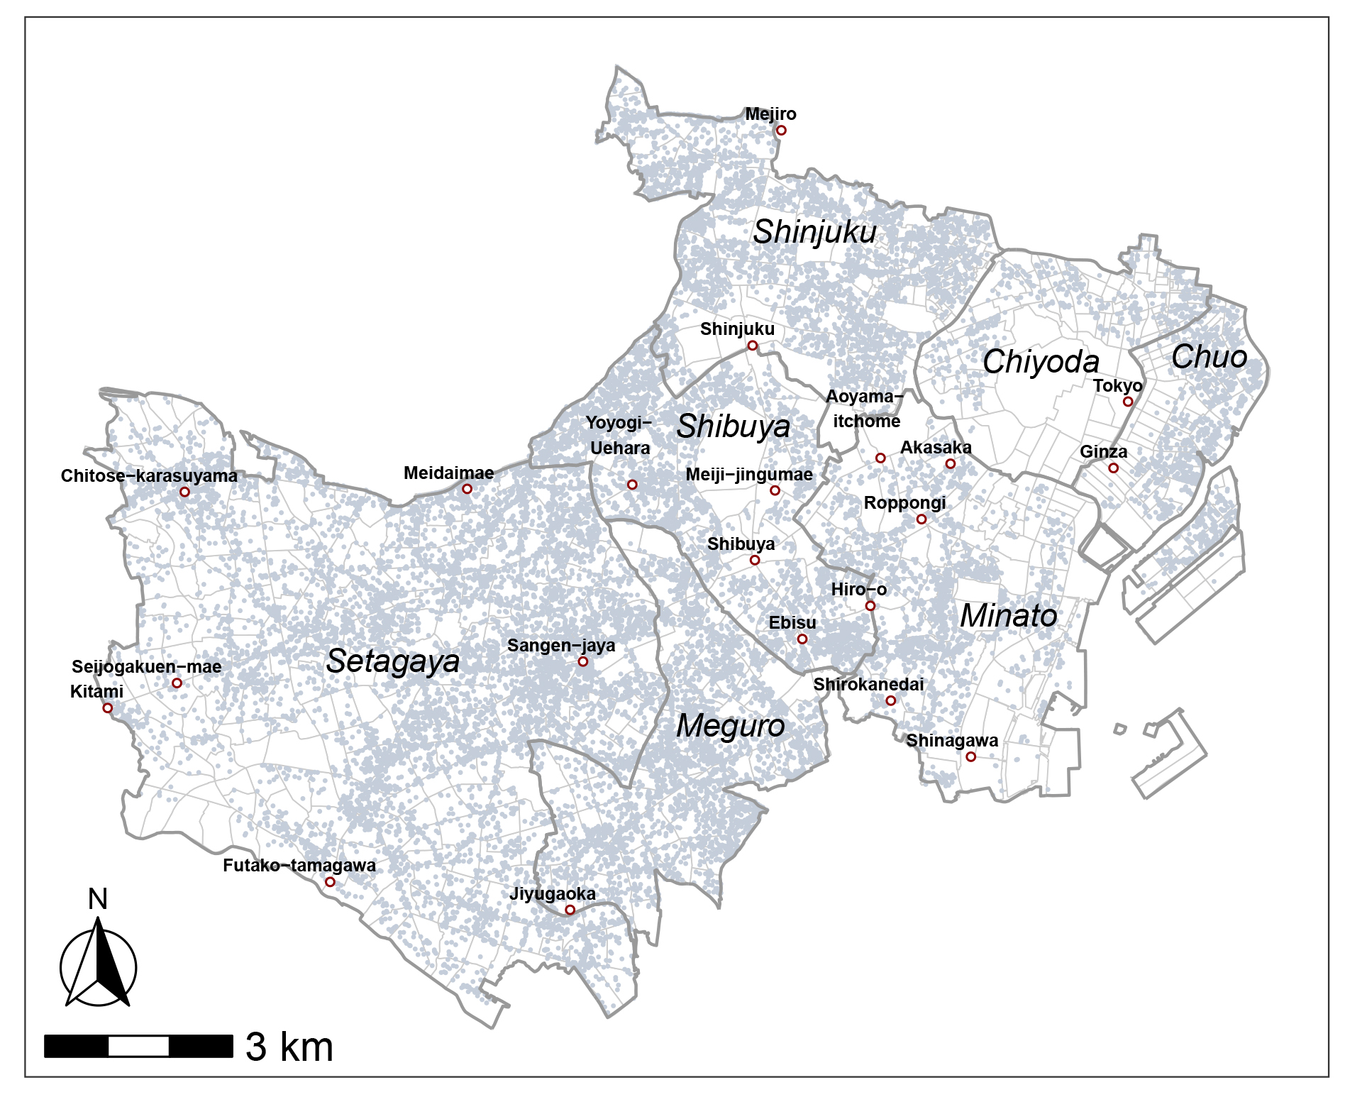
Study area and data
Study area: 7 municipalities of Tokyo, Japan ^{※1}
Data: Real estate rent data for the year 2017
size：20455, number of neighborhoods：841
Variables:
Central Tokyo
Dependent variable | The natural logarithm of rent per square meter (yen/m²)
Explanatory variables^{※2} | Walking time to the nearest station (min)
 | Apartment age (year)
 | Apartment size（m²）
 | Floor number
 | Neighborhood dummy^{※3}
House
Main station
※1 Chiyoda, Chuo, Minato, Shinjuku, Meguro, Setagaya, Shibuya ward
※2 Numeric attributes were logarithmically transformed and standardized to mean 0 and variance 1
※3 The neighborhood with the smallest residual RMSE estimated by RE-ESF-SVC was set as the reference subregion
Notes:
The study area include seven municipalities of Tokyo, Japan. The data is real estate rent data for the year 2017 which consists of about 20 thousand samples.
The study area is divided at a neighborhood level based on the administrative division of Tokyo, and over eight hundred neighborhoods are set as dummy variables. (click)
Dependent variable in this study is the natural logarithm of rent per square meter, while explanatory variables include 4 numeric attributes and the neighborhood dummy variable.

Slide 13
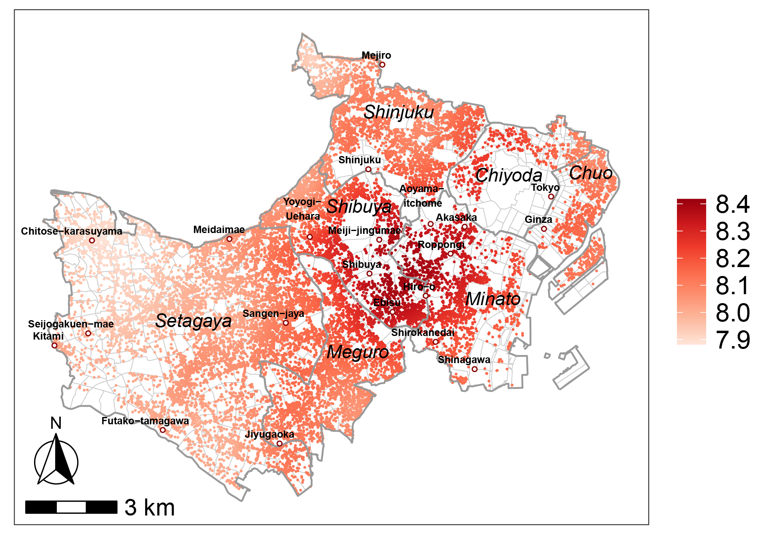
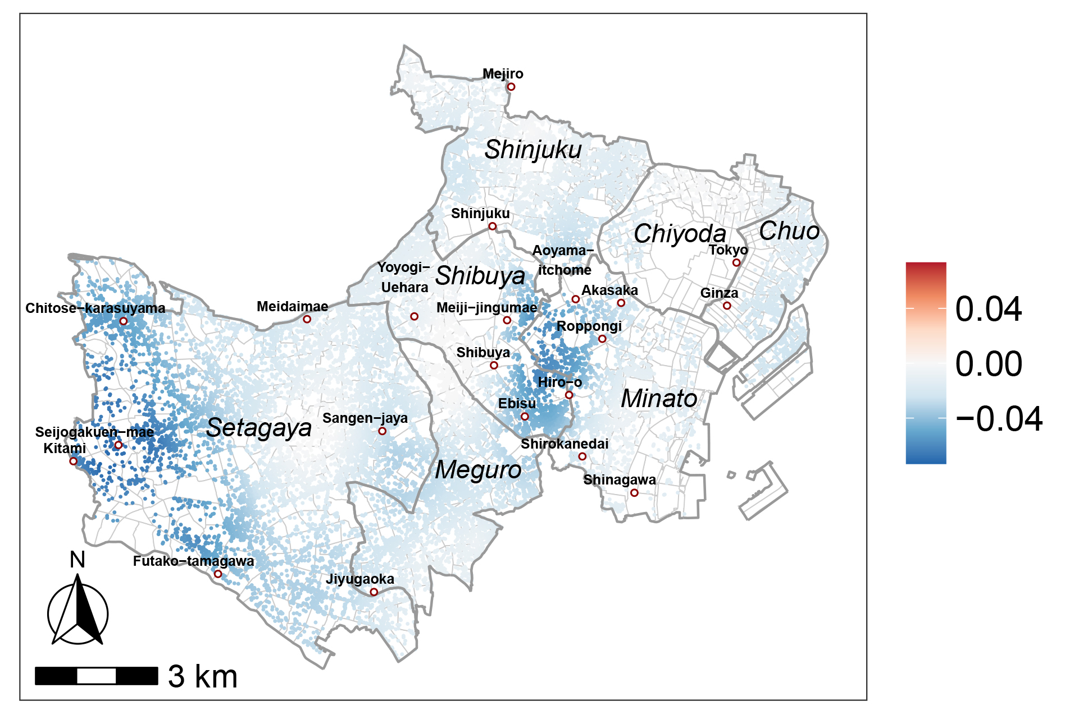
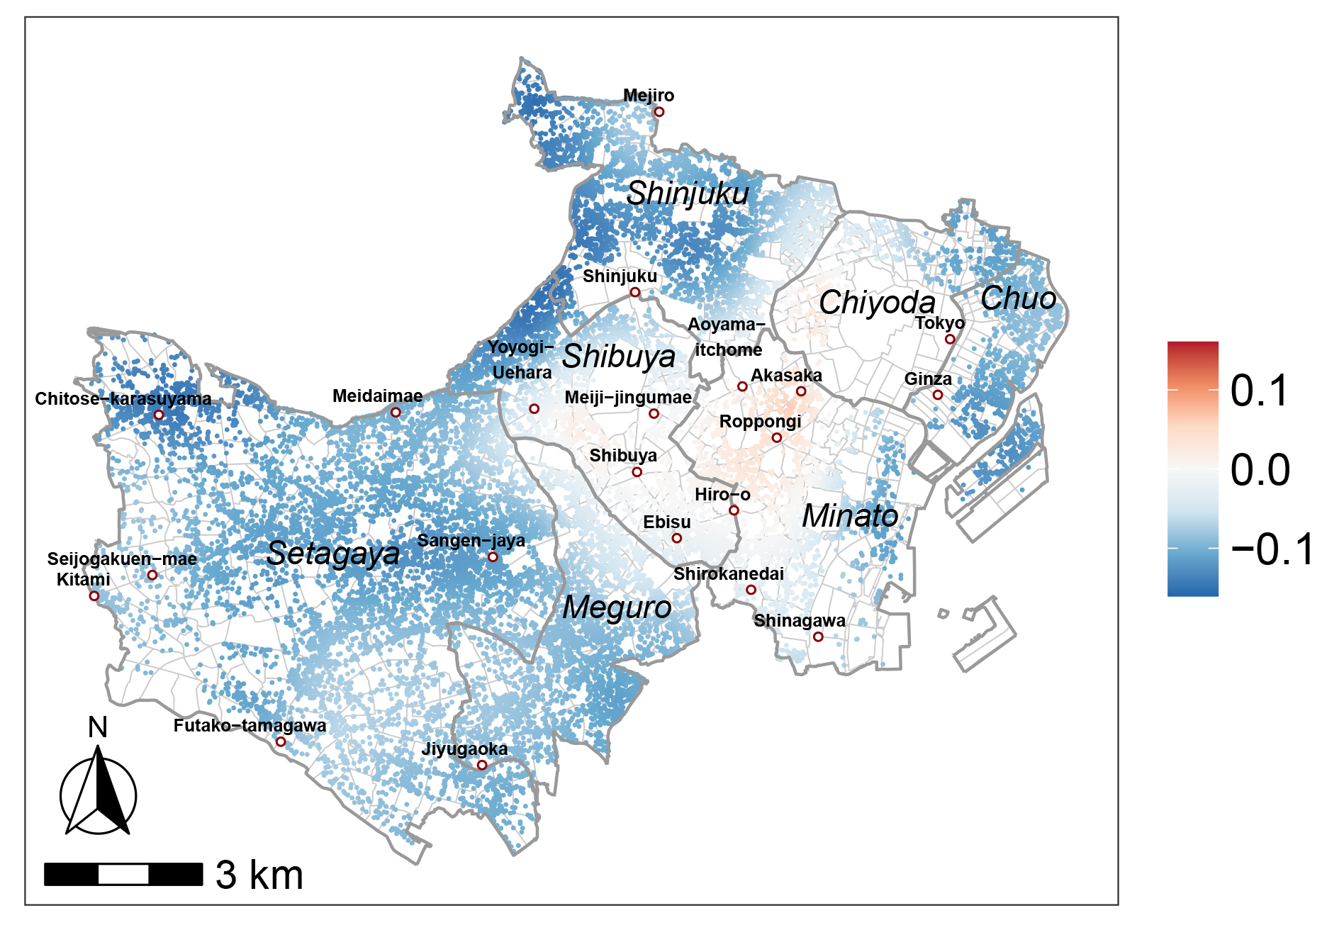
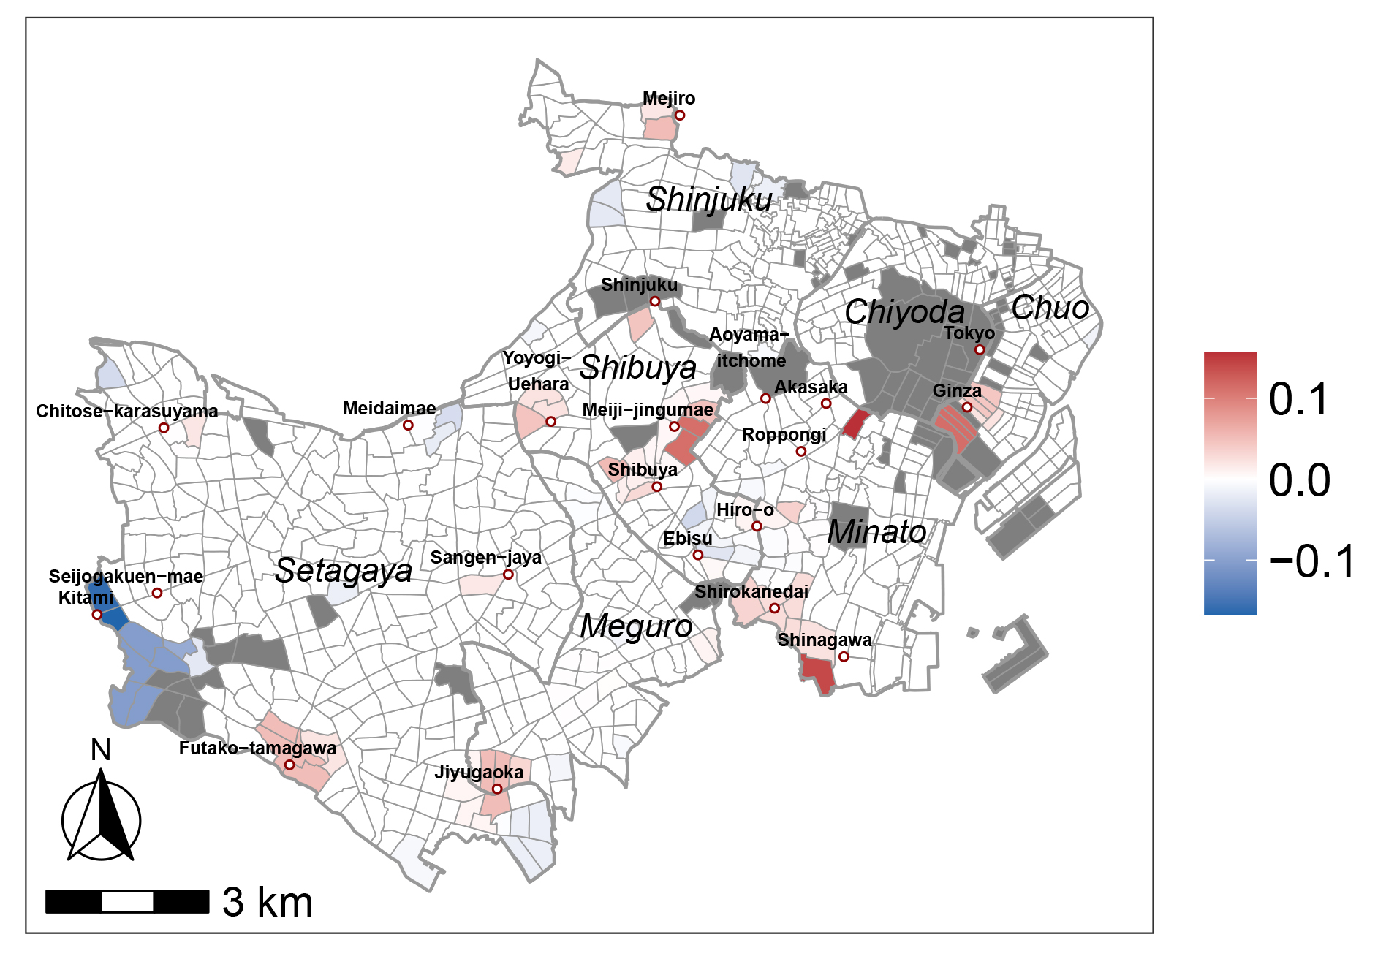
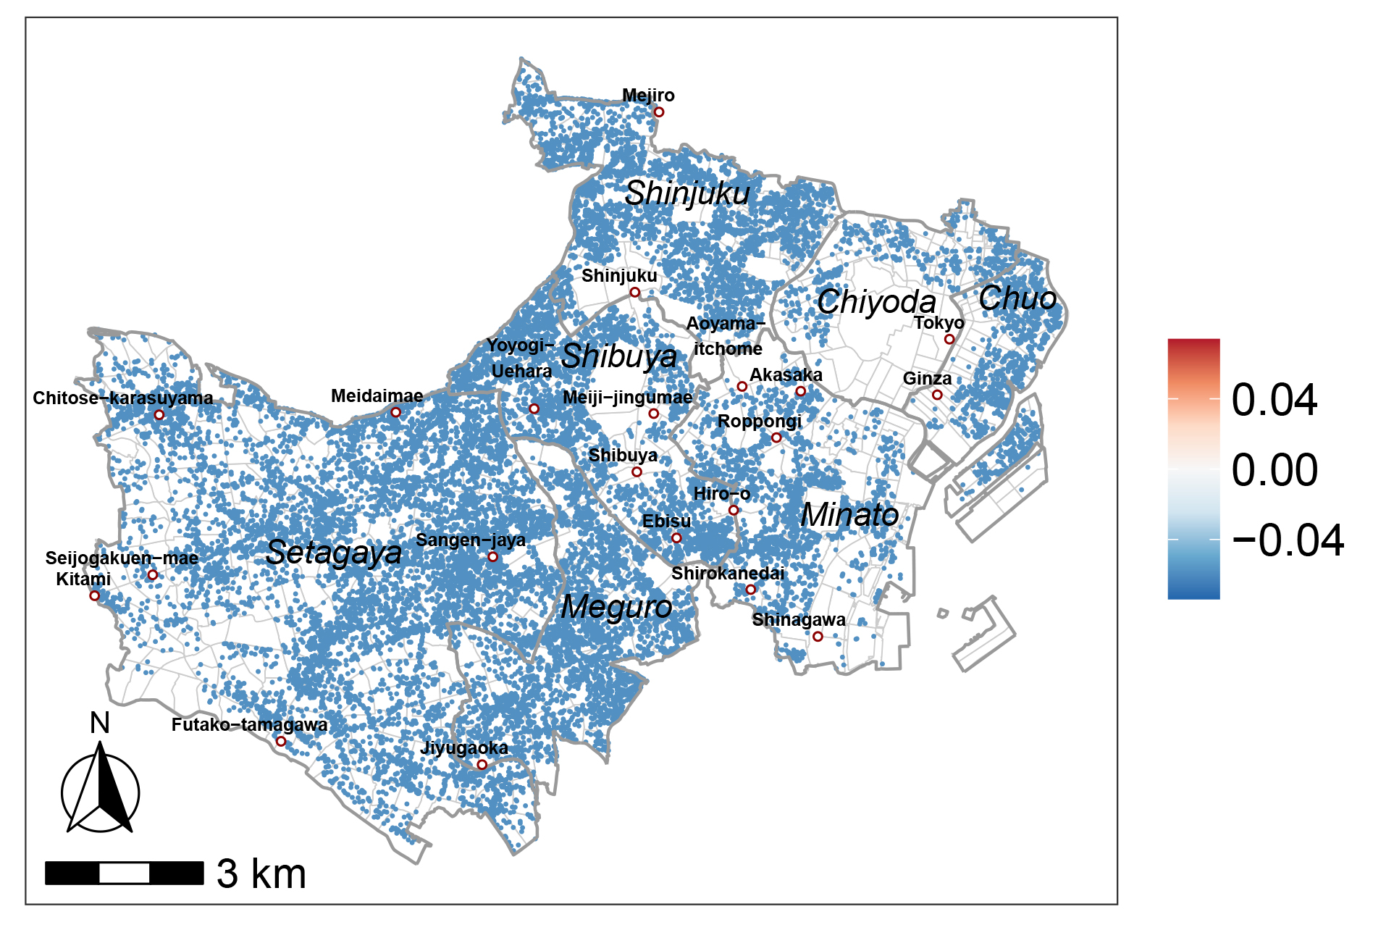
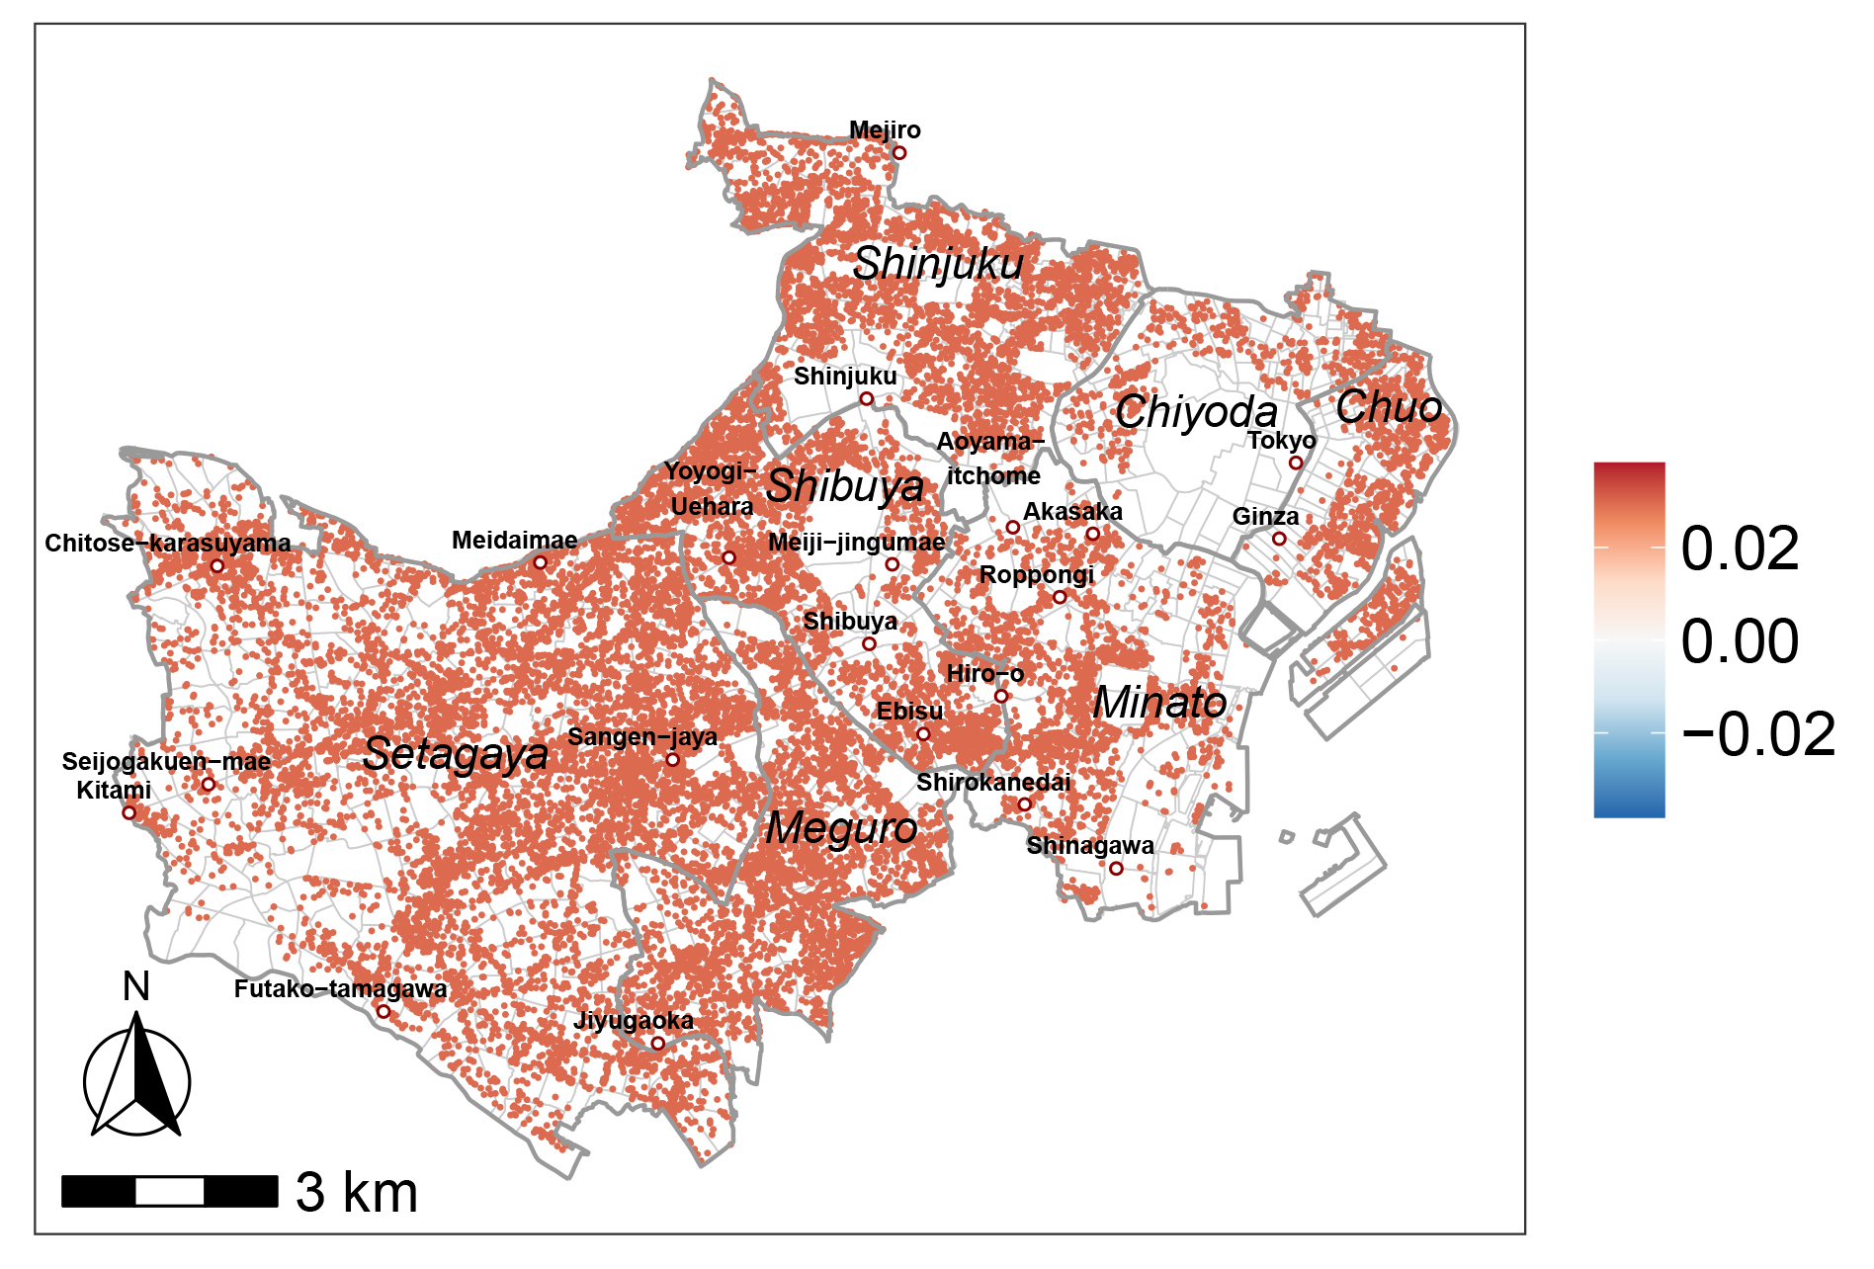
Results: the proposed model
Continuous and discrete spatial heterogeneity of rent data were extracted.
Intercept
Coefficients of numeric variables
Coefficient of neighborhood dummy
Walking time to the nearest station
Apartment area
$$α_{k}=1.219$$
$$α_{k}=0.484$$
$$α_{k}=0.940$$
Apartment age
Floor number
constant
constant
Walking time and apartment area have continuously varying impacts on rents
Apartment age and floor number have constant impacts on rents
Higher rents in brand-name neighborhoods (Futako-tamagawa, Jiyugaoka, Meiji-jingumae)
Lower rents in neighborhoods with worse locational conditions (Kitami)
Rents gradually decline from the city center to suburbs
Notes:
Here shows the result of the proposed model. It suggests that the model could extract continuous and discrete spatial heterogeneity of rent data at the same time.
First, the left figure is the pattern of intercept which presents a gradual decline of rents from the city center to the surrounding suburbs.
Then, figures on the middle are the coefficients of numeric attributes. We can see that the walking time and apartment size have continuously varying impacts on rents. However, the impact of apartment age and floor number are constant in the region.
Finally, the right figure shows the coefficient of all neighborhoods. Positive values indicate that extremely higher rents appears in specific neighborhoods. These areas are known as famous brand-name areas, which lead to high prices for houses. In contrast, negative values appear in areas near the Western boundary of the region. Worse locational conditions lead to significantly lower prices of houses there.
such Futako-tamagawa, Jiyugaoka and so on.
The non-zero estimates suggest that there are significant different price formation in those areas.

Slide 14
Results: diagnostic information
The proposed model:
has the best generalization performance and explanatory power
can better consider residual spatial dependence
Performances of the proposed model, RE-ESF-SVC and Fused LASSO
 | The proposed model | RE-ESF-SVC | Fused LASSO
Generalization performance: $BIC$ | -25483.73 | -25373.10 | -22134.13
Residual spatial dependence: Moran’s I | 0.004 | 0.008 | 0.151
Explanatory power: $Adjusted R^{2}$ | 0.645 | 0.601 | 0.448
Further compare the proposed model with RE-ESF-SVC
Notes:
Then, we compare the diagnostic information of these three models. The results shown in the table suggest that our model has the best generalization performance and explanatory power, it could also better consider the residual spatial dependence of data.
We can see that Fused LASSO is significantly less effective than the other two models. So next we will only compare the spatial pattern of the proposed model and RE-ESF-SVC.

Slide 15
Results: comparison with RE-ESF-SVC
The proposed model
RE-ESF-SVC
Intercept
Coefficient of neighborhood dummy
Intercept
Continuous and discrete spatial variations were extracted by the intercept and coefficients of neighborhood dummy, respectively
Discrete spatial variations were not successfully separated out
Notes:
Here we make a comparison with RE-ESF-SVC which could only identify continuous heterogeneity.
Compared to the proposed model that could extract continuous and discrete spatial heterogeneity respectively by different terms, RE-ESF-SVC did not successfully separate out the discrete heterogeneity from its intercept.

Slide 16
Results: comparison with RE-ESF-SVC
Coefficient of neighborhood dummy of the proposed model
The difference between intercepts of two models
Discrete spatial variations were extracted as neighborhoods with significantly different rent formations
Discrete spatial variations were not successfully separated out
Notes:
The reason could be explained by subtracting the intercept of the proposed model from that of RE-ESF-SVC. The difference is shown as the right figure.
By enlarging the right figure and comparing it with the dummy coefficient of the proposed model in the left figure, we can find that, in the neighborhoods where discrete spatial heterogeneity were detected by the proposed model, there are also significant differences between the two intercepts.
This indicates that RE-ESF-SVC could not separate out these discrete patterns from its intercept.

Slide 17
Summary
Continuous and discrete spatial heterogeneity exist simultaneously in urban housing market.
This study combines RE-ESF-SVC and Fused LASSO to extract multi-scale spatial heterogeneity for better understanding the market characteristics.
The proposed method could identify continuous and discrete spatial heterogeneity of rental housing market of Tokyo with a better performance.
Zhan Peng, Ryo Inoue
peng.zhan.p3@dc.tohoku.ac.jp

Slide 18
References
Allegretto, S., Dube, A., & Reich, M. (2009). Spatial Heterogeneity and Minimum Wages: Employment estimates for teens using cross-state commuting zones. Institute for Research on Labor and Employment:
Working Paper Series. http://escholarship.org/uc/item/1x99m65f
Anselin, L. (1989). What is special about spatial data? Alternative perspectives on spatial data analysis. Technical Report 89-4, National Center for Geographic Information and Analysis.
Atkinson, P. M., & Tate, N. J. (2000). Spatial scale problems and geostatistical solutions: A review. The Professional Geographer, 52(4), 607–623.
Bates, D.M., (2010). lme4: Mixed-effects modeling with R. http://lme4.r-forge.r-project.org/book.
Davis, F. W., Quattrochi, D. A., & Ridd, M. K. (1991). Environmental analysis using integrated GIS and remotely sensed data: Some research needs and priorities. Photogrammetric Engineering and Remote
Sensing, 57, 689-97.
Den, K., & Inoue, R. (2020). Extraction of multi-scale spatial heterogeneities fusion approach of spatially varying coefficient model and sparse modeling. The 29th Annual Meeting of the Geographic
Information Systems Conference. C24-1-3. CD-ROM.
Den, K., & Inoue, R. (2019). Extracting area and period of influence of new rail service on real estate market using Fused-MCP. GeoComputation 2019.
Dray, S., Legendre, P., & Peres-Neto, P. R. (2006). Spatial modelling: A comprehensive framework for principal coordinate analysis of neighbour matrices (PCNM). Ecological Modelling, 196(3), 483–493.
Finley, A. O. (2011). Comparing spatially-varying coefficients models for analysis of ecological data with non-stationary and anisotropic residual dependence. Methods in Ecology and Evolution, 2(2), 143–154.
Fotheringham, A. S., Yang, W., & Kang, W. (2017). Multiscale Geographically Weighted Regression (MGWR). Annals of the American Association of Geographers, 107(6), 1247–1265.
Fotheringham, A., Yue, H., & Li, Z. (2019). Examining the influences of air quality in China’s cities using multi‐scale geographically weighted regression. Transactions in GIS, 23.
Gallucci, F., A. Christofoletti, R., Fonseca, G., & M. Dias, G. (2020). The effects of habitat heterogeneity at distinct spatial scales on hard-bottom-associated communities. Diversity, 12(1), 39.
Gelfand, A. E., Kim, H.-J., Sirmans, C. F., & Banerjee, S. (2003). Spatial modeling with spatially varying coefficient processes. Journal of the American Statistical Association, 98(462), 387–396.
Goodman, A. C., & Thibodeau, T. G. (1998). Housing market segmentation. Journal of Housing Economics, 7(2), 121–143.
Goodman, A. C., & Thibodeau, T. G. (2003). Housing market segmentation and hedonic prediction accuracy. Journal of Housing Economics, 12(3), 181–201.
Griffith, D. A. (1996). Spatial autocorrelation and eigenfunctions of the geographic weights matrix accompanying geo-referenced data. The Canadian Geographer / Le Géographe Canadien, 40(4), 351–367.
Griffith, D. A. (2003). Spatial autocorrelation and spatial filtering: Gaining understanding through theory and scientific visualization. Springer, Berlin.
Griffith, D. A. (2008). Spatial-filtering-based contributions to a critique of geographically weighted regression (GWR). Environment and Planning A: Economy and Space, 40(11), 2751–2769.
Griffith, D. A., & Chun, Y. (2014). Spatial autocorrelation and eigenvector spatial filtering. Handbook of Regional Science, 1477–1507.
Harvey, D. W. (1968). Pattern, process, and the scale problem in geographical research. Transactions of the Institute of British Geographers, 45, 71–78.
Helbich, M., Brunauer, W., Vaz, E., & Nijkamp, P. (2014). Spatial heterogeneity in hedonic house price models: The case of Austria. Urban Studies, 51(2), 390–411.
Helbich, M., & Griffith, D. A. (2016). Spatially varying coefficient models in real estate: Eigenvector spatial filtering and alternative approaches. Computers, Environment and Urban Systems, 57, 1–11.
Inoue, R., Ishiyama, R., & Sugiura, A. (2020). Identifying local differences with fused-MCP: An apartment rental market case study on geographical segmentation detection. Japanese Journal of Statistics and
Data Science, 3(1), 183–214.
Jang, M., & Kang, C.-D. (2015). Retail accessibility and proximity effects on housing prices in Seoul, Korea: A retail type and housing submarket approach. Habitat International, 49, 516–528.
Matsuba, M., Tanaka, Y., Yamakita, T., Ishikawa, Y., & Fujikura, K. (2020). Estimation of tsunami debris on seafloors towards future disaster preparedness: Unveiling spatial varying effects of combined land
use and oceanographic factors. Marine Pollution Bulletin, 157, 111289.
Notes:
地理空間データの分析を通した(とおした)地域特徴の把握が，都市・地域計画分野における重要な研究課題の一つです．
分析する際に，地理現象の形成過程が場所によって異なるという空間的異質性への考慮が不可欠です。例えば、各地域を選好する住民の価値観が違うため，不動産価格形成要因に対する評価は地域によって異なっています。
また、空間的異質性は異なるスケールで作用（さよう）しています。連続的なスケールで、位置によって生成要因の影響が全域で徐々に変化していて、各要因は大域的から局所的まで様々なスケールも持っています。また、離散的なスケールというのは、ブランドエリアなど特定の場所で発生する急激な変化を指します。
これらのスケールに対して，様々な既往研究があります。
会社へのアクセシビリティやナイトライフなどの都市が提供するサービスを志向する住民は都心を志向する一方，広い物件や緑地の多さなどの住環境を重視する住民は郊外を重視するなど，その地域を選好する住民の価値観の違いによって，不動産市場が地理的に分割されていると考えられている．

Slide 19
References
McCord, M. J., McCord, J., Davis, P. T., Haran, M., & Bidanset, P. (2019). House price estimation using an eigenvector spatial filtering approach. International Journal of Housing Markets and Analysis, 13(5),
845–867.
Moore, S. M., ten Bosch, Q. A., Siraj, A. S., Soda, K. J., España, G., Campo, A., Gómez, S., Salas, D., Raybaud, B., Wenger, E., Welkhoff, P., & Perkins, T. A. (2018). Local and regional dynamics of
chikungunya virus transmission in Colombia: The role of mismatched spatial heterogeneity. BMC Medicine, 16(1), 152.
Murakami, D., & Griffith, D. A. (2019). Spatially varying coefficient modeling for large datasets: Eliminating N from spatial regressions. Spatial Statistics, 30, 39–64.
Murakami, D., Lu, B., Harris, P., Brunsdon, C., Charlton, M., Nakaya, T., & Griffith, D. A. (2019). The importance of scale in spatially varying coefficient modeling. Annals of the American Association of
Geographers, 109(1), 50–70.
Murakami, D., & Seya, H. (2019). Spatially filtered unconditional quantile regression: Application to a hedonic analysis. Environmetrics, 30(5), e2556.
Murakami, D., Yoshida, T., Seya, H., Griffith, D. A., & Yamagata, Y. (2017). A Moran coefficient-based mixed effects approach to investigate spatially varying relationships. Spatial Statistics, 19, 68–89.
Pan, Y., Roth, A., Yu, Z., & Doluschitz, R. (2010). The impact of variation in scale on the behavior of a cellular automata used for land use change modeling. Computers, Environment and Urban Systems, 34(5),
400–408.
Parker, R. J., Reich, B. J., & Eidsvik, J. (2016). A fused lasso approach to nonstationary spatial covariance estimation. Journal of Agricultural, Biological, and Environmental Statistics, 21(3), 569–587.
Patuelli, R., Schanne, N., Griffith, D. A., & Nijkamp, P. (2012). Persistence of regional unemployment: Application of a spatial filtering approach to local labor markets in Germany. Journal of Regional Science,
52(2), 300–323.
Peng, H., & Lu, Y. (2012). Model selection in linear mixed effect models. Journal of Multivariate Analysis, 109, 109–129.
Peng, Z., & Inoue, R. (2021, September). Specifying multi-scale spatial heterogeneity in the rental housing market: The case of the Tokyo metropolitan area. GIScience 2021 Short Paper Proceedings, Online
(Poznań, Poland). https://escholarship.org/uc/item/59t385np
Rosen, S. (1974). Hedonic prices and implicit markets: Product differentiation in pure competition. Journal of Political Economy, 82(1), 34–55.
Song, Y., & Sohn, J. (2007). Valuing spatial accessibility to retailing: A case study of the single family housing market in Hillsboro, Oregon. Journal of Retailing and Consumer Services, 14(4), 279–288.
Tibshirani, R., 1996. Regression shrinkage and selection via the lasso, Journal of the Royal Statistical Society: Series B (Statistical Methodology), 58(1): 267-288.
Tibshirani, R., Saunders, M., Rosset, S., Zhu, J., & Knight, K. (2005). Sparsity and smoothness via the fused lasso. Journal of the Royal Statistical Society: Series B (Statistical Methodology), 67(1), 91–108.
Tobler, W. R. (1970). A computer movie simulating urban growth in the detroit region. Economic Geography, 46, 234.
Urban, R. C., & Nakada, L. Y. K. (2021). GIS-based spatial modelling of COVID-19 death incidence in São Paulo, Brazil. Environment and Urbanization, 33(1), 229–238.
Waller, L. A., Zhu, L., Gotway, C. A., Gorman, D. M., & Gruenewald, P. J. (2007). Quantifying geographic variations in associations between alcohol distribution and violence: A comparison of geographically
weighted regression and spatially varying coefficient models. Stochastic Environmental Research and Risk Assessment, 21(5), 573–588.
Wolf, L. J., Oshan, T. M., & Fotheringham, A. S. (2018). Single and multi-scale models of process spatial heterogeneity. Geographical Analysis, 50(3), 223–246.
Wu, C., Ren, F., Hu, W., & Du, Q. (2019). Multi-scale geographically and temporally weighted regression: Exploring the spatiotemporal determinants of housing prices. International Journal of Geographical
Information Science, 33(3), 489–511.
Yang, F., Li, K., Jin, M., & Shi, W. (2021). Does financial deepening drive spatial heterogeneity of PM2.5 concentrations in China? New evidence from an eigenvector spatial filtering approach. Journal of
Cleaner Production, 291, 125945.
Yu, D., Murakami, D., Zhang, Y., Wu, X., Li, D., Wang, X., & Li, G. (2020). Investigating high-speed rail construction’s support to county level regional development in China: An eigenvector based spatial
filtering panel data analysis. Transportation Research Part B: Methodological, 133, 21–37.
Yu, J., & Zhong, H. (2021). Time varying mixed effects model with fused lasso regularization. Journal of Applied Statistics, 48(8), 1513–1526.
Hayakawa, K., & Tajima, K. (2017). Determinants of wealthy communities: An empirical analysis using condominium resale prices in Tokyo. Urban housing sciences, 2017(99), 96-101.
Notes:
地理空間データの分析を通した(とおした)地域特徴の把握が，都市・地域計画分野における重要な研究課題の一つです．
分析する際に，地理現象の形成過程が場所によって異なるという空間的異質性への考慮が不可欠です。例えば、各地域を選好する住民の価値観が違うため，不動産価格形成要因に対する評価は地域によって異なっています。
また、空間的異質性は異なるスケールで作用（さよう）しています。連続的なスケールで、位置によって生成要因の影響が全域で徐々に変化していて、各要因は大域的から局所的まで様々なスケールも持っています。また、離散的なスケールというのは、ブランドエリアなど特定の場所で発生する急激な変化を指します。
これらのスケールに対して，様々な既往研究があります。
会社へのアクセシビリティやナイトライフなどの都市が提供するサービスを志向する住民は都心を志向する一方，広い物件や緑地の多さなどの住環境を重視する住民は郊外を重視するなど，その地域を選好する住民の価値観の違いによって，不動産市場が地理的に分割されていると考えられている．

Slide 20
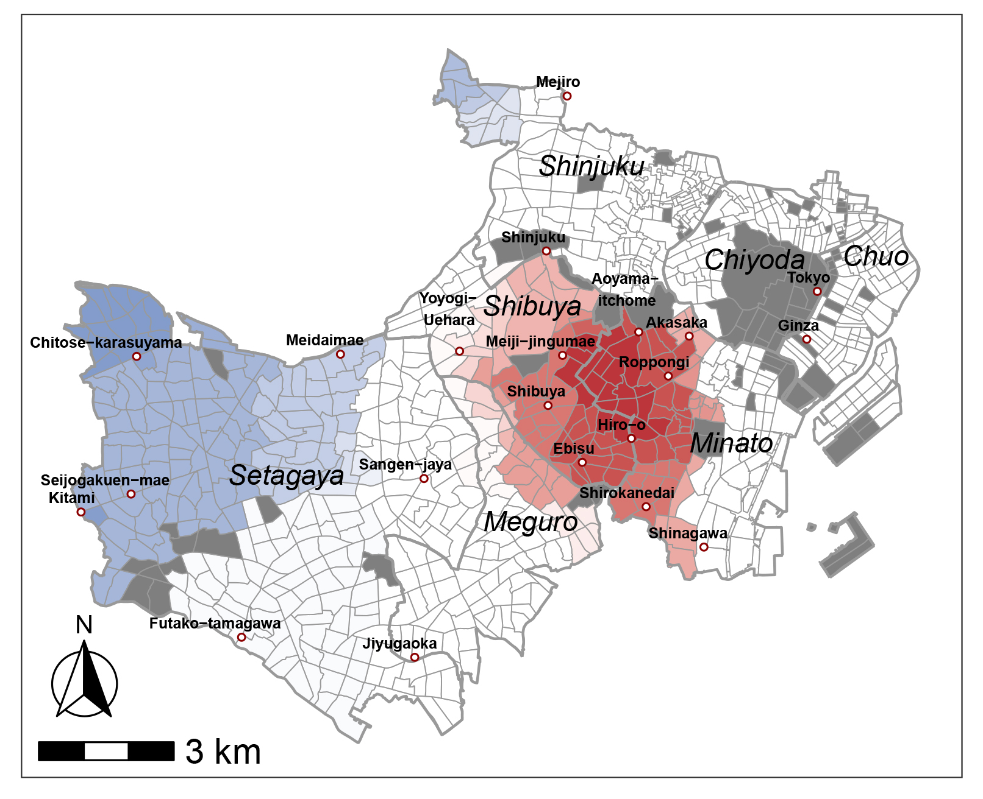
Results: comparison with Fused LASSO
The proposed model
Fused LASSO
Coefficient of neighborhood dummy
Coefficient of neighborhood dummy
Discrete spatial variations were extracted as neighborhoods with significantly different rent formations
Neighborhoods with significantly different rent formations were not identified
Notes:
Furthermore, we compare the proposed model and fused LASSO through the neighborhood dummy coefficients.
It is clear that Fused LASSO, presented on the right figure, could not identify specific neighborhoods which have significant differences as the proposed model did.

Slide 21
Results: comparison with Fused LASSO
The proposed model
Fused LASSO
Intercept
Coefficient of neighborhood dummy
Continuous spatial variations were extracted by the intercept
Continuous spatial variations were not successfully separated out
Notes:
Then, by comparing with the intercept of the proposed model, we can find that continuous spatial heterogeneity is mixed in the estimates results of fused lasso and it was not successfully separated out.

