Slide 1
The Differential responses of commutes across income groups and industries during COVID-19
AAG Conference | February 26, 2022
Bonnie Wang, Seva Rodnyansky, Marlon Boarnet

Slide 2
Motivation and Key Questions
The pandemic has exposed disparities built into commute patterns.
There has been speculation that low-income and nonwhite workers have been less able to shift to remote work and are more often considered to be mobility disadvantaged.
Pre-COVID commute pattern:
How does traffic volume change before, during, and after COVID-19?
Which type of workers is more likely to commute during COVID-19? Who takes the risk of being exposed and bears the burden of commuting during the pandemic?
How have different types of workers adapted their commute through different stages of the pandemic? Does it vary by industry and income level?
Notes:
Previous research has shown that Central Valley has highest rate of supercomputing in the nation.
the share of supercommuters in the youngest group is almost three times larger in
Central Valley than in Bay Area

Slide 3
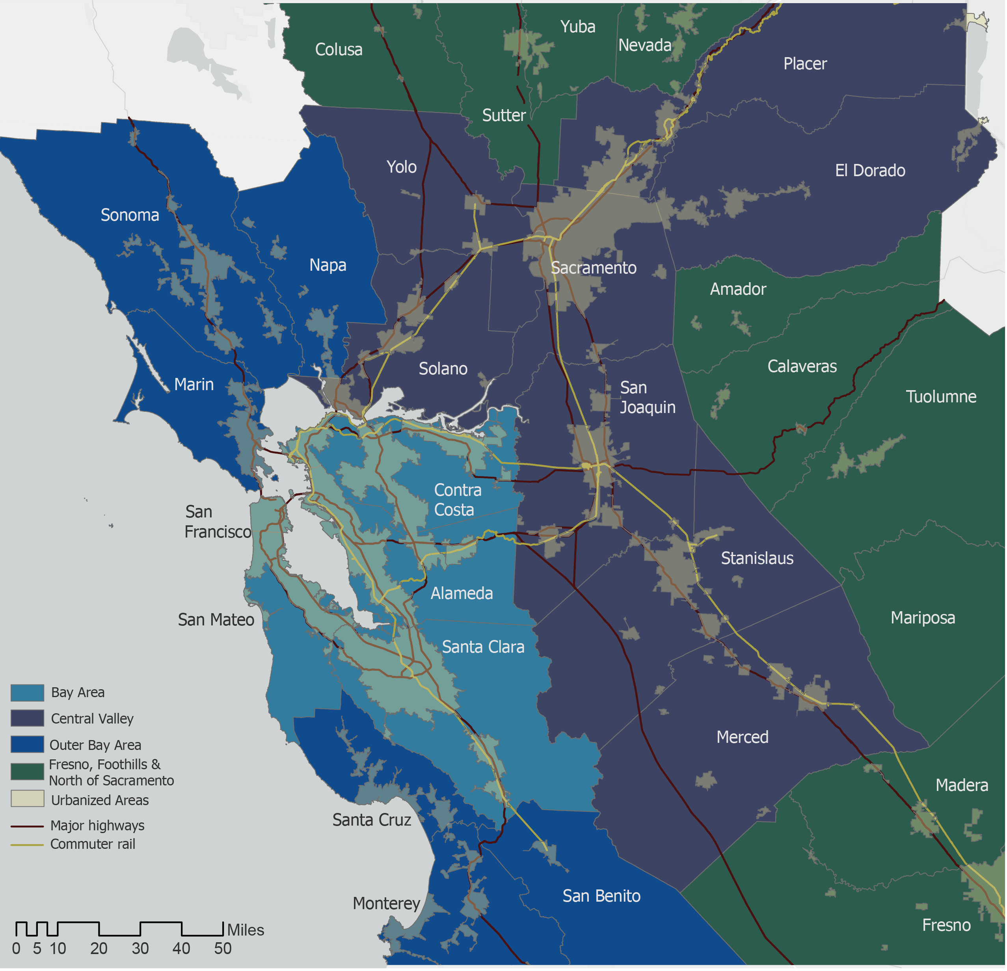
The Geographic Extent of the Study
Bay Area: Alameda, Contra Costa, San Francisco, San Mateo, and Santa Clara counties
Study Area: El Dorado, Merced, Placer, Sacramento, San Joaquin, Solano, Stanislaus, and Yolo counties
Notes:
Central Valley is divided between the Sacramento MSA and the Bay Area Belt. Worth pointing out (maybe even going back to the map for people unfamiliar with the geography).

Slide 4
Data sources
Travel:
StreetLight: Januaray 2019 – September 2021, ZCTA level
COVID-19:
California Department of Public Health: COVID-19 data, county level
Demographics:
U.S. Census Bureau’s American Community Survey (ACS) 5-year estimates: 2015-2019
Time Period:
Pre-COVID: 03/04/2019 – 03/09/2020
During-COVID: 03/10/2020 – 03/09/2021
Post-COVID: 03/10/2021 – 09/25/2021

Slide 5
Peak AM traffic trend
Traffic volumes dropped due to COVID-19 and have not fully recovered
Peak AM (6-10AM) traffic volume dropped 50% in Central Valley, 70% in Bay Area in March 2020
As of September 2021, peak AM volume still below historical average:
by 25% in Bay Area
by 15% in Central Valley
Note: weekly smoothing applied to data, major federal holidays excluded Source: Streetlight InSight

Slide 6
Supercommute rate: pre-COVID vs. during COVID
Despite decreased traffic volume over 2020, supercommute shares did not fall during COVID. In fact, some counties saw large increases
Share of Peak AM travelers going 50+ miles in one Direction
Notes:
While commute traffic decreased in aggregate, supercommute rates were same or higher among those still commuting

Slide 7
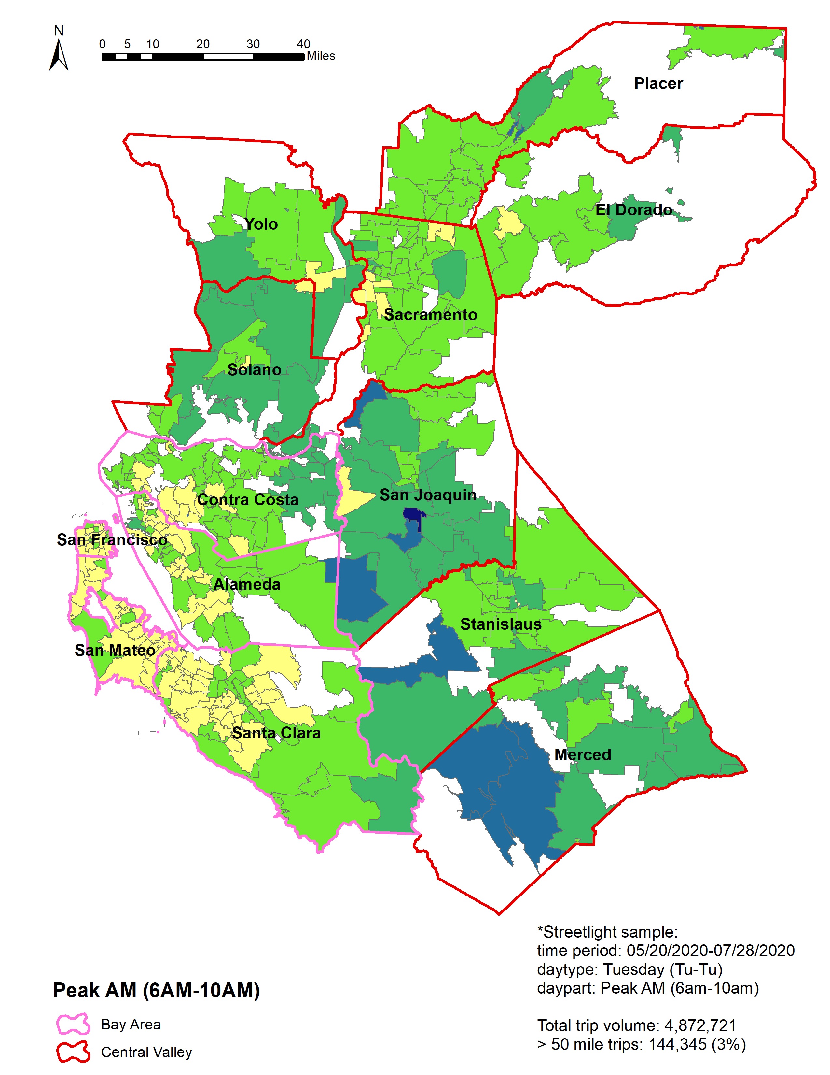
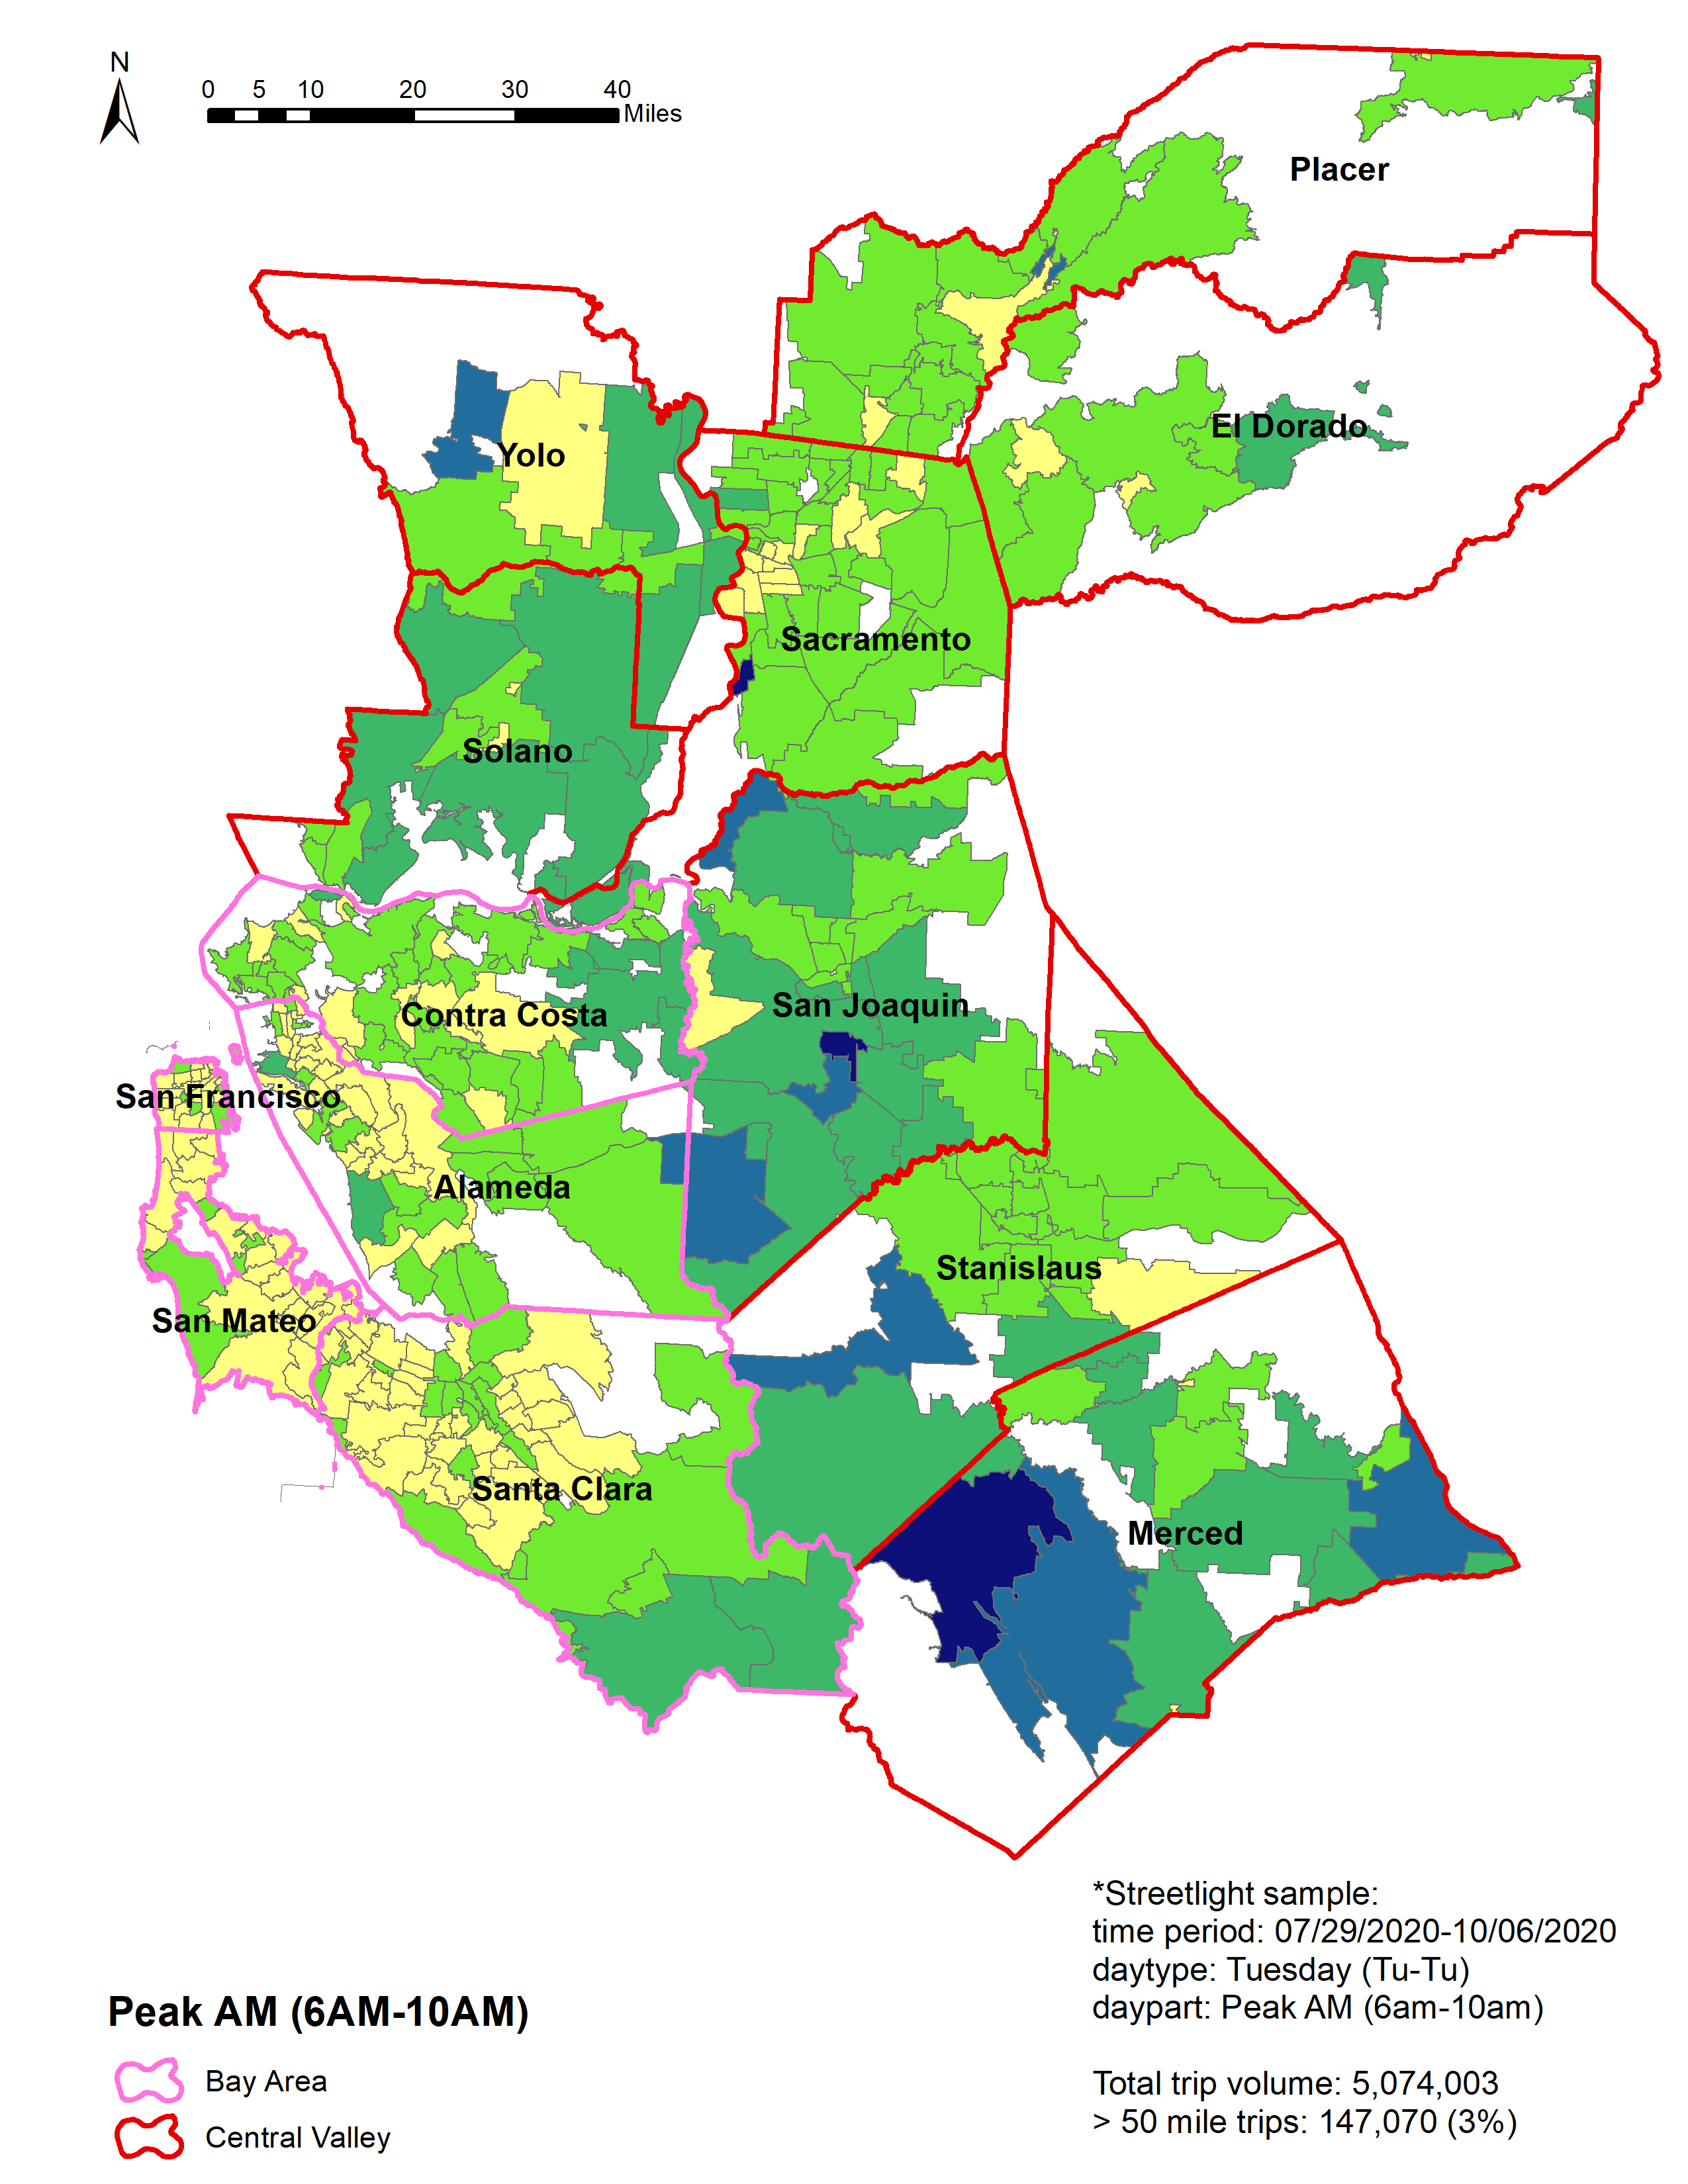
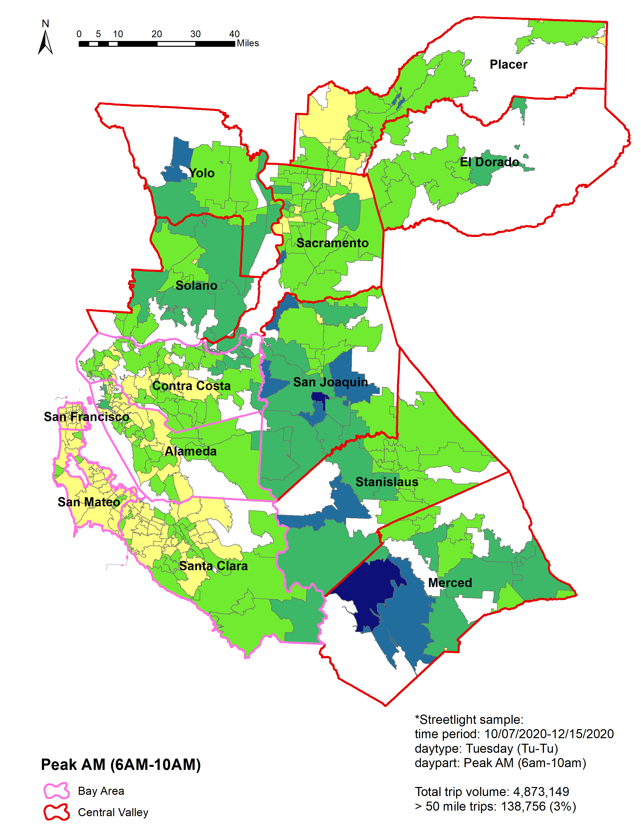
Peak AM Supercommute rates (by Zip Code)
COVID has not strongly shifted supercommute geography.
1/1/2020 – 3/10/2020
3/11/2020 – 5/19/2020
5/20/2020 – 7/28/2020
7/29/2020 – 10/6/2020
10/7/2020 – 12/15/2020
COVID-19 OUTBREAK
Source: Author calculations of data from Streetlight, Inc.

Slide 8
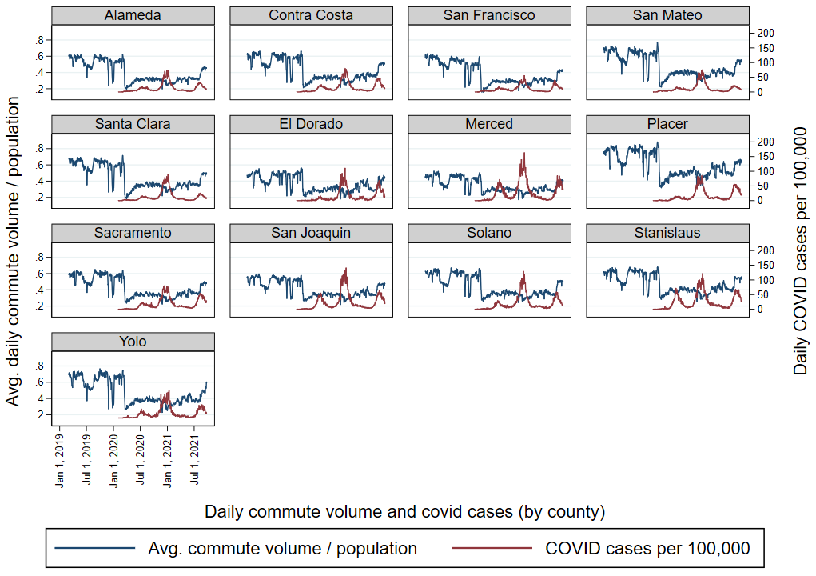
Daily peak AM traffic volume and COVID cases
Time Period: 03/04/2019 – 09/25/2021
patterns between COVID cases and traffic volume are spatially uneven

Slide 9
Methodology
Equation:
Volume_{it} = Average traffic volume during Peak AM hours (6aM-10AM),
C_{s} = Covid Stages (pre, during, post),
I_{p} = Median household income levels (<$25k, $25-49k, $50-74k, $75-99k, > $100k),
O_{q} = Occupation types (management/business/science/arts, service, sales/Office, natural resource/construction/maintenance, production/transportation/utilities),
D_{r} = Travel distance during Peak AM hours (<1, 1-14, 15-24, 25-49, > 50 miles),
w_{i} = Daily covid cases per 100,000,
x_{i} = Demographic controls (total population, total employment, % non-white, % transit commuters, % renters, % below poverty, % college graduated),
i = origin ZCTAs,
t = time index (day).
Notes:
Volume dependent variable

Slide 10
Regression Results
Categories | Variables | Coefficient
Median Houshold Income (base= <$25k) | $25-49k | 2184.673***
 | $50-74k | 4562.263***
 | $75-99k | 5920.965***
 | > $100k | 8585.930***
COVID stage * Median Household Income | during-COVID # $25-49k | -3644.481***
 | during-COVID # $50-74k | -4883.708***
 | during-COVID # $75-99k | -5854.727***
 | during-COVID # > $100k | -7659.252***
 | post-COVID # $25-49k | -2439.174***
 | post-COVID # $50-74k | -3298.201***
 | post-COVID # $75-99k | -4091.410***
 | post-COVID # > $100k | -5627.161***
Occupation (base= business/science/arts) | service | -683.310***
 | sales/Office | -439.195***
 | natural resource/construction | -2579.021***
 | production/transportation | -3847.092***
COVID rate | Daily COVID cases per 100,000 | -16.635***
Control: Demographics | Total population | 0.424***
 | Total employment | -0.119***
 | % non-white | -2875.095***
 | % transit commuters | -6191.351***
 | % renters | 902.241***
 | % below poverty | 414.484***
 | % college graduated | -4958.332***
Categories | Variables | Coefficient
COVID stage * Occupation (base= preCOVID * Occupation) | during-COVID # service | -1800.352***
 | during-COVID # sales/Office | -544.796***
 | during-COVID # natural resource/construction | 2076.762***
 | during-COVID # production/transportation | 2354.530***
 | post-COVID # service | -371.329*
 | post-COVID # sales/Office | -395.493**
 | post-COVID # natural resource/construction | 1429.983***
 | post-COVID # production/transportation | 1995.765***
Commute distance (mile) (base = <1) | 1-14 | 10894.275***
 | 15-24 | 5984.797***
 | 25-49 | 6692.092***
 | > 50 | 6358.063*
COVID stage * Commute distance (mile) | during-COVID # 1-14 | -10872.207***
 | during-COVID # 15-24 | -6091.050***
 | during-COVID # 25-49 | -6090.469***
 | during-COVID # > 50 | -5471.095
 | post-COVID # 1-14 | -8927.993***
 | post-COVID # 15-24 | -4989.415**
 | post-COVID # 25-49 | -5309.231**
 | post-COVID # > 50 | -5207.333
Constant |  | 2094.274***
Observations |  | 137628
R-squared |  | 0.795
Adjusted R-squared |  | 0.795

Slide 11
Conclusion
Income
During COVID, commute trips in ZCTAs with the highest median income decreased the most, while commute trips ZCTAs with the lowest income decreased the least.
In the post-COVID period, commute trips in lower-income ZCTAs recovered more than higher-income ZCTAs.
Occupation
primary and secondary industries generate the least commutes in the pre-COVID period, but most of them remain during the COVID period.
The commute volume of service occupation dropped the most during the COVID period and bounced back the most during the post-COVID period.
Distance
during the post-COVID period, commute trips with longer distances seem to recover the most, and commute trips with shorter distances recover the least.
Demographics
COVID rate is negatively associated with commute volume
positively associated: % renters and % below poverty
negatively associated : % non-white, % transit commuters, and % college graduates

Slide 12
Thank you!
Bonnie Wang, Department of Urban and Spatial Analysis, USC Sol Price School of Public Policy wangbonn@usc.edu
Seva Rodnyansky, Assistant Professor, Urban and Environmental Policy, Occidental College srodnyansky@oxy.edu
Marlon Boarnet, Professor and Department Chair, Department of Urban and Spatial Analysis, USC Sol Price School of Public Policy boarnet@price.usc.edu
Andre Comandon, Department of Urban and Spatial Analysis, USC Sol Price School of Public Policy comandon@usc.edu

