Slide 1
Toward the dust
Life Around the Un-dead Infrastructures of the Indo-Nepal Border

Slide 2
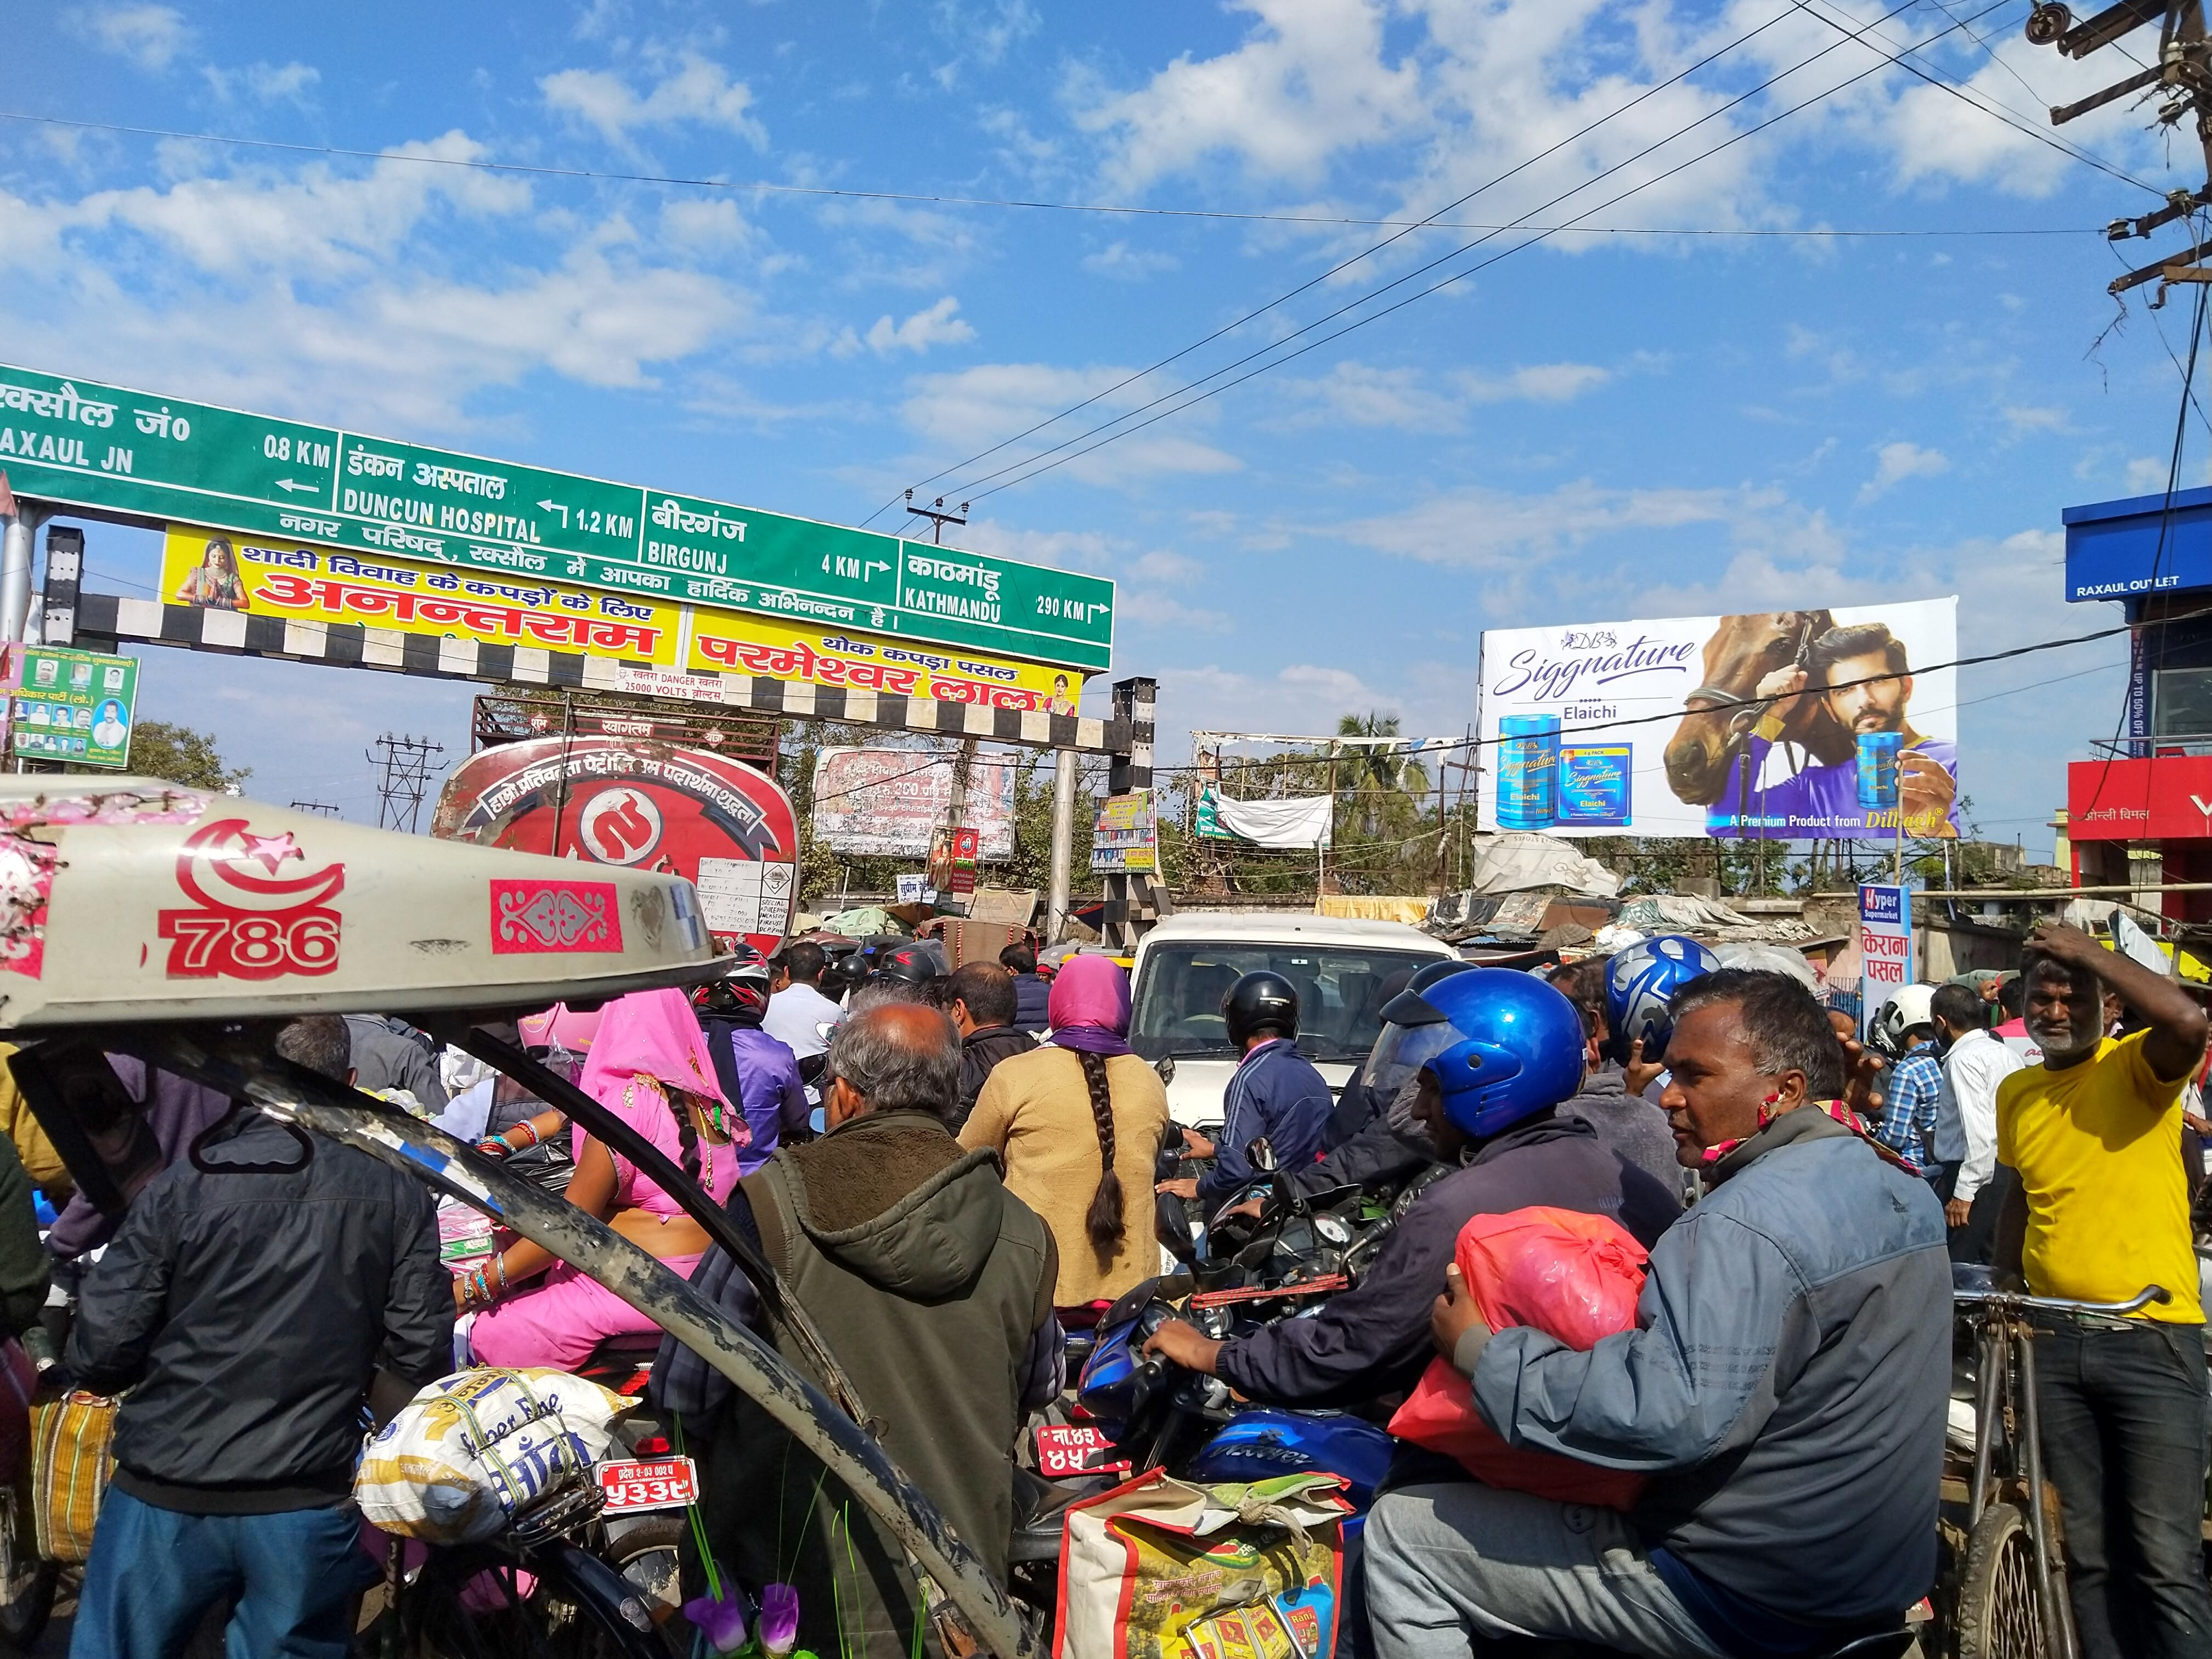
Basic Overview of the borderland
Vignette
Cross-border mobility

Slide 3
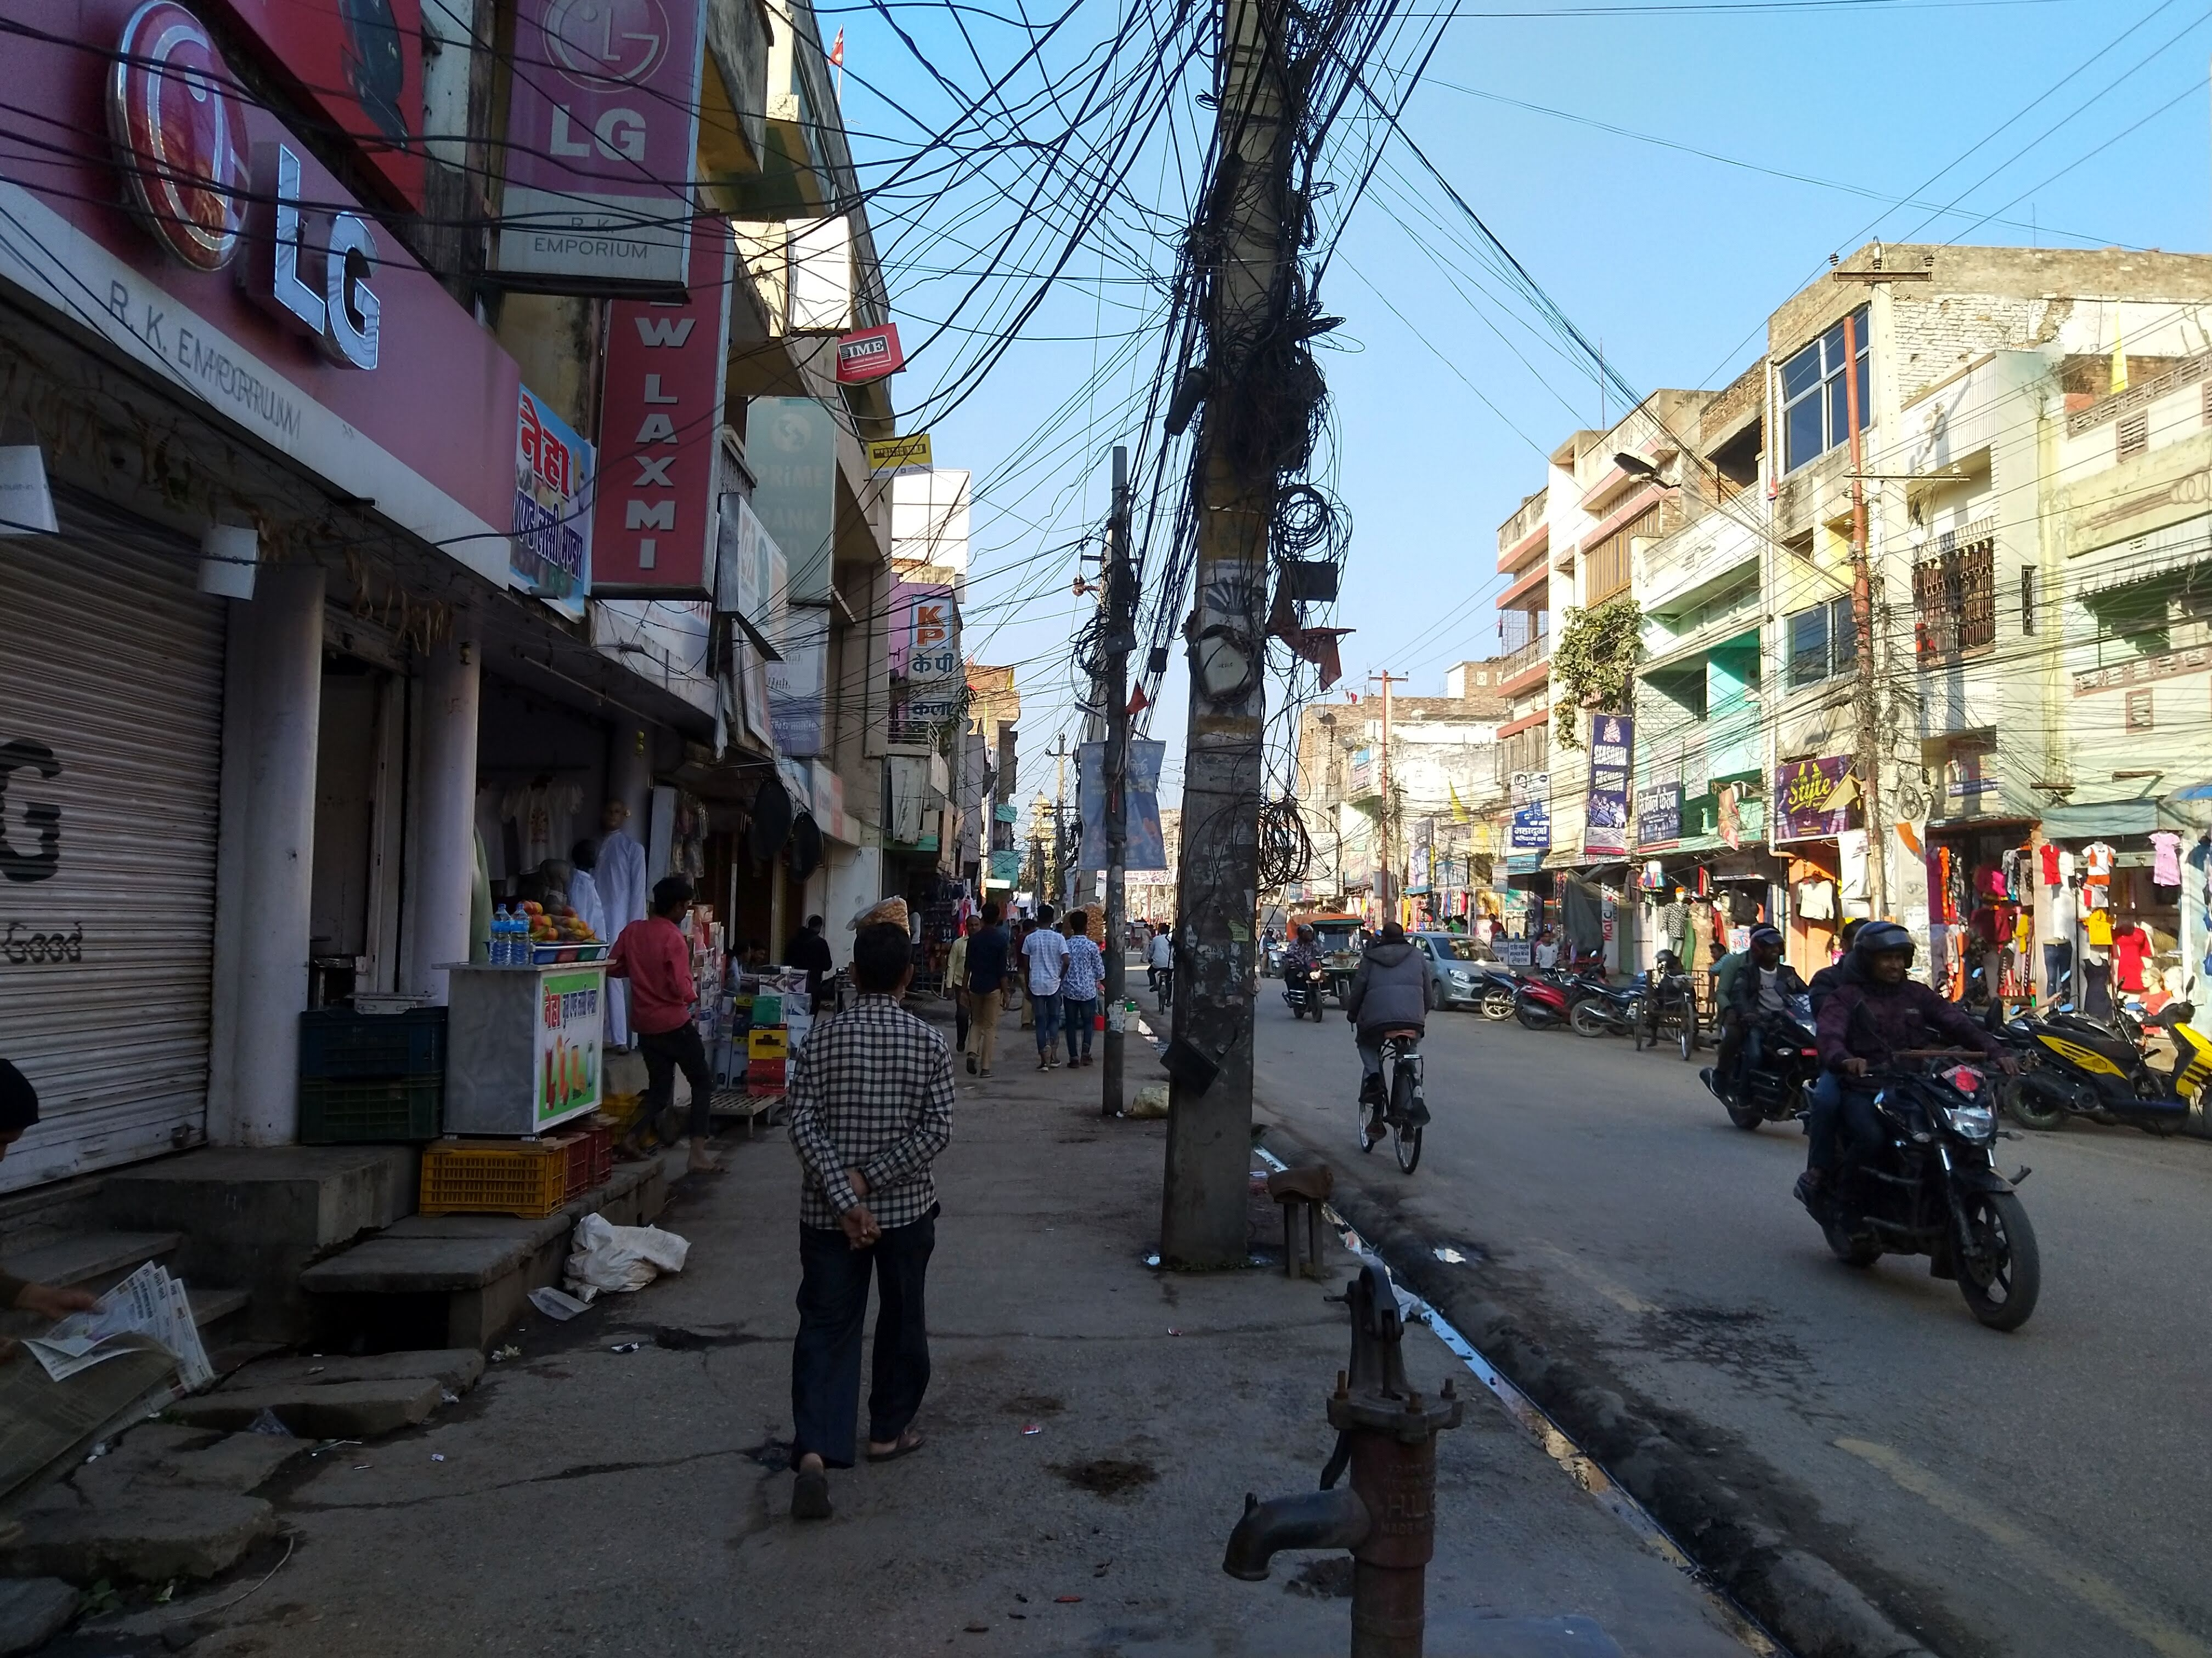

Slide 4
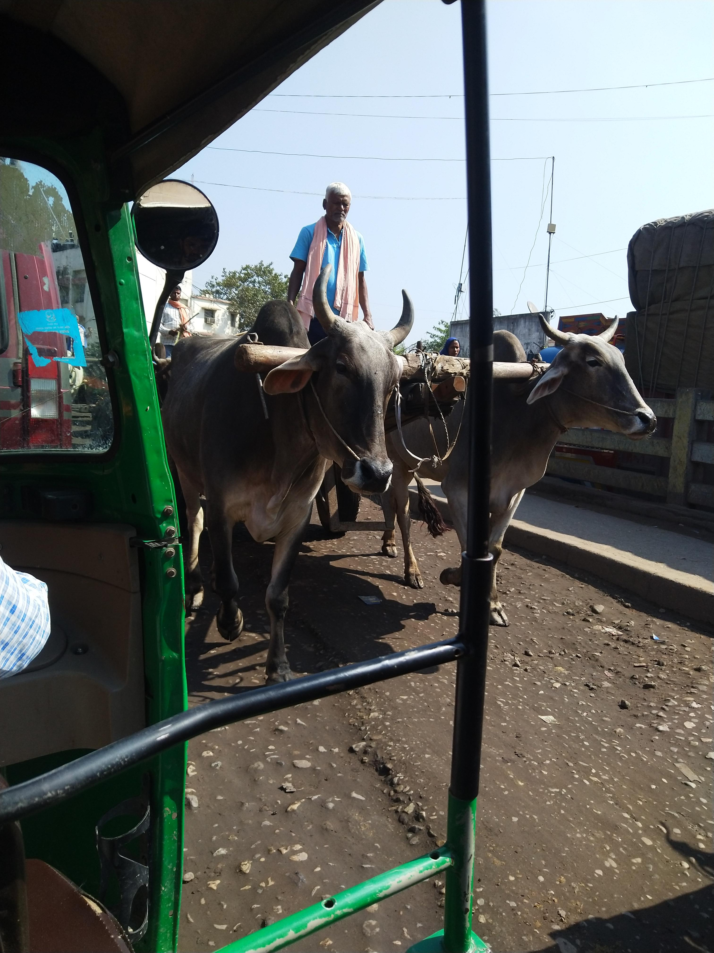

Slide 5
Introduction
- Infrastructures facilitate the relationship between goods, people, and ideas.
- Sensory Anthropology
- Sensory Deprivation vs Experience
- Buffer Zone and the mobility

Slide 6
Theory
-The exploration of the borderland and connectivity through sensing dust
- Sensory deprivation vs Experience in general
- Sensing along
- Active participation vs Passive observation

Slide 7
Questions
In what ways does the infrastructures, dust, and the border come together and explain each other in terms of their paradoxical characteristics?
Can the experience of hinderance that senses face in the borderland explain the borderland itself?
What are the ways in which dust form the experience of the border crossing?
What does studying this borderland through dust contribute to the scholarship?

Slide 8
Un-Dead Infrastructures
- Paradoxical infrastructures
- Different Un-dead infrastructures in focus:
1. The halted construction projects
2. Trains cutting the cross-border connectivity
3. The railway barricade
4. The broken-down road

Slide 9
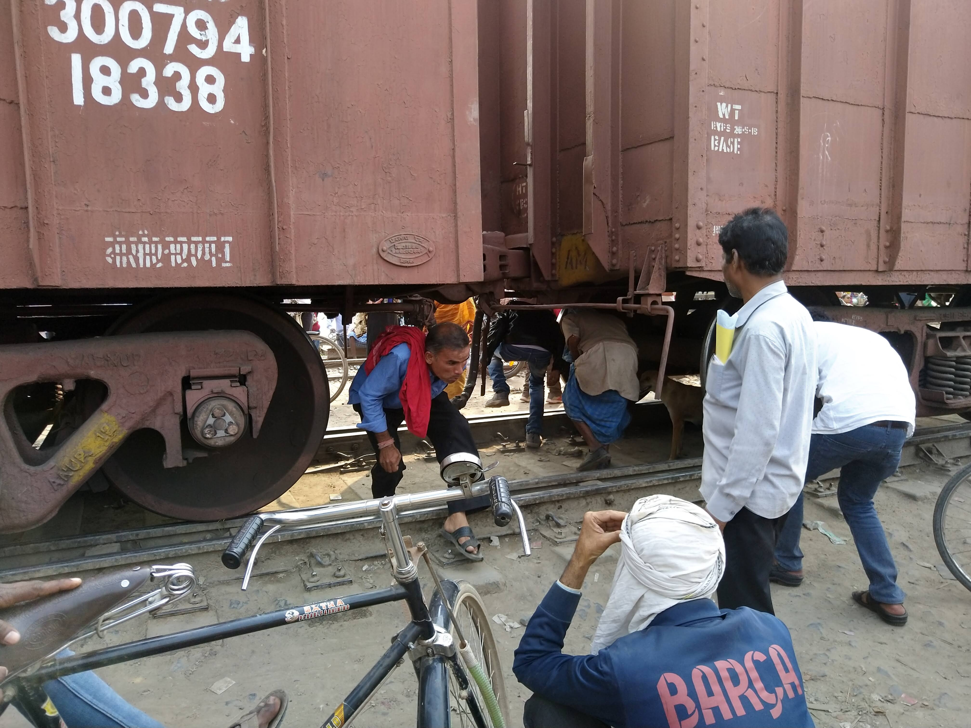

Slide 10
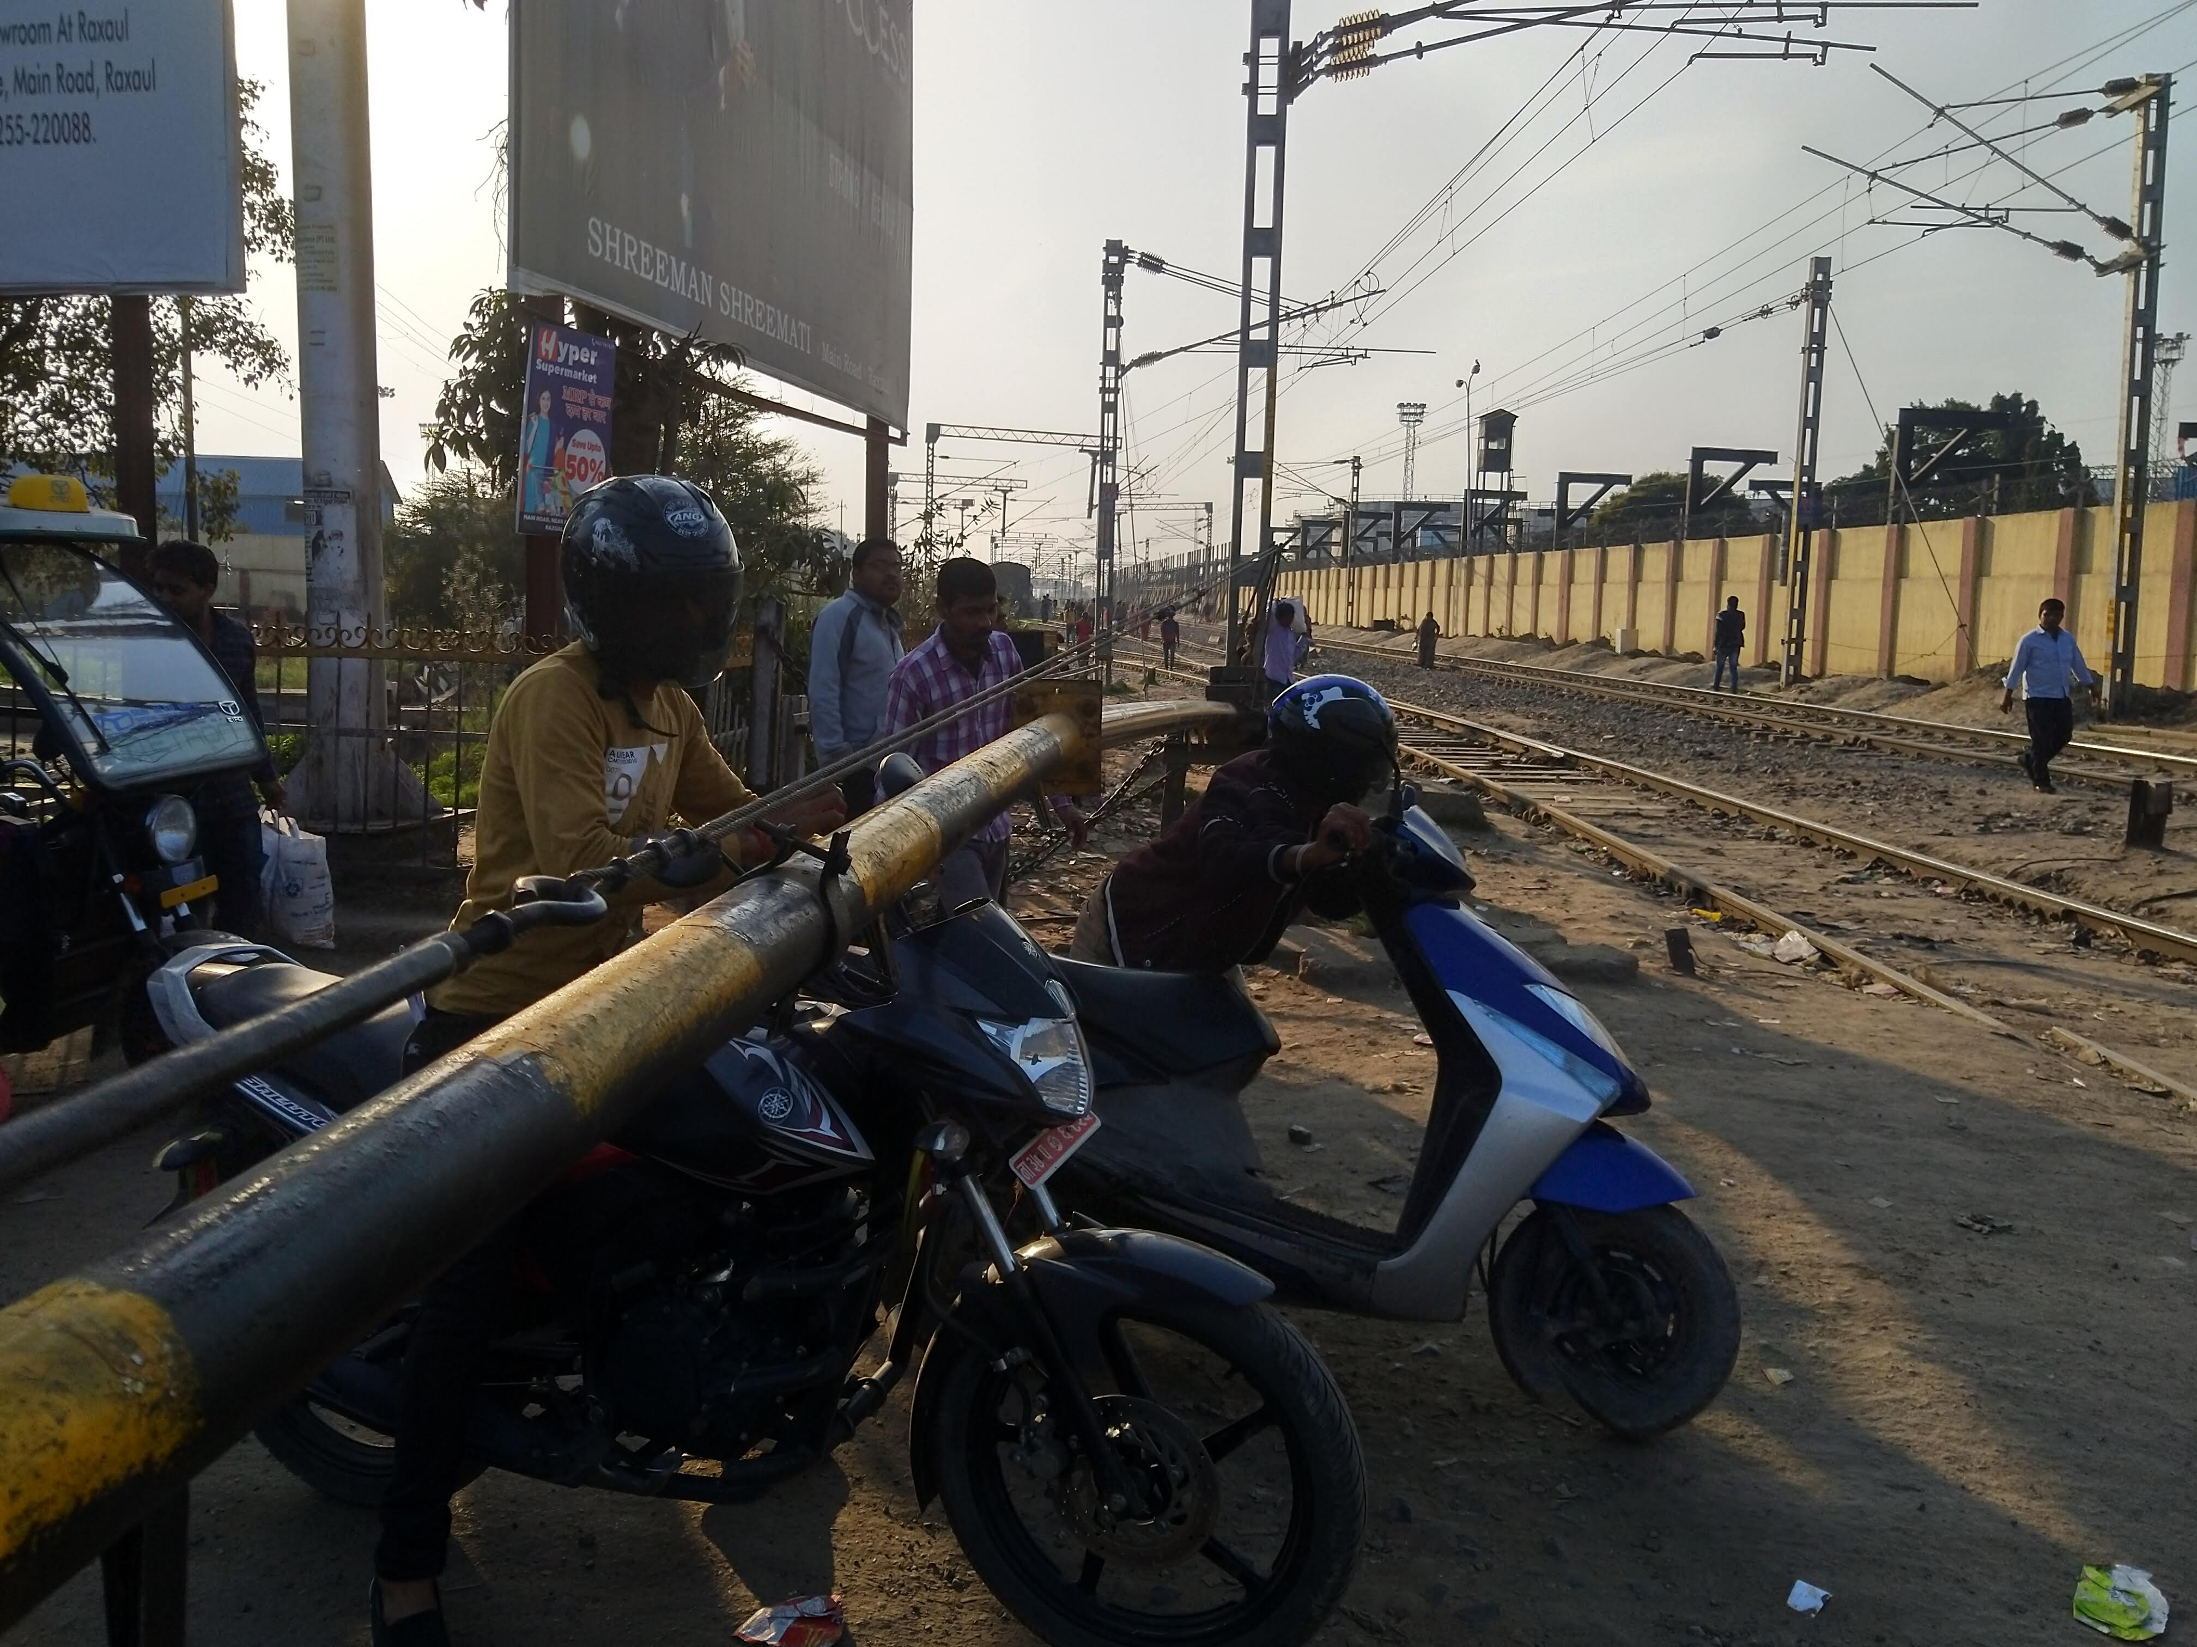

Slide 11
Facilitating and Hindering
- Development in the region
- The dust
- The sense of direction
- Transnational consumption

Slide 12
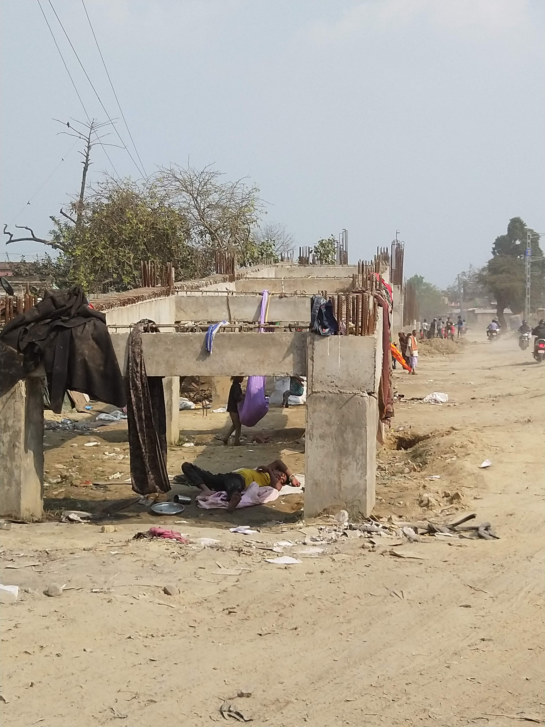
Final reflections
- undead infrastructures hinder the flow
- infrastructures develop new purposes
- dust hinder the flow
- the paradoxical characteristics of dust, the undead infrastructures, and the borderland

Slide 13
end

