Slide 1
Making Oil Digital
John Kendall
U Minnesota

Slide 2
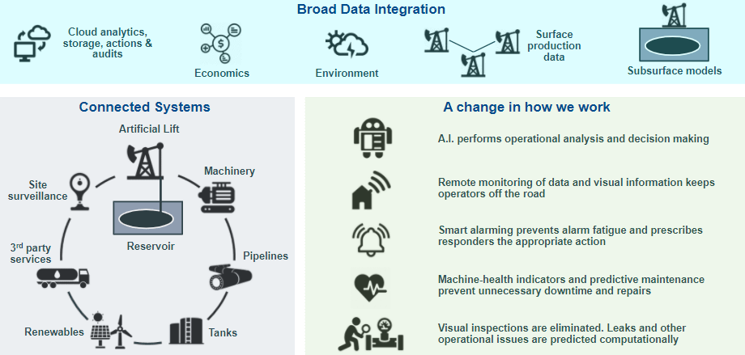
The Digital Oilfield

Slide 4
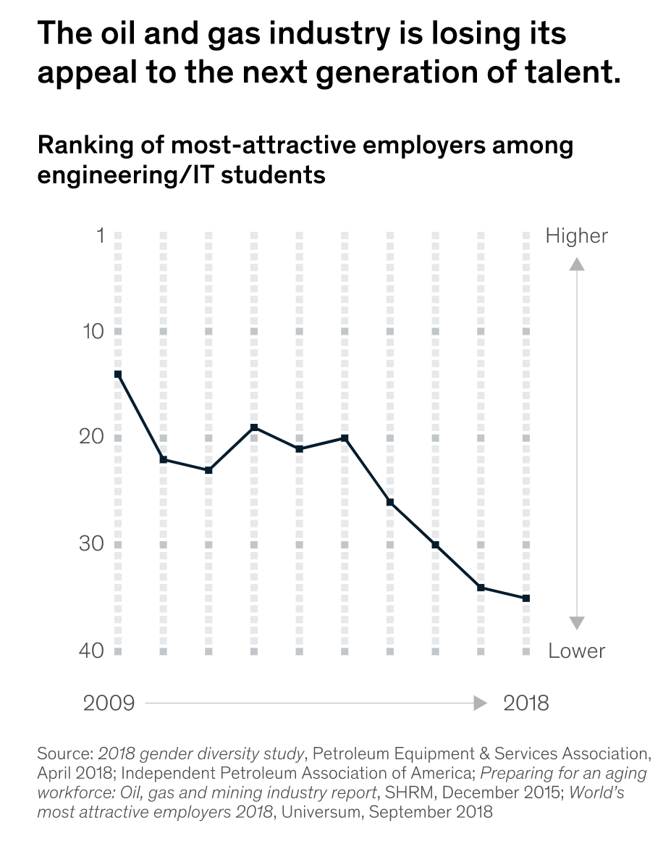

Slide 5
Schlumberger as a data science company
https://www.software.slb.com/blog/data-science-for-all

Slide 6
Johan Krebbers, IT CTO of Shell (former); VP IT Innovation at the Open Group – “Data, data, data”

Slide 7
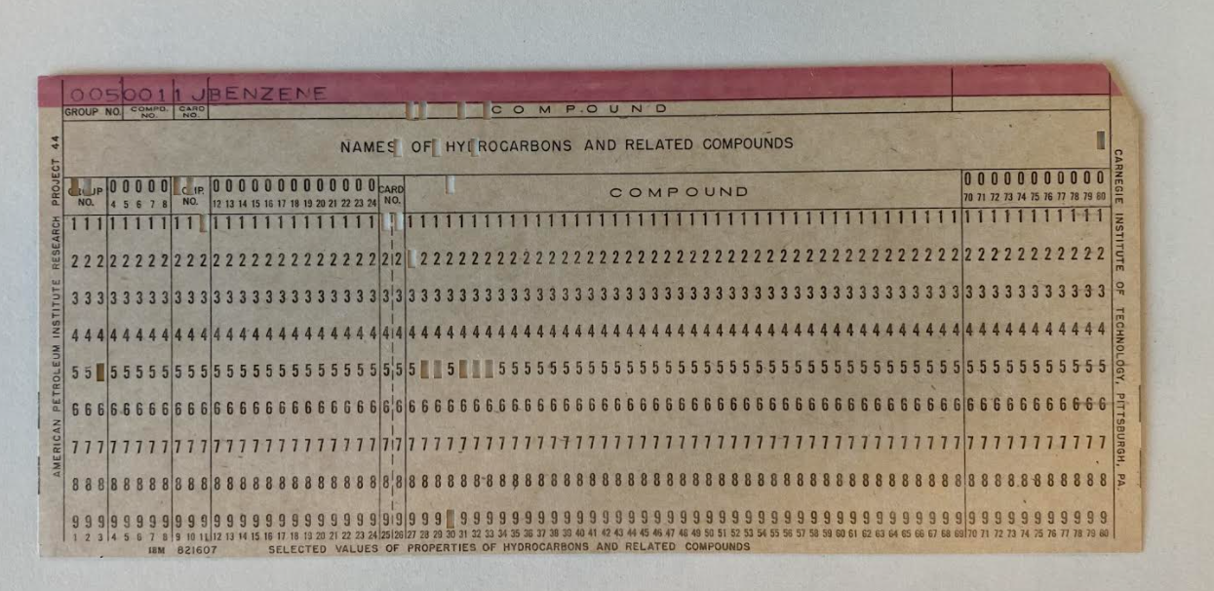
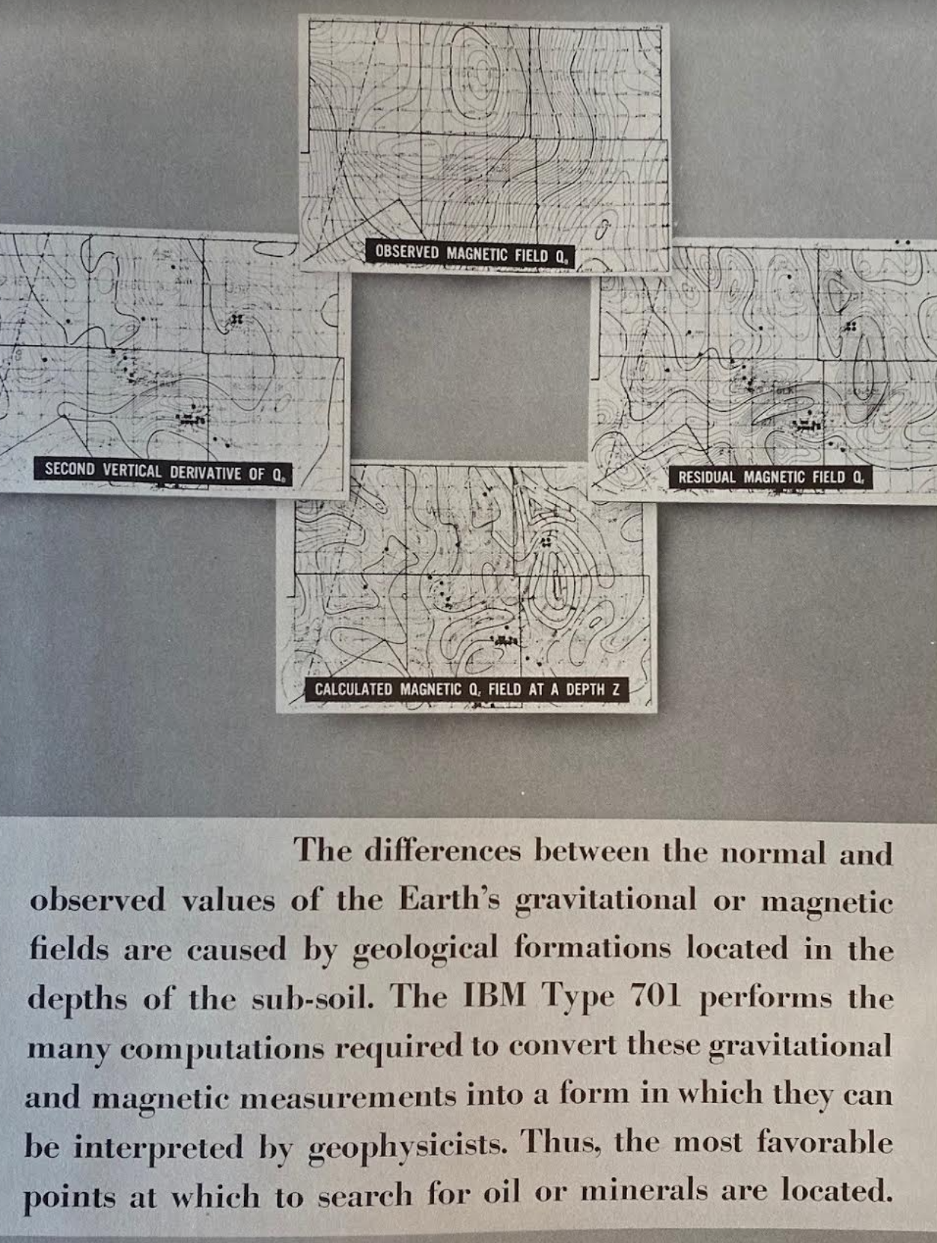
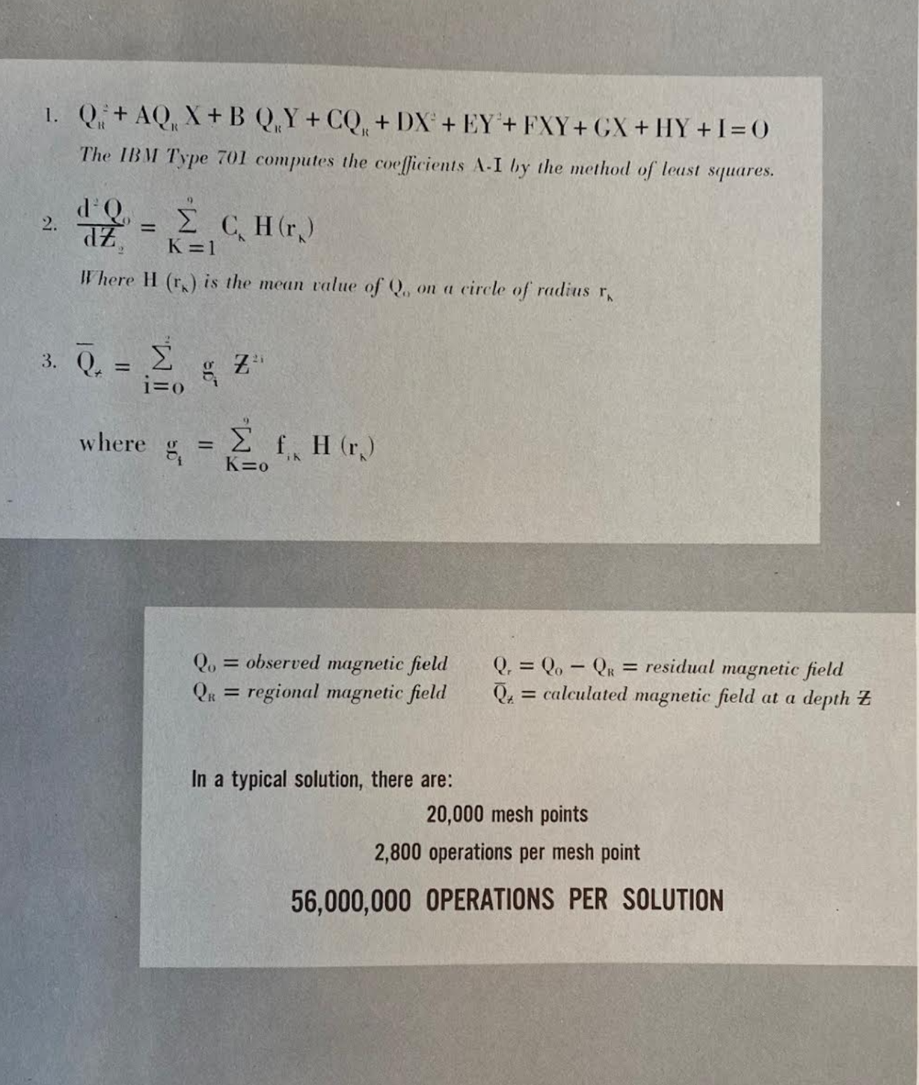
IBM Petroleum Conference, 1953
IBM punch card used by The Texas Company Research Laboratories to code American Petroleum Research Project 44 property tables, comprised in total 36,000 cards (pictured is Benzene name card).

Slide 8
“One day, [George] Wadsworth and [Patrick] Hurley fell into a discussion about the use of mathematics in geology. As the story goes, Wadsworth was needling Hurley a bit, chiding him because he thought not enough mathematics was being used in geology. Wadsworth was used to analyzing weather time-series data, which he described as data that “go up and down.” Hurley said that seismic traces also “go up and down,” and that geophysicists had to “eyeball” them in order to pick reflections. One day, on the way to the car pool, Wadsworth passed by the office of Hurley, who pulled down an issue of GEOPHYSICS with some pictures of wiggly-trace seismic records.”
-as retold by Enders Robinson (student of George Wadsworth and Norbert Wiener at MIT), “The MIT Geophysical Analysis Group (GAG) from inception to 1954,” Geophysics vol. 70, no. 4 (2005)

Slide 9
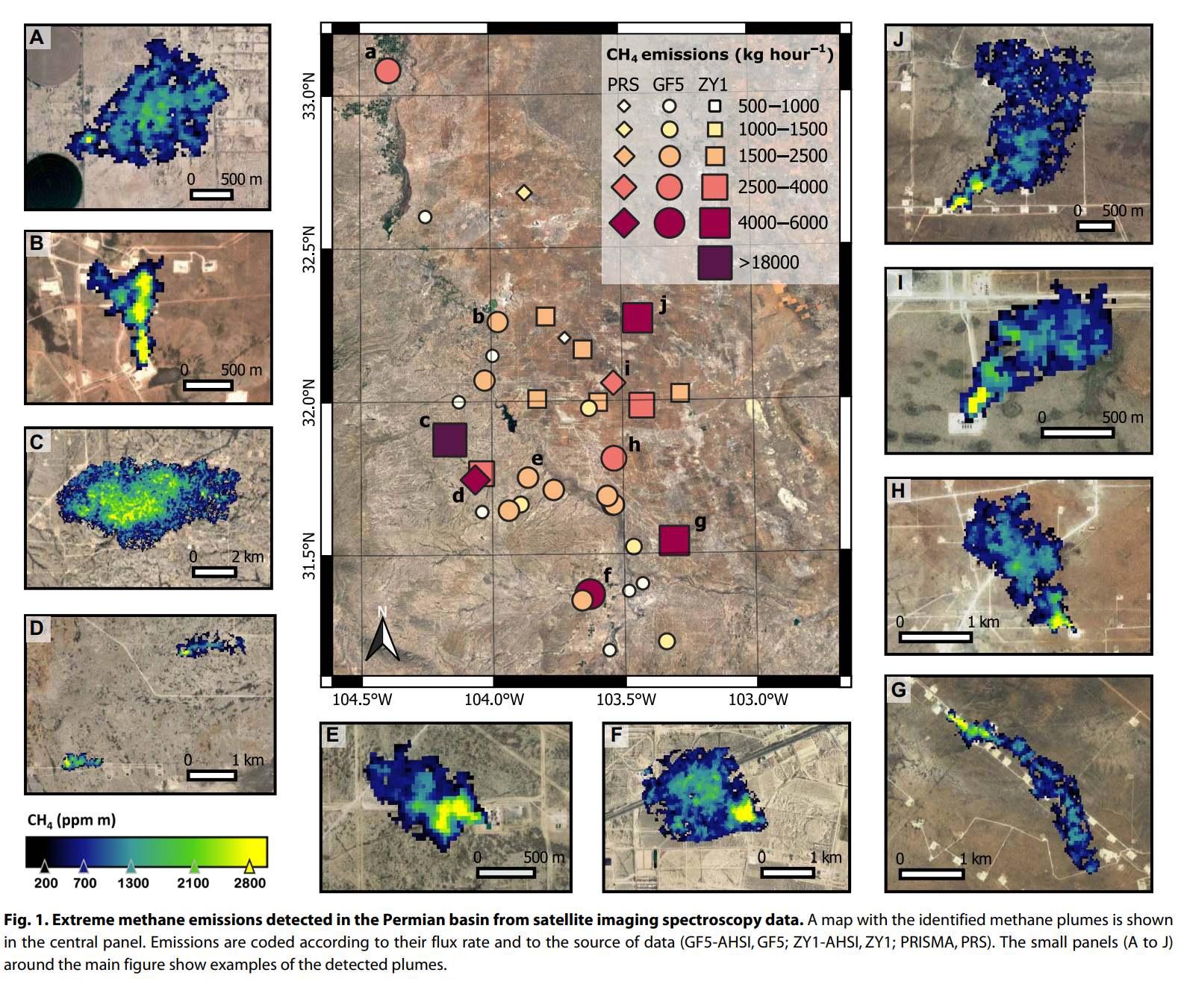
“Oil in the Cloud” (Greenpeace 2020)
“Satellite-based survey of extreme methane emissions in the Permian Basin (Irakulis-Loitxate et al. 2021)

Slide 10
Yuk Hui
Anti-substantialism
Relational ontology, drawing on Heidegger, Stiegler, and Simondon
Renewal of the critical project of Kant in light of cybernetics, as “new condition for philosophizing”
Cosmotechnics emerges from this philosophical inquiry, from QCT in China, now in conversation with decolonial thought

Slide 11
Antinomy of Technology
Thesis: technology is universal anthropological condition (Stiegler, Leroi-Gourhan)
Antithesis: technology is not universal; it is an equivocable index of ontological (or cosmological) difference (Viverios de Castro)
“Cosmotechnics” is displacement of this antinomy; does not ‘end’ modern technology but assumes its ubiquity so as to “bifurcate” its constitutive technical practices in their re-attachment to other cosmological-moral orders.

Slide 12
Missing: Labor and Capital
“Critique of capitalism is fundamentally a critique of technology” (Hui, R&C)
Marxism: ‘modern technology’ is reification of capitalist science in machinery, which informs or “modulates” surplus labor in order to increase extraction of relative surplus value (cf. Pasquinelli)
Marxist critique of cosmotechnics: ‘pluralism,’ whether cultural, ontological, or technological, is the negative expression of the false universalism of the value-form.

Slide 13
Limits to cosmotechnics
Ultimately inadequate expression of heterogeny which simply disavows in “bifurcations” the universal class it already implies negatively, rather than negating the negation in dialectical movement of labor, i.e. class struggle.
Proposal, against cosmotechnics, to reintroduce social individual, which results from engagement of labor not in re-attachment to ‘cosmological orders’ but in determinate negation of its own conditions of existence; and, in particular, in the development of collective, practical consciousness—general intellect.
In this way to autonomize information and communication technologies, in so doing bring about the practical re-evaluation of ICT—not just what makes things worth producing, but knowledge worth knowing, and life worth living (cf. Lemmens).

Slide 14
Digital oilfield from perspective of labor
Expresses present boundary condition of practical consciousness of labor – to regard not only its social being but now also the ground beneath its feet as an abstract probabilistic reality it is compelled by value-form to really reproduce—namely, in the wholesale liquidation of the Earth.
Heidegger’s QCT is a critique of reification also, yes, but not from the perspective of labor; Hui follows suit.
“Eco-Leninism” risks repeating tired Soviet scientism if it does not compel revolutionary transformation of scientific consciousness in and for itself, resolving rift between “algorithmic” and “folk knowledge” (Arboleda)
And introduce autonomy of the social individual: restoration of social consciousness to the practical, determinate mediation of its own sensuous objectivity.

