Slide 1
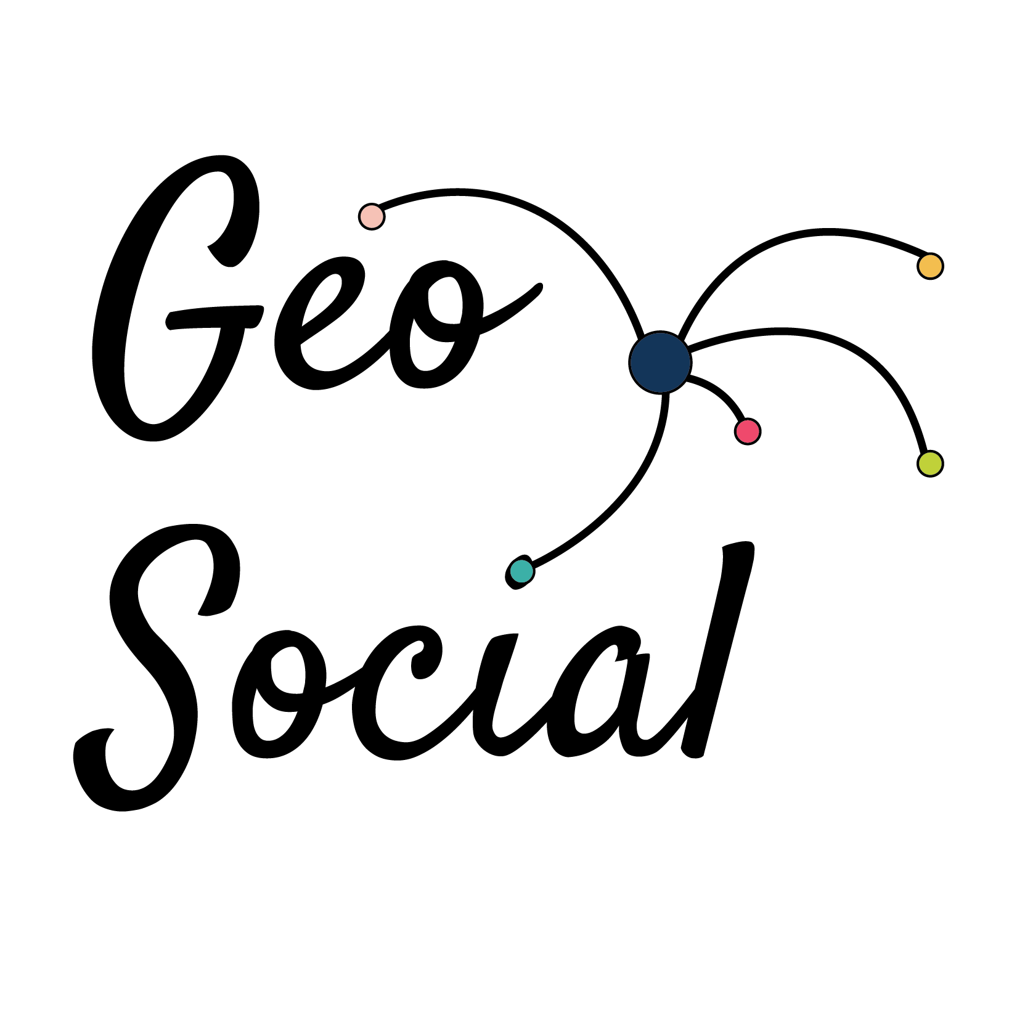
Harnessing Geospatial Big Data for Infectious Diseases
February 26, 2022
FlowMapper.org
A web-based computational and visual framework for flow mapping and analysis
Caglar Koylu*, Geng Tian & Mary Windsor
Department of Geographical and Sustainability Sciences, University of Iowa
@caglarkoylu
caglar-koylu@uiowa.edu
https://www.geo-social.com/
Caglar Koylu, Geng Tian & Mary Windsor (2022) Flowmapper.org: a web-based framework for designing origin–destination flow maps, Journal of Maps, DOI: 10.1080/17445647.2021.1996479

Slide 2
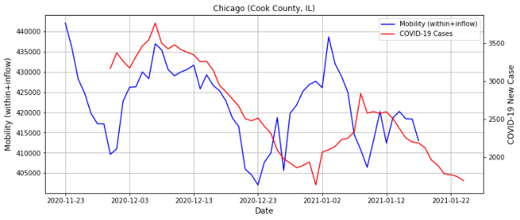
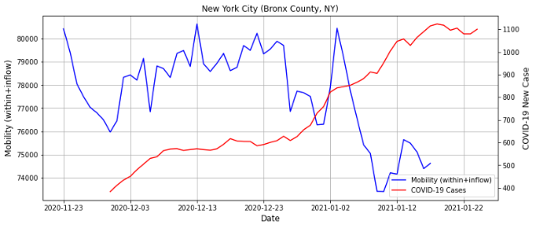
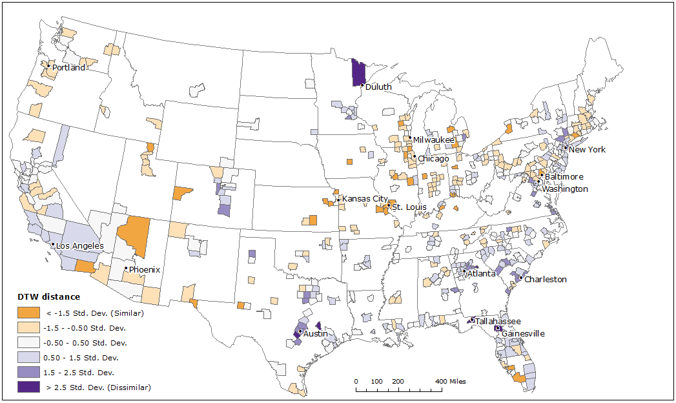
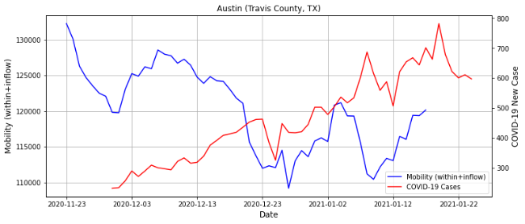
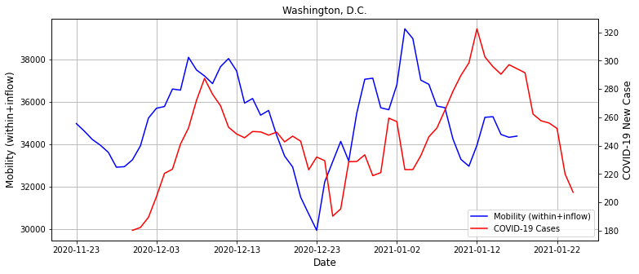
Disease Transmission & Mobility
Kwon, H., Hom, K., Rifkin, M., Tian B. & Koylu, C. (2021). Exploring the spatiotemporal heterogeneity in the relationship between human mobility and COVID-19 prevalence using dynamic time warping. GIScience 2021 Workshop on Advancing Movement Data Science (AMD’ 2021), September 27, 2021, World Wide Web.

Slide 3
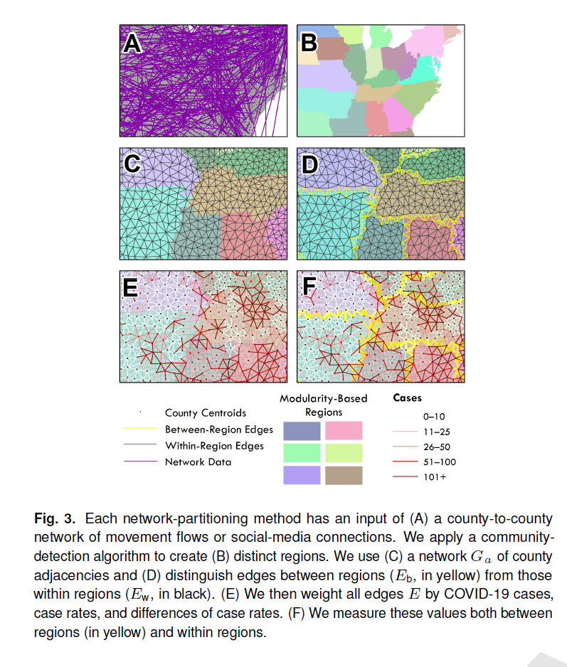
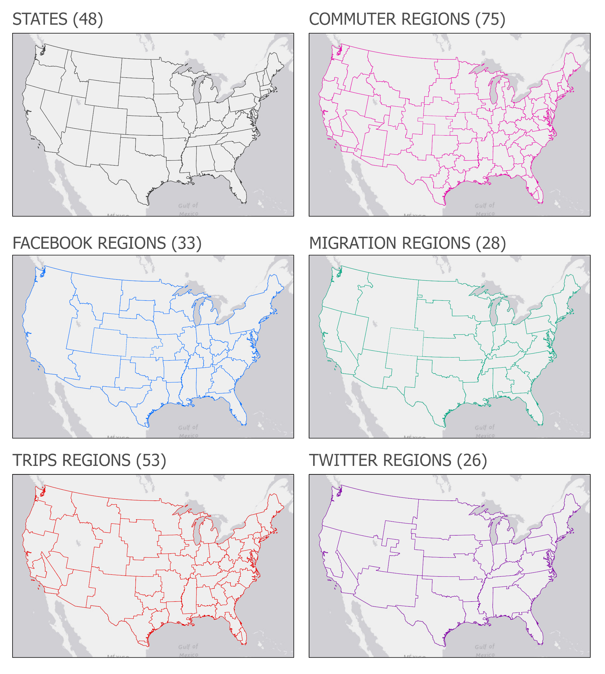
Disease Transmission & Mobility
Human-network regions for disease mitigation
Andris, C., Koylu, C., & Porter, M. (In Review) Human-Network Regions as Effective Geographic Units for Disease Mitigation

Slide 4
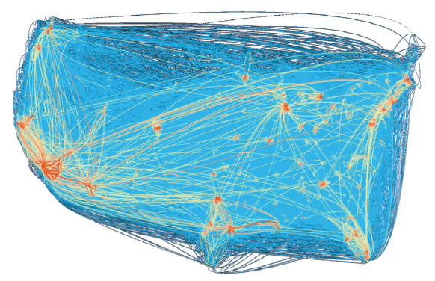
Mapping Flows

Slide 5
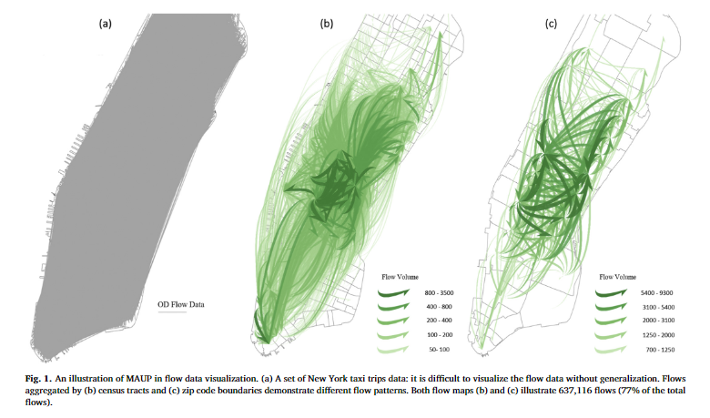
Modifiable areal unit problem (MAUP) in flow mapping
Zhu et al., 201

Slide 6
How to summarize flows?
Filtering – show the top 100 flows with the highest volume
Modularity – normalize flows based on populations or total flow volumes of origins and destinations
  Observed – Expected Flows
Aggregation
  Using predefined regions (e.g., census tracts, counties, states, etc.)
  Regionalization – identifying regions in which there are more flows within each region than between regions
Flow Density Estimation
  Smoothing flows by considering the neighboring flows of origins and destinations

Slide 7
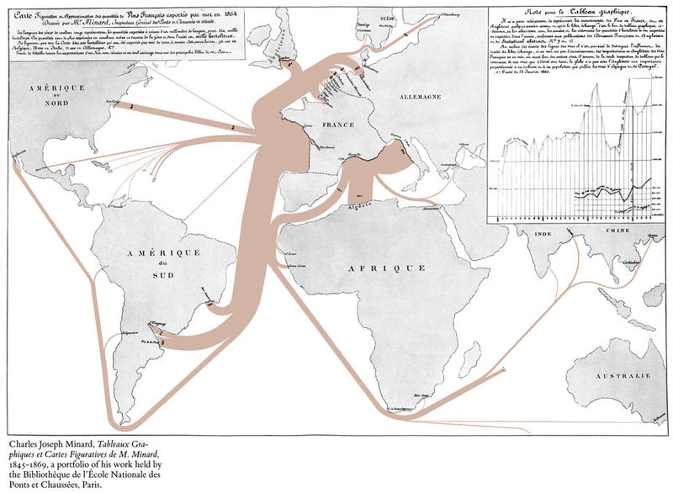
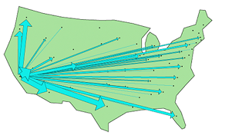
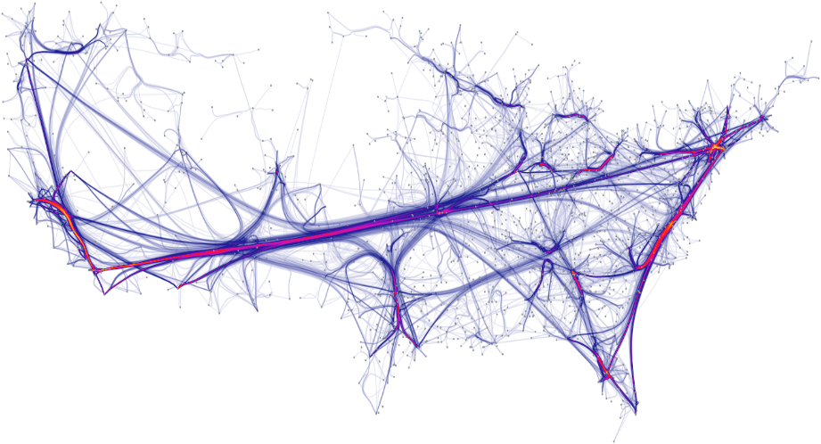
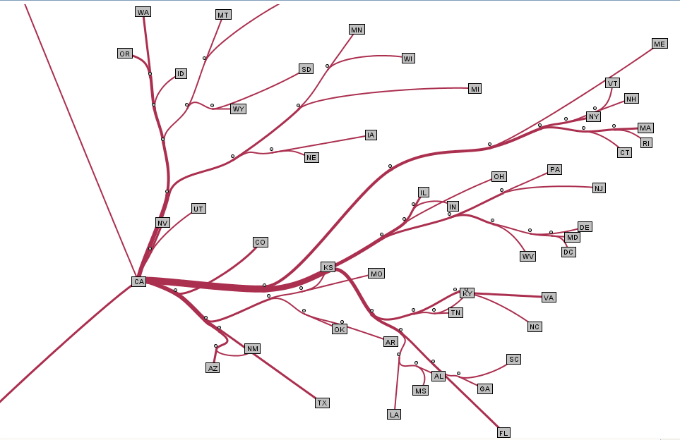
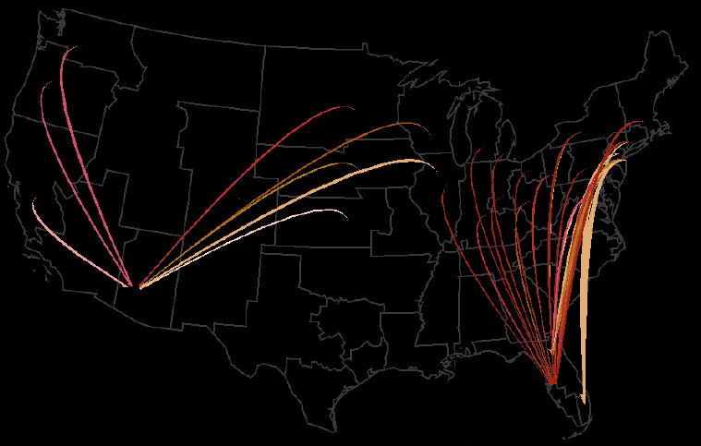
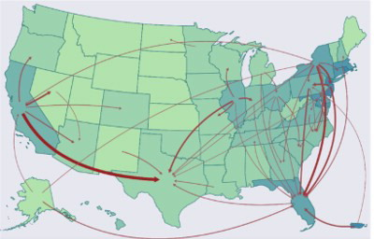
Flow Map Design
Minard 1845
Tobler 1987
Holten et al., 2010
Phan et al., 2005
Guo, 2009
Jenny et al., 2018 & Stephen & Jenny, 2017

Slide 8
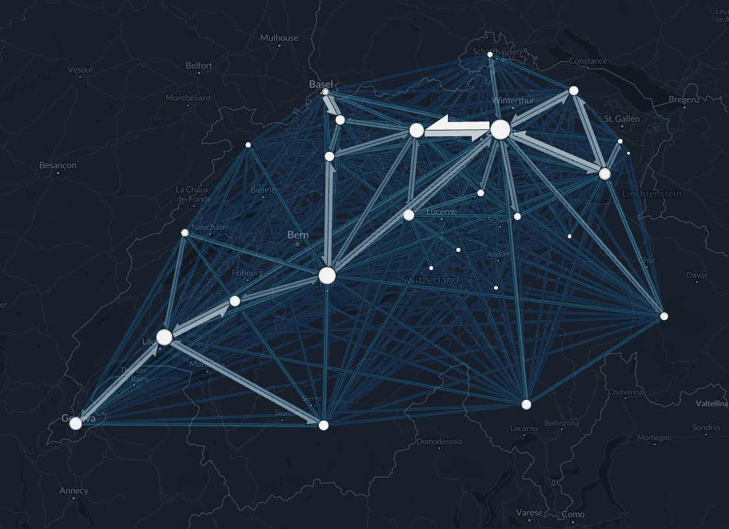
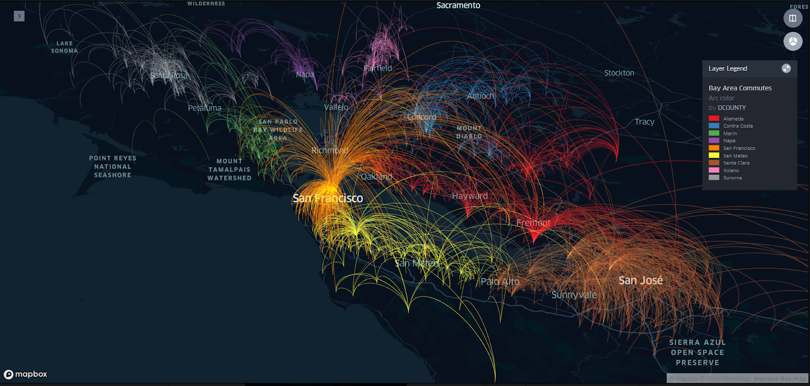
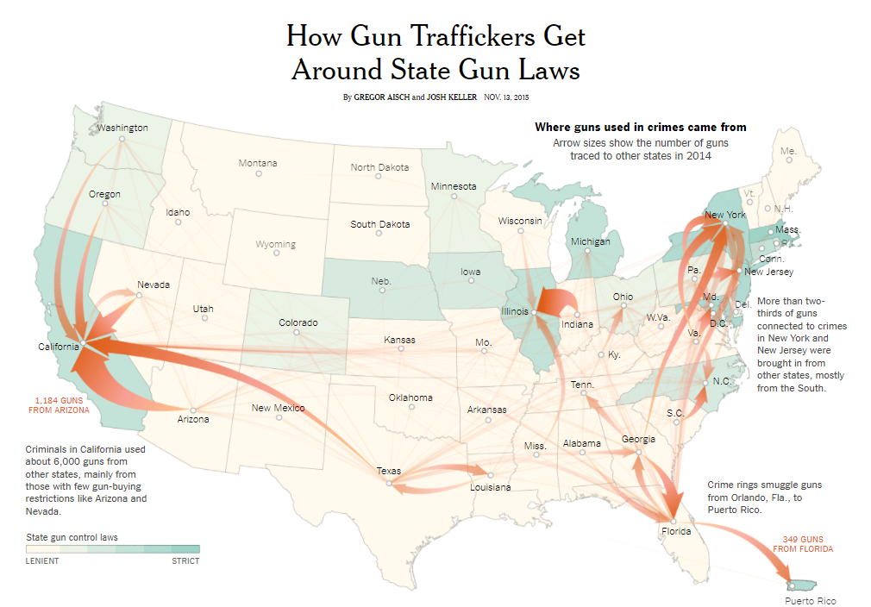
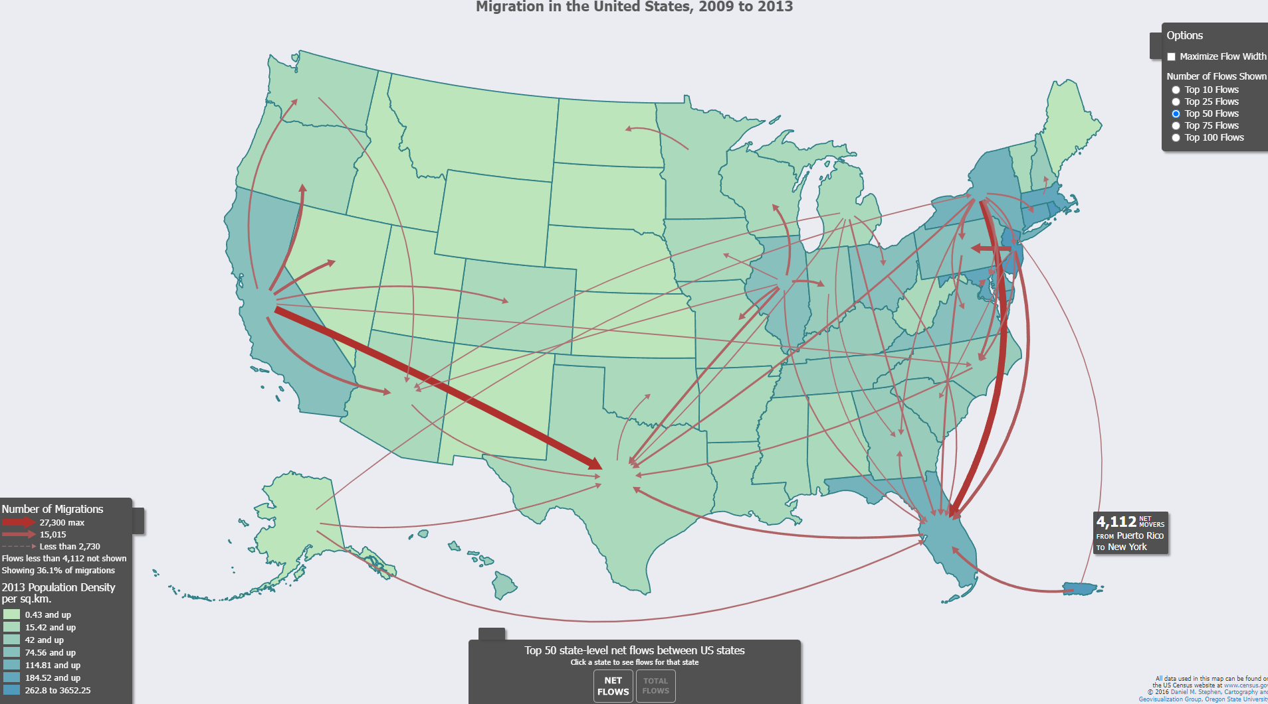
Existing Flow Mapping Systems
Kepler.gl
Flowmap.blue
US Migration Flow Mapper (Stephen & Jenny 2018)
New York Times

Slide 9
FlowMapper - Contributions
Upload and process your own data to produce, customize and share flow maps.
Customize the flow line symbology by including options to change the flow line style, width, and coloring
  Support different flow map reading tasks such as comparing flow magnitudes and directions and identifying flow and location clusters that are strongly connected with each other.
Add supplementary layers such as node symbol, choropleth, and base maps to contextualize flow patterns with location references and characteristics
User interactions to zoom, filter, and obtain details-on-demand functions to support visual information seeking about nodes, flows and regions.
Server-side computational capabilities to process, normalize and summarize large flow data to reveal natural patterns of flows.

Slide 10
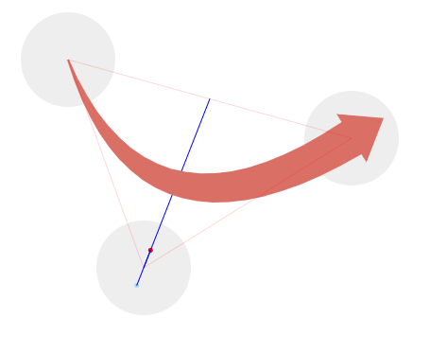
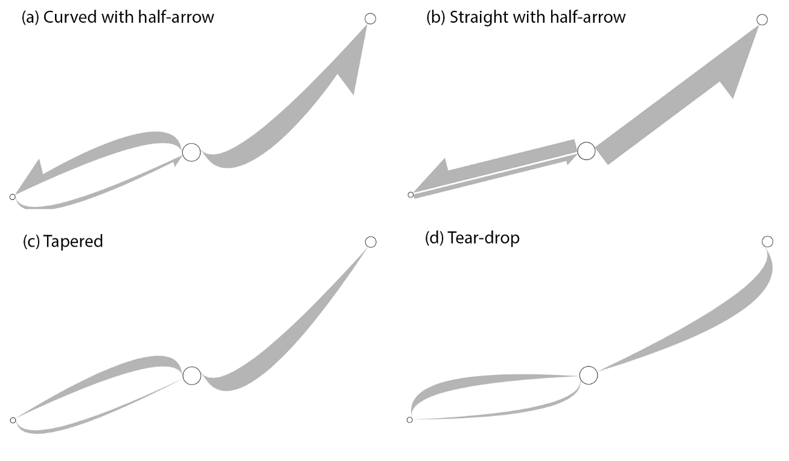
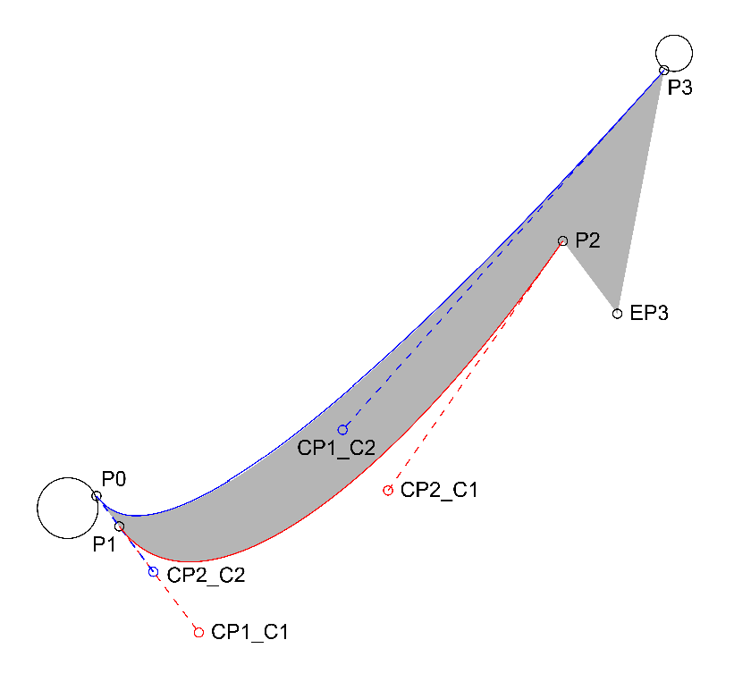
Flow Line Symbology
FlowMapper.org
New York Times
FlowMapper.org
Koylu C, Guo D. Design and evaluation of line symbolizations for origin–destination flow maps. Information Visualization. 2017;16(4):309-331. doi:10.1177/1473871616681375

Slide 11
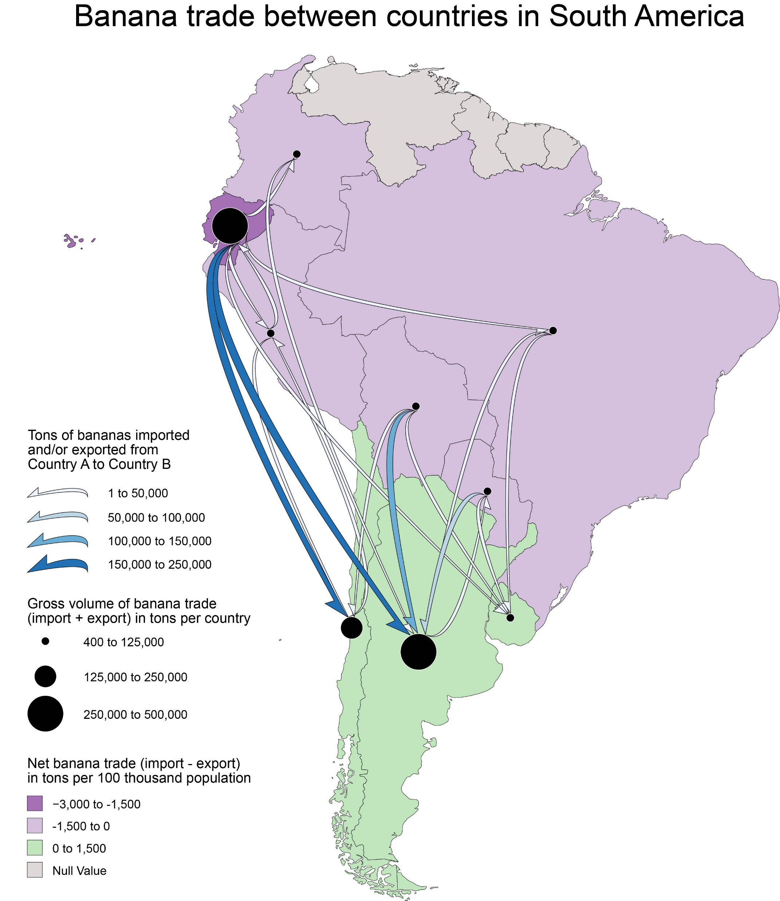
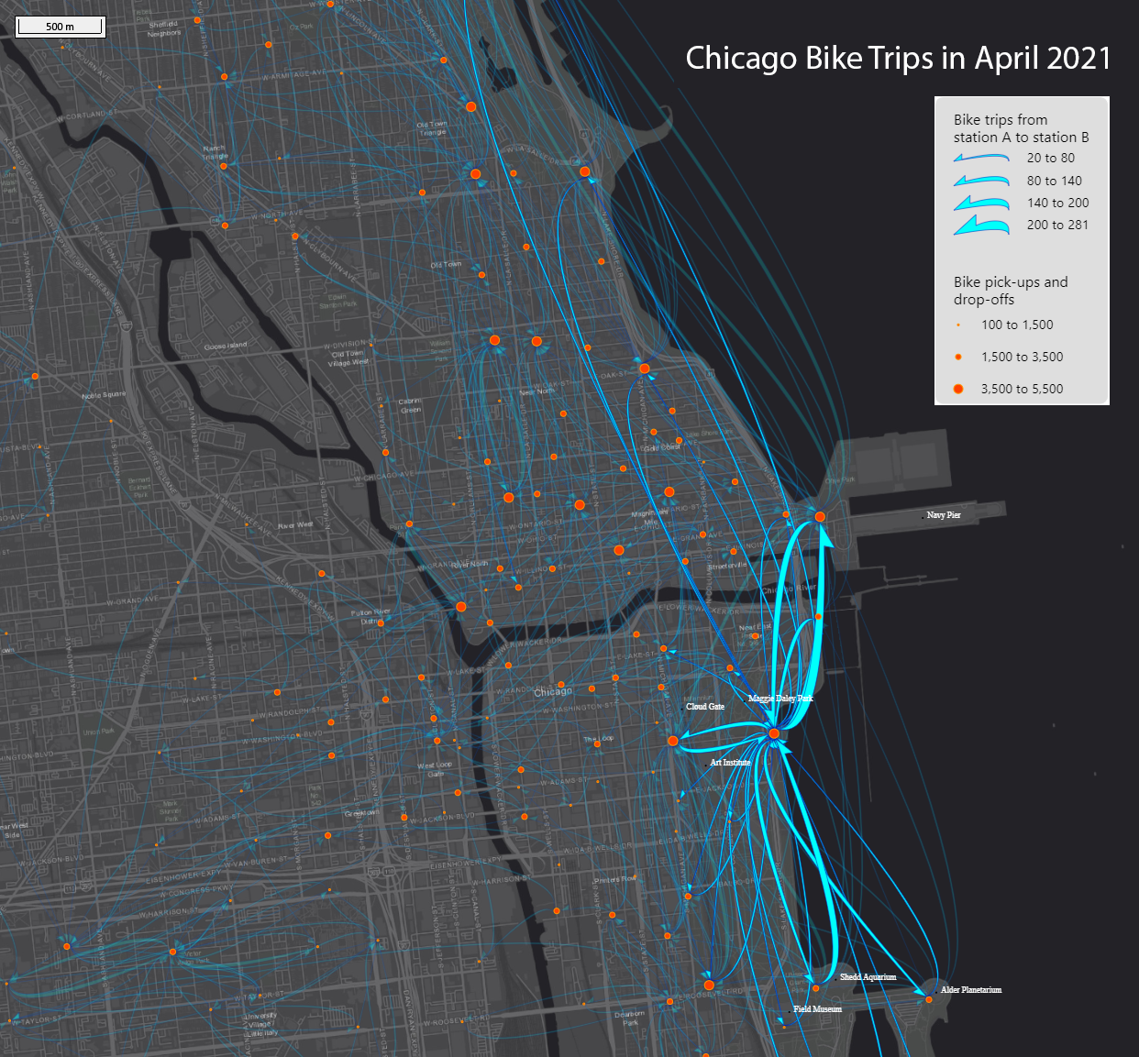
FlowMapper.org

Slide 12
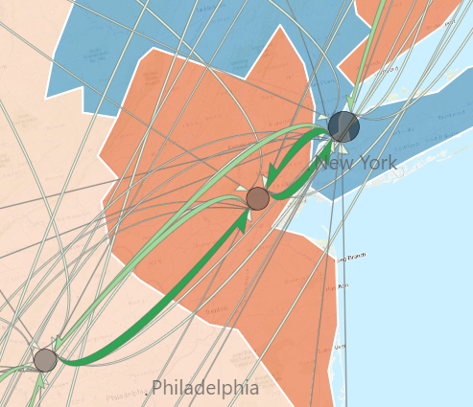
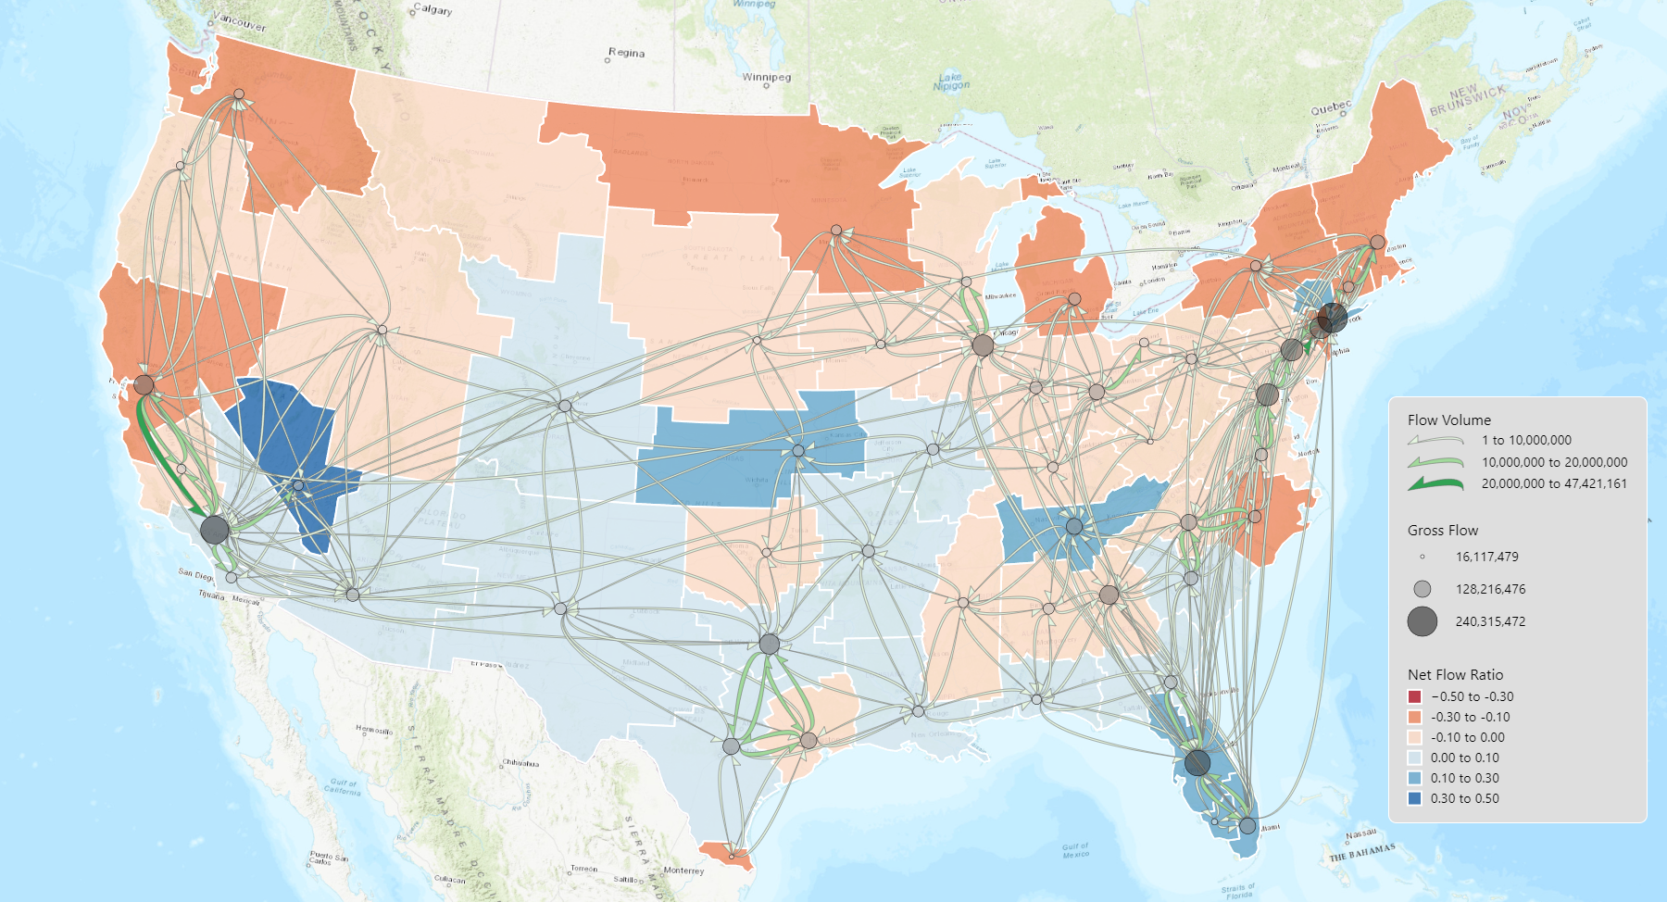
Human Mobility (SafeGraph) during COVID-19
November 1 - December 31, 2019

Slide 13
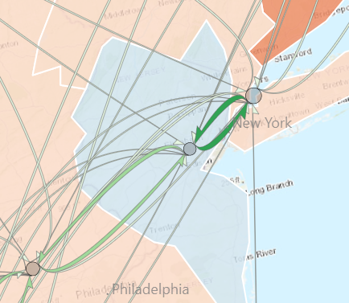
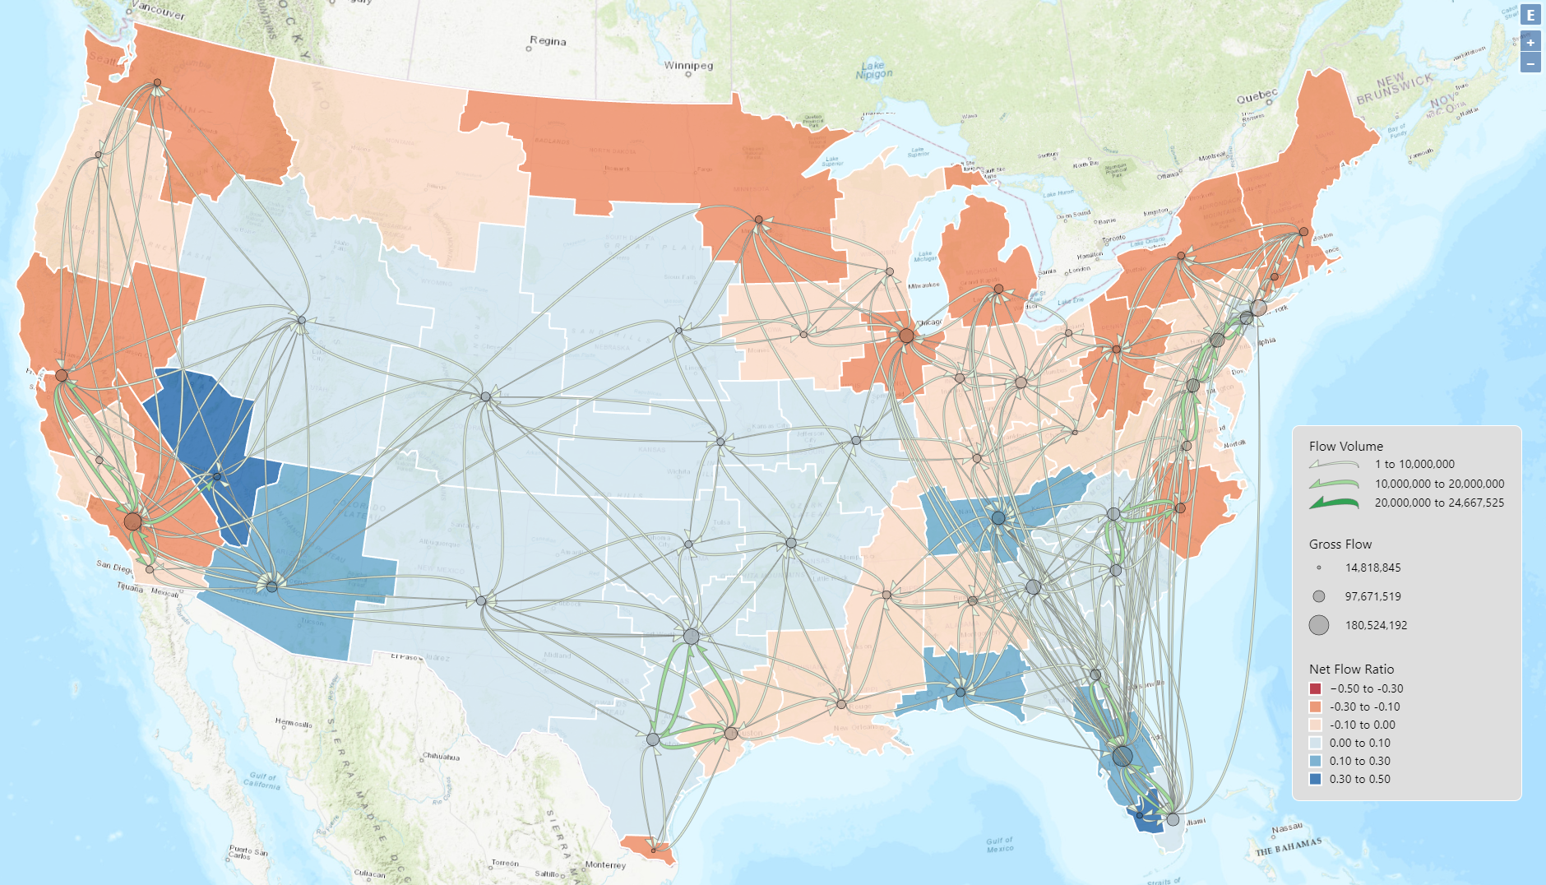
Human Mobility (SafeGraph) during COVID-19
November 1 - December 31, 2020

Slide 14
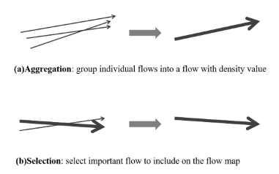
Future work: Multiscale flow mapping
Consider flows of the neighboring locations of origins and destinations
Overlaying flows with locational measures
Zhu, X., Guo, D., Koylu, C. & Chen, C. (2019) Density-Based Multi-scale Flow Mapping and Generalization, Computers, Environment and Urban Systems, 77, 101359. DOI: https://doi.org/10.1016/j.compenvurbsys.2019.101359

Slide 15
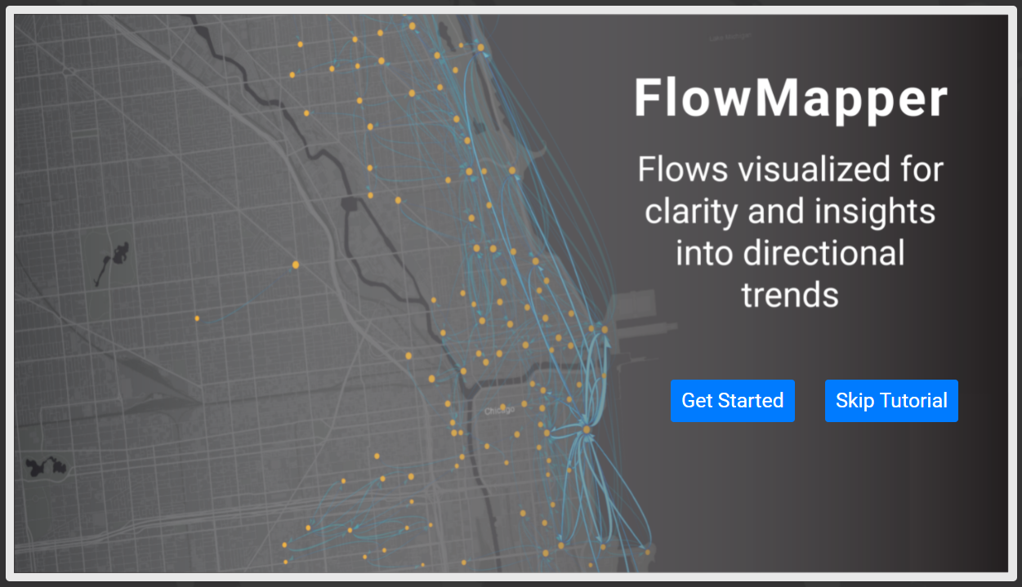

Conclusion
https://flowmapper.org
Thank you!
Any questions or comments?
caglar-koylu@uiowa.edu
@caglarkoylu
Caglar Koylu, Geng Tian & Mary Windsor (2022) Flowmapper.org: a web-based framework for designing origin–destination flow maps, Journal of Maps, DOI: 10.1080/17445647.2021.1996479

