Slide 1
Entanglements of Survival: Antillean Geographies of Freedom, Afro-Indigeneity and Diaspora
Melanie J. Newton
Associate Professor of History
University of Toronto

Slide 2
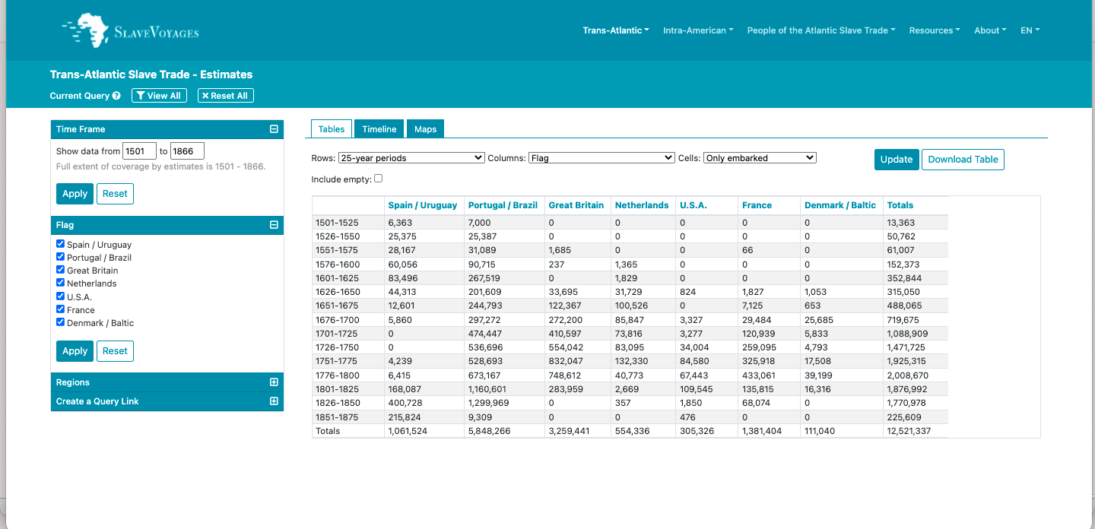
Transatlantic Slave Trade/Human Trafficking Estimates
Slavevoyages.org

Slide 3
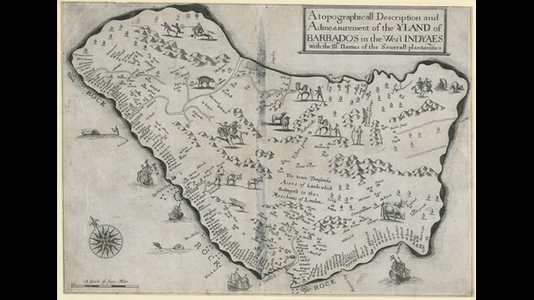
A topographicall Description and Admesurement of the YLAND of BARBADOS in the West INDYAES : With the Mrs. Names of the Severall plantacons (Richard Ligon, True and Exact History (1657)

Slide 4
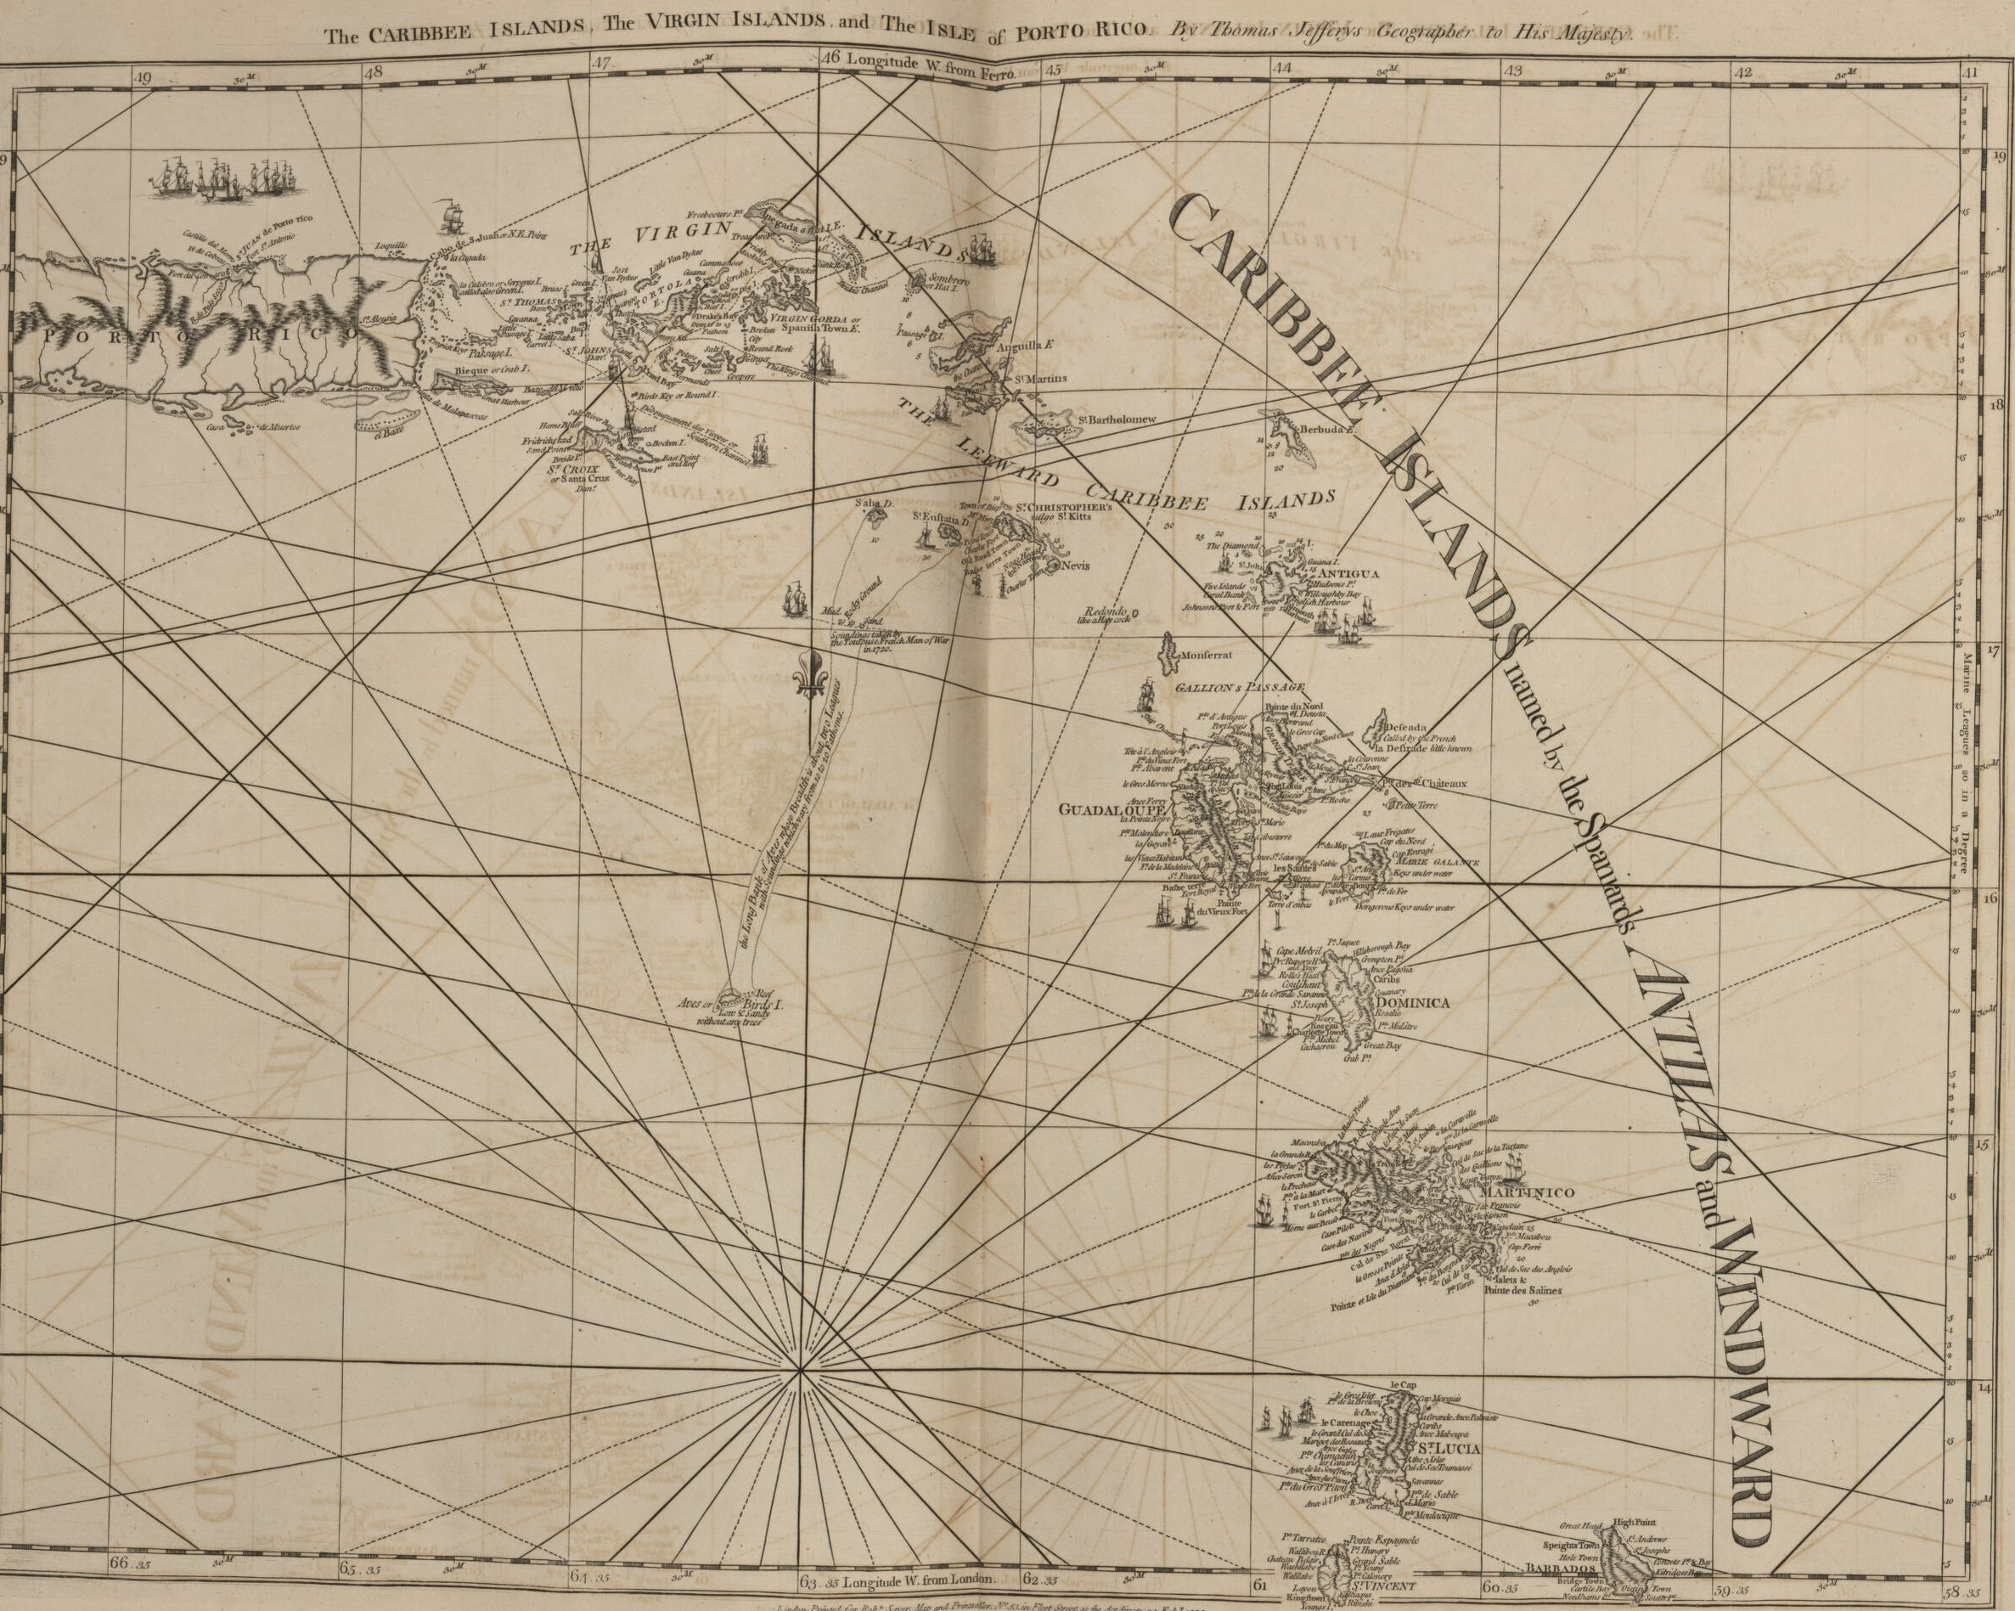
The West-India Atlas…
(Thomas Jefferys, 1775)

Slide 5
“… the centre of the Carib Republic: the place where the savages are most numerous – Dominica not approaching it…” (Labat, 1700)
Map of St. Vincent, with the post-1773 treaty ‘Carib Lands’ to the north labelled, Jefferys, Sayer and Bennett, West-India Atlas, 1775, image 52

Slide 6
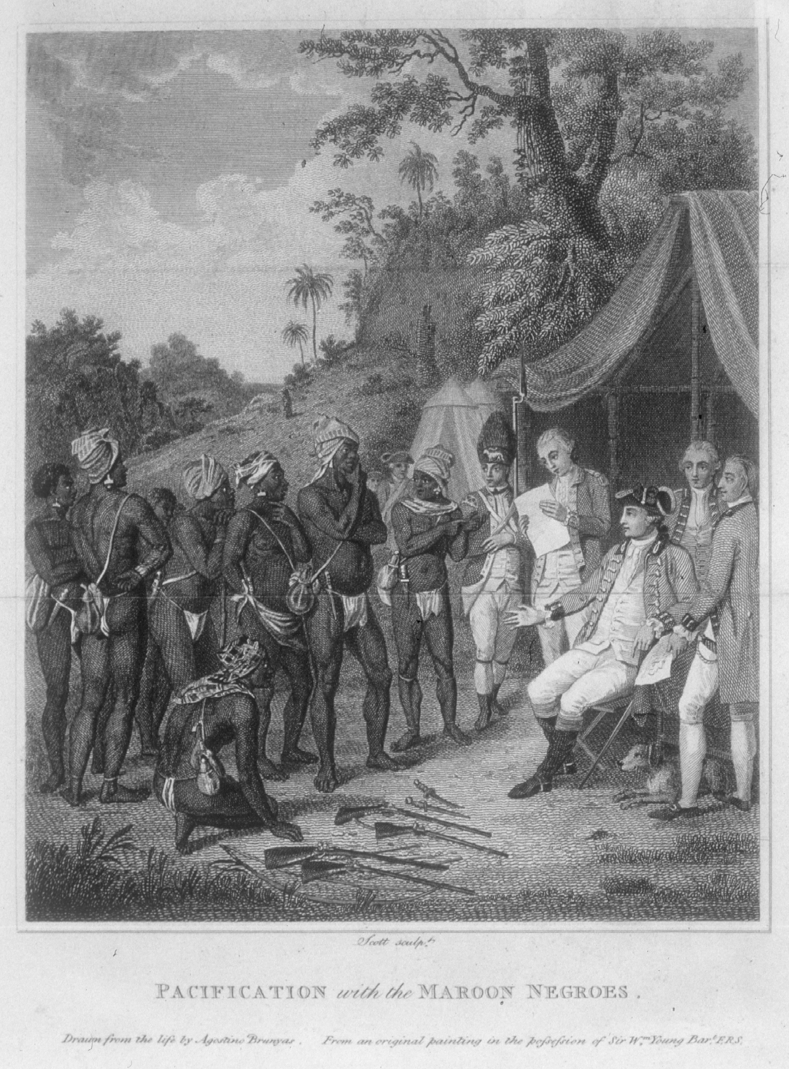
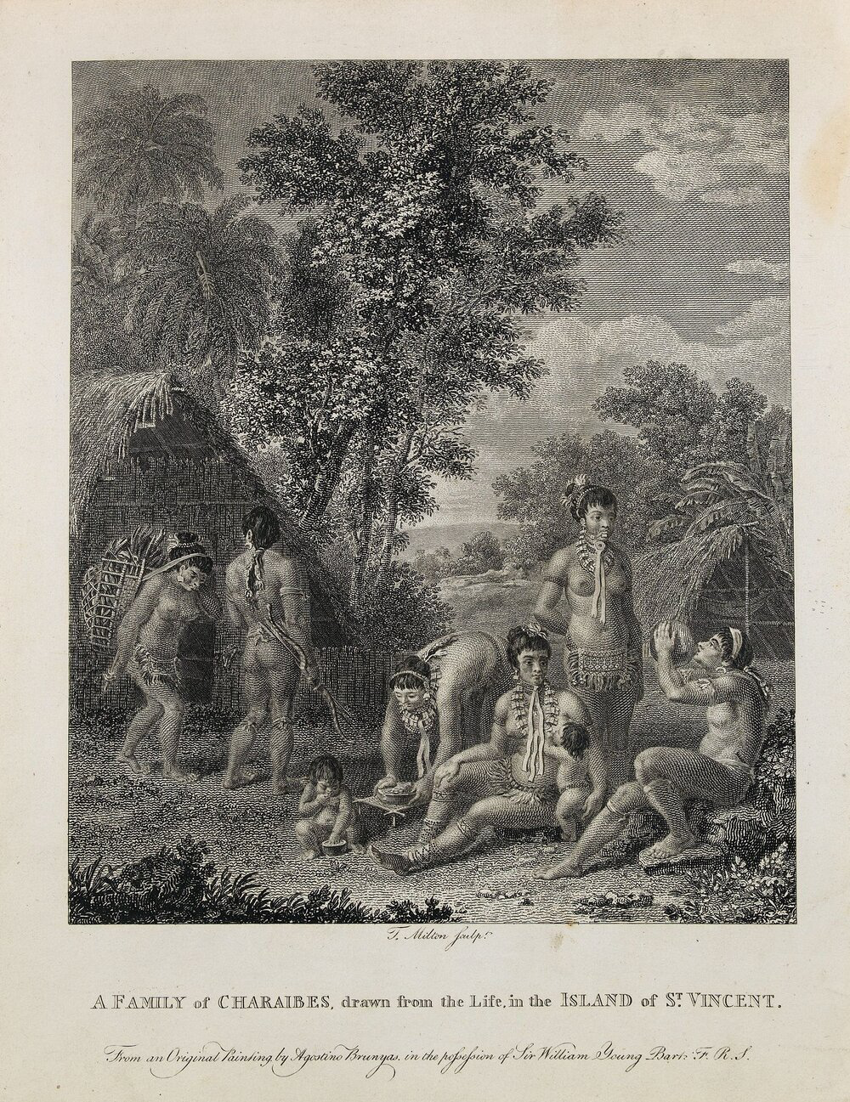
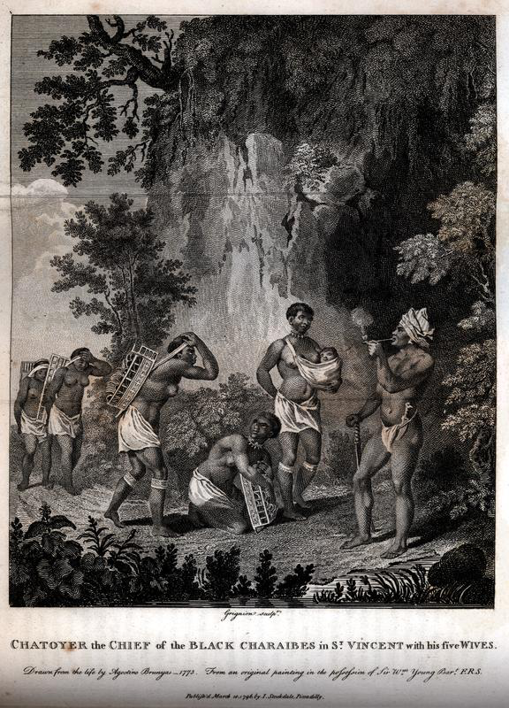
The Genocidal ‘Work’ of Art:
The artist Brunias and the Planters William Young and Bryan Edwards
Agustino Brunias (engraving, originally oil on canvas), Treaty between the British and the Black Caribs, 1773.
“A Family of Charaibes, Drawn from the Life…” (Agustino Brunias, 1770s)
Charles Grignion (engraving after Brunias), “Chatoyer the Chief of the Black Charaibes in St. Vincent with his five wives”, 1796

