Slide 1
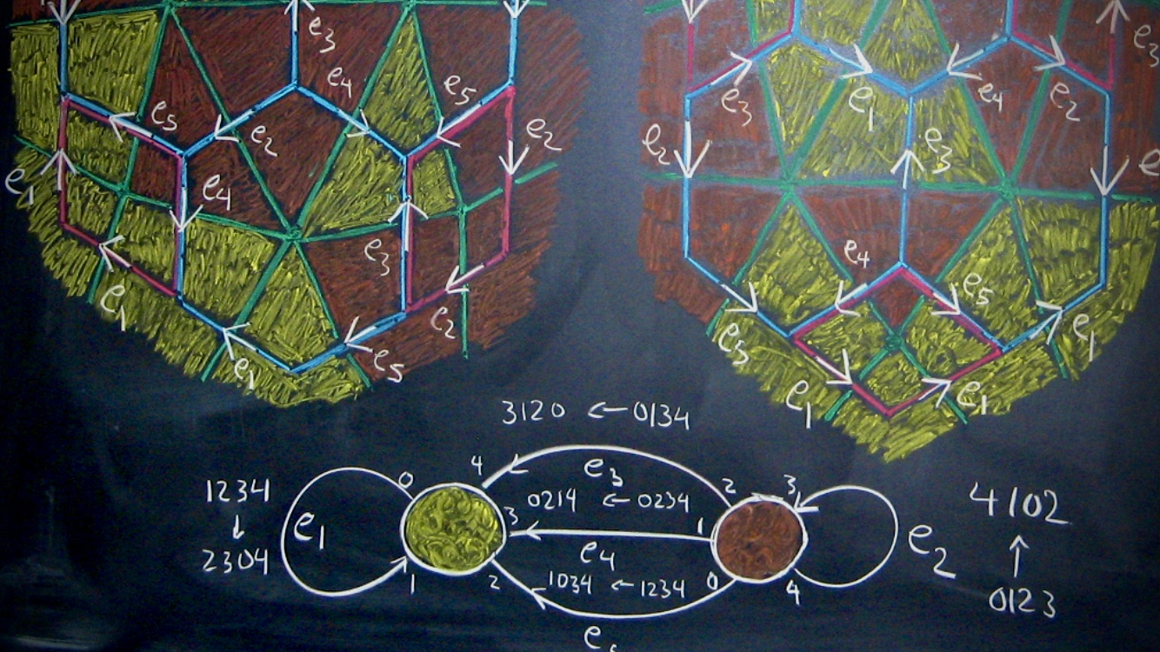
Geographic Noise
Database Reconstruction Theorems, Differential Privacy Algorithms, & the Data of the 2020 US Census

Slide 2
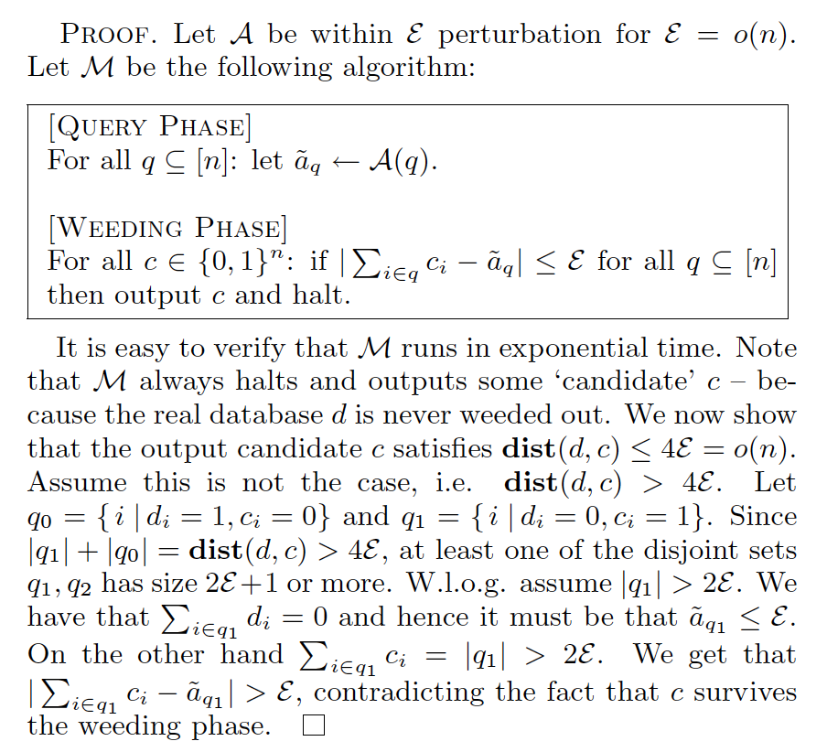
Database Reconstruction Theorems
Intuitively, to achieve database privacy one has to play a game of balancing two sets of functions:
the “private” functions that we wish to hide and
(ii) the “information” functions whose
values we wish to reveal.

Slide 3
Disclosure Protection Techniques
In 2003, Irit Dinur and Kobbi Nissim
---a surprisingly small number of random queries can reveal confidential data, because the results of the queries can be combined and then used to “reconstruct” the underlying confidential data.
Adding noise to either the database or to the results of the queries decreases the accuracy of the reconstruction, but it also decreases the accuracy of the queries. The challenge is to add sufficient noise in such a way that each individual’s privacy is protected, but not so much noise that the utility of the database is ruined.
Statistical Disclosure Limitation
Cell Suppression
no statistics from groups below a set limit are published
Top-Coding
ages higher than a certain limit are published with values of the limit
Noise Injection
random values are added to some attributes
Swapping
records for some individuals or families are “swapped”

Slide 4
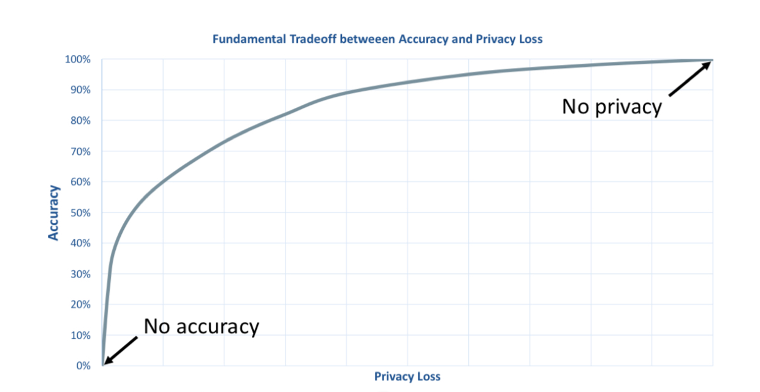
Answer perturbation / noise

Slide 5
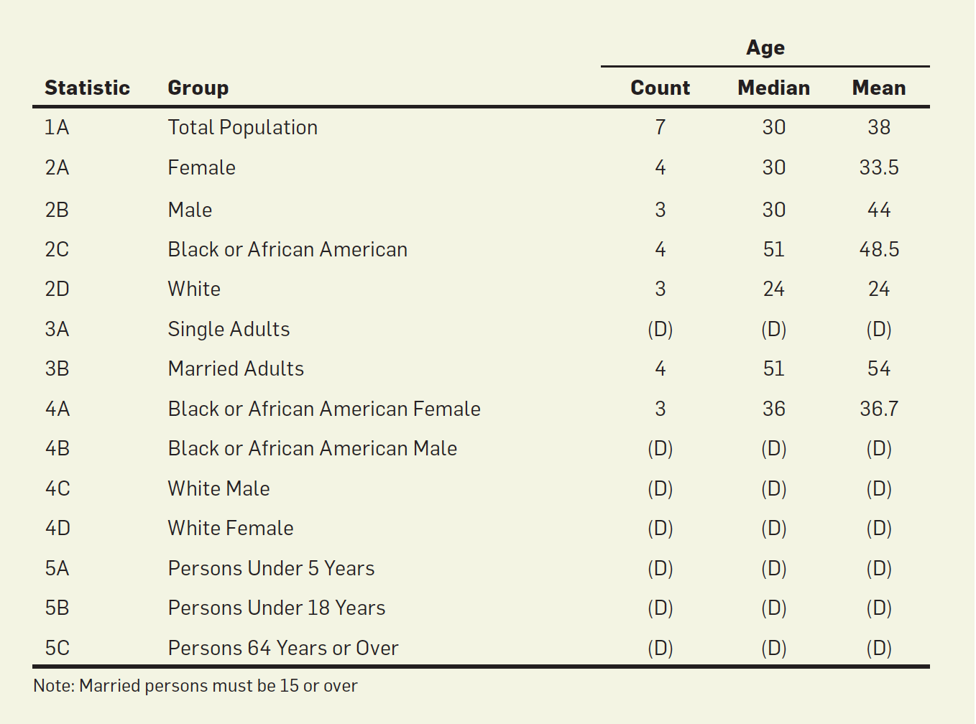
All statistical data—no individual records…
…but all the records are derived from one to one
mappings
Database reconstruction theorems say however
that if enough statistical information is released a
the unique reconstruction of the data is possible
A substantial amount of information in the database has been suppressed — marked with a (D).

Slide 6
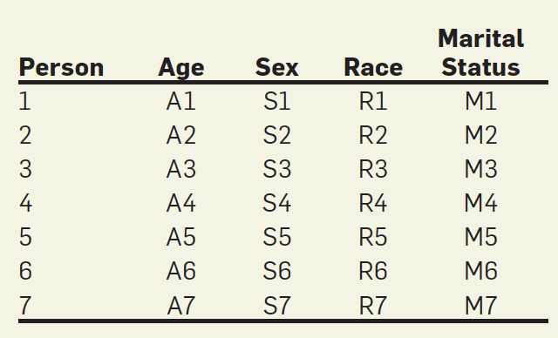
The database can be reconstructed by treating the attributes of the persons living on the block as a collection of variables.
A set of constraints is then extracted from the published table.
The database reconstruction finds a set of attributes that are consistent with the constraints.
If the statistics are highly constraining, then there will be a single possible reconstruction, and the reconstructed microdata will necessarily be the same as the underlying microdata used to create the original statistical publication.
Microdata
Unique mapping onto the original data
To mount a full reconstruction attack, an attacker extracts all of these constraints and then creates a single mathematical model embodying all constraints.

Slide 7
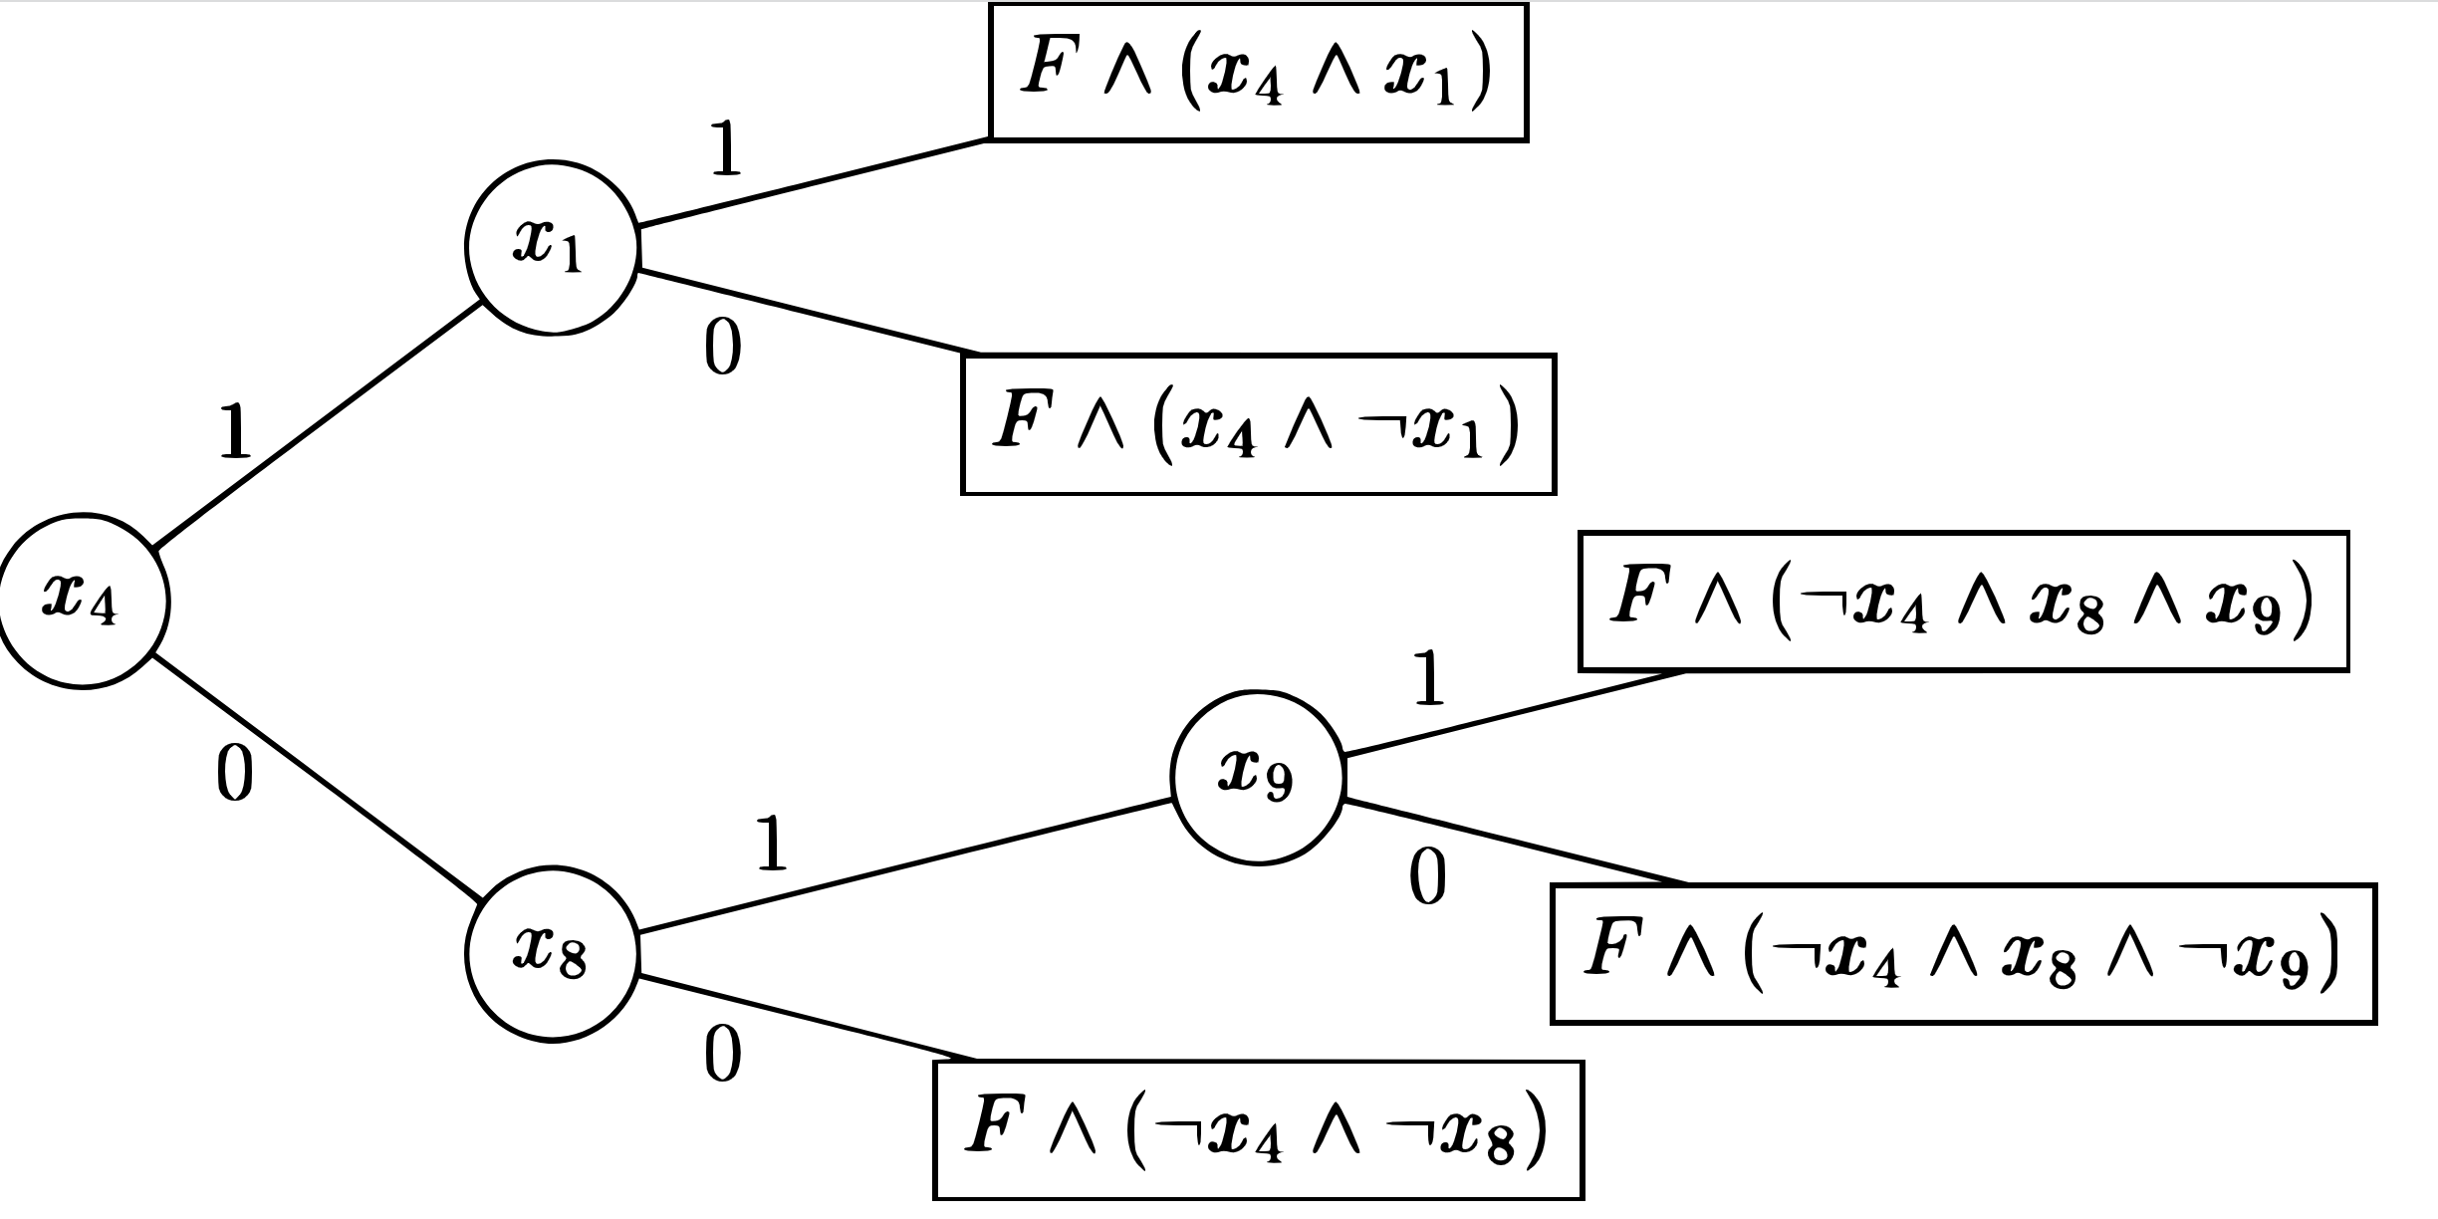
Satisfiability Solver
Translate problem into a single Boolean formula consisting of 6,755 variables arranged in 252,575 clauses. This format is called the CNF (conjunctive normal form) because it consists of many clauses that are combined using the Boolean AND operation.
Database Reconstruction Theorem
There exists a solution universe of all the possible solutions to this set of constraints. If the solution universe contains a single possible solution, then the published statistics completely reveal the underlying confidential data—provided that noise was not added to either the microdata or the tabulations as a disclosure-avoidance mechanism.

Slide 8
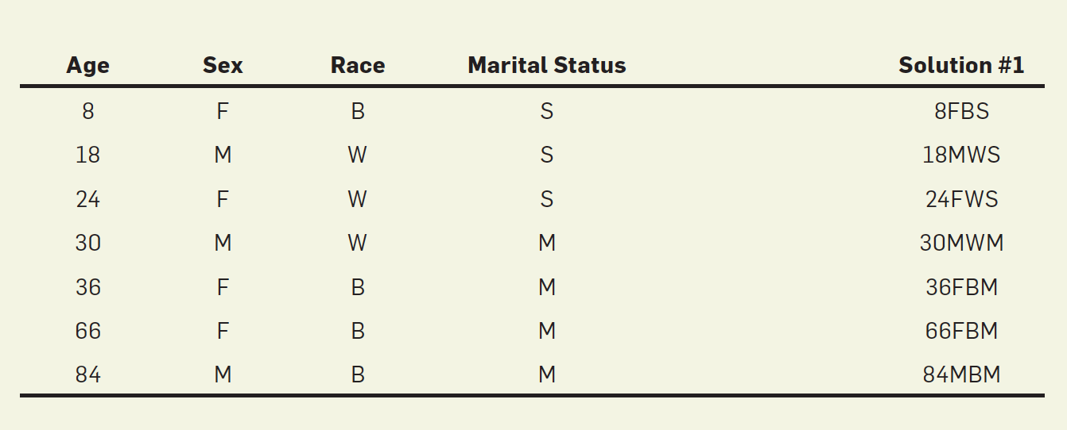
Complete & Unique Reconstruction

Slide 9
Dropping 2A and 2B increases the solution universe to eight satisfying solutions.
All of these solutions contain the reconstructed microdata records 8FBS, 36FBM, 66FBM, and 84MBM. This means that even if statistics 2A and 2B are suppressed, we can still infer that these four microdata records must be present.

Slide 10
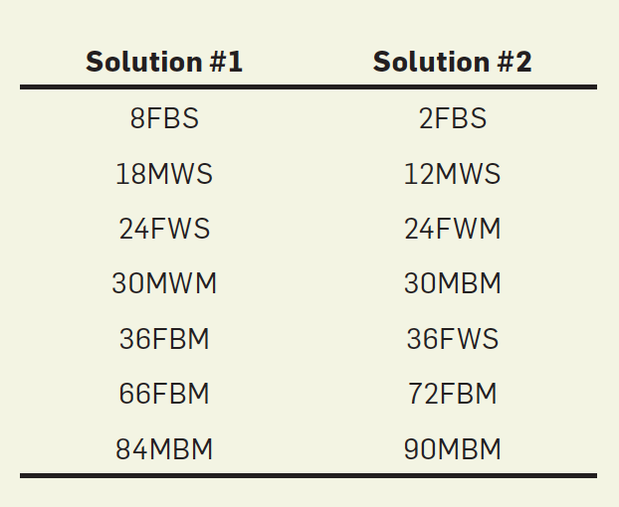
Removing the constraints for statistic 4A increases the number of solutions from one to two
No decision process possible
Solutions completely different

Slide 11
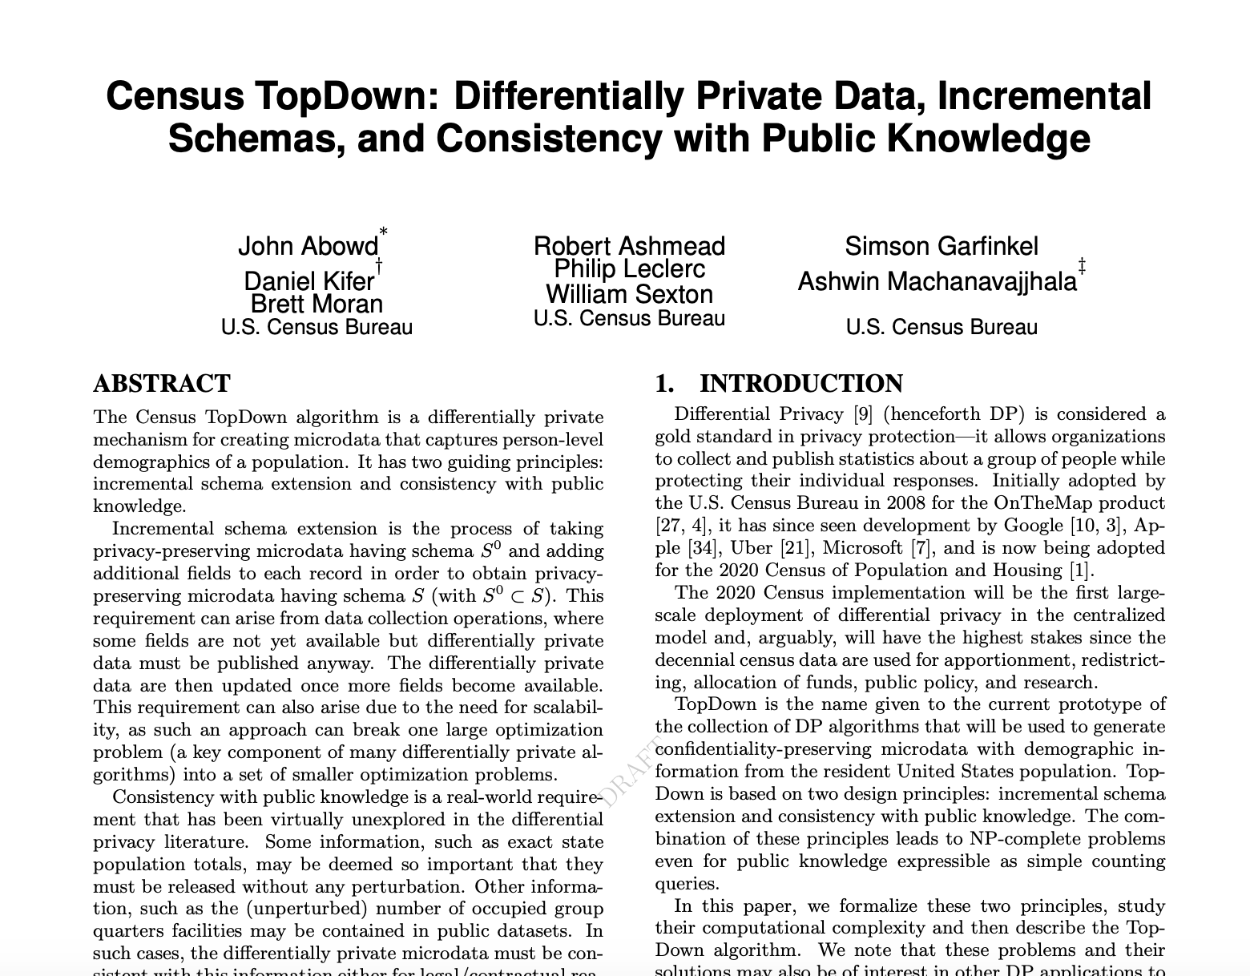
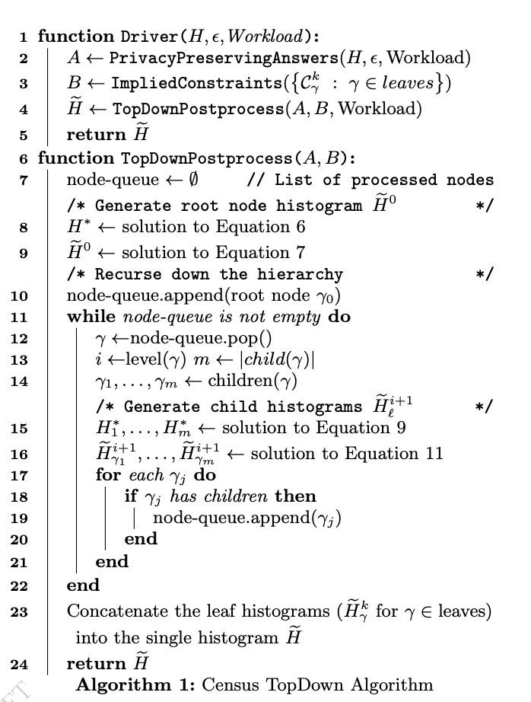

Slide 12
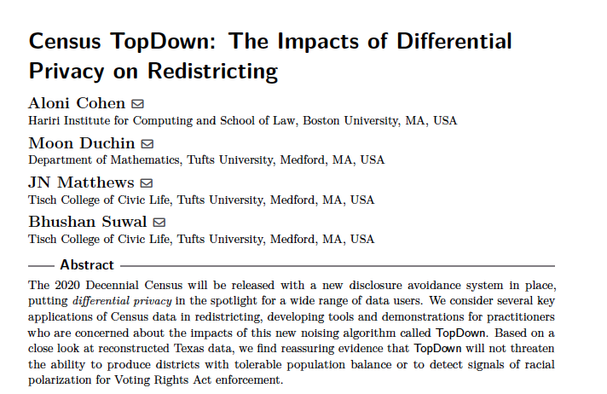
Three Possible Defenses:
Publish less data
Input noise injection
Output Noise injection
Algorithm hard to study analytically
Modeling
Based on a close look at reconstructed Texas data, we find reassuring evidence that TopDown will not threaten the ability to produce districts with tolerable population balance or to detect signals of racial polarization for Voting Rights Act enforcement.

Slide 13
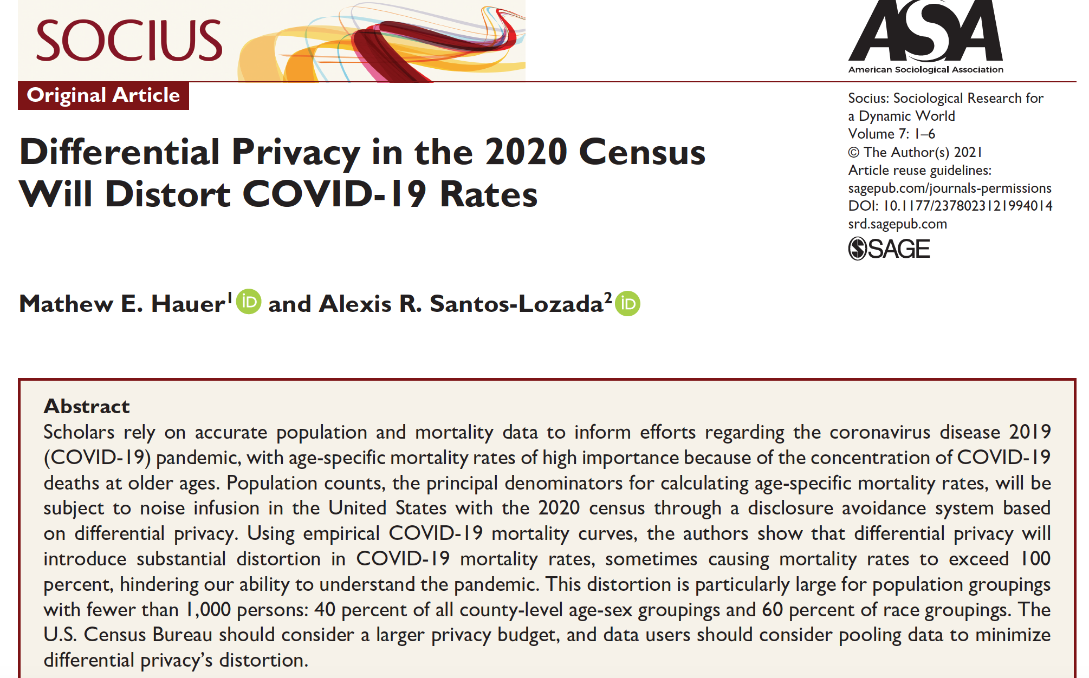
Using empirical COVID-19 mortality curves, the authors show that differential privacy will introduce substantial distortion in COVID-19 mortality rates

Slide 14
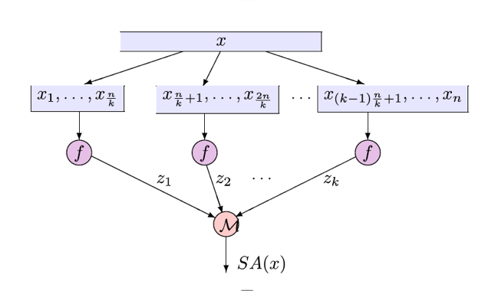
The fact that the efficient Dinur-Nissim type of reconstruction attack fail when the error is ≫n^{-1/2} does not mean it’s easy to achieve privacy with error of that magnitude.
We can achieve non-trivial error guarantees for a large number of queries simply by using a random subsample of half of the dataset, which is not a private algorithm in any reasonable sense of the word, as it can reveal everything about the chosen subset.
There are membership-inference attacks that succeed in violating privacy even when the queries are answered with ≫n^{-1/2} error.

Slide 15
