Slide 1
Enabling Reproducible Geospatial Research on CyberGISX
Anand Padmanabhan, Alexander Michels, Zhiyu Li, and Shaowen Wang
CyberGIS Center for Advanced Digital and Spatial Studies
University of Illinois at Urbana-Champaign
Urbana, IL, USA
{apadmana, michels9, zhiyul, shaowen}@illinois.edu
AAG 2022
Feb. 27, 2022

Slide 2
CyberGIS
Geographic Information Science and Systems
based on Advanced Cyberinfrastructure
Wang, S. (2010) A CyberGIS Framework for the Synthesis of Cyberinfrastructure, GIS, and Spatial Analysis. Annals of the Association of American Geographers, 100(3): 535-557
Notes:
A cross-disciplinary research field that combines GIS and Cyberinfrastructure for resolving computational and data-intensive geospatial problems.

Slide 3
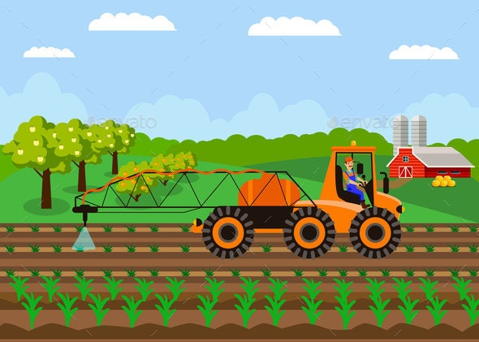
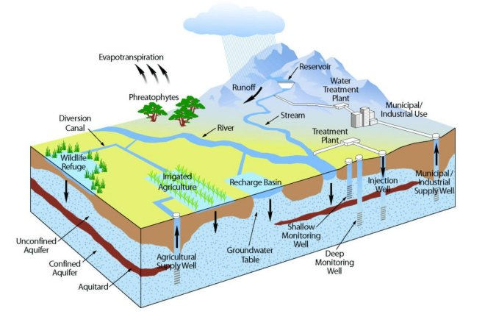
CyberGISX
An open online platform for democratizing cutting-edge cyberGIS capabilities to enable computational and data-intensive geospatial analytics.
https://cybergisxhub.cigi.illinois.edu/
Notes:
One of products from the cyberGIS research. An open online platform that enables researchers and users from different domains to access to the latest cyberGIS capabilities for conducting computational and data-intensive geospatial analytics.

Slide 4
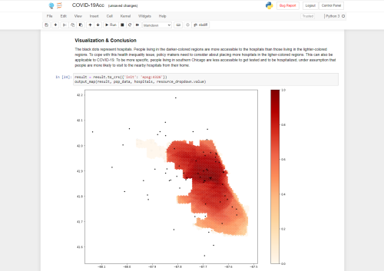
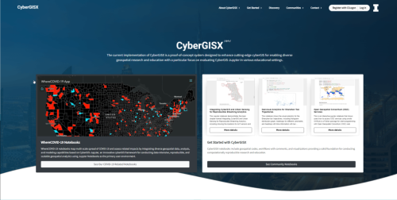
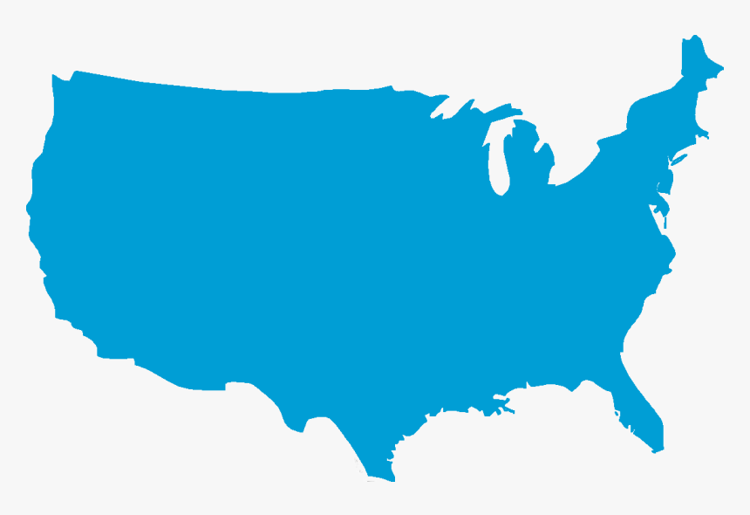
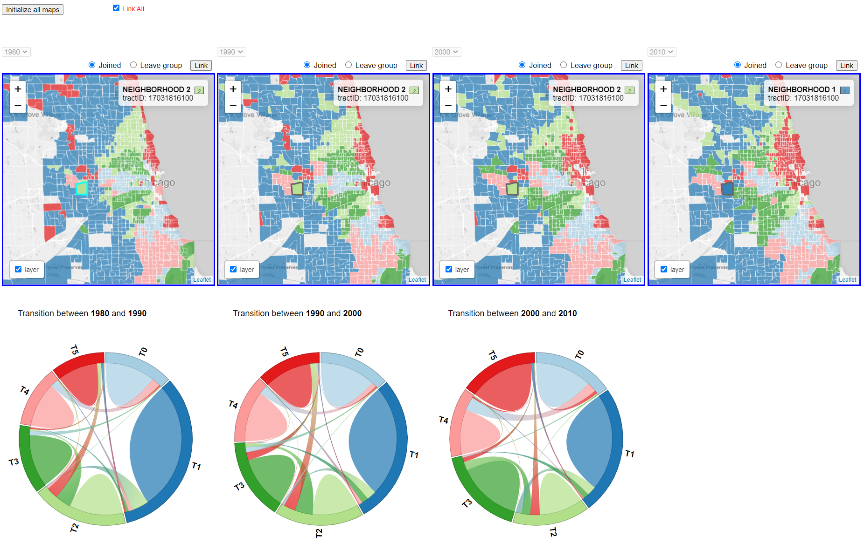
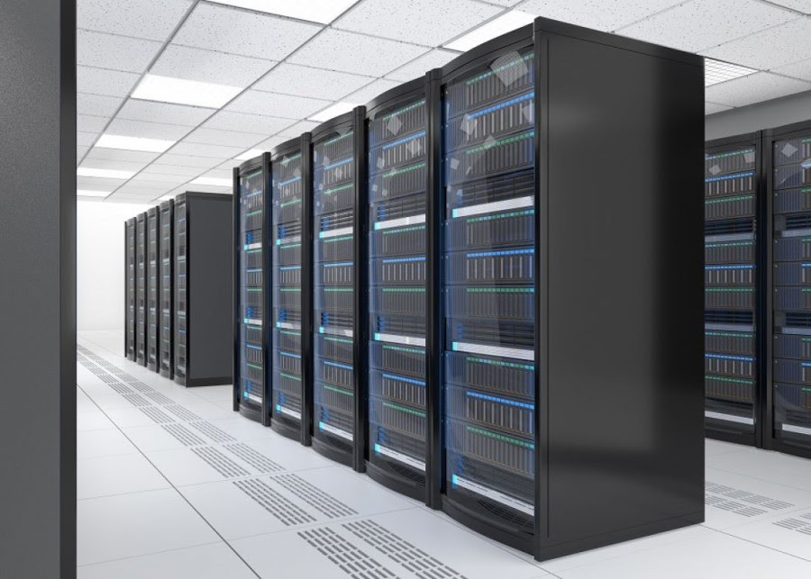
CyberGISX Components
CyberGIS-Hub
Discovery & Sharing
CyberGIS-Jupyter
Interactive Computing
High Performance Computing
CyberGIS-Compute
Large-scale Modelling
CyberGIS-Vis
Advanced Geovisualization

Slide 5
Computational Reproducibility
Challenges
Code and notebooks along with associated data need to be findable, accessible and reusable
Software and computational environment & libraries need to be matched
CyberGISX solutions
CyberGIS-Hub provides an open environment to share and find many computational notebooks along with data through an one-click solution to access and launch these notebooks
CyberGIS-Jupyter provides a scalable solution for managing software environments and associated libraries (main focus of this talk)
CyberGIS-Compute enables shared access to advanced cyberinfrastructure resources

Slide 6
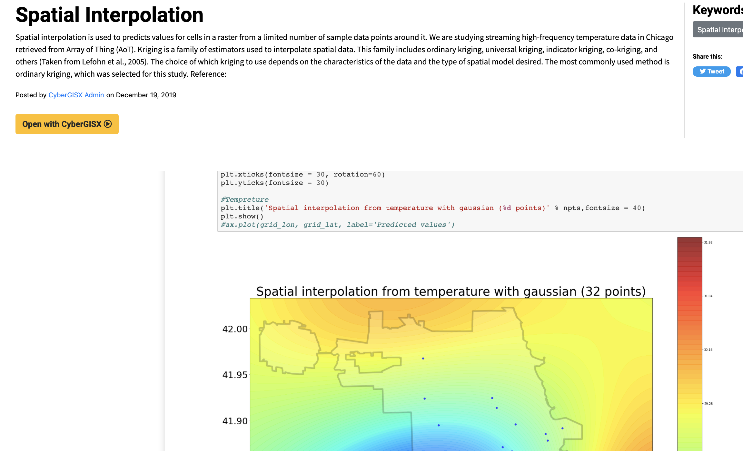
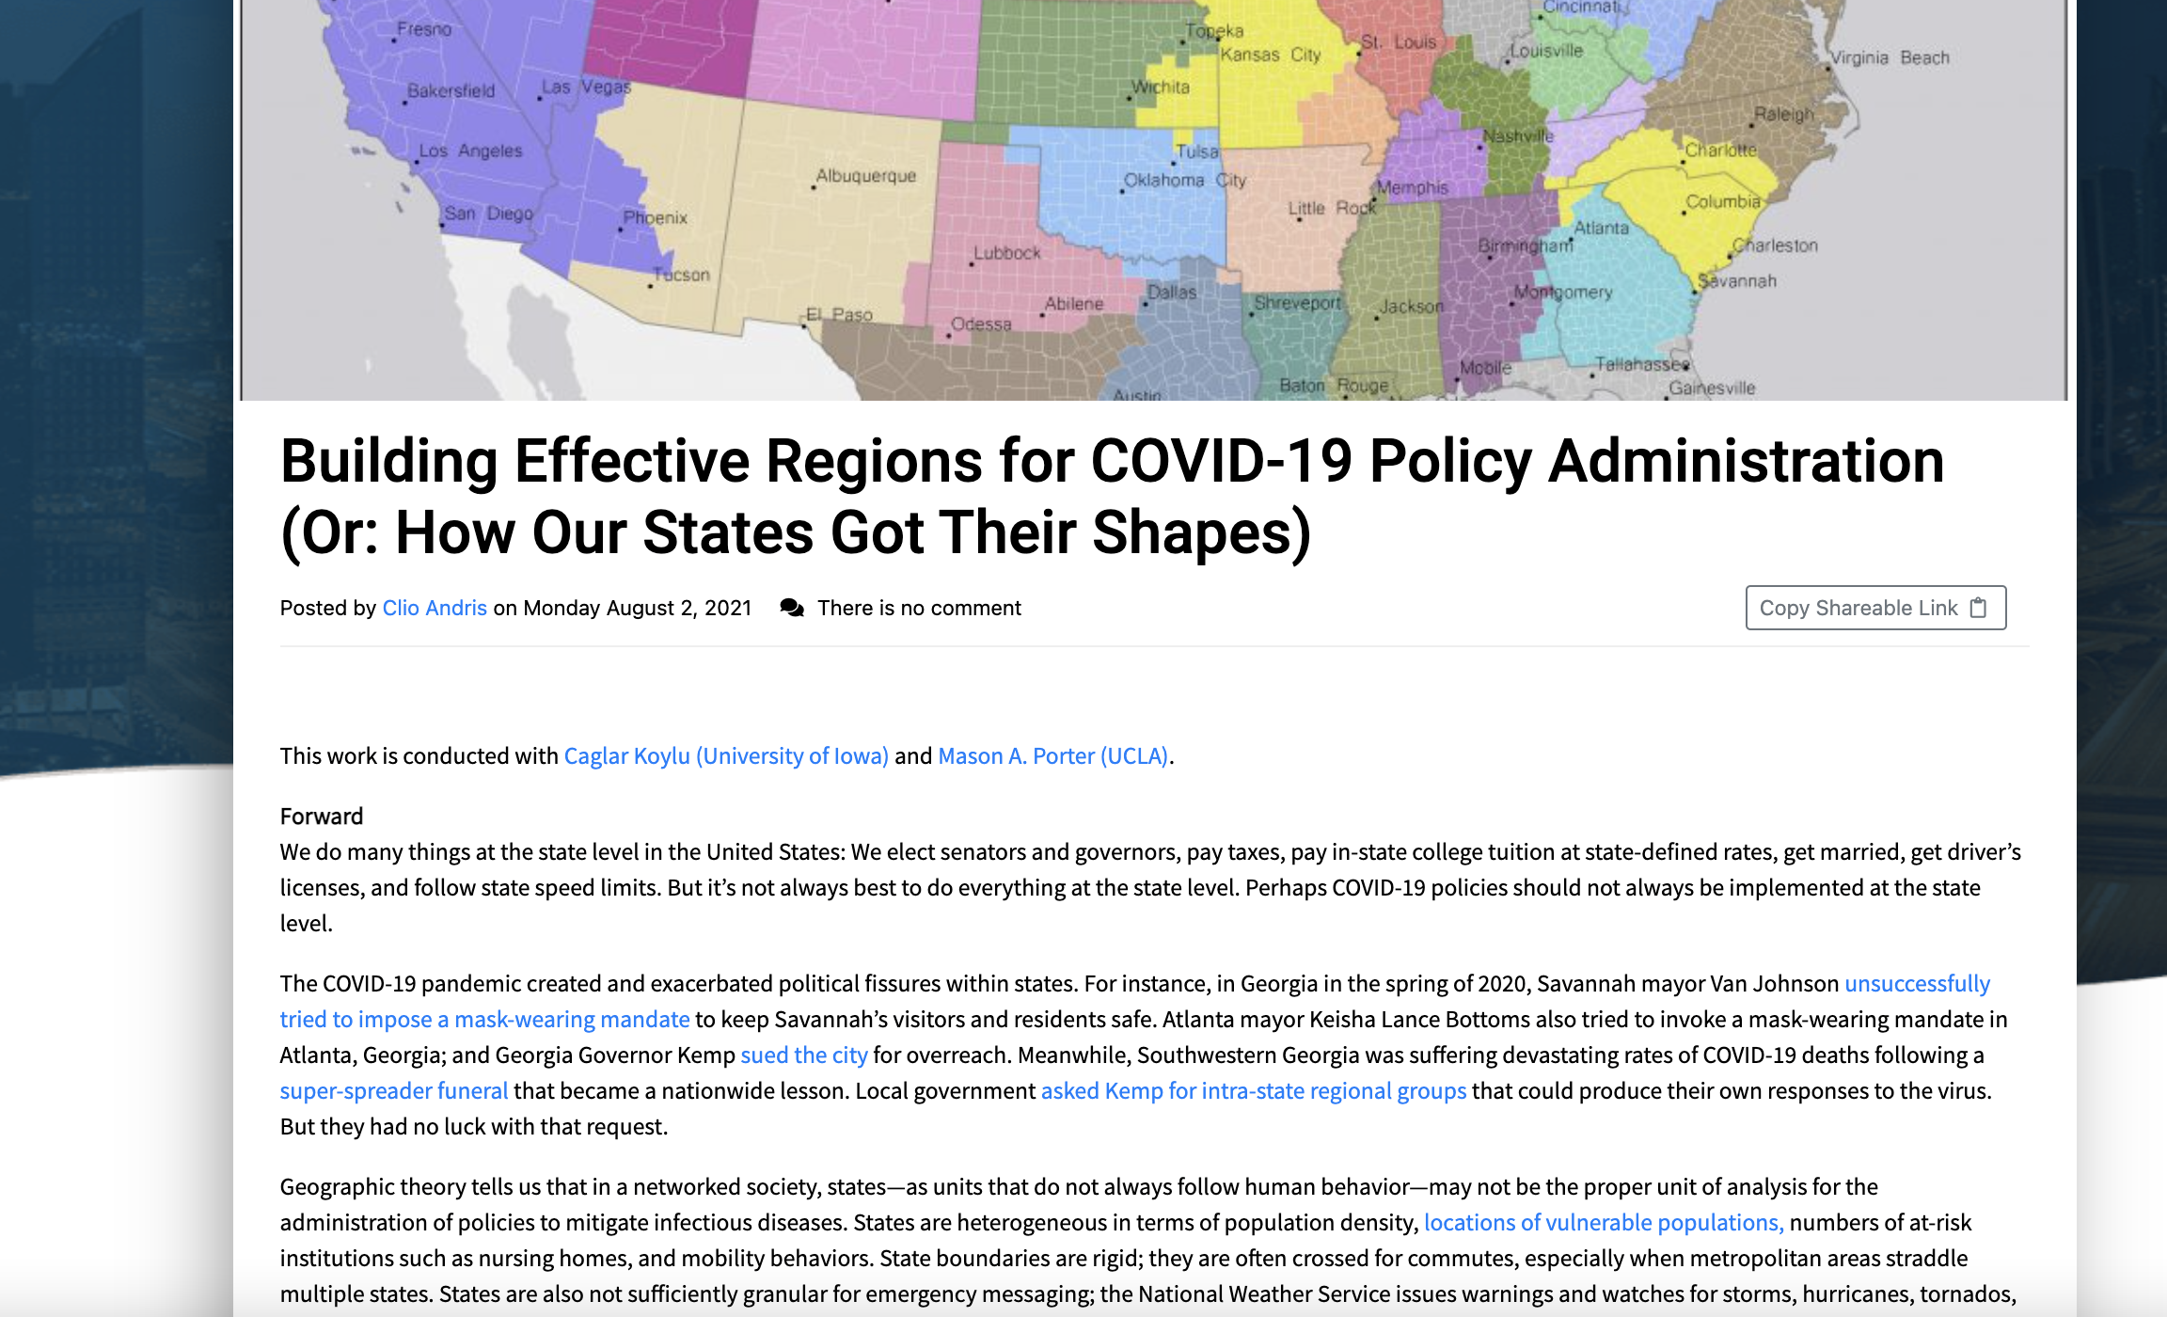
CyberGIS-Hub
One-stop access to CyberGISX platform
Use your organizational credentials
Discover shared notebooks & leave comments
One-click to open in CyberGIS-Jupyter & Reproduce each other’s work!
Share your notebooks with the community
Publish blogs to enhance knowledge sharing
Professional profile page with your contributions highlighted

Slide 7
Key Reproducibility Challenge
Important to balance a trade-off between
Providing a stable software environment may enhance reproducibility but the environment can soon become outdated
Continuously updating the software environment to keep up with advances in scientific software but making reproducibility challenging

Slide 8
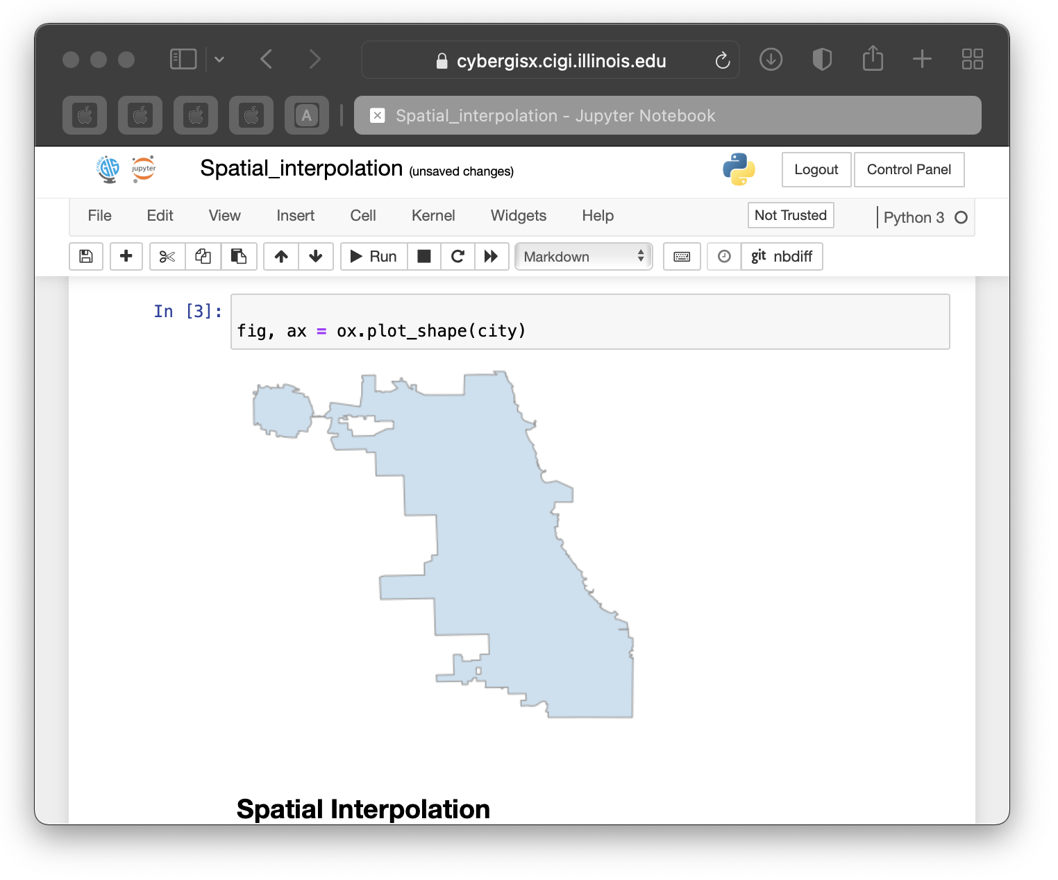
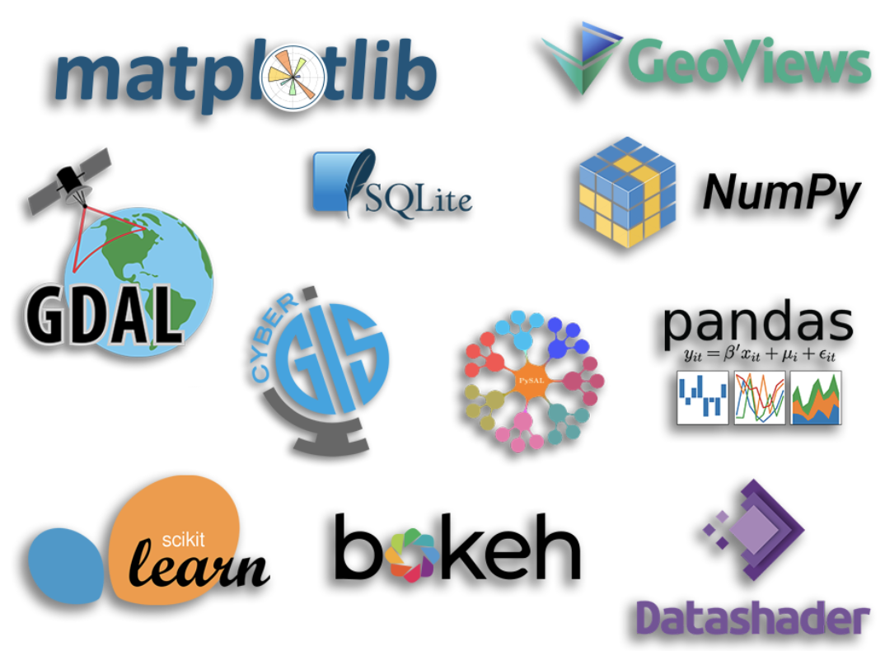
CyberGIS-Jupyter
Focus on Python programming (for now)
Pre-installed geospatial libs and cyberGIS tools
with example notebooks
Include both general & domain-specific needs in different kernels:
Python3, Hydro, GeoAI….
Periodically update/expand/swap out
Provide versioned kernels for supporting reproducibility
On-demand customization by users

Slide 9
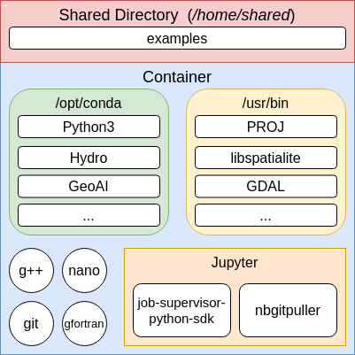
Initial Solution
Everything in one container
7.66GB compressed
22.4GB uncompressed
Notes:
Over the last few years, our approach to providing users a compute environment has been simple: everything in a single container. The diagram to the right illustrates what that looks like: you have a variety of “essentials” (bottom left), Jupyter and associated packages/extensions (bottom right), some important geospatial software (top right), and Anaconda environments to provide users with their kernels (top left). We utilized a shared directory, but only to hold a select set of example notebooks we wanted every user to have access to and some large datasets used by multiple users.
The image was quite large though, 7.66 GB compressed and 22.4 GB uncompressed.

Slide 10
Software Environment Update
Any kind of update or upgrade to our compute environment
Led to a rebuild/reinstall of some parts of our software environment
Old versions of software are no longer available in our compute environment compromising reproducibility
Notes:
Any kind of update or upgrade to our compute environment:
Led to a rebuild of some proportion of the software. This lead to wide-ranging and unexpected changes to software and Python package versions. We tried to minimize this by splitting the container into two docker images, one inheriting from the other, but some degree of this problem would always persist. The biggest issue for us was that this means all of our example notebooks would have to be retested every release.
Old versions of software are no longer available in our compute environment. In theory, we could have tried to make multiple versions of the container available, but that would be an issue because of the size of the containers and provide a technical barrier to users the minute they open the gateway. It would also mean that users would have to kill their containers and re-open a different version of the container to switch between versions of kernels.

Slide 11
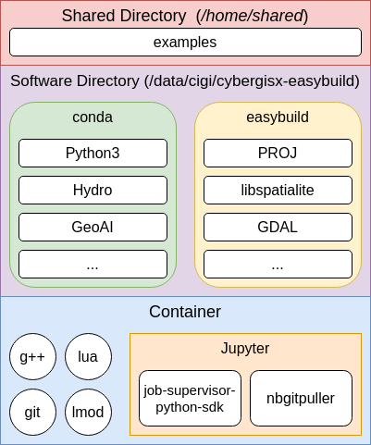
New Approach
Compute environment software is moved outside of the container. To do this, we utilize:
Easybuild - to build software and provide use with modulefiles
Lmod - for users to manage software
Conda - for Python environments
Notes:
In the new approach, we have been able to move the software responsible for providing user compute environments from the container to outside of the container. This eliminates the stresses of large and growing image sizes while allowing us to easily manage and provide as many kinds and versions of software as we see fit.
Our new approach utilizes a few amazing pieces of software:
Easybuild - provides us with a simple method to install software and generates modulefiles for us, making software management much easier. We tried writing our own install scripts/modulefiles, but Easybuild is a much simpler approach, already supports thousands of software packages, and creating Easyconfigs for unsupported software is relatively simple. By utilizing and contributing to the Easybuild ecosystem, we are hoping to lower the barriers for geospatial computing and make our software stack more easily replicable outside of the gateway.
Lmod - is a modules management tool, similar to Environmental Modules. It allows users to easily manage their compute environment by loading and unloading versions of software
Conda - on top of our software environment provided by Easybuild and Lmod, we install a Python environment to provide users with their kernels.

Slide 12
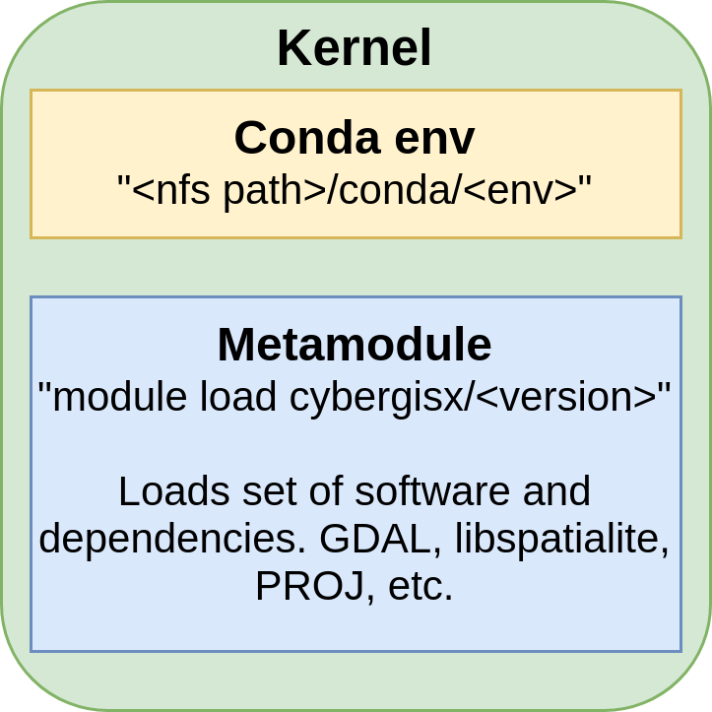
Kernels in the New Approach
The specifications for kernels are given by a JSON file and a script which runs before the kernel is started.
Notes:
The specifications (conda environment, environment variables, modules, etc.) for kernels are given by a JSON file and script which runs before the kernel is started.
The kernel in this approach is made up of two core components: the executable for the notebook (a conda environment) and a set of modules which are loaded. We specify a set of software and their versions using a “metamodule” which is simply a module that loads other modules.

Slide 13
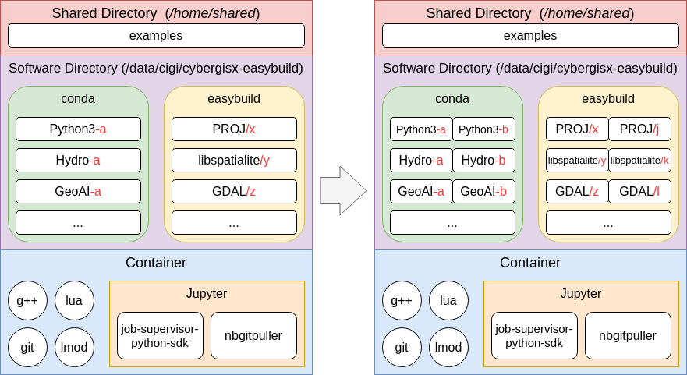
Updating in Our New Approach
Notes:
Updating our environment in the new approach is much simpler: we can install new versions of software and new kernels on the NFS without affecting users and when we are ready to push the update, we simply edit some start-up scripts to make the new configuration our default. The old configuration is available and untouched by our upgrade process.
What does this give us:
Allows for many versions of software to coexist - users can easily switch between the new and old versions of our compute environment
Container size is drastically reduced - about 4 GB
“Survives” upgrades (not rebuilt)
Flexible - users can “mix and match”

Slide 14
Summary
The new approach has balanced the tradeoff
Software environment update is streamlined
Keeping the scientific software up-to-date
Older releases of software packages are maintained
Enhancing reproducibility
The software environment is tied to every notebook
Complexity of managing the software environment is hidden from users

Slide 15
Acknowledgement
National Science Foundation
OAC-1664119
OAC-1743184
OAC-2118329
XSEDE
XSEDE ECSS

Slide 16
Questions?
Anand Padmanabhan apadmana@Illinois.edu

