Slide 1
Apply GIS and Machine Learning to Examine the Interplay of Factors Affecting COVID-19 Vaccine Rates
2/28/2022
Jian Lange, Esri jlange@esri.com
Carsten Lange, California State Polytechnic University, Pomona clange@cpp.edu

Slide 2
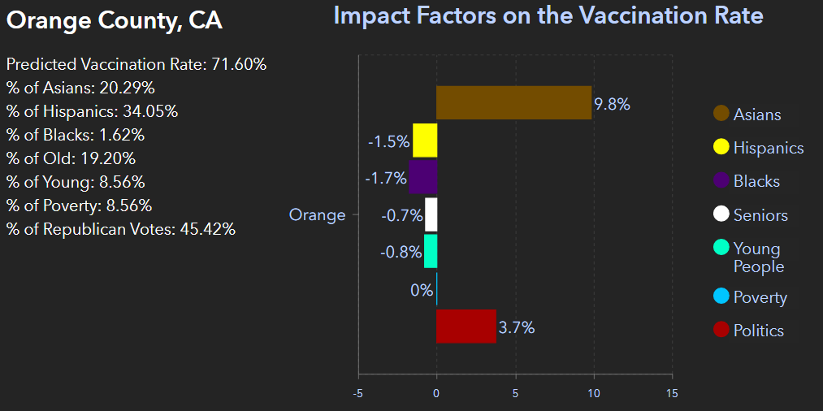
Project Goal
Identify and quantify contributing factors associated with COVID-19 vaccine rates in the US
What determines vaccination hesitance in US counties?
How much each variable impacts the predicted vaccination rate in a selected county?

Slide 3
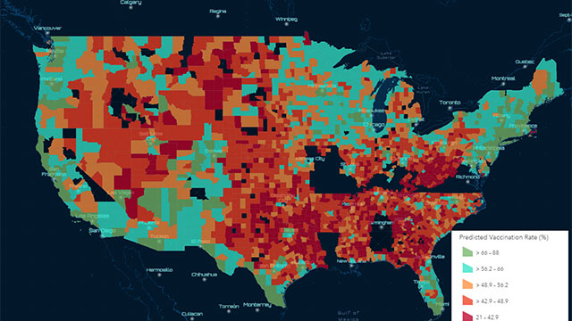
Project Area
Counties in the continental USA
3,108 records (478 incomplete data)
leaves 2,630 counties for the analysis

Slide 4
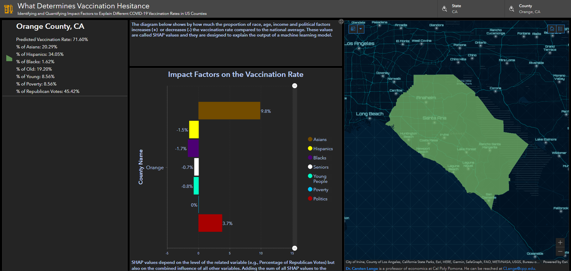
Interactive Online Dashboard
Identify vaccine impacts factors individually for each county
Results vary from county to county
Interactively search and select a county to show results

Slide 5
Project Workflow
Prepare Datasets in ArcGIS
Train and Test the Random Forest Model in R
Quantify the impact of variables based on SHAP values
Share Results in Interactive Online Dashboard

Slide 6
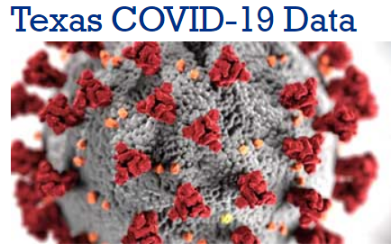
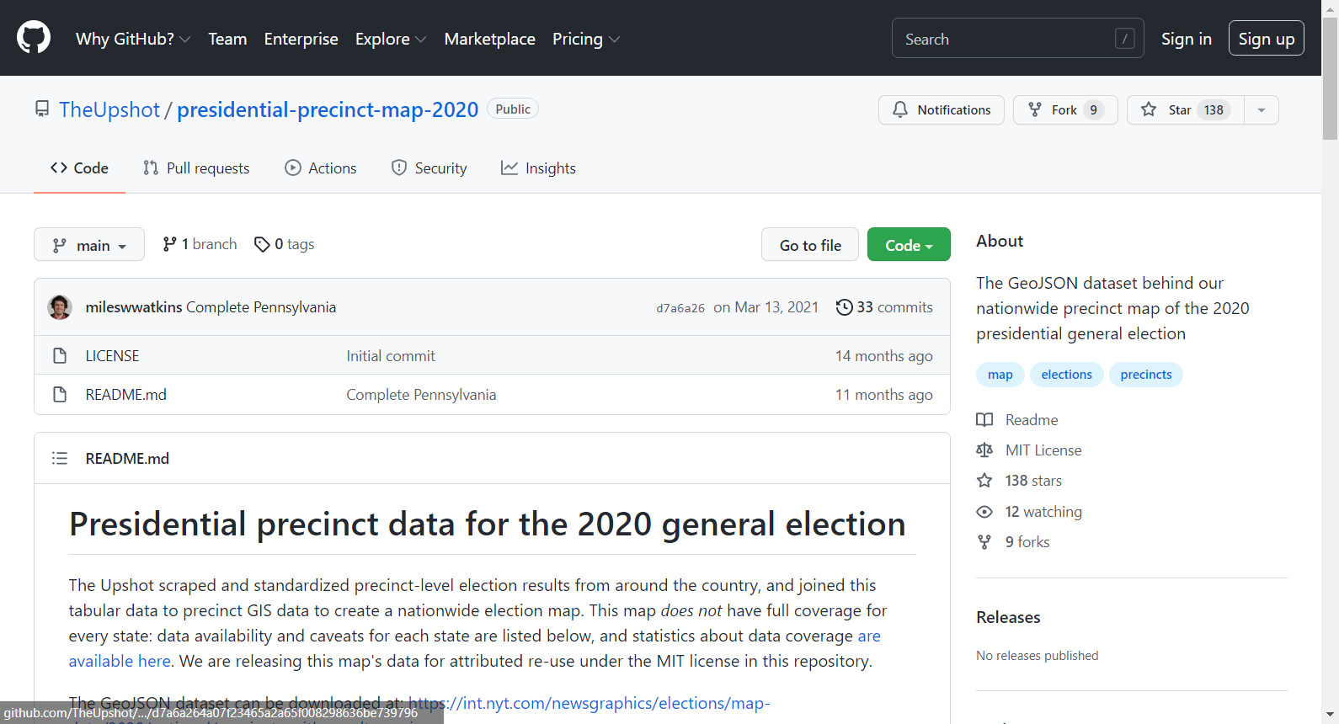
Prepare Datasets in ArcGIS
The vaccination data from CDC
% adults fully vaccinated against COVID-19 from November 2020 – September 2021
Texas county vaccination data from the Texas Health and Human Services Agency
% adults fully vaccinated against COVID-19 from November 2020 – September 2021
Precinct-level US 2020 election results from the New York Times
Political affiliation: % of Republican votes in the 2020 presidential election
GeoJSON convert to features and aggregated to US county level using ArcGIS Geoprocessing tools
ArcGIS GeoEnrichment tools used to acquire additional Esri Demographics data
Total Population and Population over 18 Years Old
Race/Ethnicity: % of Asians, African Americans, and Hispanics.
Age variables: % of younger population (20 to 25) and % of seniors (65+)
Income variable: % of Food Stamp Recipients

Slide 7
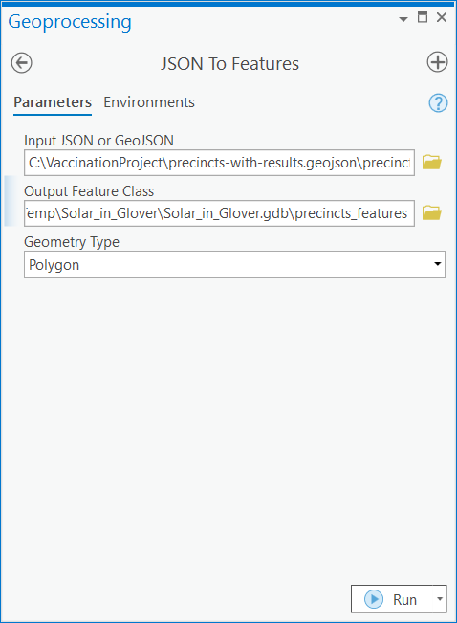
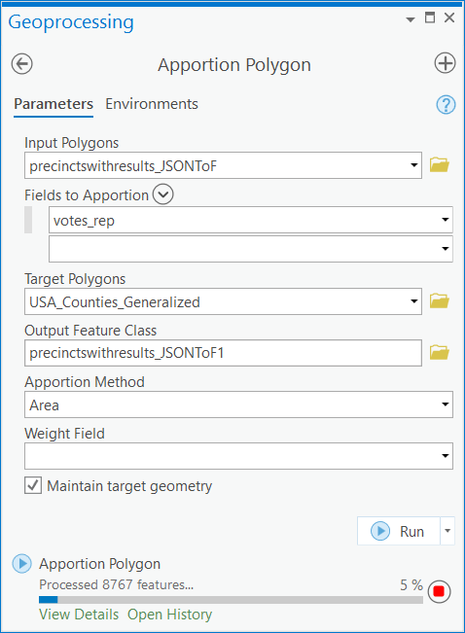
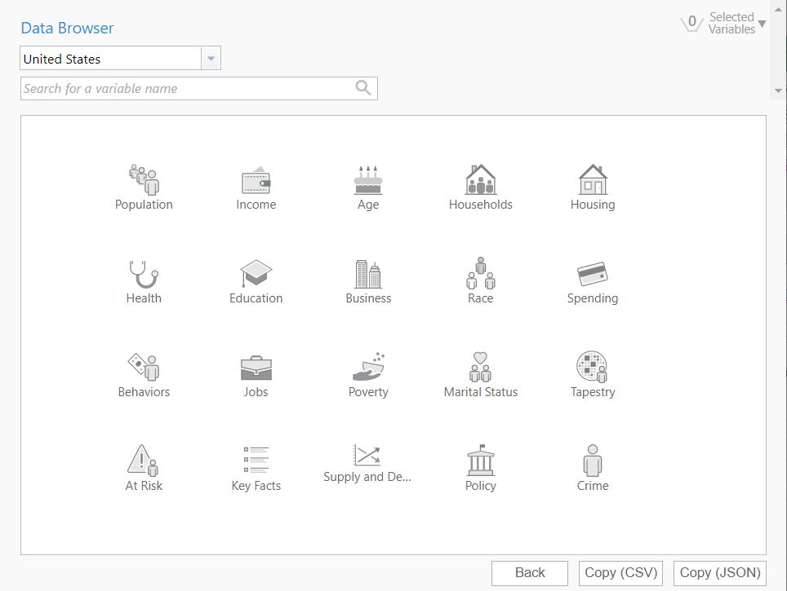
Prepare Datasets in ArcGIS
CDC and Texas Health and Human Services data (CSV) is joined with US county boundary based on FIPS code
Precinct-level election data (GeoJSON) convert to features and aggregated to US county level
ArcGIS GeoEnrichment tools used to acquire additional Esri Demographics data

Slide 8
Project Workflow
Prepare Datasets in ArcGIS
Train and Test the Random Forest Model in R
Quantify the impact of variables based on SHAP values
Share Results in Interactive Online Dashboard

Slide 9
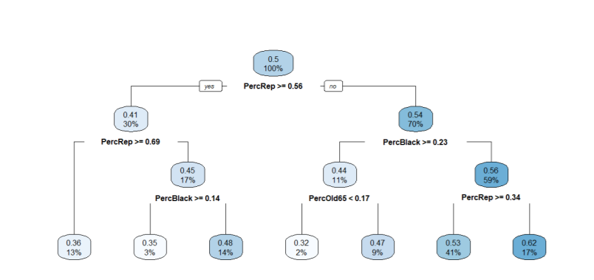
Random Forest Model
A Random Forest Model consist of many Decision Trees (2000 in our case)
Notes:
Sample Decision Tree consisting of several decision rules (left is yes)
ML Algorithm finds optimal decision rules and splitting values
All training data (counties) are led through the tree, and each ends up in one of the bins
We use training (2238 records) and testing (392) withheld from any optimization
After the training data, we predict with the testing data

Slide 10
Random Forest Model
A Random Forest Model consist of many Decision Trees (2000 in our case) The prediction of the Random Forest Model is the average of all its decision tree predictions
Notes:
All 2000 Decision trees are slightly different
Prediction of random Forest is the average prediction of all its trees.
There is an easier way to interpret a Random Forest Model
RFM is a mathematical non-linear regression formula with many parameters (splitting values) similar to OLS

Slide 11
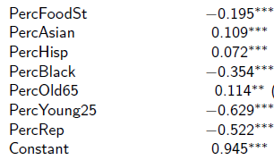
OLS and Random Forest Regression Models
Results of OLS Benchmark Model
MAE: 8.3%
% Asians
Results of Random Forest:
% Blacks
Random Forest Formula
% Hisp
Pred. Vac. Rate
MAE: 7.8%
% Senior
% Young
% Poverty
% Republ.
Notes:
Better Prediction are not the only advantage of Random Forest

Slide 12
OLS | Random Forest
linear | non-linear
no interaction effects | interaction effects
interpretation: average of all counties | interpretation: individual counties

Slide 13
Project Workflow
Prepare Datasets in ArcGIS
Train and Test the Random Forest Model in R
Quantify the impact of variables based on SHAP values
Share Results in Interactive Online Dashboard

Slide 14
SHAP Values: Random Forest is not a Black Box Model Anymore
% Asians
% Blacks
Black Box ???
% Hisp
Pred. Vac. Rate
% Senior
% Young
% Poverty
% Republ.

Slide 15
How are SHAP Values Calculated?
% Asians
Random Forest Model
X
X
% Poverty
Pred. Vac. Rate
X
X
% Republ.
Notes:
For the sake of the argument, let us assume we have only 3 predictor variables
We want to measure the impact of Asians:
We could measure the marginal impact given Poverty and Politics
We could measure the impact of Asian alone compared to considering no variable
...

Slide 16
SHAP Values for One County

Slide 17
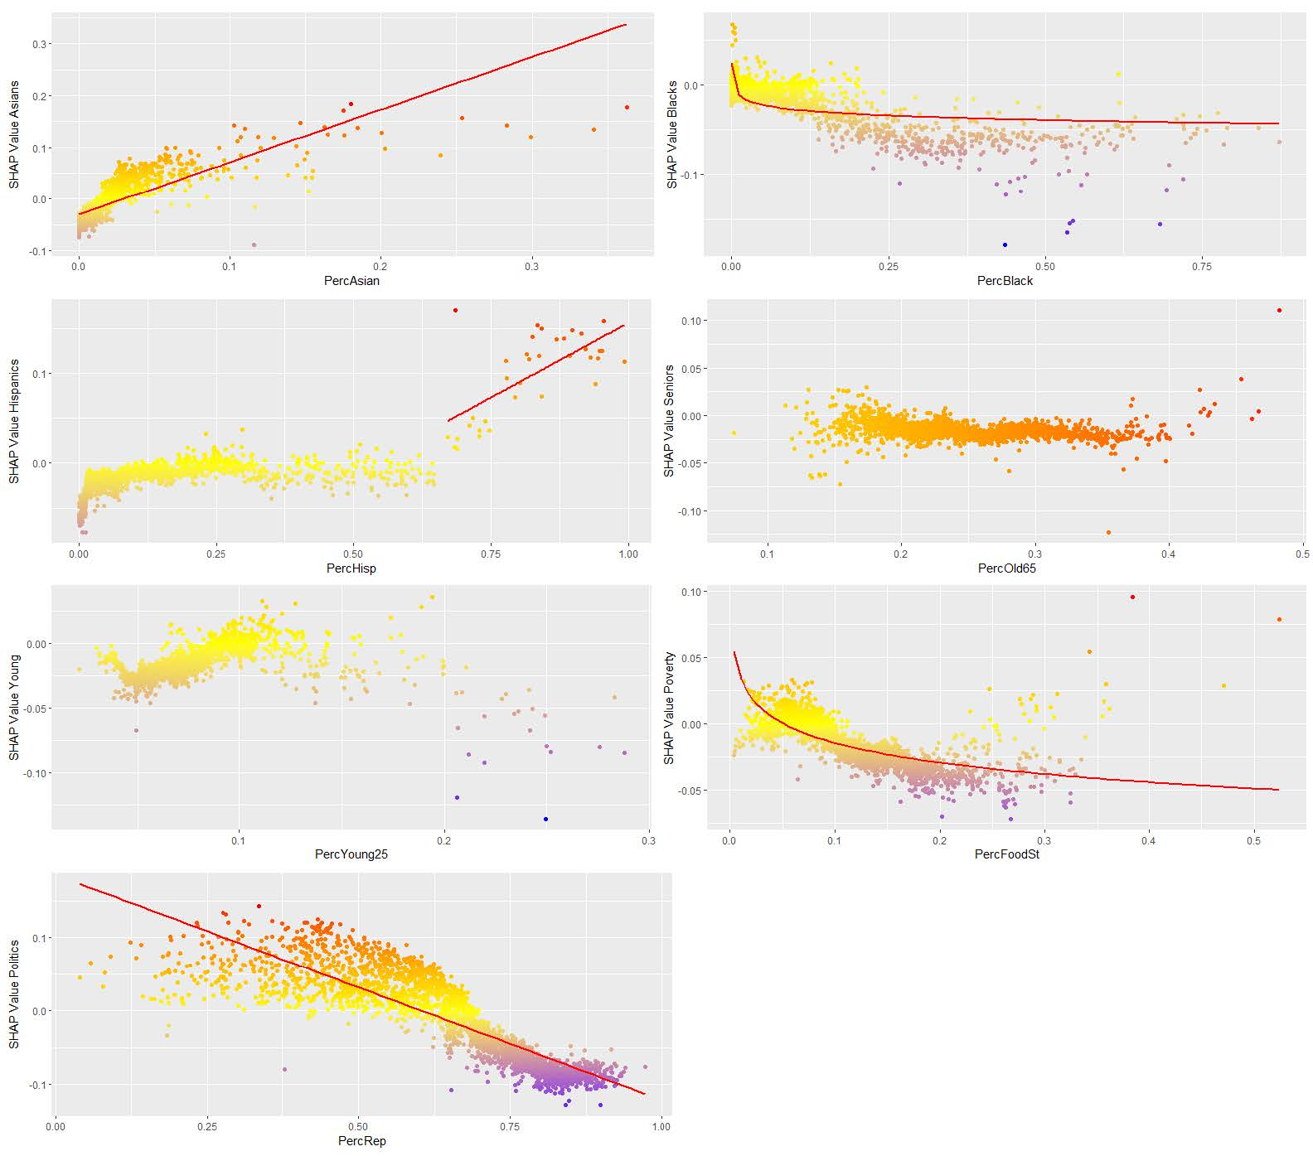
Shap Values for All Counties by Impact factor

Slide 18
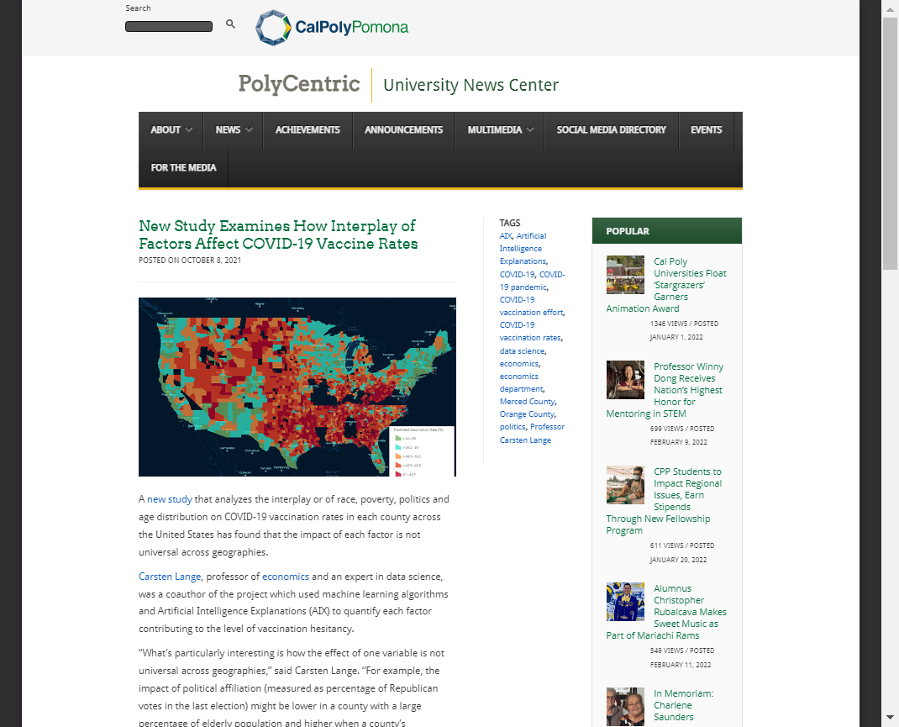
More Resources
For more details on the project, read the full article here.
For a summary of the project, read the news release here.
To view the interactive GIS dashboard , visit our page.

Slide 19
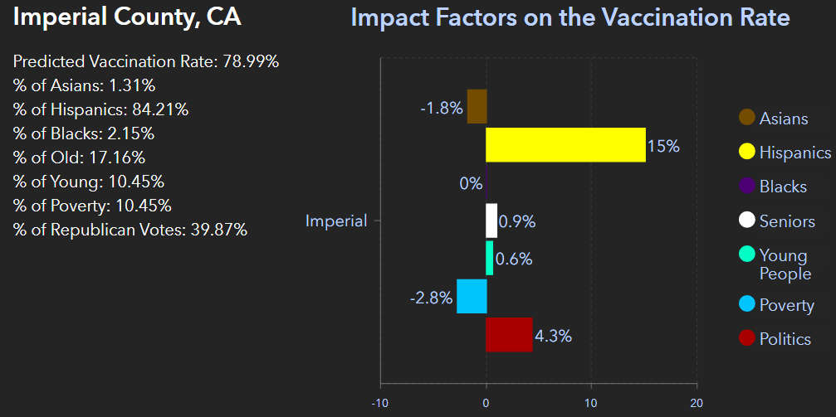
Unique Insights
Predominately Hispanic Counties Have High Vaccination Rates

Slide 20
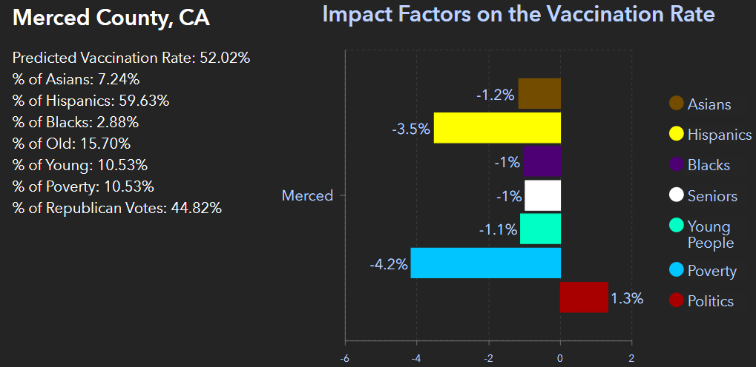
Unique Insights
Politics Matters but the Impact Varies Even in Similar Political Climates

Slide 21
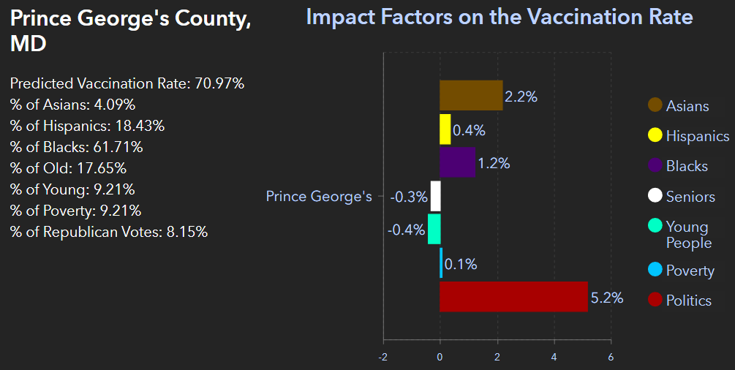
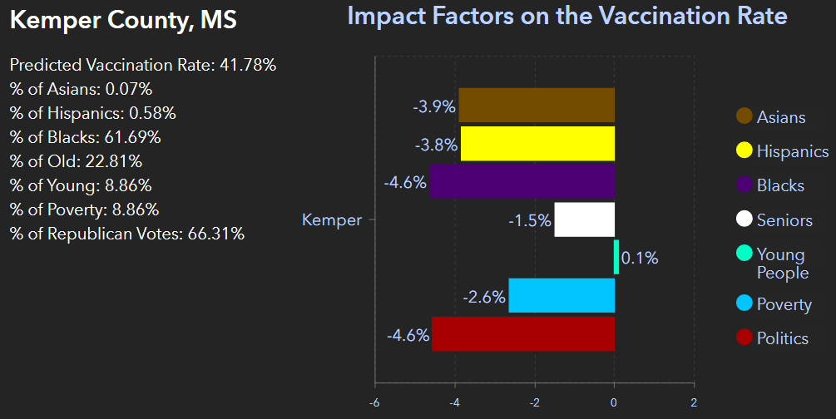
Unique Insights
African American Communities Vary across Dierent Geographies

