Slide 1
Honoring Mothers and Babies: Respectful Historical Geographies of Maternal and Infant Mortality
Meghan Cope Dept. of Geography & Geosciences University of Vermont, USA @geomeg mcope@uvm.edu
Notes:
Upper-left image: Melchers, Gari, 1860-1932, artist, 1907; Library of Congress: https://www.loc.gov/resource/det.4a26152/
Bottom-left image: “Indian Mother and Children in a Tent”, 1900; https://www.loc.gov/resource/ppmsc.02304/
Right-hand image: “Present-day mother and child”, 1937; Little Rock, Arkansas; https://www.loc.gov/resource/ppmsc.01036/
Center image – ideal baby wrappings demonstrated, from Visanska, S. A. (1917). Better babies; a guide to the practical care of the mother and young child. Atlanta, Ga.: Foote & Davies company; accessed at Hathi Trust: https://hdl.handle.net/2027/loc.ark:/13960/t7sn1bn1x

Slide 2
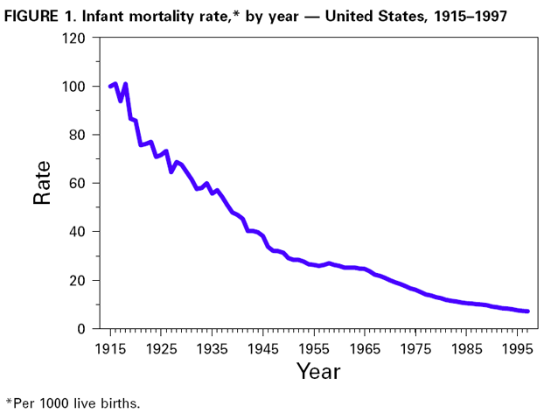
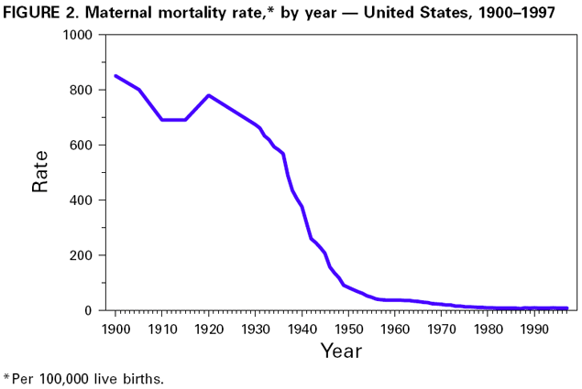
Some data…
Notes:
https://www.cdc.gov/mmwr/preview/mmwrhtml/mm4838a2.htm

Slide 3
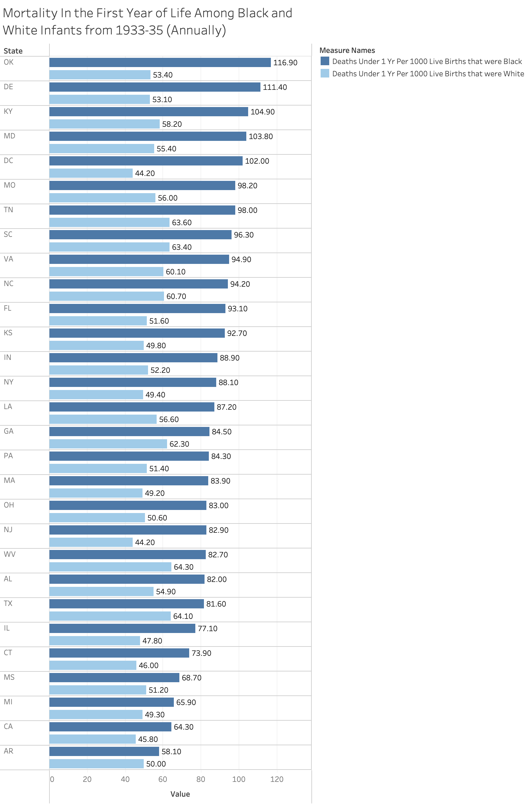
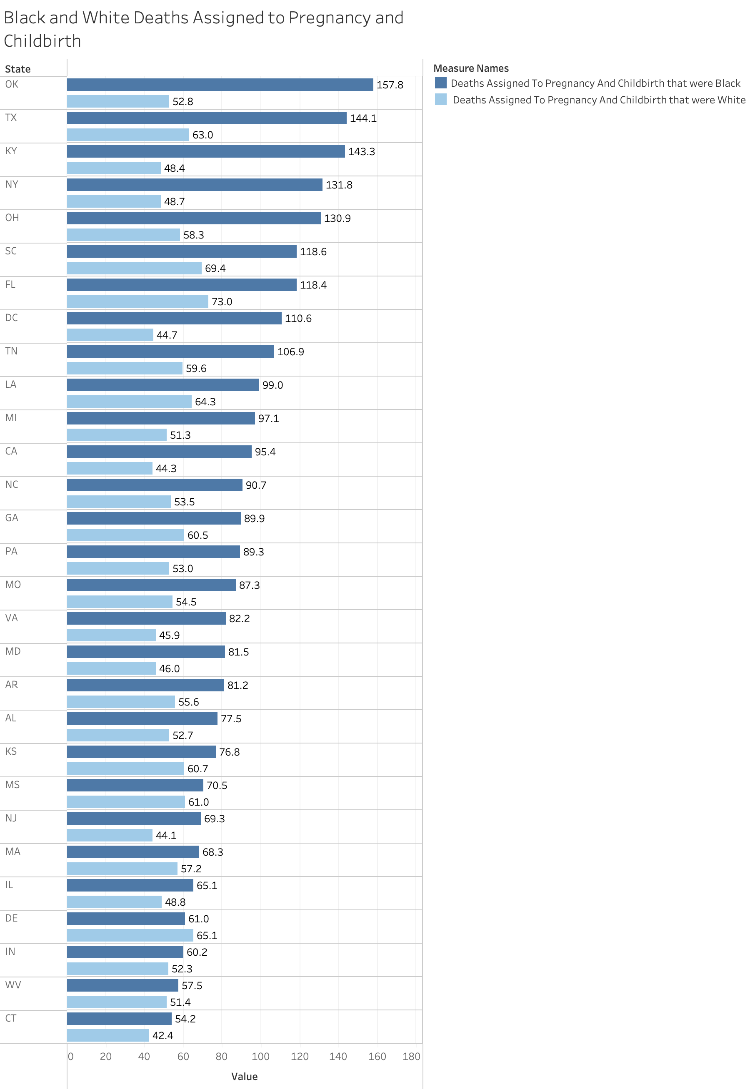
IMR and Maternal mortality by race and state
Source: Tandy, Elizabeth, 1937, “Infant and Maternal Mortality Among Negroes”, Washington, DC: Children’s Bureau, US Dept. of Labor.
Notes:
Data visualization by Molly Myers

Slide 4
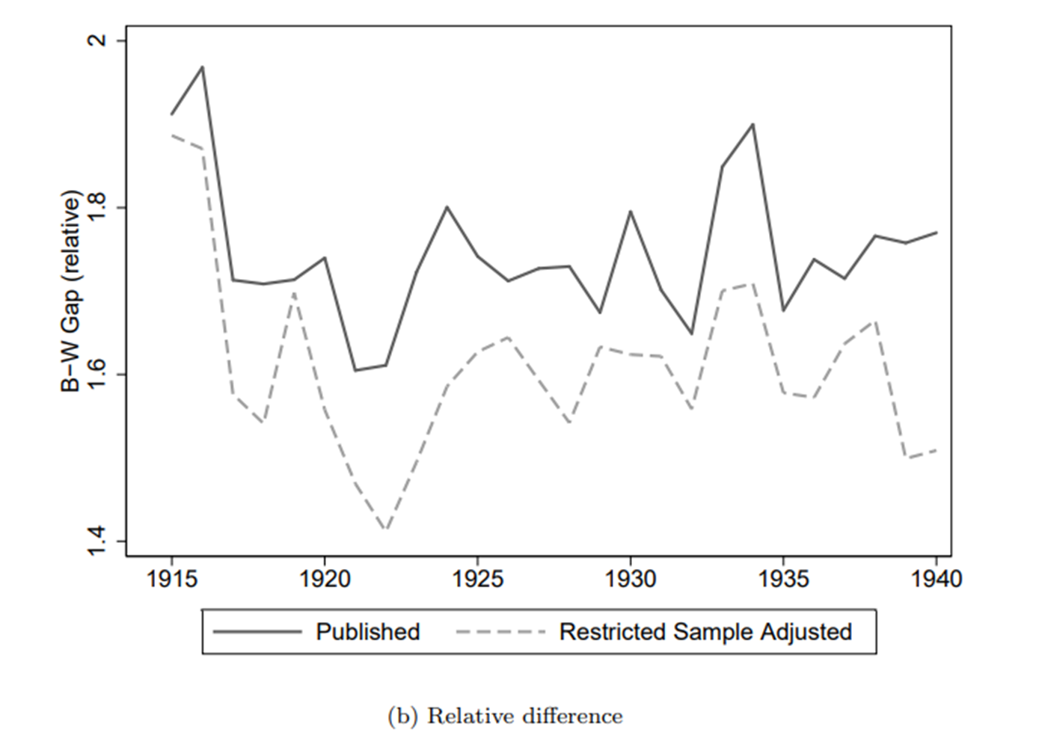
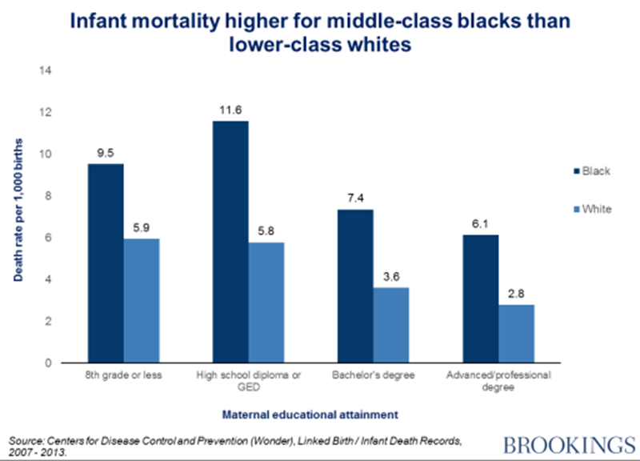
Severe racial gaps, even in corrected estimates…
… that have not diminished.
Notes:
Left chart: Eriksson, et al. 2017, Revising Infant Mortality Rates for the Early 20th Century United States, NBER Working Paper; https://www.nber.org/system/files/working_papers/w23263/w23263.pdf
Right chart: https://www.brookings.edu/blog/social-mobility-memos/2016/10/21/6-charts-showing-race-gaps-within-the-american-middle-class/

Slide 5
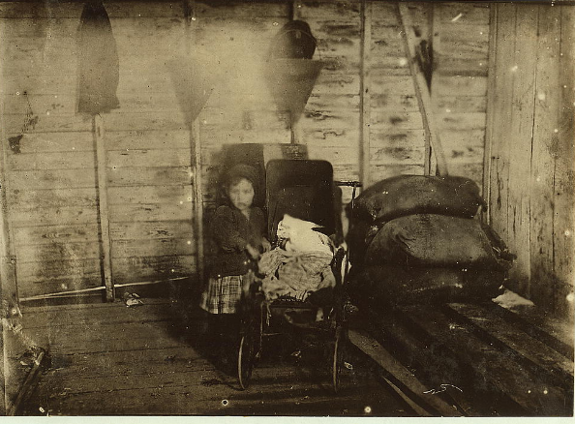
Observers at the time…
“It is difficult for the careful student of this problem to avoid the conclusion that the real underlying factor of infant mortality and the chief consideration in the health and welfare of babies is the strength, character, health, and intelligence of the mother.” … [infant mortality is] the result not of poverty, or the cleanly or sanitary condition of the home, or even of the physical strength of the parents, but of the amount of intelligent attention and care which the mother bestows upon her baby” (Hibbs, 1916, “The Mother and Infant Mortality”, American Statistical Society, pp 58-59)
“The high infant mortality rate for children of newer immigrants, illiterates, and those who cannot speak English is perhaps affected by the fact that they are at the same time generally of the poorest families and are housed in the most insanitary and unhealthful part of the city” (Duke, 1915; Children’s Bureau investigation of Johnstown, PA)
Notes:
Photo: 1911, Dunbar, LA; Lewis Hine Collection; https://www.loc.gov/resource/nclc.00921/

Slide 6
Great-grandmothers
Sadie
Mazola
Gladys
Catherine

