Slide 1
Children’s learning and labor in 20th century US
Is it possible to move beyond ‘child as victim’ when doing archival research?
Dena Aufseeser
Geography and Environmental Systems
UMBC
daufsee@umbc.edu

Slide 2
‘Modern’ childhood
-based on the belief that childhood is a time for school and play, to be spent with the nuclear family.
  -separate spaces for children and adults
  -children should not engage in paid labor
From the fact-finding report of the Midcentury White House Conference on Children and Youth
-“The tradition in which the young now grow up distinguishes sharply between work and not-work. Work, in general, is that which one is required to do to earn one’s livelihood.”
-“the young grow up in an atmosphere in which work is equated with drudgery, but honorific; and leisure is equated with release, but suspect.”
“The question today is whether the American model, passed primarily to meet the needs of adults, is in the best interest of all children?” Lindenmeyer, 2006

Slide 3
Fair Labor Standards Act of 1938
-uneven regulation of children’s work contributions, both formally and informally.
-ultimately gained enough support to pass when adult unemployment rates skyrocketed following the Great Depression
Today:
-provides a minimum age of 18 for any nonagricultural jobs that are deemed particularly hazardous (this does not include domestic work)
-14 and 15 year olds may work outside school hours in non-manufacturing, non-hazardous jobs
-children as young as 12 can work in agricultural jobs on large farms, unlimited hours when school is not in session.
-children of any age can work on small/family farms

Slide 4
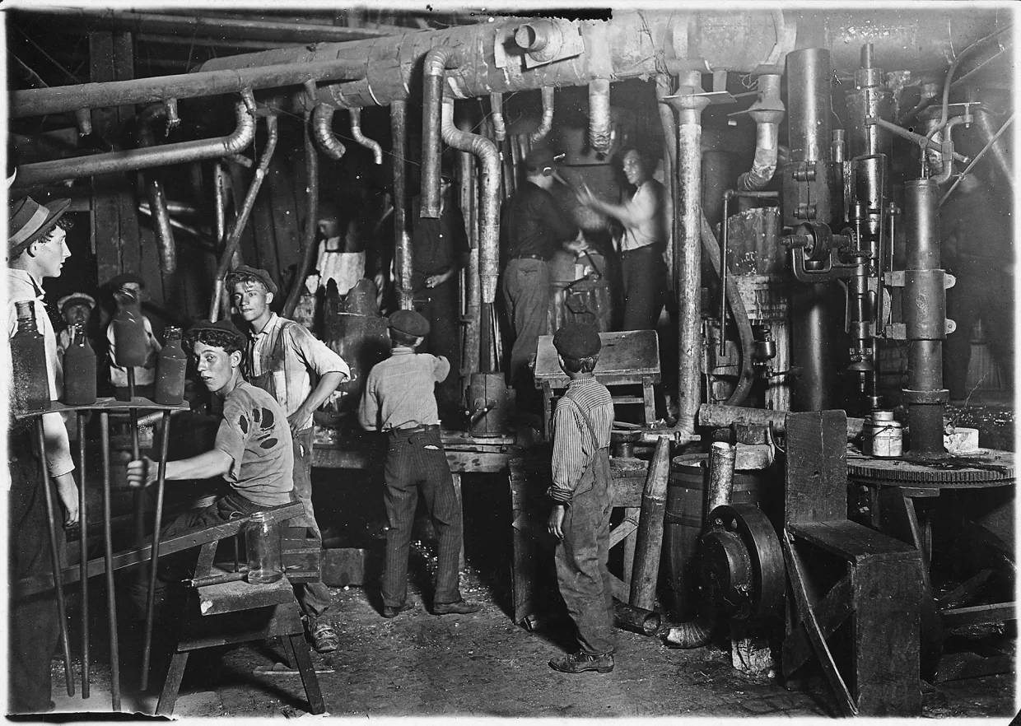
Organizing for better wages
‘Baby strikers’, lots of children among strikers protesting mill working conditions in Pennsylvania
-tensions between some adult’s goals and children’s goals
-youth likely saw themselves as “legitimate and autonomous workers with interests and rights similar to adults” –Lindenmeyer, 2006
Lewis Hine

Slide 5
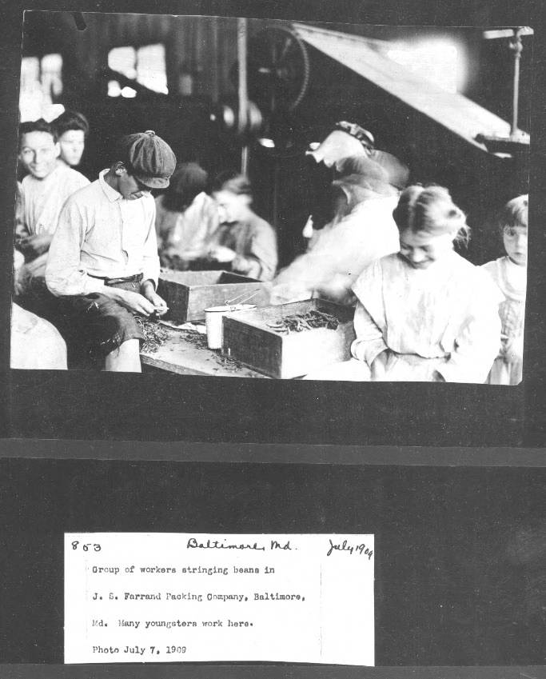
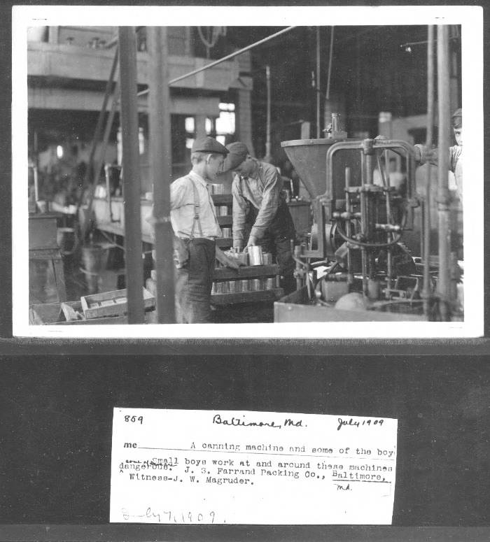
The importance of captions and labels
‘appalling images of the plight of child laborers’

Slide 6
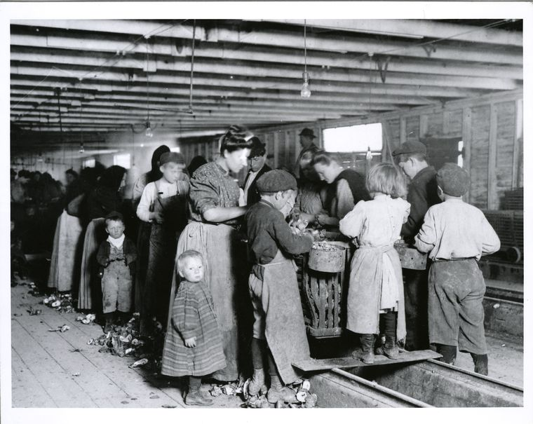
Care and/or exploitation?
7-year old girl went to school while her older siblings and parents worked.
She reported that after school, she “just waited.” –from Warburton’s notes, Hidalgo County, Texas
-Lewis Hine

Slide 7
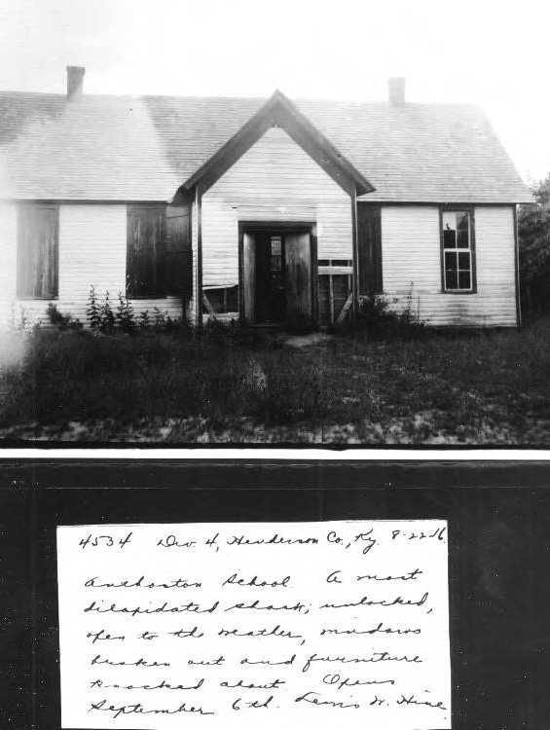
School and learning
Anthoston School. A most dilapidated shack; unlocked, open to the weather, windows broken out and furniture knocked about. Location: Henderson County, Kentucky
“sent child home from school because he was too young.”
-school does not provide experiences of value
- 12-year old girl has no shoes or clothing, cares for younger siblings

Slide 8
Discourses of poverty and relief
On the surface agreement that children deserving of aid.
“Many of the states, however, have rules and regulations which prevent the giving of aid for a variety of technicalities. In some cases, the child or its parents must have lived for a year within the state; in others, if they become dependent children, it has to be proved that the parent has been absent for a year and that legal steps have been taken against the parent to make him contribute support. Otherwise the state will not allow them to receive aid.”- Eleanor Roosevelt
Older children, especially Black children, considered suitable for labor or instead confined to state homes for potentially problematic behavior.
Sanchez family was denied aid because they had not been in the same town for at least 6 months.
“In six months, we may be dead.”

Slide 9
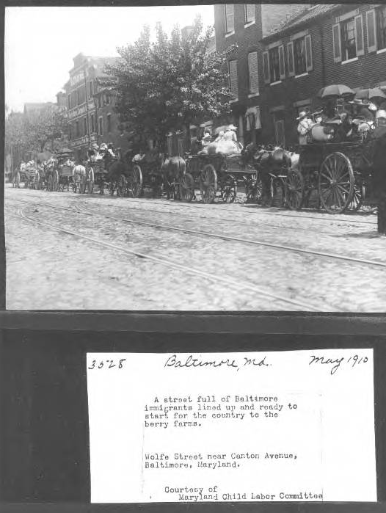
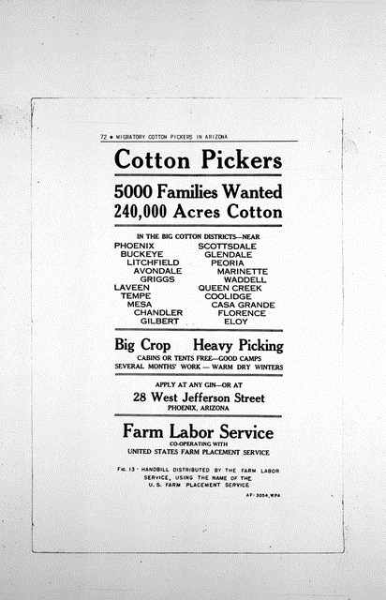
A family affair
A justification for low wages- “That is the beauty of our Baltimore situation, they all live at home and so can live so much more cheaply.”-employer quoted in National Consumer League report, 1918

Slide 10
“We saw a lot of the country. Another year, my eldest son and daughter are planning to leave me at home, while they go out and beginning with the berry picking follow the wheat harvesting straight through the summer.”
“it made quite a gay scene, there are always one or more tents where pop, lemonade, peanuts and such can be bought. Sometimes, there is a merry-go-round and a shooting gallery where they young people, who have all put on fresh clothes can walk out and enjoy themselves at the expense of a few nickels. It took my children some time to get used to this part of the life, and at first when we would come in from the berry fields they stuck at my heels, helping me with the cooking and other domestic cares necessary even in tent life.”

Slide 11
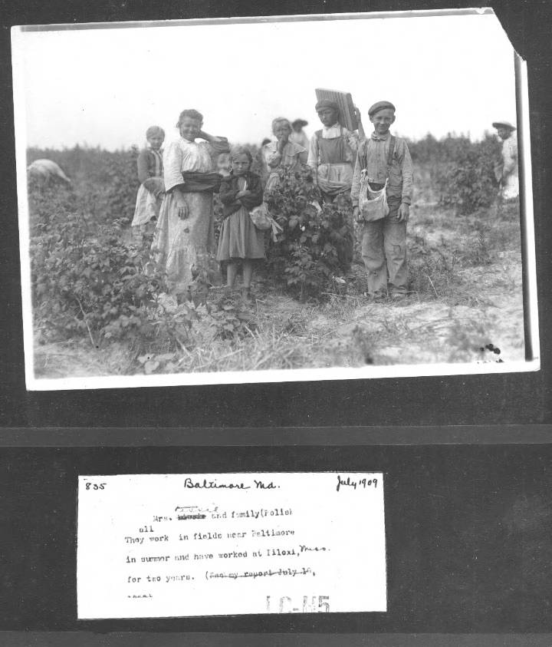
“Don’t like to work but I must. My mother makes me” -11-year old Jesse from Baltimore
“When I turn 16, I'm quitting school and working the fields.”- girl in the Glades, Florida

Slide 12
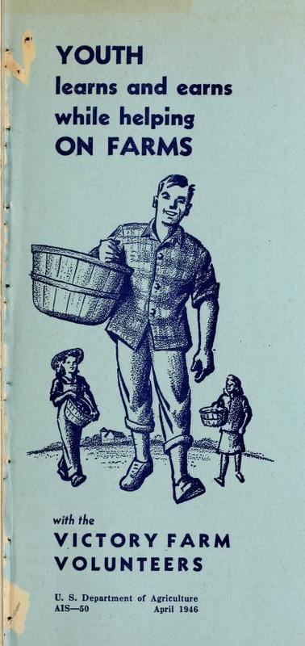
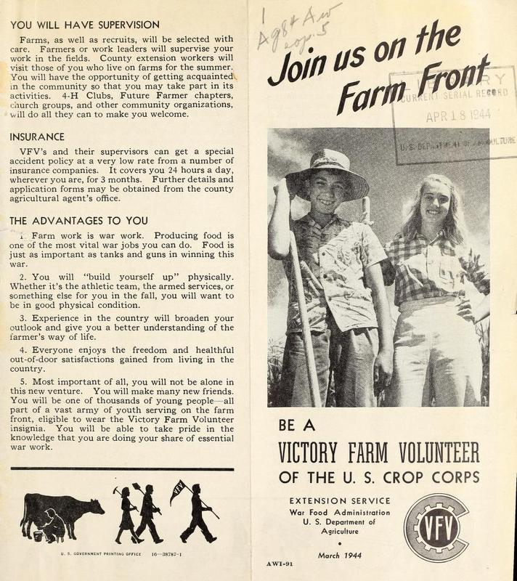

Slide 13
Victory Farm Volunteers
“Thanks for the memory
Of aches and pains received
Of how we’ve been deceived—
Fresh air and exercise
But if we are not wise
We ache from feet to eyes
Thank you so much
Thanks for the memory
Of fields all green with beans
And oh those awful scenes.”
-Farmerette Fanfare, cited by Ossian, 2012
“lean tanned and with some saved money in our pockets we came home to Baltimore in the fall in time for the beginning of the school year.”

Slide 14
Living archives
What strategies can we use today to avoid common ‘silences’ in future archives?
How do we balance IRB (human subjects) requirements with children’s own stated desires and opinions?
-expanding what counts as archival material
-recognizing that some people may wish to remain invisible, especially in particular types of archives

