Slide 1
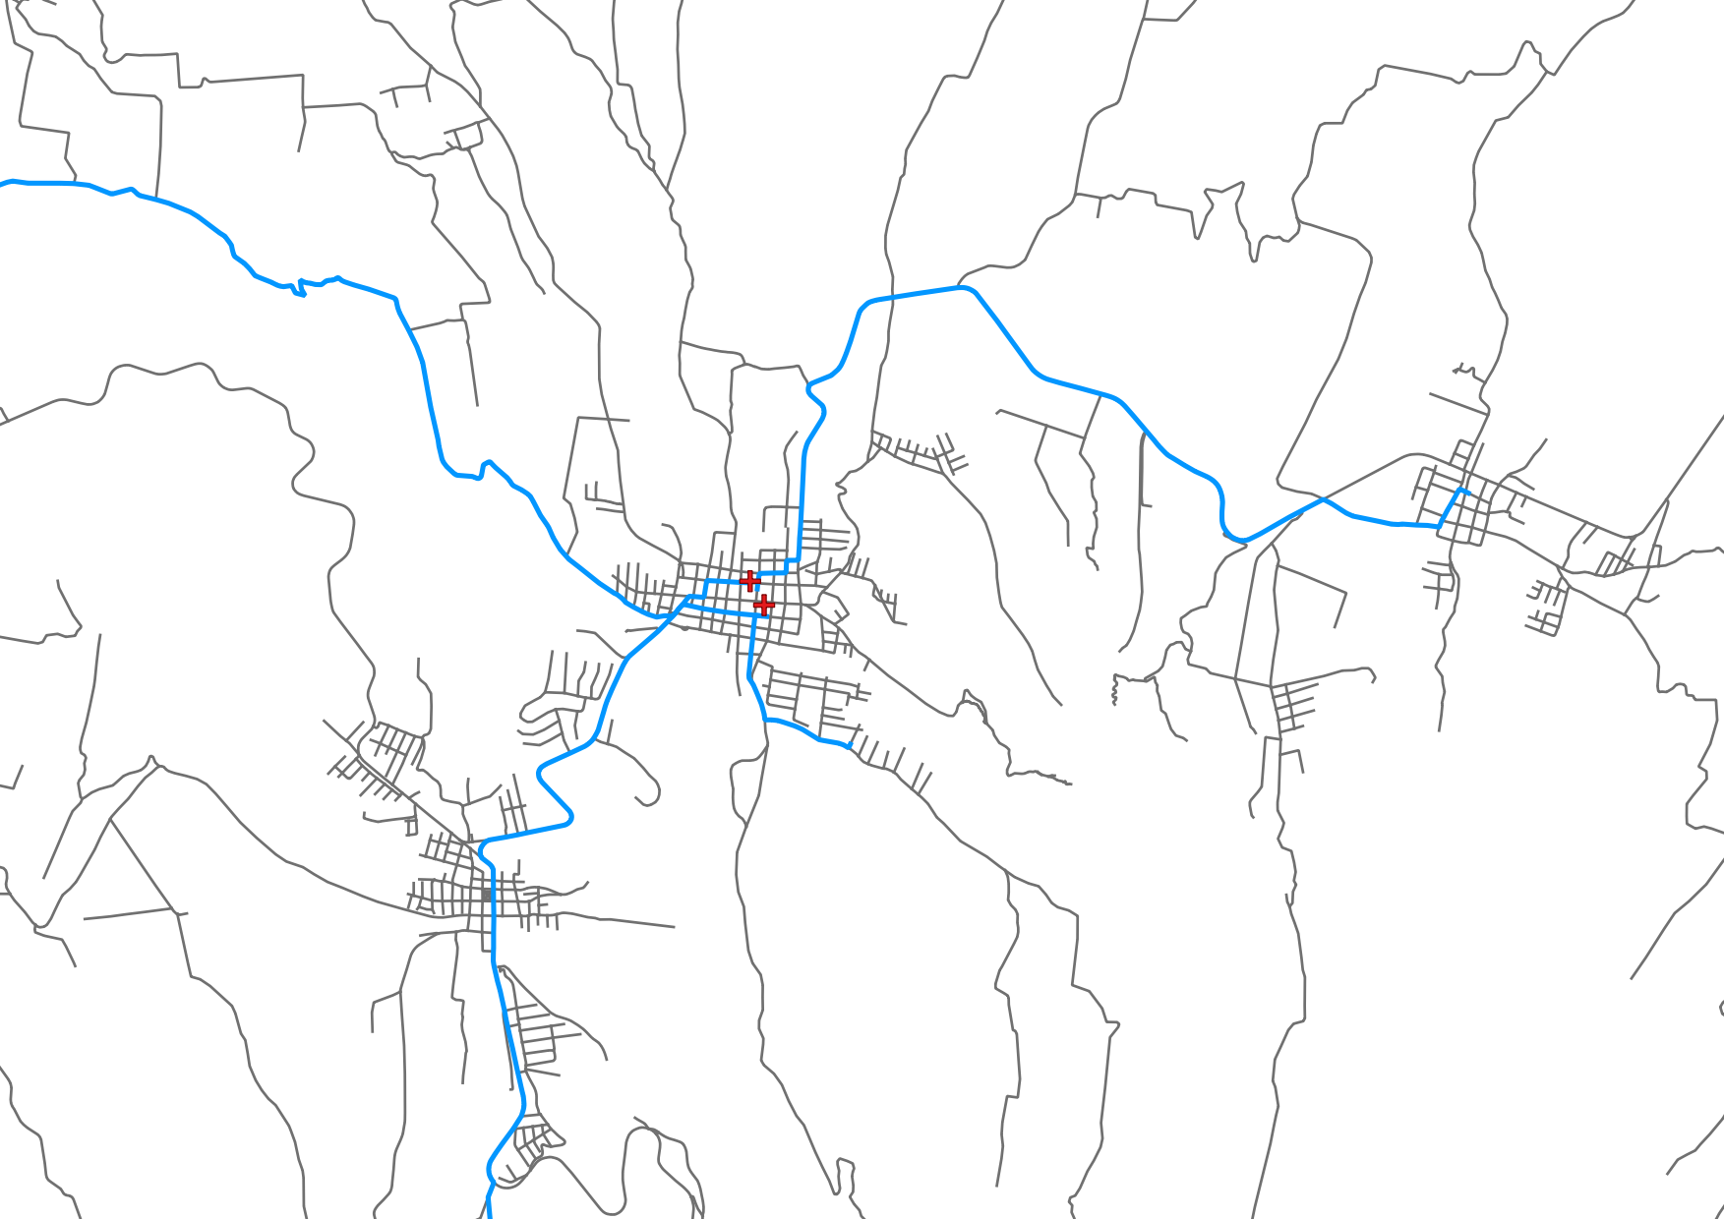
Understanding access to healthcare: The impact of data inequalities on measures of spatial access
Kirsty Watkinson, Jonathan Huck, Angela Harris
MCGIS, University of Manchester, UK

Slide 2
Goal 3:
“Ensure healthy lives and promote well-being for all at all ages“
Notes:
Sustainable development goals - goal number 3 by 2030. Ensuring healthy lives requires access to healthcare. But globally we can observe an inquality in access to healthcare - populations in rural areas of lower income countries experiencing relatively worse access to healthcare
What are the consequences of these inequalities?
Emergency healthcare
Maternal health
Increase in non-communicable disease in lower income countries
Infectious diseases

Slide 3
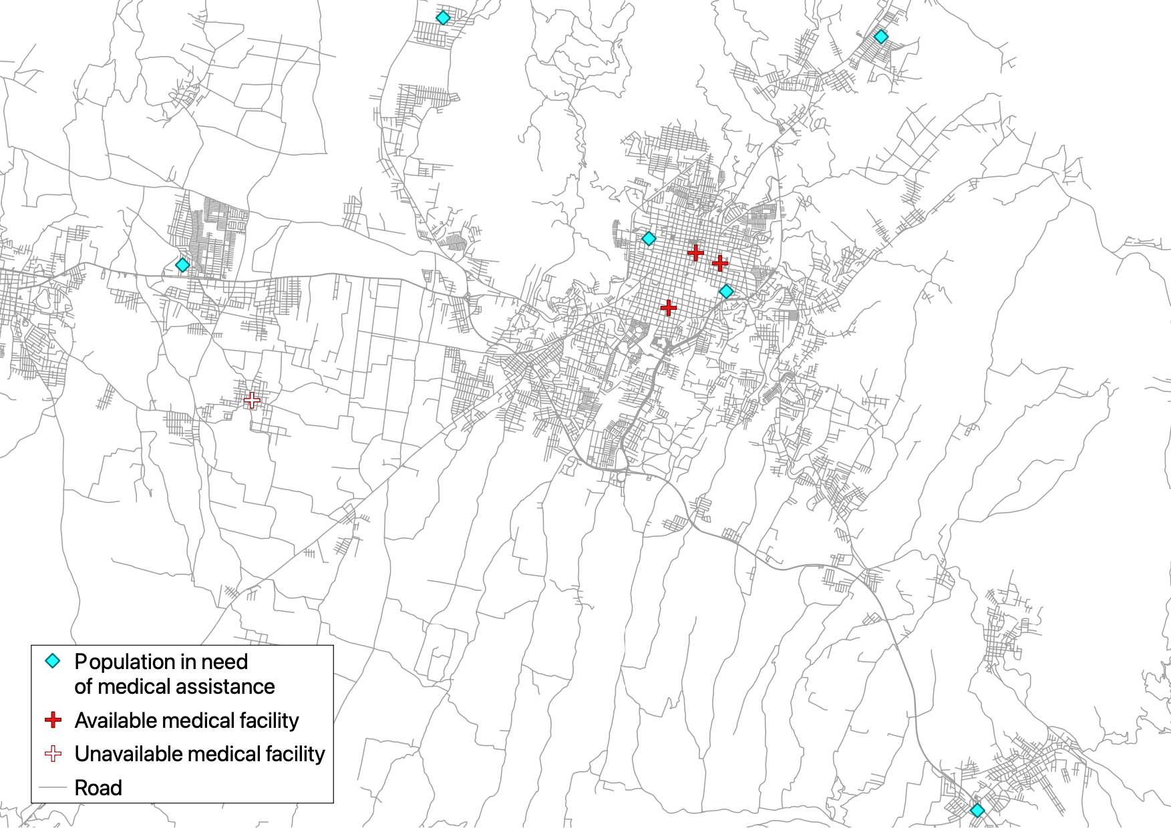
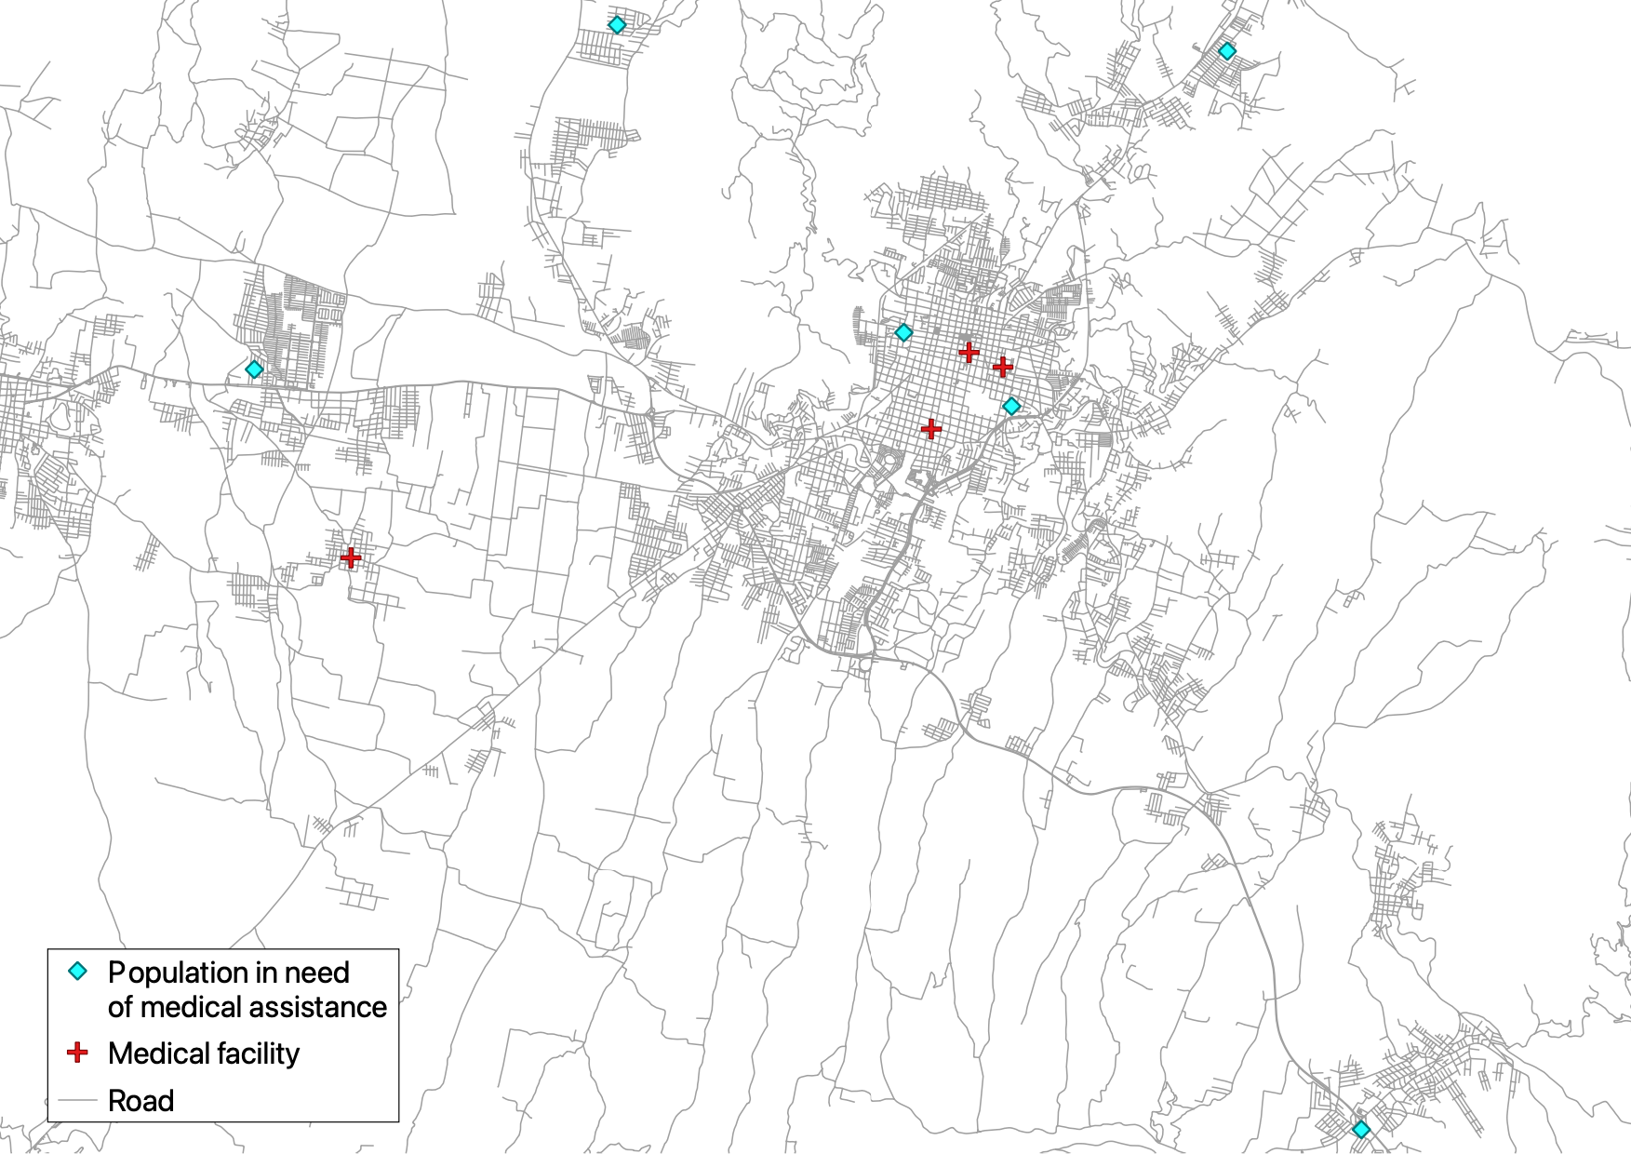
Access: Availability, affordability, acceptability
Notes:
What do we mean by access to healthcare? Access is made up of 3 dimension.
Availability describes the spatial dimensions of access e.g. the distribution of available healthcare facilities and the route travelled to access them.
We are focusing on availability as geographical barriers often determine access to healthcare in rural ares of lower income countries- normally have to travel much further to access healthcare and don‘t necessarily have the means to travel there. Therefore spatial dimensions often used to inform policy interventions aimed at reducing inequalities in access.

Slide 4
Access: Availability, affordability, acceptability
Notes:
Affordability describes whether a needy person has the financial means (physical money or insurance) to pay for a service. For example here the medical facility now white represents an unaffordable facility which can no longer be accessed so people have to travel further.

Slide 5
Access: Availability, affordability, acceptability
Notes:
Acceptability – whether the level of care provided is acceptable. For example the medical facilitiy also now white represent a facility where medical care isn’t as acceptable so people chose to go to other healthcare facilities.

Slide 6
Access: Availability, affordability, acceptability
Notes:
We are focusing on availability as geographical barriers often determine access to healthcare in rural ares of lower income countries- normally have to travel much further to access healthcare and don‘t necessarily have the means to travel there. Therefore spatial dimensions often used to inform policy interventions aimed at reducing inequalities in access.

Slide 7
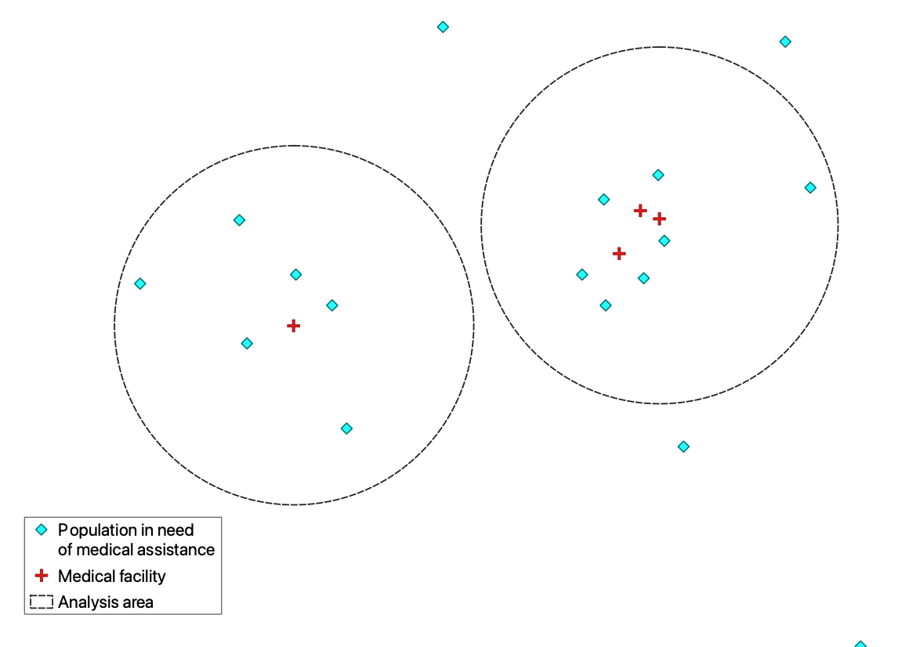
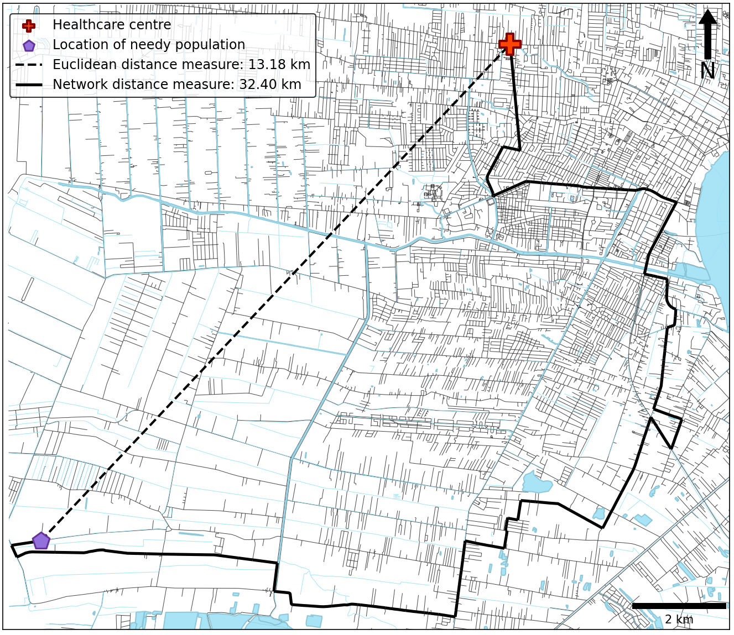
Measuring healthcare availability
Notes:
How do we measure spatial access to healthcare?
If we have only have data on the location of medical facilities we estimate availability using population provider ratios. Which is a simple ratio between number of facilities and the total population in a region. E.g. on the left it is 1 to 6 and the on the right it is 3 to 7 so the right has better availability of healthcare.
If we have data on the location of the population we can estimate availability using distance measurements:
1) Euclidean - straight line distance between needy population point and the nearest healthcare centre
2) Network distance - uses road and path network or a friction surface to reflect more realistically how people travel through the environment. Preferred method.
However limitations:
1) Euclidean normally overestimates access so people believed to have better access than they really do
2) Network distance depends on access to appropriate network data e.g. road and path network. Some countries, particularly lower income countries don’t have access to complete and up to date road and path networks. If road and path network incomplete what happens to our measure of access??

Slide 8
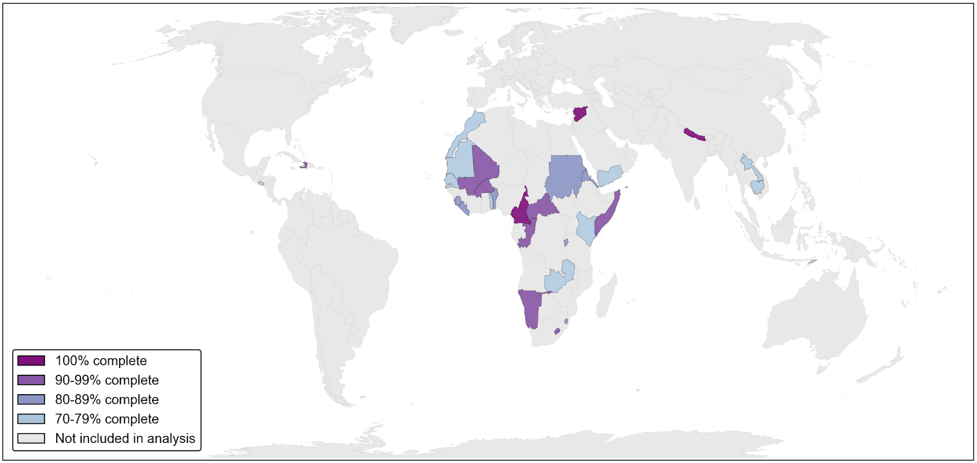
How much data is enough data?
Notes:
To answer this we decided to explore the question of how much data is enough data?
To do this I am running a sensitivity analysis on hopefully 29 countries that meet two conditions:
Had a road completeness of over 70% on OpenStreetmap as estimated by Millard-Ball and Barrington-Leigh (2019) so that road and path networks were complete enough to run the analysis and
Chose OpenStreetMap as this is the most viable source of data for lower income countries where authoritative data may not be accessible
Were classified by the united nations development report as a ‘developing’ country as these are countries that are more likely to face barriers to healthcare

Slide 9
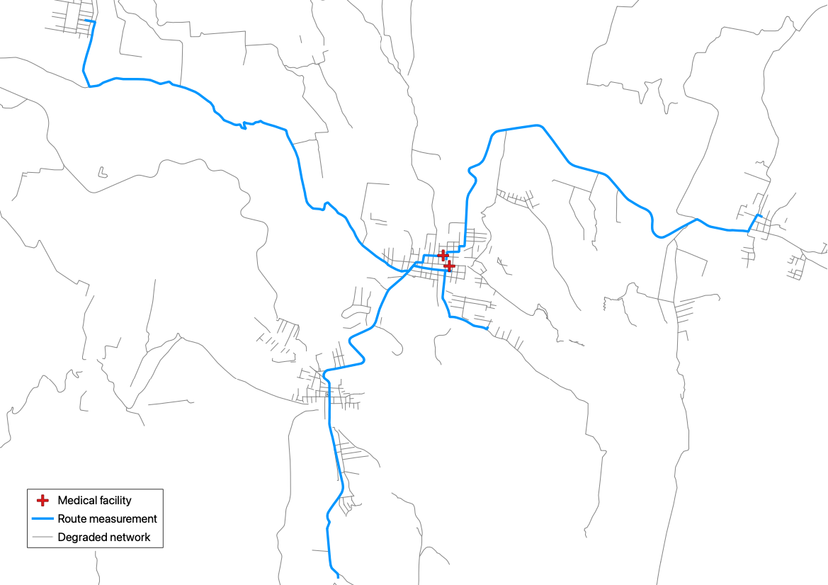
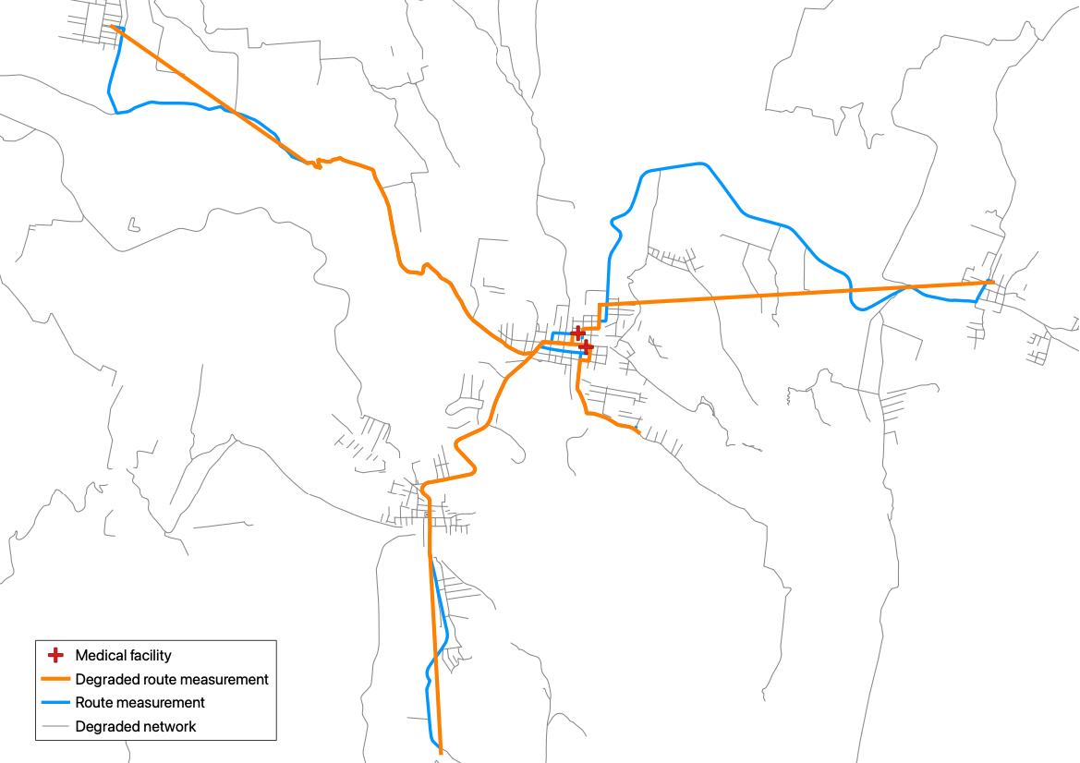
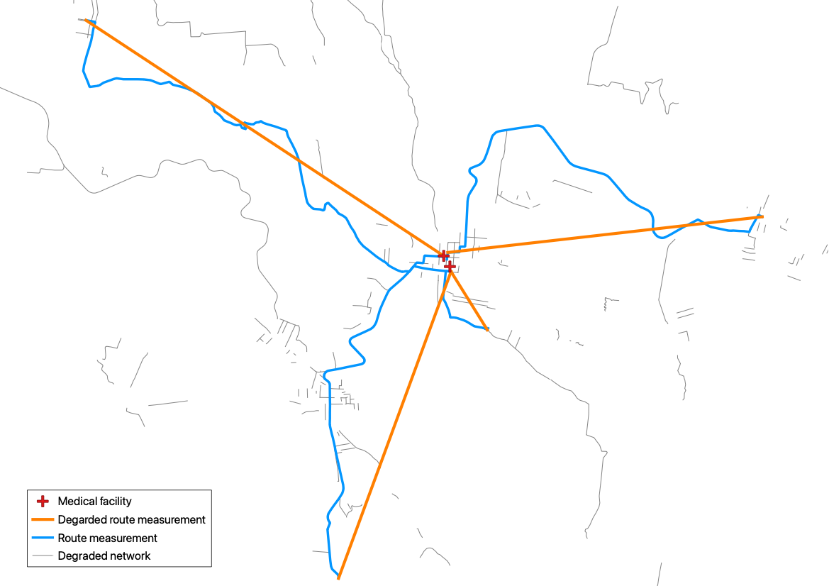
How much data is enough data?
70%
50%
20%
Data sources: OpenStreetMap road and path network, OpenStreetMap healthcare facility locations, WorldPop Constrained Populaton Counts
Software used: PostgreSQL, PostGIS, PgRouting, OSM2PO, Osmosis
Notes:
How did we answer this question?
First the road and path network and location of healthcare facilities for each country was downloaded from OpenStreetMap and loaded into a database.
We than ran an analysis 100 times for each country.
First random population points were selected. The number of points selected was proportional to the the total population of the country
Then starting with the road and path network at its highest level of completeness the distance from each population point to its nearest healthcare centre was calculated.
If a network route was possible was done using a shortest path algorithm. This was either done for the entireity of the route or for a routable section and the rest was calculated as a straight line distance. Each time a network route was measured, the Euclidean distance was also measured.
If no routing was possible at all the Euclidean distance was measured.
A mean distance to healthcare was then calculated and recorded alongside how many network routes were calculated.
After this the road and path network was degraded by 10% which was completed by randomly turning off 10% of edges in each road and path category (primary, secondary, tertiary, unclassified and path).
After this distance measurements were carried out again and the mean distance to healthcare calculated.
Network degradation and route calculation was repeated until the road and path network was 0% where the Euclidean distance was measured for all population points.

Slide 10
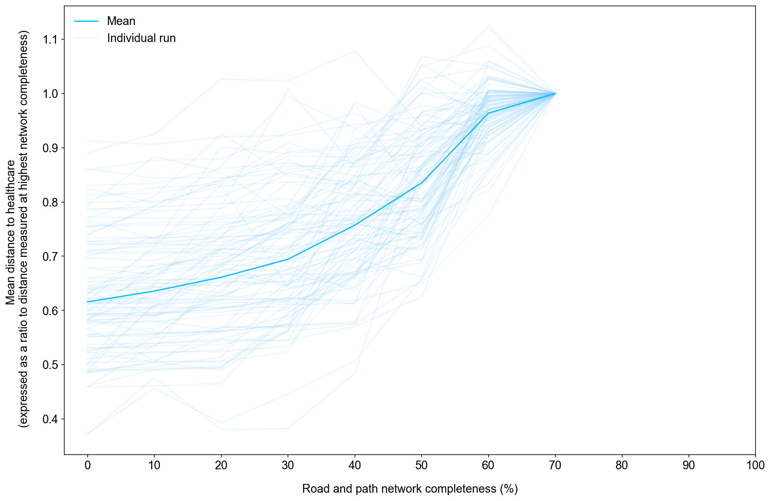
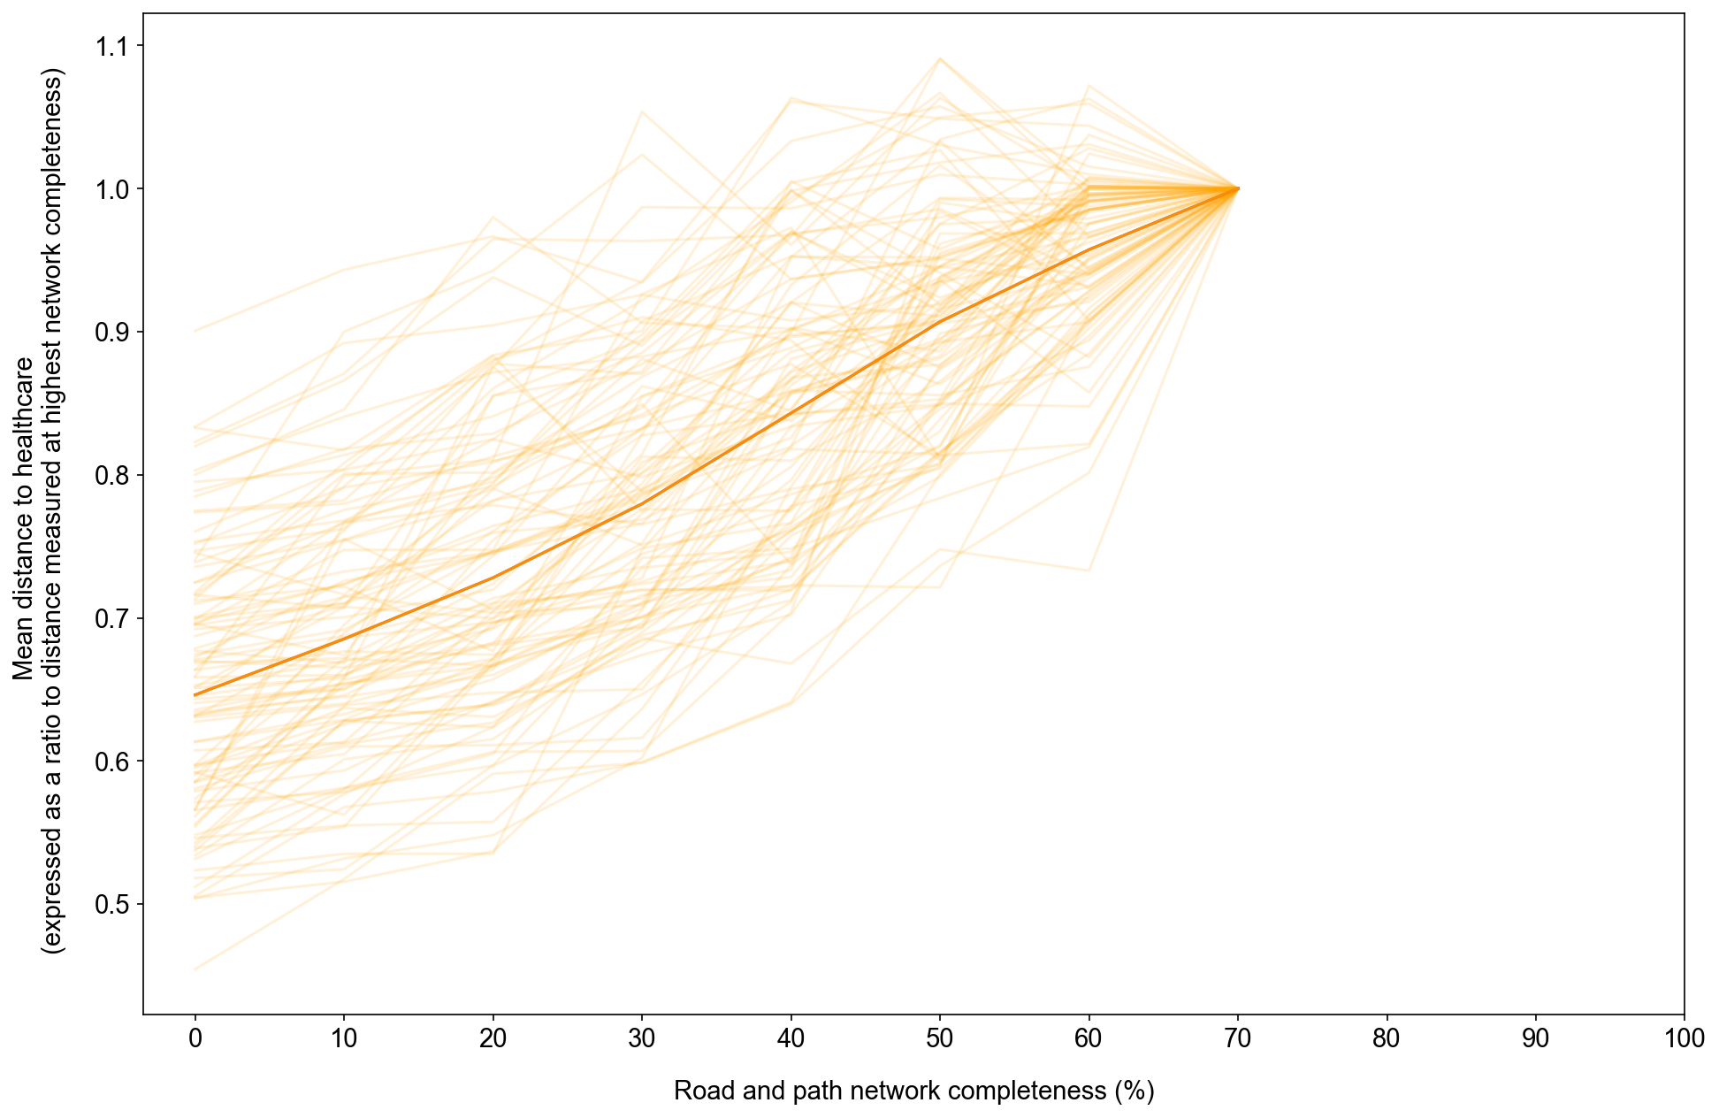
RQ1: How does distance to healthcare change with increasing road and path network completeness?
El Salvador
Yemen
Notes:
For some countries the impact on decreasing road and path network density is clear. For El Salvador estimated distance to healthcare was on average 38 % higher at 70% completeness and would likely be higher if the dataset was complete. This equalled an underestimation of distance travelled by almost 7km which if walking on foot is over an hour of extra travel time.
Yemen was similar with a 35% increase in mean distance to healthcare at 70% compelte. Which equalled an underestimation of 2.3 km if Euclidean is used and an additional 30 minutes of travel time if walking on foot.
These results suggest Euclidean distance and incomplete network datasets lead to an underestimation of spatial access to healthcare.

Slide 11
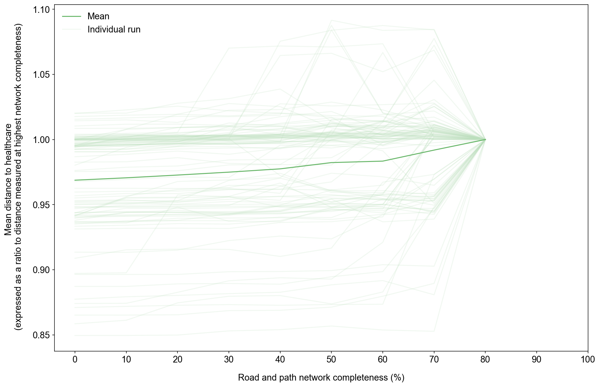
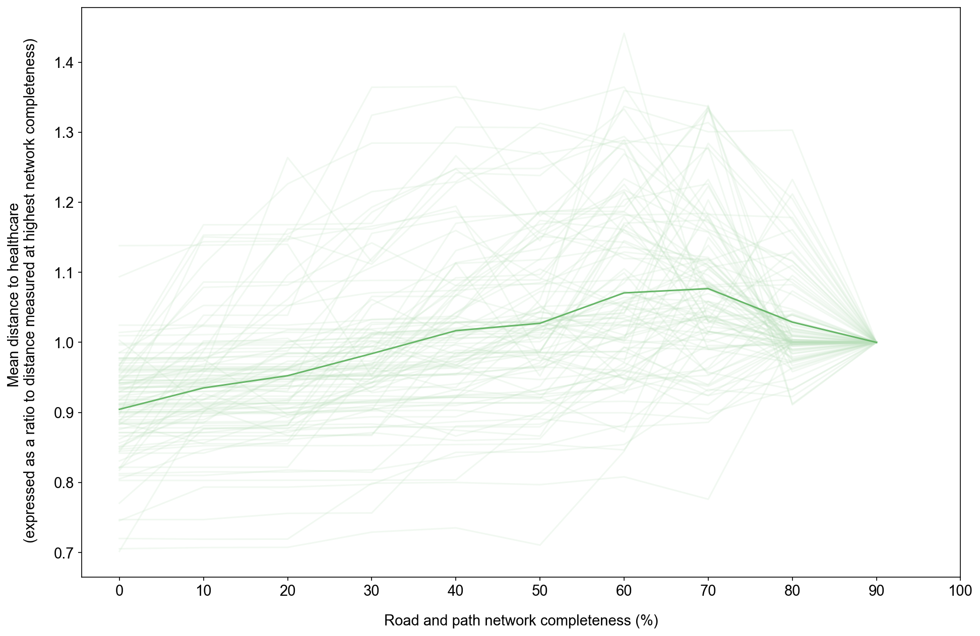
RQ1: How does distance to healthcare change with increasing road and path network completeness?
Liberia
Namibia
Notes:
However in other countries the impact of network completeness appears to be less important.
In Liberia only a 3% increase in mean distance to healthcare is observed but this does still equal a 1.5km increase in distance travelled at higher levels of dataset completeness.
For Nambia we observe an interesting behaviour where mean distance is actually higher at 70% completeness and mean distance is around 17% higher which. Then decreases to around and 9.5% increase in mean distance. Though visually changes in network completeness don't appear to have a big impact on distance travelled but the difference between 0 and 70% is almost 20km. Which means spatial access likely a lot lower than when estimated by Euclidean distance.

Slide 12
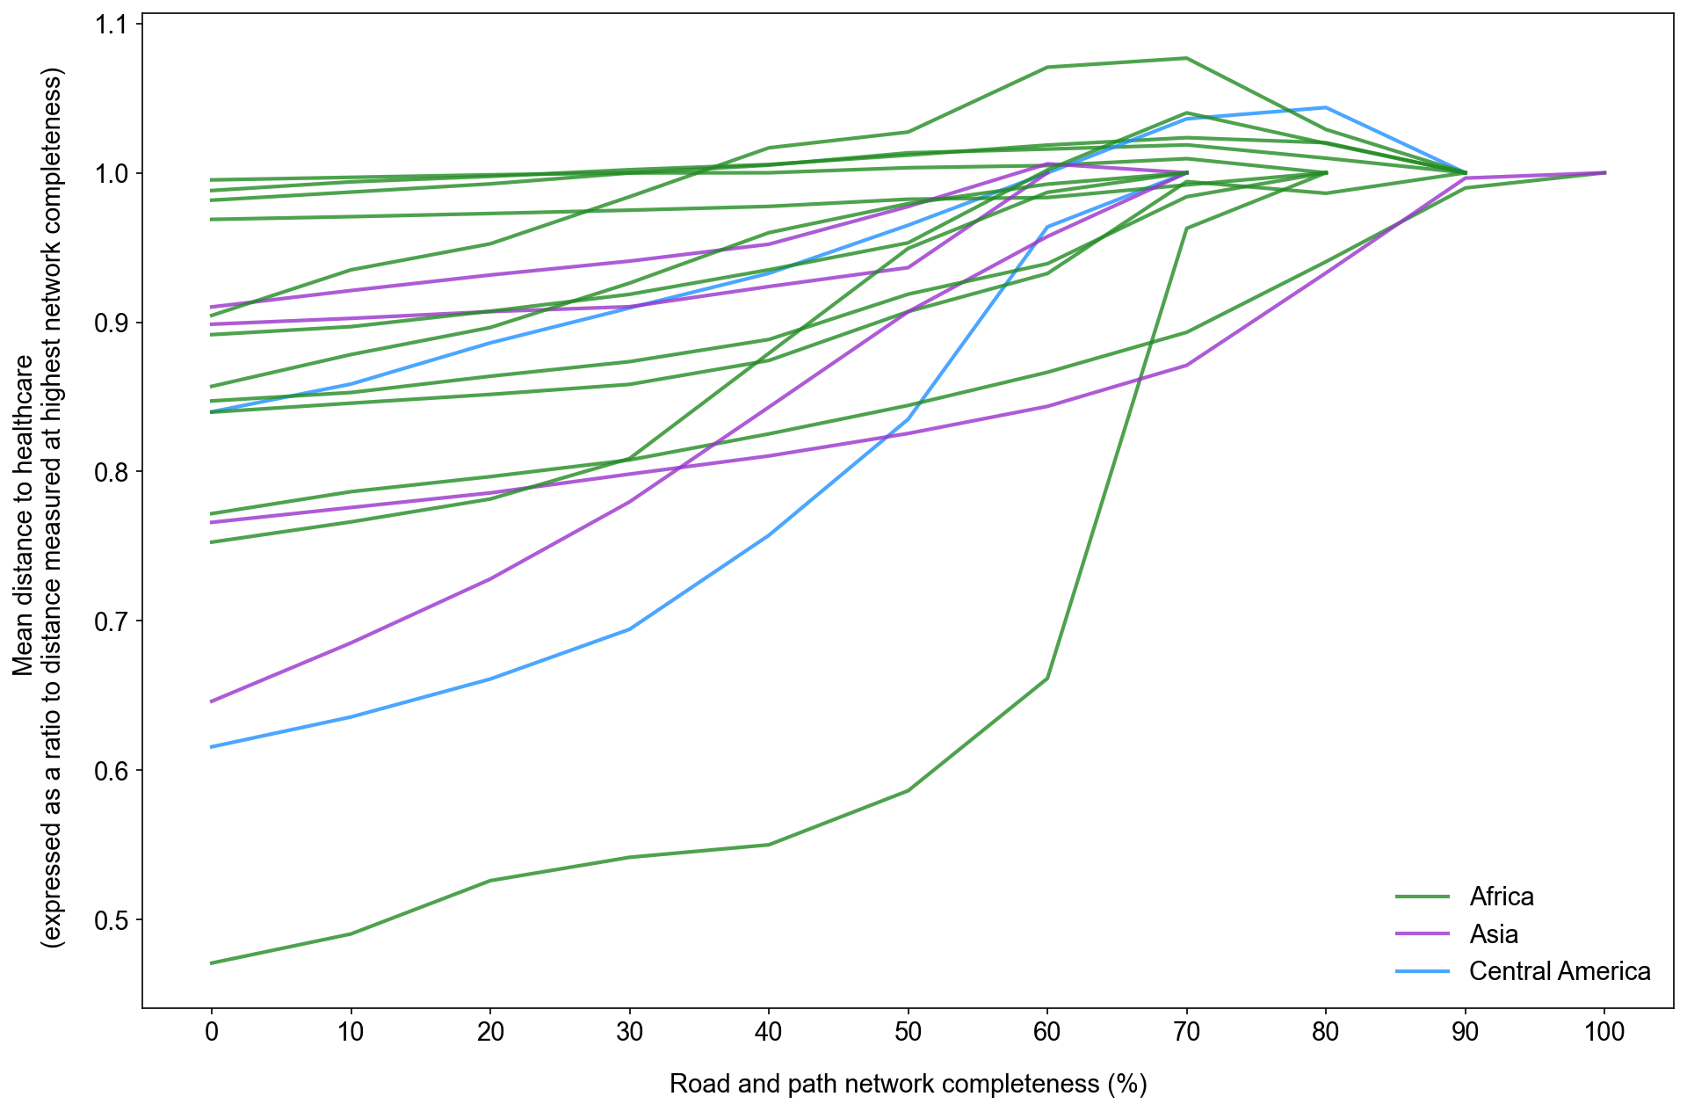
RQ1: How does distance to healthcare change with increasing road and path network completeness?
Notes:
When we look at all the countries together overall we observe variation in the change in distance to healthcare measured with varying levels of dataset completeness. Some countries you have very little difference, less than 5% difference in distance measured. Whereas other countries there are much larger variations, over a 50% underestimation of distance measured in Eswatini.
No clear consitent level of completeness where changes in distance become negligible, though the larger increases in distance measured appears to happen at lower levels of completeness (between 30 to 70%) completeness. However many of the countries don't have datasets that are 100% complete so whether we would see large increases beyond 70% is unknown.

Slide 13
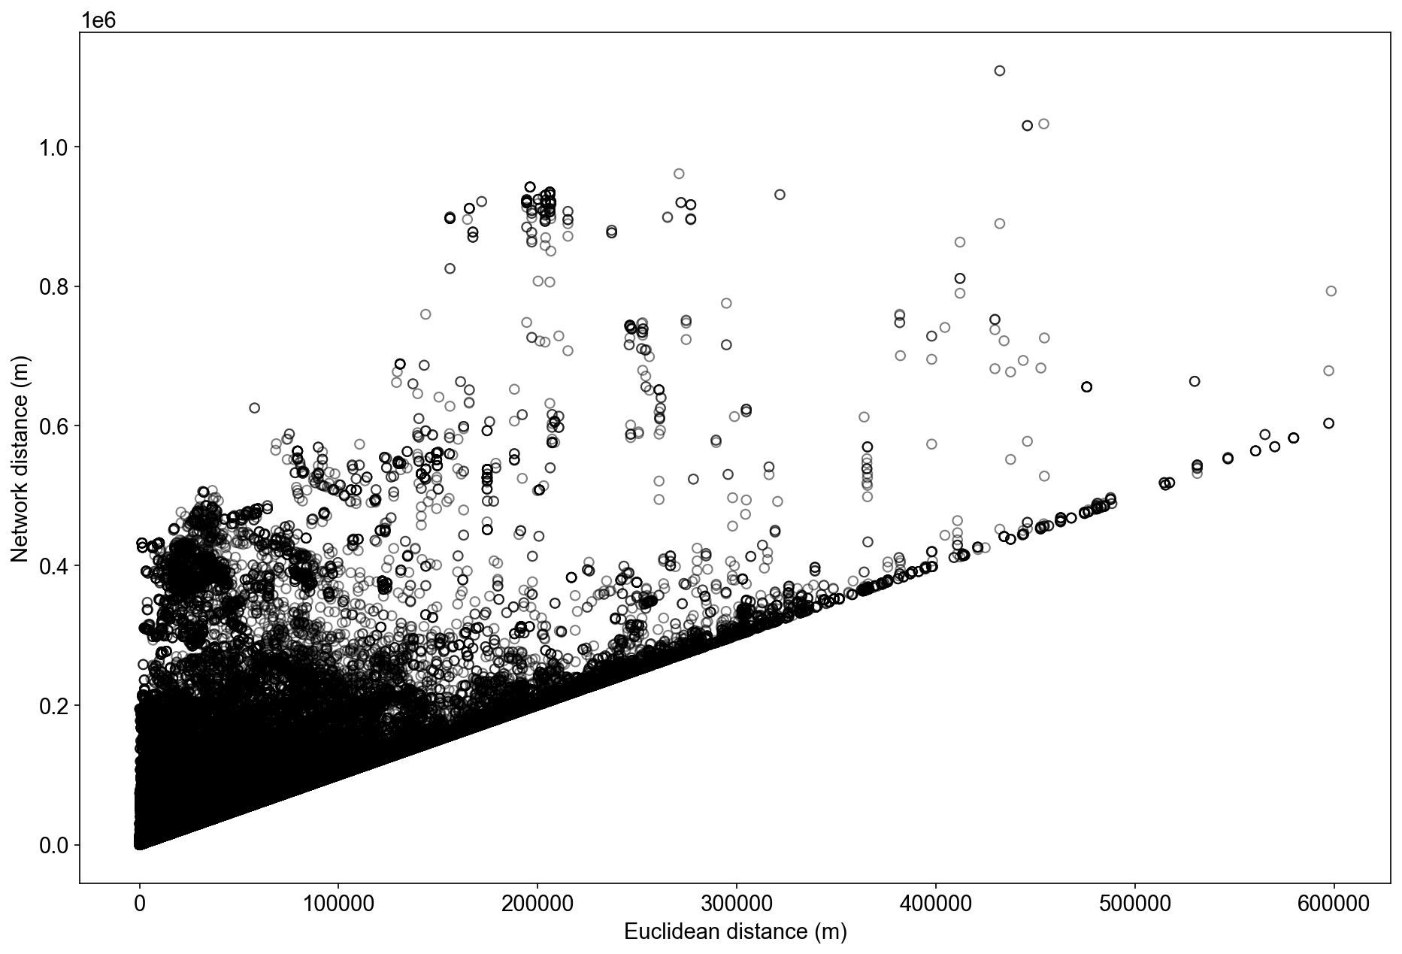
RQ2: What is the relationship between network distance and Euclidean distance?
Notes:
If we dig a little deeper into the relationship between network and euclidean distance we can see in general as you increase network distance euclidean distance increases too. However, we can see a lot of occasions where euclidean distance is a lot lower than the network distance measured and the variables are deviating beyond a 1 to 1 relationship.

Slide 14
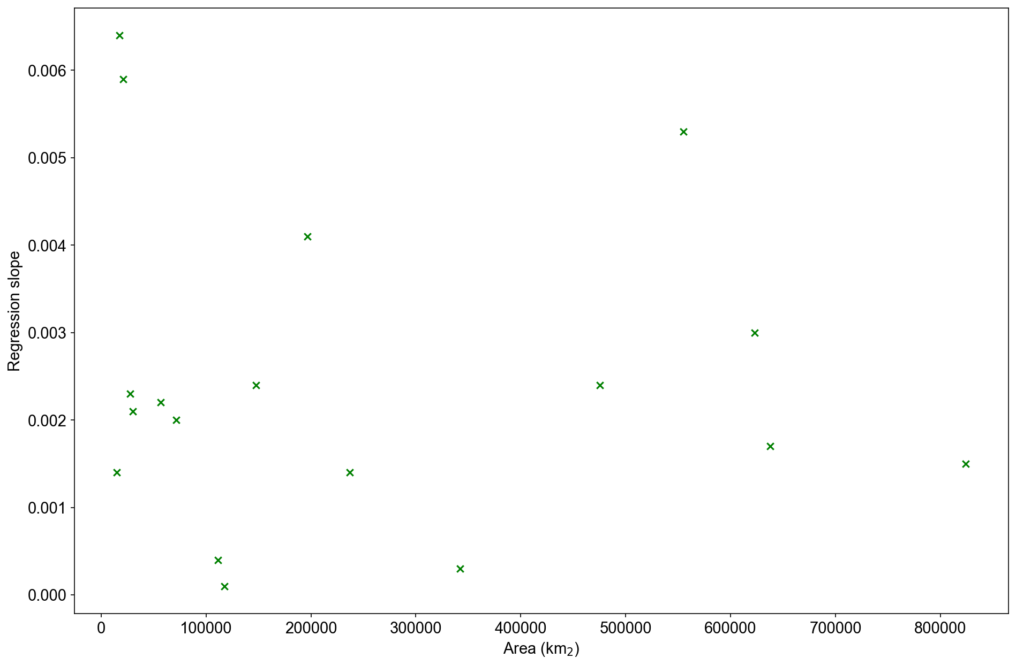
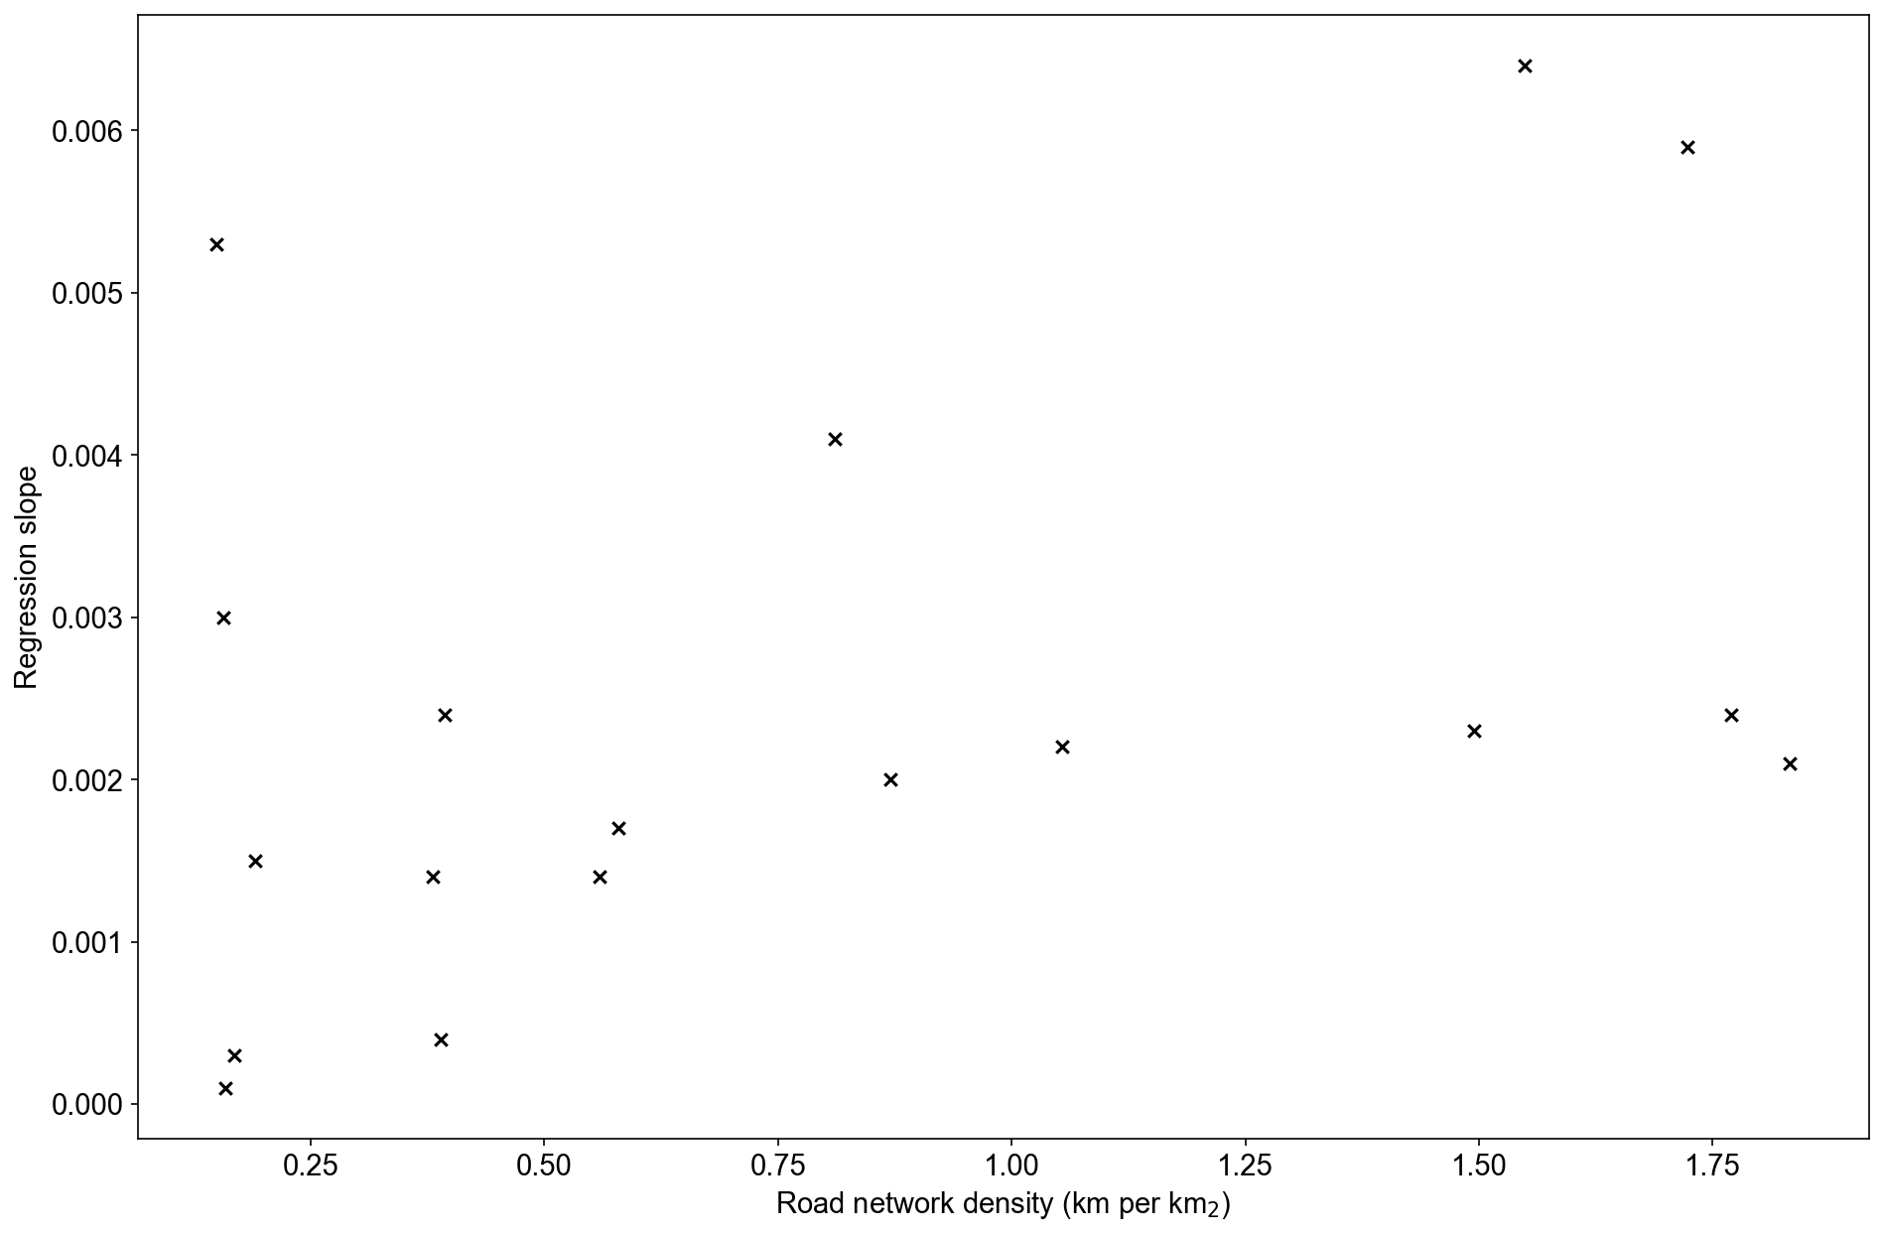
RQ3: What is the relationship between changes in mean distance to healthcare and a) size of country b) road network density and c) healthcare centre density
Size of country (km₂)
Road network density
Notes:
After plotting distance curves and the relationship between network and euclidean distance we want to further understand why there is variation in the distance curves of each country. We plan to fit sigmoidal curves to each country's profile but in the interest of time for this talk we have done a simple linear regression and plotted the slope of the trend line against 3 variables, the size of the country, the road network density and density of primary healthcare facilities.
From the charts we can see for area and road network density you general see steeper slope where a country is larger and where the road network density is higher. This makes sense as previous literature has reported under smaller areas of analysis Euclidean distance and network distance are measured as similar. It also makes sense that as the road network density increases there is increased complexity in the route travelled which would lead to increases in the distance measured.

Slide 15
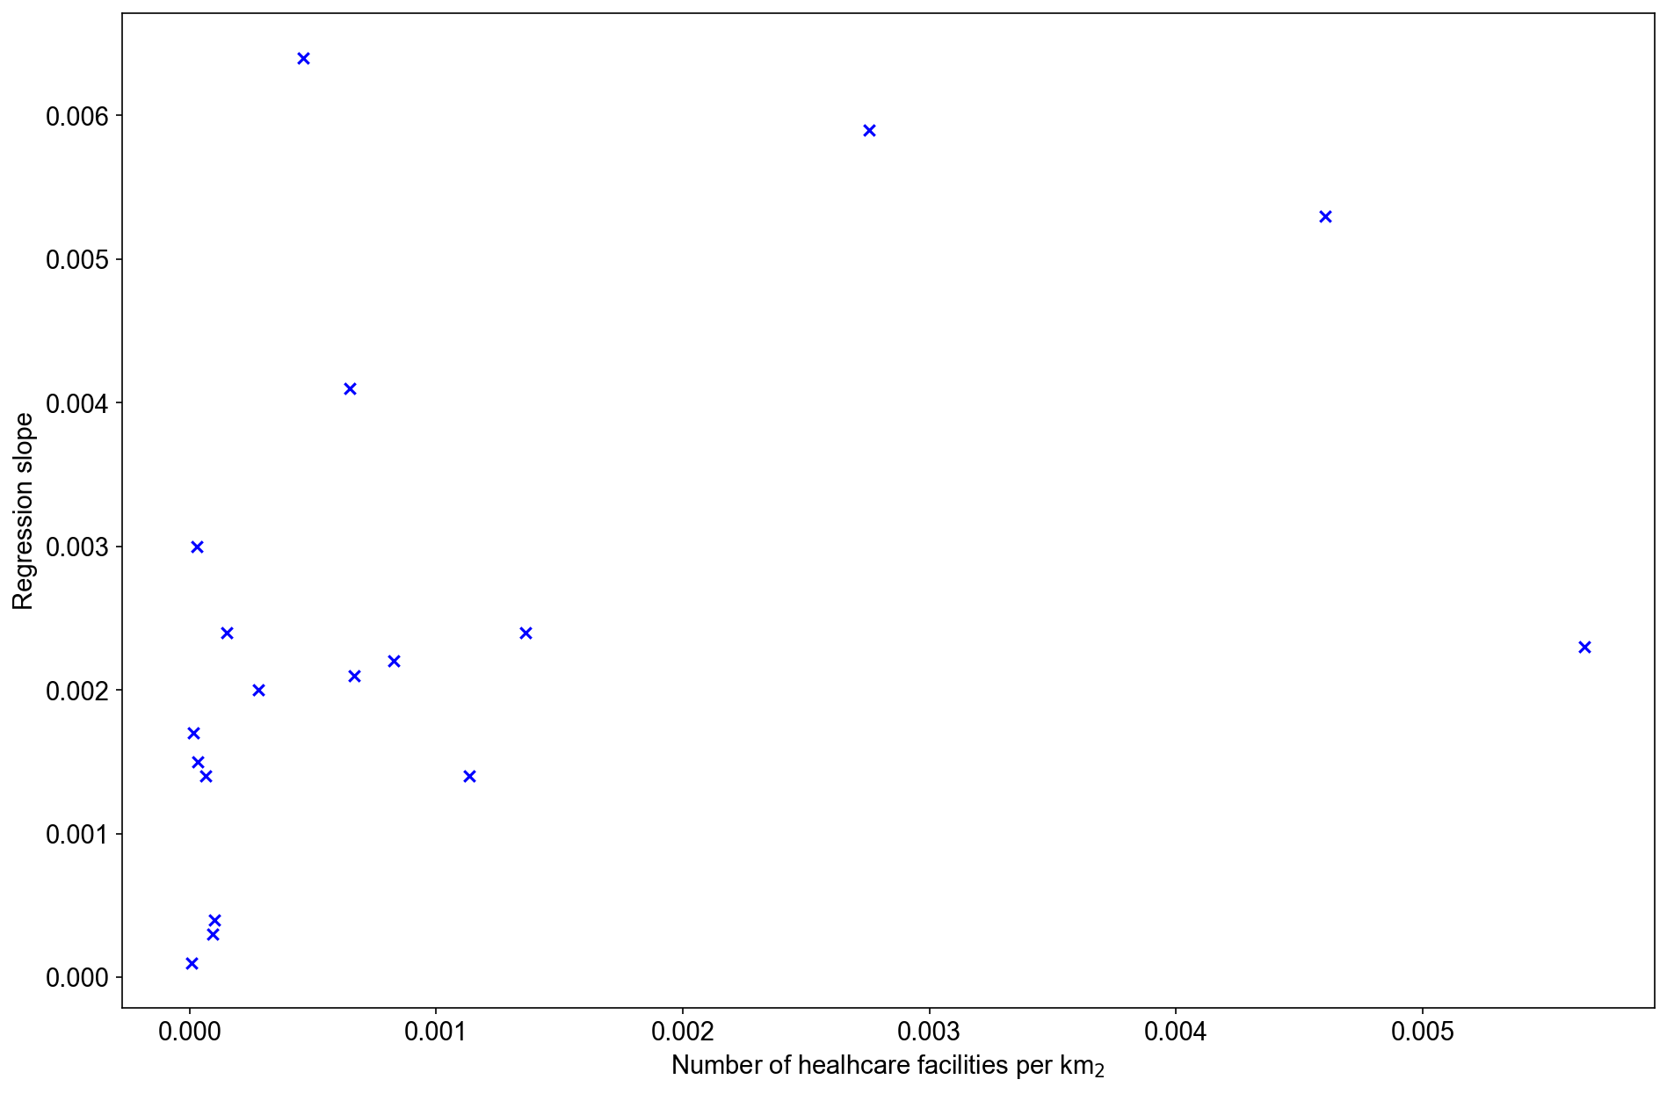
RQ3: What is the relationship between changes in mean distance to healthcare and a) size of country b) road network density and c) healthcare centre density
Healthcare facility density
Notes:
When comparing the density of primary healthcare centres the trend is less clear. You have a cluster near the start of the chart and then some outliers. Further analysis required when all countries have been analysed to understand the relationship. May be distorted as the completeness of the healthcare facility dataset is also likely to vary between country to country.

Slide 16
Conclusions
1) Incomplete road and path networks lead to an underestimation of spatial access to healthcare
Implication: High levels of road network dataset completeness should be aimed for in volunteered datasets
2) Euclidean distance underestimates distance to travelled to healthcare
Implication: Where possible network distance should be used to estimate spatial access to healthcare
3) Possible links between shape of distance profile and size of country/road network density but further research required
Notes:
Globally there is an inequality in spatial access to healthcare. We can estimate spatial access in a number of different ways but the choice of method and the results are dependent on the completeness of road and path datasets.
Our research which explored the impact of volunteered road and path network completness on estimation of spatial access to healthcare has revealed that 1) we should be aiming for complete road and path network datasets in order to reliably estimate spatial access, though what level of completeness is required is still unclear. This is because our research demonstrates that 2) in general Euclidean distance leads to an underestimation in distance travelled and consequently spatial access to healthcare. Finally There are possible links between the magnitude of change and the size of country and road network density but further analyis is required to confirm.
Other future work could include exploring the impact of dataset completeness in higher income countries where datasets tend to be complete and the possiblity of modelling the profile of the curve beyond the level of a datasets current completeness.

Slide 17
Questions?
kirsty.watkinson@mancheste.ac.uk @KLWatkinson
jonathan.huck@manchester.ac.uk @jonnyhuck
angela.harris@manchester.ac.uk @AngelaHarris78

Slide 18
References BARRINGTON-LEIGH, C. MILLARD-BALL, A. 2019. The world’s user-generated road map is more than 80% complete. PLOS ONE. 12.

