Slide 1
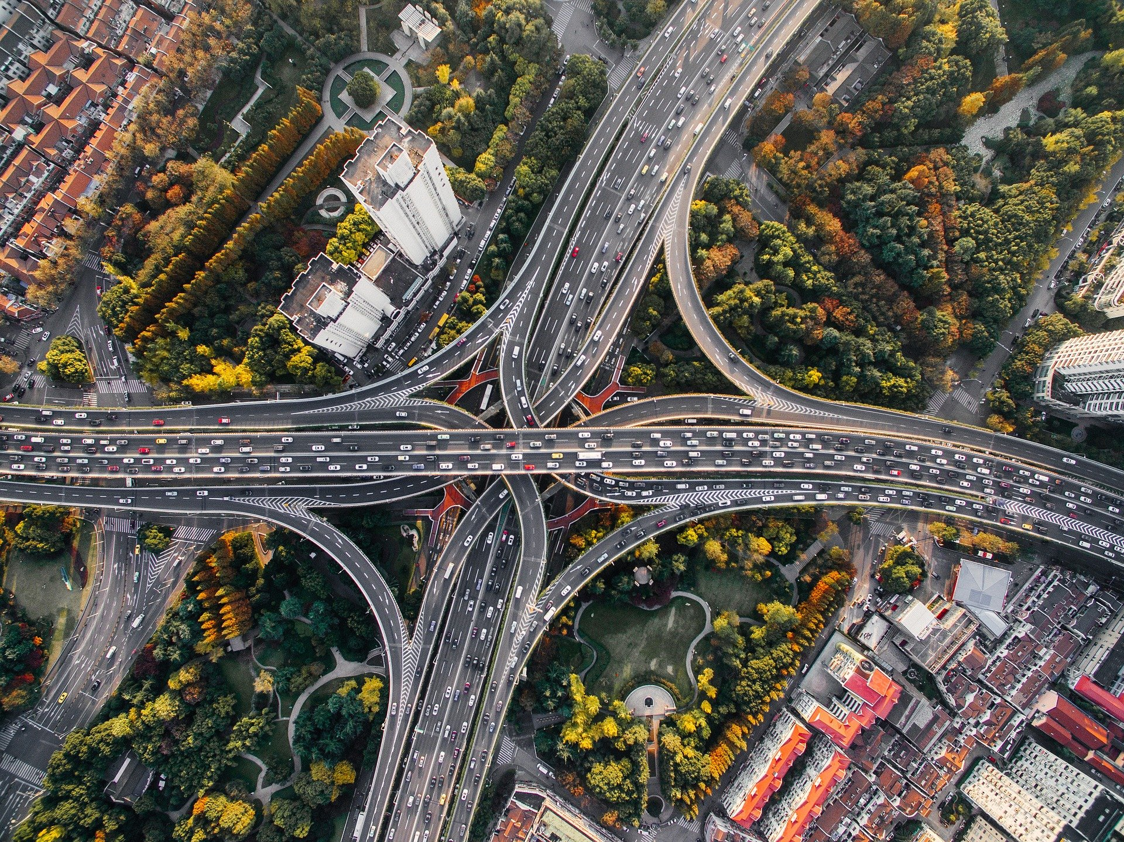
Spatiotemporal Traffic Database Construction and Congestion Pattern Analysis
Using Online Traffic Maps: A Case Study of Metropolitan Atlanta, Georgia, U.S.A.
Presented by
Hyunmin Kim | Kyunghee University
| Geography, GIS
| Department of Geography
| Kyunghee University, Seoul, Korea
| earth940709@khu.ac.kr
Authors
Jeong Chang Seong | University of West Georgia
Hyeokjin Hong | Kyunghee University
Seorim Cho | Kyunghee University
Ana Stanescu | University of West Georgia
Chul sue Hwang | Kyunghee University
2022 AAG Annual Meeting

Slide 2
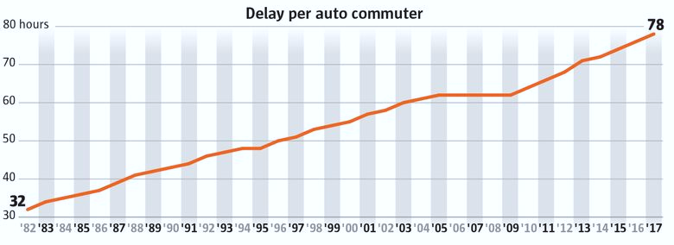
Introduction
Research Topic
Data
Analysis & Result
Conclusion
Pollutants From Cars
Time Spent per Day
🚗
66 min
National Household Travel Survey,2017
≒
67 min
Americans' Eating Patterns and Time Spent on Food: The 2014 Eating & Health Module Data. USDA
🍴
Traffic Delay in Major Cities
INRIX, 2018
PAGE 2

Slide 3
Introduction
Research Topic
Data
Analysis & Result
Conclusion
Traffic Pattern
Individual's Response to Traffic Congestion
Recurrent Traffic Congestion
DOT, 2019
Recurring
55 %
Non
recurring
45 %
<
insufficient capacity
unrestrained demand
ineffective management of capacity
PAGE 3

Slide 4
Introduction
Research Topic
Data
Analysis & Result
Conclusion
Research Objectives
Develop new method for collecting congestion data
&
Analyzing traffic congestion patterns
Using the Google traffic image to build a traffic database
Change in the frequency of congestion by day
Analysis of major congestion points
Congestion pattern extraction and visualization
PAGE 4

Slide 5
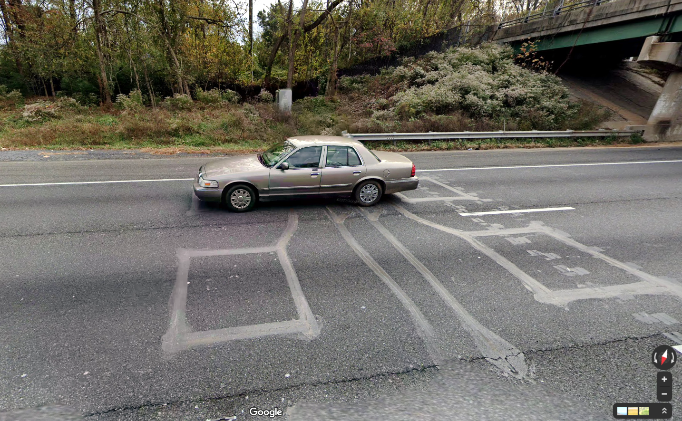
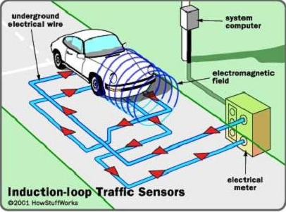
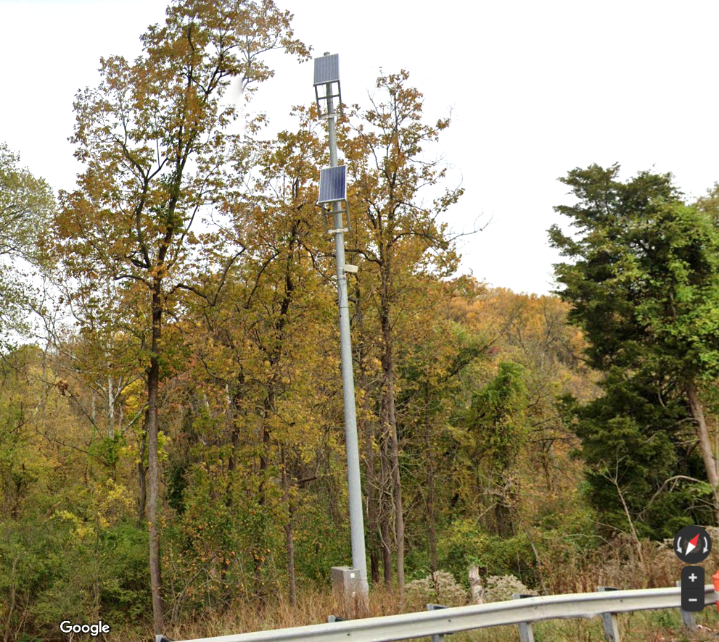
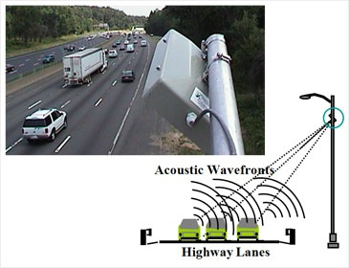
Introduction
Research Topic
Data
Analysis & Result
Conclusion
What traffic data was used?
Sensor-based data collection for traffic research
Former Research about Traffic Pattern (Seong et al., 2011)
Automatic Traffic Recorders(ATRs)
- Annual Average Daily Traffic(AADT)
- Predict traffic volume or traffic congestion
Maintenance
cost
limited
collection points
PAGE 5

Slide 6
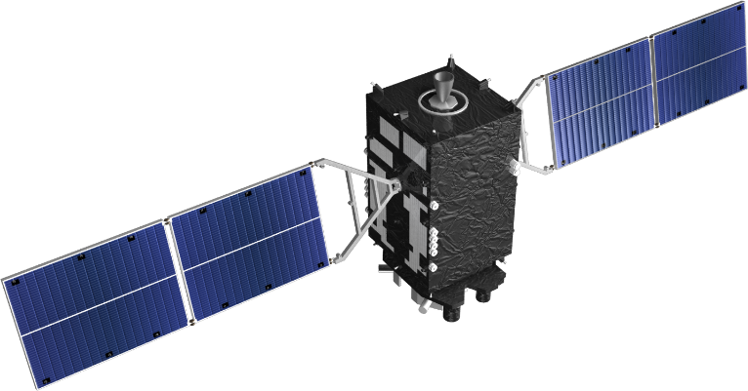
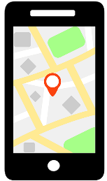
Introduction
Research Topic
Data
Analysis & Result
Conclusion
What is Floating Car Data?
Estimating traffic condition from crowd location data
Location
Time
GPS Signal
🚗
🚗
🚗
🚗
Traffic Volume
Data
Processing
🚗
🚗
Speed
PAGE 6

Slide 7
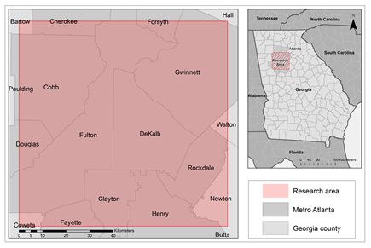
Introduction
Research Topic
Data
Analysis & Result
Conclusion
Daily Auto Travel per Licensed Driver
Research Area
2015 National Household Travel Survey
1.6
1.4
1.2
1.0
0.8
0.6
0.4
0.2
0.0
2014
2015
UT
WY
GA
NM
OK
IN
MS
ND
FL
DC
WV
ID
MN
NV
WI
MO
NC
AL
TX
HI
TN
MD
MT
OH
CA
VA
MI
AZ
KY
MA
KS
ME
NI
NY
CO
DE
AH
LA
IL
SC
IA
CT
VT
OR
RI
WA
NE
SD
NH
PA
AK
<
Research Area
States
Average
GA
LA
NY
SF
GA
Metro Atlanta
57min
73 min
……
Georgia County
GA ranked third in the Daily
Auto Travel per Licensed Driver in the US
Atlanta, one of the world's
10 worst cities for congestion
(INRIX, 2016-2017)
PAGE 7
https://www.volpe.dot.gov/news/how-much-time-do-americans-spend-behind-wheel

Slide 8
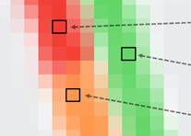
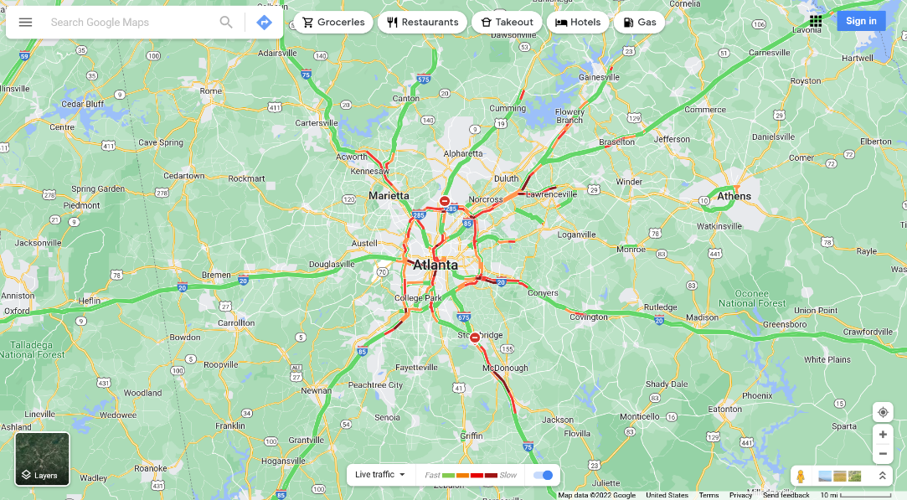
Introduction
Research Topic
Data
Analysis & Result
Conclusion
How to Use Google Traffic Data?
How to extract data from Google traffic information images
Heavy Congestion
R : 129 | G : 31 | B : 31
Moderate Congestion
R : 242 | G : 60 | B : 50
No Congestion
R : 100 | G : 215 | B : 110
Low Congestion
R : 255| G : 150| B : 80
The level of congestion indicated by
the color of the traffic information
PAGE 8
https://www.volpe.dot.gov/news/how-much-time-do-americans-spend-behind-wheel

Slide 9
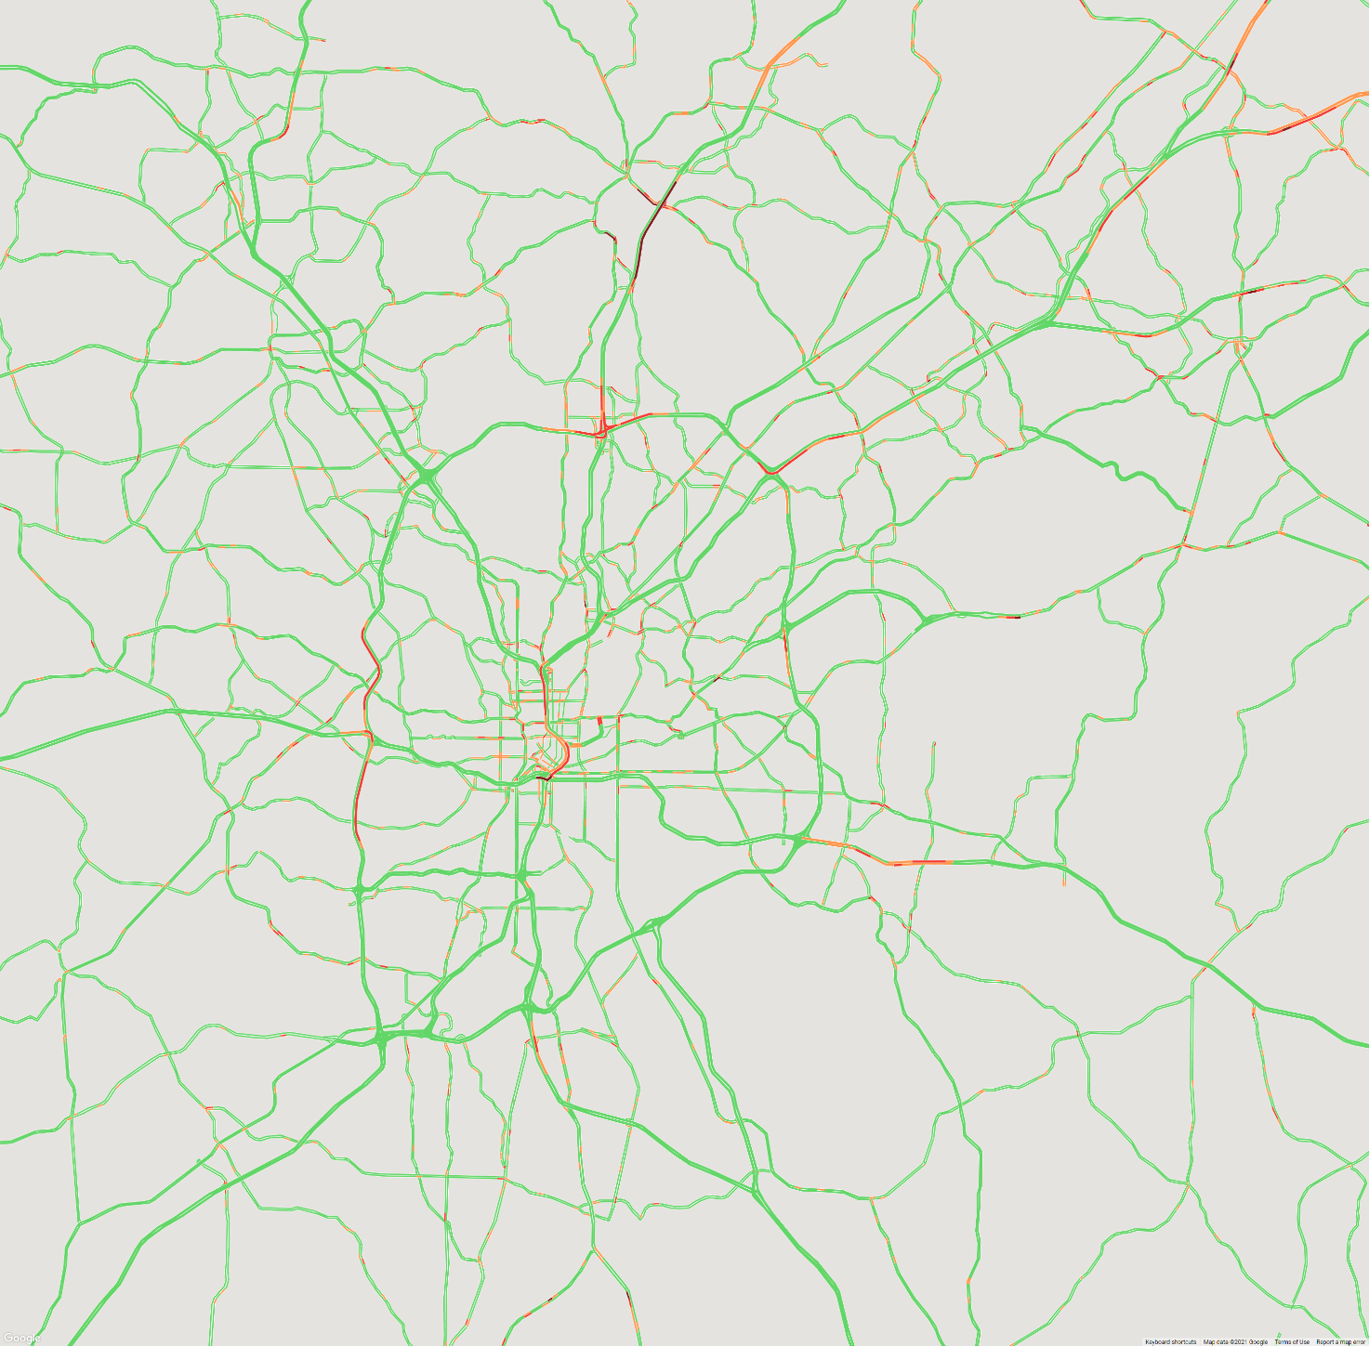
Introduction
Research Topic
Data
Analysis & Result
Conclusion
1. Data collection
https://www.google.com/maps/@39.1269755,-77.1876252,12z/data=!5m1!1e1/
Latitude
Longitude
Scale
Traffic Layer
Collect Snapshot every 10 minutes
Snapping Google Maps image
From September 25 to October 22th, 2021 (28 Days)
1 Day (144 Image) -> 4 Weeks (5032 Image)
2. Extract Traffic Congestion Information
Create a masking layer along the road Pixel
Extract the RGB value of each image pixel
Convert extracted pixel RGB to Congestion Index(CI)
3. Create 3D Spatiotemporal Dataset
Stack each time layers to create 3D Spatiotemporal data
Python Numpy’s multi-dimensional array structure
X axis : Longitude / Y axis : Latitude / Z axis : Time
PAGE 9

Slide 10
Introduction
Research Topic
Data
Analysis & Result
Conclusion
1. Data collection
Collect Snapshot every 10 minutes
Snapping Google Maps image
From September 25 to October 22th, 2021 (28 Days)
1 Day (144 Image) -> 4 Weeks (5032 Image)
2. Extract Traffic Congestion Information
Create a masking layer along the road Pixel
Extract the RGB value of each image pixel
Convert extracted pixel RGB to Congestion Index(CI)
3. Create 3D Spatiotemporal Dataset
Stack each time layers to create 3D Spatiotemporal data
Python Numpy’s multi-dimensional array structure
X axis : Longitude / Y axis : Latitude / Z axis : Time
PAGE 10

Slide 11
Introduction
Research Topic
Data
Analysis & Result
Conclusion
1. Data collection
Collect Snapshot every 10 minutes
Snapping Google Maps image
From September 25 to October 22th, 2021 (28 Days)
1 Day (144 Image) -> 4 Weeks (5032 Image)
2. Extract Traffic Congestion Information
Create a masking layer along the road Pixel
Extract the RGB value of each image pixel
Convert extracted pixel RGB to Congestion Index(CI)
3. Create 3D Spatiotemporal Dataset
Stack each time layers to create 3D Spatiotemporal data
Python Numpy’s multi-dimensional array structure
X axis : Longitude / Y axis : Latitude / Z axis : Time
PAGE 11

Slide 12
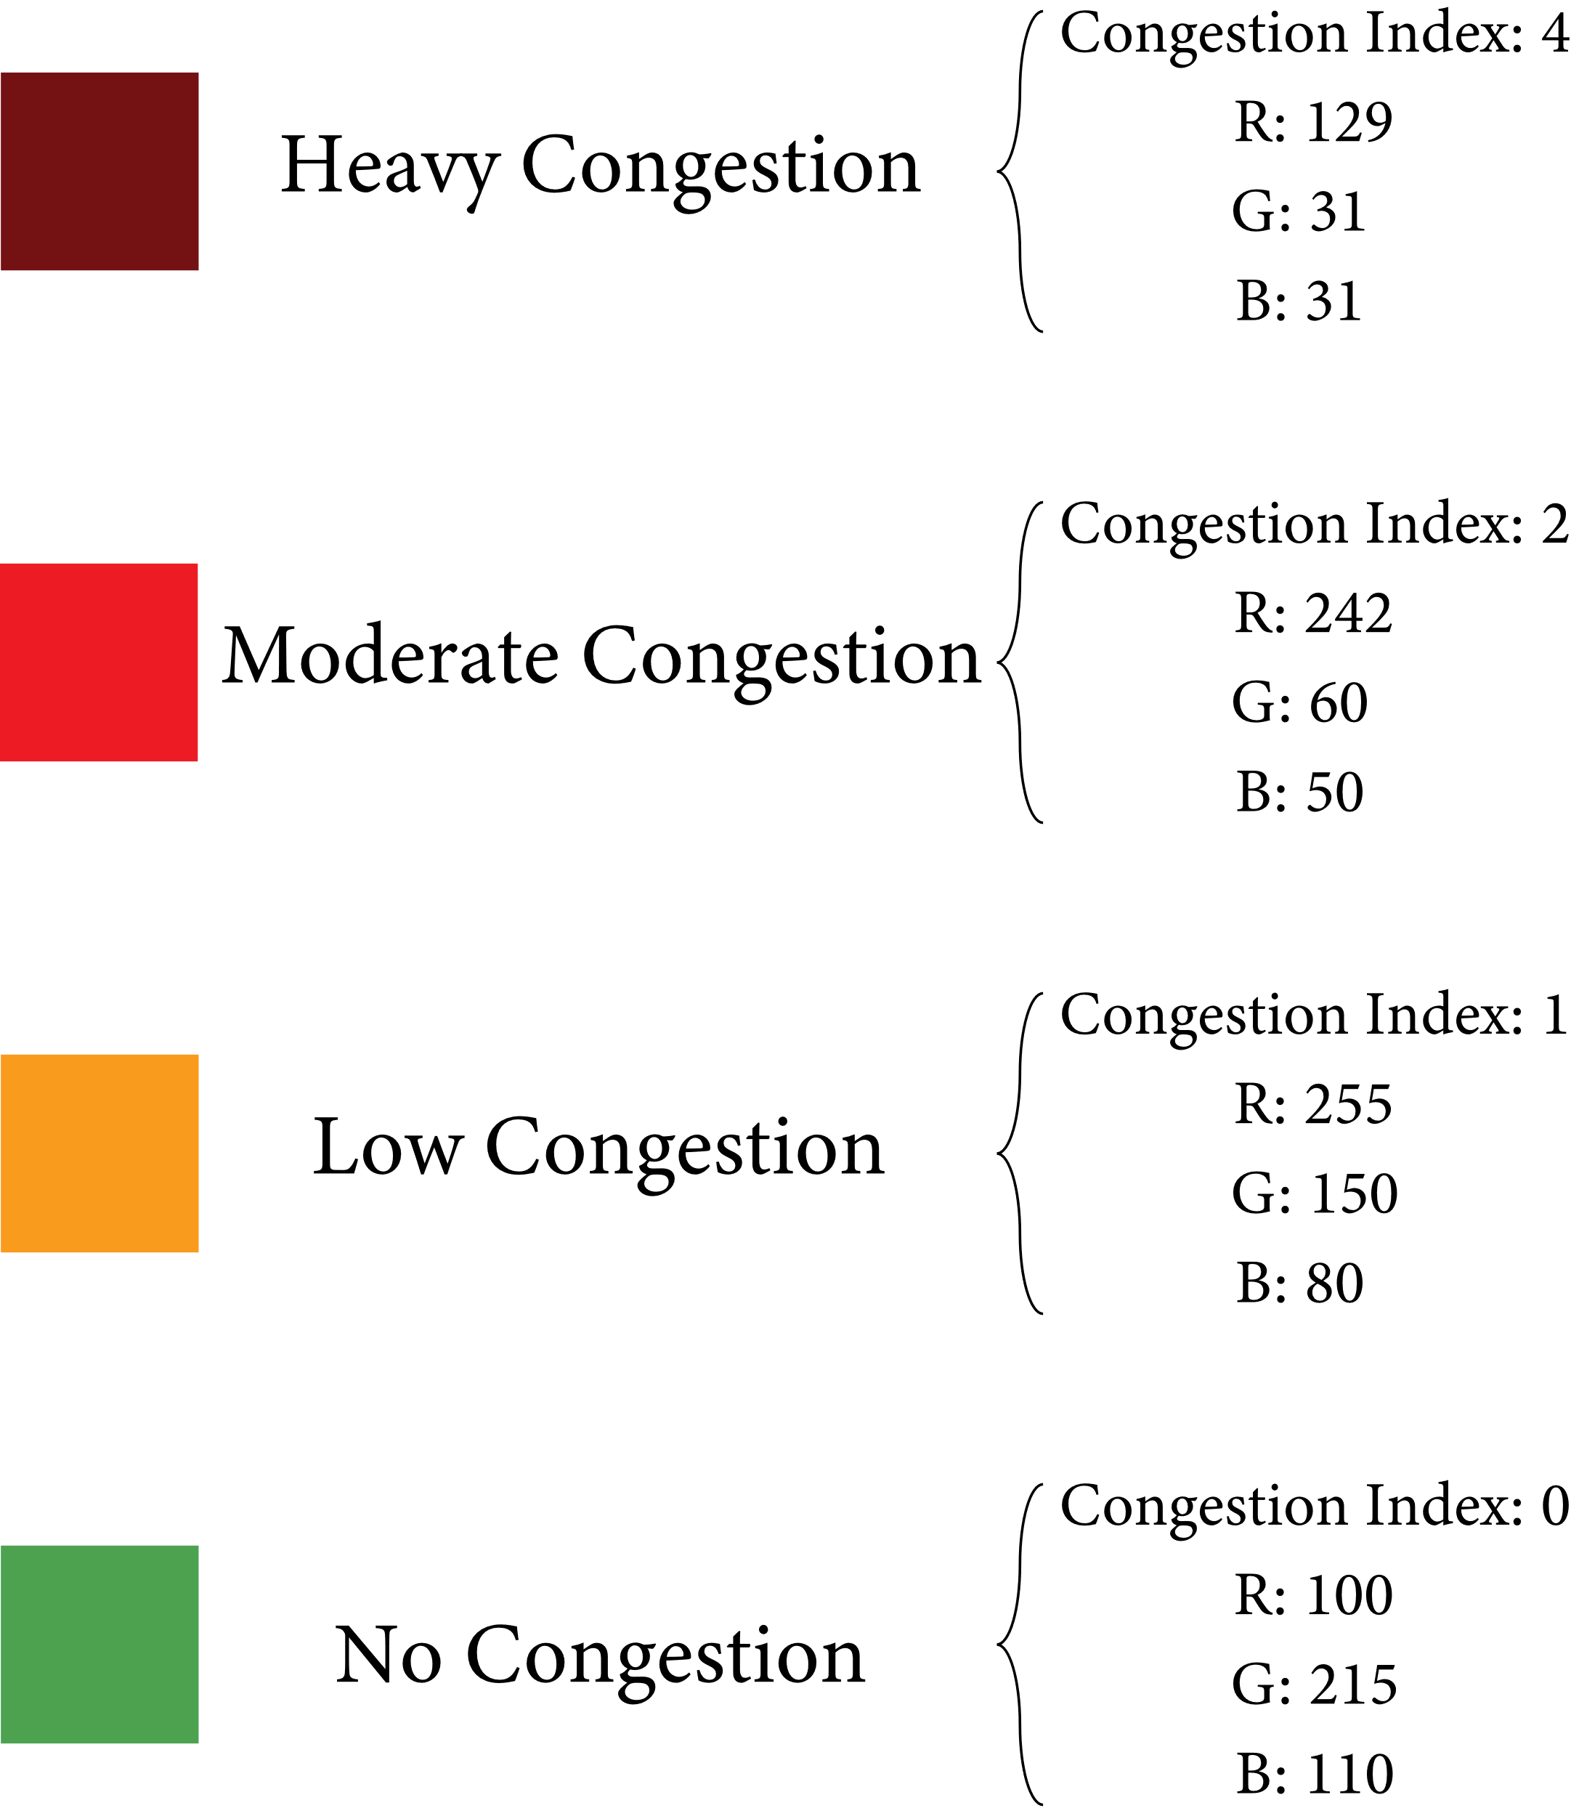
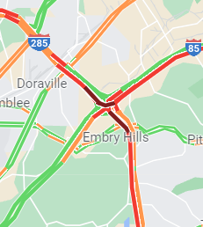
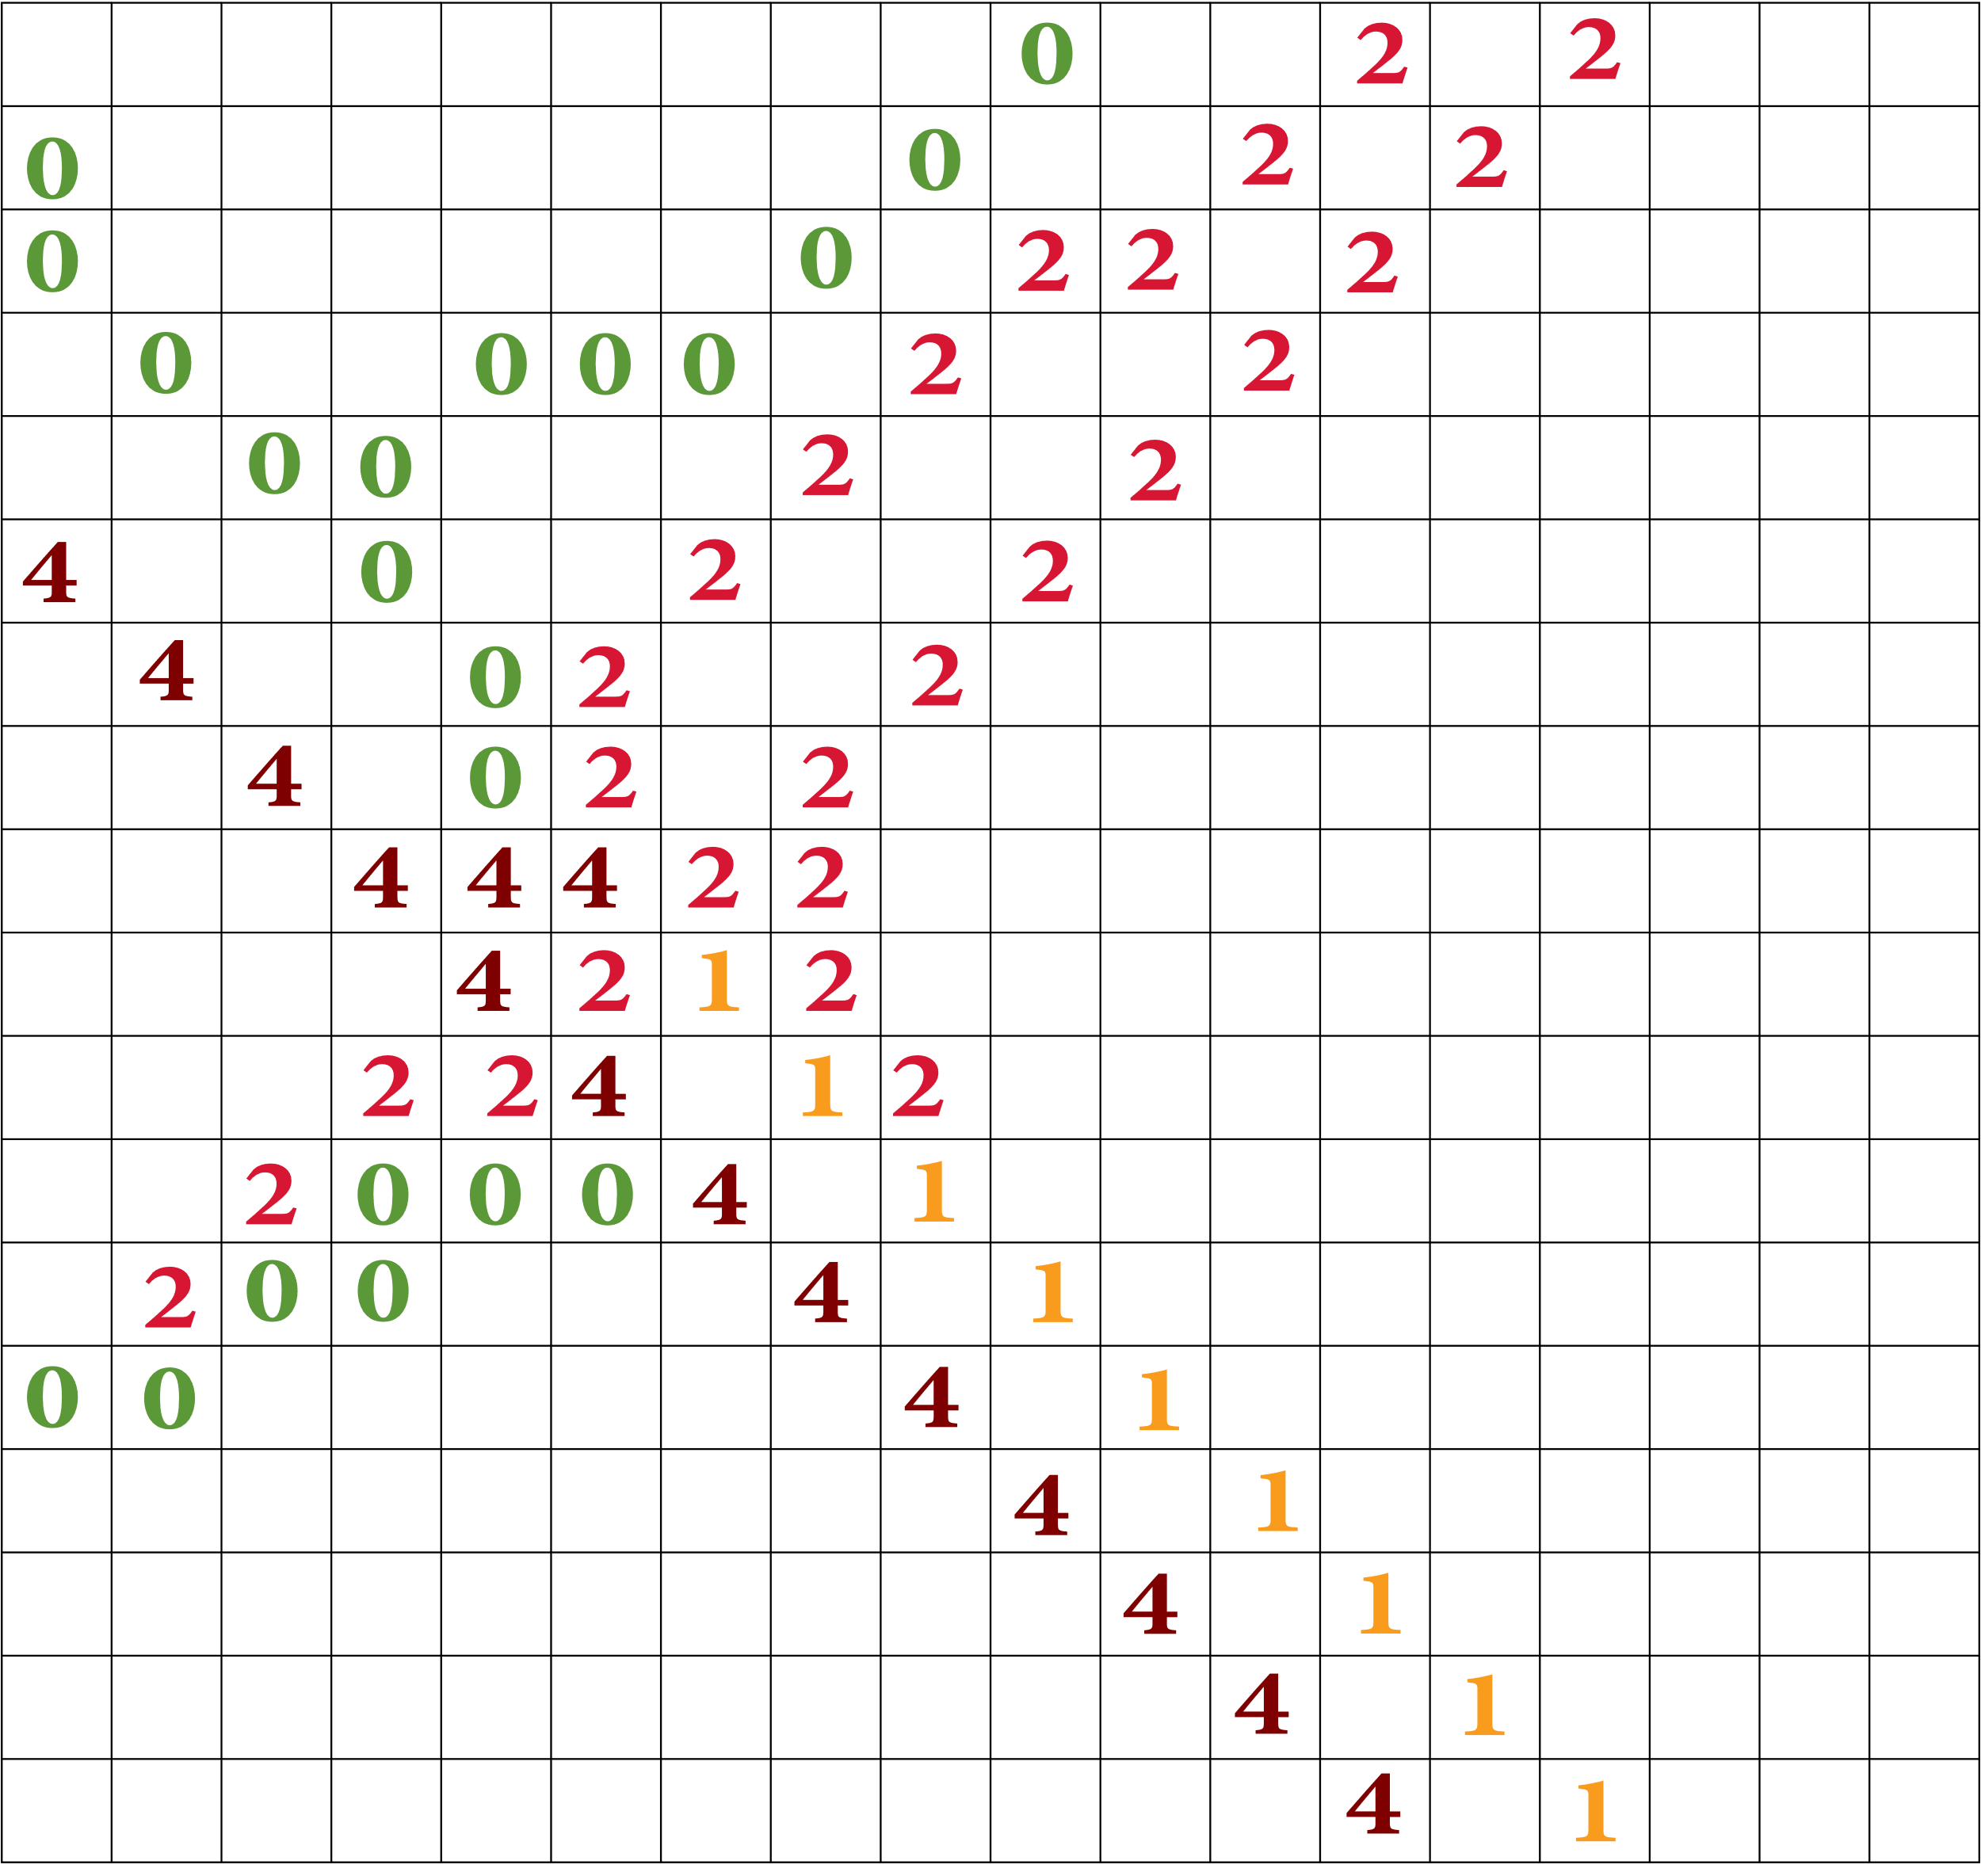
Introduction
Research Topic
Data
Analysis & Result
Conclusion
1. Data collection
Collect Snapshot every 10 minutes
Snapping Google Maps image
From September 25 to October 22th, 2021 (28 Days)
1 Day (144 Image) -> 4 Weeks (5032 Image)
2. Extract Traffic Congestion Information
Create a masking layer along the road Pixel
Extract the RGB value of each image pixel
Convert extracted pixel RGB to Congestion Index(CI)
3. Create 3D Spatiotemporal Dataset
Stack each time layers to create 3D Spatiotemporal data
Python Numpy’s multi-dimensional array structure
X axis : Longitude / Y axis : Latitude / Z axis : Time
PAGE 12

Slide 13
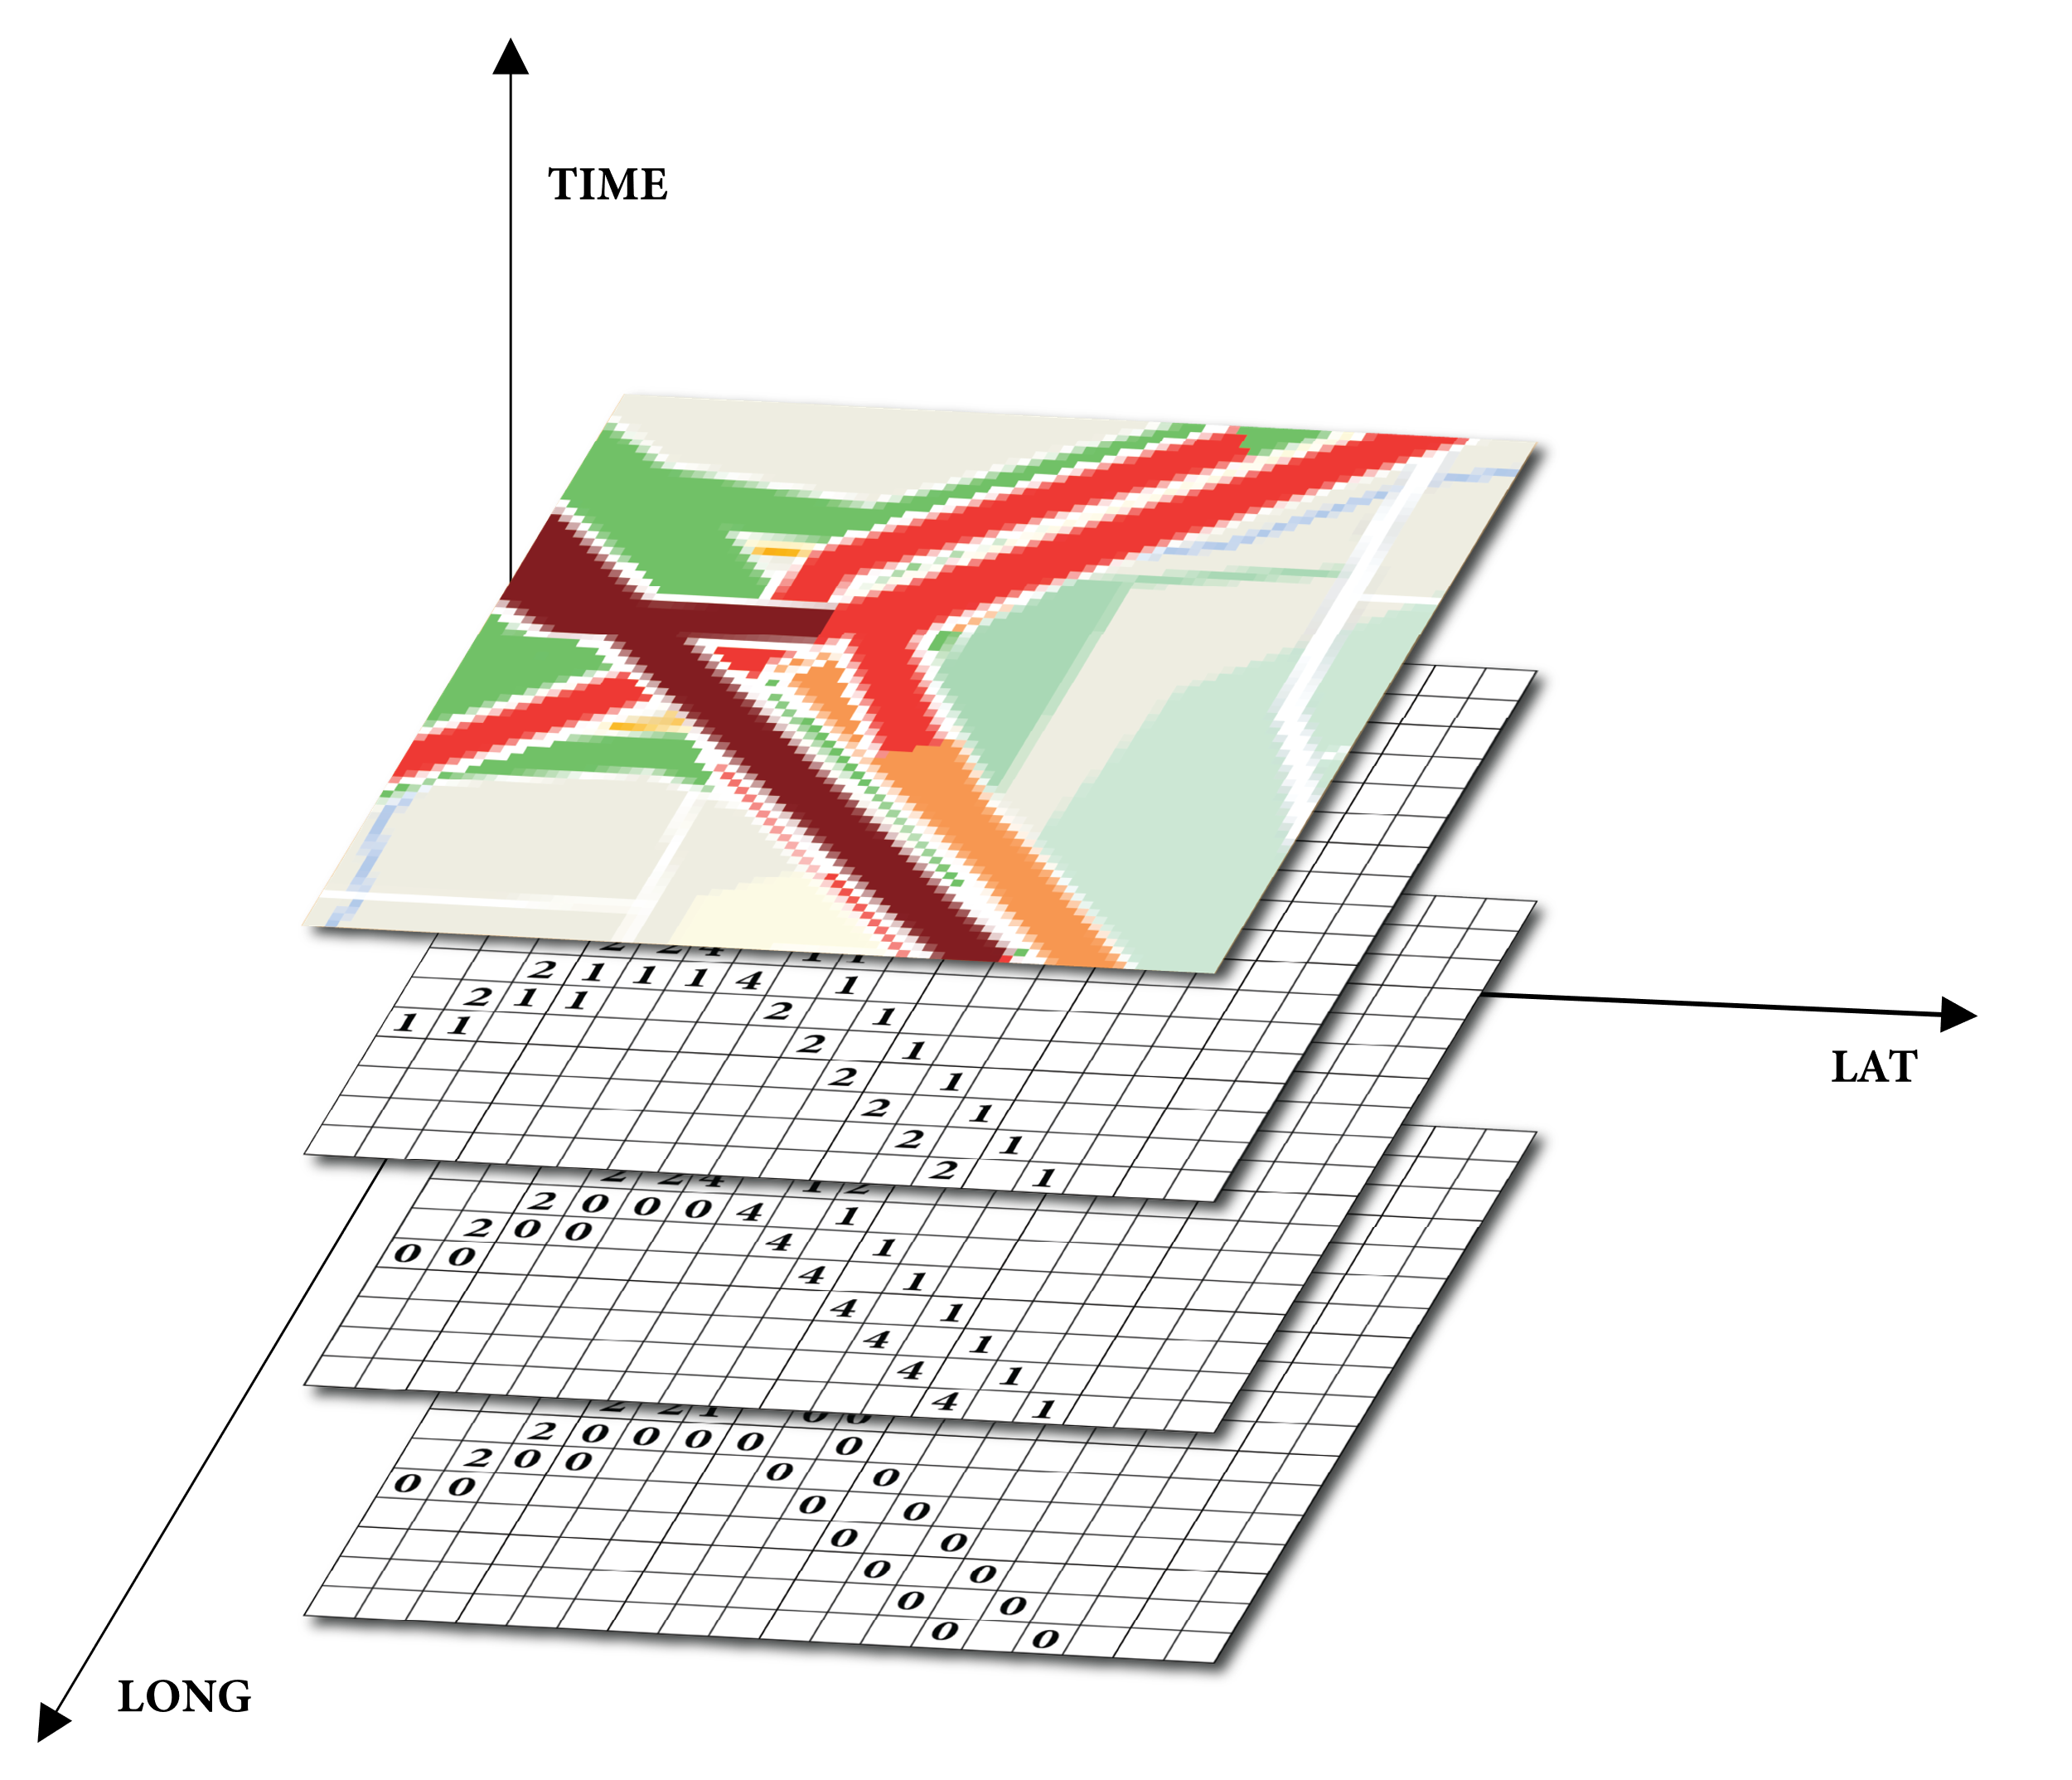
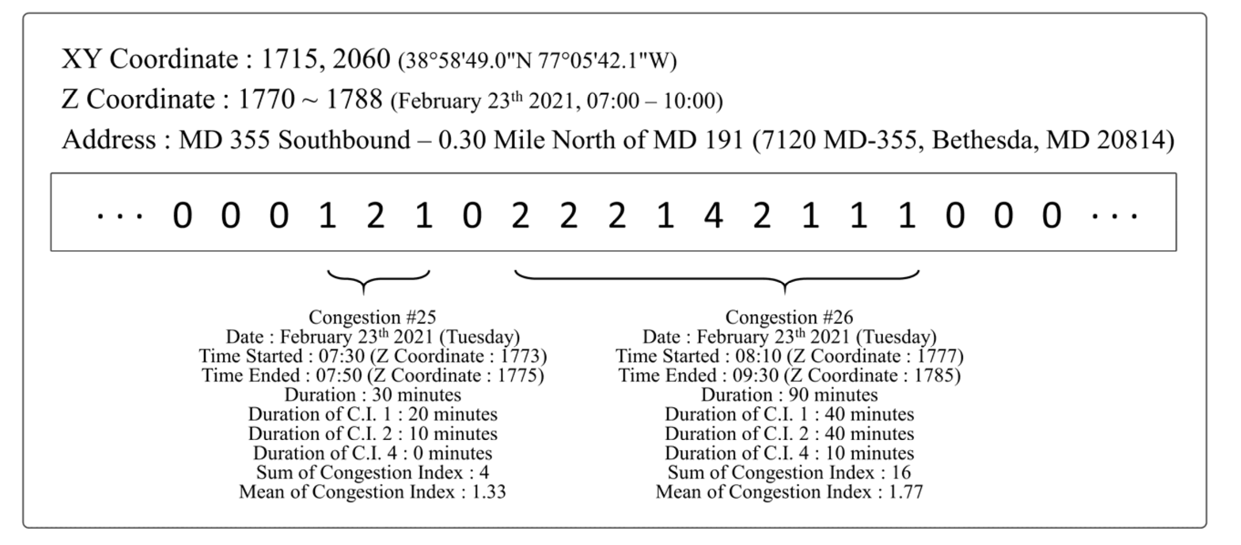
Introduction
Research Topic
Data
Analysis & Result
Conclusion
1. Data collection
Collect Snapshot every 10 minutes
Snapping Google Maps image
From September 25 to October 22th, 2021 (28 Days)
1 Day (144 Image) -> 4 Weeks (5032 Image)
2. Extract Traffic Congestion Information
Create a masking layer along the road Pixel
Extract the RGB value of each image pixel
Convert extracted pixel RGB to Congestion Index(CI)
3. Create 3D Spatiotemporal Dataset
Stack each time layers to create 3D Spatiotemporal data
Python Numpy’s multi-dimensional array structure
X axis : Latitude / Y axis : Longitude / Z axis : Time
PAGE 13

Slide 14
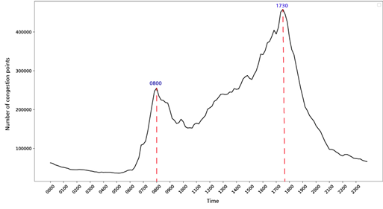
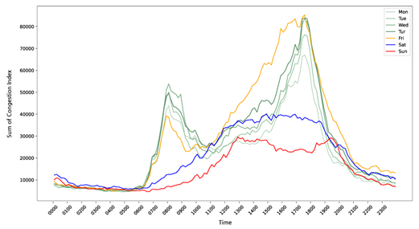
Introduction
Research Topic
Data
Analysis & Result
Conclusion
Change in the frequency of congestion by day
Sum of congestion frequency over time
Congestion frequency over time for each day of the week
PAGE 14

Slide 15
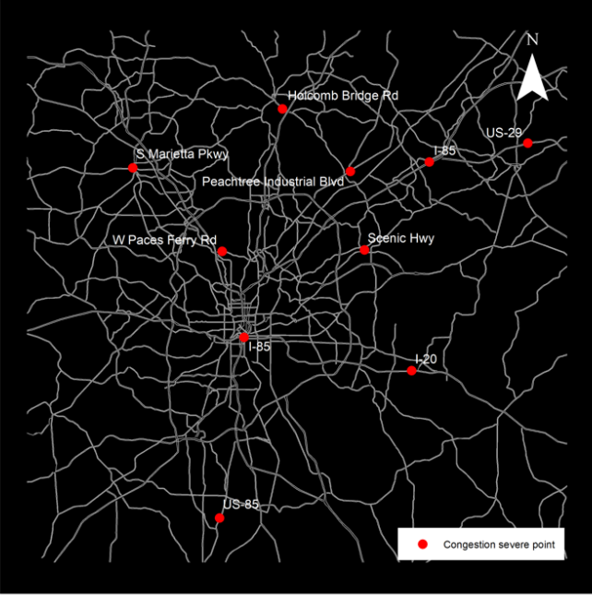
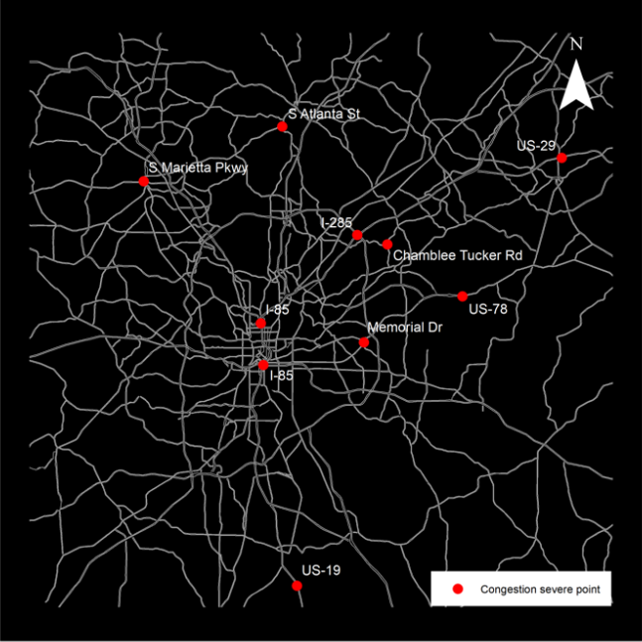
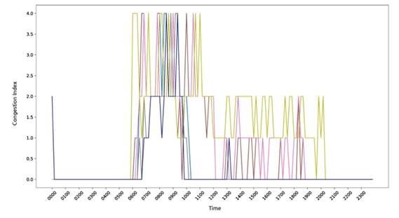
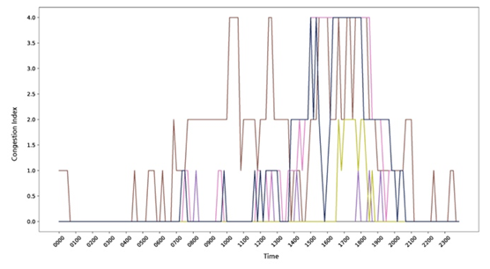
Introduction
Research Topic
Data
Analysis & Result
Conclusion
Analysis of major congestion points according to traffic congestion times
Morning Major Congestion Point
Evening Major Congestion Point
PAGE 15

Slide 16
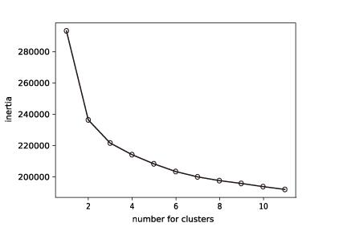
Introduction
Research Topic
Data
Analysis & Result
Conclusion
Why K-means Clustering Method?
Optimal Number of Clusters
- Measuring Euclidean distance
- Iteratively work to minimize the distance from the center point assigned to the cluster
- Identify the structure hidden in unlabeled data by grouping similar types of data
- Inertia considers the variances of each cluster
- Silhouette coefficient reflects the variance between groups together
- Data characteristic
- spatiotemporal data
- data size
- Fast
- Maximize differences between groups
- Minimize differences within groups
- Versatile
- Various data can be classified without prior information
Number of Cluster | 2 | 3 | 4 | 5 | 6 | 7 | 8 | 9 | 10 | 11
Silhouette Score | 0.612 | 0.51 | 0.452 | 0.417 | 0.415 | 0.38 | 0.372 | 0.365 | 0.362 | 0.354
PAGE 16

Slide 17
Introduction
Research Topic
Data
Analysis & Result
Conclusion
Pattern Extraction and Visualization
Pattern 0
: Very Light All Day
Pattern 1
: Very light Daytime
Pattern 2
: Very Heavy Morning/Very light Afternoon
Pattern 3
: Very light Morning/Very Heavy Afternoon
Pattern 4
: Light Daytime/Heavy Congestion Lunch
Pattern 5
: Heavy Morning/Very Heavy Afternoon
PAGE 17

Slide 18
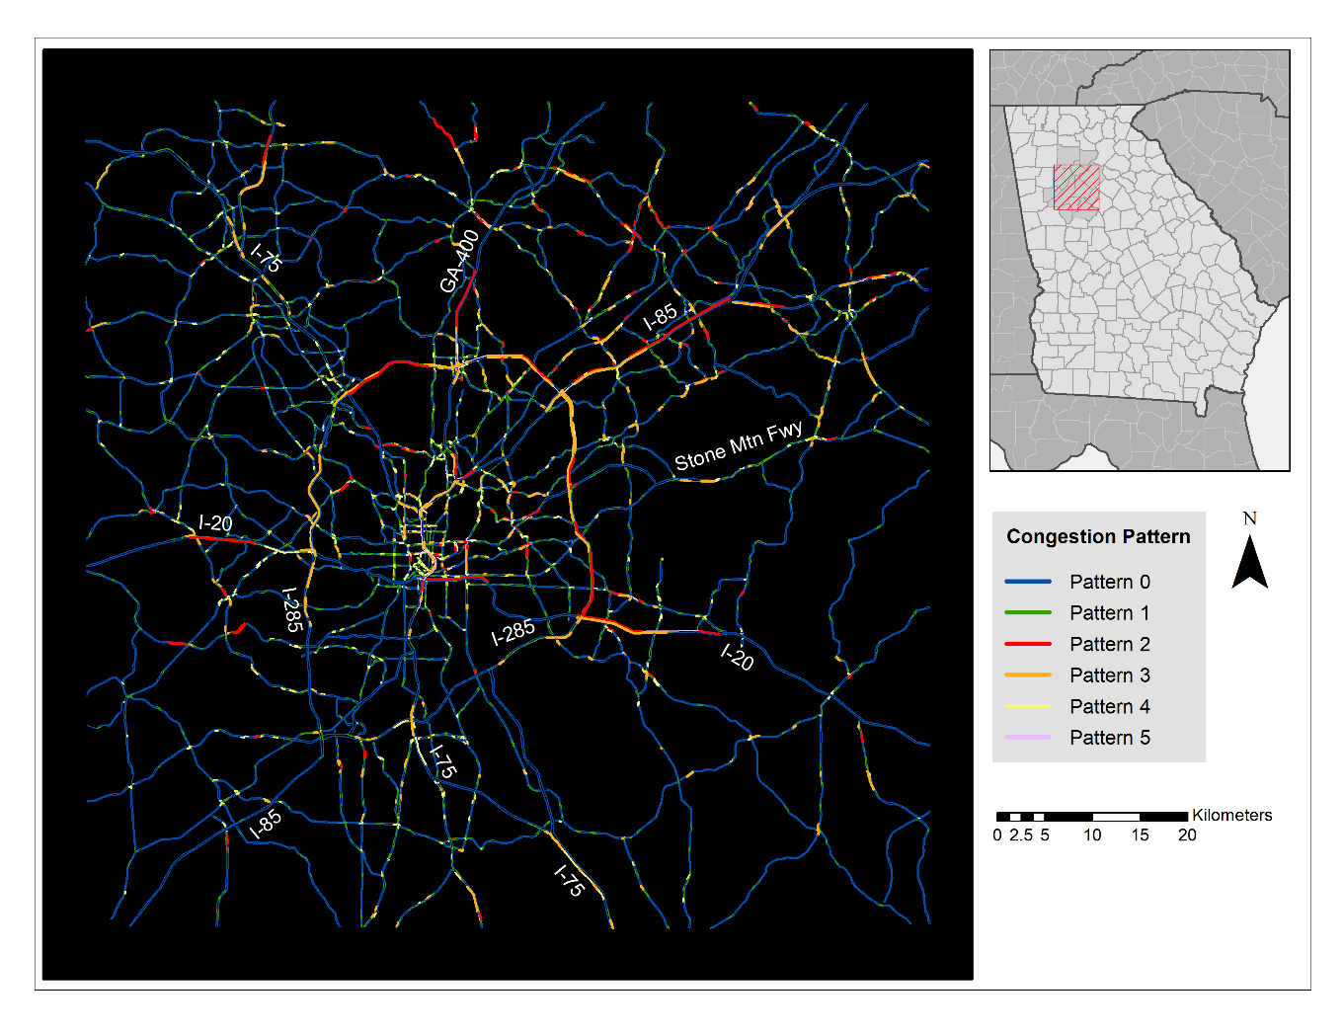
Introduction
Research Topic
Data
Analysis & Result
Conclusion
Pattern 0
: Very Light All Day
Pattern 1
: Very light Daytime
Pattern 2
: Very Heavy Morning/Very light Afternoon
Pattern 3
: Very light Morning/Very Heavy Afternoon
Pattern 4
: Light Daytime/Heavy Congestion Lunch
Pattern 5
: Heavy Morning/Very Heavy Afternoon
PAGE 18

Slide 19
Introduction
Research Topic
Data
Analysis & Result
Conclusion
Central Business District
Pattern 2
: Very Heavy Morning/Very light Afternoon
Pattern 3
: Very light Morning/Very Heavy Afternoon
PAGE 19

Slide 20
Introduction
Research Topic
Data
Analysis & Result
Conclusion
Pattern 4
: Light Daytime/Heavy Congestion Lunch
Pattern 5
: Heavy Morning/Very Heavy Afternoon
PAGE 20

Slide 21
Introduction
Research Topic
Data
Analysis & Result
Conclusion
Conclusion
Development of 3-D traffic congestion data collection method using Google Map Image
Collect high-resolution data for coverage of metropolitan areas.
Main congestion time of the study area & Characteristics of congestion by day of the week
Find areas where congestion occurs significantly over time and which congestion happened in an area.
The congestion pattern was analyzed through cluster analysis, and spatial analysis was presented
through visualization results.
Discussion
General enough to use, without significant investment of data collection equipment or proprietary software
Efficient movement planning through congestion information for citizens
Understand the overall urban congestion phenomenon and use it as a basis for policy decisions
according to specific points
PAGE 21

Slide 22
Spatiotemporal Traffic Database Construction and Congestion Pattern Analysis
Using Online Traffic Maps: A Case Study of Metropolitan Atlanta, Georgia, U.S.A.
Presented by
Hyunmin Kim | Kyunghee University
| Geography, GIS
| Department of Geography
| Kyunghee University, Seoul, Korea
| earth940709@khu.ac.kr
2022 AAG Annual Meeting

