Slide 1
Buildings Characterization at Global Scale: Challenges of Geospatial Semantics
Alexandre Sorokine Oak Ridge National Laboratory SorokinA@ornl.gov
AAG 2022 Symposium on Data-Intensive Geospatial Understanding in the Era of AI and CyberGIS: Advanced CyberGIS
2/28/2022 Virtual

Slide 2
Introduction
What is building characterization?
Why is it important?
Most of what we do happens inside a building
What do we need to know to reliably describe any building in the world?
Data challenges
Diversity
High semantic resolution
Data quality
© Wikimedia commons

Slide 3
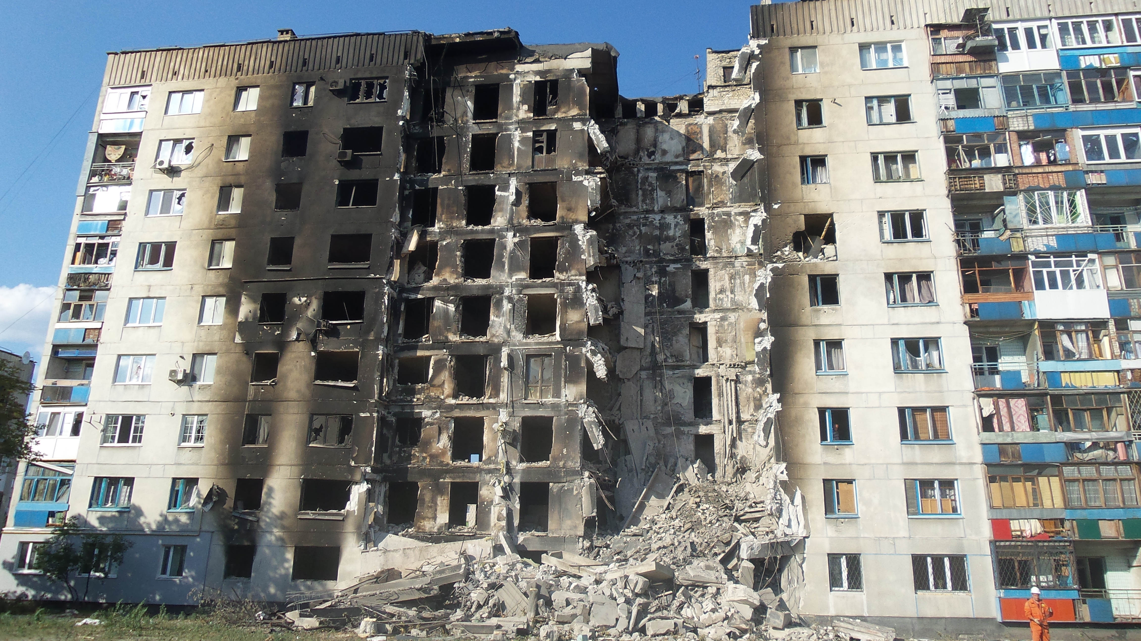
Potential Applications
Disaster planning and mitigation of hazards
Earthquakes
Hurricanes
Floods
Military action
...
Population mapping
Population estimates (size, number of floors, purpose, …)
Energy analysis
3D modeling
…

Slide 4
The Fields of Research
Models of the buildings in construction engineering
Physical characteristics
Materials
Structure
Geology and geophysics
Policies
Building codes
Enforcement and deviations
Environment
Culture
…
Building Characterization
Engineering
Geophysics
Environment
Culture
Policies

Slide 5
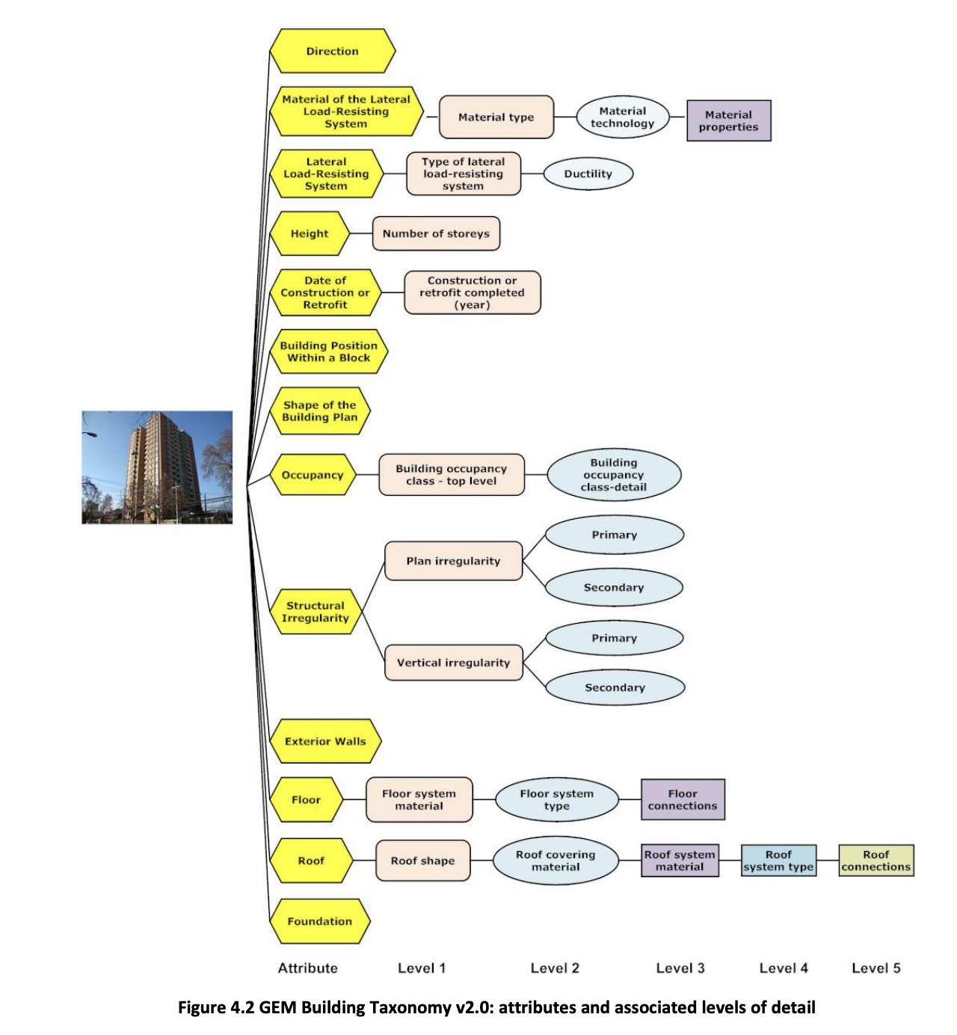
GEM Taxonomy

Slide 6
GEM Building Attributes
1. Direction [of loading system]
2. Material of the lateral load-resisting system
3. Lateral load-resisting system
4. Height
5. Date of construction or retrofit
6. Occupancy [purpose]
7. Building position within a block
8. Shape of the building plan
9. Structural irregularity
10. Exterior walls
11. Roof
12. Floor
13. Foundation system

Slide 7
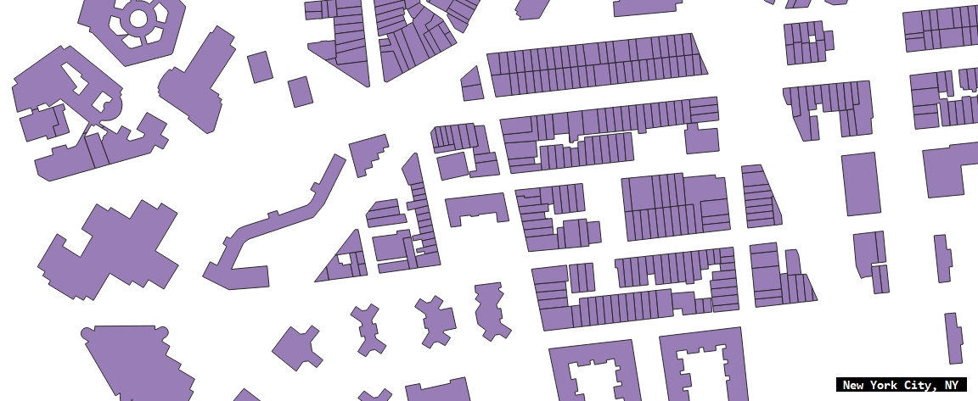
Data Sources: Buildings Data
Building footprints, parcel, or point with attributes
Volunteered Geographic Information
OpenStreetMap
Specific projects like collecting data on historical buildings
Realtors’ and property data
Hard to get a complete dataset

Slide 8
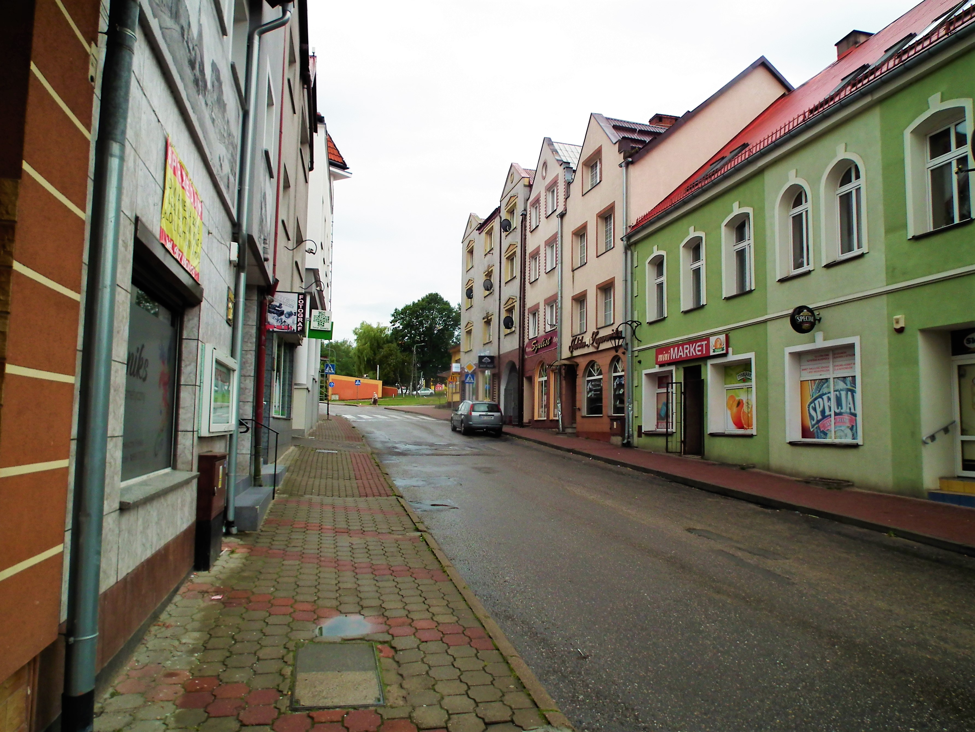
Data Sources: Imagery
Remote sensing imagery
Ground-based imagery
StreetView
Contributed photos
Limitations
All imagery needs labor-intensive processing or AI
Local knowledge is needed
Not all information can be extracted from imagery
Structure type and material

Slide 9
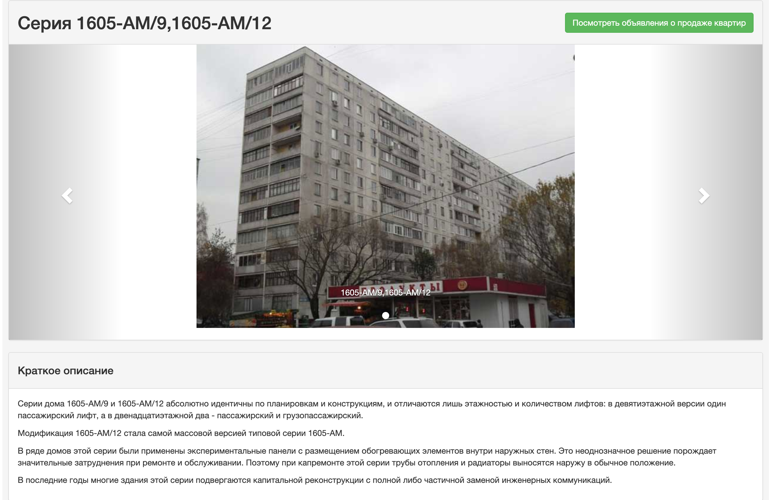
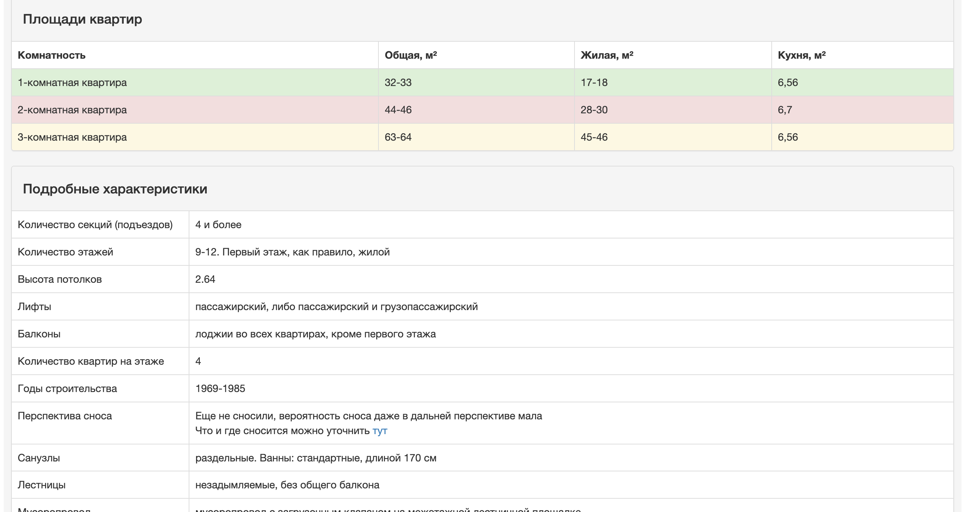
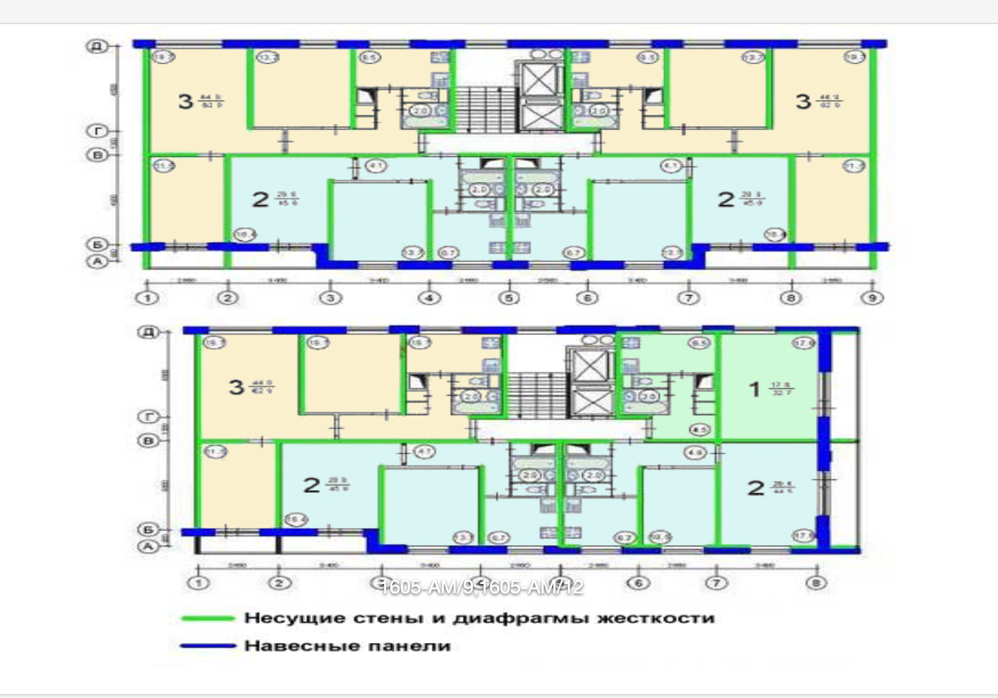
Data Sources: Building Codes
Very rich source of information
Detailing engineering information
Depends on the administrative unit and year
© Wikimedia commons

Slide 10
Data Challenges
Uneven data quality
Spatial
Temporal
Attribute
Temporal issues
Change of the buildings
Change in the data
Change of the regulations
Change of administration boundaries
Conflation
Footprints
Attributes
Conflict resolution
Normalization of attributes
GEM as a model
Translation tables
Detecting and fixing errors

Slide 11
Unifying Attributes
Steps
Implementation
Preliminary data cleaning
Dictionary building
Attribute
Values
Development translation tables
Manual step
Converting input dataset into a format with unified semantics
PostGIS-based system
Python code to generate SQL
Requirements
Ease of modification
Repeatability

Slide 12
Summary
Work in progress
Use cases were presented
Rich and detailed data
Current work
Filling gaps
Automating image processing
Automating attribute translation with NLP

Slide 13
Questions?

Slide 14
Copyright and Disclaimer
This manuscript has been authored by UT-Battelle, LLC, under contract DE-AC05- 00OR22725 with the US Department of Energy (DOE). The US government retains and the publisher, by accepting the article for publication, acknowledges that the US government retains a nonexclusive, paid-up, irrevocable, worldwide license to publish or reproduce the published form of this manuscript, or allow others to do so, for US government purposes. DOE will provide public access to these results of federally sponsored research in accordance with the DOE Public Access Plan (http://energy.gov/downloads/doe-public-access-plan).

