Slide 1
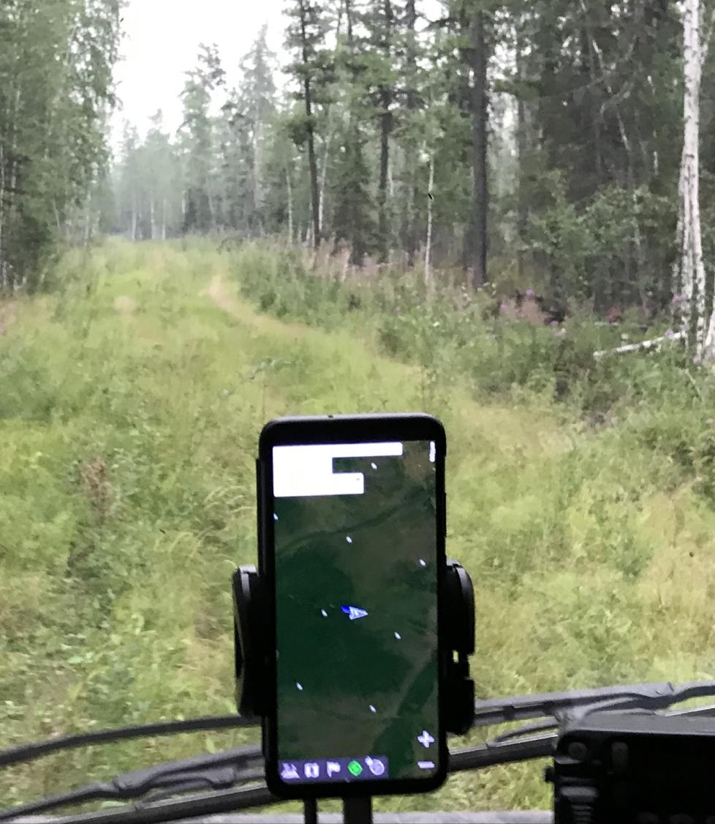
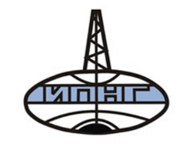
Informal Roads and Subsistence Infrastructure in Siberian Taiga Communities Annual Meeting of the American Association of Geographers (virtual) February 24 – March 1 2022 Kuklina V., Kobylkin D., Sizov O., Krasnoshtanova N., Bilichenko I., Bogdanov V., Petrov A., Shiklomanov N.

Slide 2
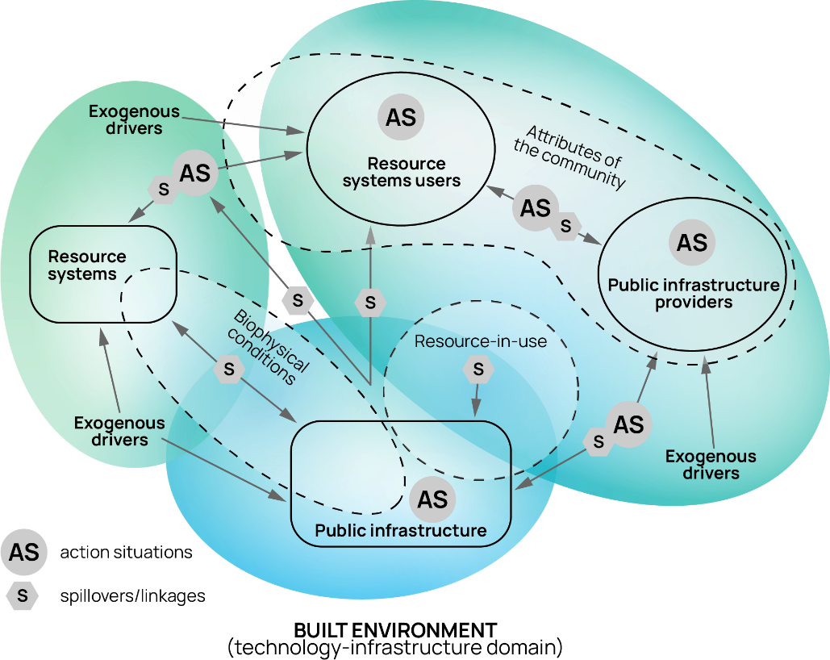
Informal roads and subsistence infrastructure in social-ecological-technological systems (SETS) framework
Where is infrastructure?
How is it created and maintained?
Who are the users and infrastructure providers?
What resources are accessed?
How different kinds of infrastructure interact?
Adapted from: Yu, D., Qubbaj, M., Muneepeerakul, R., Anderies, J., & Aggarwal, R. (2015). Effect of infrastructure design on commons dilemmas in social−ecological system dynamics. Proceedings of the National Academy of Sciences of the United States of America, 1

Slide 3
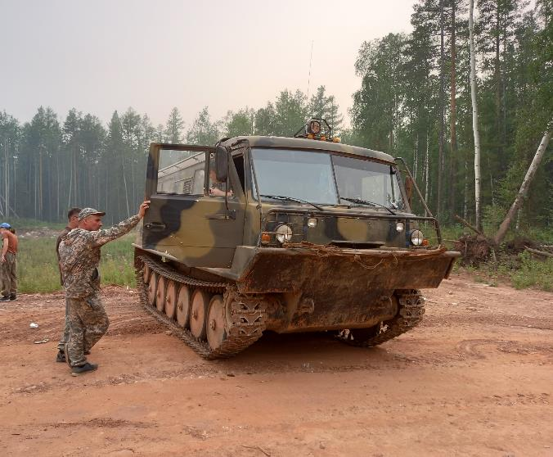
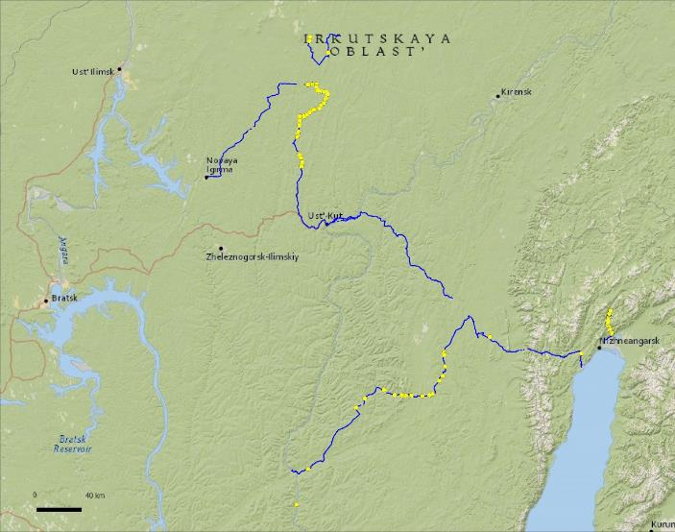
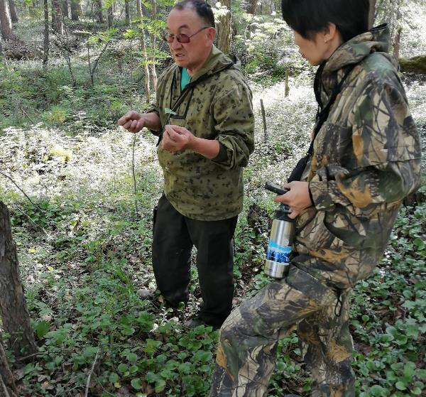
Data & methods:
Field studies:
In the village of Vershina Khandy and town of Magistralny of Kazachinsko-Lenskiy district, the village of Tokma of Katangskiy district and the city of Ust-Kut of Irkutsk region and the village of Kholodnoie and the city of Severobaikalsk of the Republic of Buryatia in 2019, 2020 and 2021
14 in-depth interviews
Mobile methods (interviews on the move, photos, observations)
Participatory mapping (SAS-Planet)
Informal roads detection: OSM, WorldView (2015-2016), Planet, topographical maps
Studies of fires: MODIS and VIIRS (2016) and Sentinel-2 (2017)

Slide 5
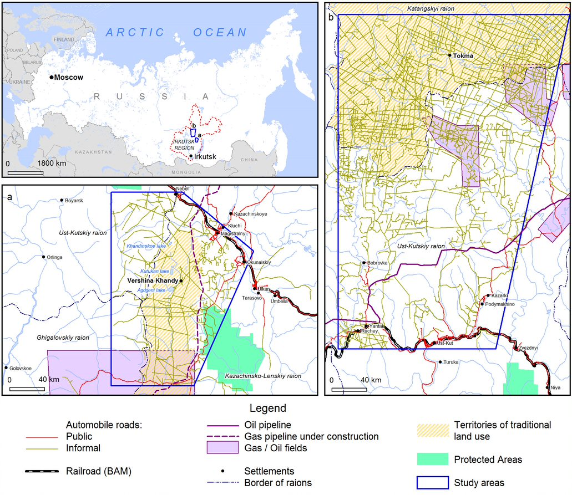
Study area

Slide 6
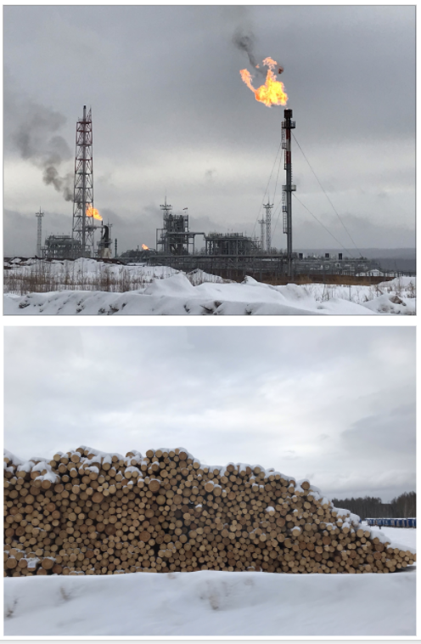
Public infrastructure providers
Characteristics | Tokma area | Vershina Khandy area
Municipality | Nepskoie for the village Tokma (54 people) | Inter-settlement territory for the village Vershina Khandy (from 6 to 20 people)
Study area (ha) | 2107,000 (predominantly Russian Forest Fund) | 696,500 (predominantly Russian Forest Fund)
Territories of Evenki traditional land use (ha) | 1,115 (obshchina Tokma) | 299,067 (obshchina Khandinskaya)
Major pipelines | Transneft: East Siberia – Pacific Ocean oil pipeline (ESPO) | Gasprom: Power of Siberia
Oil and gas service roads | Irkutsk Oil Company (INK) | Gasprom
Forest roads | Transsiberian Forest Company (TSLK) | RusForest forest company
Seismic line clearings | GeoTek | Gasprom sub-contractors

Slide 7
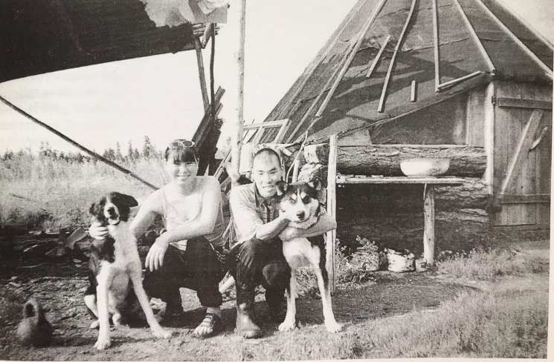
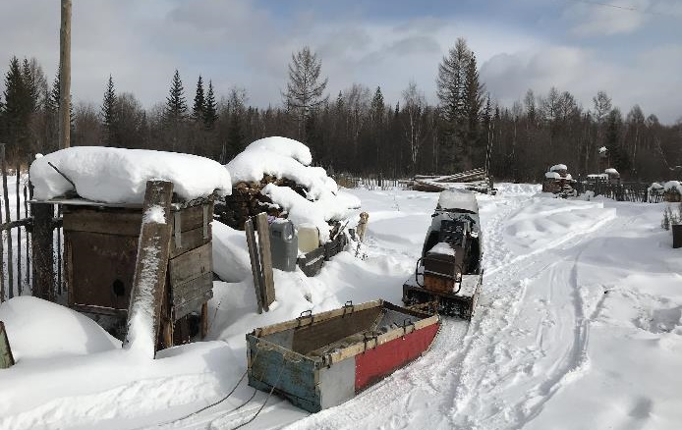
Local resource users: Evenki and old-settler communities
Evenki – Tungus-speaking Indigenous group
Epistemology:
- long-term observations as knowledge infrastructure
- blurred boundaries between human and non-human beings
- kin and reciprocity relations with non-humans
- arguish - reindeer trails
Traditional land use:
abandoned reindeer herding
hunting for ungulates for subsistence,
fishing,
gathering Siberian pine nuts, berries and herbs
hunting on sables and other fur animals for cash income
Territories of traditional land use contested
Notes:
In the Kazachinsko-Lenskii raion the example of nomadic Evenki urban dwellers is especially evident. While most of the year many obscene members live in urban settlements of Magistralny, Ulkan, Okunayskoie, during the winter hunting season and summer fishing seasons they come back to the Khanda area using informal roads. As such, informal roads serve as mediators for this multilocational dwelling that link urban Evenki with their homeland and serve as a source of resilience.

Slide 8
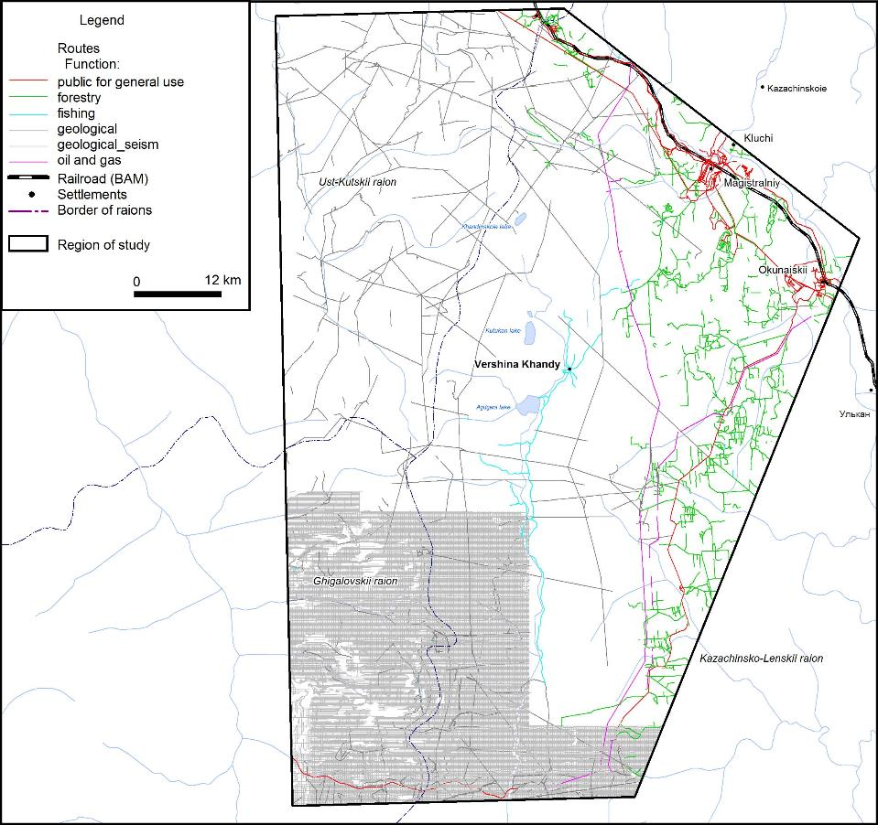
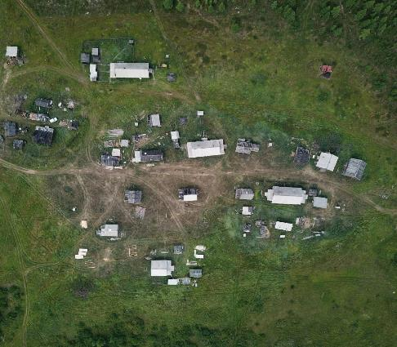
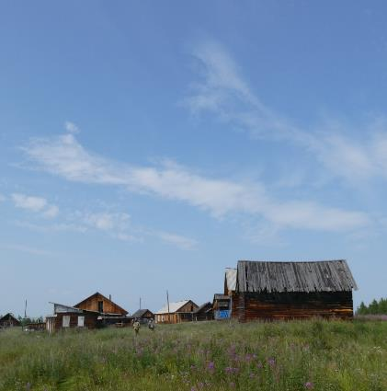
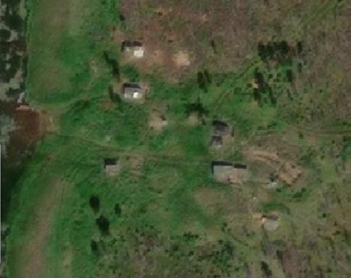
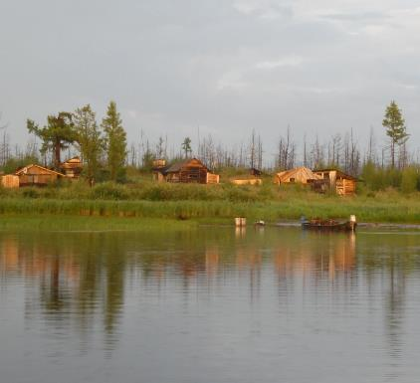
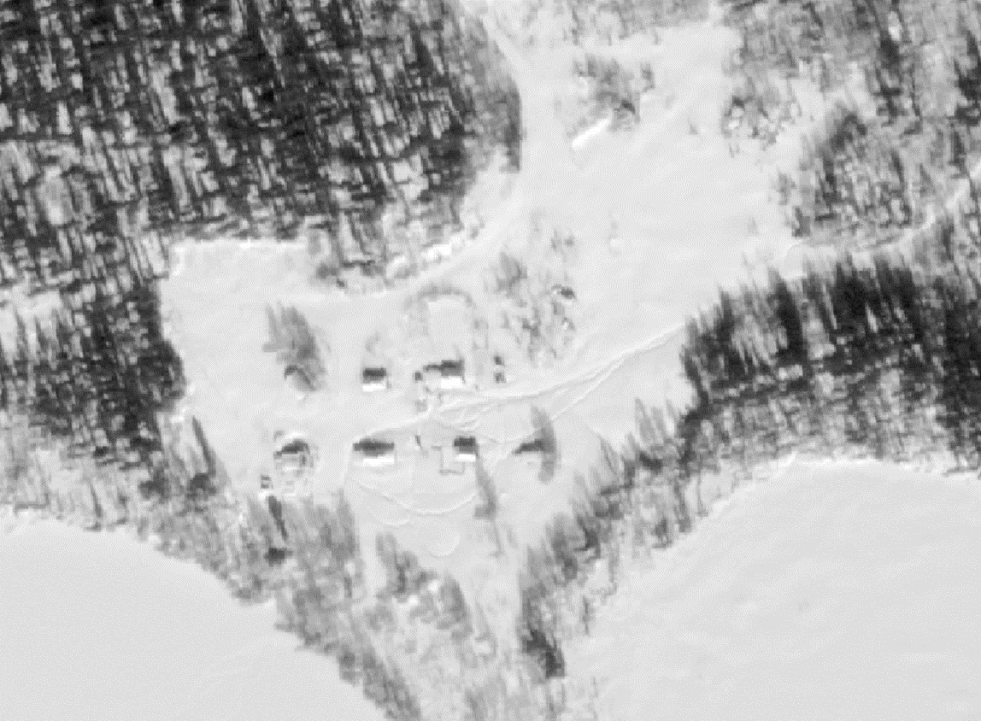
Informal roads as mediators for multilocational dwelling
1
1
2
3
Kogonay lake
2
3
Notes:
In the Kazachinsko-Lenskii raion the example of nomadic Evenki urban dwellers is especially evident. While most of the year many obscene members live in urban settlements of Magistralny, Ulkan, Okunayskoie, during the winter hunting season and summer fishing seasons they come back to the Khanda area using informal roads. As such, informal roads serve as mediators for this multilocational dwelling that link urban Evenki with their homeland and serve as a source of resilience.

Slide 9
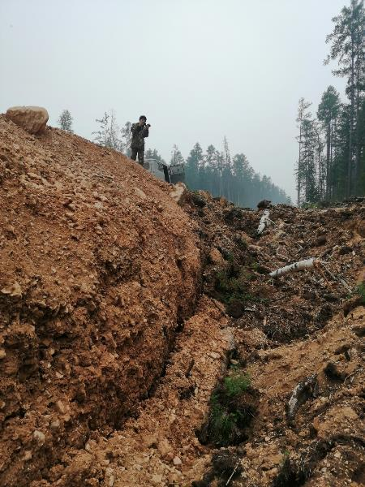
Subsistence, seismic clearings and service roads
A: And here is the 16th drilling rig which was abandoned from drilling. They did 2 seasons, made such (service) roads, now I will show you whether you have ever seen such roads or not? (searches in the phone). Here's the video. Here is a wall, more than 10 meters high
Q: What is this wall?
A: This is the road. Here I had a putik (snowmobile trail), I had an ideal road - profile (seismic clearing) and putik. And this is how they poured it. It is useless for animals, deer fall from there. They try to climb up and fail. (showing video) Here I had a path passing, setting traps - everything was demolished. There is a drilling rig further on, it is not yet known whether they will find oil there, or not. Maybe they will find it, since they are doing such a disaster. This is how much soil they have here, they have heaped stones here. That's where it's lower, it's probably 3 meters in total. But a very steep slope. This is such a nightmare. From there, if a car crashes, then everything, consider death, from such a height. From there, a person either rolls over stones, or that’s all, breaks all his bones.” (male, 60, Tokma, August 3, 2021)

Slide 10
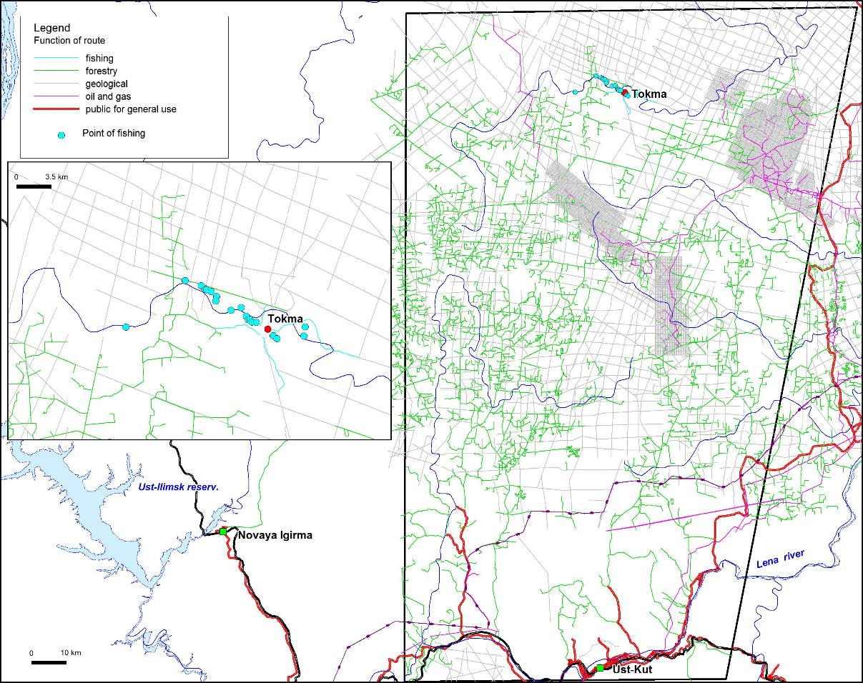
Local vs. non-local resource users
“We already called to Fish Department, or how they are correctly called, told them that such crowds come to us and catch so many fish. And they just answered that fishing with rods is not prohibited” (female, 65, Tokma, 2016, interview by N. Krasnoshtanova)
“We go fishing far from the village, because there are a lot of anglers here, a lot of people come! It seems to me that anglers already come from all over Russia. Therefore, you won't catch a lot of fish here already” (female, 60, Tokma, 2016, interview by N. Krasnoshtanova)

Slide 11
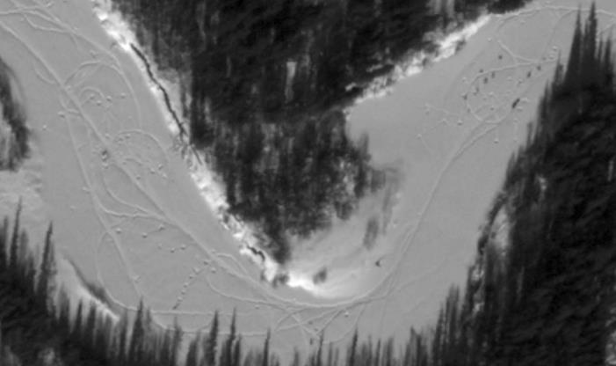
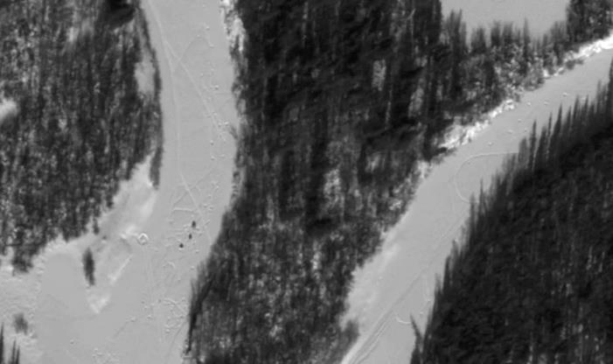
Local vs. non-local resource users
“We already called to Fish Department, or how they are correctly called, told them that such crowds come to us and catch so many fish. And they just answered that fishing with rods is not prohibited” (female, 65, Tokma, 2016, interview by N. Krasnoshtanova)
“We go fishing far from the village, because there are a lot of anglers here, a lot of people come! It seems to me that anglers already come from all over Russia. Therefore, you won't catch a lot of fish here already” (female, 60, Tokma, 2016, interview by N. Krasnoshtanova)
Fishermen on the Nepa river. WV01_20150311 (from Polar Geospatial Center)

Slide 12
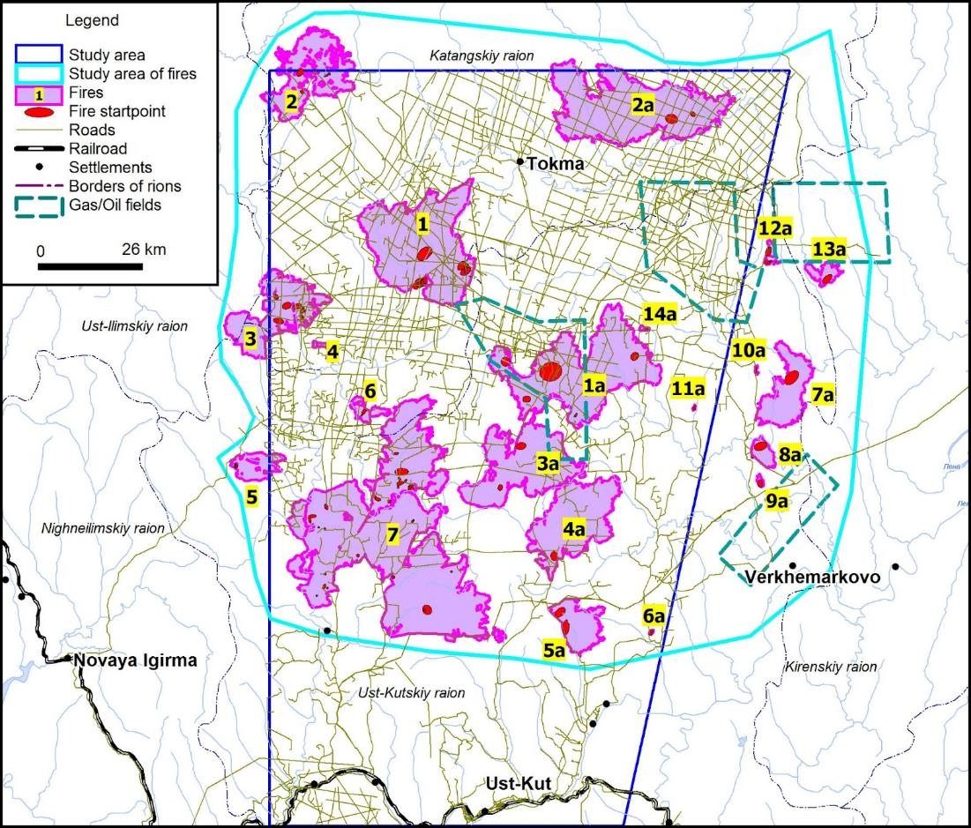
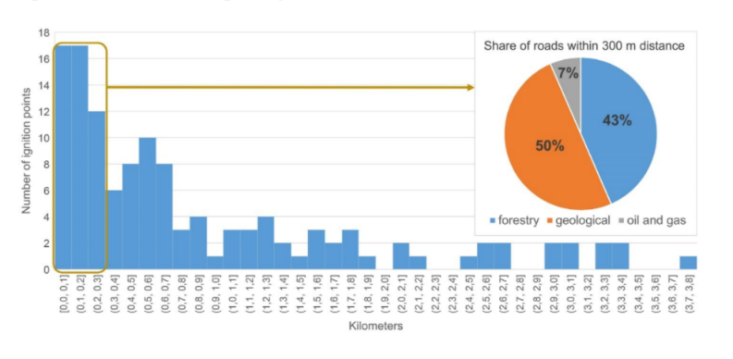
Indirect effects of informal roads on subsistence infrastructure:
“My hunting plot burned after them, it was from them. They drove their tanks in summer. It’s not allowed in summer, it’s forbidden. They have exhaust pipes, diesel fuel there, sparks fly. And where the tank was moving - the last three fires. My Siberian pine forest, my winter hut, all burnt because of them” (male, 35, Vershina Khandy, 4 August 2019)
“After the lumberjacks, these fires started. We believe that it is they who are to blame for these fires. They throw so much wood there, ... half of the wood is left, and in heaps they arrange. They begin to burn them, ... well, maybe it would be possible to burn them, if there was a guard, it is necessary to keep watch so that the fire would not go. And where will you show up in the summer? It would be another matter in winter. Well, that's all, and all these conflagrations begin precisely with cutting areas for some reason. (male, 70, Tokma, 9 March 2020)

Slide 13
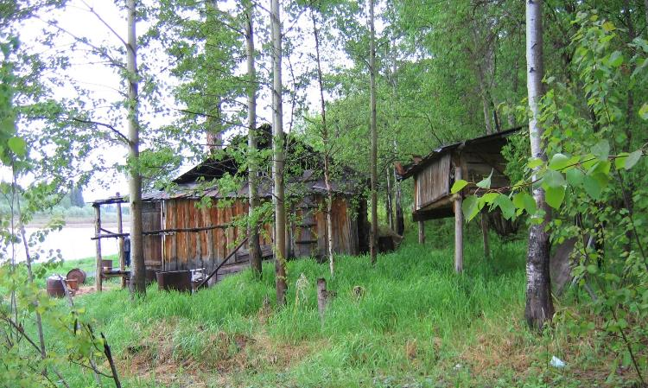
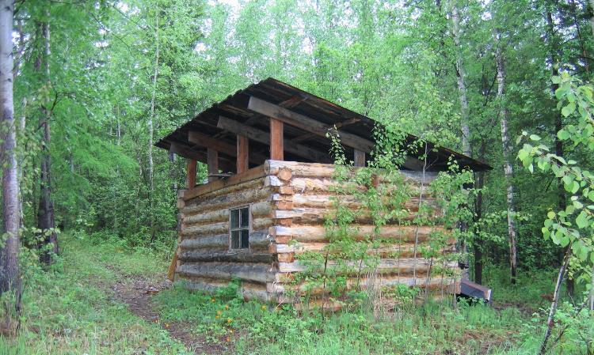
Wildfire management
“They see 300 km from fire to the settlement, and 50 km - to a river through which the fire will not pass. People can be thrown over 1,000 km, and it still makes no sense. And if there is, first of all, permafrost, the number of swamps and streams. That is, there is a weak ground fire, vapors conceal this and do not cause significant harm, it reaches the limit to some larger stream of the river, it will stop. Basically, the permafrost begins to burn superficially, water begins to thaw, after all, it enters the Katangsky region: the hotter the summer, the more water. I have not seen peat fires there during my 4 years of work, when I was dealing with fires. Surface fires are going on, occasionally turning into crown fires somewhere to some distance, and turning again into surface one, that's it. In the Katanga region there is not much dry peat, there is permafrost immediately” (male, 60, Jun 26, 2021, Irkutsk).
“Now this is my base, how many traps have burned down. Once fire was on when it went down the Bereya and down the Nepa, we thought our winter hut would burn down, so we put out the fire with my sister. Almost got burned. It was both on grass and on trees, here are spruce forests, and here is an old burned-out place, here are birch forests” (male, 35, March 11 2020, Tokma).
Hunting huts on the Nizhniaia Tunguska river. Photo by V. Kuklina, July 2006

Slide 14
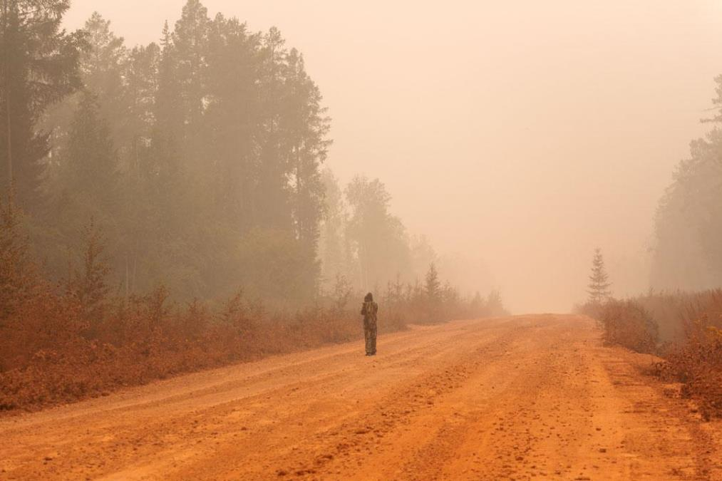
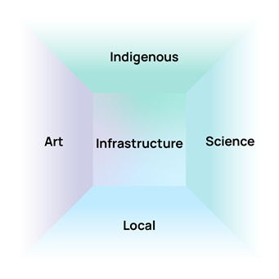
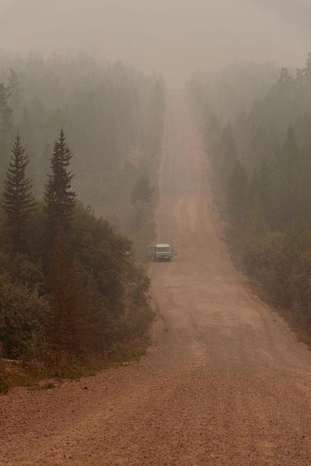
Mobilizing knowledge for recognition of subsistence infrastructure
Session “Mobilizing Arts, Science, Local and Indigenous communities for knowledge co-production in arts-based research” on March 28 at 9.40

Slide 15
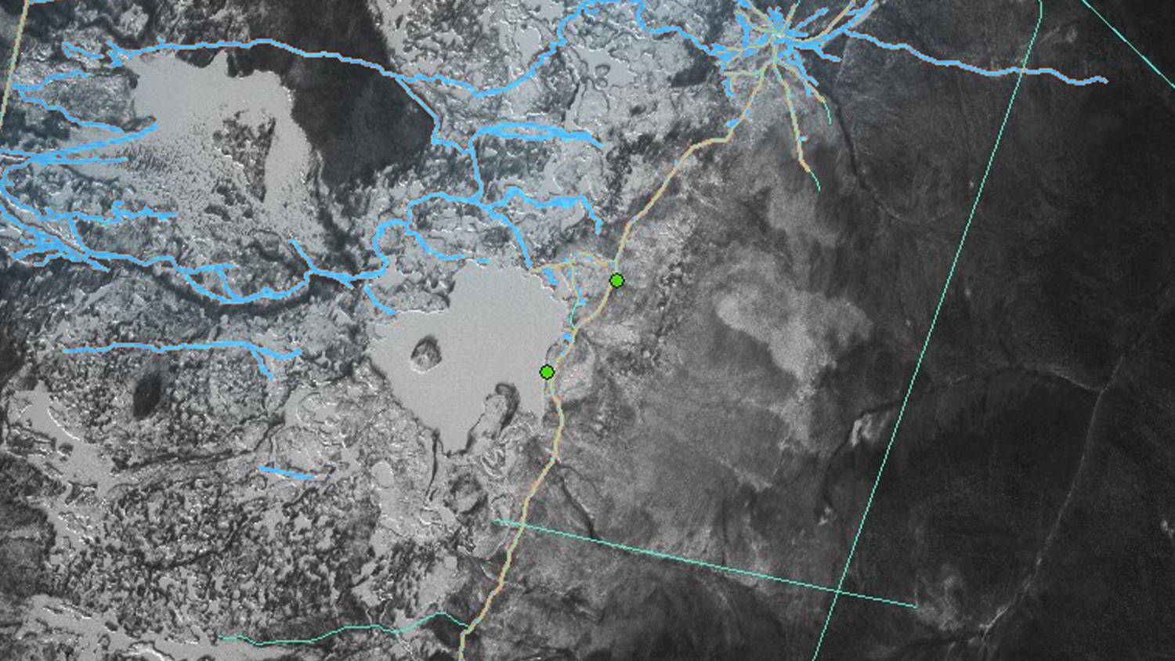
Acknowledgements:
Project "Informal Roads: The Impact of Unofficial Transportation Routes on Remote Arctic Communities" supported by National Science Foundation (#1748092)
Local and Indigenous partners
Contact information on specific research components:
Social research and integration: Vera Kuklina kuklina@gwu.edu
Local and Indigenous knowledge: Natalia Krasnoshtanova knesun@mail.ru
Landscape studies: Irina Bilichenko irinabilnik@mail.ru
Remote sensing: Oleg Sizov kabanin@yandex.ru, Elena Rasputina elenaistoma@gmail.com
Cartography: Viktor Bogdanov victvss@gmail.com
Synthesis of knowledge: Andrey Petrov andrey.petrov@uni.edu

