Slide 1
High Performance Computing for Address Level Climate Data Extraction
Jeff Blossom, Devika Kakkar, Wendy Guan
Center for Geographic Analysis, Harvard University
2022 AAG Annual Meeting

Slide 2
Background – NIH ECHO Program
Environmental influences on Child Health Outcomes (ECHO)
A national effort to enhance the health of children and adolescents through research that may help inform healthcare practices, programs, and policies
Contains over 60 cohorts across the US (shown on the map below).
Notes:
https://www.nih.gov/research-training/environmental-influences-child-health-outcomes-echo-program

Slide 3
Background – Project Viva
A study on one of the ECHO program cohorts
Boston metro-based
The cohort contains some 2,000 mothers and children
Project objective (one of many): To examine the effects of climate related environmental exposures (temperature, precipitation, humidity) at cohort geocoded residential address locations over time.
Needs to associate climate variables to cohort addresses across 19 years
Notes:
https://www.hms.harvard.edu/viva/

Slide 4
PRISM Climate Data
Variables: 7 daily climate variables
Precipitation
temperature (min, mean, max)
vapor pressure deficit (min, max)
dew point
Temporal Extent: 40 years from 1981 – 2020
Spatial Extent: 48 contiguous United States
Spatial Resolution: 800-meter resolution PRISM dataset
File Format: .BIL raster, one raster per variable per day
Data Volume: over 100K raster files, each 85 MB, total 8 TB
Oregon State University
https://prism.oregonstate.edu/
For this project we used 19 years (~3.5 TB) of this dataset, years 1999 – 2017
Notes:
PRISM stands for Parameter-elevation Regressions on Independent Slopes Model. https://prism.oregonstate.edu/FAQ/#:~:text=PRISM%20datasets%20are%20provided%20in,tools%20can%20read%2Fimport%20BIL

Slide 5
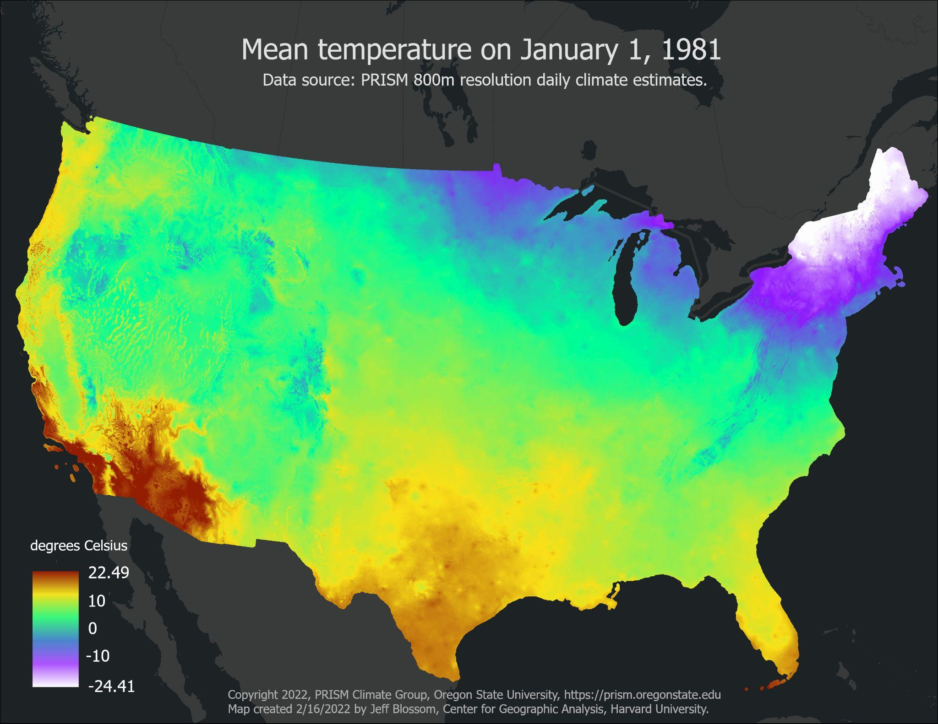

Slide 6
Input Cohort Data
4,796 cohort address locations in 19 years (1999 - 2017)
Input data format*:
address_id,Longitude,Latitude,Start_date,End_date
001_1,-88.8896,30.8862,19991128,20021226
001_2,-89.5246,34.6690,20021227,20110104
002_1,-72.2499,42.4215,19991227,20030221
002_2,-70.7325,-41.9593,20030222,20100103
002_3,-69.6060,46.1955,20100104,20160105
10+ million “patient/days” for climate data extraction
*Longitude, Latitude locations listed here are randomly determined, they are not actual patient locations.

Slide 7
Traditional Methods
R based Processing of PRISM data
Using “exactextractr” and exact_extract() command to process PRISM rasters
Takes 2-3 weeks to process 1 climate variable for 14 years for 4*4 km resolution PRISM for 3-digit zcta level (~1000 shapefiles)
ArcGIS based Processing of PRISM data
Uses “extract multi values to points” on the PRISM rasters, with scripting in Python.
Takes roughly one week to process 7 monthly climate variables for 34 years for 2.4 million input address locations.

Slide 8
Challenges
Need to improve on traditional extraction methods
more efficient, low cost
Local resources are insufficient
need Cloud/ Cluster resources for scaling
Single operator is insufficient
need a combination of powerful spatial operators
Manual operations are not feasible
need automation

Slide 9
Computing Tools and Environment
+
Open-source object-relational database system
CPU based processing; just a few GPU based functions
Over 500 spatial data processing tools
Advanced Raster data processing capabilities
Compute: 100,000 compute nodes, 8-64 cores/node, 12Gb to 512Gb memory/node
Software: CentOS 7, Slurm job manager, Singularity, 1000+ scientific tools and programs
Storage: 100 GB (Home dir), 4TB+ (Lab storage), 2.4PB (Global scratch),
#144 in TOP500 Supercomputers in the world

Slide 10
Major Processing Steps
Creation of database
Loading of climate rasters and patient addresses
Extraction of 7 climate variables for all person/days
Calculation of additional climate variables
Automation of the processes
Scaling of the solution on the cluster computing environment

Slide 11
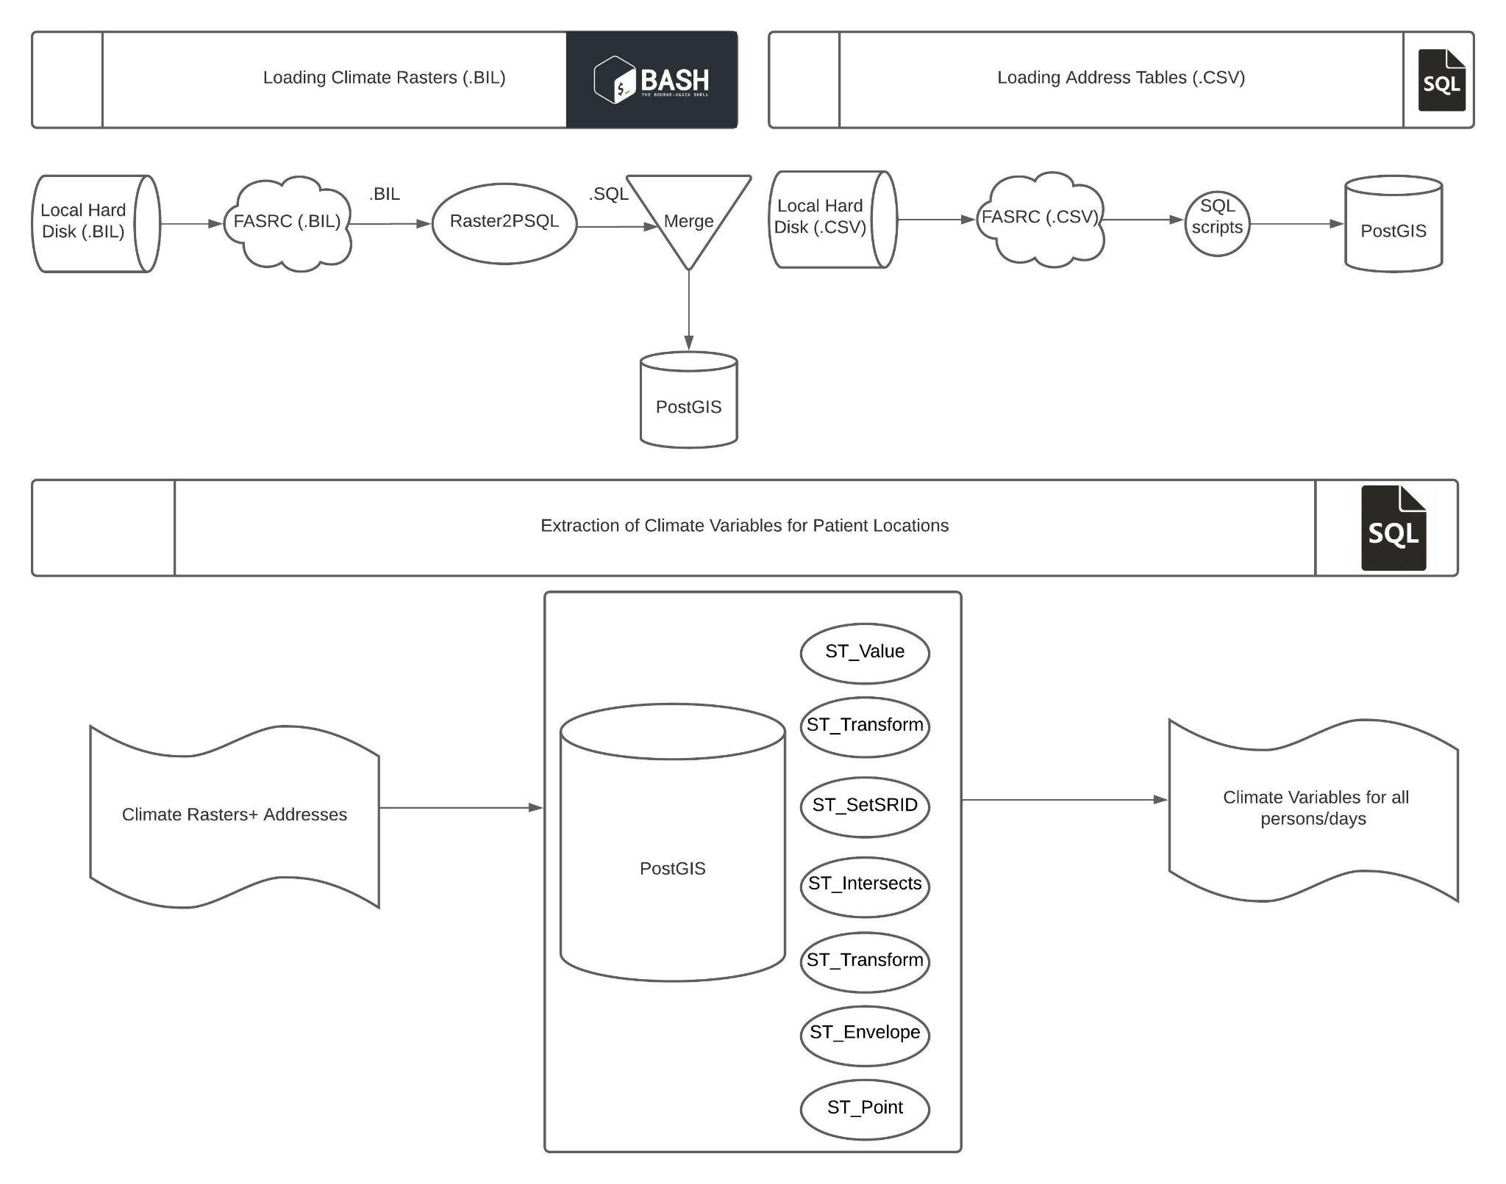
Architecture Diagram

Slide 12
Scaling for Performance Optimization
Input/instance
-2 Batches of 4796 addresses each
- 19 years of Raster Data
7 servers:
1 server for each climate variable
Output/ instance
7 Climate variable extracted for 19 years for ~ 10,000 addresses
Scaling can be applied in two ways due to independence of attributes:
Across years (# years = 19): More resources, slower processing
Across climate variables (# variables = 7): Less resources, faster processing
Optimal Performance was obtained by scaling across the variables:
24 hours for loading 19 years (~3.5 TB) of raster data
4 days for processing 72+ million observations

Slide 13
Results
Seven climate variables extracted for 10+ million “patient-days”
Absolute and relative humidity calculated using the existing mean temperature and dewpoint variables for all person/days
Sample results with 9 climate variables for all person/days:
address_id,day,ppt,tmean,tmin,tmax,tdmean,vpdmin,vpdmax,rh,ah
001_1,19991128,3.125,12.500,11.0,15.5,7.810,0.126,9.864,73.095,8.033
001_1,19991129,4.646,6.300,4.43,10.54,0.710,0.245,6.525,67.436,4.992
001_1,19991130,0.000,9.070,7.2,14.56,-4.740,3.493,12.423,37.357,3.307
001_1,19991201,0.000,12.760,5.34,17.45,-4.090,5.817,15.749,30.701,3.429
001_1,19991201,0.647,13.420,8.65,19.34,2.250,1.930,17.131,46.738,5.438

Slide 14
Summary of the Approach
Development of a proof-of-concept solution using a combination of PostGIS spatial operators
Automation of this solution using a combination of bash and SQL scripting
Optimal scaling of this solution on Harvard’s High-Performance Computing Cluster

Slide 15
Novelty of the Approach
Scalable
Can be easily scaled to bigger datasets
Replicable
Can be replicated on other raster datasets and clusters
Time-efficient
- 24 hours for loading 19 years of raster data
- 4 days for processing 72+ million observations
Leverages Existing Resources
Implemented on Harvard’s Computing Cluster
High-Performance Computing of Raster Big data
Open Source PostGIS based processing

Slide 16
Ongoing and Future Work
Two Harvard medical researchers are currently working with the Project Viva climate data extracts in health outcome related studies.
Distribute the solution to work on non-Harvard computing environments.
The Project Viva cohort is a Harvard study, allowing for processing data in a secure Harvard controlled environment by Institutional Review Board (IRB) approved personnel.
Other cohorts are spread out among many Universities, with most restricting cohort data to residing on local environments, handled by IRB approved personnel for that University.
This approach can be applied to the free PRISM 4km resolution climate data, or any geospatial study involving extracting values from temporal raster data, such as NDVI, night lights, etc.
Notes:
Jeff -- I was added to the project Viva IRB to allow handling of the input lat/long address data for this project. I made sure Devika did not work with the input lat/long address data – I just told her what input file her scripts should point to. To check Devika’s results, I mapped some individual lat/long points and manually loaded the climate rasters to do spot checks in ArcGIS Pro.

Slide 17
References
[1] Project Viva: https://www.hms.harvard.edu/viva/
[2] PRISM Climate Data: https://prism.oregonstate.edu/
[3] Introduction to Cluster Computing on FASRC: https://www.rc.fas.harvard.edu/wp-content/uploads/2019/12/Intro-to-Cannon.pdf
[4] About Postgis: https://postgis.net/
[6] Children’s Respiratory and Environment Workgroup (CREW): https://www.rhoworld.com/federal-project-pages/childrens-respiratory-and-environment-workgroup-crew/
[7] National Health Institute ECHO project: https://www.nih.gov/research-training/environmental-influences-child-health-outcomes-echo-program

Slide 18
Acknowledgement
This work is partially supported by NIH grant UH3OD023286 and NSF Award #1841403.
We acknowledge Heike Gibson of HSPH for help in data management and analysis, and the PRISM Climate Group at Oregon State, including Chris Daly and Dylan Keon who provided guidance on using the PRISM data.
Co-authors:
Jeff Blossom jblossom@cga.harvard.edu
Devika Kakkar kakkar@fas.harvard.edu
Wendy Guan wguan@cga.harvard.edu

Slide 19
Abstract
Project Viva is a Boston based longitudinal study including a cohort of some 2,000 mothers and children. The goal of Project Viva is to find ways to improve the health of mothers and their children by looking at the effects of mother's diet as well as other factors during pregnancy and after birth. A key part of the analysis is calculating various social and environmental exposures at the Viva cohort member address locations. For this part of the project, daily precipitation, temperature, and humidity estimates were extracted for 4,796 cohort address locations for the years 1999 – 2017, resulting in over 10 million patient/days of calculations. Input climate data is the 800-meter resolution PRISM Spatial Climate Dataset for the Conterminous United States (PRISM=Parameter-elevation Relationships on Independent Slopes Model, Oregon State University). The PRISM dataset is published in .BIL raster format, with one raster representing one climate variable per day. Data extraction is executed on a high-performance computing cluster running a PostgreSQL database with the PostGIS extension. This presentation will discuss details of this project including methods used, code developed, processing time statistics, project conclusions, and next steps.

