Slide 1
Flood risk assessment in Limbe (Cameroon) using a GIS weighed sum method
BY Lucy Deba Enomah

Slide 2
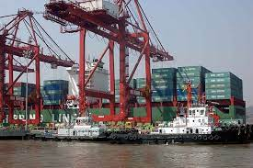
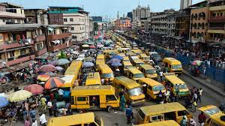
Introduction
Coastal zones pull factors
Rich natural resources that support subsistence
Logistical reasons
Recreational, socio-economic and cultural activities
Rapid population growth and urbanization in coastal areas in Africa
Increased Risk of dangerous and costly flooding in coastal regions
Climate Change
Urbanization
Land subsidence

Slide 3
Introduction Cont’d
Uncontrolled urban growth settlement
Risk zonation policy developed to manage flood is bureaucratic and financially burdensome
Lack of adequate information due to limited technical skills
Lack of adequate resources (financial and material).
Flood prevention is of utmost important to coastal cities.
GIS has been successfully used to visualize the scale of flooding as well as to evaluate flood maps to generate flood damage assessment maps and flood risk maps

Slide 4
Study area
Location: Southwest Region
Elevation: 458m
Two seasons: Dry (Nov to march) and rainy (April to Oct)
Main Rivers: Limbe River and Ejengele
Average annual temperature: 26°C
Annual rainfall average is 2000 mm and peak average rainfall of 3000 mm

Slide 5
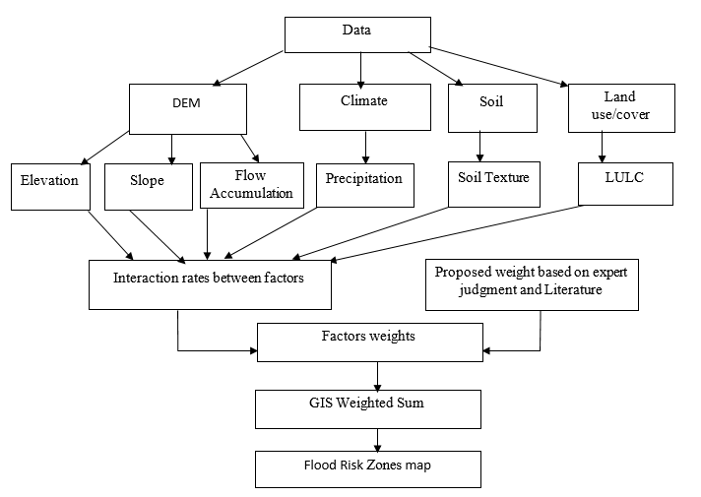
Methodology

Slide 6
Factors

Slide 7
Factor interactions
 | Soil texture | LULC | Slope | Elevation | Precipitation | Flow Accumulation
Soil Texture | No effect | Major | No effect | No effect | No effect | Major
LULC | No effect | No effect | Minor | No effect | Major | Major
Slope | Minor | Major | No effect | No effect | No effect | Major
Elevation | Major | Major | Minor | No effect | Major | Major
Precipitation | major | Minor | No effect | No effect | No effect | Major
Flow Accumulation | No effect | Major | Minor | No effect | No effect | No effect

Slide 8
Factor Weights
 | Interaction Btw Factors | Rates | Product
Soil Texture | 2 major + 0 minor | (2*1)+(0*0.5) | 2
LULC | 2 major + 1 minor | (2*1)+(1*0.5) | 2.5
Slope | 2 major + 1 minor | (2*1)+(1*0.5) | 2.5
Elevation | 4 major + 0 minor | (4*1)+(0*0.5) | 4
Precipitation | 2 major + 1 minor | (2*1)+(1*0.5) | 2.5
Flow Accumulation | 1 major + 1 minor | (1*1)+(1*0.5) | 1.5
Elevation
Flow Accumulation
Slope
LULC
Precipitation
Soil texture

Slide 9
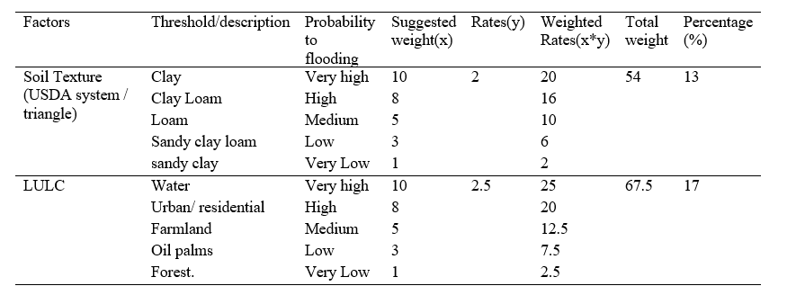
Factor Weight Cont’d

Slide 10
Statistical analysis of Flood risk zones
Flood zones | Values
Very Low | 4.47 km²
Low | 8.58 km²
Medium | 10.81 km²
High | 11.32 km²
Very high | 13.36 km²

Slide 11
Flood Risk zones and Landuse
 | LULC Classes
Flood Risk Zones | Urban/Residential | Forest/oil Palms | Farmland
Very Low | 0.3 | 6.5 | 22.4
Low | 3.5 | 24.0 | 37.4
Medium | 14.5 | 33.6 | 25.0
High | 33.8 | 25.8 | 11.8
Very High | 47.8 | 10.0 | 3.6

Slide 12
Impact Analysis of Flood Risk Zones

Slide 13
Conclusion
This study was conducted to assess the effectiveness of remote sensing and GIS for Flood risk zones mapping.

