Slide 1
Deep Learning Artificial Intelligence (AI) for improving classification accuracy for the National Land Cover Database (NLCD)
Patrick Danielson, Kory Postma, and Brian Granneman (Contributer)
KBR, contractor to the U.S. Geological Survey (USGS)
Earth Resources Observation and Science (EROS) Center,
Sioux Falls, SD 57198, USA.
Work performed under USGS Contract 140G0121D0001.
Jodie Riegle - U.S. Geological Survey (USGS) Denver (Contributer)
Jon Dewitz
U.S. Geological Survey (USGS)
Earth Resources Observation and Science (EROS) Center,
Sioux Falls, SD 57198, USA.

Slide 2
Major Topics
NLCD Background
What is AI Deep Learning?
Developing AI in the cloud
Overall, AI Regression Design
AI Regression Results
AI Regression Next Steps
Conclusions

Slide 3
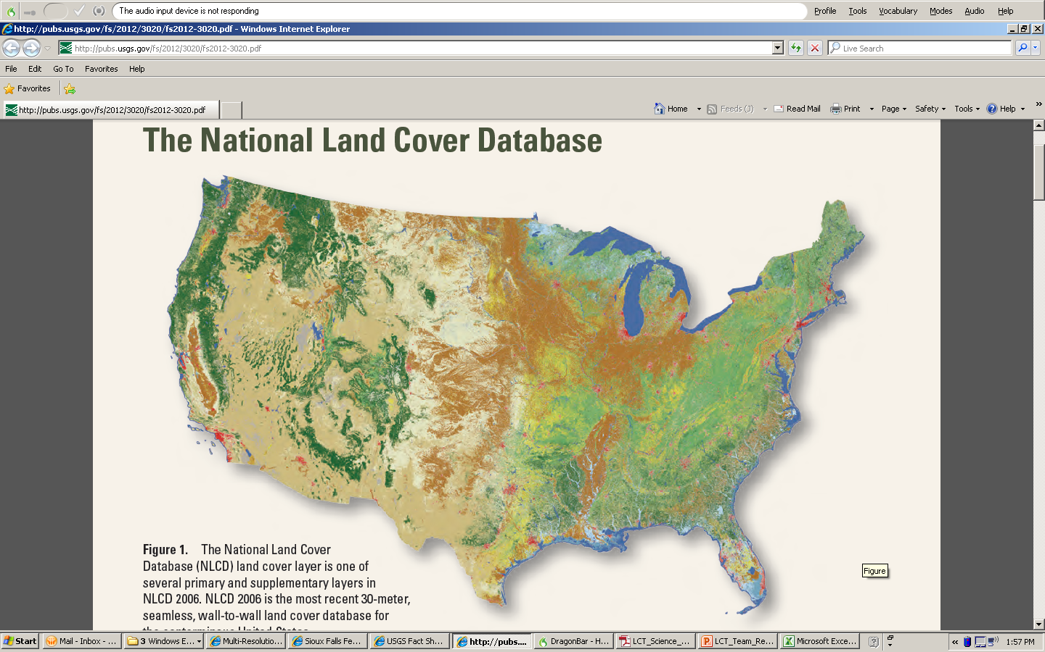
Background
Products available on the
MRLC website www.mrlc.gov
NLCD is a Landsat derived 30m suite of land cover products covering the United States created by 10 Federal partners (Multi-Resolution Land Characteristics Consortium)

Slide 4
Background
NLCD Landcover Method Approach relies
on 4 “pillars” of information including:
1. Spectral Information (Landsat pixels)
2. Ancillary Data (Specialized Land Cover)
3. Shape and Context (Segmentation)
4. Succession and Trajectory (time series)

Slide 5
Background

Slide 6
What is AI Deep Learning?
Source: KDNuggets

Slide 7
Developed AI in Cloud
Credit: URL:
https://margaretmz.medium.com/anaconda-jupyter-notebook-tensorflow-and-keras-b91f381405f8
Credit: URL:
https://margaretmz.medium.com/anaconda-jupyter-notebook-tensorflow-and-keras-b91f381405f8
Credit: URL:
https://www.google.com/url?sa=i&url=https%3A%2F%2Fdatashoptalk.com%2Fthe-quick-and-dirty-of-running-spotfire-on-aws%2F&psig=AOvVaw3_TohEZhOM37FDefTqnJKj&ust=1630438186413000&source=images&cd=vfe&ved=0CAsQjRxqFwoTCOC496u-2fICFQAAAAAdAAAAABAD
Credit: URL:
https://margaretmz.medium.com/anaconda-jupyter-notebook-tensorflow-and-keras-b91f381405f8
Credit: URL:
https://margaretmz.medium.com/anaconda-jupyter-notebook-tensorflow-and-keras-b91f381405f8
Notes:
For NLCD we developed AI in the Pangeo using Python with Tensor flow and Keras and this was all developed in a Jupyter Notebook. Using AWS we could utilize the computing resources in addition it made it very easy to import various other Python modules because the versioning.

Slide 8
Overall AI Design - Machine Learning (ML)/Artificial Intelligence (AI) Deep Learning Regression
Notes:
On the left we feed in and massage input data that we then feed into a normalizer that prepares the data for the neural network that is in the middle after going through the neutral network on the output we get a list of probabilities for each classification we then take the maximum probability and use that for the most likely NLCD classification

Slide 9
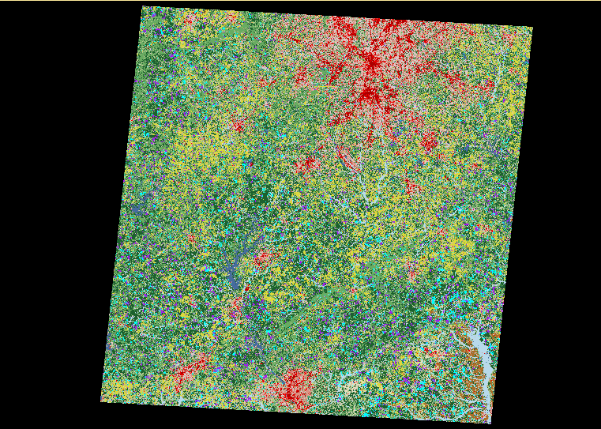
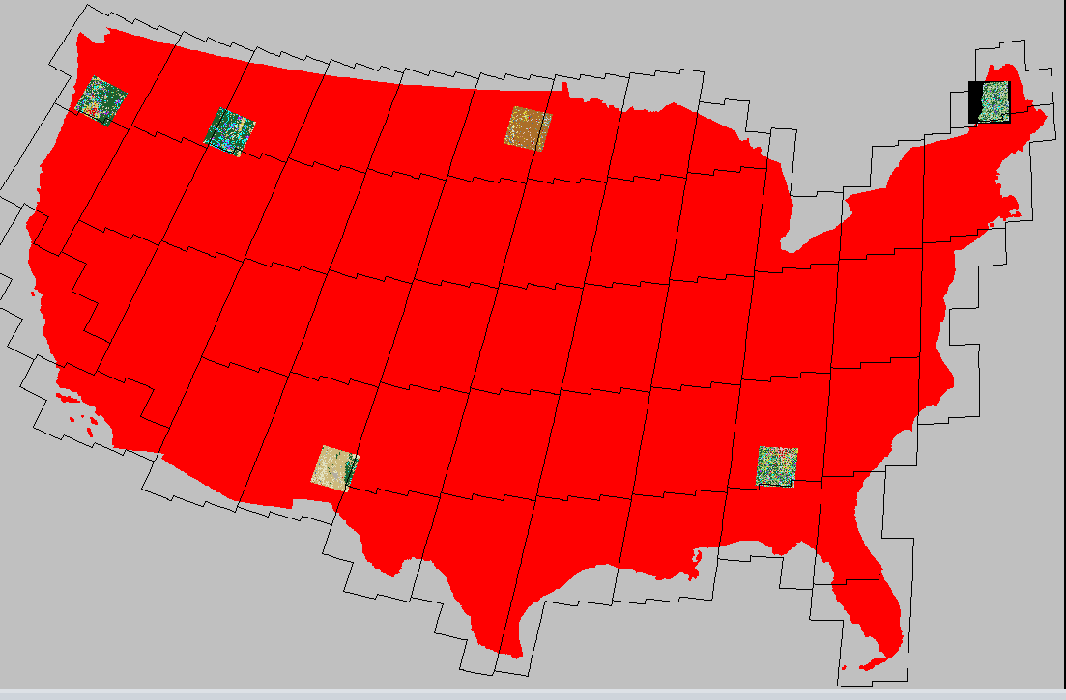
P19/R37 Atlanta Georgia Regression Results
Notes:
The map on the left is our study areas for testing the AI Deep Learning Method. Our study areas cover a variety of different landscapes today I am going to talked about path row 19/37 around Atlanta Georgia. Reason for using this path row it has variety of different land cover classes from forest cutting to forest regrowth to wetland change to urban change to forest to ag change.

Slide 10
P19/R37 Atlanta Georgia Regression Results
AI Regression
See5
Google Earth
AI/ See5 Differences
Landsat 2019 Leafon
Notes:
Now I am going to show you some results form our AI regression output for 19/37. Looking at the slide on the top left is our output from AI Regression and the top right is the output from See5 which is a decision tree classifier that based on rulesets. We have been using See5 since 2001 to generate our predictions for NLCD. On the lower left is a heat map that shows the differences between the AI output classification and See5 Classification and on the lower right is the Landsat 2019 Leafon image. Finally on the right is the Google Earth image.
For this example AI classified this particular patch as conifer forest as where as See5 classified this patch as Ag and on the heat map there is a big difference between AI and See5. AI classified this patch correctly which you can tell by the Landsat and Google Earth

Slide 11
P19/R37 Atlanta Georgia Regression Results
AI Regression
See5
Google Earth
AI/ See5 Differences
Landsat 2019 Leafon
Notes:
In this example AI classified this particular patch as shrub and grass and See5 classified this path as Ag. AI classified this patch correctly based on the Landsat and Google Earth image

Slide 12
P19/R37 Atlanta Georgia Regression Results
AI Regression
See5
Google Earth
AI/ See5 Differences
Landsat 2019 Leafon
Notes:
In this example AI classified this particular patch as conifer forest and See5 classified this path as woody wetland. AI classified this patch correctly based on the Landsat and Google Earth image

Slide 13
P19/R37 Atlanta Georgia Regression Results
AI Regression
See5
Google Earth
AI/ See5 Differences
Landsat 2019 Leafon
Notes:
In this example AI classified this particular patch as agriculture and See5 was all over the place wasn’t sure to call this. AI classified this patch correctly based on the Landsat and Google Earth image

Slide 14
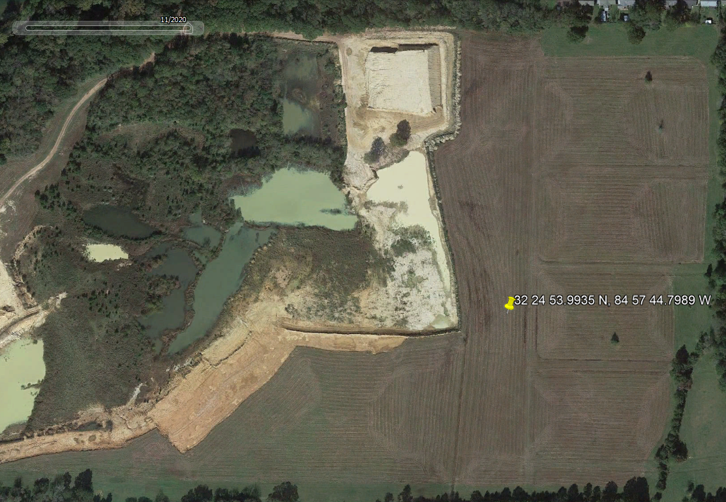
P19/R37 Atlanta Georgia Regression Results
AI Regression
See5
Google Earth
AI/ See5 Differences
Landsat 2019 Leafon
Notes:
In this example AI classified this particular patch as agriculture and See5 classified this patch as haypasture and some ag. AI classified this patch more correctly

Slide 15
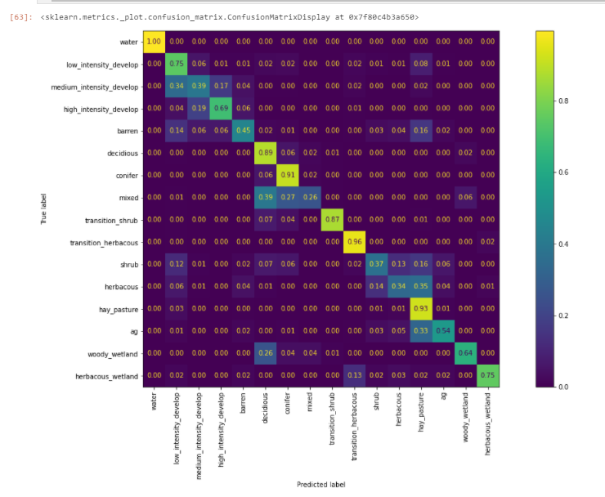
P19/r37 – Confusion Matrix comparing AI versus See5 based on the test data
AI Regression
See5
Notes:
Kory

Slide 16
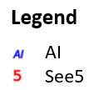
P19/r37 confusion matrix correctness for classification
Open Space
Low Intensity
Hay/
Pasture
Woody Wetland
Herbaceous Wetland
Medium Intensity
High Intensity
Barren
Mixed Forest
Young Forest
Transition Shrub
Transition Herbaceous
Herbaceous
Crops
Water
Deciduous
Conifer
Shrub
Notes:
Kory

Slide 17
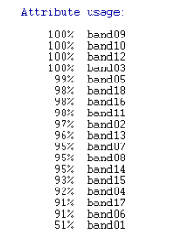
P19/r37 Atlanta Georgia Test Results Independent Variables Importance
Weight Influence | Neural Network Independent Variables
31.22 | Leafon Band 5
20.60 | Leafon 6
18.82 | Leafoff 3
17.33 | Leafoff 6
16.84 | Forest Disturbance Date
16.74 | Leafoff 5
12.56 | Leafon 2
10.53 | Leafoff 2
6.55 | Leafon 4
5.80 | Leafoff 4
3.68 | Leafon 1
3.35 | DEM
3.27 | Leafon 3
2.52 | Leafoff 1
1.33 | Posidex
0.39 | CTI
0.38 | Aspect
0.09 | Compact P
Model Usage | See5 Independent Variables
100 | Leafon 3
100 | Leafon 4
100 | Leafon 6
100 | DEM
99 | Forest Disturbance Date
98 | Leafoff 6
98 | Leafoff 4
98 | Leafon 5
97 | CTI
96 | Leafoff 1
95 | Leafon 1
95 | Leafon 2
95 | Leafoff 2
93 | Leafoff 3
92 | Posidex
91 | Leafoff 5
91 | Compact P
51 | Aspect
e.g., if you remove Leafon 5 then the neural network accuracy will drop by 31.22 percent
Notes:
Kory

Slide 18
AI Regression Next Steps
Add more training data (temporally and spatially)
Expand our AI models to the whole CONUS
Explore other neural network models (e.g., CNN)
Test our current AI method with Landsat Collection 2 imagery
Notes:
1 bullet- Adding more training data both temporally and spatially could improve our classification by using surrounding pixels instead of just pixel drilling.
2nd bullet – We want to generate one model covering CONUS and we can use that model to generate predictions. Advantage this could potentially save time because we only have to generate the AI model once and areas that lack training data could potentially help classify those areas correctly
3rd bullet –Try other deep learning techniques to see if that can give us better results like Convolutional Neural Networks (CNN) where you can zoom in and out look at the surrounding pixels.

Slide 19
Conclusions
Less noisy outputs
Models are only as good as your training data
Larger models give better predictions but use more resources
Notes:
1st bullet: with our tests AI has less noise then SEE5 patches are more spatially coherent
2nd Have a good training data is very important but one thing we notice with AI is even in areas that have poor training AI was able to predict the correct label
3rd Use wider and deeper models give us better predictions but use more resources

Slide 20
Questions?

