Slide 1
Stratified random sampling generates the
Total Operating Characteristic with
an application to flood mapping
https://www.mdpi.com/2072-4292/13/19/3922
Robert Gilmore Pontius Jr and Zhen Liu
rpontius@clarku.edu and zhenliu3@clarku.edu

Slide 2
Please do these things.
Use the Total Operating Characteristic (TOC) to analyze the relationship between a binary variable and an rank variable.
Read the journal article at https://www.mdpi.com/2072-4292/13/19/3922
Use free software from https://lazygis.github.io/projects/TOCCurveGenerator
Get the forthcoming book entitled
Metrics That Make a Difference https://link.springer.com/book/9783030707644

Slide 3
Users should consider several thresholds.
There are various ways to select a threshold and the selection can influence the results substantially.
The use of a single threshold insufficiently represents the performance of the index.
index
Diagnosis
Reference

Slide 4
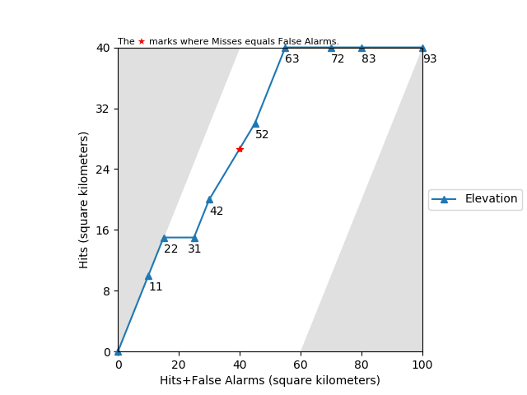
We combine TOC and Stratified Random Sample.
Total Operating Characteristic (TOC) is a method to compare index variables to a binary variable.
Stratified random sampling is more efficient than simple random sampling.
Data Source
Census
Simple Random
sampling
Stratified Random
sampling

Slide 5
Example data show the concepts.
Elevation
11
22
31
42
52
52
52
63
72
72
72
83
93
93
Reference
P
P
A
P
P
P
A
P
A
A
A
A
A
A
Stratum 1
20 sq. km
Assumption: Low elevation indicates high suspicion of water
Stratum 2
40 sq. km
Stratum 3
40 sq. km

Slide 6
We calculate the weights for strata.
Index
11
22
31
42
52
52
52
63
72
72
72
83
93
93
Rank
1
2
3
4
5
5
5
6
7
7
7
8
9
9
Reference
P
P
A
P
P
P
A
P
A
A
A
A
A
A
Size
Weight
Stratum 1
20 sq. km
20/2 = 10 sq. km/observation
Eq. 1
Stratum 2
40 sq. km
40/8 = 5 sq. km/observation
Stratum 3
40 sq. km
40/4 = 10 sq. km/observation

Slide 7
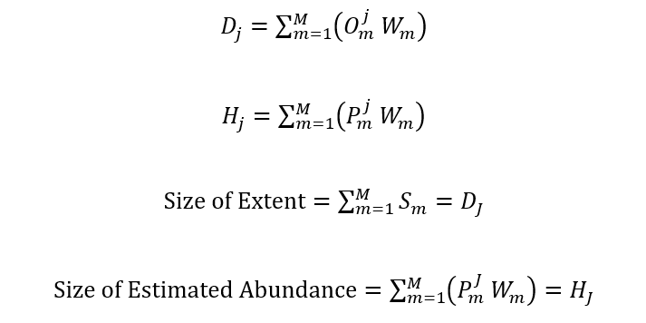
TOC curve considers several thresholds.
Index
11
22
31
42
52
52
52
63
72
72
72
83
93
93
1
2
3
4
5
5
5
6
7
7
7
8
9
9
Rank
1
2
3
4
5
5
5
6
7
7
7
8
9
9
Reference
P
P
A
P
P
P
A
P
A
A
A
A
A
A
Eq. 2
$D_{9}=2∗10+8∗5+4∗10=100$
$D_{7}=2∗10+8∗5+1∗10=70$
$D_{8}=2∗10+8∗5+2∗10=80$
$D_{1}=1∗10+0∗5+0∗10=10$
$D_{2}=1∗10+1∗5+0∗10=15$
$D_{3}=2∗10+1∗5+0∗10=25$
$D_{4}=2∗10+2∗5+0∗10=30$
$D_{5}=2∗10+5∗5+0∗10=45$
$D_{6}=2∗10+5∗5+1∗10=55$
Eq. 3
$H_{8}=1∗10+4∗5+1∗10=40$
Hits
$H_{1}=1∗10+0∗5+0∗10=10$
$H_{2}=1∗10+1∗5+0∗10=15$
$H_{3}=1∗10+1∗5+0∗10=15$
$H_{4}=1∗10+2∗5+0∗10=20$
$H_{5}=1∗10+4∗5+0∗10=30$
$H_{6}=1∗10+4∗5+1∗10=40$
$H_{9}=1∗10+4∗5+1∗10=40$
$H_{7}=1∗10+4∗5+1∗10=40$
Eq. 4
$Size of Extent=100$
Eq. 5
$Size of Estimated Abundance=40$
Hits + False Alarms

Slide 8
We define the TOC space.
Index
11
22
31
42
52
52
52
63
72
72
72
83
93
93
Rank
1
2
3
4
5
5
5
6
7
7
7
8
9
9
Reference
P
P
A
P
P
P
A
P
A
A
A
A
A
A
$$Lower boundary: H=0$$
$$0<H<Abundance$$
$$Upper boundary: H=Abundance$$
$$Right boundary:$$
$$H=D+Abundance−Extent$$
$$Left boundary: H=D$$
$$H<D<H+Extent−Abundance$$
Hits
Hits + False Alarms

Slide 9
Our software creates the TOC diagram.
Index
11
22
31
42
52
52
52
63
72
72
72
83
93
93
Rank
1
2
3
4
5
5
5
6
7
7
7
8
9
9
Reference
P
P
A
P
P
P
A
P
A
A
A
A
A
A
$$Lower boundary: H=0$$
$$0<H<Abundance$$
$$Upper boundary: H=Abundance$$
$$Right boundary:$$
$$H=D+Abundance−Extent$$
$$Left boundary: H=D$$
$$H<D<H+Extent−Abundance$$

Slide 10
TOC provides useful measures.
Each Point reveals four central entries in the contingency table
Area under the TOC curve (AUC) summarizes the performance across the TOC space
The point where diagnosed quantity of presence equals estimated abundance shows how allocation errors affect the result

Slide 11
TOC provides useful measures.
Each Point reveals four central entries in the contingency table
Area under the TOC curve (AUC) summarizes the performance across the TOC space
The point where diagnosed quantity of presence equals estimated abundance shows how allocation errors affect the result
$$AUC =\frac{Area under the curve in the TOC space}{Area of the TOC space}$$

Slide 12
TOC provides useful measures.
Each Point reveals four central entries in the contingency table
Area under the TOC curve (AUC) summarizes the performance across the TOC space
The point where diagnosed quantity of presence equals estimated abundance shows how allocation errors affect the result

Slide 13
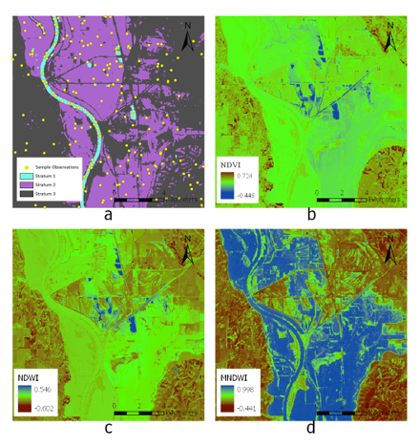
The TOC applies to flood mapping after the cyclone in 2019.
Objective To evaluate the performance of three water indices
Strata 1 area that is water under non-flood conditions
2 land that was flooded by previous floods
3 land that remained unflooded during previous floods
Sample Stratum 1 has 50 points
Stratum 2 has 100 points
Stratum 3 has 50 points
Reference Presence versus Absence of Water during 2019 cyclone
Indices Normalized Difference Vegetation Index (NDVI)
Normalized Water Index (NDWI)
Modified Normalized Water Index (MNDWI)
Figure 3. Maps of (a) Strata and sample points, (b) NDVI, (c) NDWI, and (d) MNDWI

Slide 14
MNDWI performs the best.
Figure 4. TOC curves for MNDWI, NDVI, and NDWI for (a) the entire TOC parallelogram and (b) the upper left corner of the TOC parallelogram

Slide 15
MNDWI performs the best.
Area Under Curve

Slide 16
TOC Curve Generator performs the analysis.
Zhen Liu created software available for free at https://lazygis.github.io/projects/TOCCurveGenerator
The software:
Reads input data in various formats.
Sets weights according to the strata information.
Shows multiple TOC curves in one figure.
Labels the points with threshold values.

Slide 17
Read the journal article https://www.mdpi.com/2072-4292/13/19/3922 Use the free software https://lazygis.github.io/projects/TOCCurveGenerator Read Metrics That Make a Difference https://link.springer.com/book/9783030707644
Robert Pontius
rpontius@clarku.edu
www.clarku.edu/~rpontius
Zhen Liu
zhenliu3@clarku.edu
lazygis.github.io

Slide 18
TOC curve for strata shows more information than Uniform.
Index
11
22
31
42
52
52
52
63
72
72
72
83
93
93
1
2
1
2
2
2
2
3
2
2
2
3
3
3
Rank
1
2
1
2
2
2
2
3
2
2
2
3
3
3
Reference
P
P
A
P
P
P
A
P
A
A
A
A
A
A
Eq. 2
$D_{1}=2∗10+0∗5+0∗10=20$
$D_{3}=2∗10+8∗5+4∗10=100$
$D_{2}=2∗10+8∗5+0∗10=60$
Eq. 3
$H_{1}=1∗10+0∗5+0∗10=10$
Hits
$H_{3}=1∗10+4∗5+1∗10=40$
$H_{2}=1∗10+4∗5+0∗10=30$
Eq. 4
$Size of Extent=100$
Eq. 5
$Size of Estimated Abundance=40$
Hits + False Alarms

Slide 19
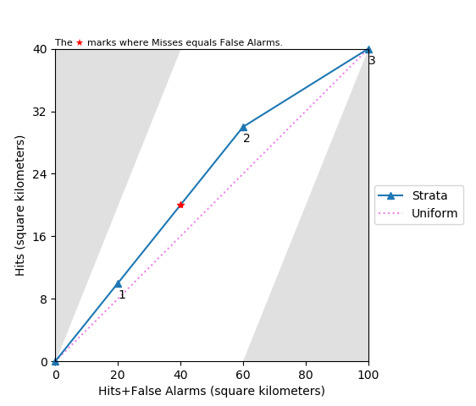
TOC curve for strata shows more information than Uniform.
Index
11
22
31
42
52
52
52
63
72
72
72
83
93
93
1
2
1
2
2
2
2
3
2
2
2
3
3
3
Rank
1
2
1
2
2
2
2
3
2
2
2
3
3
3
Reference
P
P
A
P
P
P
A
P
A
A
A
A
A
A
Eq. 2
$D_{3}=2∗10+8∗5+4∗10=100$
Eq. 3
$H_{3}=1∗10+4∗5+1∗10=40$
Eq. 4
$Size of Extent=100$
Eq. 5
$Size of Estimated Abundance=40$

Slide 20
We rank the observations.
Index
11
22
31
42
52
52
52
63
72
72
72
83
93
93
Reference
P
P
A
P
P
P
A
P
A
A
A
A
A
A
Stratum 1
20 sq. km
Assumption: Low elevation indicates high suspicion of water
Stratum 2
40 sq. km
Stratum 3
40 sq. km
Unique values in Index: 11, 22, 31, 42, 52, 63, 72, 83, 93
Rank
1
2
3
4
5
6
7
8
9
Index
Interval
(-∞,11]
(11,22]
(22,31]
(31,42]
(42,52]
(52,63]
(63,72]
(72,83]
(83,93]

