Slide 1
Inclusive Accessibility A deep learning-based space-time framework integrating person-based hard and soft constraints
Presented By: Armita Kar
Advisors: Dr. Huyen T.K. Le and Dr. Harvey J. Miller

Slide 2
Background
Inclusive accessibility: A measure that
addresses heterogenous perceptions of mobility barriers and travel experiences
across individuals and social groups
while evaluating their access to multimodal transportation system.

Slide 3
Background
Hard constraints
Explicit, easily quantifiable, and non-negotiable.
Space-time constraints (travel time budget, location of fixed activities, activity duration)
Cost constraints (travel budget)
Physical ability to walk/bike
Socio-demographics
What would be the cost?
Can I walk/bike for that long?
How much time do I have?

Slide 4
Background
Soft constraints
Implicit, difficult to quantify, and relies on the decision-making strategies of individuals.
Preferences for network and service quality
Perception of safety
Perception toward built environment
Do they have proper infrastructures on my route?
What would be the cost?
What would be the traffic like?
Do I like the surrounding area?
Can I walk/bike for that long?
Which one would be more comfortable?
How much time do I have?
Which one would be safer?

Slide 5
Background
Do they have proper infrastructure my route?
What would be the cost?
What would be the traffic like?
Do I like the surrounding area?
Can I walk/bike for that long?
Which one would be more comfortable?
How much time do I have?
Which one would be safer?
Perception of accessibility constraints varies by:
Age group, gender, income and personal lived experiences
Objective: Measuring person-based inclusive accessibility based on hard and soft constraints

Slide 6
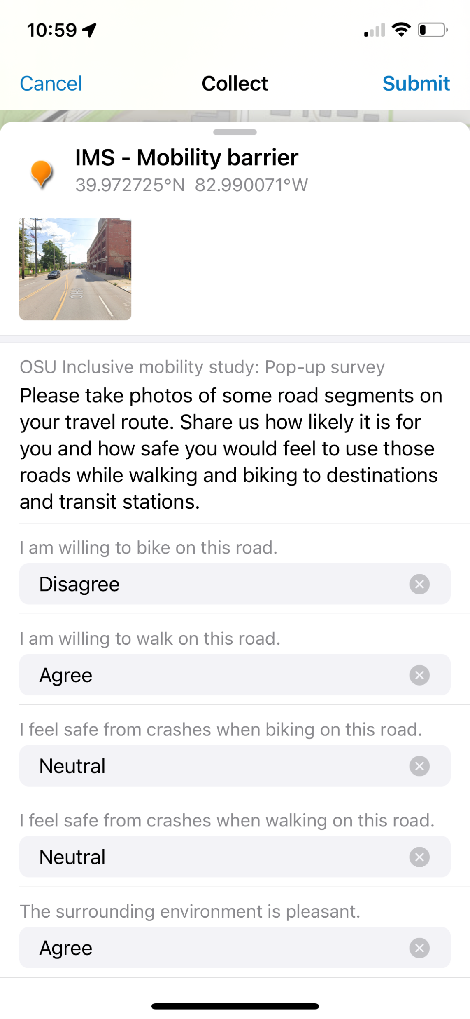
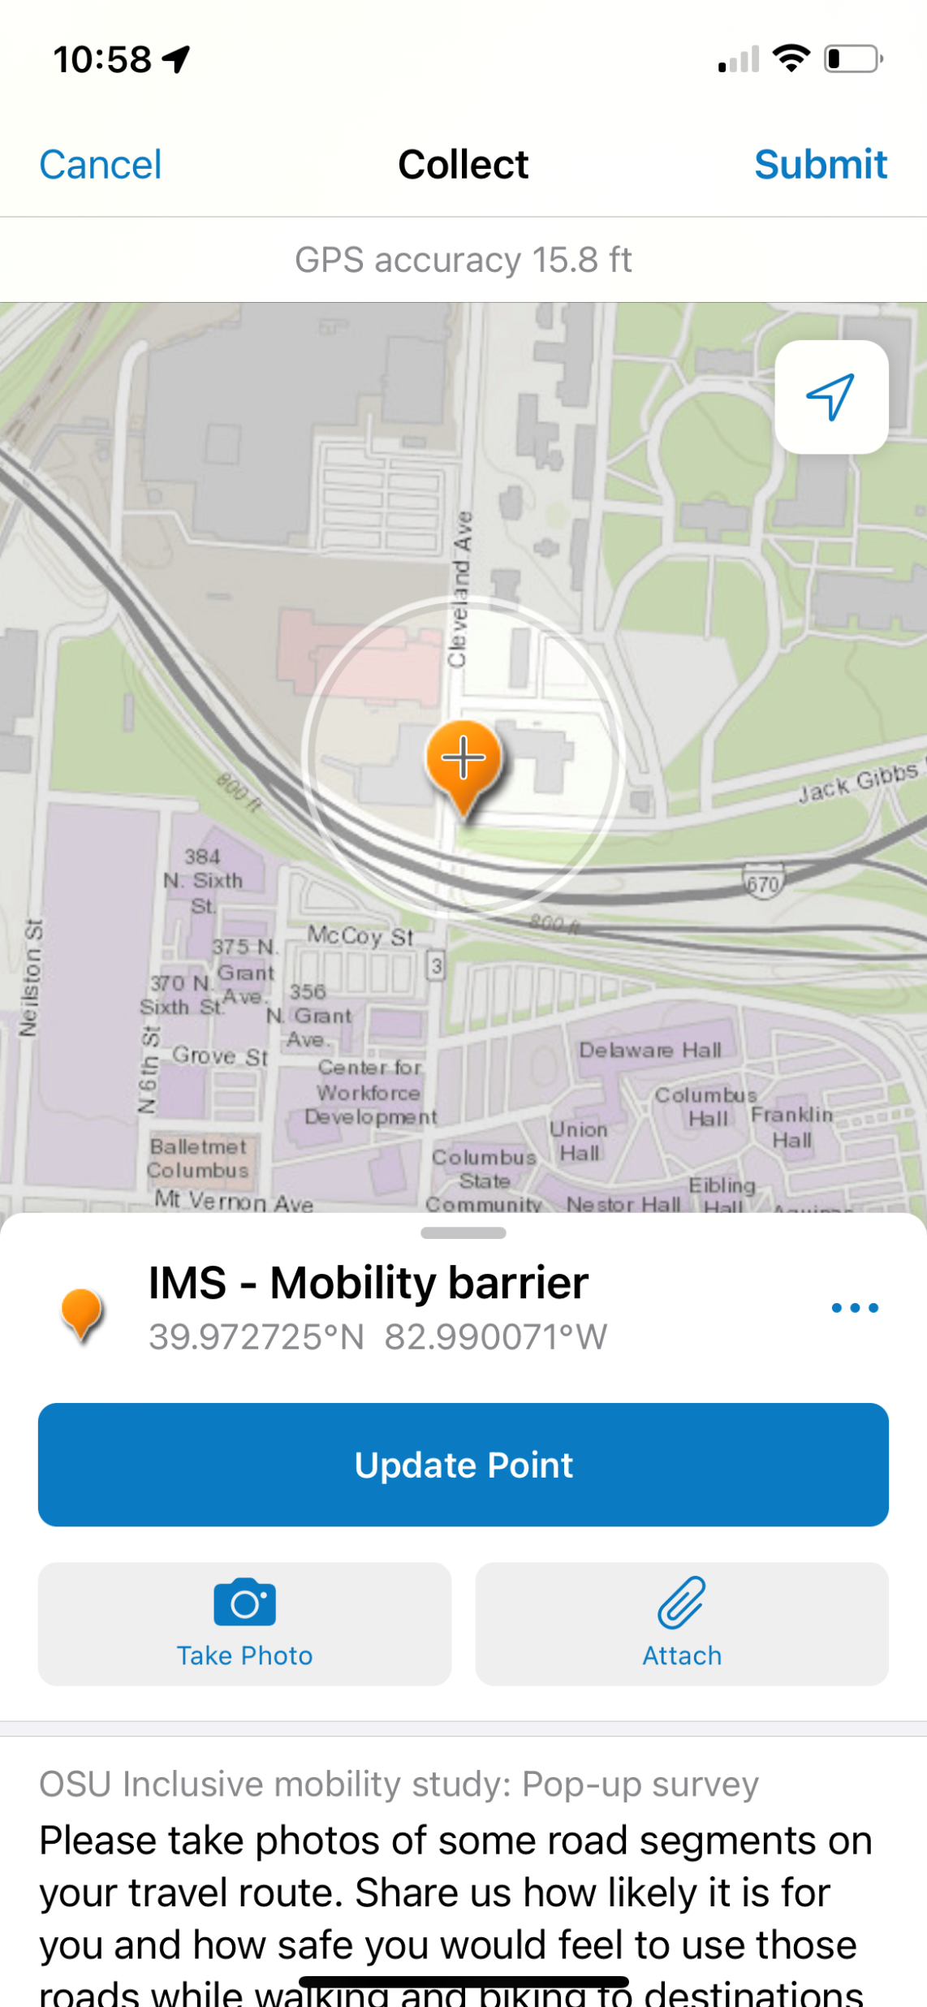
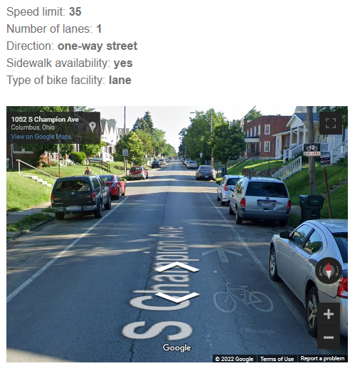
Primary Data
- Online survey
Pop-up survey using ArcGIS Field Maps
Score road segments based on:
Willingness to bike
Safety while biking
Willingness to walk
Safety while Walking
Quality of surrounding environment

Slide 7
Impedance score definition
Model 1 : Prediction of network-based walking impedance score on a scale of 1-3
Output
Input features
$$Walking impedance score=f (Walk willingness, walk safety,$$
$$surrounding environment quality)$$
Network characteristics (Number of lanes, speed, functional class, one-way, traffic volume)
Sidewalk characteristics (Availability, buffer, ADA compliance, surface type)
Land use characteristics (Light and dense vegetation within 10-feet road buffer)
Model 2 : Prediction of network-based biking impedance score on a scale of 1-3
Output
Input features
$$Biking impedance score=f (Bike willingness, bike safety,$$
$$surrounding environment quality)$$
Network characteristics (Number of lanes, speed, functional class, one-way, traffic volume)
Bikeway characteristics (Infrastructure type, width, level of service, buffer, surface type)
Land use characteristics (Light and dense vegetation within 10-feet road buffer)

Slide 8
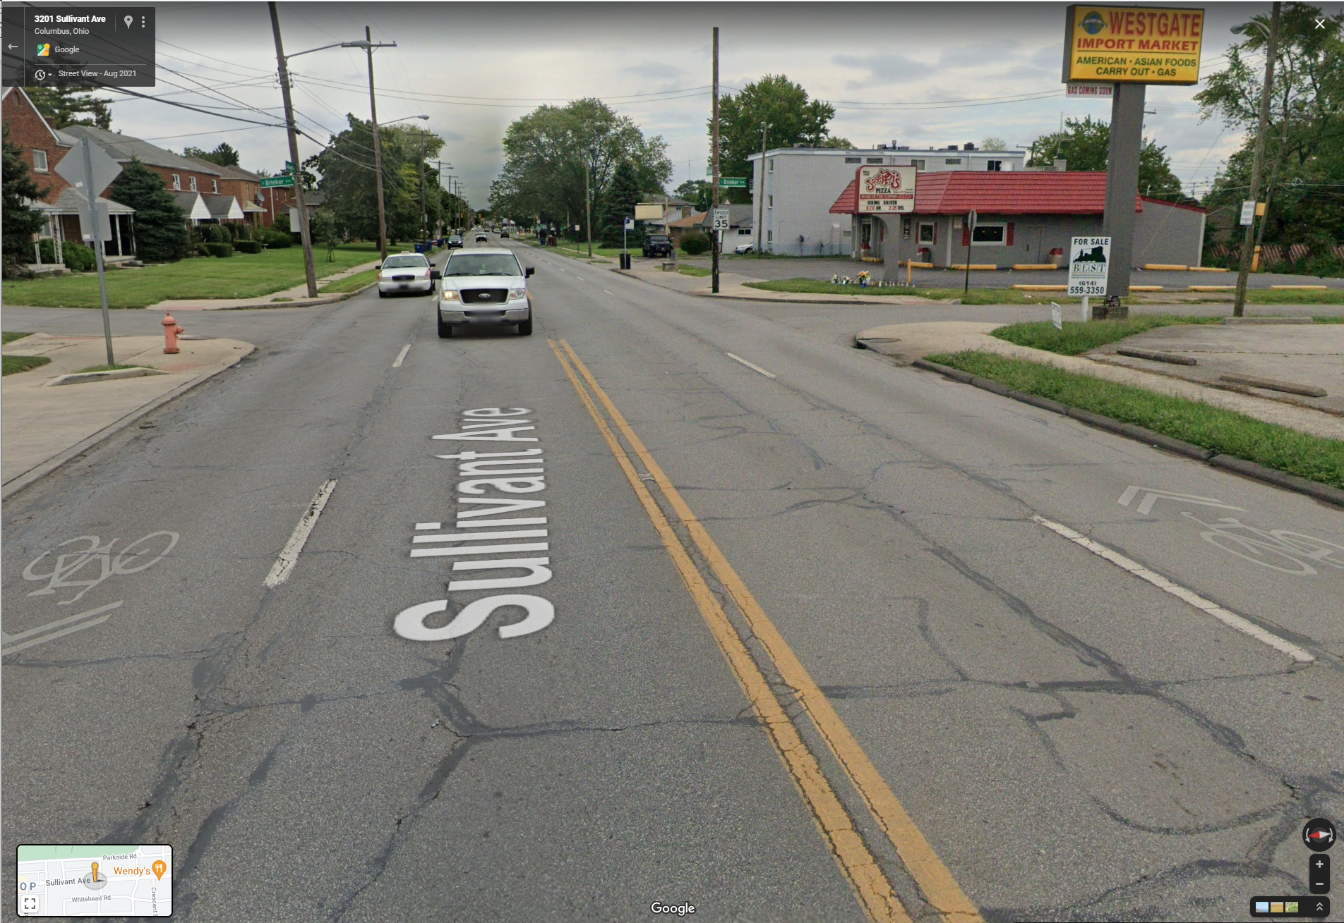
Model definition
3-ways 10-shots
Data processing
One-hot encoding for the categorical variable
Min/max scaling for the continuous variable
Models based on the concepts of Human in the loop and few shot learning:
Siamese network with triplet loss
Compared model performances with
Logistics regression
Random forest
Class 1: Agree | Class 2: Neutral | Class 3: Disagree
Img 1 | Img 1 | Img 1
Img 2 | Img 2 | Img 2
…. | …. | …..
Img 10 | Img 10 | Img 10
Speed limit:35
Number of lanes: 4
Direction: Bi-directional
Sidewalk availability: Yes
Type of bike facility: Sharrow
……
Traffic volume: low
f1
f2
f3
.
.
fn
Example of input feature vector

Slide 9
Siamese network with triplet loss
Popular in learning from little data
A neural network architecture with identical subnetworks
Estimates the similarity of the inputs by comparing its feature vectors
The training process generates image triplets (anchor, positive and negative) and compares the anchor input with positive and negative inputs.

Slide 10
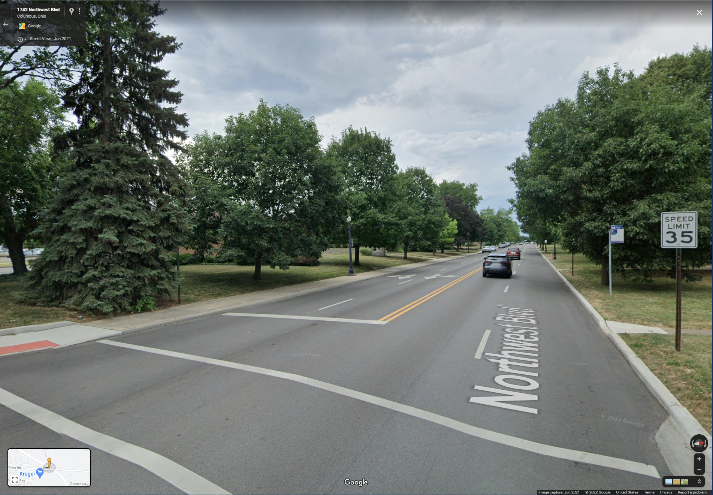
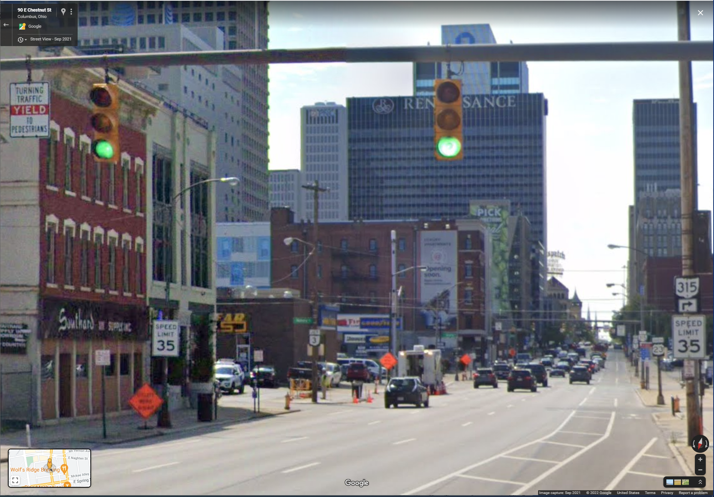
Siamese network with triplet loss
Speed limit:35
Number of lanes: 4
Direction: Bi-directional
Sidewalk availability: Yes
Type of bike facility: Sharrow
Traffic volume: low
f1
f2
f3
.
.
fn
f1
f2
f3
.
.
.
fn
Speed limit:35
Number of lanes: 4
Direction: Bi-directional
Sidewalk availability: Yes
Type of bike facility: none
Traffic volume: low
Triplet loss
f1
f2
f3
.
.
.
fn
Speed limit:35
Number of lanes: 3
Direction: One-way street
Sidewalk availability: Yes
Type of bike facility: bike lane
Traffic volume: high

Slide 11
Feature space
Negative: class 3
Positive: class 1
Anchor: class 1
The loss function minimizes the distance between an anchor and positive input and maximizes the distance between an anchor and negative input.
$L\left(a, p, n\right)=\sum_{i=1}^{N}{max\left\{d\left(a_{i}, p_{i}\right)−d\left(a_{i},n_{i}\right)+margin, 0\right\}⁡},$ where, $d\left(x_{i},y_{i}\right)={\left|x_{i }− y_{i}\right|}^{2}$

Slide 12
Logistic Regression and Random Forest
Stratified CV with 10 folds and 3 repetitions
Applied random search for hyperparameter tuning
Set aside 1% dataset for testing
 | Accuracy (Logistic regression) | Accuracy (Random forest)
Walking impedance score | Train: 71% Test: 70% | Train: 73% Test: 90%
Biking impedance score | Train: 71% Test: 70% | Train: 73% Test: 70%
Notes:
The model is biased toward the distribution.
Walking:
C: 0.7022970616406576,
penalty: l2,
solver: lbfgs
Biking:
C:0.17100653483575906,
penalty: l2,
solver: newton-cg

Slide 13
Siamese network with triplet loss
- Designed fully connected layers with dropout and batch normalization techniques
Applied K-nearest neighborhood as classifier
Walking impedance score
KNN accuracy = 90%
Biking impedance score
KNN accuracy = 93%

Slide 14
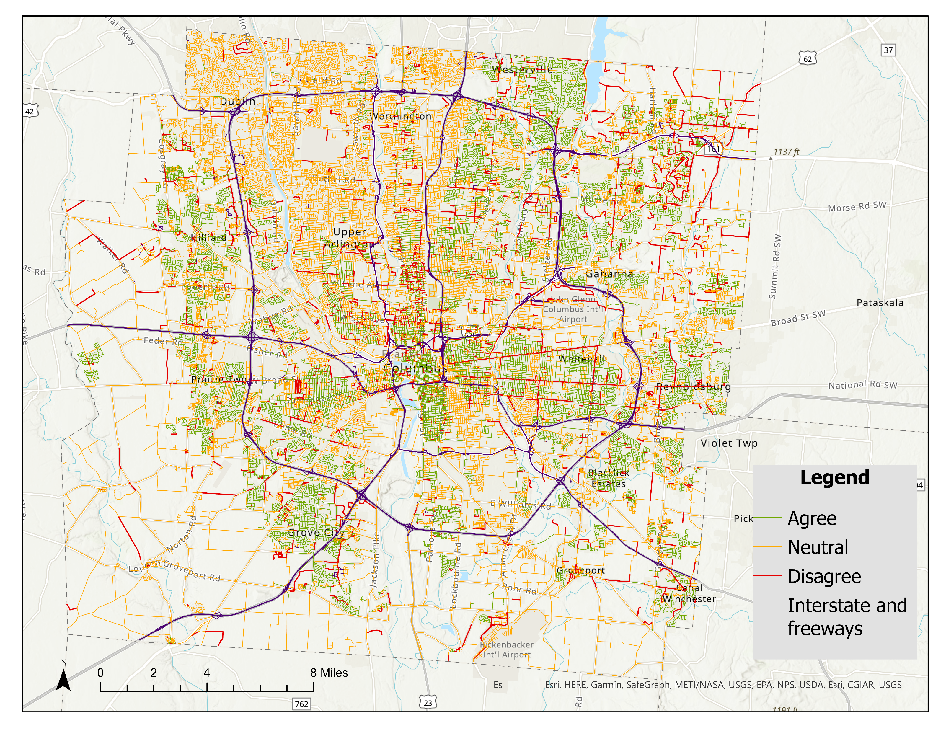
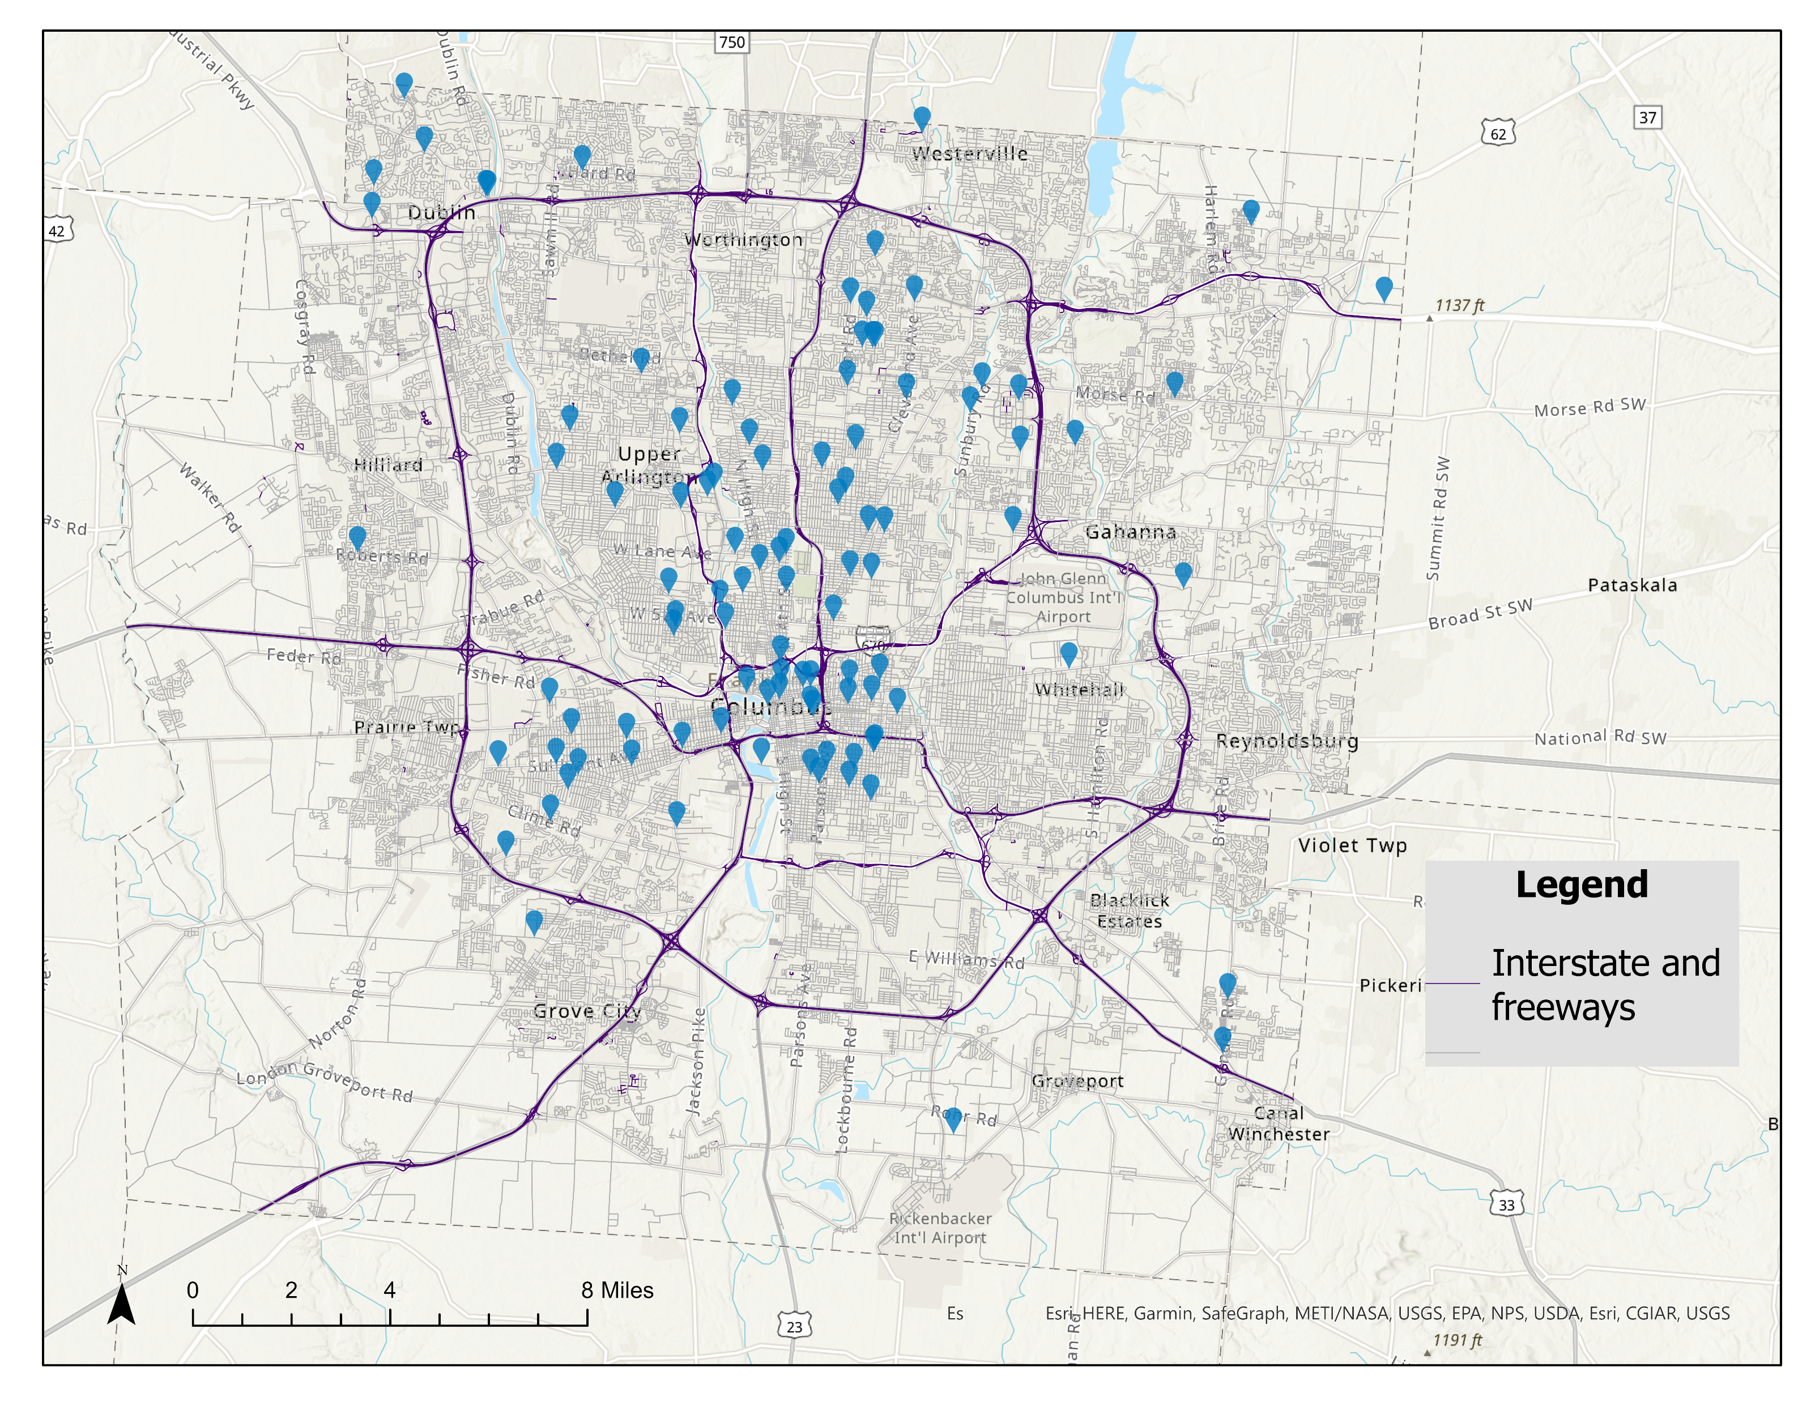
Predicted walking impedance score
Locations with data observations

Slide 15
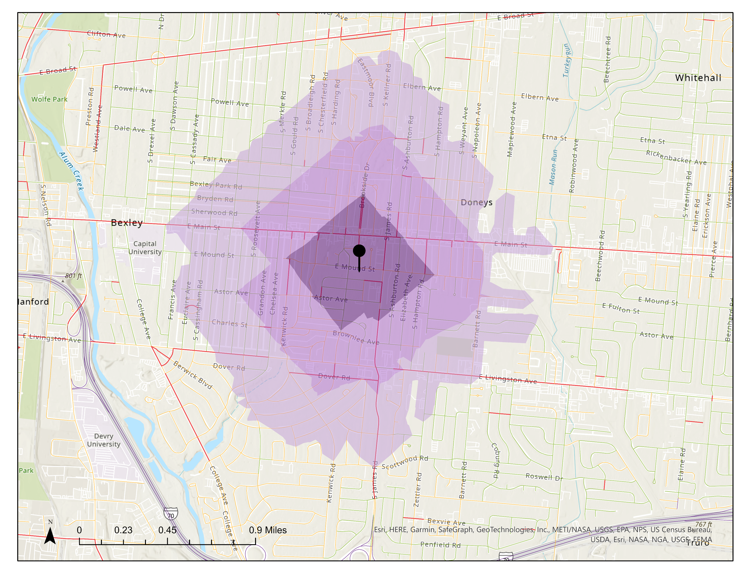
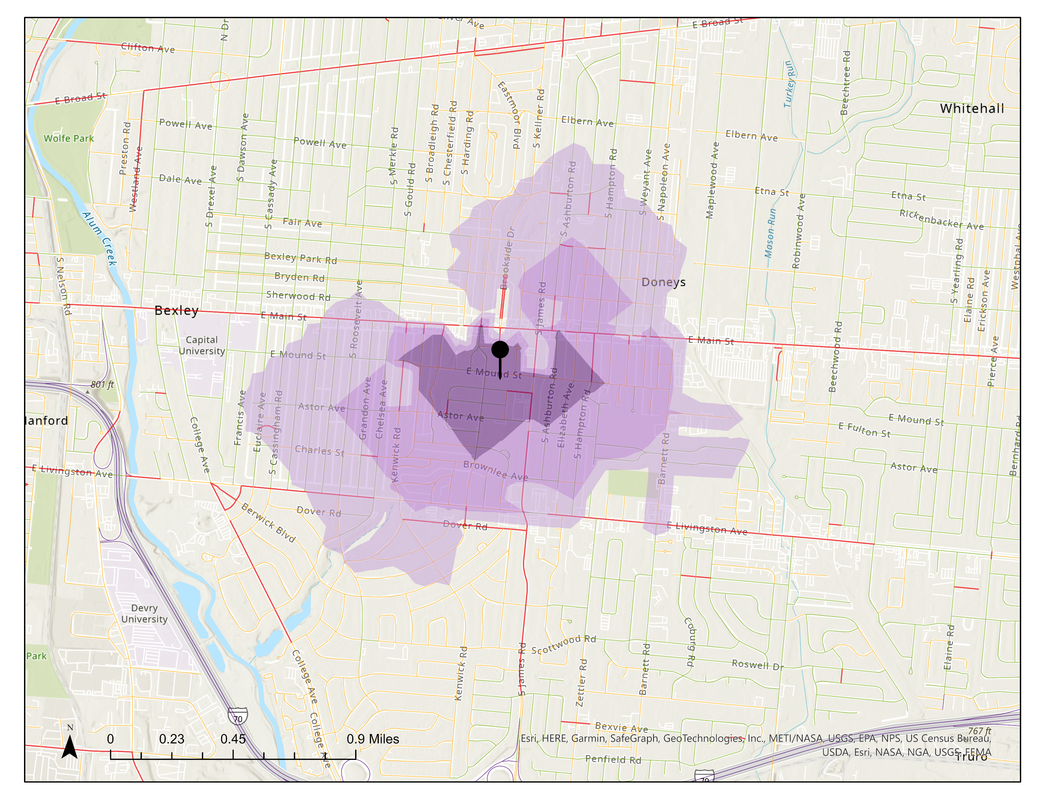
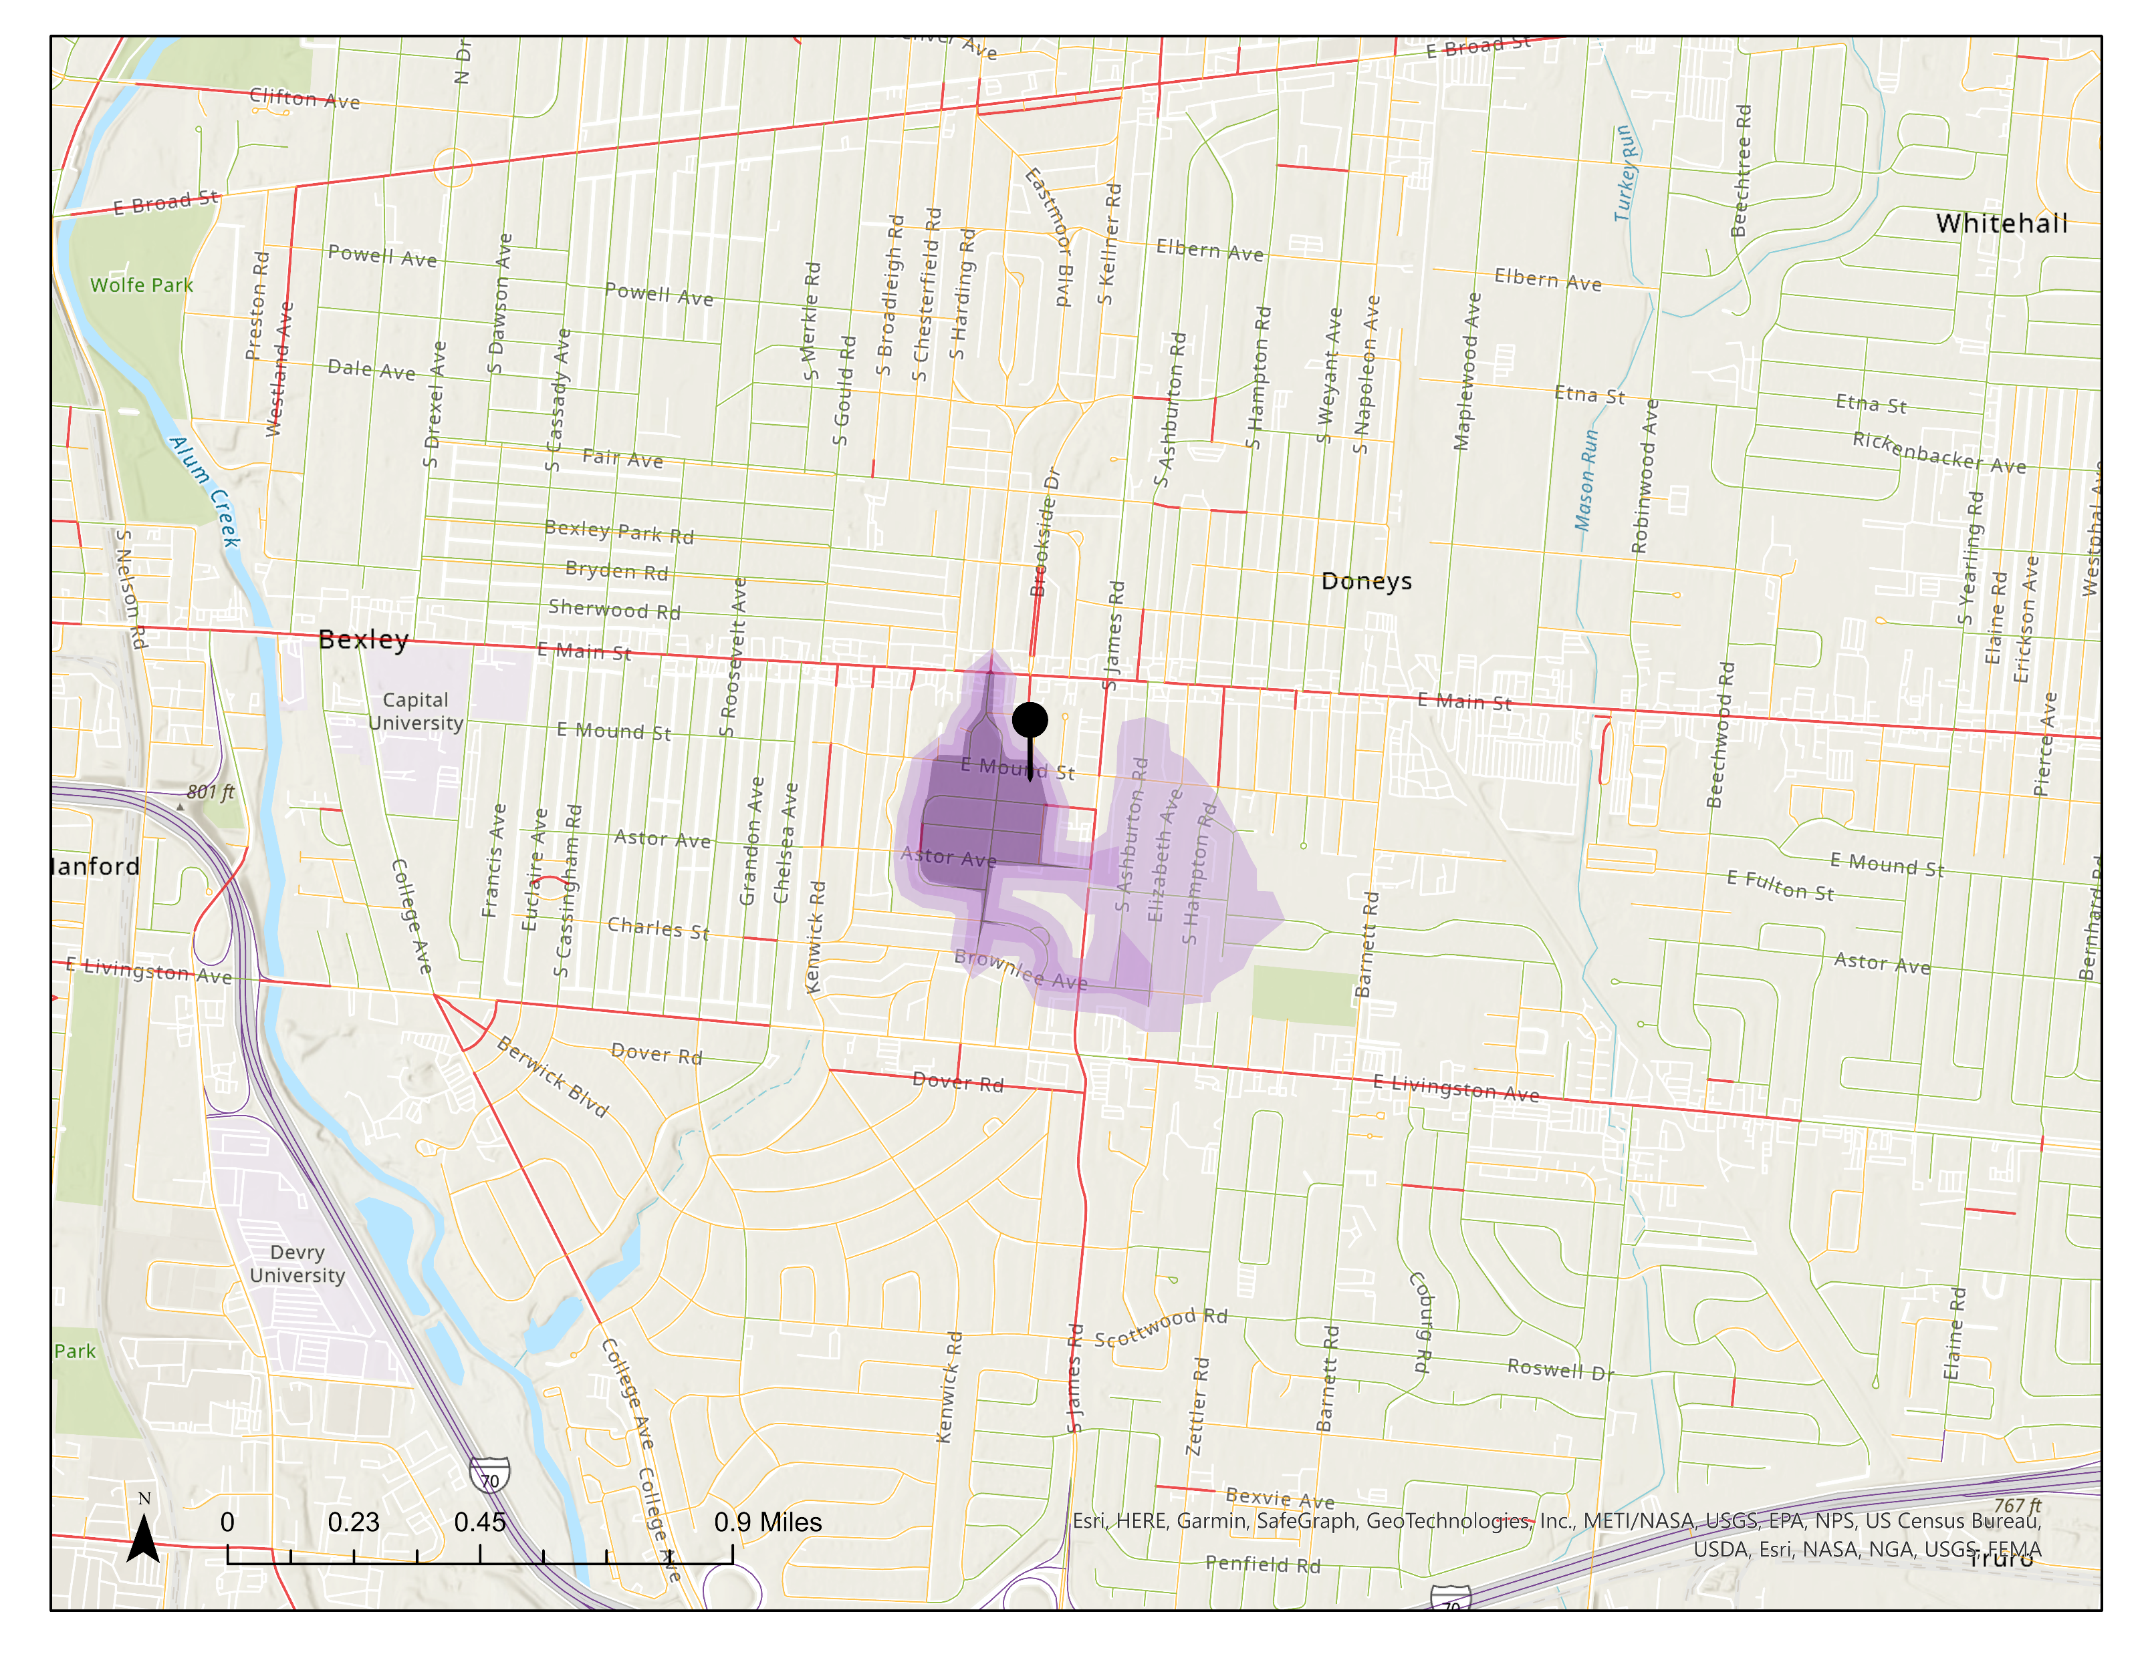
Person-based inclusive accessibility
Inclusive space-time prism (ISTP) is a subset of the classic space-time prism (STP) that minimizes the varied soft constraints of individuals based on their socio-economic strata and scale of analysis.
Examples demonstrate walking accessibility.
Classic space-time accessibility
Inclusive accessibility
Without considering soft impedances
Considering networks where soft impedances are labelled as ‘Agree’ or ‘Neutral’
Considering networks where soft impedances are labelled as ‘Agree’

Slide 16
Next steps
Fine-tuning the impedance prediction models with survey datasets
Integrating multimodal transportation system into the inclusive STP model
Designing a 3D representation of inclusive STP demonstrating its time-dependence
Aggregating person-based inclusive accessibility across social groups and geographic scales
Demonstrating an application of inclusive accessibility measures in transportation planning and network design.

Slide 17
Contributions
Accessibility to multimodal transportation
Time geography
Transport equity
Qualitative GIS
Urban planning
Scientific contributions
An inclusive measures of understanding accessibility and equity at scale across all modes of transportation.
A systematic method to converge both hard and soft constraints at multiple geographic scales
Social contributions
An application in evaluating transportation projects through identifying their key beneficiaries with an emphasis on social equity.
Replicable by cities to determine need-specific transportation strategies for marginalized groups with special mobility needs.

Slide 18
Thank you!

Slide 19
Appendix

Slide 20
Model definition
Output: Prediction of network-based walking impedance score on a scale of 1-3
Variable | Data type | Range / Categories | Source
Network characteristics
Number of Lanes | Continuous | 1 - 4 | MORPC (2021)
Speed | Categorical | 15 – 65 mph
Functional class | Categorical | 3: Principal arterial, 4: Minor arterial, 5: major collector, 6: minor collector, 7: local road
Oneway | Binary | Yes/No
Average traffic volume | Continuous | Max: 12155 | Object segmentation/ StreetLight Data
Sidewalk characteristics
Sidewalk availability | Binary | Yes/No | MORPC (2021)
Buffer | Binary | Available or not
ADA Compliance | Binary | Yes/No
Surface type | Binary | Concrete or not
Land use characteristics
Total light vegetation within the 10-feet road buffer | Continuous |  | NDVI using Landsat 8 images
Total dense vegetation within the 10-feet road buffer | Continuous

Slide 21
Model definition
Output: Prediction of network-based biking impedance score on a scale of 1-3
Variable | Data type | Range / Categories | Source
Network characteristics
Number of Lanes | Continuous | 1 - 4 | MORPC (2021) | MORPC (2021)
Speed | Categorical | 15 – 65 mph
Functional class | Categorical | 3: Principal arterial, 4: Minor arterial, 5: major collector, 6: minor collector, 7: local road
Oneway | Binary | Yes/No
Average traffic volume | Continuous | Max: 12155 | StreetLight Data | Object segmentation/ StreetLight Data
Bikeway characteristics
Infrastructure type | Categorical | Shared (Sharrow, bike boulevard, signed route) On street (Bike lane, paved shoulder) Separated (path of street, multiuse path) | MORPC (2021) | MORPC (2021)
Width | Continuous
Level of service | Continuous
Buffer | Binary | Available or not
Surface type | Binary | Concrete or not
Land use characteristics
Total light vegetation within the 10-feet road buffer | Continuous |  | Open Street Map | NDVI using Landsat 8 images
Total dense vegetation within the 10-feet road buffer | Continuous

