Slide 1
Trends in Treatment for Cannabis Use Disorder and Cannabis Use Amongst Young Adults and Adolescents in the United States, 2008-2018
Presenter: Tom McKeon, MPH PhD Candidate
Department of Geography and Urban Studies Temple University
Co-Authors: Jeremy Mennis, PhD, Gerald J. Stahler PhD

Slide 2
Recreational cannabis legalization (RCL) has expanded among US states, presenting novel concerns for Cannabis Use Disorder (CUD)
CUD in adolescents (age 12-17), and in young adults (age 18-24), exhibit the highest rate of cannabis use among all age groups.
2021 statistics by the National Institute on Drug Abuse reported that 12% of adolescents (age 12 to 17) and 35% of young adults (age 18 to 24) used cannabis in the past-month.
Since 1996, 36 states adopted laws legalizing medical and/or recreational cannabis in some form.
RCL may drive increasing cannabis use within the population, and, thus, the prevalence of CUD.
RCL may have the effect of reducing treatment-seeking behavior among those with problematic cannabis use by reducing the stigma associated with frequent use and by reducing the recognition and perception of problematic use.

Slide 3
Study Aims
Investigate trends in the association of cannabis use and admission to CUD treatment among adolescents and young adults in the US during 2008 to 2018
This time period covers before and after RCL was first enacted in the US at the state level in 2012 (Colorado and Washington).
Cannabis use in the past month does not necessarily lead to CUD; rather, serves as a general proxy for occasional cannabis use in order to investigate the trajectory of, and the impact of recreational legalization on, the relationship between cannabis use and CUD treatment utilization.
We used the proportion of past-month cannabis users admitted to treatment for CUD, a measure we refer to as the PUA (i.e. the Proportion of Users Admitted). The PUA is calculated for each state for each year from 2008 to 2018 using data derived from the US Substance Abuse and Mental Health Services Administration (SAMHSA).
Understanding trajectories of cannabis use and CUD treatment admissions among adolescents and young adults can shed light on emerging public health concerns around cannabis legalization among the age groups most vulnerable to CUD.

Slide 4
Hypotheses
1) Given that CUD treatment admission among those with CUD has declined, coupled with observed cannabis use prevalence that is increasing (among young adults) or relatively stable (among adolescents) over the study period, we hypothesize that the PUA decreased significantly across the US from 2008 to 2018 for both adolescents and young adults.
2) Given the potential for RCL to enhance social acceptability of cannabis use, and thus potentially suppress treatment-seeking behavior among those with CUD, we hypothesize that states enacting RCL sustained greater PUA declines following recreational legalization as compared to states where recreational cannabis use remained illegal.

Slide 5
Materials and Methods
SAMHSA’s Treatment Episode Dataset – Admissions (TEDS-A), provided annual state-level CUD treatment admissions data for 2008-2018 comprising of admissions to publicly funded treatment programs in the US (TEDS, 2020).
Admissions where the primary substance used was cannabis were extracted for adolescents (age 12-17) and young adults (age 18-24), yielding a total of 997,220 young adult and 911,431 adolescent CUD admissions.
Annual adolescent and young adult admissions rates (i.e., the percentage of the population of each age group admitted for CUD treatment) for each state were calculated by dividing the number of treatment admissions by the state population for each age group.
Dataset included 530 state-year observations for young adults and 529 observations for adolescents, both covering 50 states over eleven years.
The SAMHSA’s National Survey of Drug Use and Health (NSDUH) provided state-level annual survey data estimates of the percentage of the population who used cannabis in the past month for adolescents and young adults (age 18-25) (NSDUH, 2021),
We joined the two-year pooled cannabis use data to the treatment admissions data based on the latter NSDUH year, e.g., the 2008-2009 pooled cannabis use estimate was joined to the 2009 treatment admissions data.
For each age group, and for each state and year, the annual CUD treatment admissions rate was divided by the past-month cannabis use percentage estimate to yield the PUA.

Slide 6
Investigating first hypothesis of PUA decline over time
Regressed the PUA on year (as a dummy variable, where 2008 serves as the referent) for young adults and adolescents in separate models. We implemented both unadjusted models and adjusted models that account for other state-year level covariates which may influence the PUA over time aside from recreational legalization.
Covariates included an index of socioeconomic disadvantage, percent Black, percent Hispanic, percent without health insurance, percent Medicaid enrollment, and substance use disorder treatment availability (number of treatment centers per 10,000 adolescent or young adult population (SAMHSA, 2020)). The Kaiser Family Foundation provided data on Medicaid coverage and percent uninsured (Kaiser Family Foundation, 2021). The US Census Bureau provided data for the socioeconomic and race variables (Census, 2021).

Slide 7
Investigating Second Hypothesis: Effect of RCL on PUA
Difference-in-differences analysis used to test whether the difference in pre- and post-RCL PUA rates differed between states enacting RCL and states which did not enact RCL during the study period.
We set the RCL status to begin the year after recreational legalization was established in each RCL state (e.g., Colorado enacted RCL in 2012 so in our analysis the first RCL year was set to 2013).
We ran an unadjusted difference-in-differences model and an analogous set of adjusted difference-in-differences models incorporating the covariates listed previously.
Notes:
(2008 served as the referent year), a dummy variable representing states which ever enacted RCL at any time during the study period (1= states that enacted RCL at any time during the study period, 0=other), and the difference-in-differences variable indicating the years following RCL enactment in RCL states (1= RCL states in years following RCL enactment, 0=other). We then ran

Slide 8
Sensitivity Testing
We tested the sensitivity of our analytical results to other parameterizations of the difference-in-differences models.
First, we refit the adjusted difference-in-differences model to restrict treatment admissions tallies to non-criminal justice referrals to treatment, as legalization likely affects the rate of those entering treatment for CUD from the criminal justice system.
Second, we restricted the set of counterfactuals to states without medical cannabis legalization (MCL) during the study period, and, in separate models, to states with RCL or MCL (but excluding non-MCL) during the study period.
Notes:
All models were estimated in R Version 4.0.2 using OLS regression and two-tailed significance tests at p < 0.05.

Slide 9
Results
Table 1. Descriptive statistics of past-month cannabis use and treatment admissions in states with recreational cannabis legalization (RCL) at any time during the study period, 2008-2018, and non-RCL states (mean reported, standard deviation in parentheses).
Variable | Non-RCL States | RCL States
Percentage of adolescents using cannabis in past-month | 6.87 (2.59) | 9.08 (1.42)
Percentage of young adults using cannabis in past-month | 18.53 (7.76) | 24.7 (4.71)
Treatment admissions rate of young adult cannabis users (per 10,000) | 34.77 (24.02) | 23.49 (14.15)
Treatment admissions rate of adolescent cannabis users (per 10,000) | 36.41 (30.54) | 41.89 (27.04)
Proportion of adolescent cannabis users admitted to treatment (per 10,000) (PUA) | 543.43 (452.46) | 468.04 (303.59)
Proportion of young adult cannabis users admitted to treatment (per 10,000) (PUA) | 195.82 (142.61) | 97.26 (58.82)
For both age groups:
The mean percentage using cannabis use in the past month is higher and the PUA is lower, in states ever enacting RCL during the study period compared to states that never enacted RCL.

Slide 10
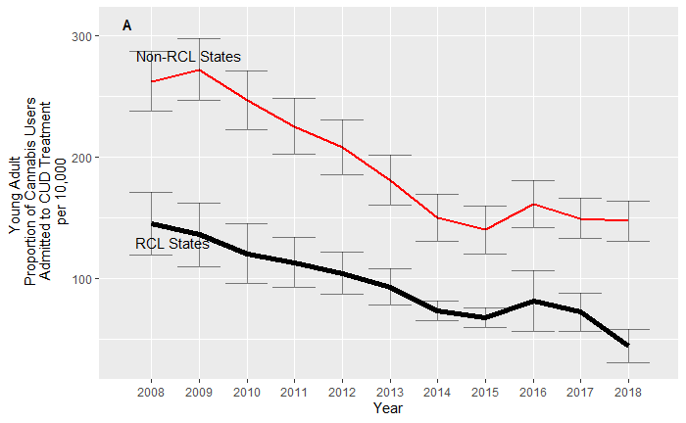
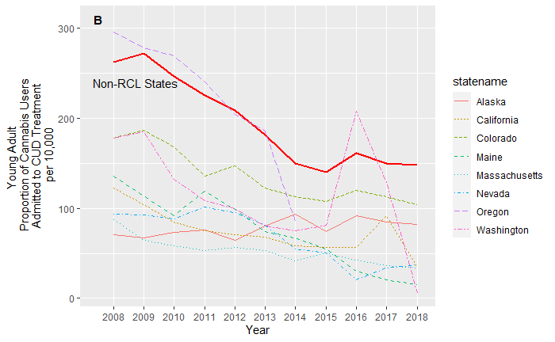
Trajectory of the Proportion of Cannabis Users Admitted to Treatment: Young Adults

Slide 11
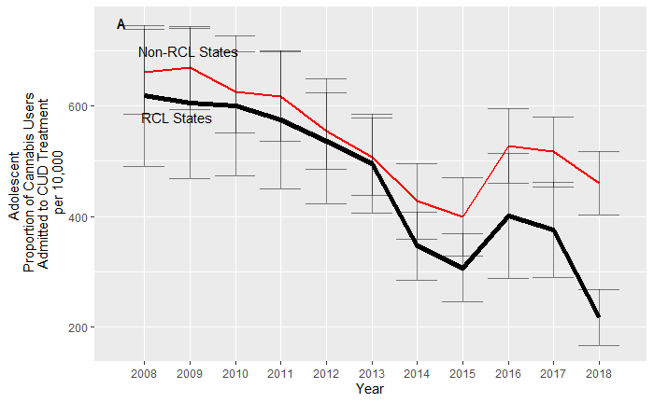
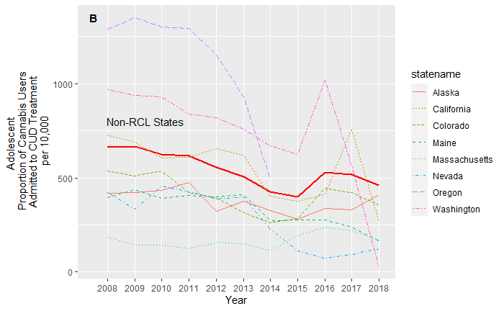
Trajectory of the Proportion of Cannabis Users Admitted to Treatment: Adolescents
Notes:
Figure 2 shows the analogous mean PUA trajectories as in Figure 1 but for adolescents. Similar to young adults, the adolescent mean PUA is declining, although the regression of PUA on year indicates that only years 2014, 2015, and 2018 have significantly (p<0.05) lower PUA values than 2008 (Table 2). Results were similar for the adjusted model (Table 2). This appears to be due to greater variability in adolescent PUA values among both states that enacted RCL (at any time during the study period) and states that never enacted RCL, as compared to young adults, as well as a pronounced increase in the PUA from 2015-2016 among adolescents before a continuing decline, as illustrated in Figure 2A. Adolescent mean PUA values are consistently lower in states enacting RCL at any time during the study period as compared to states which never enacted RCL (Figure 2A), though the difference between the two groups is less than that observed for young adults, with several individual RCL states having PUA values higher than the mean non-RCL state PUA value for several years (Figure 2B)

Slide 12
Difference-in-Differences Models of the Proportion of Cannabis Users Admitted to Treatment
Our hypothesis that the PUA declined significantly following the legalization of recreational cannabis use is not supported. Although, for young adults, states enacting RCL at any time during the study period had significantly lower PUA values generally as compared to non-RCL states, consistent with the RCL and non-RCL state group trend lines.
Results of the adjusted difference-in-differences models were similar to the unadjusted model results for both adolescents and young adults. Results of the sensitivity tests, including restricting the treatment admissions in the PUA calculation to those with non-criminal justice referrals, and altering the set of counterfactual states were similar to the main results and did not cause us to change our conclusions.

Slide 13
Discussion
We integrated national data on cannabis use and substance use disorder treatment admissions to investigate the effect of RCL on PUA in adolescents and young adults.
During 2008-2018, the PUA declined in young adults and adolescents.
Among young adults PUA was significantly lower in states which enacted RCL at any time during the study period, compared to those that did not.
PUA was lower in states enacting RCL, but this was the case prior to as well as after RCL.
We do not find evidence that recreational legalization actually caused the observed declines in the proportion of past-month cannabis uses entering CUD treatment, or any additional change in decline apart from that observed over all states generally.

Slide 14
Discussion
Our results are consistent with previous research that has found falling CUD treatment admissions combined with increasing or stable cannabis use prevalence among adolescents and young adults which would produce the PUA trends we observe.
Conversely, perceptions of harm from cannabis use are decreasing, and social acceptance is increasing.
Thus, treatment-seeking behavior among frequent users, and pressure to seek treatment from family and friends even given problematic cannabis use, may be suppressed, even as the prevalence of cannabis use rises.

Slide 15
Limitations
The NSDUH survey data is self-reported, and some cannabis users may be hesitant to report usage, which may also be related to whether respondents live in states enacting RCL or not.
The TEDS-A data were missing for a handful of states over time and may be subject to state and year variations in data collection practices.
Rules and regulations regarding the production, sale, and consumption of recreational cannabis vary among states, even among those designated as RCL states in our analysis.
While we attempted to account for other factors in our analysis that could impact the PUA, such as treatment center availability, there may be other unaccounted for factors affecting either cannabis use or CUD treatment, such as cultural factors that vary from state to state and evolve over time.

Slide 16
Limitations
Despite these limitations, this study contributes to an improved understanding of current patterns of the association between cannabis use and CUD treatment in the context of recreational cannabis legalization among adolescents and young adults, the age groups potentially most vulnerable to the negative health impacts of increasing liberalization of recreational cannabis.
As social and legal norms around cannabis continue to loosen across the US and throughout the world, it is critical to continue to evaluate the impact on these particularly vulnerable populations.

