Slide 1
Exploring the Spatial Associations between Air Pollution and Congenital Anomalies in the U.S.
Charlie Zhang,
University of Louisville
Kristina Zierold,
University of Alabama at Birmingham

Slide 2
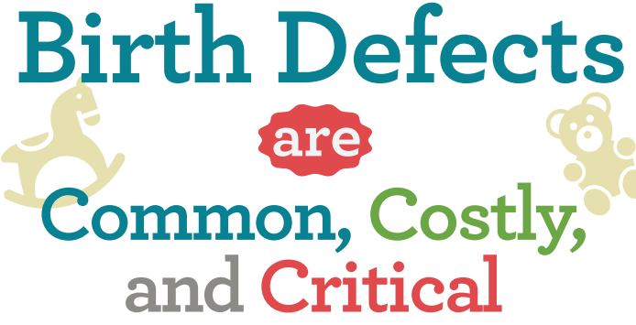
Nature of the Problem
Newborn congenital anomalies (or birth defects) are a critical and costly public health problem
About one in every 33 babies in the U.S. is born with a birth defect.
Worldwide, about 6% babies worldwide are born with a congenital anomaly.
Birth defects are the leading cause of infant mortality and have a profound impact on the health and wellbeing of infants and their families.
Each year, total hospital costs for U.S. children and adults with birth defects exceed $2.6 billion
Notes:
Each year, total hospital costs for U.S. children and adults with birth defects exceed $2.6 billion, not including outpatient care or many provider charges.

Slide 3
Risk Factors of Birth Defects
Scholars believe that birth defects are generally attributable to genetic, maternal, and environmental factors
The specific causes of most birth defects are unclear
Environmental risk factors, such as exposure to metal(loid)s and radioactive elements have been found to be associated with several birth defects, e.g., cardiac, oral facial and neural tube defects.
However, the findings are inconsistent and further research into environmental exposures is necessary to clarify them.

Slide 4
Research Objectives
This study aims to investigate the spatial associations between prevalence of birth defects in the U.S. and maternal exposure to airborne toxic emissions from Toxic Release Inventory (TRI) facilities.
With a special interest in examining the adverse impacts of metal(loid)s from coal-fired power plants and the affiliated coal ash storage facilities, which are major sources of environmental pollution.
Findings can help us better understand the linkages between air pollution and birth defects in newborns and thus providing guidance for environmental and public health policies.

Slide 5
Data and Methods
Data on birth defects were obtained from U.S. Centers for Disease Control and Prevention (CDC) WONDER online query system
Natality for 2016 – 2020 (expanded)
Aggregated to counties based on mother’s residence
Data for airborne toxic exposures from TRI facilities were acquired from the Environmental Protection Agency (EPA)’s Risk-Screening Environmental Indicators (RSEI) geographic microdata (RSEI-GM)
Modeled annual environmental fate, exposure, and toxicity information of chemicals from air pollutants

Slide 6
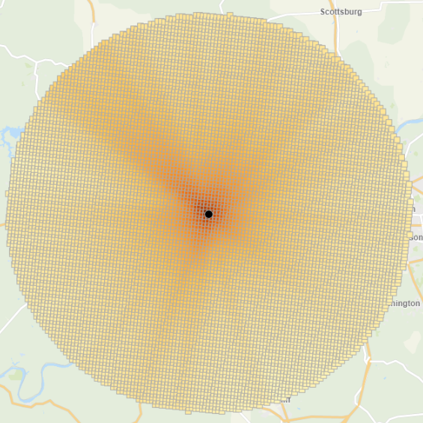
Data and Methods (Cont.)
RSEI-GM includes estimates for -
Toxicity-weighted concentrations of chemicals
Arsenic, cadmium, lead, lithium, manganese, mercury, and selenium
Gridded data for 810m by 810m within a radius of 50 km² surrounding each TRI facility
RSEI indicators were aggregated to counties
Data for coal-fired power plants obtained from the EPA
302 power plants across the contiguous U.S.
733 coal ash storage sites
29 states had more than 3 coal-fired power plants
810m by 810m

Slide 7
Data Methods (Cont.)
We used GIS to overlay data for birth defects with TRI RSEI concentrations and calculate distances from each county to its closest coal-fired power plant
We calculated the odds ratio for counties within a 10-mile distance to coal-fired power plants
We performed independent samples t tests to compare the differences in birth defect prevalence between counties in proximity to power plants and beyond three distance thresholds (5, 10, and 20 miles).
Multiple linear regression was used to investigate the correlations of airborne pollution and birth defects.

Slide 8
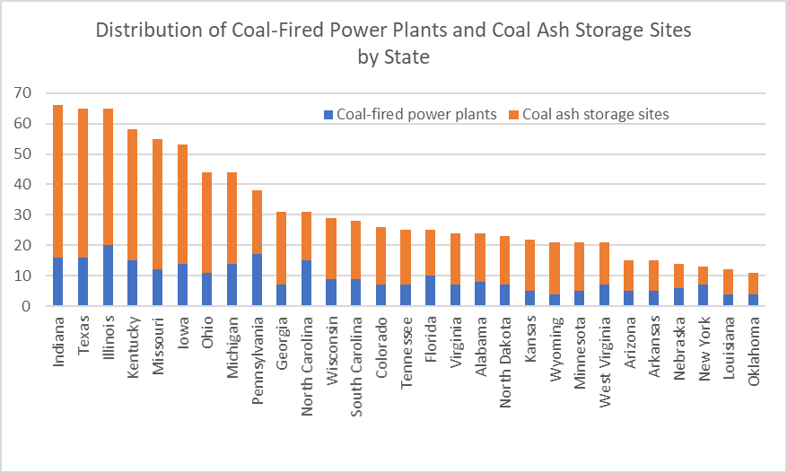
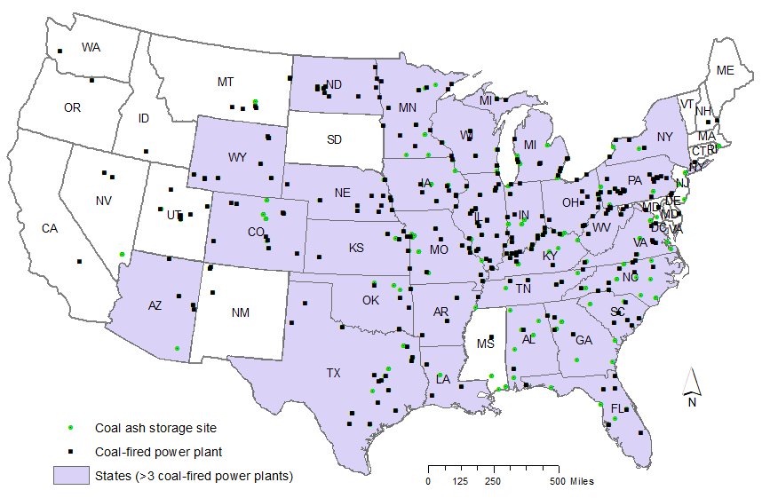
29 States with More Than 3 Coal-Fired Power Plants

Slide 9
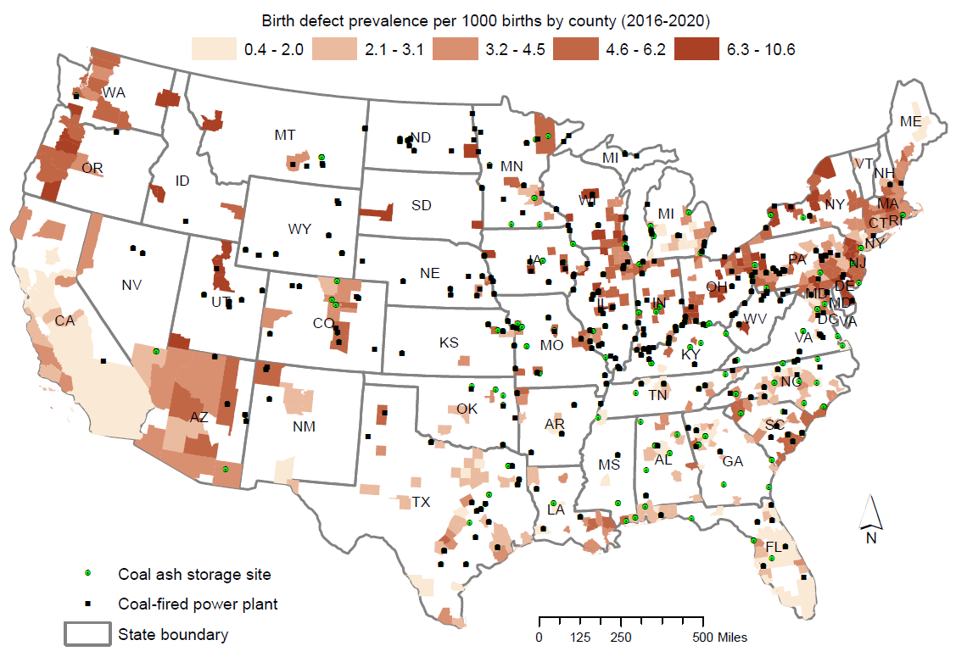
Birth Defects and Locations of Coal-Fired Power Plants

Slide 10
Odds Ratio of Birth Defects for Counties in Proximity to Power Plants
The results showed that proximity to coal-fired power plants (less than 10-mile) corresponds to an odds ratio of 1.24 (95% CI: 1.21, 1.68), indicating proximity to coal-fired power plants might be an environmental risk factor for elevated levels of birth defects.
Exposure vs. None-Exposure | Birth defects | No birth defects
Exposure: Counties less than 10-mile to a power plant (154) | 11,411 | 3,181,640
None-Exposure: Counties more than 10- mile to a power plant (253) | 13,825 | 4,798,360
Odds ratio of birth defects | 1.24 (95% CI: 1.21, 1.68)

Slide 11
Distance and Birth Defect Prevalence
Counties were divided into two groups: Within and Outside using three distance thresholds
The results of independent samples t-test showed that counties closer to coal-fired power plants were more likely to have higher prevalence of birth defects than those that were far away.
Comparison of BD prevalence rates using three distance buffers (numbers of counties in each ground indicated in parentheses)
Counties | 5-mile buffer | 10-mile buffer | 20-mile buffer
Within threshold | 409.20 (115) | 406.12 (154) | 388.27 (223)
Outside threshold | 354.77 (292) | 348.26 (253) | 348.20 (184)
Independent t-test | t = - 2.578* | t = -3.097** | -2.307*
*Significance level of 0.05; **Significance level of 0.01

Slide 12
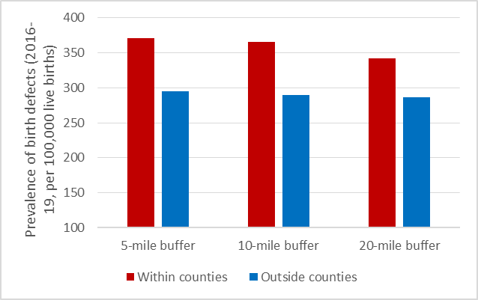
Prevalence of Birth Defects and Proximity to Coal-Fired Power Plants

Slide 13
Results of Multiple Regression (n = 561)
Dependent variable - Count of birth defects per county
Adjusted R Squared = 0.644
Largest variance inflation factor (VIF) <1.2
Independent variables | Coefficient | Standard error | t | p-value
(Constant) | -31.527 | 91.928 | -.343 | .732
Total number of births | .002 | .000 | 28.300 | <.001
Mother’s age (years) | 3.642 | 1.761 | 2.068 | .039
Average birth weight | -.004 | .018 | -.194 | .847
Pre-pregnancy BMI | -.074 | 2.055 | -.036 | .971
Average number of visits | -2.310 | 1.791 | -1.290 | .198
Distance to power plant (km) | -.124 | .031 | -4.053 | <.001
Toxicity concentration | 5.305E-11 | .000 | 1.652 | .099

Slide 14
Conclusion
We found some preliminary results with respect to the connections between proximity/exposure to airborne pollutants from TRI facilities and birth defects
Counties closer to TRI facilities had higher birth defects rates than those far away
An odds ratio of 1.24 indicates elevated risks of birth defects for counties in proximity to TRI facilities
Statistically significant correlations identified between birth defects and distance and toxicity-weighted concentrations after accounting for demographic covariates

Slide 15
Limitations and Discussions
Individual-level data were aggregated to counties by CDC. Data for some counties were suppressed
Populations less than 100,000 persons
Count of birth defects of 9 or fewer
We only analyzed data for all birth defects. However, birth defects can be divided into a variety of different types ranging from congenital heart disease to down syndrome.
Concentrations of RSEI-based indicators for each type of metals (i.e., Arsenic, cadmium, lead, lithium, manganese, mercury, and selenium) were not extracted in the current analysis.

Slide 16
Discussions
While EPA RSEI database are useful, toxicity-based concentrations of chemicals were modeled results that are sensitive to the choices of model parameters and algorithms
It can only be used for identifying areas with extraordinary situations of concern that are worth additional investigations to ascertain the health risks of the released chemicals including metal exposures
Future studies should account for additional confounding factors including maternal morbidity and toxic pollutants from water and land sources

