Slide 1
Seeing the forest and the trees: holistic view of social distancing on the spread of COVID-19 in China
Danlin Yu
Montclair State University
AAG 2022, New York, NY, March 1

Slide 2
Outline
The COVID-19 spread in China
Data
COVID-19 spread: daily new cases
Social distancing measures: big data
Methods
Spatial panel regression
Geographically weighted panel regression
Results and discussion
Summary

Slide 3
The COVID-19 Spread in China
The outbreak of the new virus in early 2020 caught everyone off guard
Strategies were designed as the diseases spread
Strict social distancing measures implemented sine around the Chinese New Year, 2020
Cases started to abate around early May

Slide 4
The COVID-19 Spread in China
Social distancing measures work
Many scenarios around the world suggest such
Question:
Will social distancing measures work everywhere, all the time?
Are there patterns of the effectiveness of social distancing measures?
What guidance such pattern could provide for public health policies?

Slide 5
Data
Case data
Data collected at the prefecture administrative level
The occurrence of daily new cases is used to represent the spread of COVID-19
Data available from Tencent’s COVID-19 website (https://news.qq.com/zt2020/page/feiyan.htm?from=timeline&isappinstalled=0#/?nojump=1)

Slide 6
Data
Social distancing measures
Search engine (Baidu), policy document analysis, Baidu migration (https://qianxi.baidu.com/2020/)
A python code developed to learn and extract the data
Eight measures identified: Within city travel (travelcity), Daily migration (addmig), Daily net gain of migrants (netmin), school closures (school), workplace closures (work), quarantine status (quarantine), closure of inter-city transportation (intercity), and self-initiated tourist count (tourist)

Slide 7
Data
Daily data are treated with indirect inversed normal transformation (I-INT) strategy
This study collects four categories of societal background information, including the total population, local economic status, health care system status, and infrastructure status.
All data are collected from the 2019 statistical yearbook or calculated based on the 2019 road network and high-speed rail information.

Slide 8
Data
I-INT strategy
Both the case data and social distancing measures are regressed with the background information
Residuals for the case data regression models are inverse normal transformed
Residuals for the social distancing measures regression models are used as proxies for social distancing measures
Regression models are established between the I-INT case residuals and social distancing measures residuals

Slide 9
Methods
Spatial panel regression
The Forest View
Geographically weighted panel regression
The Trees View
Test
One-tailed significant tests

Slide 10
Methods
GWPR
Treats each year as an individual spatial event
Bandwidths for every year are calibrated per cross-sectional GWR strategy
For each prefecture, an unbalanced but geographically weighted panel data set can be established (hence the name)
Panel estimation happens for each prefecture to acquire the varying coefficients based on panel analysis

Slide 11
Results and discussion – the forest view
Fixed effect spatial lag panel regression model results
Social distancing measures | Estimate | Std. Error | t-value | Pr(>|t|)
travelcity | 0.077 | 0.009 | 8.945 | 0.000 ***
addmig | 0.019 | 0.007 | 2.521 | 0.012 **
netmin | -0.004 | 0.007 | -0.569 | 0.569
school | -0.024 | 0.016 | -1.491 | 0.136
work | -0.022 | 0.020 | -1.089 | 0.276
tourists | 0.000 | 0.000 | 0.190 | 0.849
quarantine | -0.033 | 0.015 | -2.172 | 0.030 *
intercity | 0.005 | 0.014 | 0.328 | 0.743
Spatial autoregressive coefficient Lambda | 0.418 | 0.006 | 68.197 | 0.000 ***
Significance codes: ***: 0.001; **: 0.01; *: 0.05; .: 0.1 (one-tailed test)

Slide 12
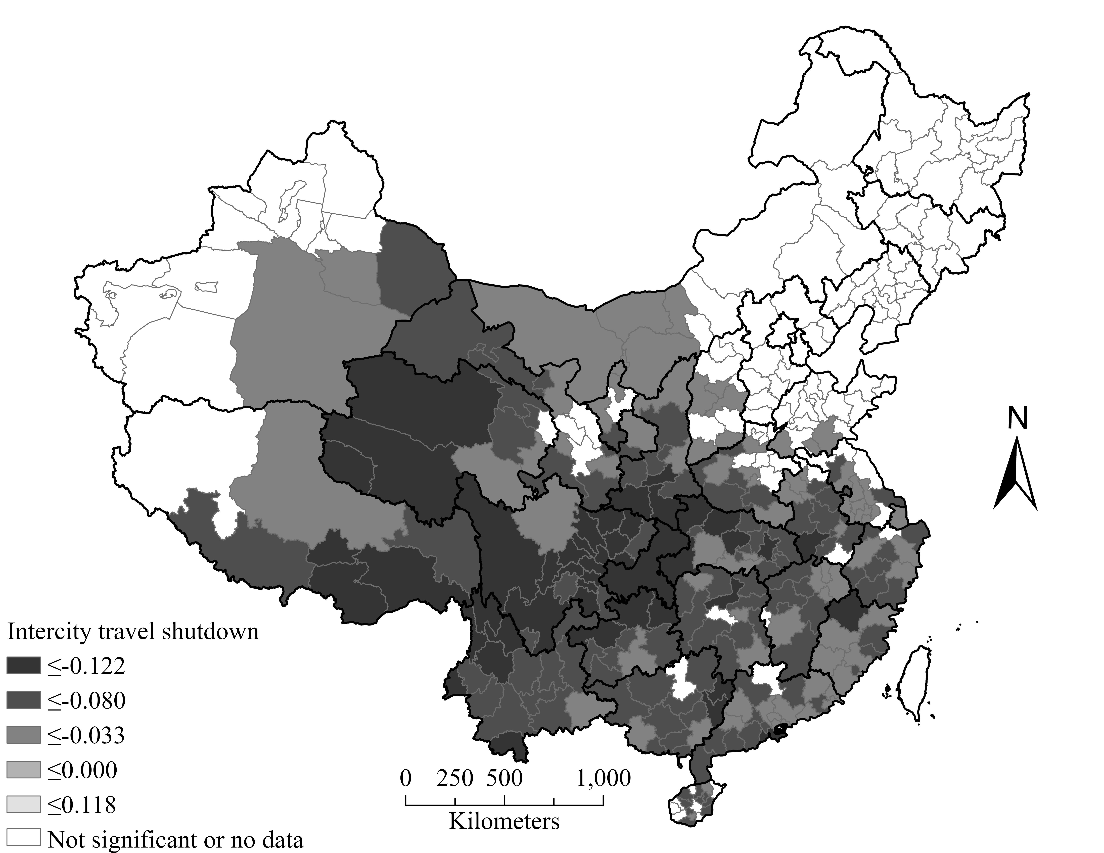
Results and discussion – the trees view

Slide 13
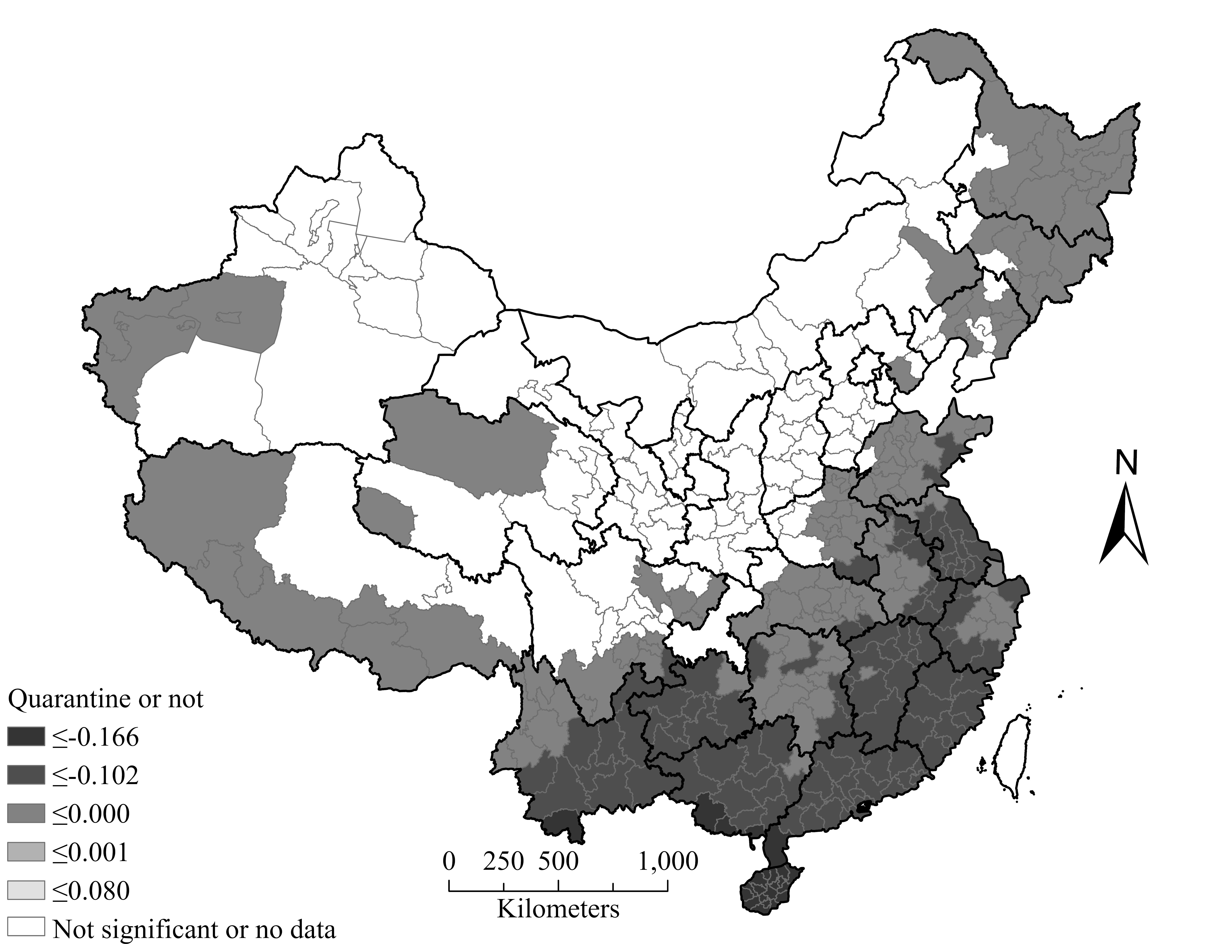
Results and discussion – the trees view

Slide 14
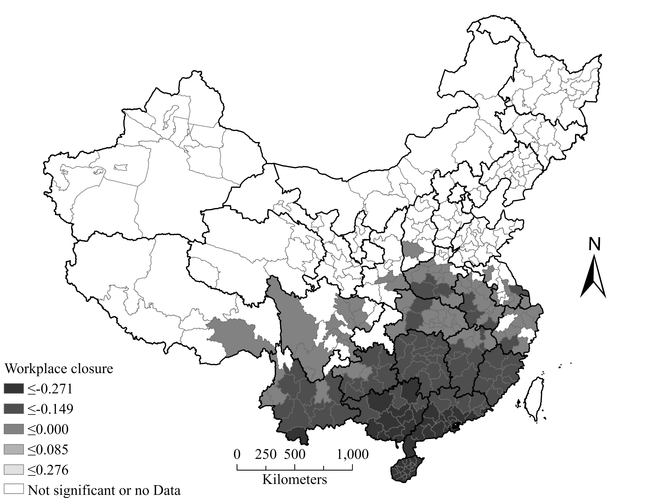
Results and discussion – the trees view

Slide 15
Results and discussion – the trees view

Slide 16
Results and discussion
The Forest view suggests:
The primary contributing factors for the daily spread of COVID-19 are the intensity of inner-city travel, the intensity of daily migration, and workplace closure.
The results suggest that the rigorous lock-down policy implemented in Wuhan after January 23rd, 2020 and later to the entire nation contributes significantly to curb the overall spread of the COVID-19 in China.

Slide 17
Results and discussion
The Trees view:
All but the net migration show significant contribution to curb the spread of COVID-19 at the 95% confidence level in some prefectures in China, but not all prefectures
The inner-city travel intensity is the primary factor for the spread of the disease around the epicenter
Inter-city travel bans and workplace closure, worked primarily in prefectures immediately around the epicenter and the Peral River Delta Urban Agglomeration, where the largest temporary migrant destinations in China locate
The quarantine policy does not seem to have a distinctive pattern, though where it worked, it seems to work the best to curb the spread

Slide 18
Summary
Spatial data analysis provides unique viewing angles, need further promotion.
Analyzing geographical phenomena at local levels facilitates our understanding for complex social, public health, and policy dynamics
A full spectrum of spatial analysis is the next stage of research paradigm

Slide 20
Thank you for your attention

